Slide 1
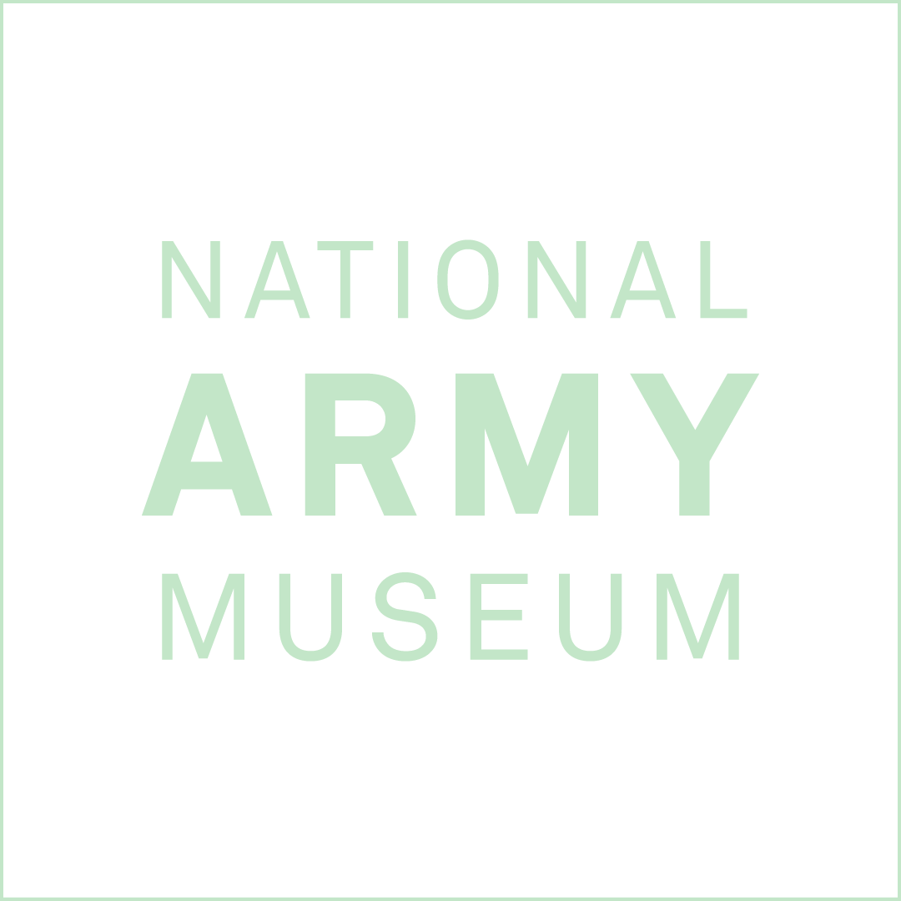
EXPLORING THE BRITISH CIVIL WARS THROUGH ART
History Teacher CPD Source Pack

Slide 2
ABOUT THIS RESOURCE
This PowerPoint presentation contains a selection of images and archives from the Collection of the National Army Museum (NAM).
Unless otherwise stated in the notes, the images can be freely used for non-commercial purposes within the classroom. You can use the entire presentation or choose individual images for use in other non-commercial contexts. When using individual images in other contexts, please always retain the attribution statements provided in this document (e.g. NAM. 2005-08-66-1).
By downloading this document and using these images you agree to these terms of use, including your use of the attribution statement specified for each object by NAM.

Slide 3
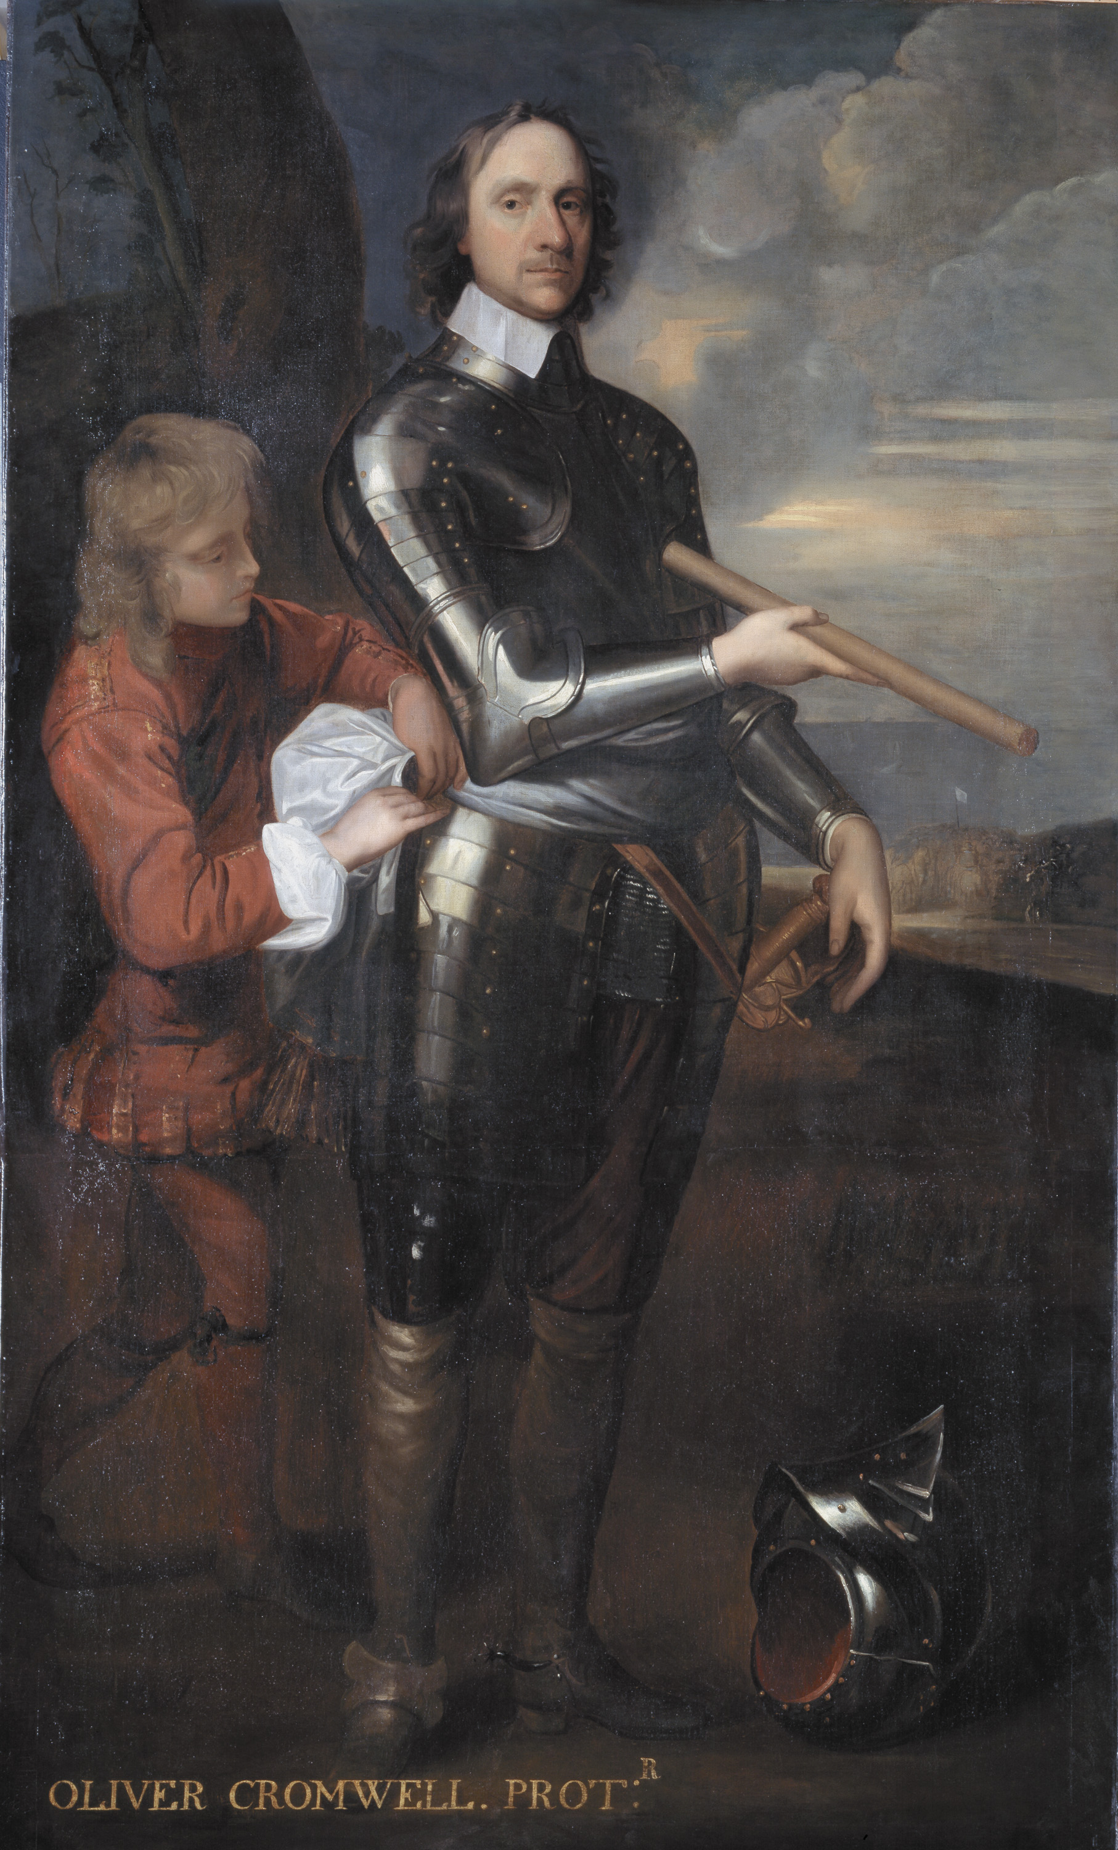
Notes:
Oliver Cromwell, Lord Protector of England, 1650 (c).
Oil on canvas, artist unknown, after Robert Walker (1599 (c)-1658), 1650 (c).
Cromwell (1599-1658) rose to prominence in the committees of the House of Commons and fought in the early campaigns of the Civil Wars of Britain (1639-1651) under the Parliamentarian Earl of Essex. In 1644, he commanded the cavalry of the Eastern Association at the Battle of Marston Moor; in 1645 he was in command of the cavalry of the newly-formed New Model Army at the Battle of Naseby.
By the time of the execution of King Charles I in 1649, Cromwell had become the foremost general in the New Model Army, a force of men chosen for their prowess and dedication rather than by name or wealth. He gained enormous prestige with victories at the Battles of Preston (1648), Dunbar (1650) and Worcester (1651). This was not diminished by his harsh campaign in Ireland (1649-1650) which was marked by the massacres at Drogheda and Wexford. He continued the Elizabethan policy of settling Protestants in Ireland and came to symbolize this hated policy which gave England political dominance. In 1653 Cromwell became Lord Protector of England, a position he held until his death in 1658. He was buried at Westminster Abbey. However, upon the Restoration of the monarchy, his body was disinterred and, with other regicides, his head was placed upon a pole above Westminster Hall.
This portrait has suffered as a result of its sitter's controversial career, having been slashed across the face. Ironically, the artist Walker borrowed the pose from the work of Van Dyck, King Charles I's painter.
NAM. 1988-11-1-1

Slide 4
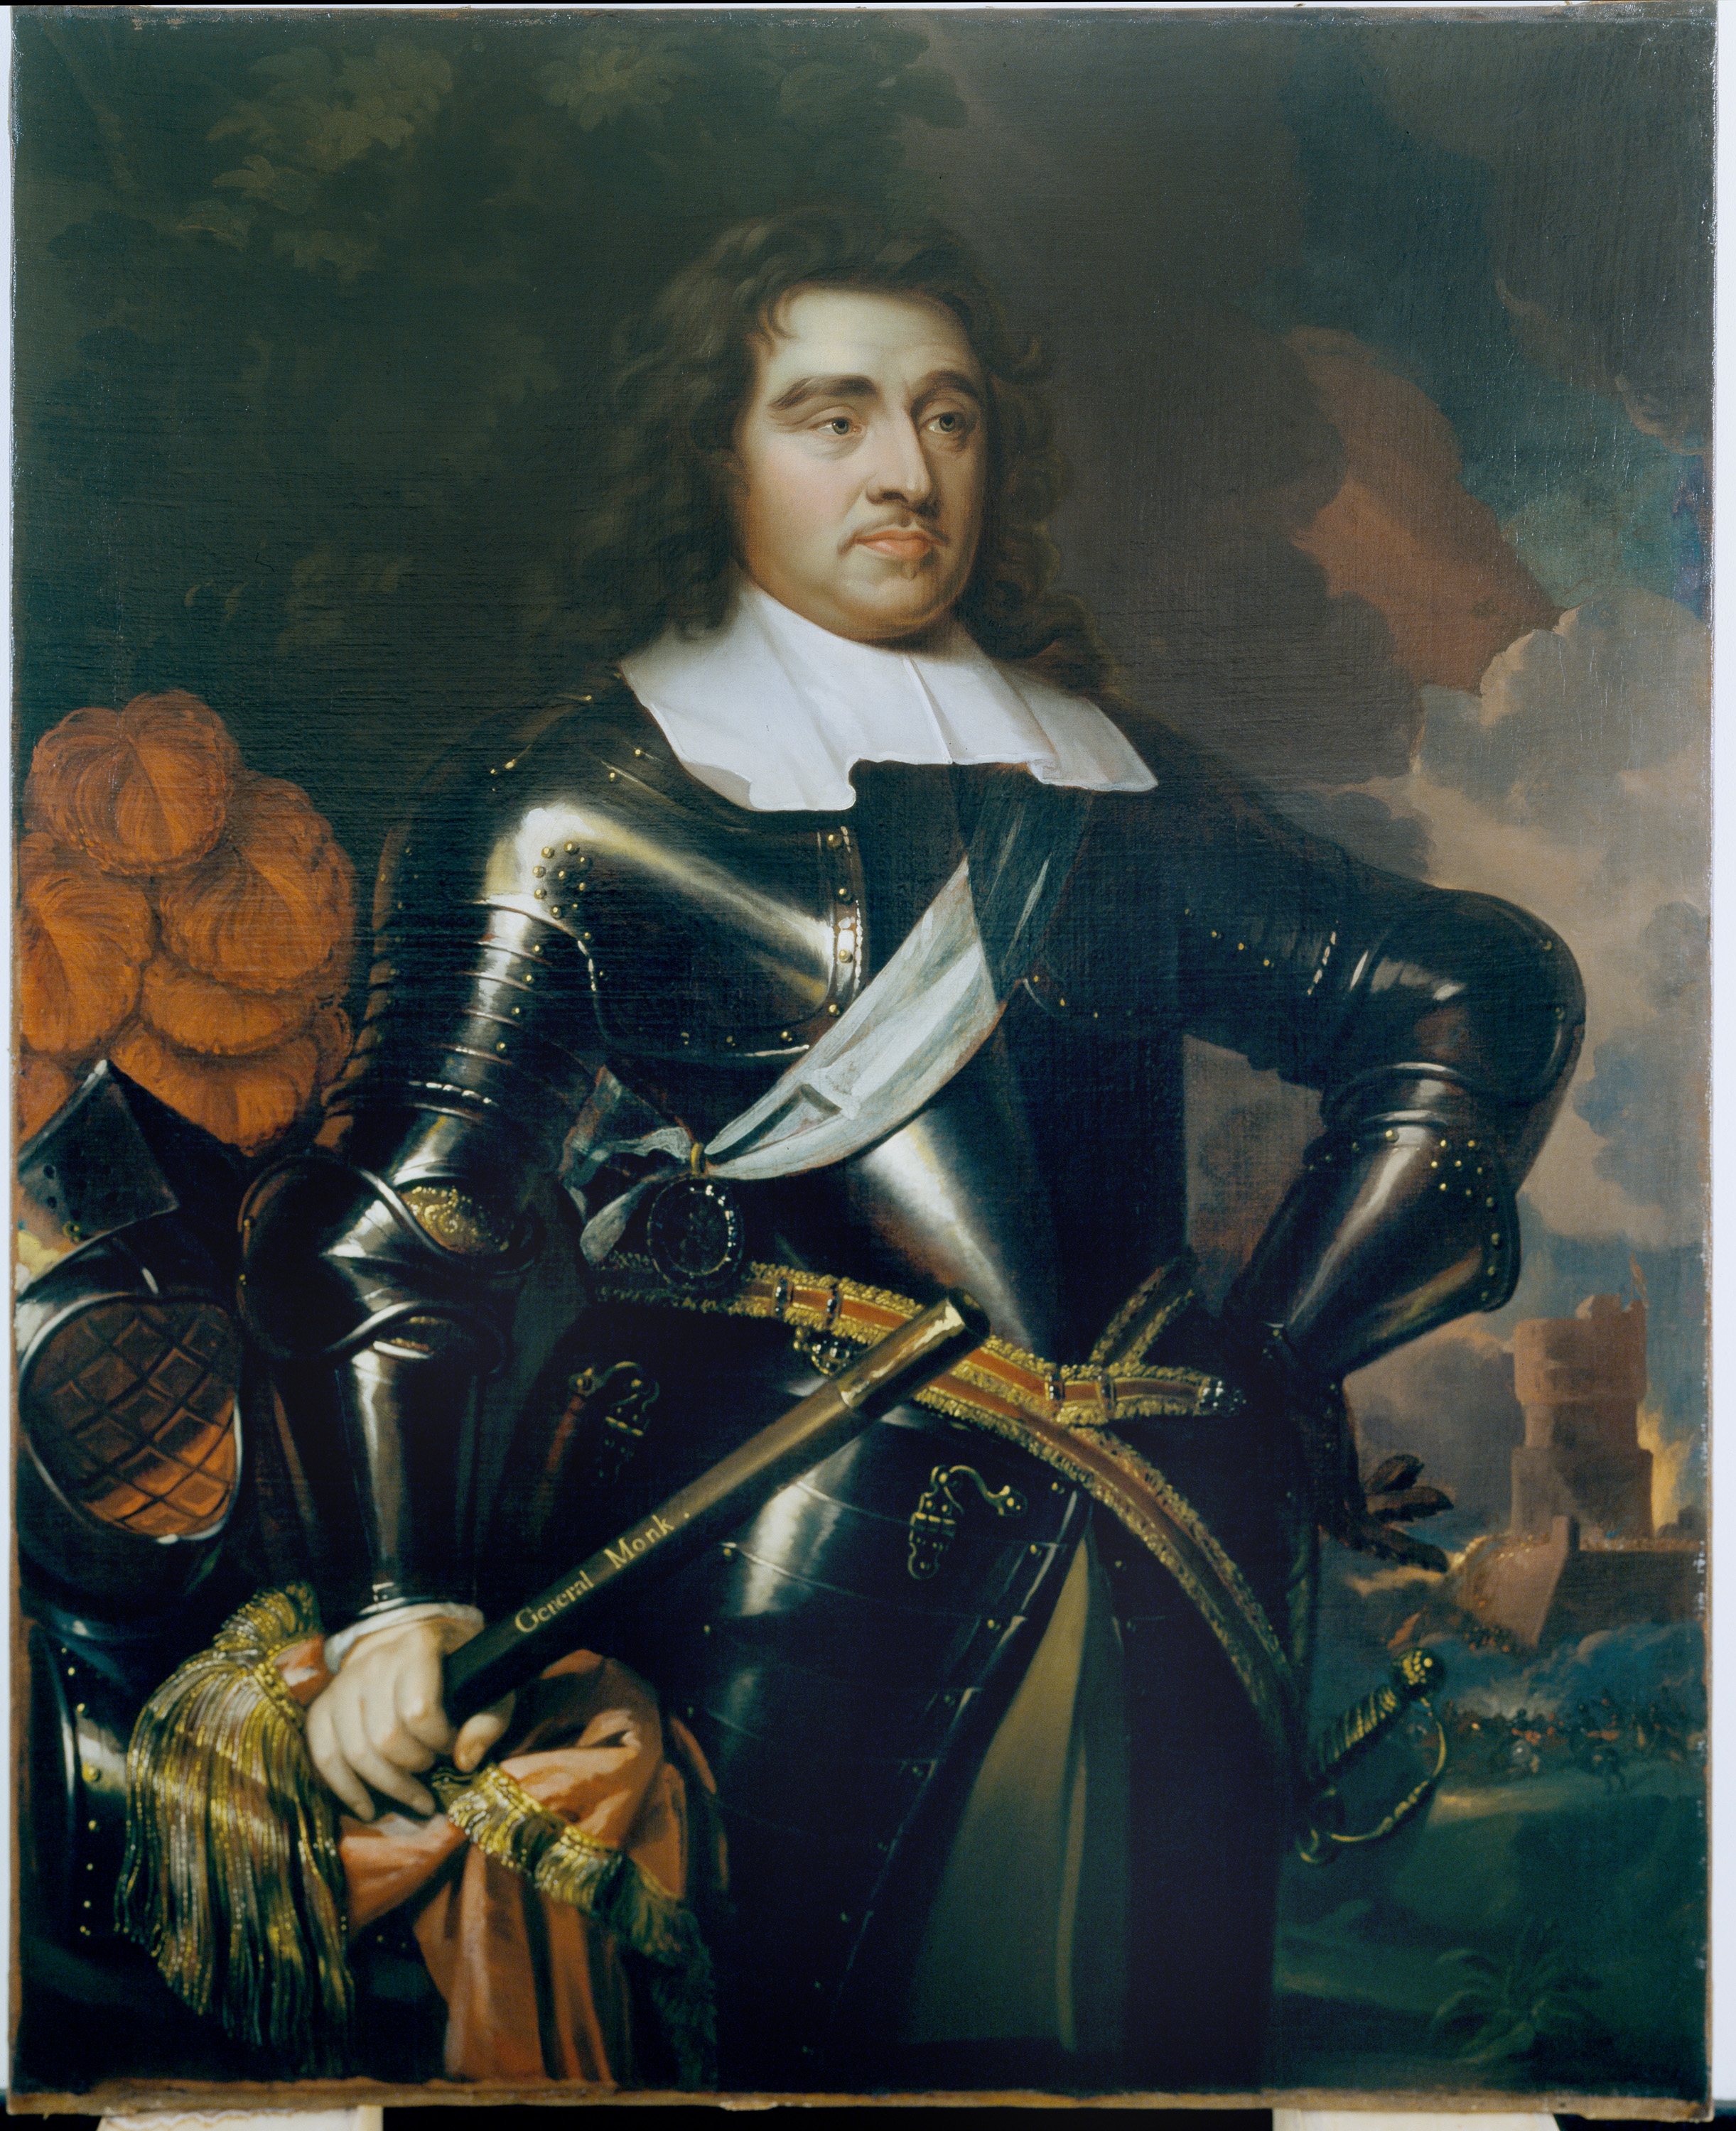
Notes:
General George Monk, 1st Duke of Albemarle, 1665 (c).
Oil on canvas, artist unknown after Samuel Cooper (1609-1672), 1665 (c).
After serving with the Dutch in the 1630s, Monk (1608-1670) fought for King Charles I in Ireland during the English Civil War, commanding a regiment of foot. He later served in Ireland and Scotland on behalf of Parliament, eventually becoming Commander in Chief of the Parliamentary Army in Scotland.
When Oliver Cromwell the Lord Protector, died in 1652, Monk was considered as a possible successor. Although he refused to accept supreme power, Monk retained control of the Army which he had brought south to London, and was thus able to use his influence for the restoration of the Stuart monarchy in 1660. After the Restoration, Charles II raised Monk to the peerage as Duke of Albemarle and he became Captain General, of the King’s forces confirmed by a patent for life.
A contemporary described Monk as ‘a very comely personage, his countenance very manly and majestic, the whole fabric of his body very strong’. A man of great energy, he rose early in the morning and, although he had little education and spelt badly, he always accomplished much. As a commander, he was noted for his understanding of the art of war and for his care of his men.
In this painting he is wearing the sash and the Lesser George (sash badge) of the Order of the Garter, and holds a baton, a symbol of military authority.
NAM. 1985-02-1-1

Slide 5
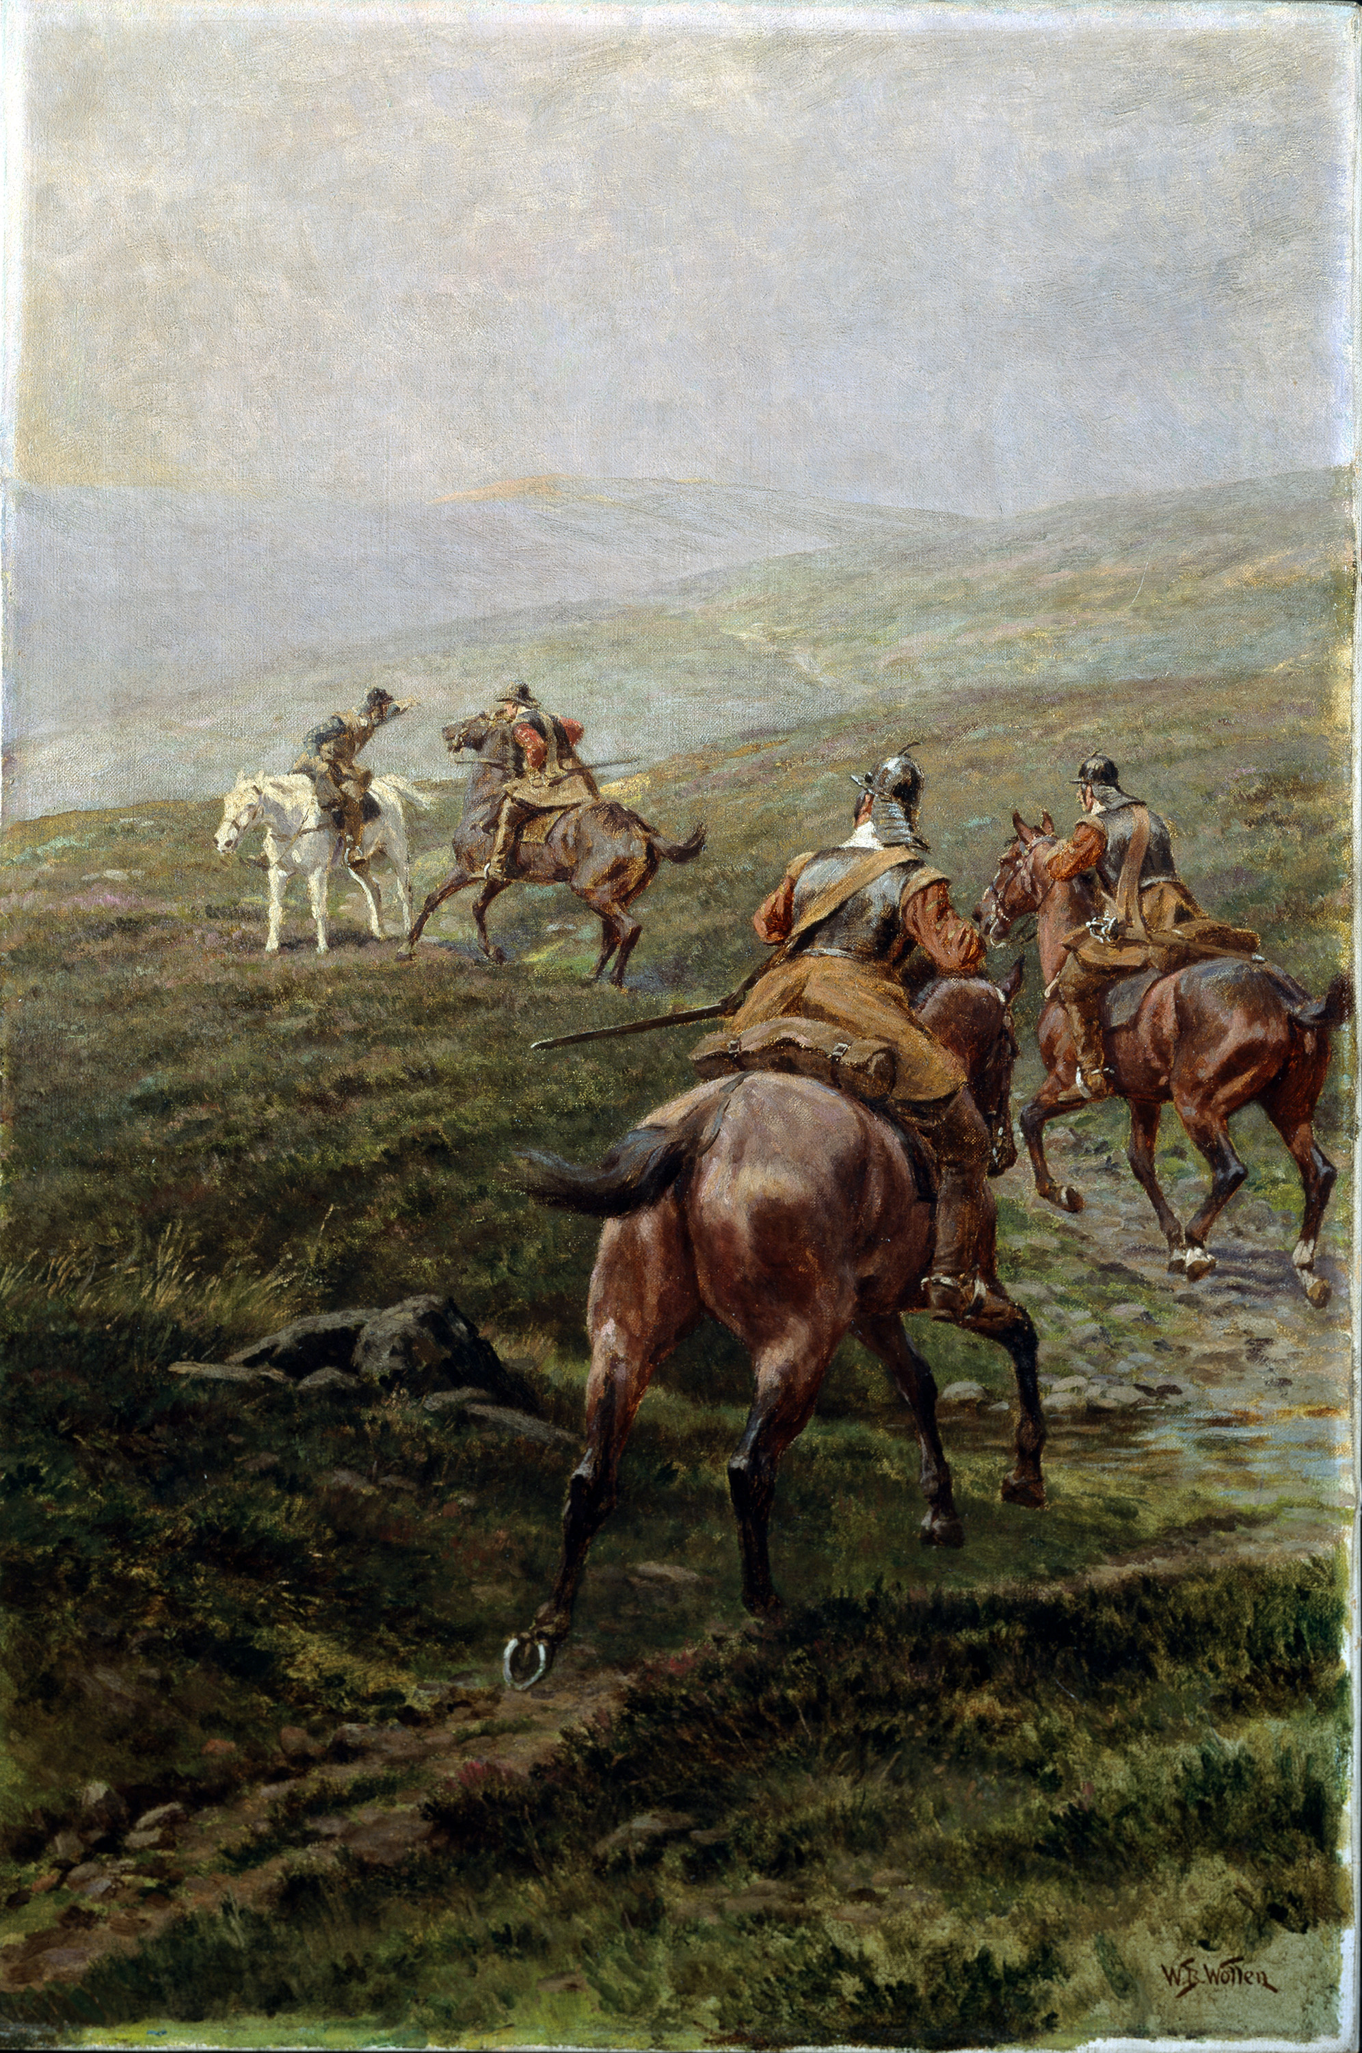
Notes:
‘News’. Horsemen of the New Model Army, 1645 (c).
Oil on canvas by William Barns Wollen (1857-1936), 1910 (c).
Three horsemen of the New Model Army receiving news from a fourth rider, on moorland. Soldiers who fought mounted on horseback were known as cavalry. During the English Civil Wars (1642-1651) they made up a third to a half of most armies. The men depicted in this painting are harquebusiers or light cavalrymen. A fully equipped harquebusier would possess a sword, a pair of pistols, helmet, buff coat, back and breastplate, and a steel gauntlet to cover his bridle hand.
NAM. 1965-05-46-1

Slide 6
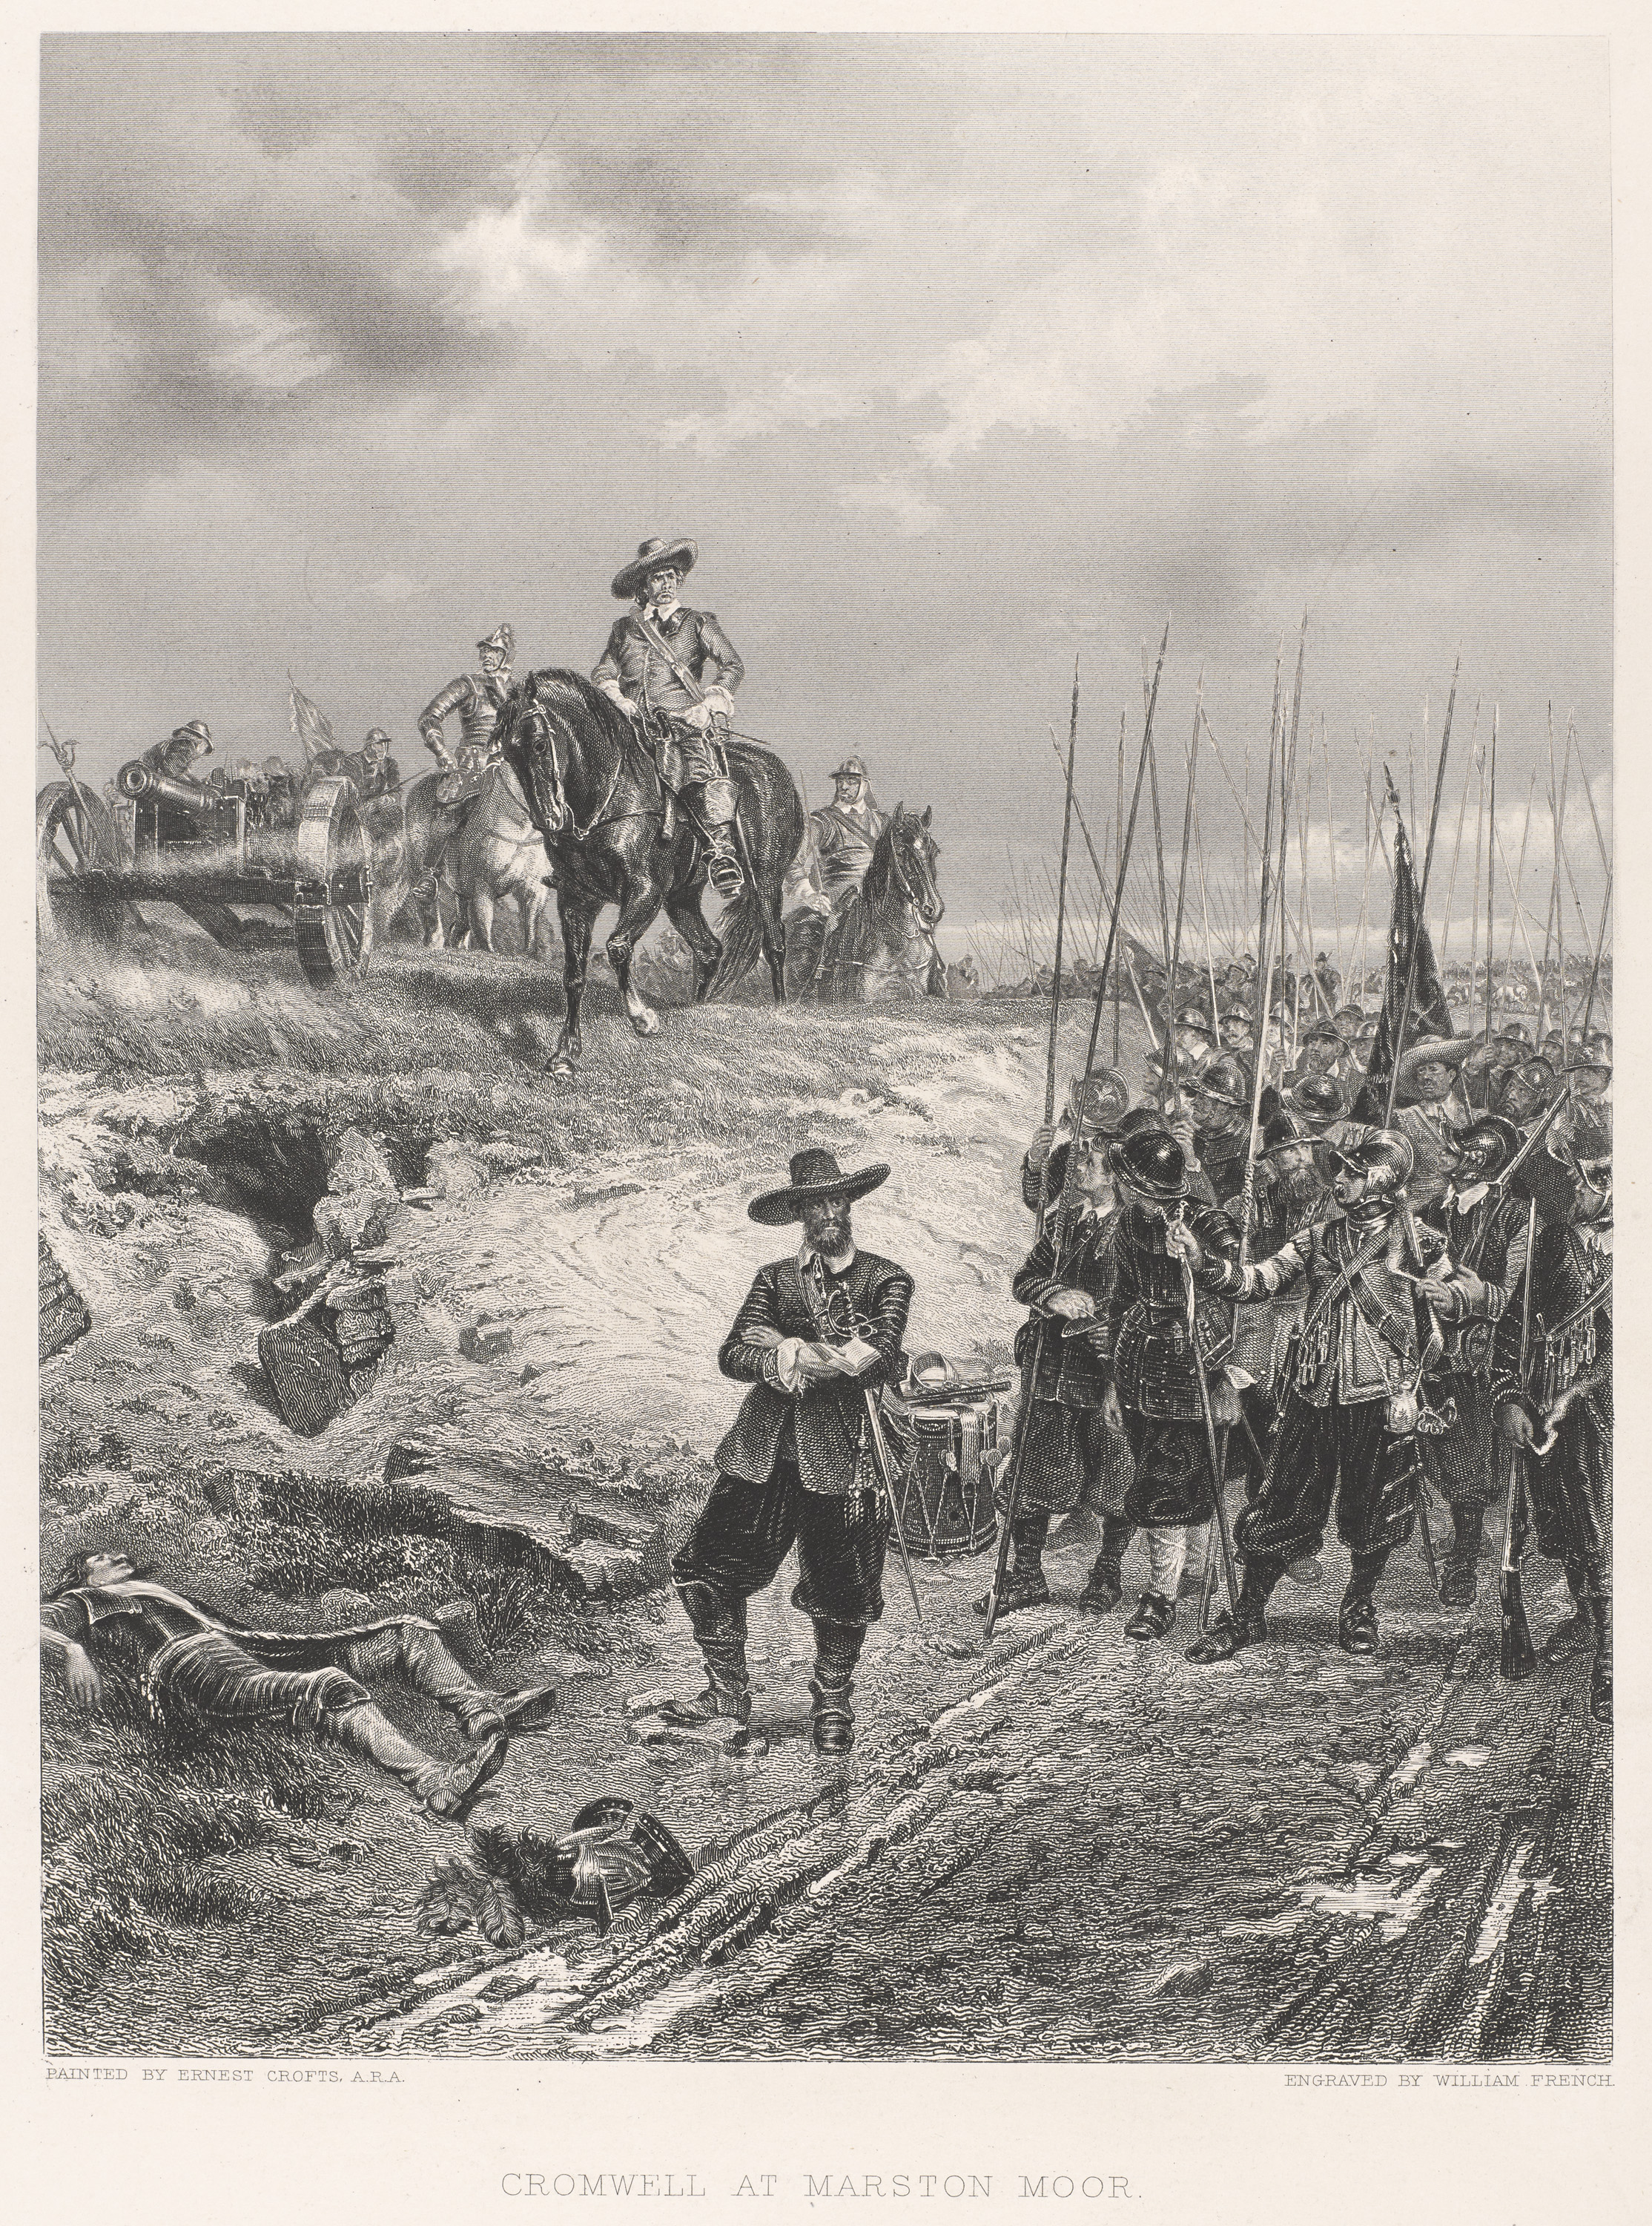
Notes:
General Oliver Cromwell at Marston Moor, 1644.
Engraving by William French after Ernest Crofts ARA, published by J S Virtue and Company Limited, London, 1860 (c).
Cromwell was over 40 years old when he began his military career. At the outbreak of the Civil War in 1642 he served as captain of a troop of horse which he raised for Parliament. He was a natural cavalry commander and soon rose through the ranks.
In February 1644 he was appointed cavalry commander of the Army of the Eastern Association. In July that year, this formed part of the Parliamentarian forces at the Battle of Marston Moor, in which Cromwell commanded the cavalry of the left wing. Here the discipline of his troopers enabled them to deliver a decisive charge at the end of the battle.
NAM. 1999-04-158-1

Slide 7
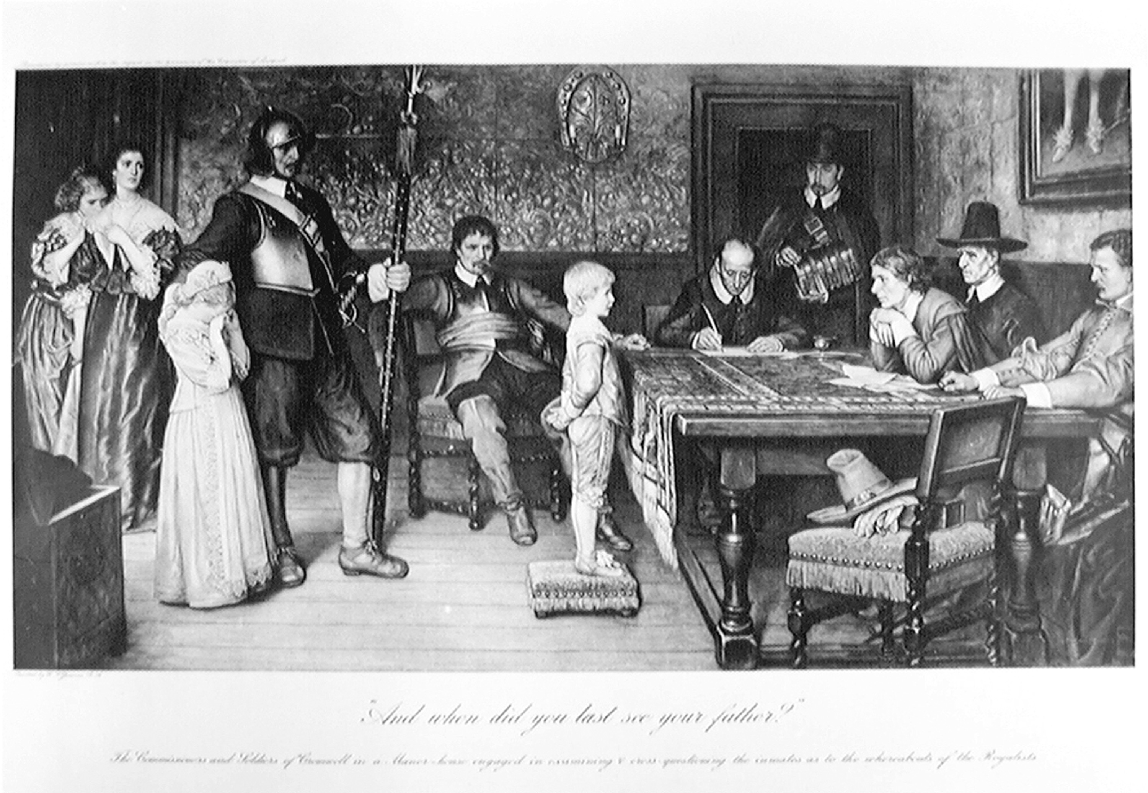
Notes:
‘And When did you last see your father?’
Photogravure after the painting by William Frederick Yeames, 1917 (c).
Published as a Supplement to ‘Holly Leaves’ the Christmas Number of the ‘Illustrated Sporting and Dramatic News’.
Commissioners and soldiers of the Parliamentarian Army question a small boy as his mother and sisters watch fretfully, 1642 (c).
The painting by William Frederick Yeames (1835-1918) is now in the Walker Art Gallery, Liverpool.
NAM. 1999-11-143-1

Slide 8
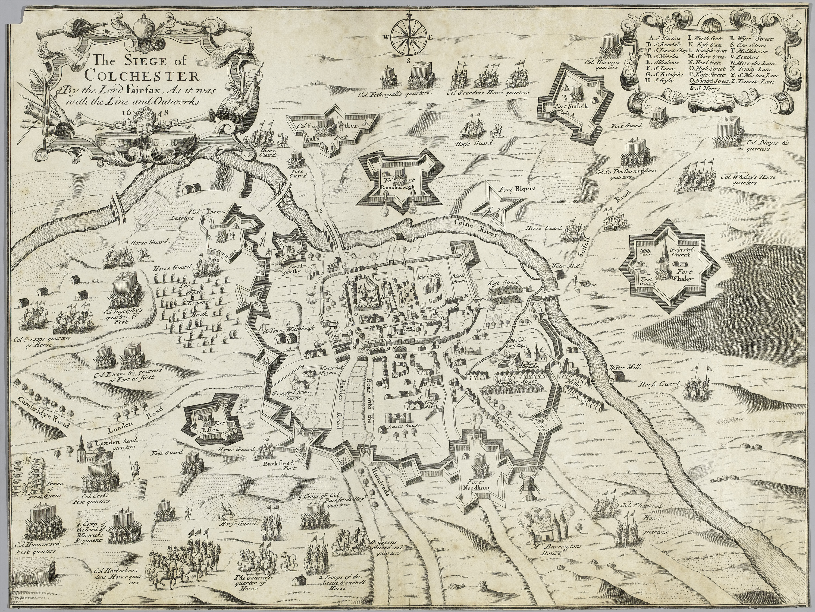
Notes:
’The Siege of Colchester by the Lord Fairfax, as it was with the line and outworks 1648’.
Engraving published 1648 (c).
A birds-eye view of the town and surrounding area, forts and positions of the parliamentary army. The siege lasted for 11 weeks and despite suffering extreme hardship and hunger, Lord Norwich’s Royalist garrison only surrendered following news of the defeat of the Royalist army in the North of England at the Battle of Preston (1648).
NAM. 2000-05-37-1

Slide 9
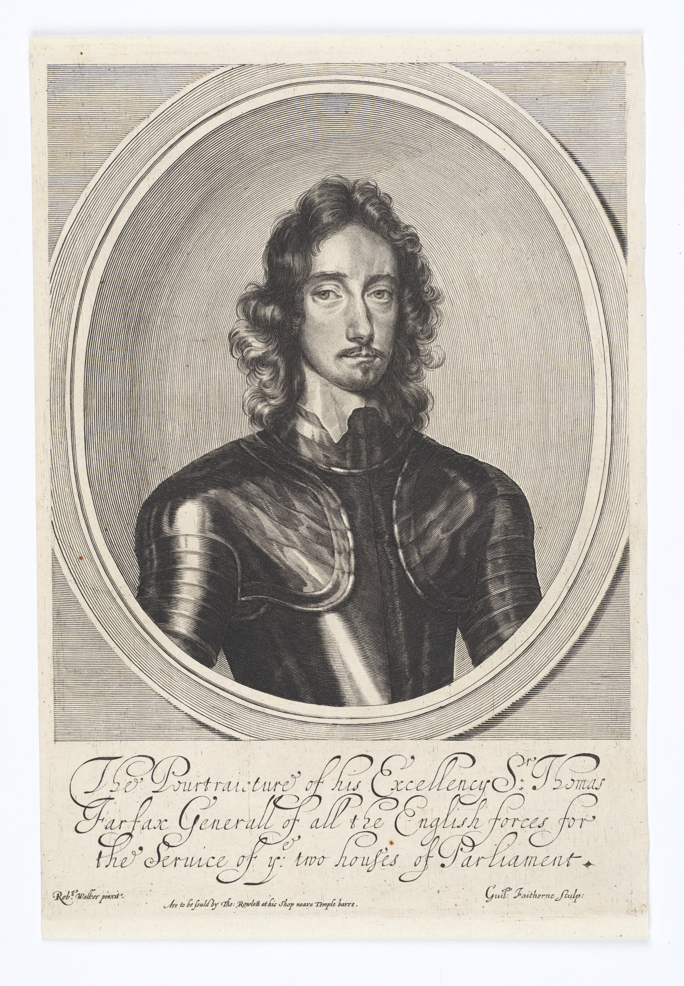
Notes:
‘The Pourtraiture [sic] of his Excellency Sir Thomas Fairfax Generall of all the English Forces’, 1645 (c).
Engraving by W Faithorne after Robert Walker, published 1645 (c).
Fairfax (1612-1671) was arguably the most important general of the Civil War. As Commander-in-Chief of the New Model Army, he played a key role in the defeat of the Royalists, yet after the death of Oliver Cromwell he was also instrumental in the Restoration of King Charles II.
The Fairfaxes were prominent amongst gentry families supporting Parliament in northern England. Throughout 1643, often fighting against great odds, they pinned down larger Royalist forces, preventing them from marching south to reinforce the king. In a series of battles, culminating in the Parliamentarian victory at Winceby in October 1643, Fairfax established a reputation as a courageous cavalry commander, always willing to be in the thick of the action. He was also lucky (a quality which Napoleon admired in a general). Although wounded on several occasions, he survived all his injuries. By the end of 1643 he was recognised as one of Parliament’s most valuable commanders.
Fairfax’s victories at Nantwich in January, and Selby in April 1644, cemented his reputation. Although his command was routed at the battle of Marston Moor (July 1644) his efforts in holding out against the odds the previous year had laid the groundwork for the Parliamentarian victory.
In December 1644, at the age of just 32, Fairfax was appointed commander of the New Model Army. In less than six months, he forged the remains of three older Parliamentarian armies into a new battle-winning force. Its first test came in June 1645 at the battle of Naseby, where years of battlefield experience and an instinctive sense of timing enabled Fairfax to smash the Royalist army in just two hours. The next month he destroyed the last effective Royalist field army at the battle of Langport and followed this with a mopping up operation which culminated in the fall of Oxford, the Royalist capital, in June 1646.
Fairfax was popular with his men, but could be ruthless when circumstances demanded it. During the Second Civil War he ordered two of the captured Royalist defenders of Colchester to be shot, and in 1649 ordered the execution of a number of army mutineers.
Fairfax was out of his depth in politics and often found himself out-manoeuvred. He refused to attend the trial of Charles I in 1649 and tried to avert the king’s execution. He remained in England during Cromwell’s invasion of Ireland, and refused to lead the invasion of Scotland in 1650, which caused him to resign his command. Always opposed to military rule, in 1660 Fairfax raised troops in Yorkshire to support General George Monck. By neutralising Parliamentarian forces in the north, he gave Monck the chance to march south and restore King Charles II.
NAM. 2000-05-47-1

Slide 10
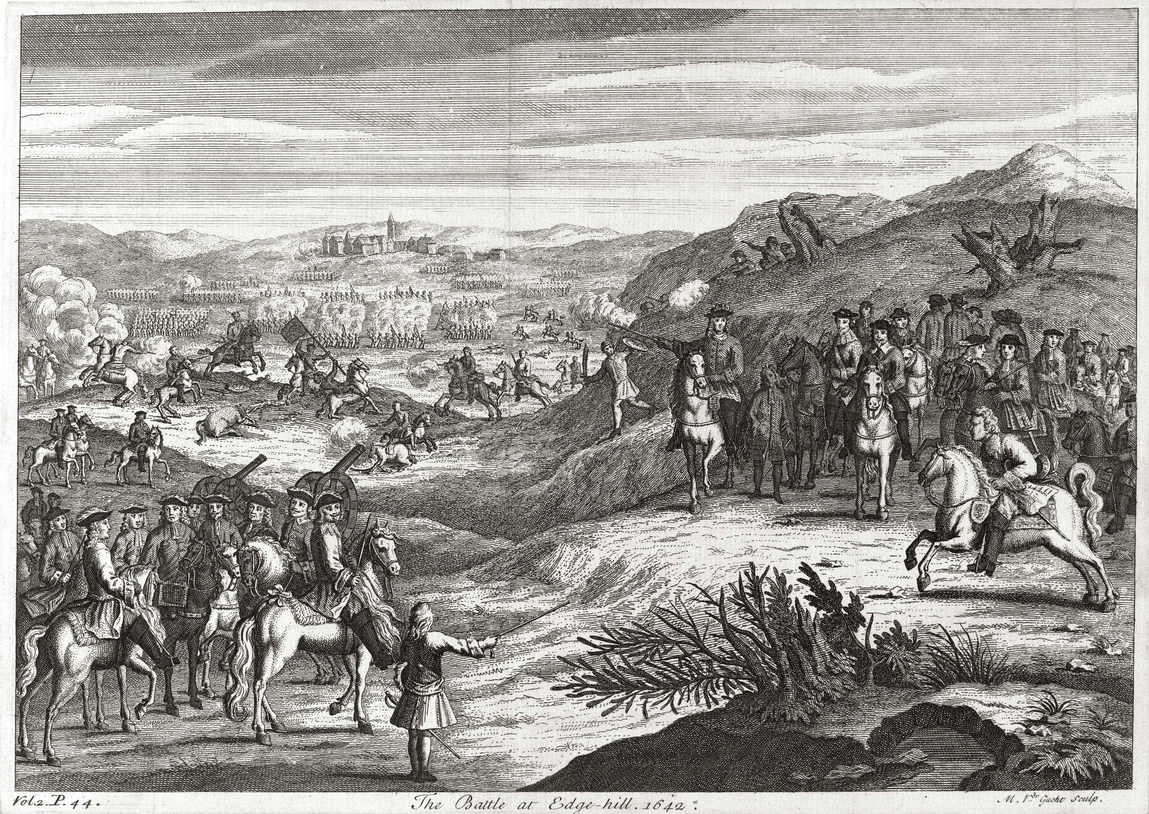
Notes:
The Battle of Edgehill, 1642.
Engraving by Michael van de Gucht, published 1710 (c).
Edgehill, near Banbury, was the scene of the first major battle of the Civil War. The opposing armies, commanded by the King and the Earl of Essex, each numbered about 14,000 men.
The battle opened with an exchange of artillery fire. The Royalist cavalry, commanded by Prince Rupert, then charged and routed their opponents. However, their success carried them away from the battlefield and, in their absence, the Parliamentarians inflicted heavy losses on the Royalist infantry. After four hours both sides were too exhausted to continue fighting. Over 3,000 casualties had been inflicted, but this later engraving gives no indication of the carnage of the battlefield.
Essex retreated north, leaving the road to London open, and giving the King the chance to march on the capital. Charles was slow to take advantage of this opportunity however, giving Parliament the time to assemble forces at Turnham Green to resist him.
NAM. 2000-06-66-1

Slide 11
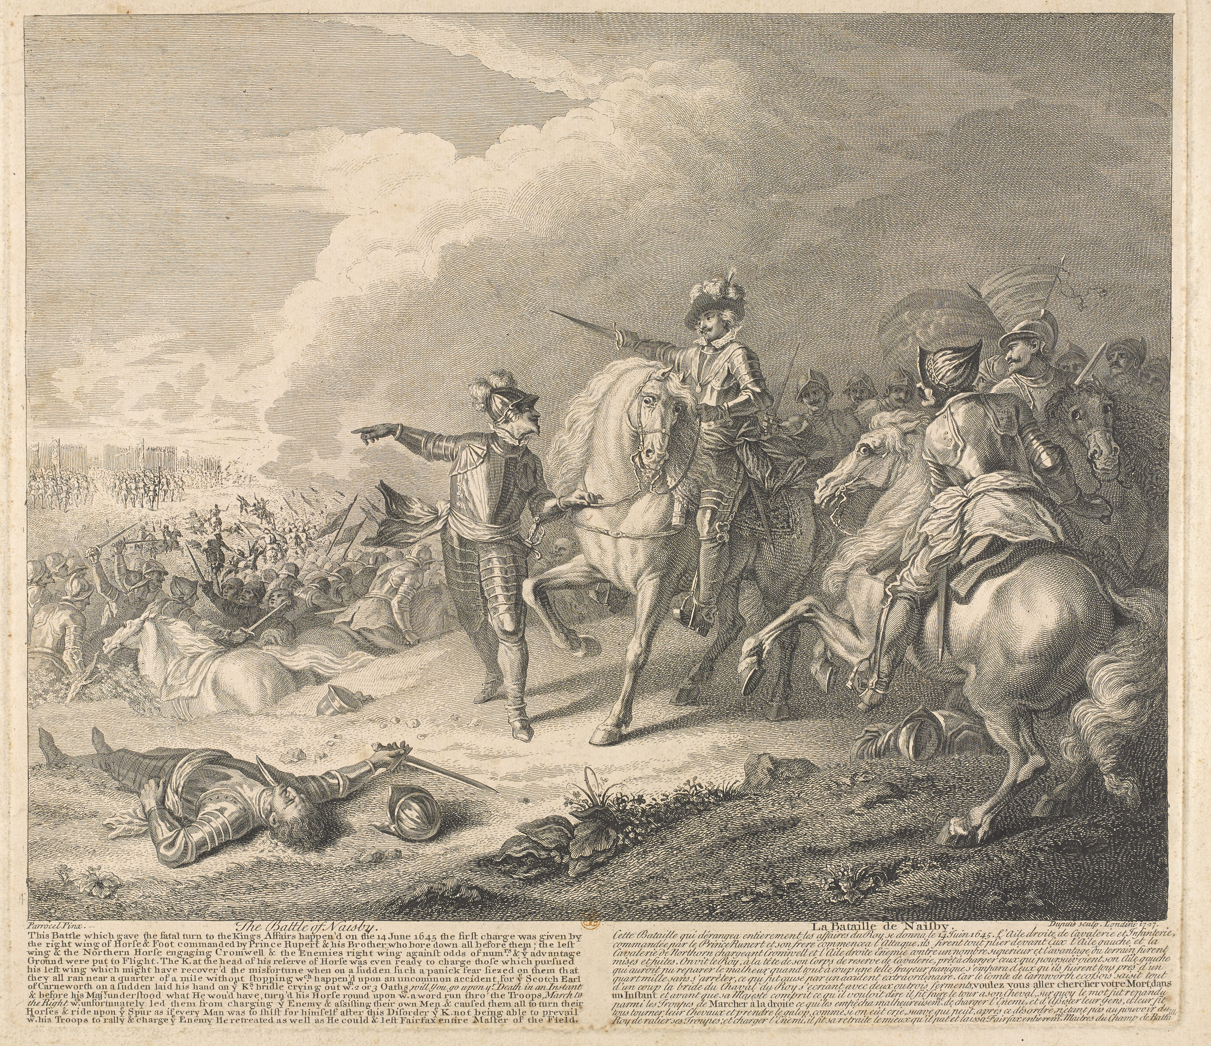
Notes:
The Battle of Naseby, 14 June 1645.
Engraving by Dupuis after Charles Parrocel, publisher unknown, 1728.
Naseby won the First English Civil War (1642-1646) for Parliament and ensured that, whatever happened subsequently, the monarch would never again be supreme in British politics. It was a victory secured by Parliament’s radically different New Model Army, a national fighting force not tied to a region or locality, and the immediate predecessor of the British Army of today.
The battle was also a victory for the discipline that Oliver Cromwell instilled in his cavalry. Initially triumphant on the left, Prince Rupert’s Royalist horsemen charged wildly off the battlefield in pursuit of their opponents. In contrast, Cromwell’s ‘Ironsides’, victorious on the opposite flank, rallied immediately and attacked the Royalist infantry from behind. Although these had been getting the better of their fight against the Parliamentarian foot soldiers, they now surrendered. The resulting defeat of King Charles I’s army was total and final while Cromwell’s victory set the seal on his personal ascendancy.
NAM. 1971-02-33-266-1

Slide 12
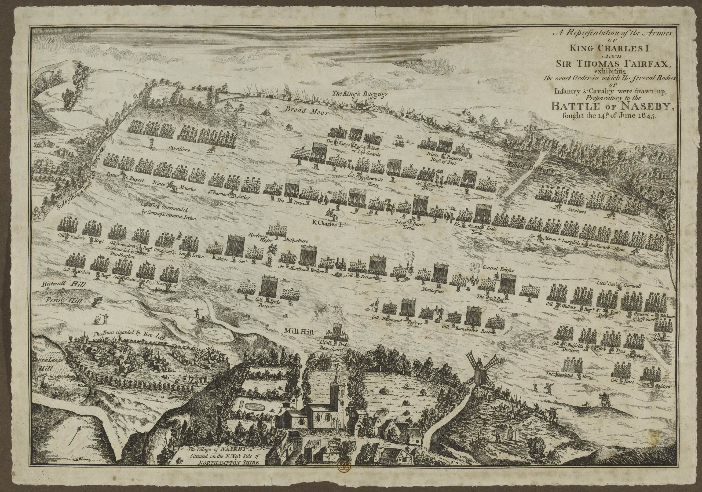
Notes:
‘A representation of the Armies of King Charles I and Sir Thomas Fairfax exhibiting the exact order preparatory to the Battle of Naseby’.
Line engraving, 1645 (c).
Naseby won the First English Civil War (1642-1646) for Parliament and ensured that, whatever happened subsequently, the monarch would never again be supreme in British politics. This was a victory secured by Parliament’s radically different New Model Army, a national fighting force not tied to a region or locality, and the immediate predecessor of the British Army of today. The defeat of King Charles I’s army was total and it set the seal on Oliver Cromwell’s personal ascendancy.
The battle itself was a victory for the discipline that Cromwell instilled in his cavalry. Initially triumphant on the left, Prince Rupert’s Royalist horsemen charged wildly off the battlefield in pursuit of their opponents. In contrast, Cromwell’s ‘Ironsides’, victorious on the opposite flank, rallied immediately and attacked the Royalist infantry from behind. Although these had been getting the better of their fight against the Parliamentarian foot soldiers, they now surrendered.
This contemporary map of Naseby comes from a Parliamentarian source, which was concerned to magnify the achievements of the New Model Army. It shows both armies to be of approximately equal size, whereas the Royalists (9,000) were in fact heavily outnumbered by their opponents (13,500).

Slide 13
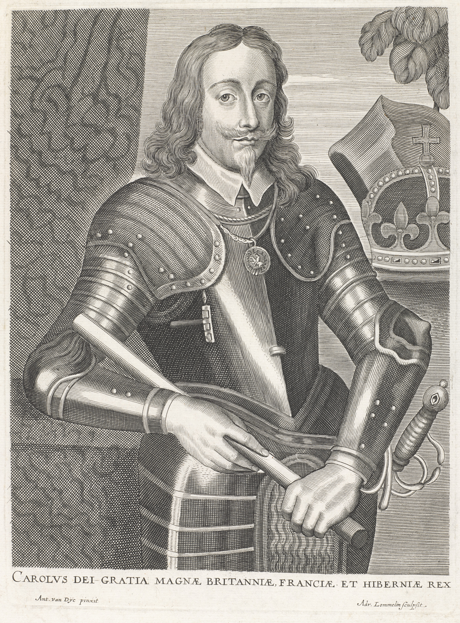
Notes:
‘Carolus dei Gratia Magnae Britanniae, Franciae et Hiberniae’.
Line engraving by A Lommelin after Sir Anthony Van Dyck, published 1660 (c).
King Charles I’s (1600-1649) struggles with and eventual dismissal of Parliament, along with his imposition of taxes and attempts to impose religious uniformity, eventually caused civil war in Britain. Finally defeated during the Second Civil War (1648-1649) he was tried on the charge that he 'traitorously and maliciously levied war against the present Parliament and the people'. He was executed in Whitehall on 30 January 1649.
NAM. 1992-02-201-1

Slide 14
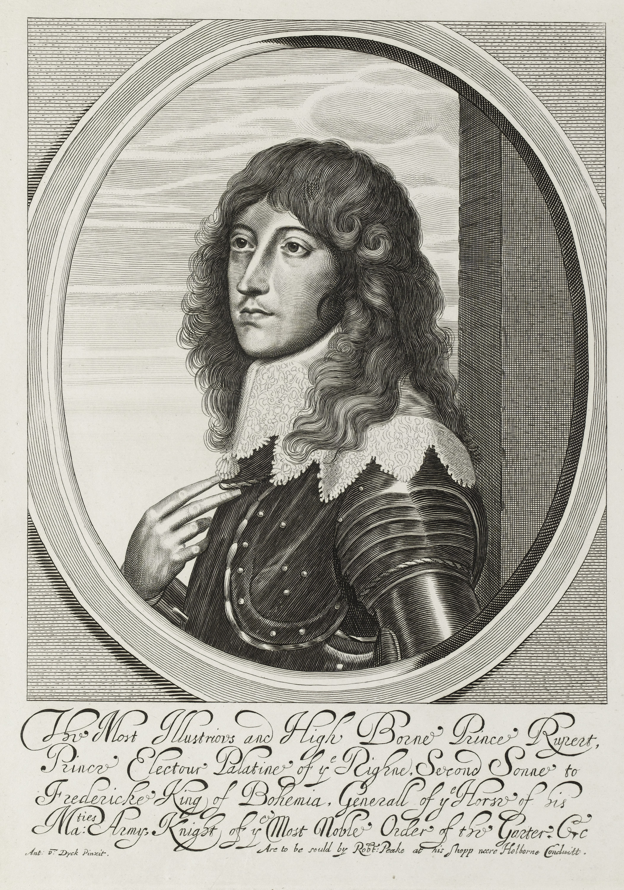
Notes:
The Most Illustrious and High Borne Prince Rupert. Oval bust portrait, in armour’, 1640 (c).
Line engraving after Sr Anthony Van Dyck, a later impression of a print originally published by Robert Peake, London, 1640 (c).
Prince Rupert of the Rhine (1619-1682) was a nephew of King Charles I and a charismatic Royalist cavalry commander during the First Civil War (1642-1646). Rupert had considerable success during the early years of the conflict. His drive, determination and experience of European military techniques brought him several victories, but he eventually surrendered to Parliamentarian forces after the fall of Oxford in 1646 and was banished from England.
NAM. 1992-02-211-1

Slide 15
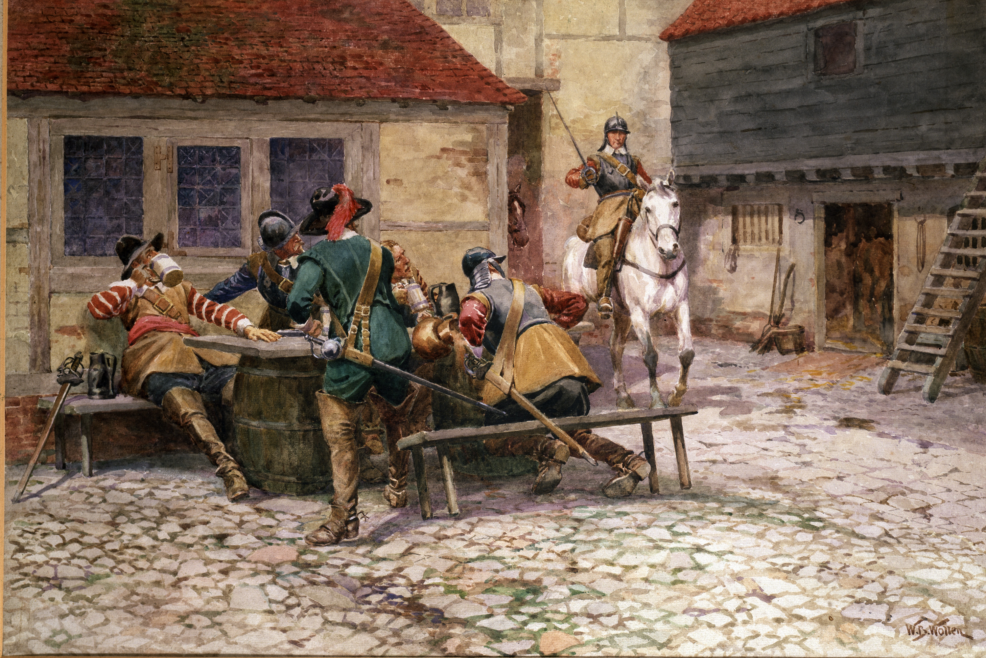
Notes:
Troopers of the English Civil War, 1645 (c).
Watercolour by William Barns Wollen, 1900.
This water colour depicts a mounted soldier surprising four other men as they drink outside a tavern. During the English Civil Wars (1642-1651) cavalry made up a third to a half of most armies. The men depicted in this painting are harquebusiers. A fully equipped harquebusier would possess a sword, a pair of pistols, a helmet, buff coat, riding boots, back and breastplate, and a steel gauntlet to cover his bridle hand. It was often the case however that cavalrymen of both the Parliamentary and Royalist armies had a mix of these items, depending on what was available to them.
NAM. 1967-05-57-1

Slide 16
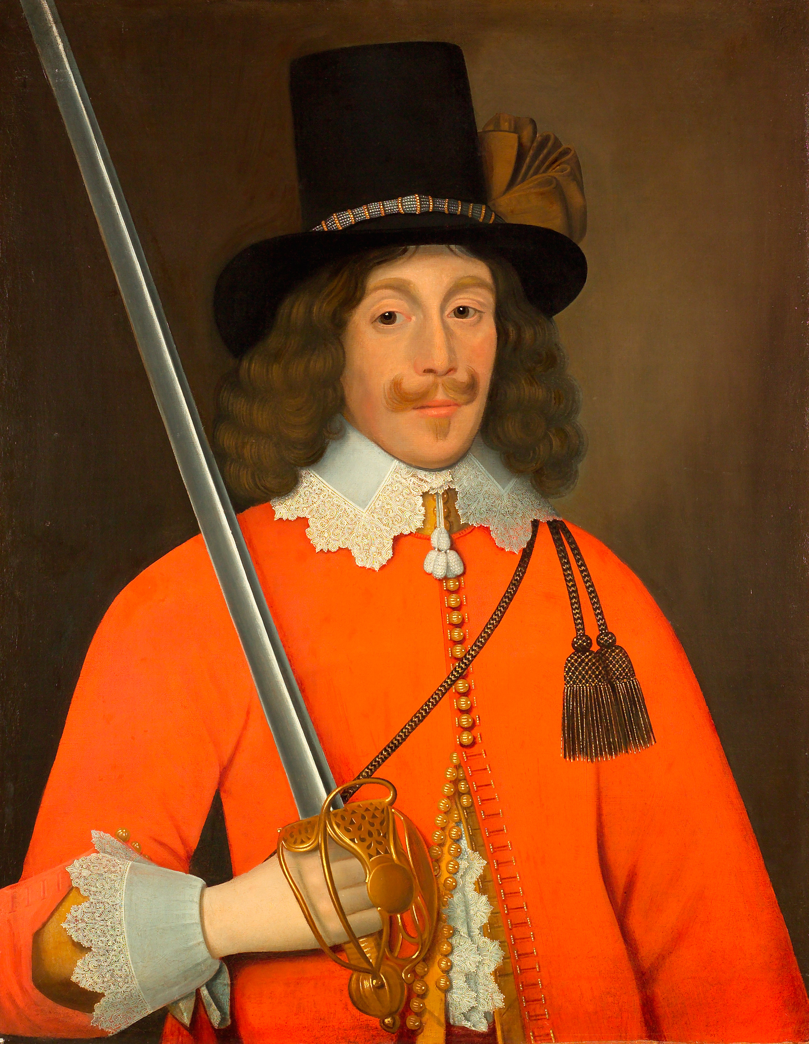
Notes:
Portrait, traditionally said to be of Colonel John Hutchinson, Parliamentarian and Governor of Nottingham Castle, 1643 (c).
Oil on canvas, attributed to John Souch of Chester (1593 (c)-1645), 1643 (c).
Colonel John Hutchinson (1615-1664) was a regicide: one of the 59 Commissioners who signed the death warrant of King Charles I in 1649. During the Civil War he joined the Parliamentarian army with his cousin, Henry Ireton, and led the defence of the city of Nottingham.
On the Restoration of the monarchy in 1660, many regicides were executed for treason. Others were hunted down and assassinated, exiled or locked up. The bodies of those who had already died, such as Oliver Cromwell and Henry Ireton, were exhumed and then publicly hanged, beheaded and thrown into a pit. Instead, with the help of his wife, John Hutchinson managed to escape with an incredibly light punishment: he lost his position as a Member of Parliament. However, in 1663 he was implicated in an armed rebellion and imprisoned. He died in 1664.
NAM. 2006-06-8-1

Slide 17
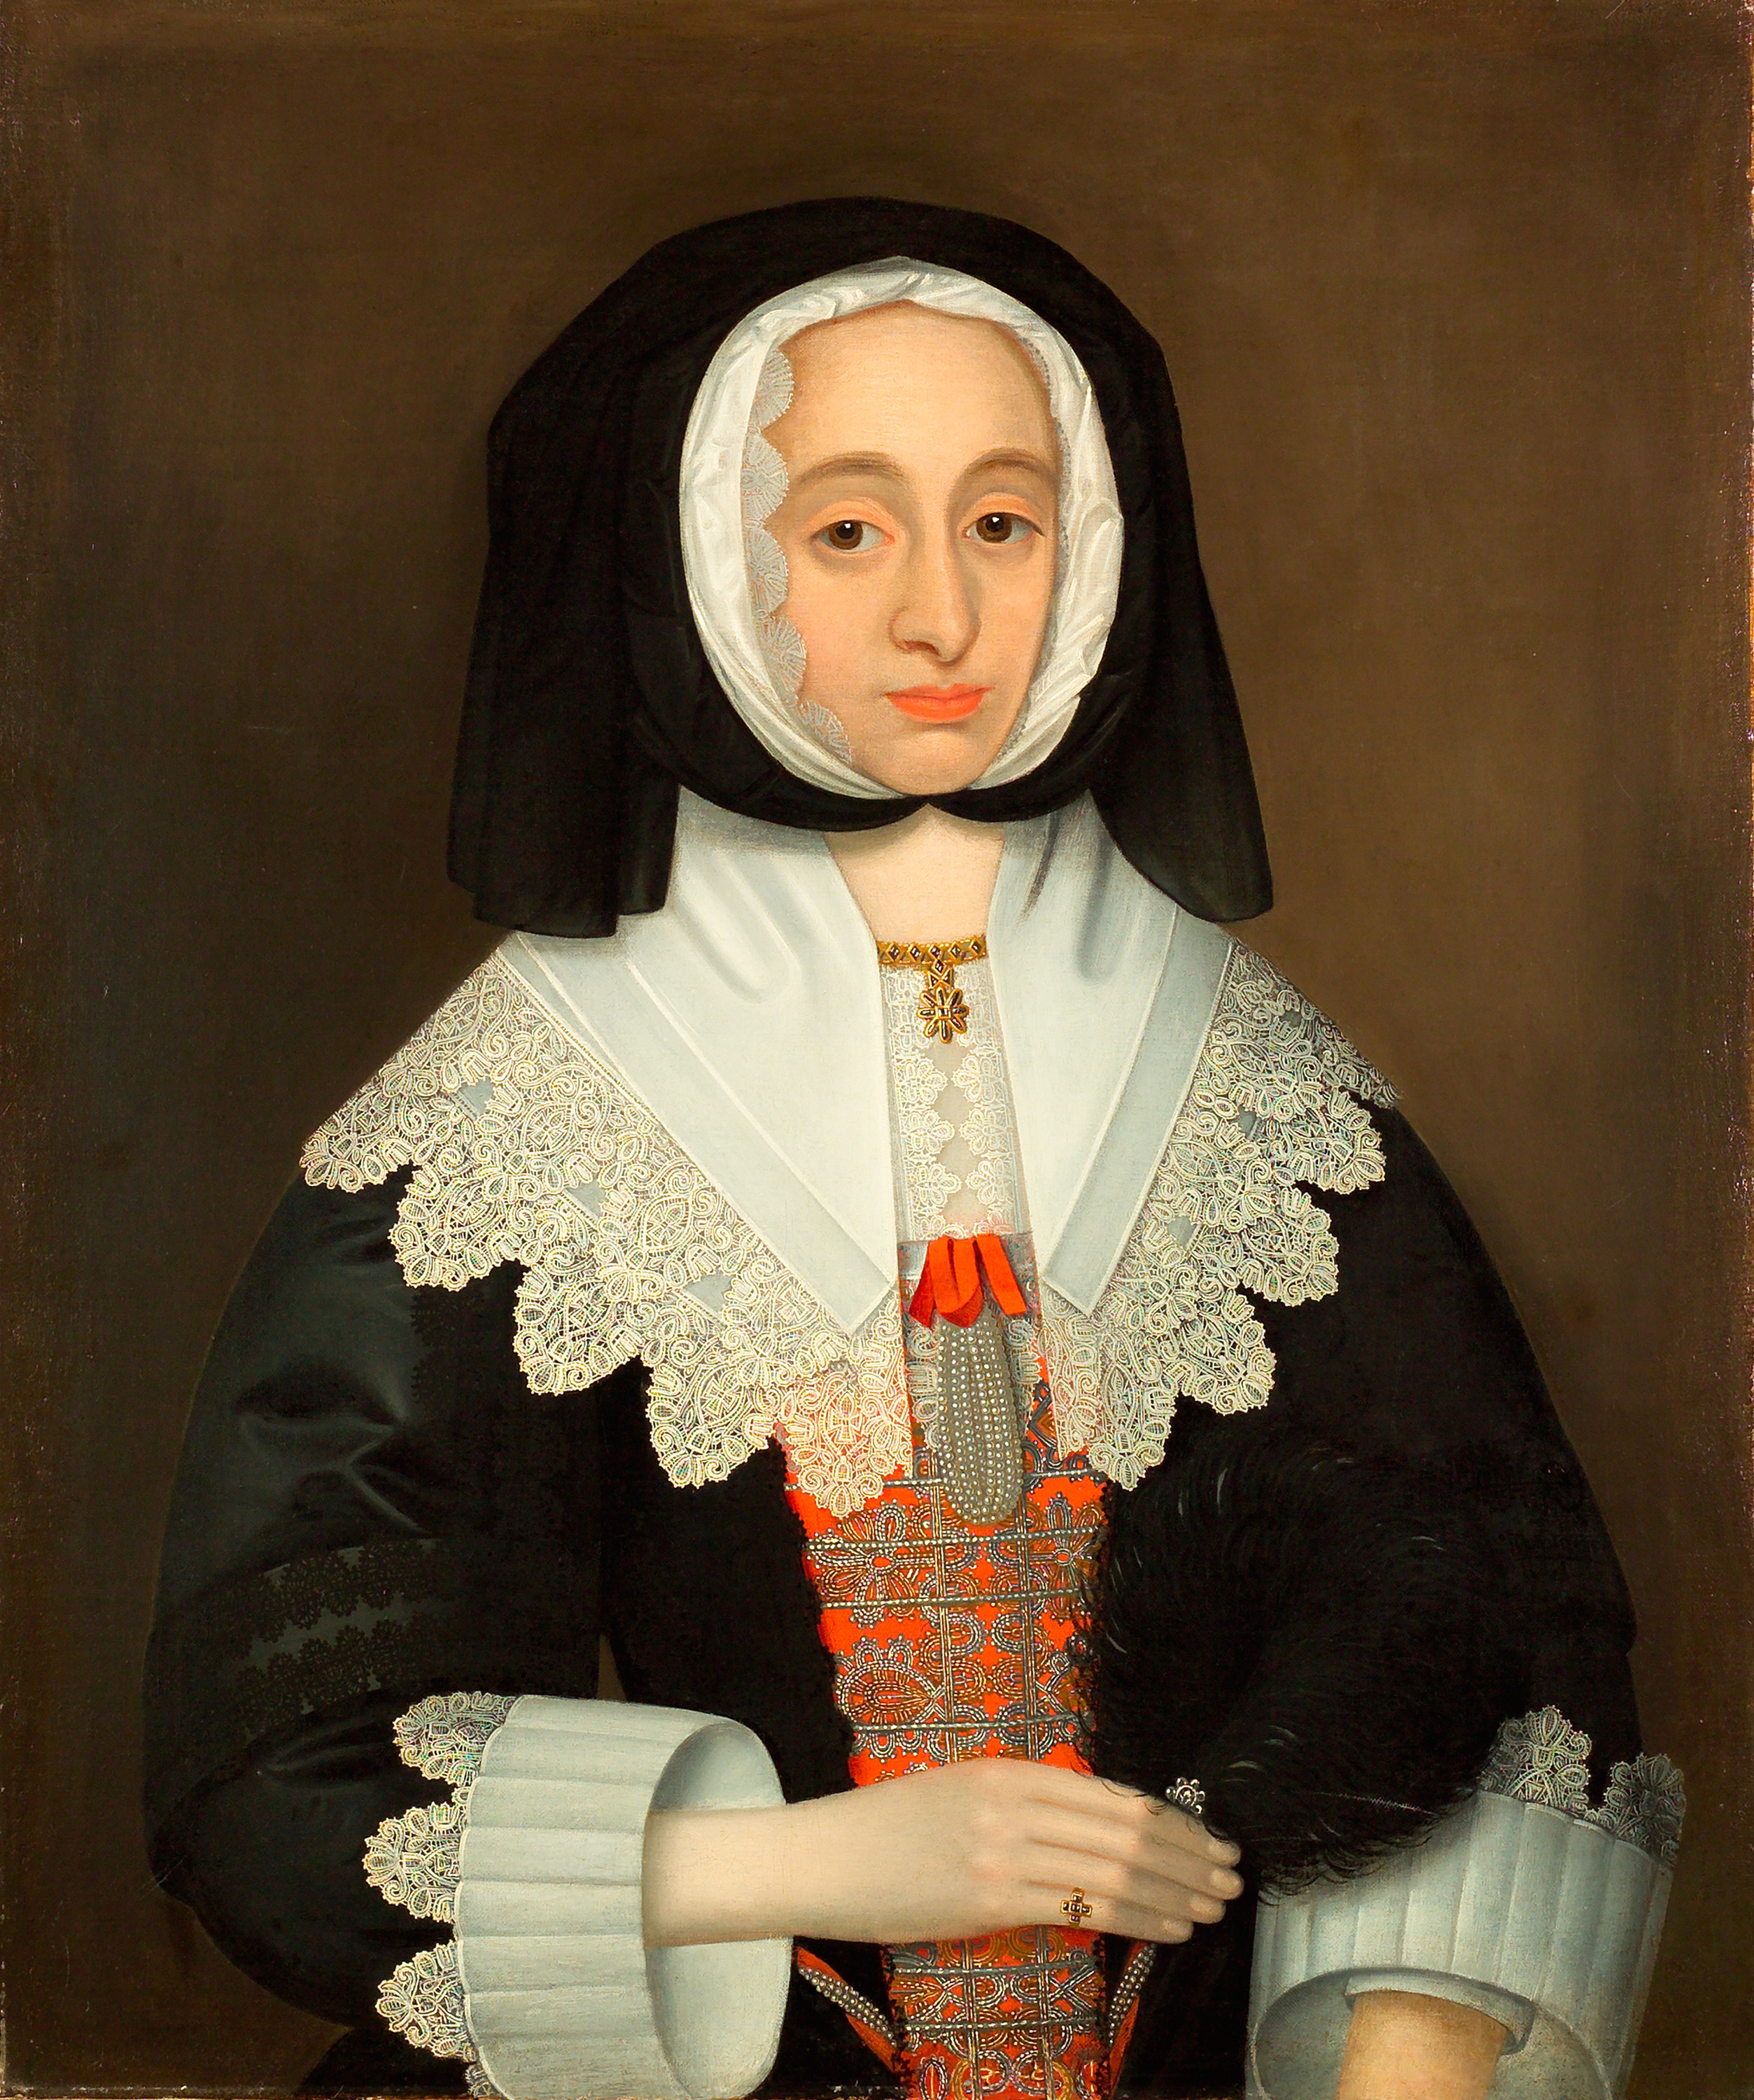
Notes:
Portrait, traditionally said to be of Mrs Lucy Hutchinson, 1643 (c).
Oil on canvas, attributed to John Souch of Chester (1593 (c)-1645).
Colonel John Hutchinson was a regicide: one of the 59 Commissioners who signed the death warrant of King Charles I in 1649. During the Civil War he joined the Parliamentarian army with his cousin, Henry Ireton, and led the defence of the city of Nottingham.
On the Restoration of the monarchy in 1660, many regicides were executed for treason. Others were hunted down and assassinated, exiled or locked up. The bodies of those who had already died, such as Oliver Cromwell and Henry Ireton, were exhumed and then publicly hanged, beheaded and thrown into a pit. Instead, with the help of his wife, John Hutchinson managed to escape with an incredibly light punishment: he lost his position as a Member of Parliament. However, in 1663 he was implicated in an armed rebellion and imprisoned. He died in 1664.
Lucy Hutchinson (1620-1681) was a remarkable woman. She was well educated, which was unusual for women in the early 1600s. Devoted to her husband, she used her family connections to campaign for a lenient sentence for him. Following his death, Lucy felt her husband’s name needed to be cleared: the biography she wrote to explain his behaviour, ‘Memoirs of the Life of Colonel Hutchinson’, was one of the first to be written by a woman. It was not published until 1806, but its success and significance have meant that, today, she is better known to historians than her husband.
NAM. 2006-06-9-1

Slide 18
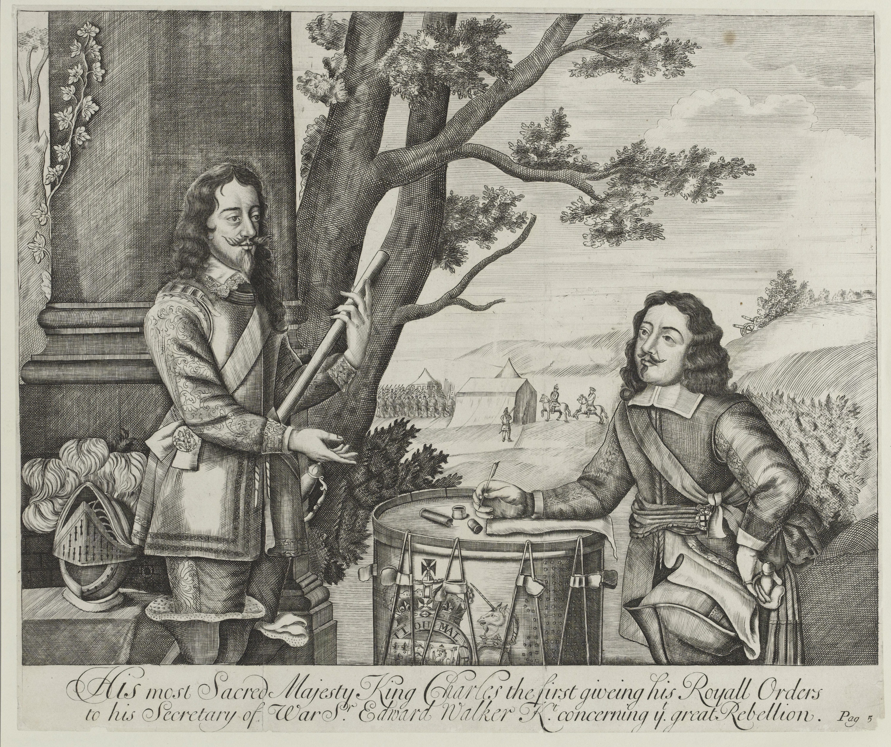
Notes:
‘His Most Sacred Majesty King Charles the first giving his Royal Orders to his Secretary concerning the great Rebellion’.
Engraving by an unknown artist from Sir Edward Walker’s ‘Historical Discourses’ published 1705.
King Charles I's (1600-1649) struggles with and eventual dismissal of Parliament, along with his imposition of taxes and attempts to impose religious uniformity, eventually caused civil war in Britain. Finally defeated during the Second Civil War (1648-1649) he was tried on the charge that he 'traitorously and maliciously levied war against the present Parliament and the people'. He was executed in Whitehall on 30 January 1649.
NAM. 1990-11-29-1

Slide 19
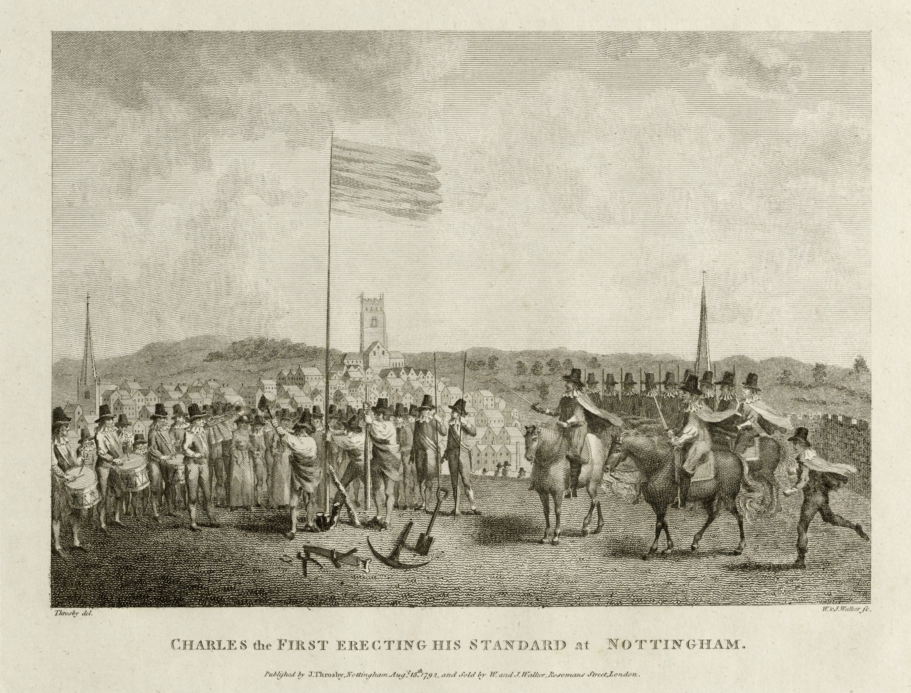
Notes:
‘Charles the First Erecting his Standard at Nottingham’, 1642.
Line engraving by W and J Walker after J Throsby, published by J Throsby, Nottingham, 15 August 1792.
On 22 August 1642 King Charles I raised his royal standard at Nottingham, effectively marking the start of the First Civil War (1642-1646). The conflict was the outcome of his long struggle with and eventual dismissal of Parliament, along with his imposition of taxes and attempts to impose religious uniformity.
Finally defeated during the Second Civil War (1648-1649), he was tried on the charge that he 'traitorously and maliciously levied war against the present Parliament and the people'. He was executed in Whitehall on 30 January 1649.
NAM. 1990-06-34-1

Slide 20
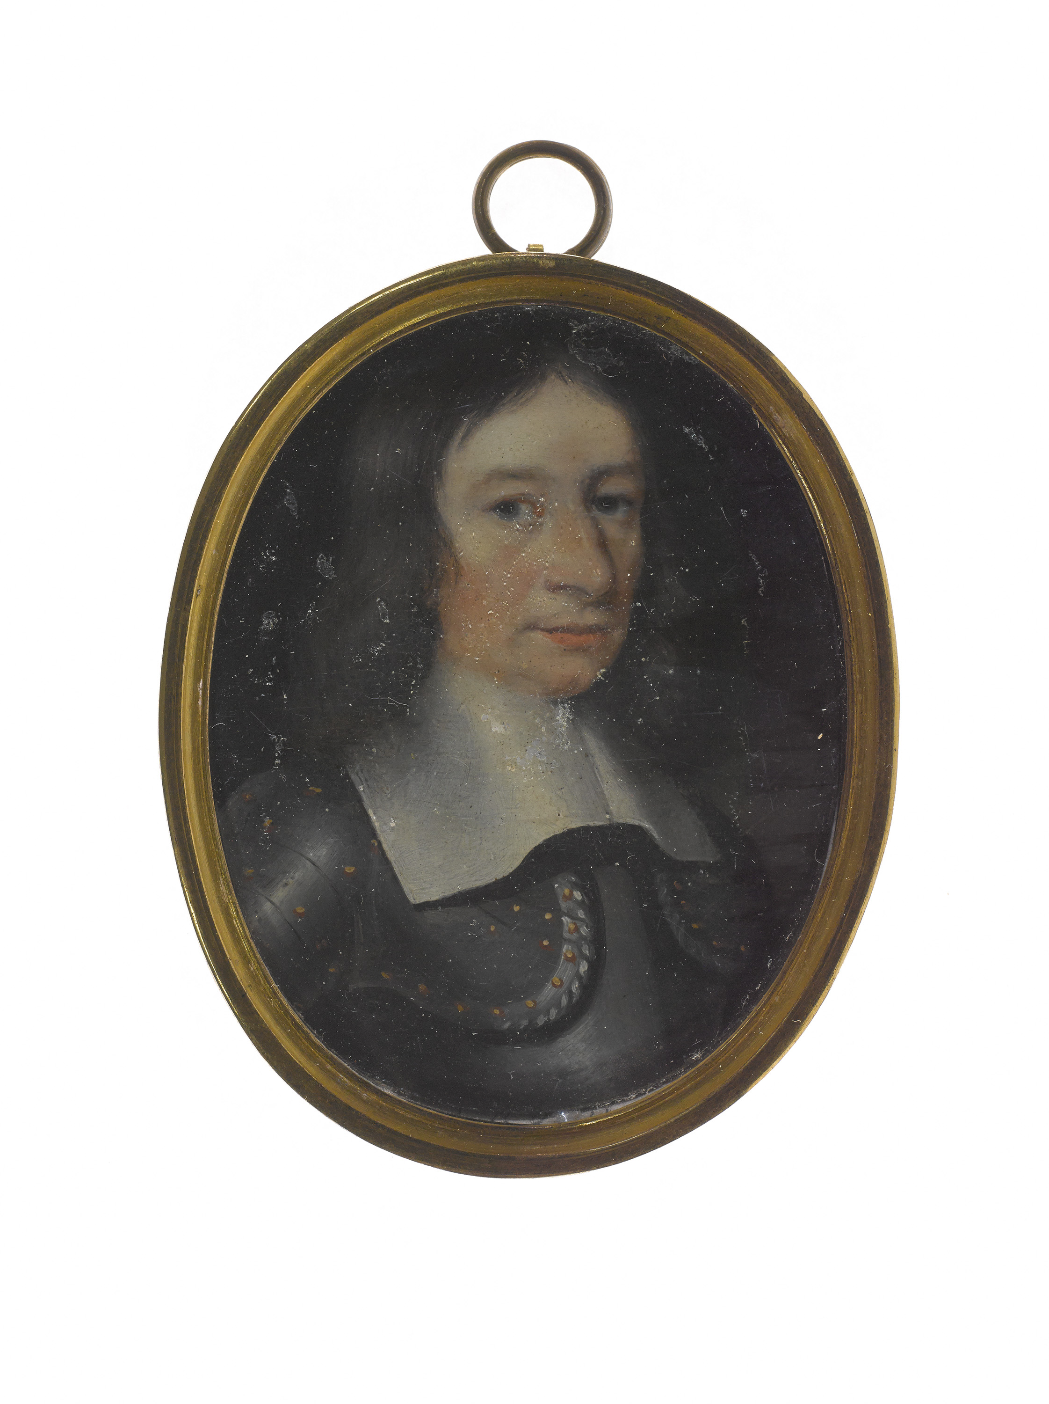
Notes:
Sir John Gell 1650 (c).
Miniature portrait in oil on copper, English school, 1650 (c).
Sir John Gell (1593-1671) was High Sheriff of Derbyshire when he was commissioned as colonel to raise a Parliamentarian regiment during the English Civil War (1642-1651). His regiment took part in several engagements including the sieges of Chester and Lichfield and the Battle of Hopton Heath.
In 1645, Sir John failed to intercept the Kind’s troops in their flight from Naseby to Leicester. This gave rise to suspicions about his allegiances and he was accused of taking part in plots against the Commonwealth and was committed to the Tower of London in 1650. Gell was tried by the High Court and condemned to forfeit his estates. However, he was released in 1652 and obtained a full pardon the following year.
NAM. 1994-07-194-1

Slide 21
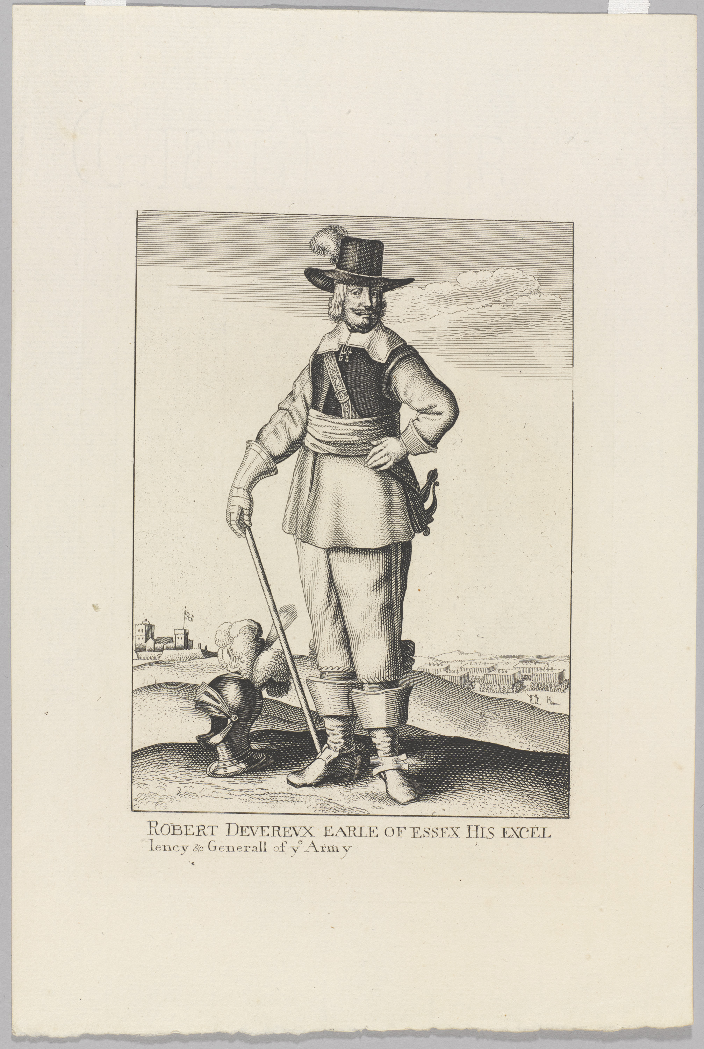
Notes:
‘Robert Devereux, Earl of Essex, His Excellency, etc Generall of ye Army’, 1644 (c).
Etching by Wenceslaus Hollar, published 1644 (c).
Essex (1591-1646) was a leading opponent of Charles I’s political and religious policies. He had little military experience but was appointed General of the Parliamentarian army for his strength of character and social standing.
On 23 October 1642, Essex commanded Parliament’s forces at Edgehill, the first major battle of the war. The following month, at Turnham Green, his troops blocked the Royalist advance on London. On 20 September 1643, following his relief of the besieged city of Gloucester, Essex engaged the Royal army, under the personal command of King Charles, at Newbury. The resulting battle was indecisive, but the Royalists were severely weakened by their losses of men and supplies.
The following year, Essex committed a major strategic blunder, marching into Cornwall where he was trapped by the King’s superior forces. In September 1644, after fighting at Lostwithiel, many of his troops were cut off and forced to surrender. He resigned his command the following year.
NAM. 1979-06-55-1

Slide 22
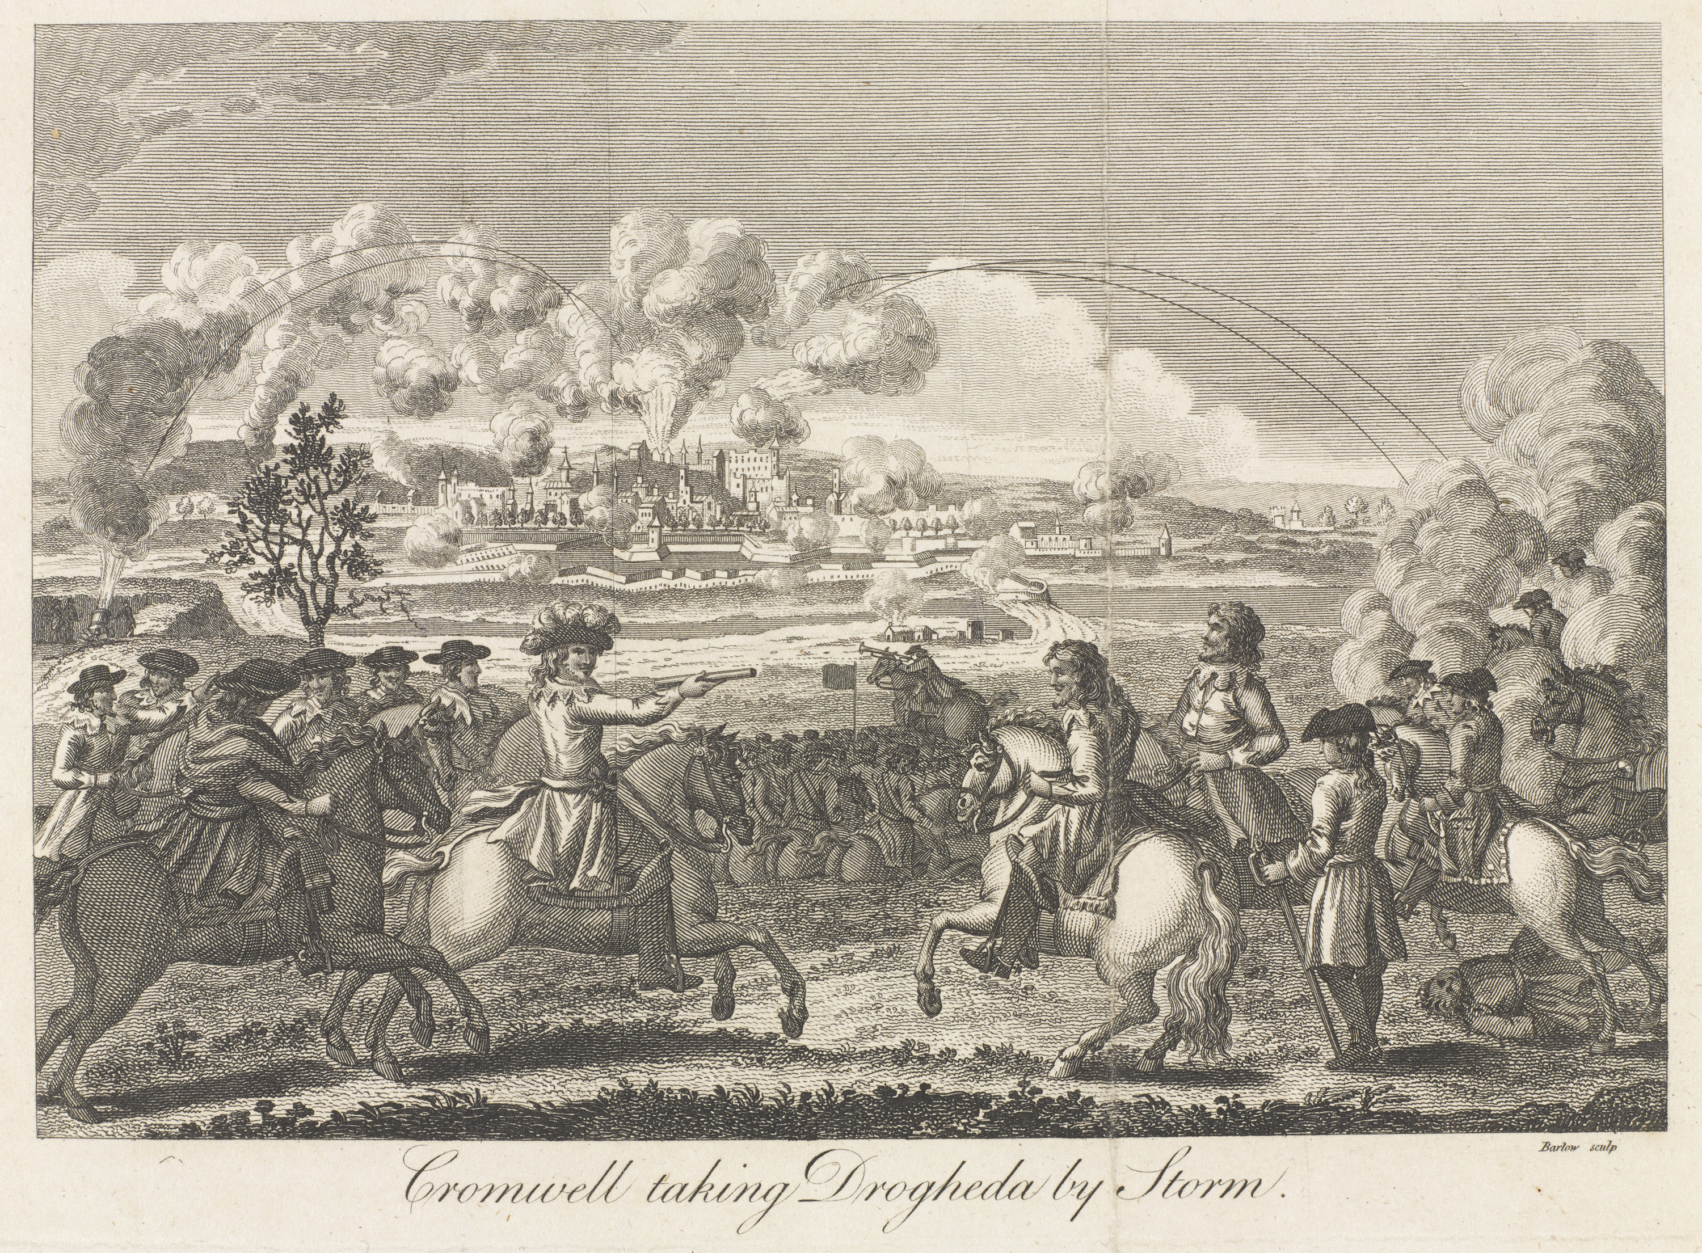
Notes:
‘Cromwell taking Drogheda by Storm’, 1649.
Engraving by Barlow, 1649 (c), published, 1750 (c).
Oliver Cromwell is perhaps best remembered for his campaign in Ireland (1649-1650), undertaken by Parliament to eliminate support for the exiled Charles II. The campaign opened with massacres at Drogheda and Wexford, where there was widespread slaughter of soldiers and civilians alike. Cromwell justified this on the grounds that it was consistent with the laws of war and that it would encourage more rapid surrenders elsewhere, thus saving lives. Many other Royalist garrisons did indeed surrender when Cromwell offered them generous terms, but Drogheda remains a blot on his reputation.
In August 1649, Cromwell landed in Ireland to end support for the exiled Charles II. The campaign opened with massacres of Catholic soldiers and civilians at Drogheda and Wexford. The subsequent conquest replaced the native Irish Catholic land-owning classes with colonists with a British Protestant identity.
NAM. 1993-06-136-1

Slide 23
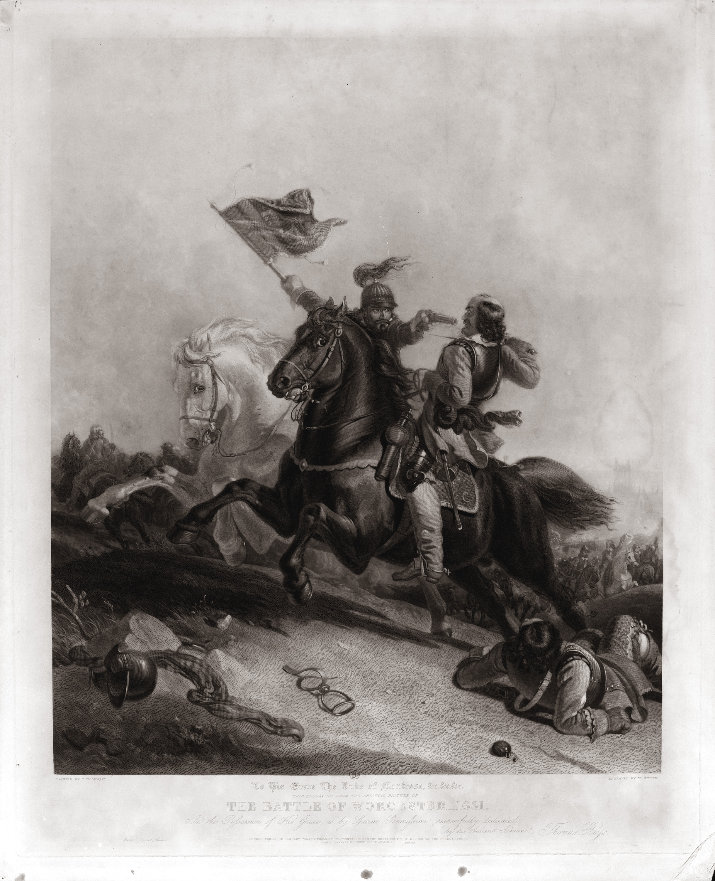
Notes:
The Battle of Worcester, 1651.
Mezzotint by W Giller after T Woodward, published by T Boys, 1844.
In 1650 Oliver Cromwell led a pre-emptive invasion of Scotland, to strike at Scottish support for King Charles II. At first out-manoeuvred by the Scots, he achieved a brilliant victory at the battle of Dunbar (September 1650) although outnumbered almost two to one. A year later he won a crushing victory over the Scots at the battle of Worcester, which was to be his last major field action. His victory at Worcester marked the end of the Civil Wars.
NAM. 1971-02-33-473-1

Slide 24
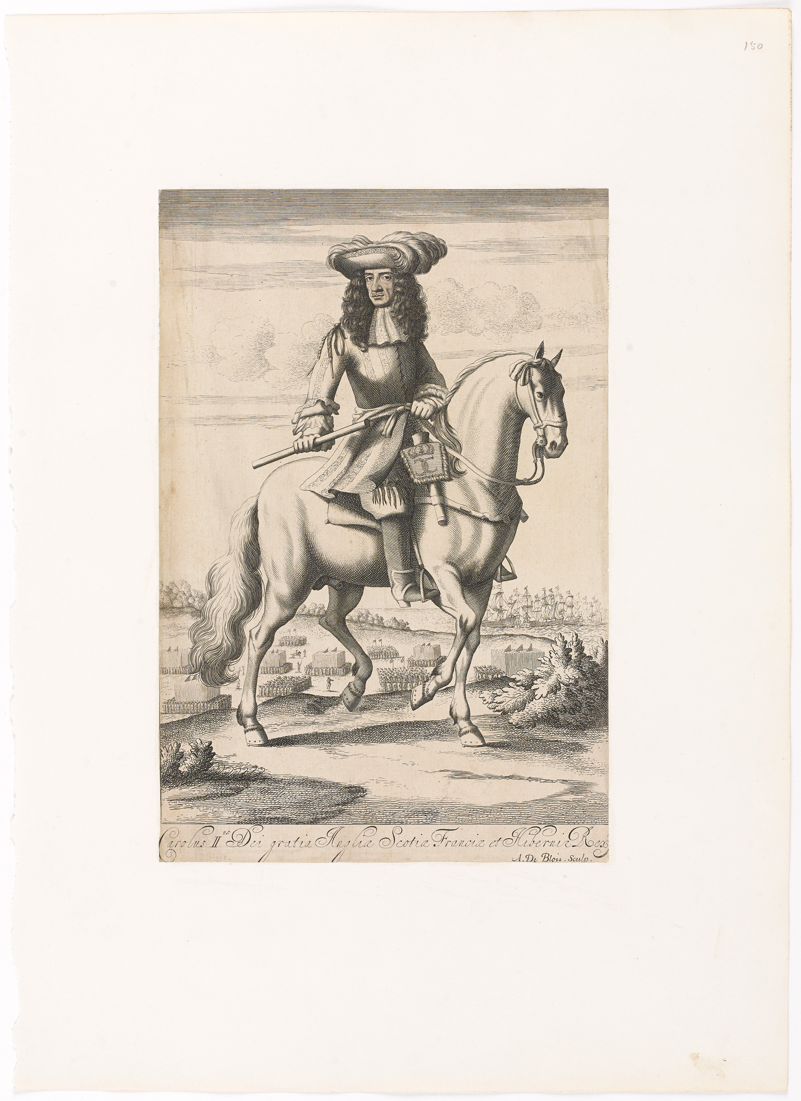
Notes:
‘Carolus II Dei gratia Anglia Scotia Francia et Hibernie Rex’, King Charles II, 1658 (c).
Engraving by A de Blois, published in 1658 (c).
The exiled eldest son of the executed Charles I, Charles landed in Scotland in 1650 to claim the throne. Marching south, he was defeated by Oliver Cromwell at the Battle of Worcester on 3 September 1651 and forced back into exile, remaining abroad until the Restoration in 1660.
Charles became the first British monarch to maintain a standing army in peacetime. The regiments which he founded in exile, together with those of the New Model Army which changed their allegiance in 1660, formed the basis of this force. On 26 January 1661, he issued the warrant creating what became the British Army.
NAM. 2000-06-73-1

Slide 25
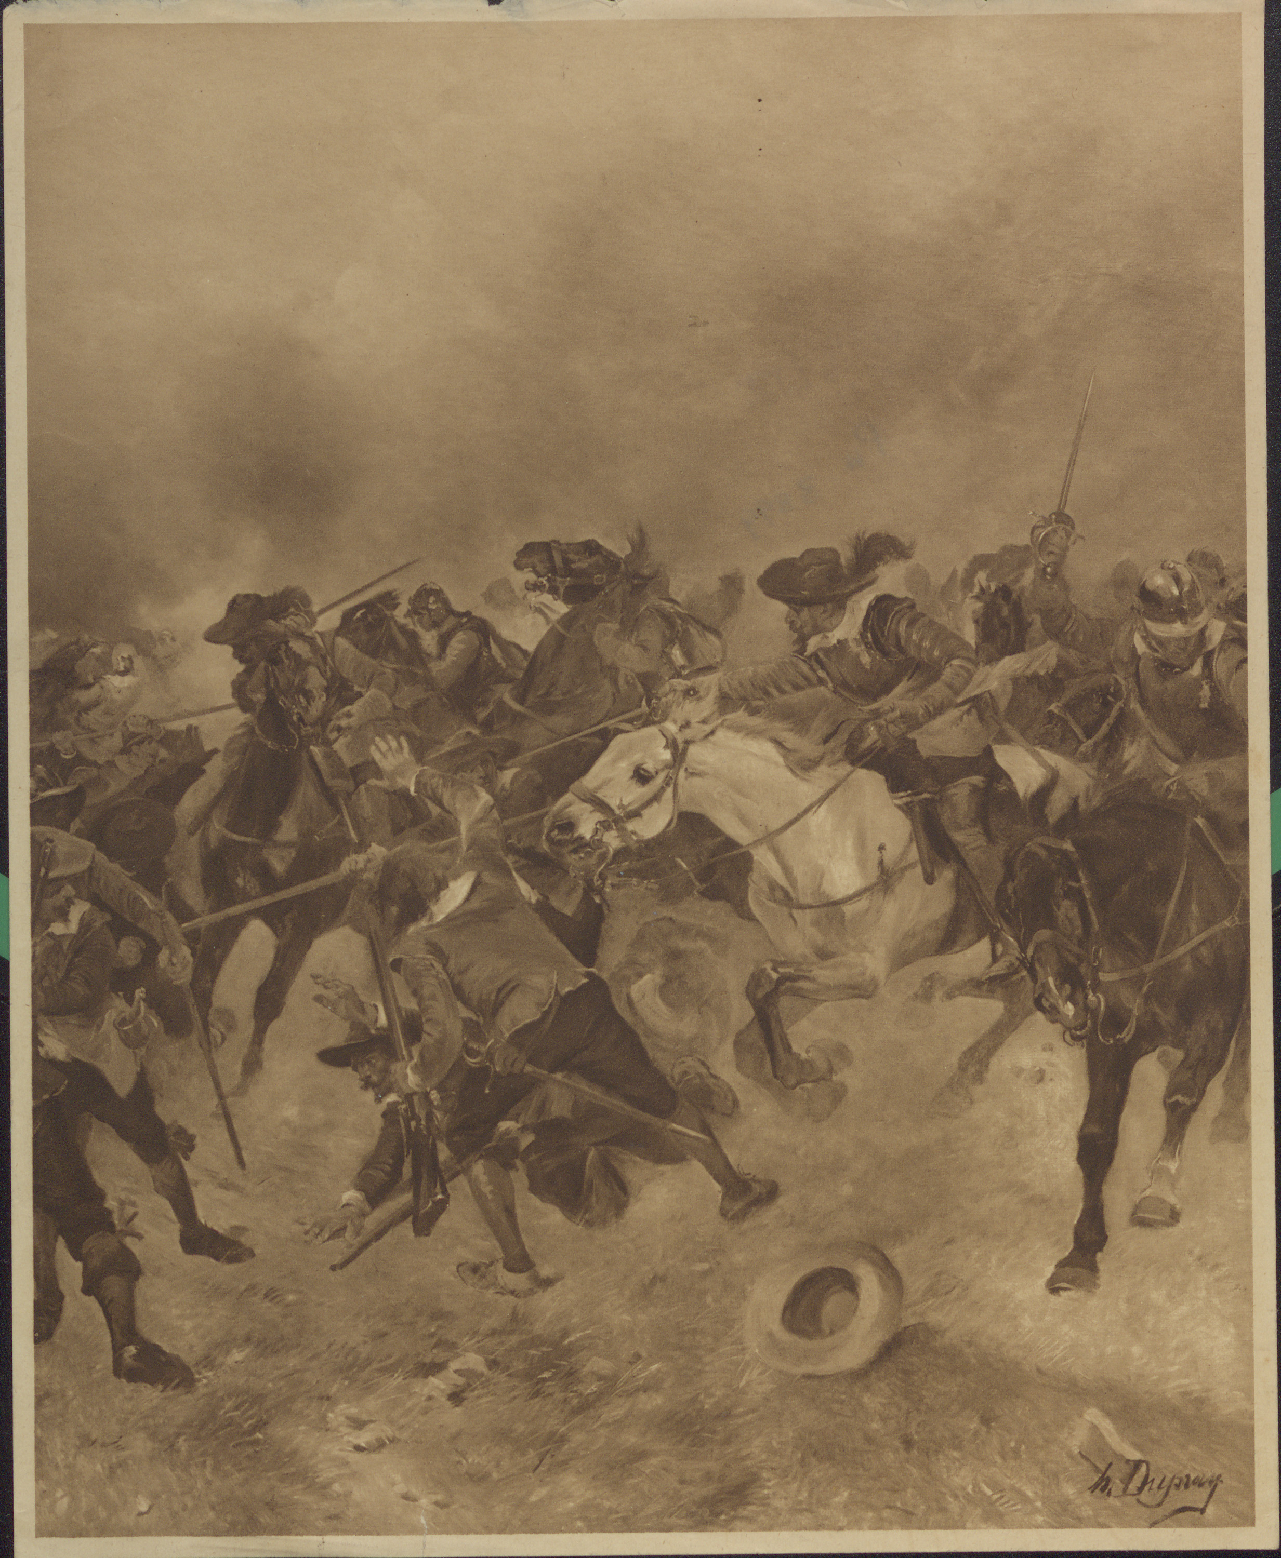
Notes:
The Battle of Marston Moor, 1644.
Photo-mechanical print after artist Henri Dupray, 1902 (c).
From the book by William Maxwell, 'British Battles', published by Charles Letts and Company, London, 1902.
NAM. 1963-09-597-6

Slide 26
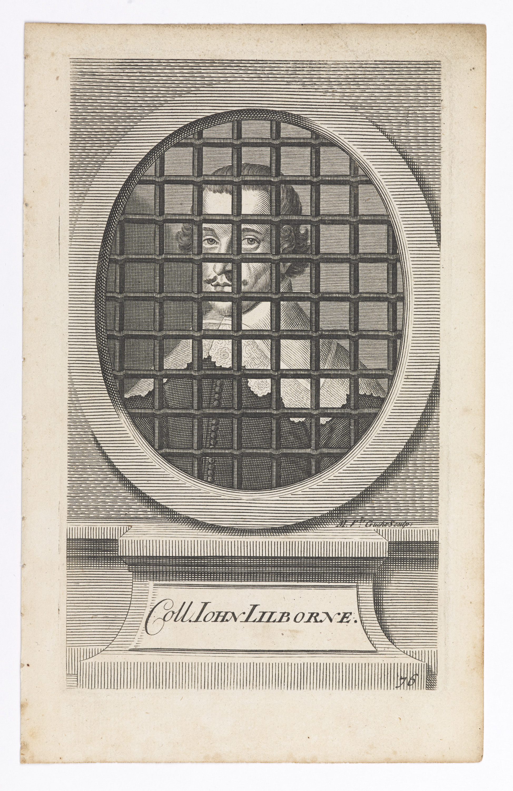
Notes:
Coll JOHN LILBORNE.
Line engraving after an unknown artist, nd.
Originally plate 76 in Edward Ward’s ‘A History of the Rebellion’, published by J Morphew, London, 1713.
From a group of 81 numbered line engravings of Civil War and Protectorate figures by Michael van der Gucht after Sir Anthony van Dyck and others, nd.
NAM. 1995-01-131-72

