Slide 1
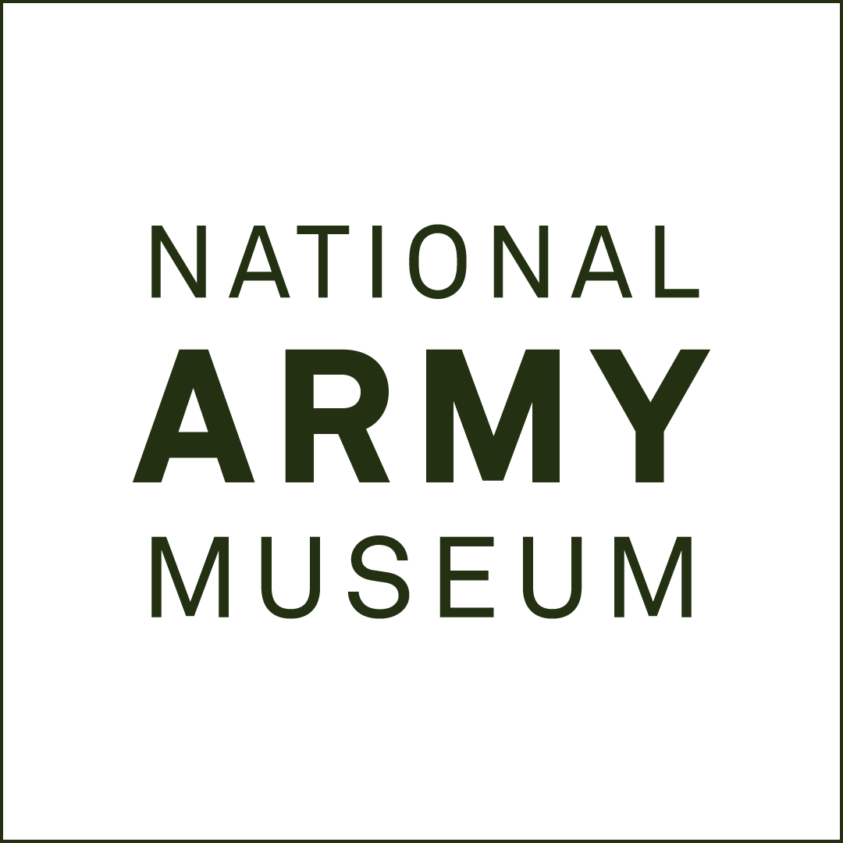
THE BRITISH OCCUPATION OF GERMANY, 1945-49, AND THE ORIGINS OF THE COLD WAR
History Teacher CPD Source Pack

Slide 2
ABOUT THIS RESOURCE
This PowerPoint presentation contains a selection of images and archives from the Collection of the National Army Museum (NAM).
Unless otherwise stated in the notes, the images can be freely used for non-commercial purposes within the classroom. You can use the entire presentation or choose individual images for use in other non-commercial contexts. When using individual images in other contexts, please always retain the attribution statements provided in this document (e.g. NAM. 2005-08-66-1).
By downloading this document and using these images you agree to these terms of use, including your use of the attribution statement specified for each object by NAM.

Slide 3
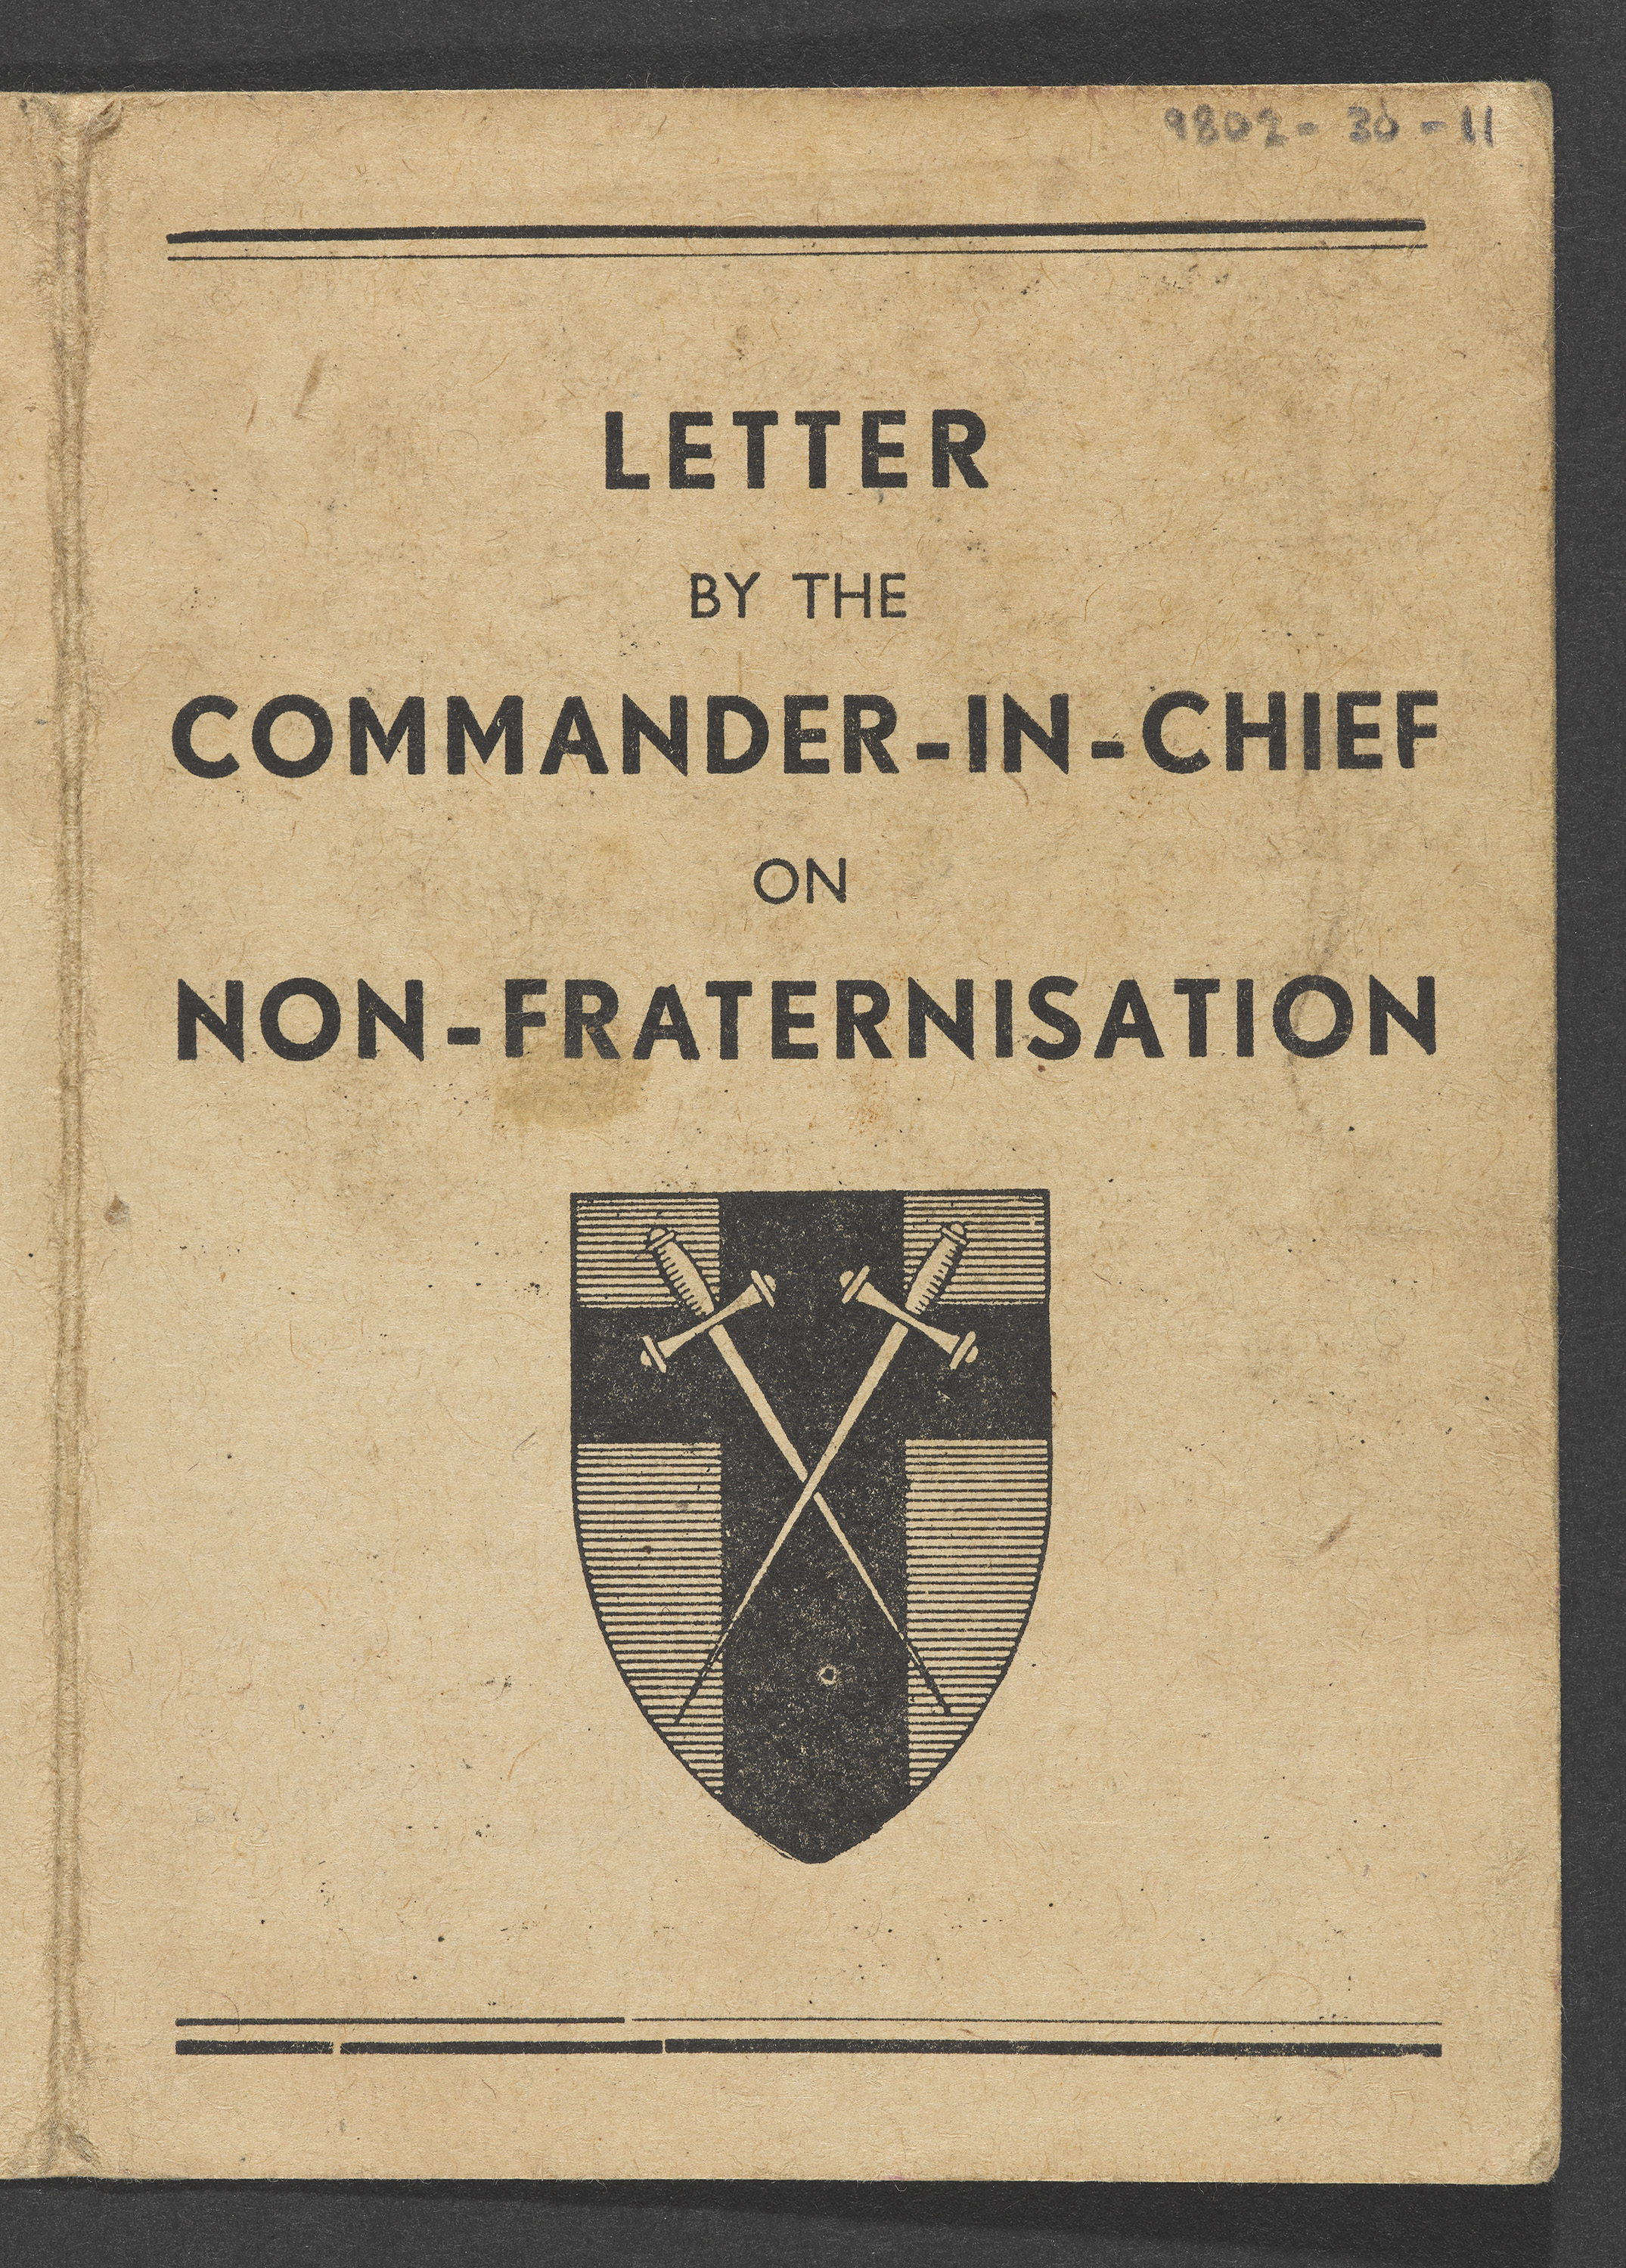
Notes:
Letter No 1 from Commander-in-Chief on non-fraternisation, March 1945.
Introduced as the British Army first crossed into enemy territory, soldiers were expressly forbidden to have any social contact with Germans. In March 1945, Field Marshal Montgomery sent a letter outlining this policy to the soldiers of 21st Army Group. Its main focus was on enforcing a sense of defeat on the Germans.
From papers of I R Beddington (née Farquhar), Auxiliary Territorial Service, attached to Royal Army Medical Corps, 25 British Military Hospital in Munster, North Rhine Westphalia.
NAM. 1998-02-30-11

Slide 4
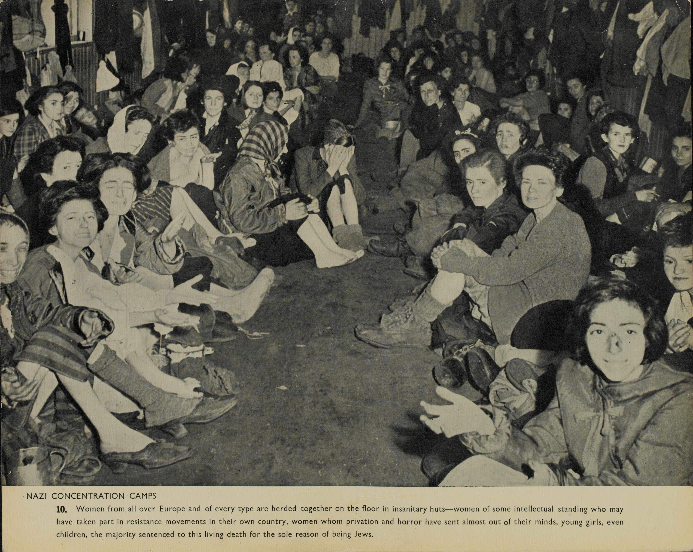
Notes:
Female prisoners at Belsen, April 1945
Photograph, World War Two, 1945.
Belsen was the first concentration camp to be liberated by British troops, on 15 April 1945. When soldiers of the 11th Armoured Division arrived they found the camp littered with dead and dying prisoners, many of whom were recent arrivals from Auschwitz and other camps in the east. The camp was overcrowded and around 60,000 starving people, many suffering from typhus, tuberculosis and dysentery, required immediate aid. Many more had already perished from disease, starvation and brutality. Among the many victims were Anne Frank and her sister Margot, who both died of typhus a month before the camp's liberation.
Despite the best efforts of medical staff, hundreds of prisoners died in the days after the liberation. In the weeks that followed, British troops also buried over 10,000 bodies in mass graves. Evacuation of the camp began on 21 April and the last hut was burned to the ground on 21 May 1945.
In this photo, women and girls from all over Europe are gathered together on the floor of an unsanitary hut at the Bergen-Belsen camp near Hanover in Germany.
One of 23 photographs of Nazi Concentration Camps, issued by the Ministry of information.
NAM. 1994-04-105-11

Slide 5
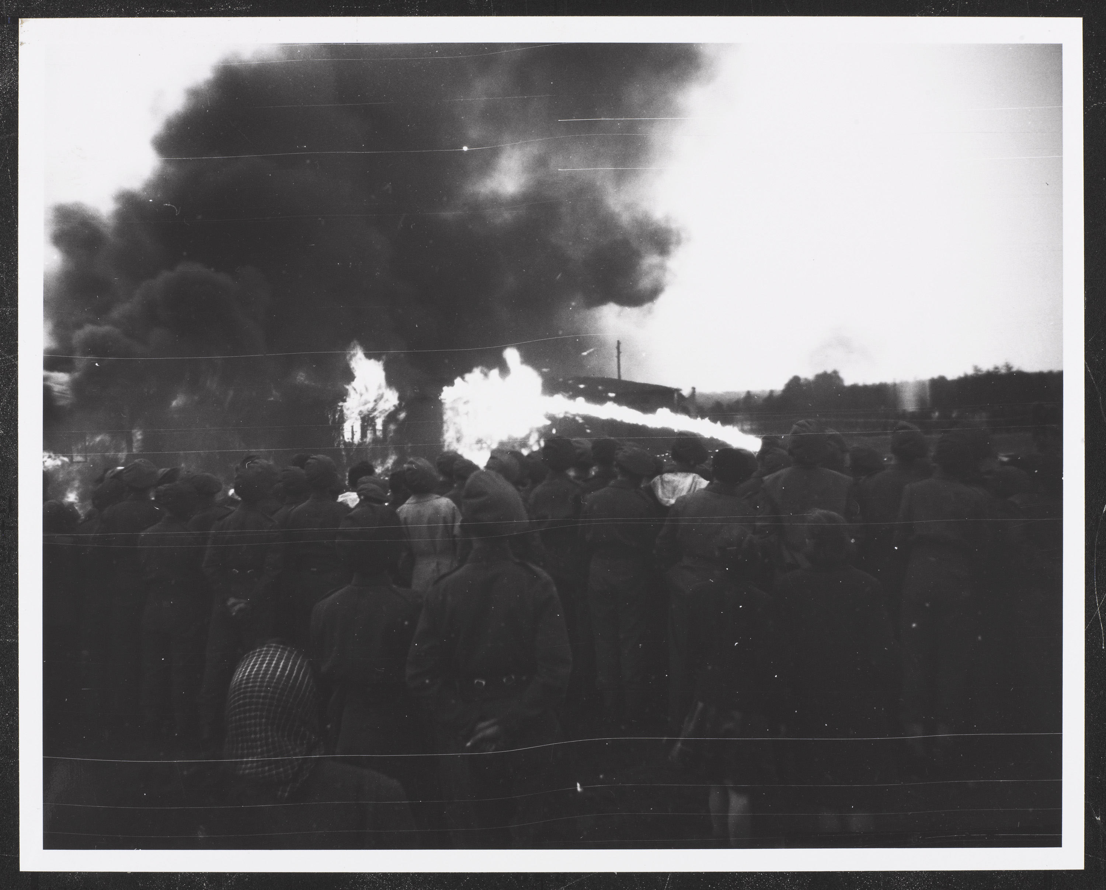
Notes:
The burning of Belsen Concentration Camp, Germany, 2 May 1945
Photograph by Tom Pocock, World War Two, North West Europe (1944-1945), 1945.
NAM. 1996-06-157-8

Slide 6
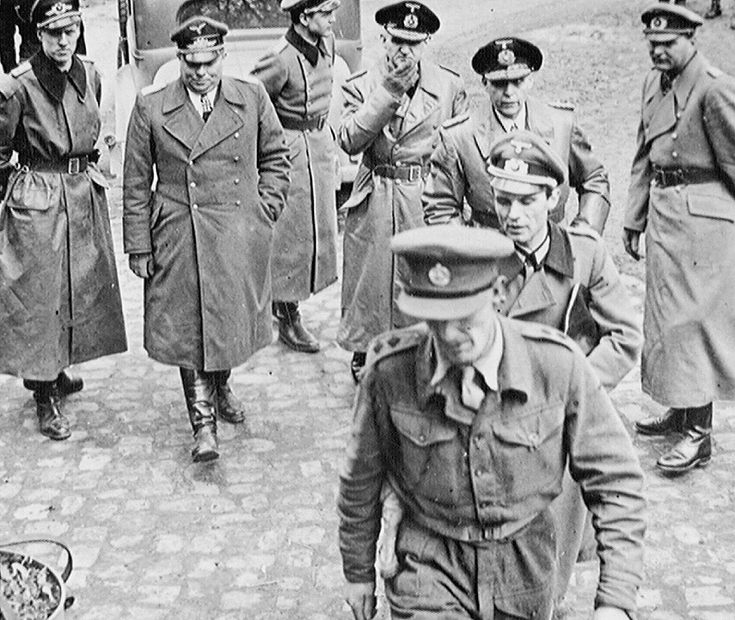
Notes:
Germans officers arrive at 21st Army Group HQ asking for surrender terms, 3 May 1945.
Photograph, World War Two, North West Europe, 1945.
In March 1945 Field Marshal Montgomery's 21st Army Group had crossed the Rhine in a brilliantly executed assault. Montgomery now hoped to lead his men in a thrust towards Berlin. Instead, he was ordered to encircle the Ruhr while the American 12th Army Group advanced into central Germany. Montgomery's forces then advanced onto the North German Plain and liberated Denmark. On 4 May, after weeks of fierce fighting, he received the surrender of the German forces opposed to him at Luneberg Heath. After the surrender, 21st Army Group was renamed the British Army of the Rhine (BAOR) on 25 August 1945. It eventually formed the nucleus of the British forces stationed in Germany throughout the Cold War.
NAM. 1997-01-52-12

Slide 7
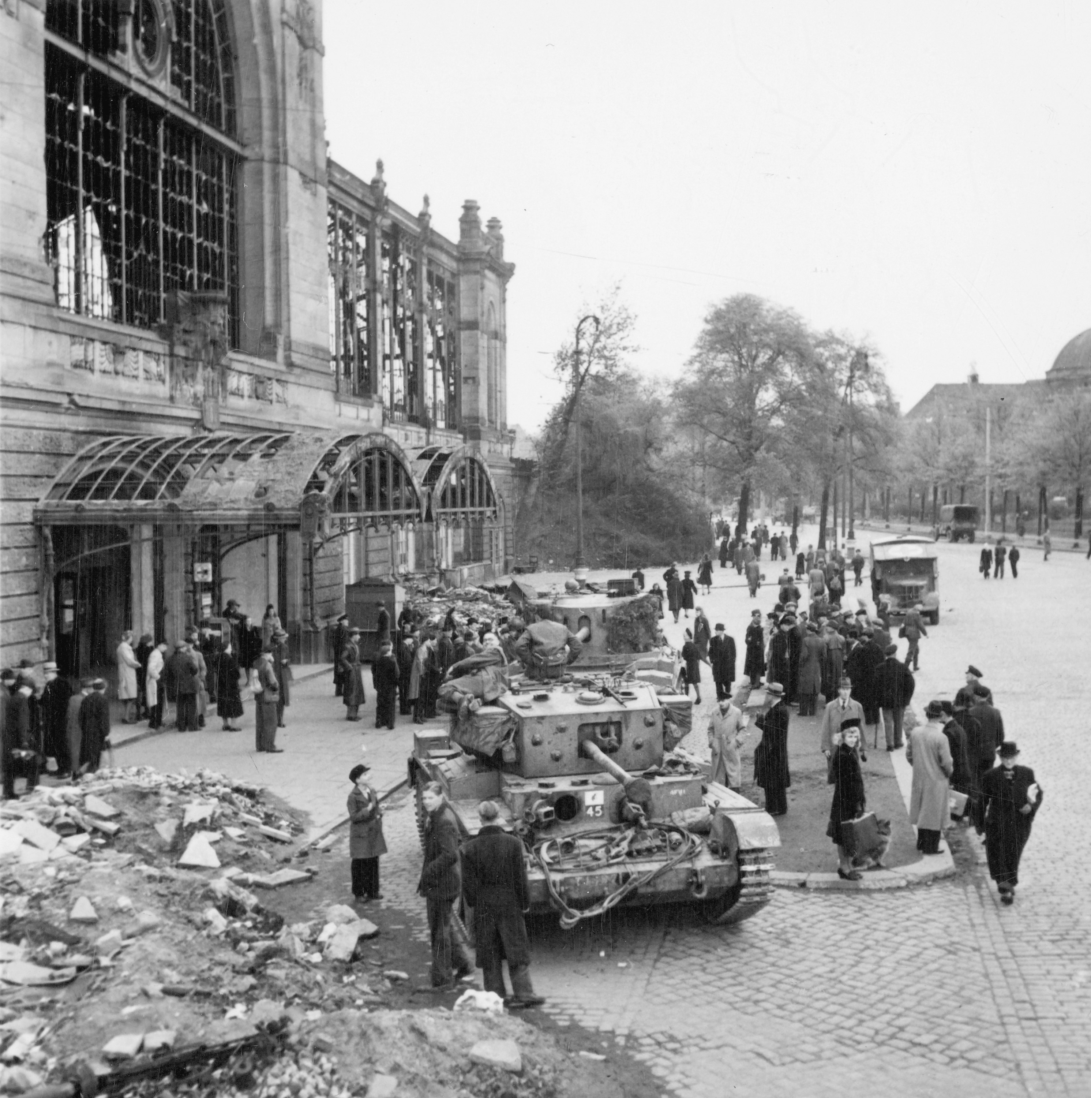
Notes:
German civilians gather around British tanks in occupied Hamburg, 5 May 1945.
Photograph, World War Two, North West Europe, 1945.
Elements of General Sir Bernard Montgomery's 21st Army Group occupied Hamburg on 3 May 1945 after crossing the River Elbe. They then pushed on towards Denmark and the Baltic Sea, where they met the Red Army advancing from the east.
NAM. 1985-10-134-46

Slide 8
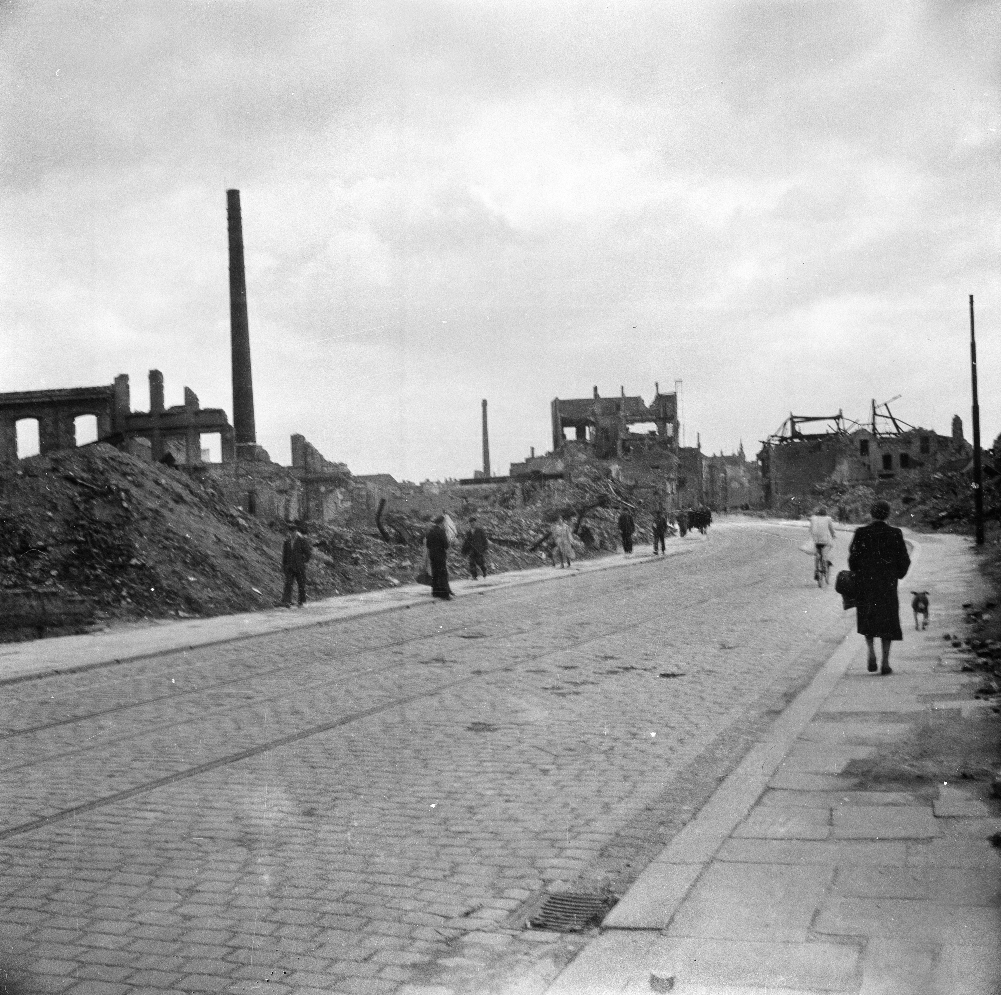
Notes:
Bomb damage in Hamburg, May 1945.
Photograph by Major Wilfred Herbert James Sale, MC, 3rd/4th County of London Yeomanry (Sharpshooters), World War Two, North West Europe, 1945.
German civilians pass the remains of damaged buildings. A vital port and industrial centre, Hamburg was repeatedly bombed by the Allies during the war, leaving most of the city in ruins. In July 1943, the Royal Air Force bombed the city in mass raids for seven nights in a row, the sixth of which created a firestorm that killed thousands. Altogether, the week long operation led to around 40,000 deaths in the city.
From an album containing 198 photographs and captions compiled by Major W H J Sale, MC, 3rd/4th County of London Yeomanry (Sharpshooters), 1944-1945.
NAM. 1975-03-63-22-183

Slide 9
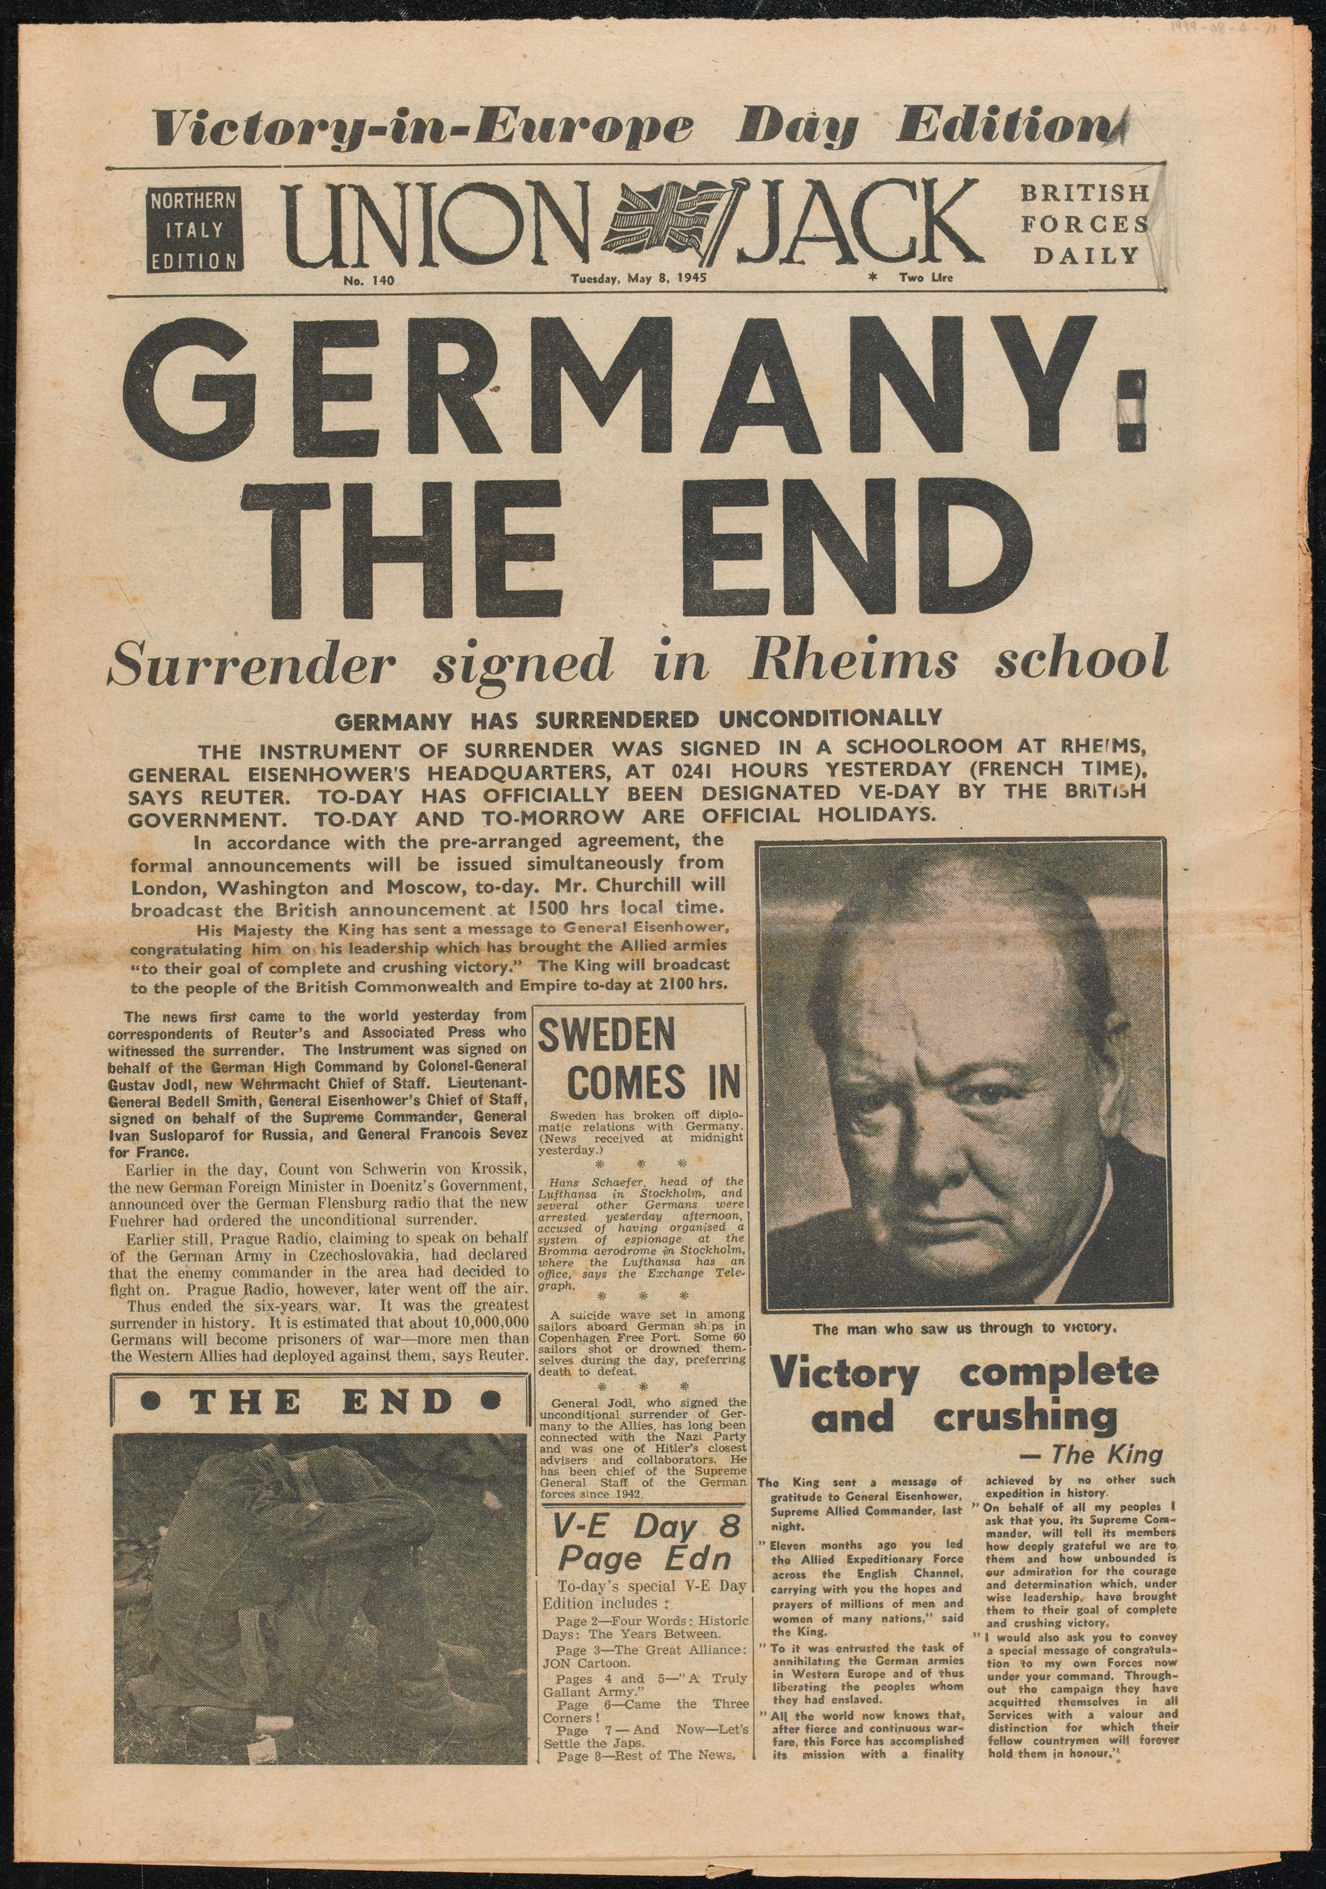
Notes:
‘Union Jack’, British Forces daily newspaper, Northern Italy Edition, No 140, 8 May 1945.
This Victory in Europe Day edition of the newspaper marked the formal end of the war and celebrated Nazi Germany’s unconditional surrender the day before.
In Britain, VE Day was declared a public holiday. In towns and cities across the nation people marked the victory with street parties, dancing and singing. Similar scenes occurred all over the British Empire and Commonwealth and in military camps and bases across the world wherever British troops were stationed.
From papers collected by Captain John Edmund Cradock Hartopp, Royal Engineers, 1940-1945 (c).
NAM. 1999-08-4-49

Slide 10
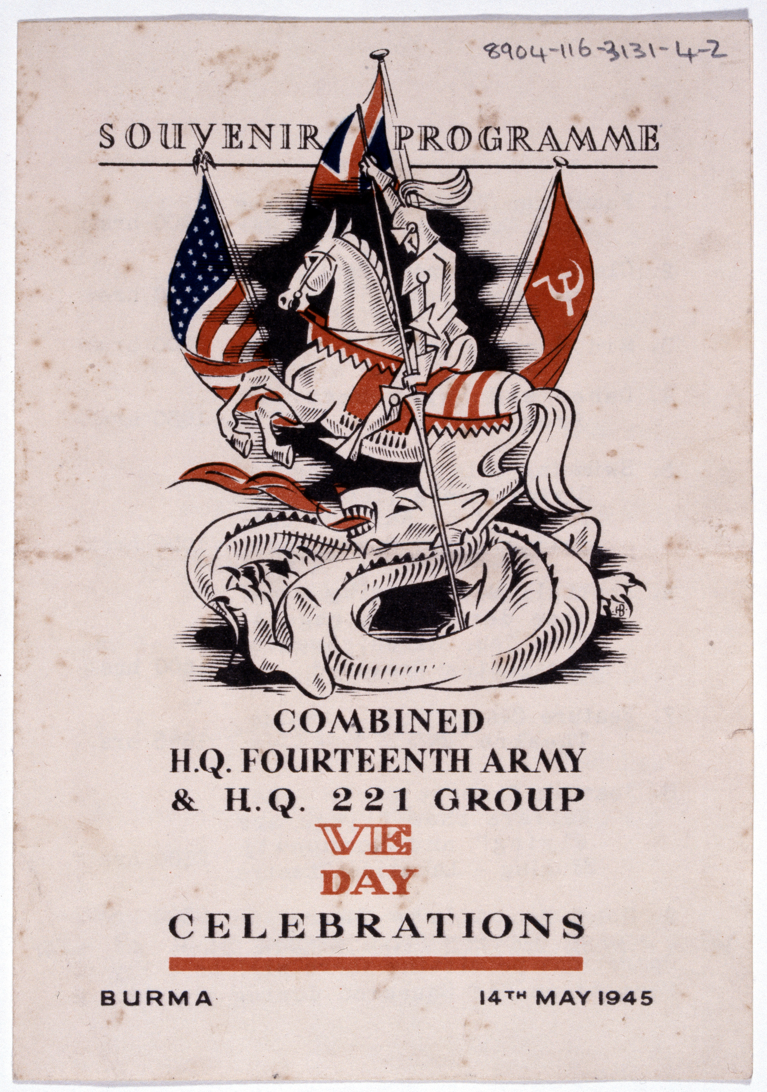
Notes:
Souvenir programme Combined HQ Fourteenth Army, HQ 221 Group VE Day Celebrations 14 May 1945.
Programme depicts St George on horseback, spearing a dragon below him with his lance. Three flags are behind him (L-R): flag of the United States, the Union Jack and the flag of the Soviet Union.
NAM. 1989-04-116-3131-4

Slide 11
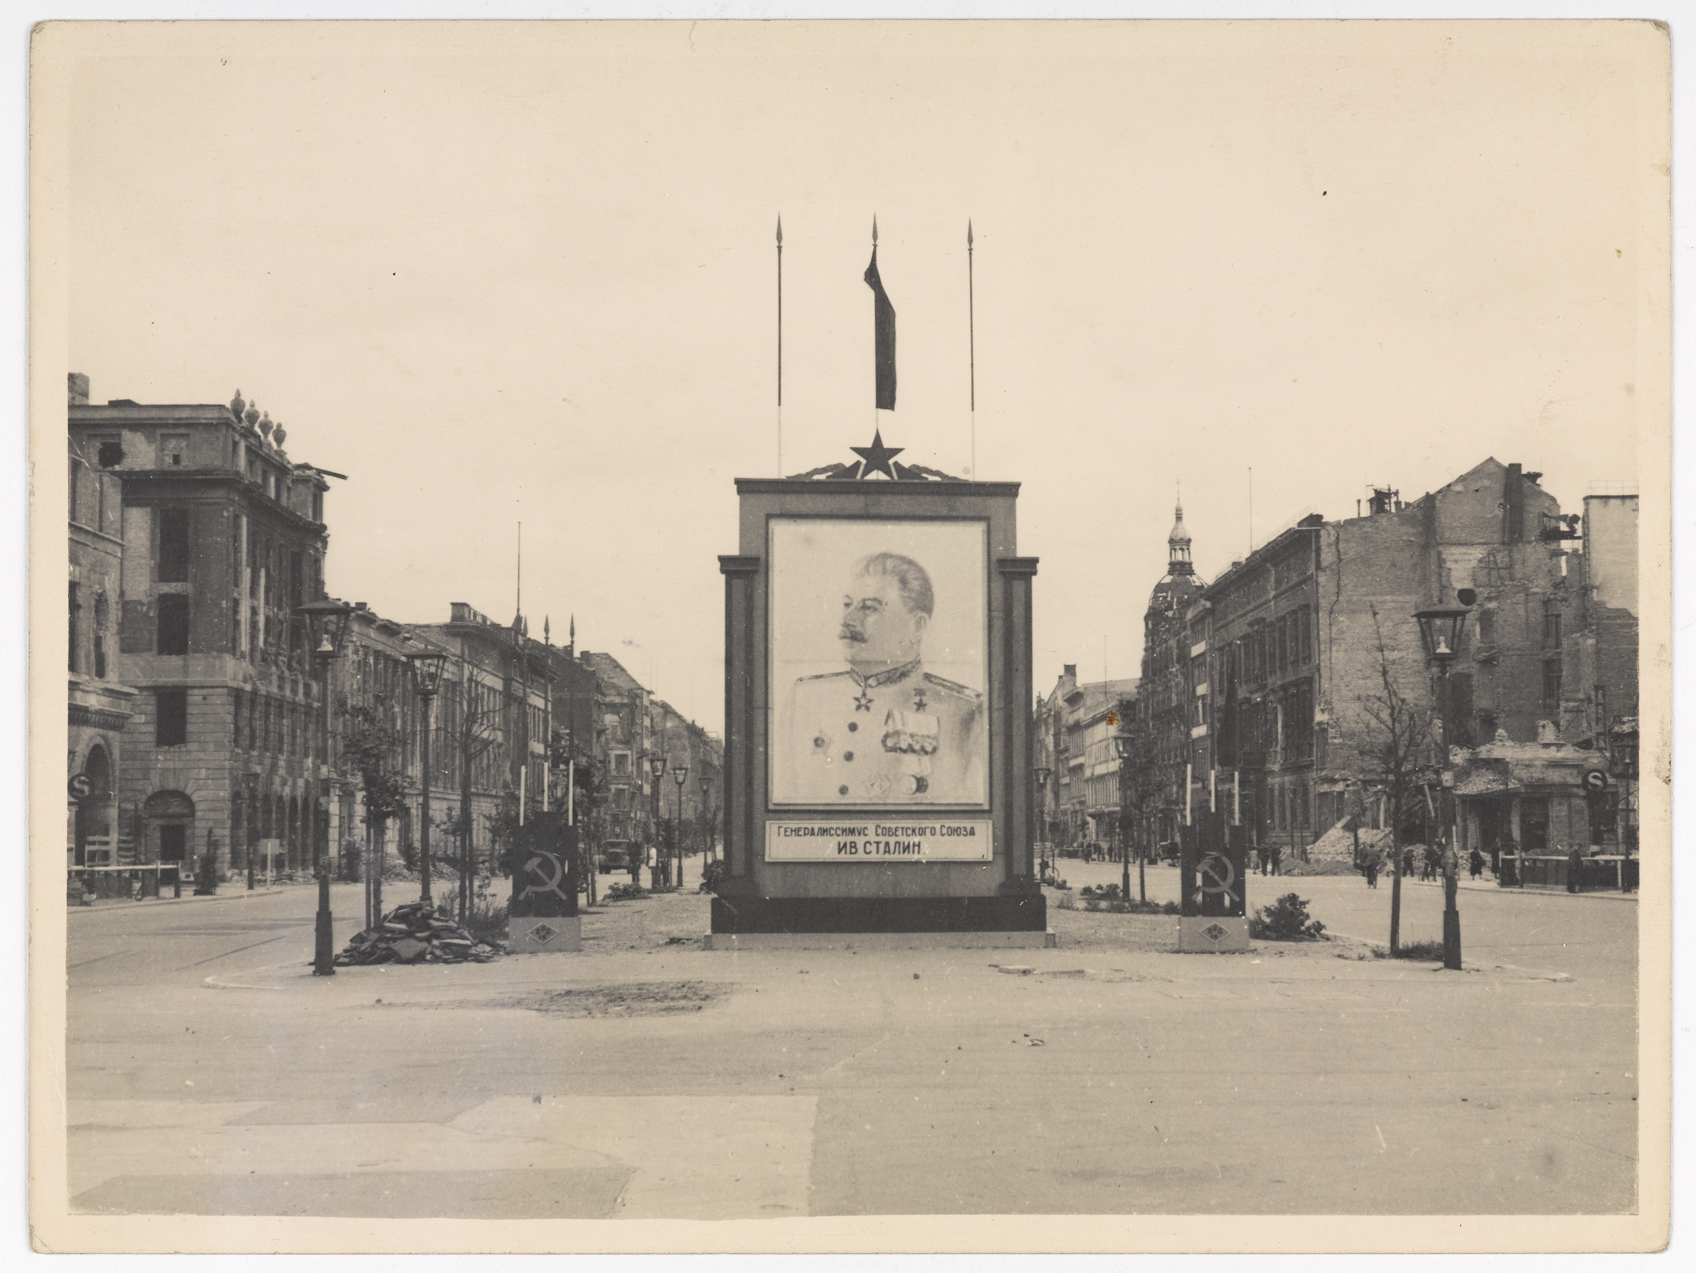
Notes:
Soviet propaganda in Berlin, 1945.
Photograph by Atelier Badekow, World War Two (1939-1945), 1945.
Although the Red Army had captured Berlin in April-May 1945, they allowed the Western Allies of Britain, France and the United States to jointly occupy the German capital. As relations between the West and the Soviet Union declined, the three Allied occupation zones eventually became West Berlin. The Soviet zone of East Berlin, along with the rest of eastern Germany, was meanwhile transformed into a Communist state.
NAM. 2007-11-37-76
Copyright: The Estate of Martin Badekow

Slide 12
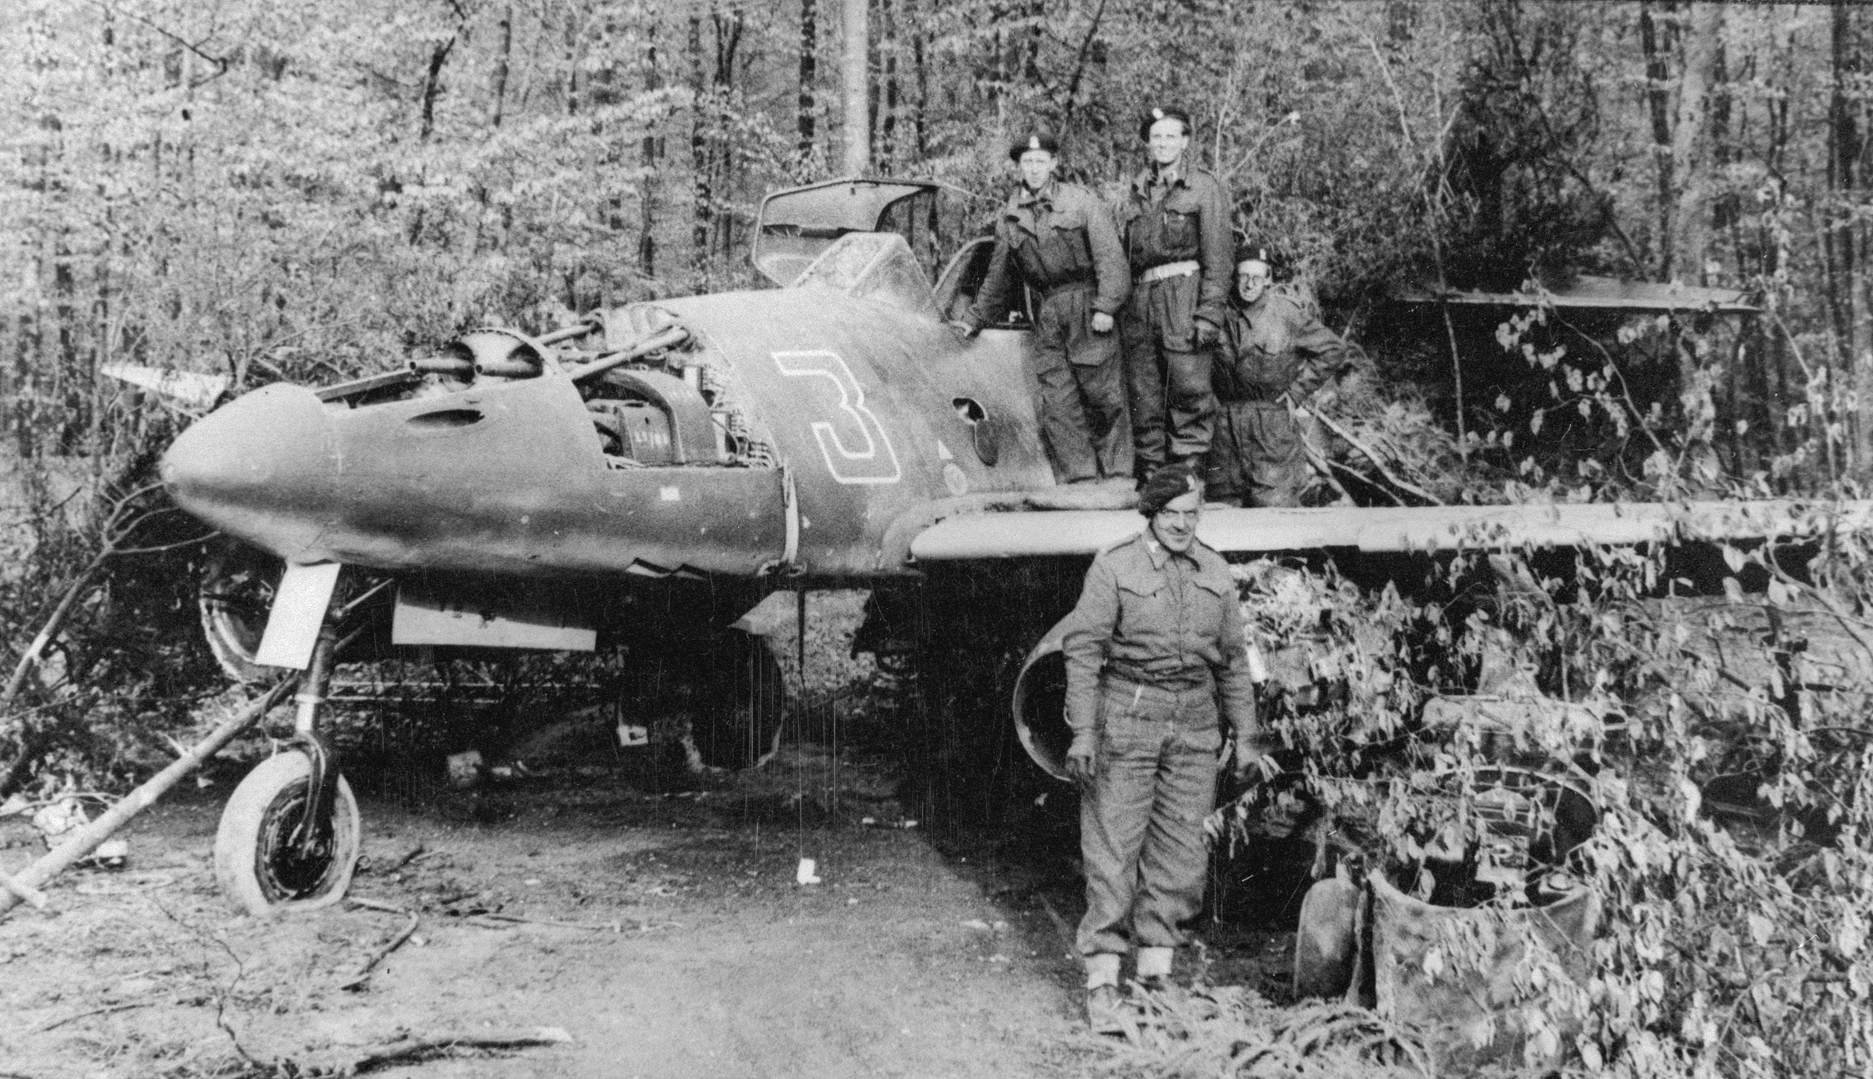
Notes:
Examination of a German jet fighter by a British tank crew, May 1945.
Photograph by Captain Edward K Deeming, 15th/19th King's Royal Hussars, World War Two, North West Europe (1944-1945), 1945.
Members of 15th/19th King's Royal Hussars inspect a Messerschmitt Me 262 Schwalbe jet, the world's first effective jet fighter aircraft. It was introduced in 1944 as a fighter-bomber and interceptor warplane. The Allies and the Soviets quickly gathered up all surviving Me 262s at the end of the war and adopted many of the aircraft's specifications in their own jet programmes.
NAM. 1995-04-28-35

Slide 13
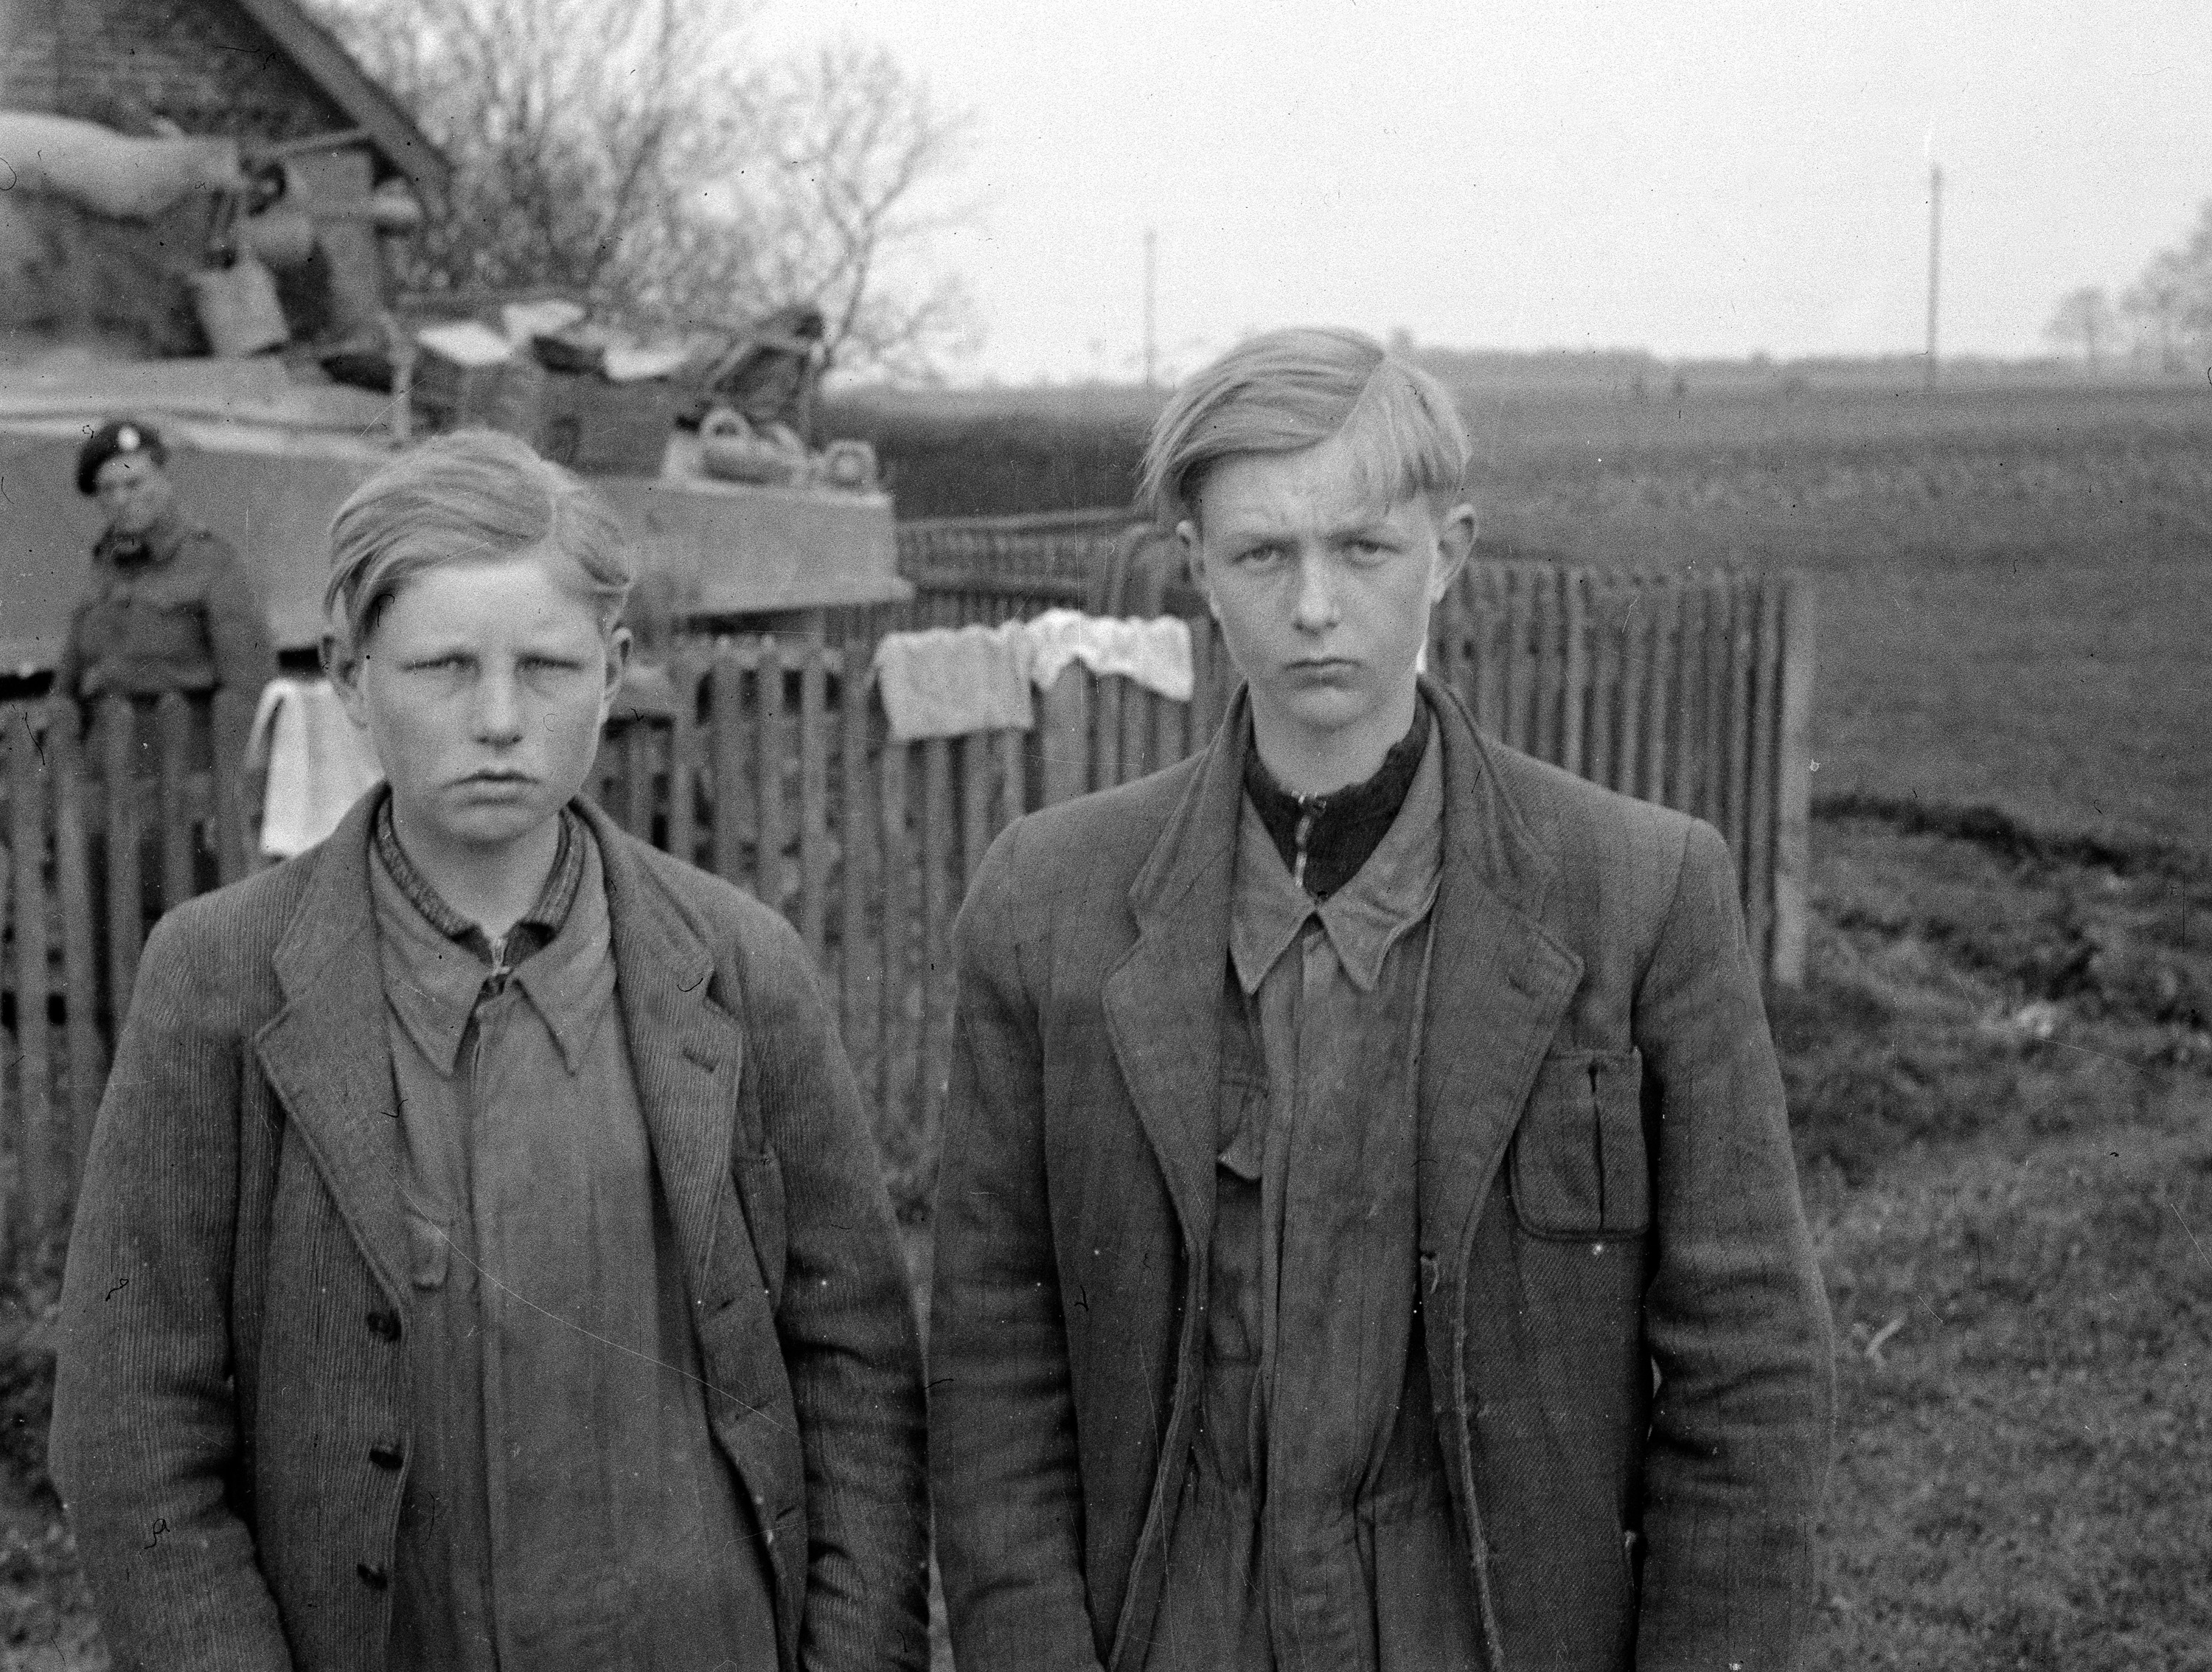
Notes:
‘Two Werewolves picked up at Asendorf’, 1945.
Photograph by Major Wilfred Herbert James Sale, MC, 3rd/4th County of London Yeomanry (Sharpshooters), World War Two, North West Europe, 1945.
The ‘Werwolf’ plan was a last-ditch Nazi resistance effort aimed at encouraging acts of sabotage and reprisals against collaborators in the areas occupied by the Allies. Although the Allies took the threat very seriously it achieved little. It was however a useful propaganda device that helped convince the regime’s most ardent supporters to carry on fighting.
From an album containing 198 photographs and compiled by Major W H J Sale, MC, 3rd/4th County of London Yeomanry (Sharpshooters).
NAM. 1975-03-63-22-66

Slide 14
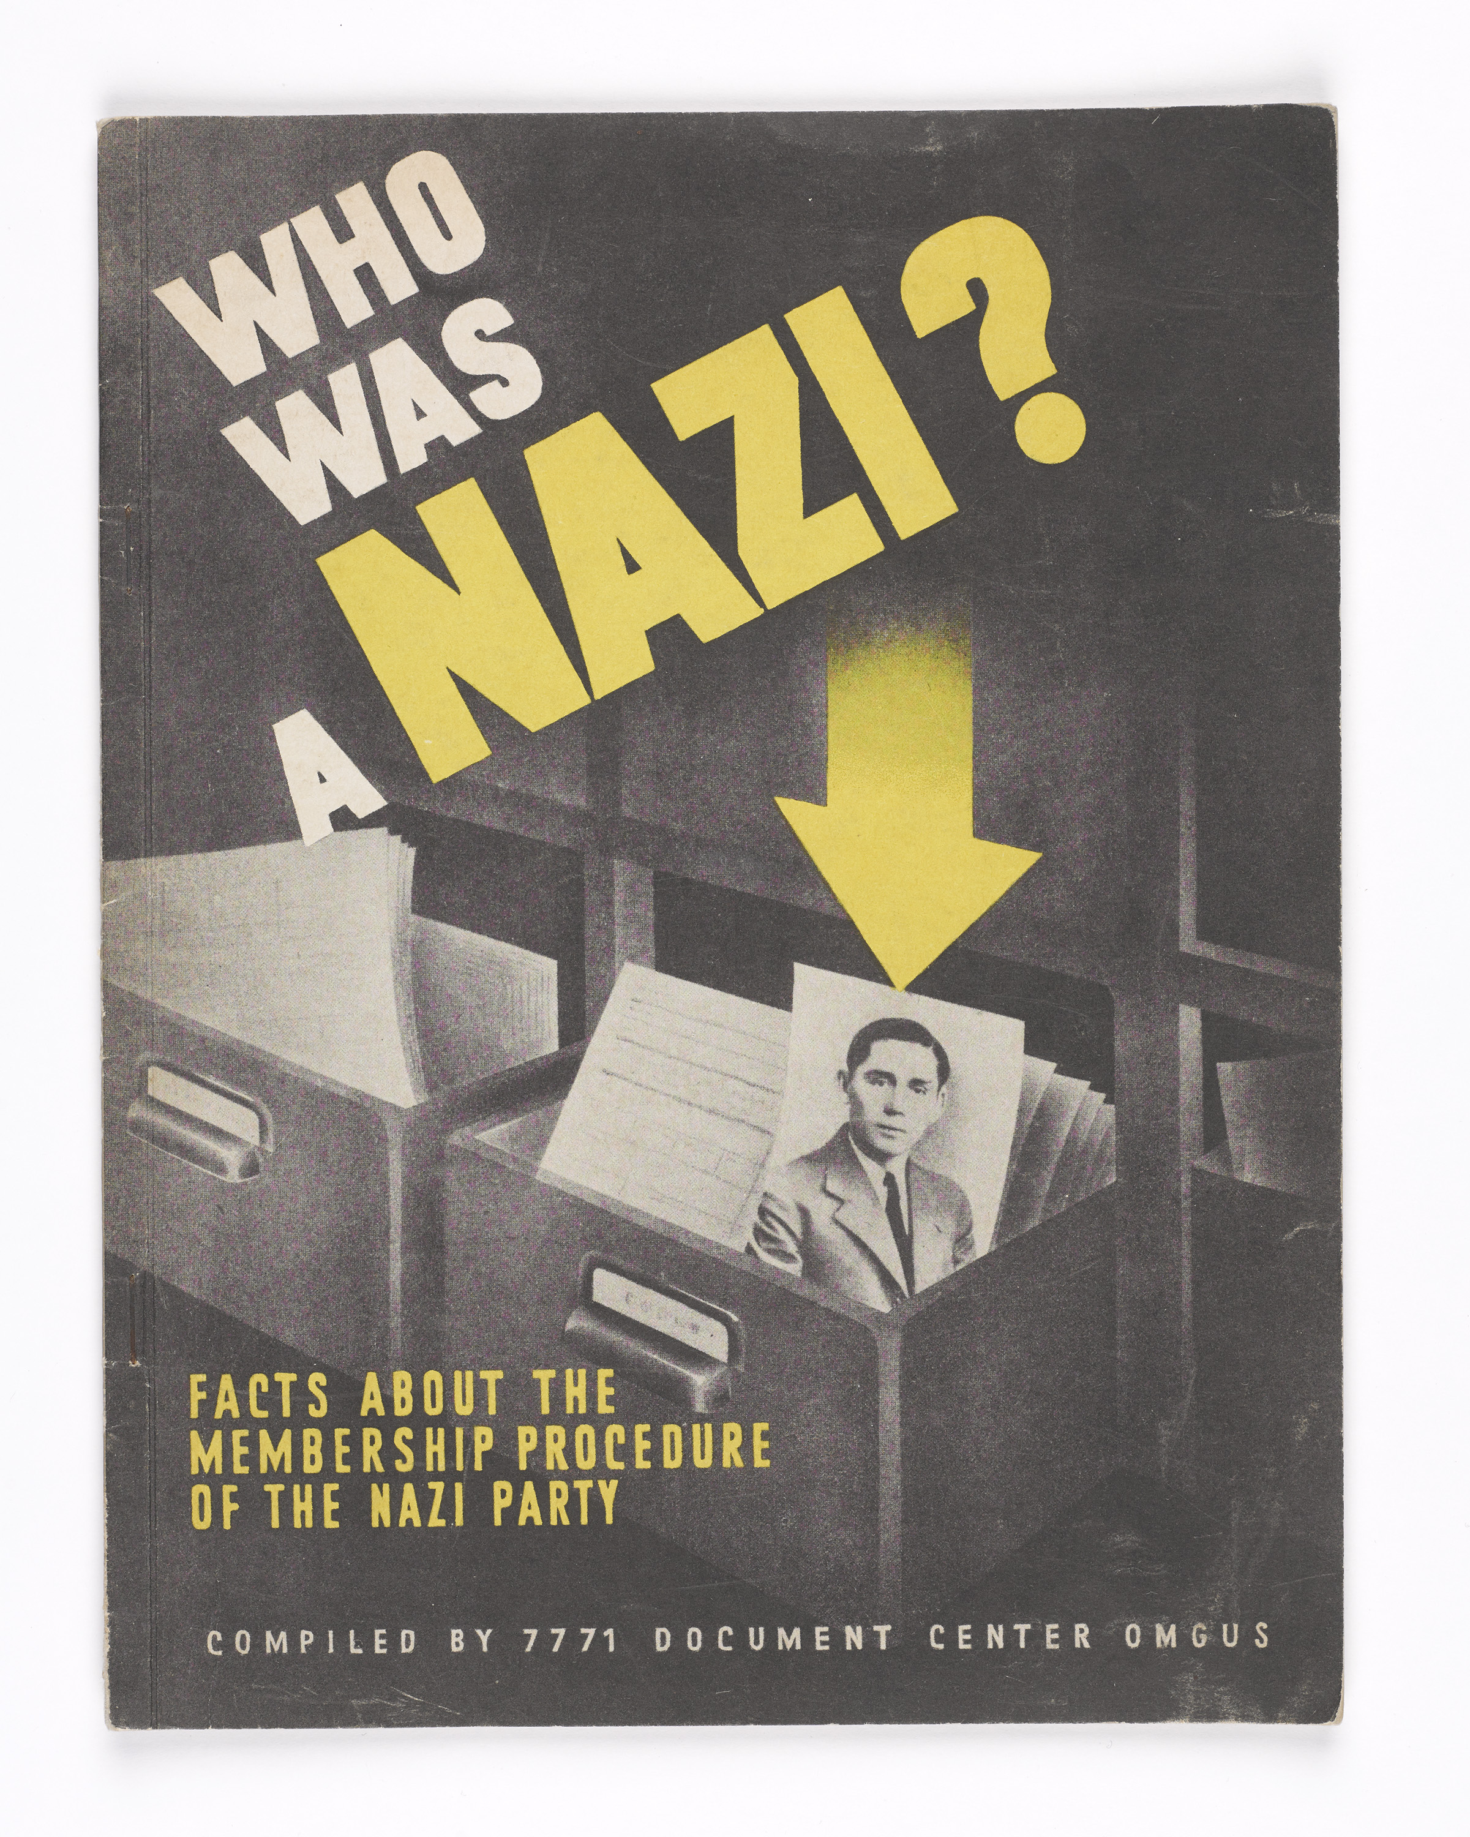
Notes:
'Who was a Nazi? Facts about the membership procedure of the Nazi Party', 1947.
This de-nazification publication was compiled by 7771 Document Centre of the Office for Military Government (US) in June 1947. It was used by Major F A Fitton, a member of the Civil Affairs Staff Centre and a Police Staff Officer with the Allied Control Commission for Germany (CCG) between 1947 and 1951. The de-nazification campaign aimed to rid German and Austrian politics, industry, media, arts, and the judiciary of Nazis. Former party and SS members were removed from positions of power and influence.
NAM. 2005-01-91-35

Slide 15
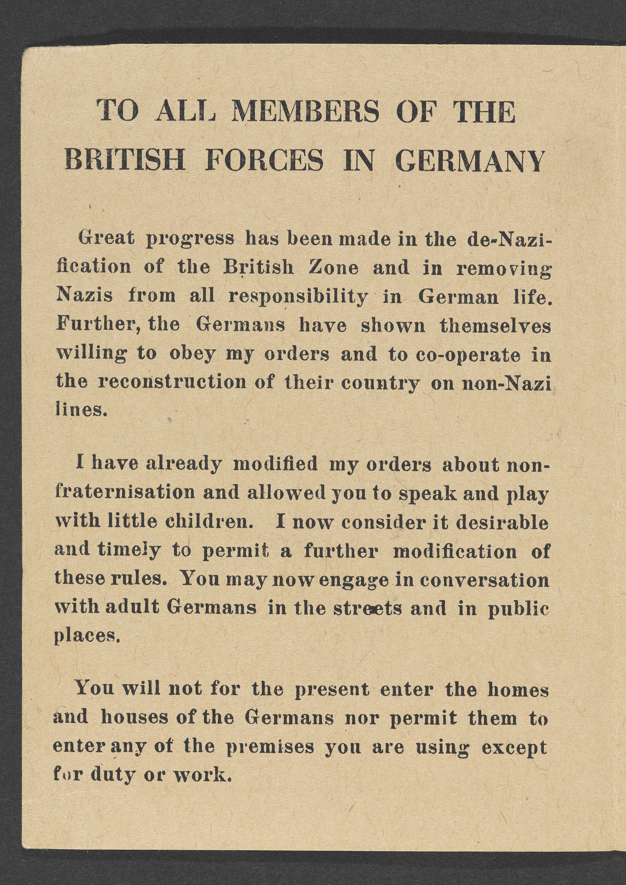
Notes:
Letter No 3 by the Commander-in-Chief on non-fraternisation, 14 July 1945.
This printed leaflet published Field Marshal Montgomery’s updated guidelines on relations between soldiers of the newly formed British of the Rhine and German civilians, including authorising troops to hold conversations with adult Germans in public.
NAM. 1996-01-30-2

Slide 16
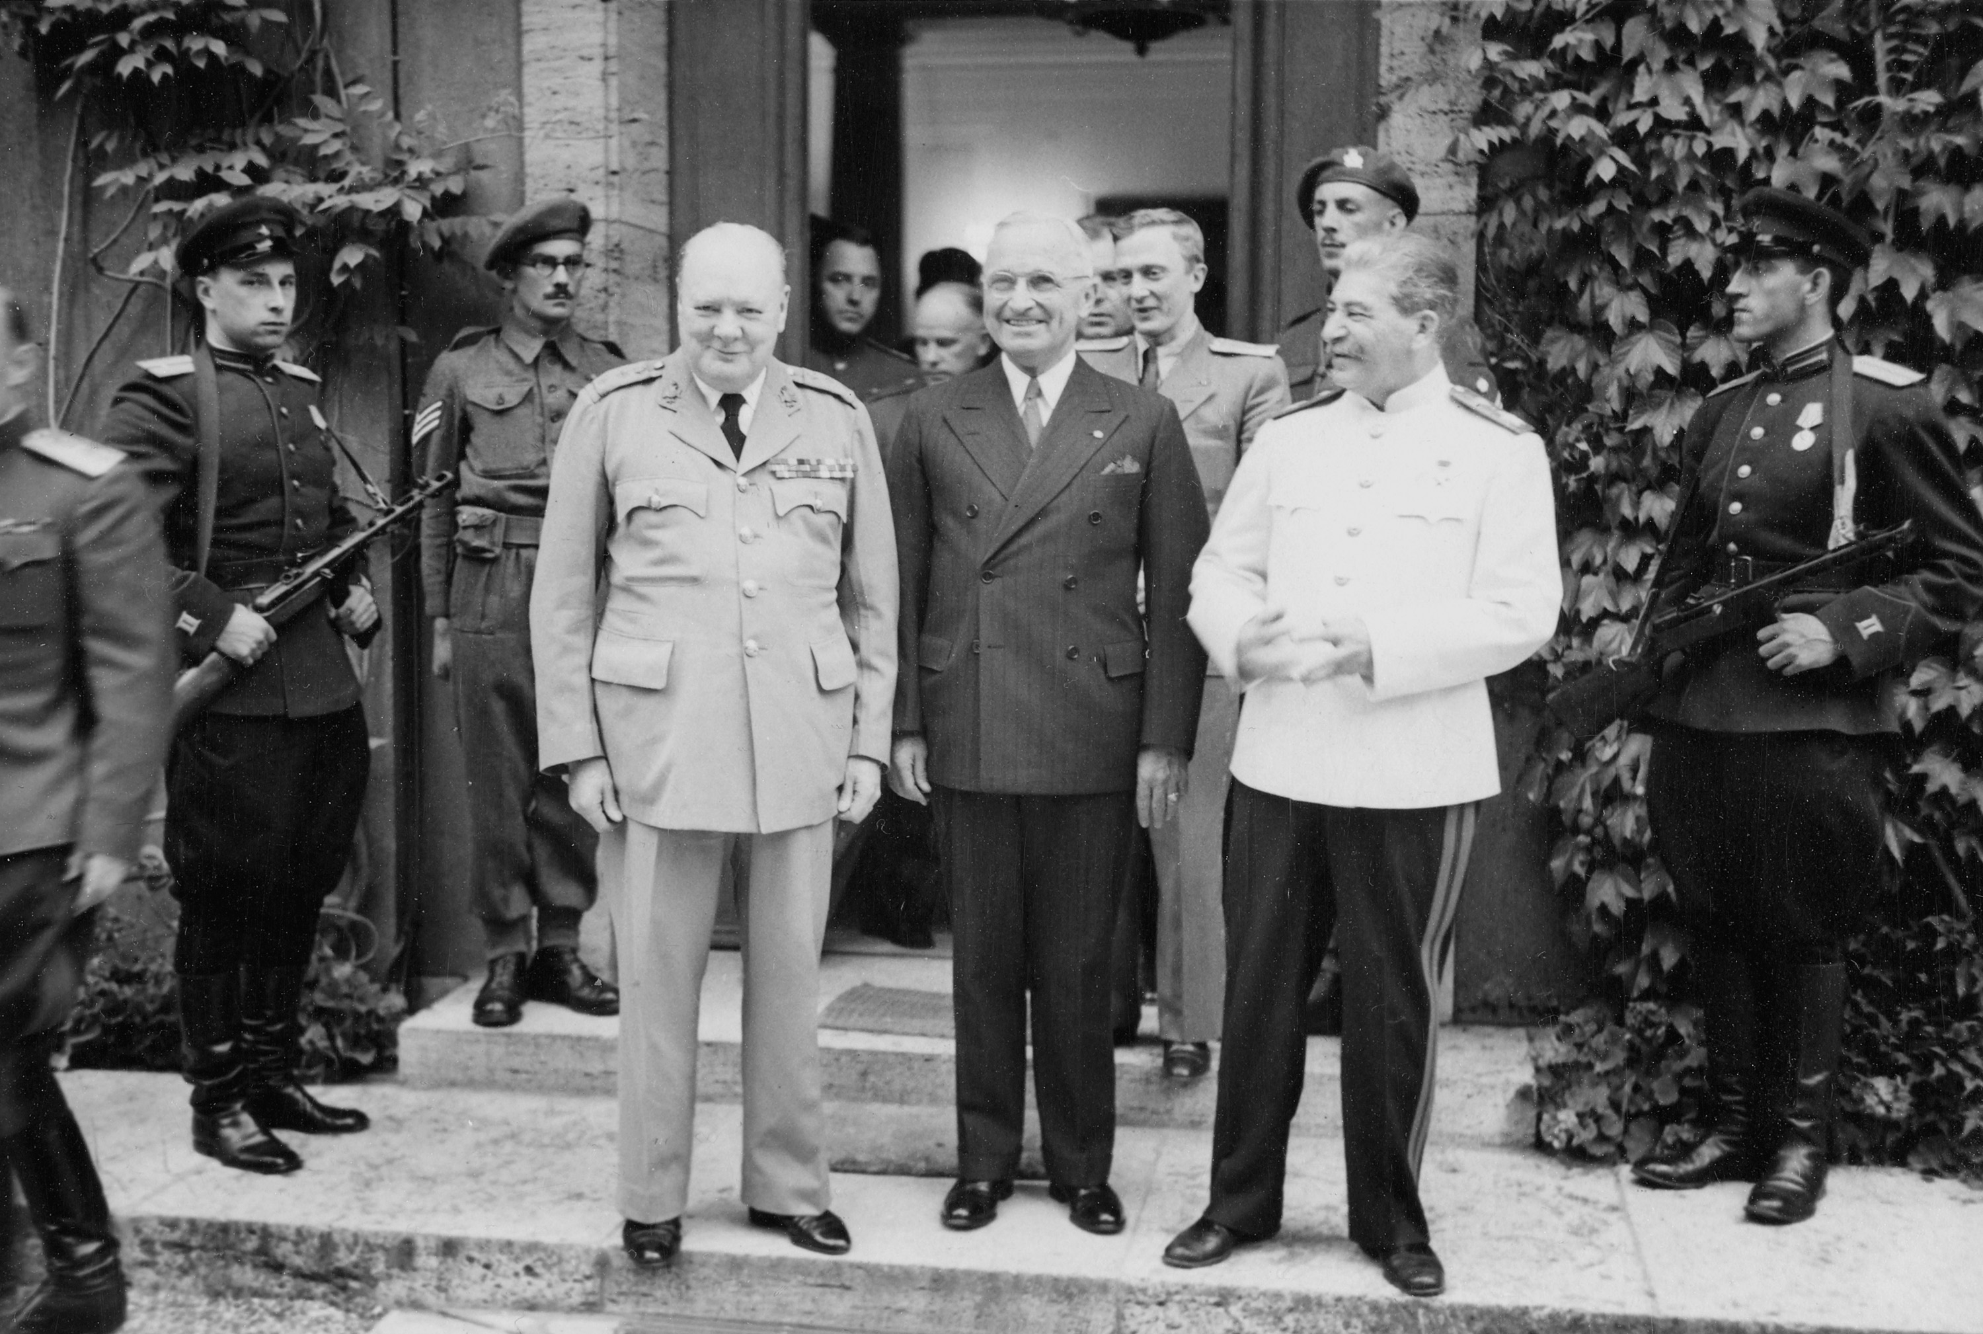
Notes:
President Harry Truman, Marshal Joseph Stalin and Prime Minister Winston Churchill during the Potsdam Conference, 1945.
Photograph, World War Two (1939-1945), 1945.
The United States, Soviet Union and Britain met at Potsdam in Germany between 17 July and 2 August 1945 to decide how occupied Germany should be administered and to establish the post-war international order. When Churchill arrived at Potsdam he was still Prime Minister, but when the results of the recent British General Election became known he was replaced as Prime Minister and leader of the British delegation by Clement Attlee.
NAM. 1985-10-134-62

Slide 17
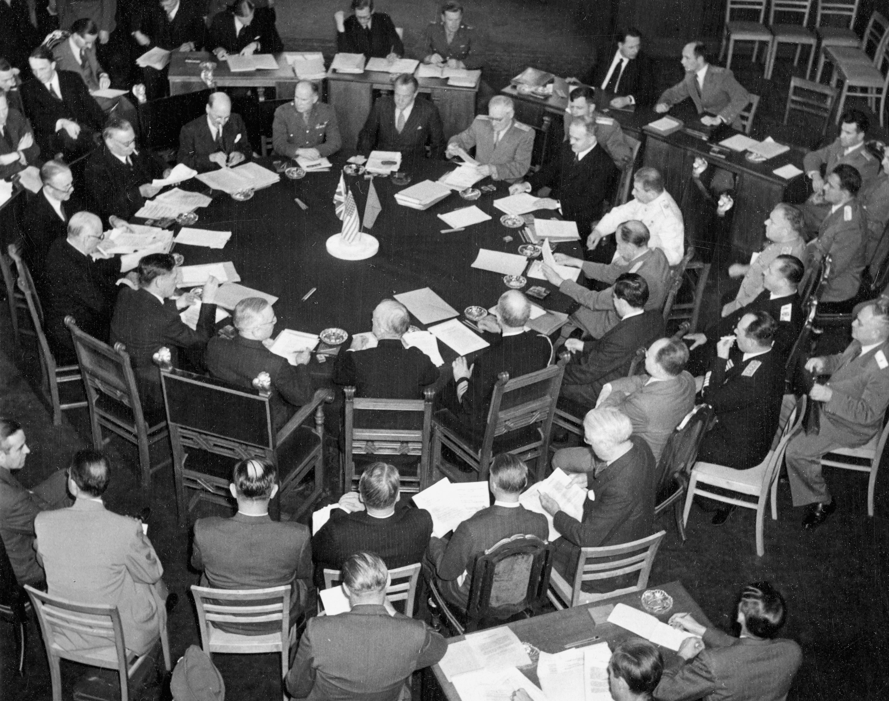
Notes:
Photograph showing scene at the Potsdam Conference, 1945.
NAM. 1985-10-134-70

Slide 18
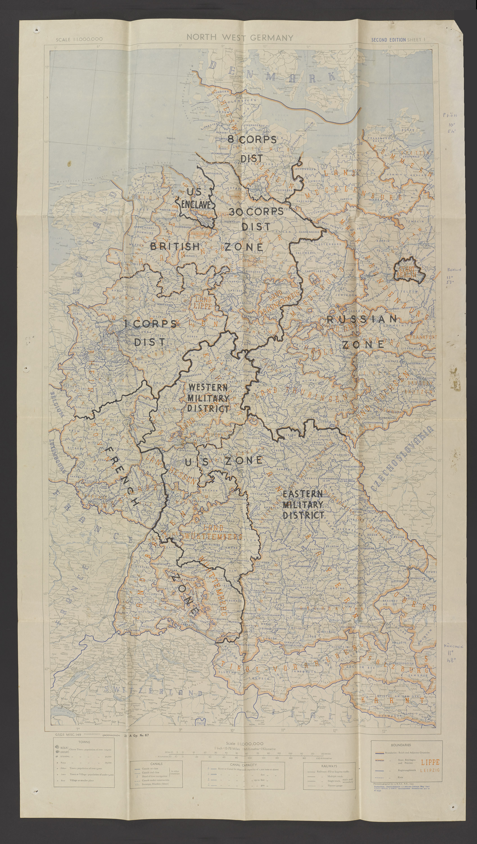
Notes:
Map of Germany, 1942, customised to show the borders of the different zones of occupation in 1945.
The Allies had decided at Yalta in February 1945, well before the end of the war, how a defeated Germany would be governed after their eventual victory in the Second World War. As with plans for Austria, Germany would be divided into four Zones of Occupation, with each of the victorious powers taking responsibility in their Zone. This structure was established by the Berlin Declaration on 5 June 1945, which pronounced the end of the Third Reich and the replacement of all German civic and political authority by that of the Allies. They would be the sole political and legal authority in their Zones of the defeated Germany. The Potsdam Conference of 17 July to 2 August 1945 later formalised the goals of the four powers, that Germany should be demilitarised and de-Nazification should take place at all levels of society, and also confirmed the Zones of Occupation of Germany and Berlin. The four main powers would work together in the Berlin-based Allied Control Council, constituted on 30 August 1945, which would oversee matters relating to the country as a whole.
This map belonged to Marjorie Buy, who served with the Auxiliary Territorial Service in VIII Corps' district of Germany in 1945.
NAM. 2018-03-6-5-1

Slide 19
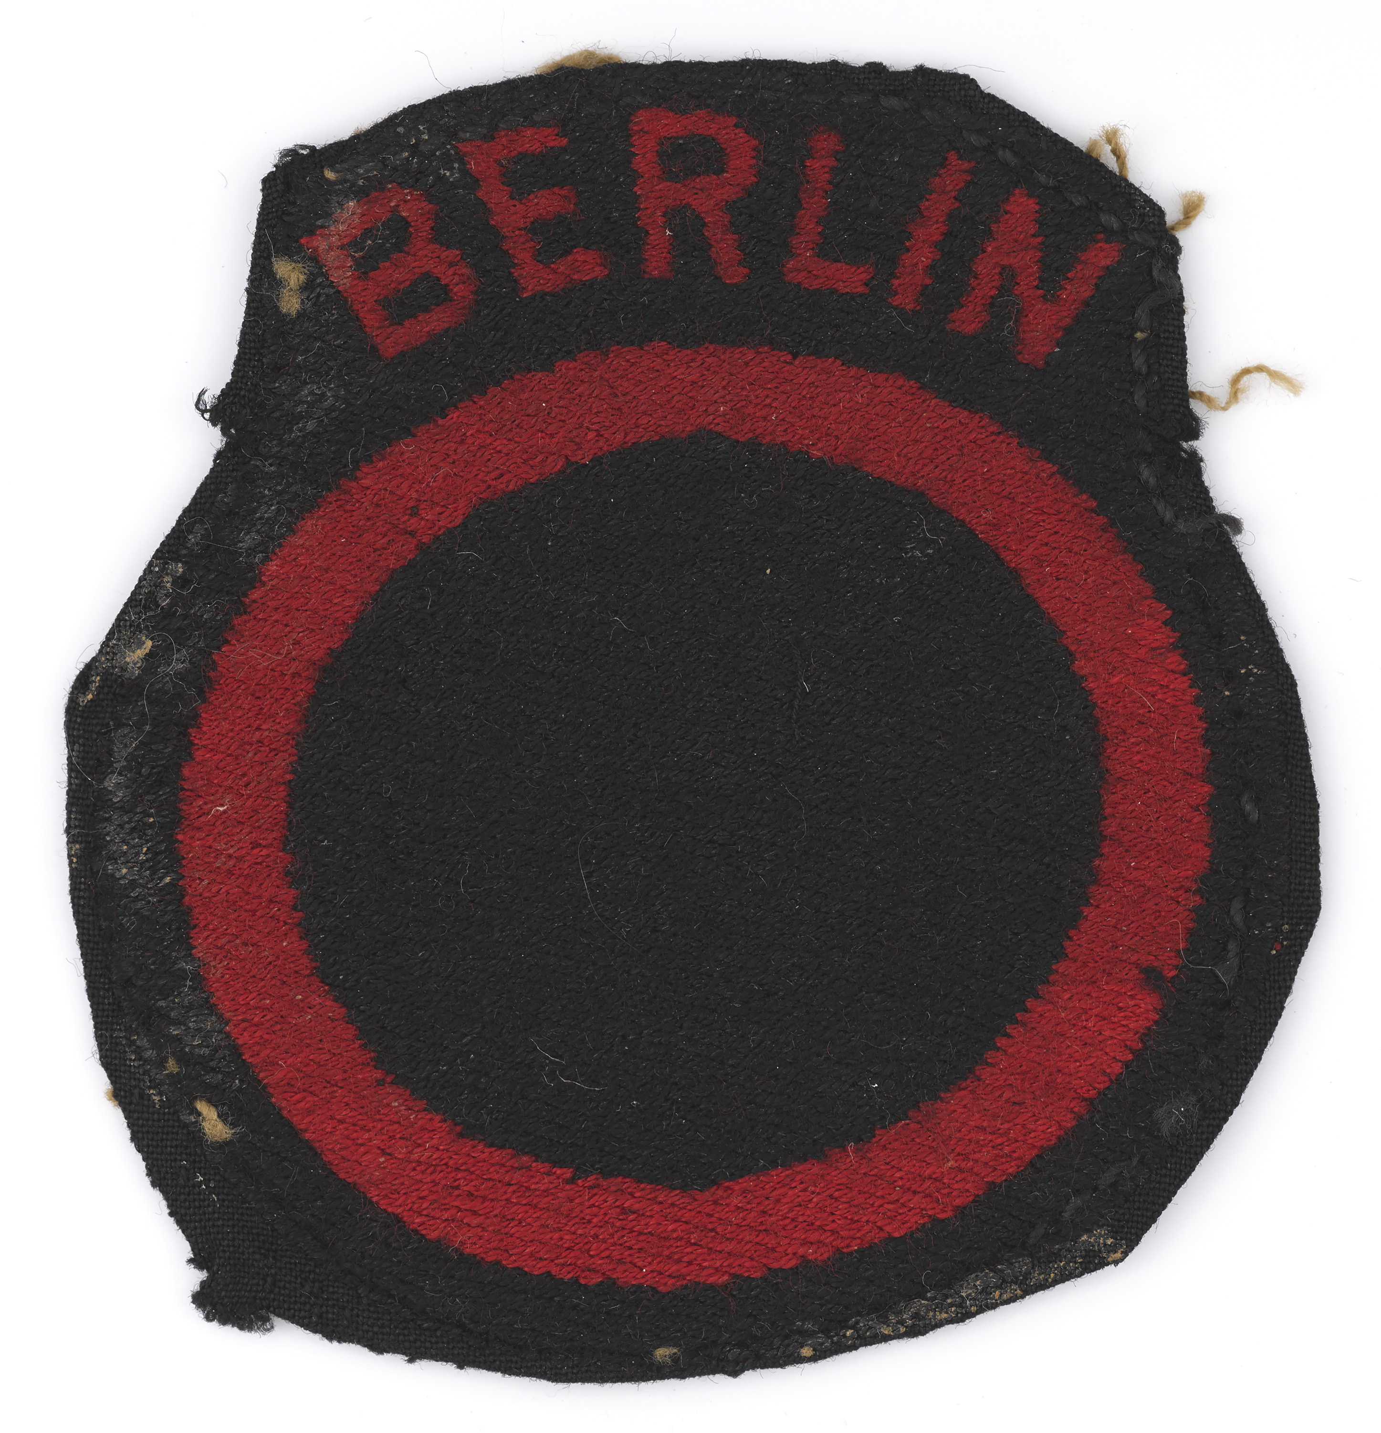
Notes:
Formation badge, British Troops Berlin, worn by Captain John Harper-Nelson, Argyll and Sutherland Highlanders (Princess Louise’s), 1952 (c).
This formation badge was adopted shortly after the occupation of the British Zone of Berlin in 1945 by the 7th Armoured Division and attached troops for the Administrative HQ of the British sector. Legend has it that it was used to denote the city of Berlin, encircled by the Soviets occupying East Germany. In 1952, the badge was augmented with 'Berlin' at the top.
NAM. 1993-04-46-1

Slide 20
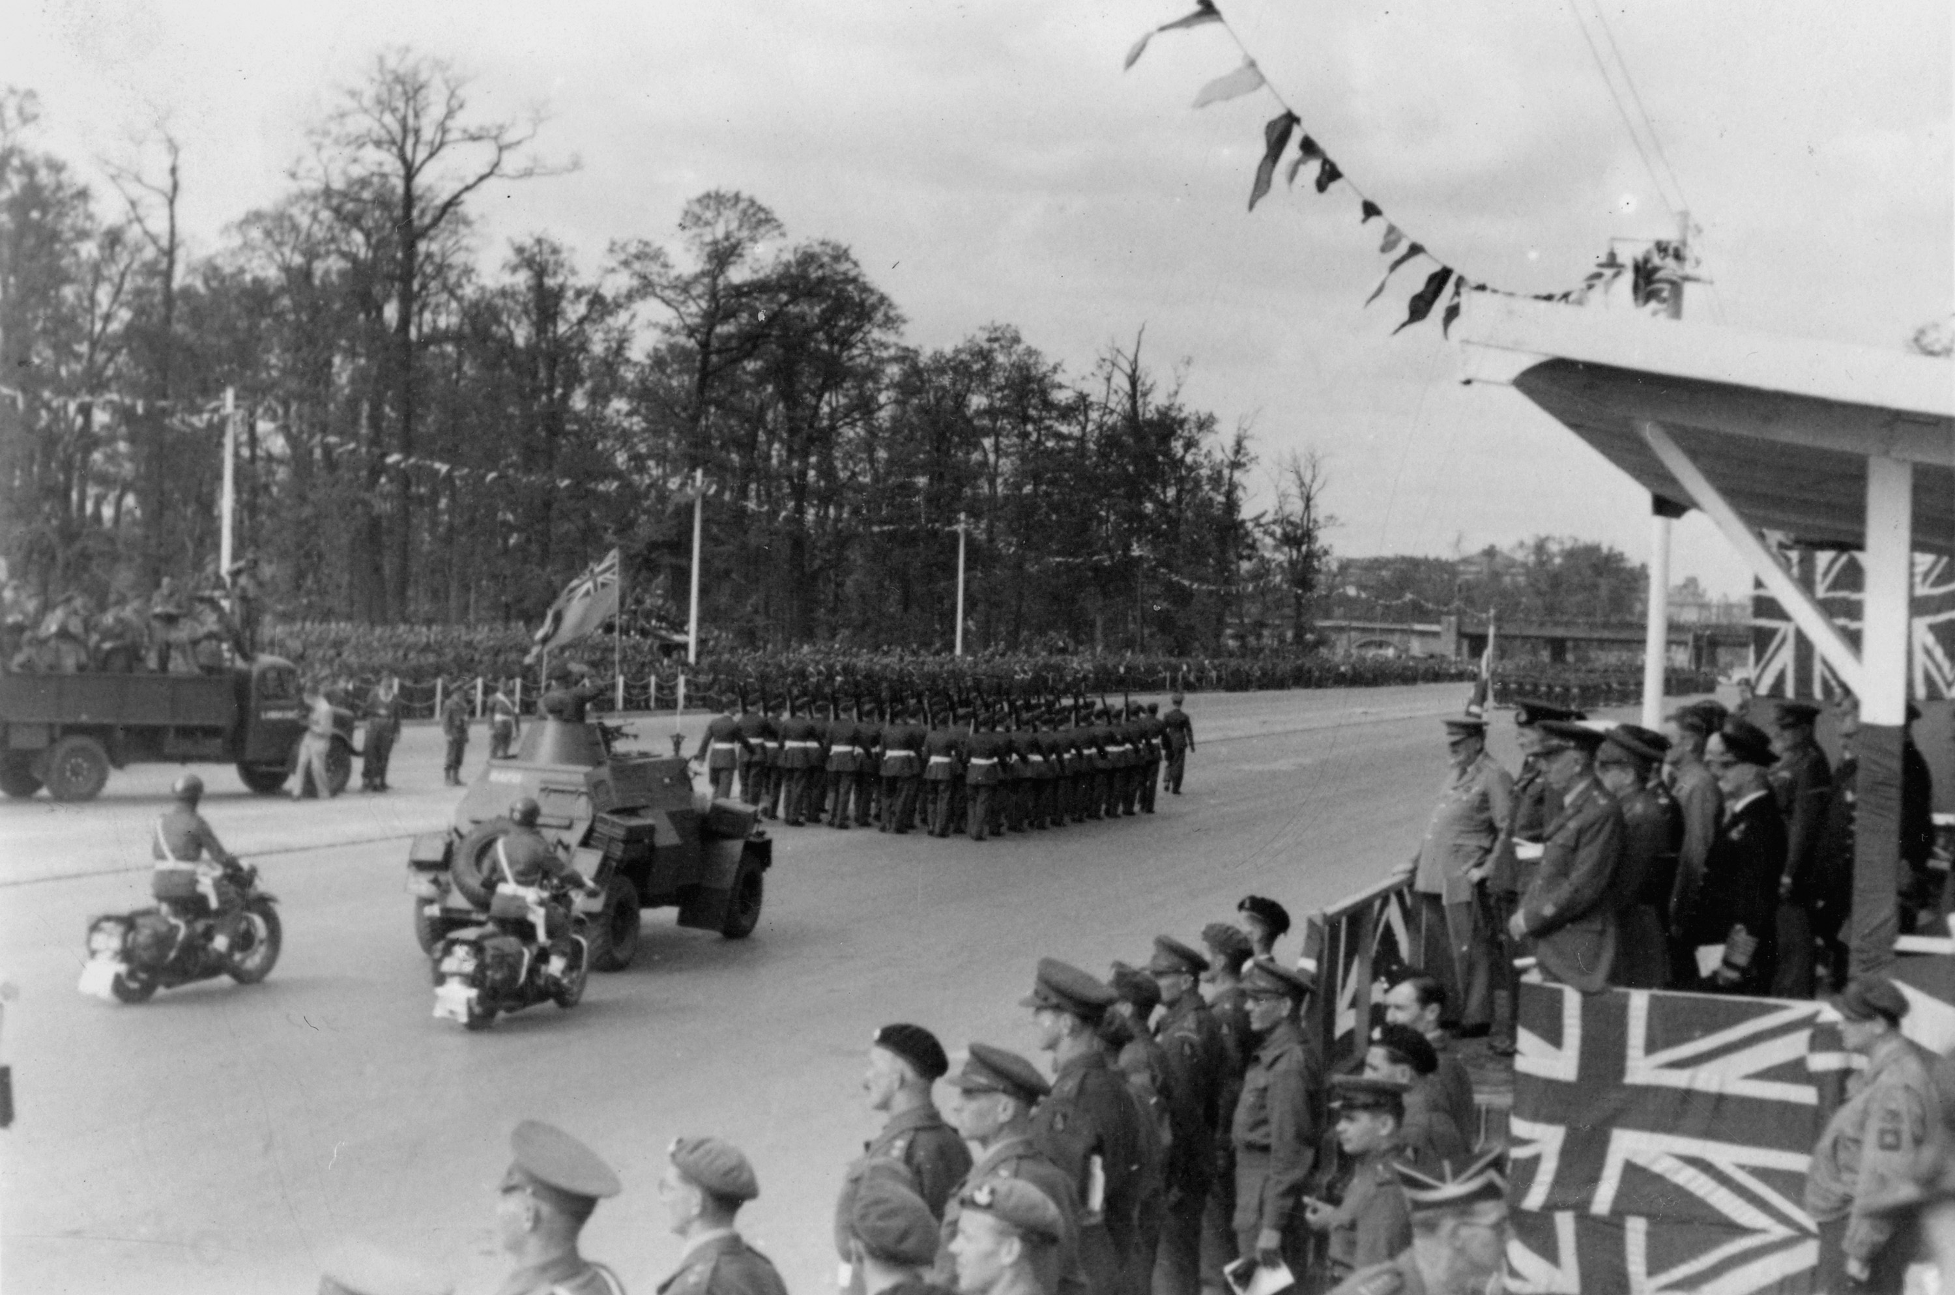
Notes:
Photograph showing a British Victory Parade, Berlin, Germany, 21 July 1945.
On 21 July 1945, the British held a victory parade through Berlin to commemorate and celebrate the end of the war. Many other parades had already been held across the British zone. While an integral part of the Victory in Europe (VE) celebrations, these events also helped enforce a sense of defeat on the Germans and served to remind them that they were occupied. Winston Churchill and FM Montgomery are in the grandstand. Royal Air Force (RAF) personnel marching in a parade in Berlin. An RAF Humber light reconnaissance car and motorcyclists bring up the rear.
One of 65 photographs collected by Junior Commander Margot Marshall (later Cooper), Auxiliary Territorial Service, World War Two, North West Europe (1944-1945).
NAM. 1995-02-100-23

Slide 21
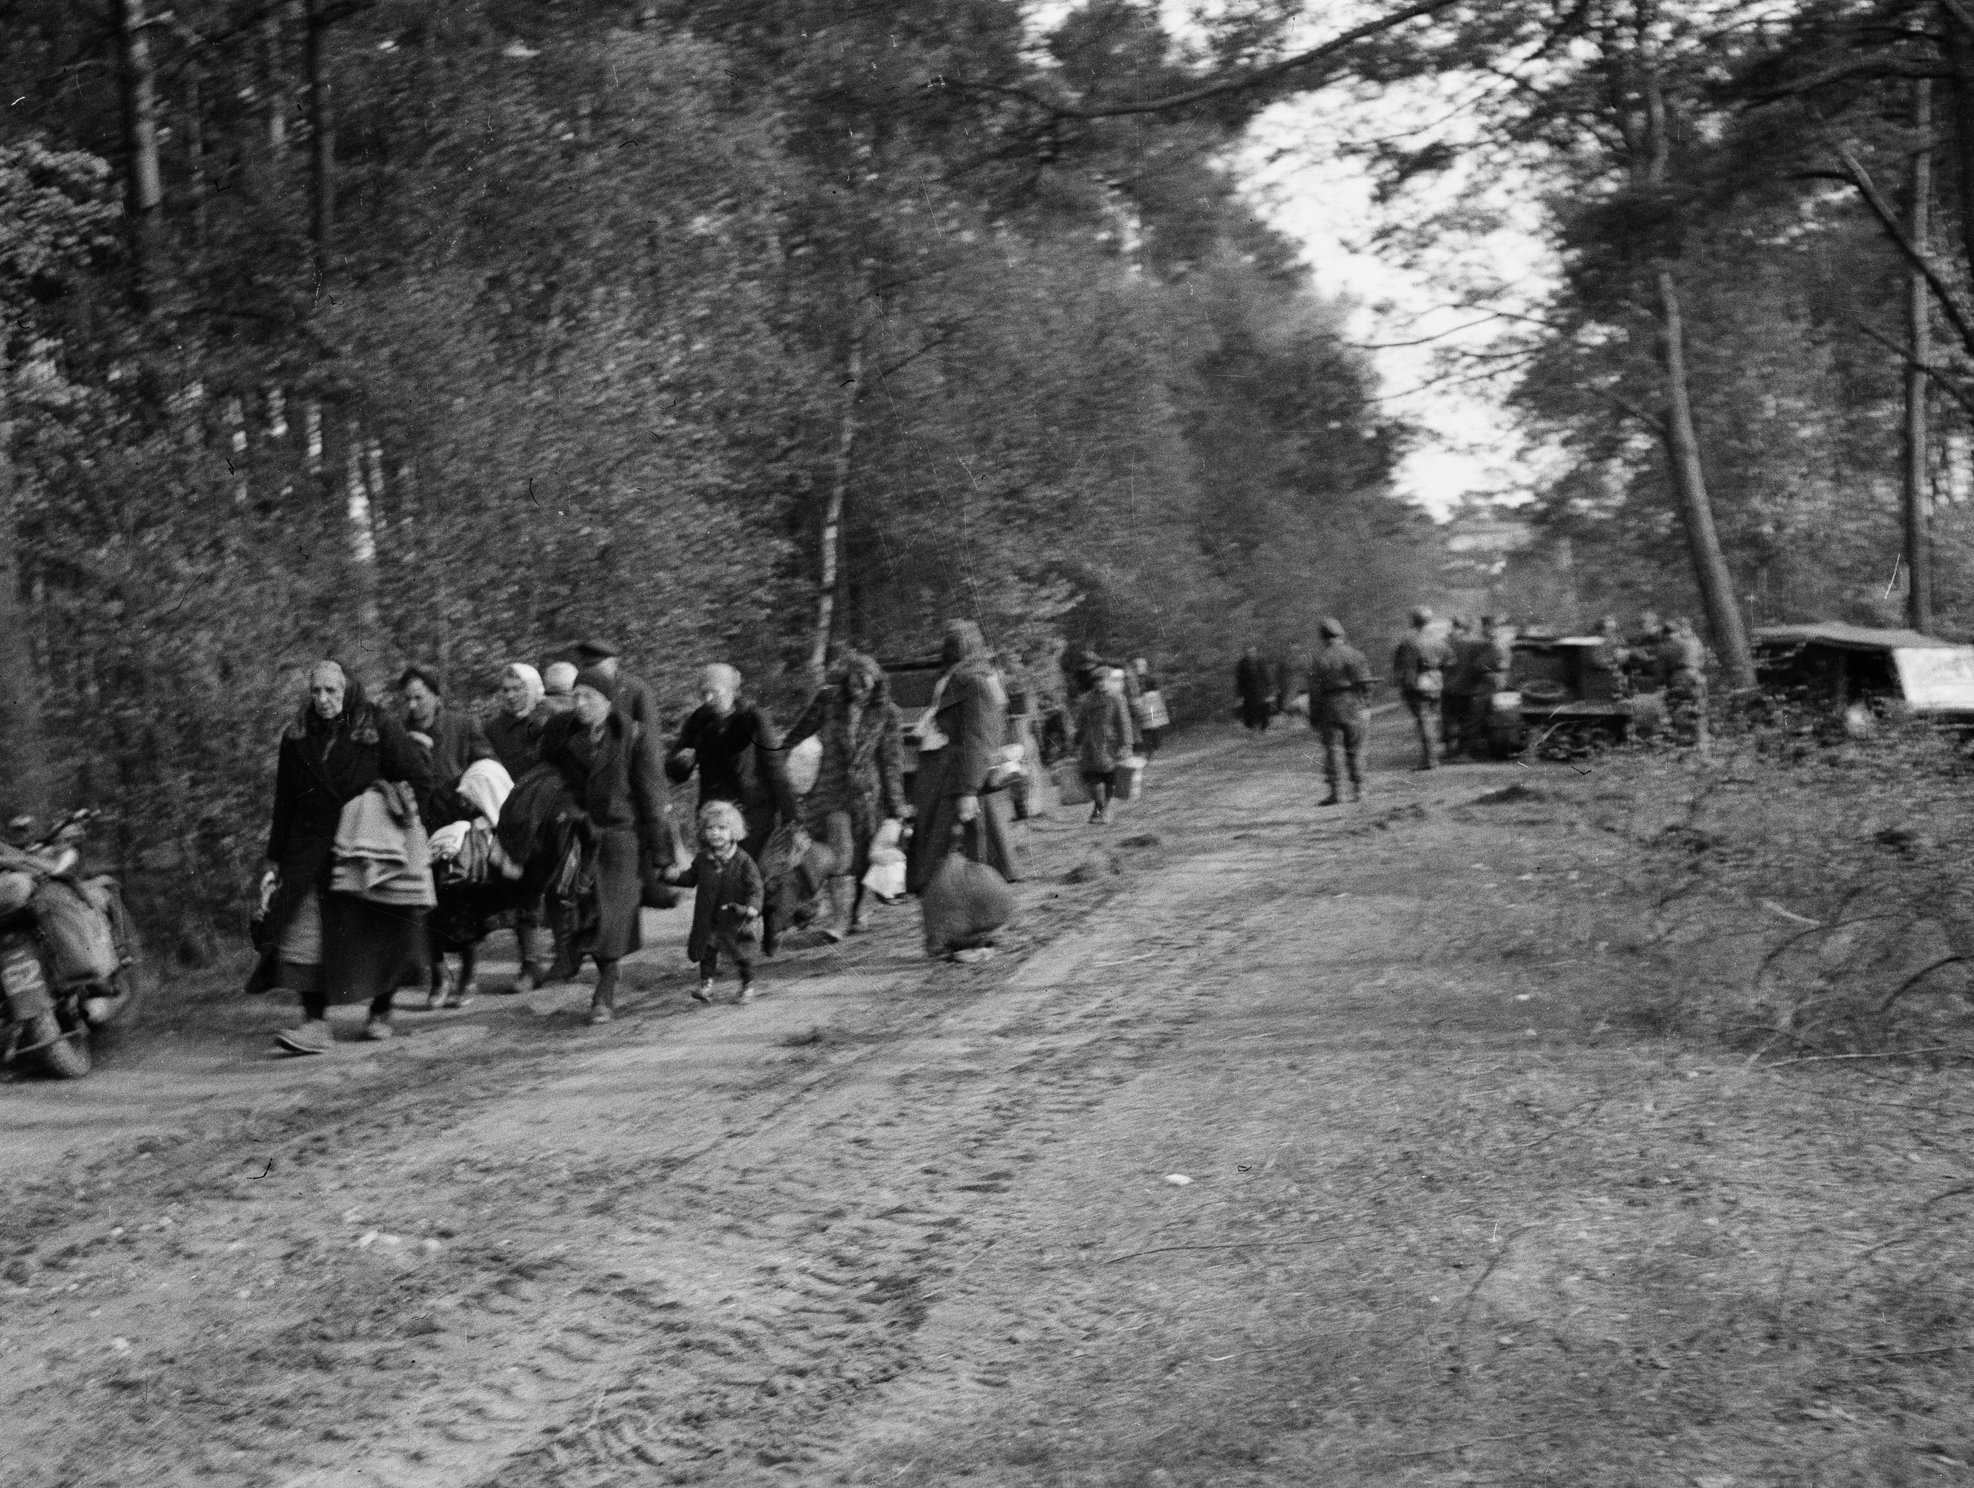
Notes:
German refugees, 1945.
Photograph, World War Two, North West Europe (1944-1945), 1945.
At the end of the war, the western Allies also had to deal with millions of German refugees. Many were from Germany's eastern provinces and had fled the vengeful Red Army, or were ethnic Germans forcibly expelled from countries like Poland and Czechoslovakia. Due to its location on the Baltic, the British occupation zone received a great number of German refugees who had come by sea. This made the existing accommodation shortage even worse and also caused a reduction in the food ration in early 1946. Eventually, most German refugees obtained accommodation and work as the economy recovered. The Germans expelled from Eastern European countries were assimilated by being granted German citizenship.
From an album containing 198 photographs and captions compiled by Major Wilfred Herbert James Sale, MC, 3rd/4th County of London Yeomanry (Sharpshooters), 1944-1945.
NAM. 1975-03-63-22-135

Slide 22
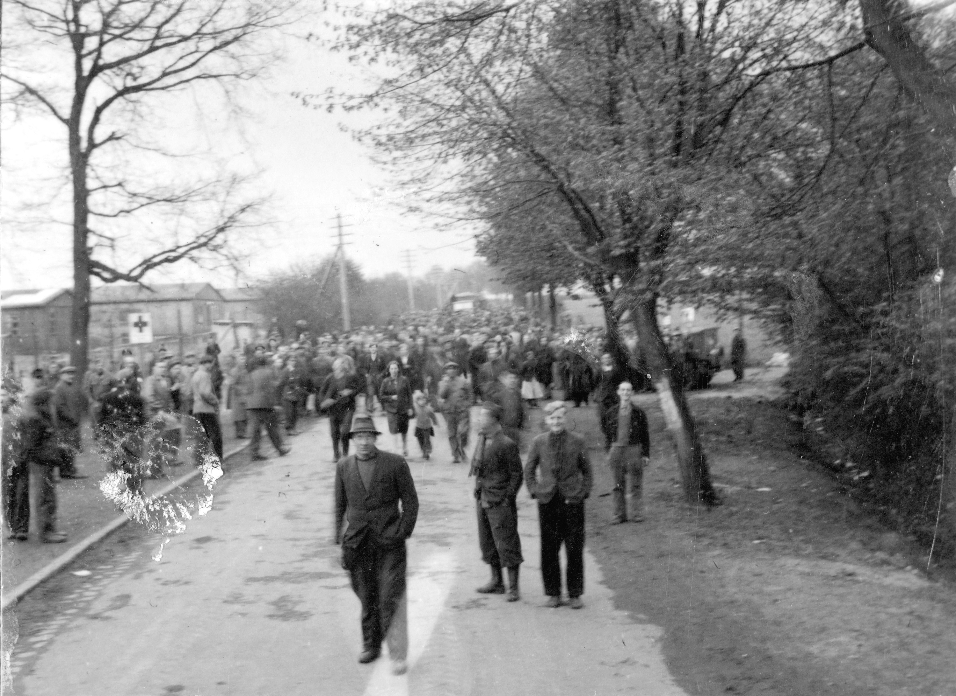
Notes:
'Liberated displaced persons mainly Poles', 1945.
Photograph, World War Two, North West Europe (1944-1945), 1945.
In the weeks and months after the end of the war in May 1945 thousands of demobilised soldiers, displaced persons, slave labourers and refugees had to processed, medically treated and then sent home. For months, millions of people were on the move across war-ravaged Europe.
From an album containing 198 photographs and captions compiled by Major Wilfred Herbert James Sale, MC, 3rd/4th County of London Yeomanry (Sharpshooters), 1944-1945.
NAM. 1975-03-63-22-136

Slide 23
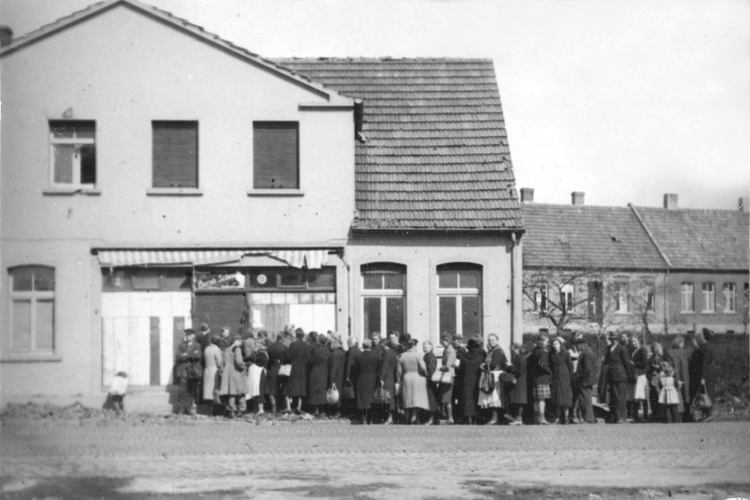
Notes:
Germans queuing for food in Pinneberg, 1945.
Photograph by Major Wilfred Herbert James Sale, MC, 3rd/4th County of London Yeomanry (Sharpshooters), World War Two, North West Europe, 1945.
With agriculture and industry in ruins after the war, the population of the British occupation zone of Germany experienced food shortages and rationing for several years. Although the Control Commission mobilised ex-soldiers and civilians to bring in harvests and restart industry, life only improved for most following the creation of West Germany and its subsequent economic revival in the early 1950s.
From an album containing 198 photographs and captions compiled by Major W H J Sale, MC, 3rd/4th County of London Yeomanry (Sharpshooters), 1944-1945.
NAM. 1975-03-63-22-175

Slide 24
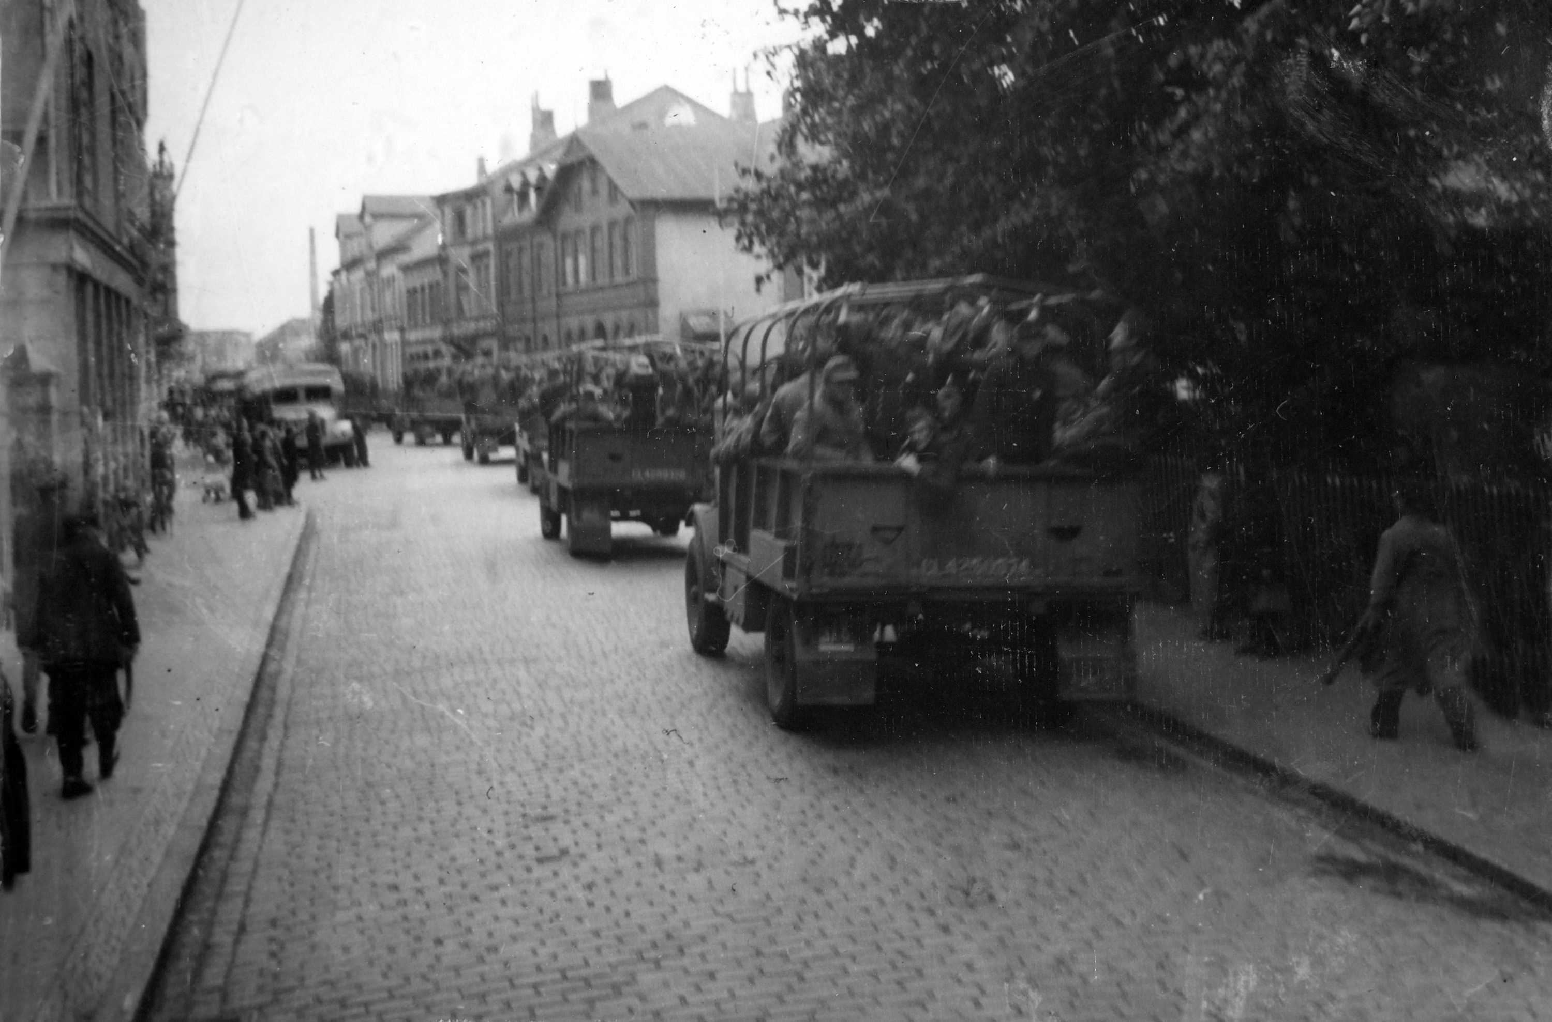
Notes:
Demobilised German prisoners of war, Elmshorn, 1945.
Photograph by Major Wilfred Herbert James Sale, MC, 3rd/4th County of London Yeomanry (Sharpshooters), World War Two, North West Europe, 1945.
Operation BARLEYCORN, masterminded by Major General Gerald Templer, saw thousands of the former German POWs who had been captured and detained in the British Zone released between June and September 1945, in order to work the land and bring in the harvest.
This photograph shows a number of vehicles carrying soldiers down a street in Elmshorn in Schleswig-Holstein in Northern Germany.
From an album containing 201 photographs and captions compiled by Major W H J Sale, MC, 3rd/4th County of London Yeomanry (Sharpshooters).
NAM. 1975-03-63-23-30

Slide 25
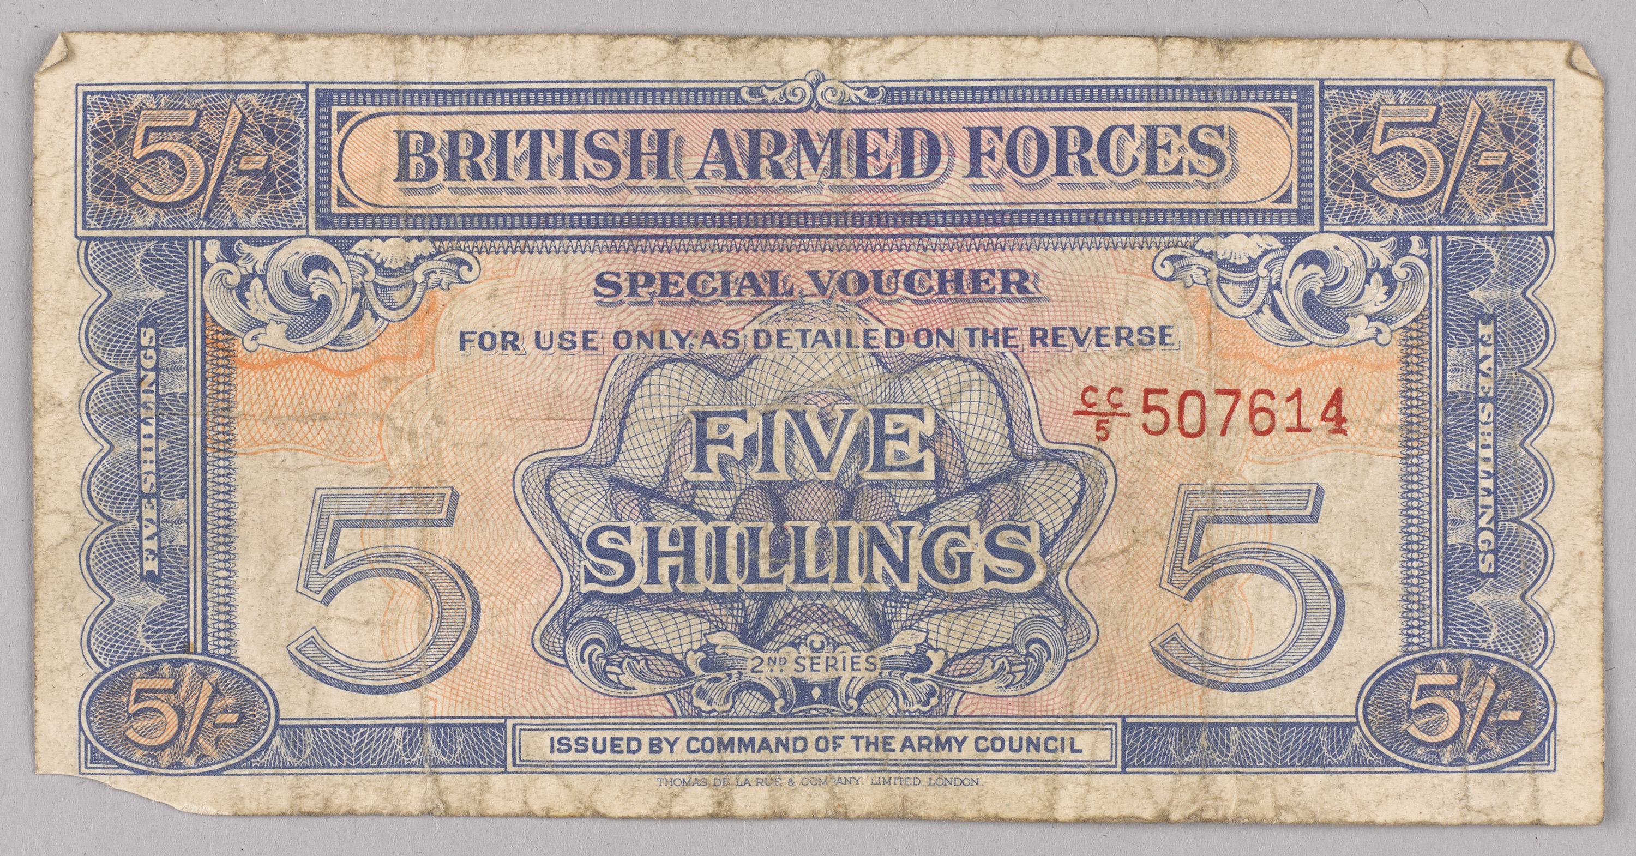
Notes:
British Armed Forces vouchers for 3d and 5/ -, 1948 (c).
Two currency vouchers collected by 14741155 Sergeant A R Wilson, Durham Light Infantry and Northamptonshire Regiment, North West Europe 1944-1947.
In the immediate aftermath of the Second World War, illicit deals and commerce was utterly rampant across the British Zone of Occupation in Western Germany. This was due to a shortage of food, the useless value of paper marks, a lack of transport for proper distribution for supplies, a lack of working German courts. But the implications of the occupation were also having an effect, with smuggling from neighbouring Holland and Luxembourg, from the French Zone and even reportedly by ‘Belgian troops in Belgian Army lorries’ contributed to the chaos.
In the absence of a functioning economy, cigarettes became the major currency. But anything could be used to barter with. Bernard Tamplin, who served in the British Army of the Rhine (BAOR) as a National Serviceman between 1947 and 1949, was a willing participant:
‘They couldn’t get coffee for love nor money, and the Germans do like coffee. So when I went to England I used to come back loaded with 10 pounds of coffee beans. You could smell me coming. How I ever got through customs I’ll never know. You could sell five pounds of beans for something else - I had two civilian suits made while I was in Germany. It was all on the black market. It was stuff we sold that we shouldn’t have had. But that was the way life was ... Cigarettes were terribly short in Germany and their tobacco was awful, so they used to like English cigarettes. For 200 cigarettes you could get a suit. There was nothing in the German shops at all. It was all black market.’
Indeed, so pervasive was the black market that in the various towns and cities they operated brazenly like normal marketplaces, in full view of the authorities.
In March 1946, it was decided that a special military voucher system was needed to try to curtail the black market in the British Zone of Occupied Germany. On 1st August 1946, the first series of 52.4 million British Armed Forces Special Vouchers (BAFSV), valued at just over £10 million, were printed and officially issued in Germany. The soldiers would be part paid in these, and they were the only accepted currency in the NAAFI canteens and various messes. However, the ingenuity of the local black market quickly reacted and absorbed these, and they entered wider circulation. In mid-1947 plans were made to issue a second series, and then immediately demonetise the first to limit the conversion of illicitly gained first-series vouchers. This scheme was carried out on 6th January 1948 and, combined with the beginnings of an economic recovery, helped break the back of the black market. These are example of those 2nd series editions.
From a collection of papers of 14741155 Sergeant A R Wilson, Durham Light Infantry and Northamptonshire Regiment, North West Europe 1944-1947.
NAM. 1994-06-169-12

Slide 26
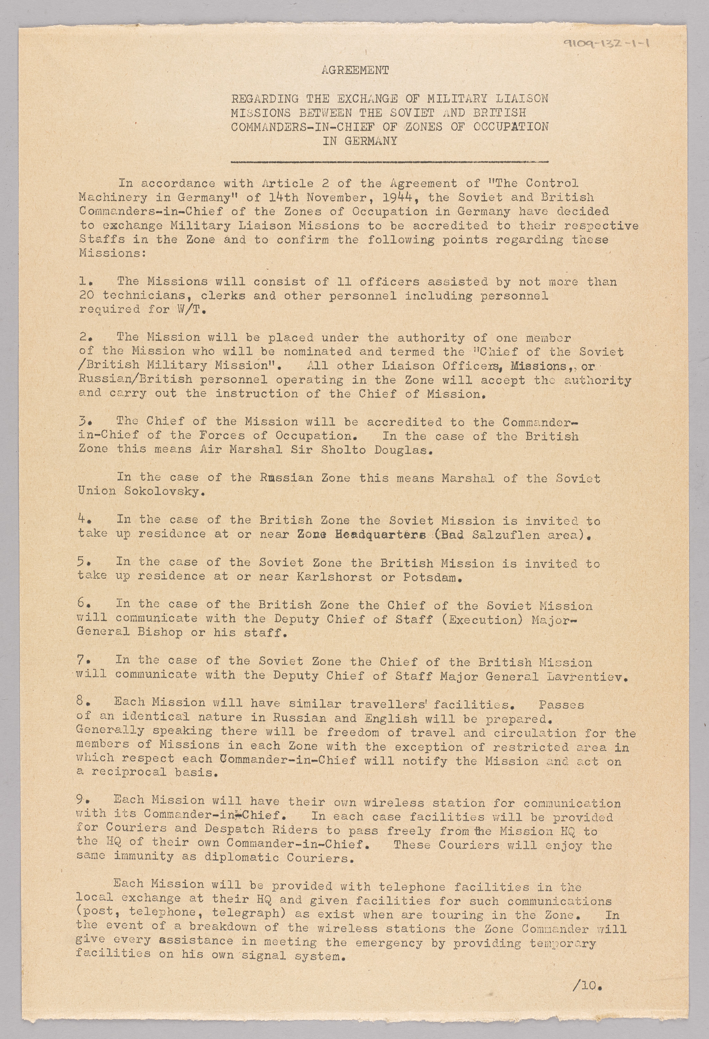
Notes:
Copy of the Agreement Regarding the Exchange of Military Liaison Missions Between the Soviet and British Commanders-in-Chief of Zones of Occupation in Germany, 16 September 1946.
At the end of World War Two,Berlin was divided into zones, one of which was allocated to each of the Allied powers; Britain, France, the USA and the Soviet Union. Reciprocal agreements were made between the Soviet and British Commanders-in-Chiefs to exchange Military Liaison Missions to facilitate the administration of the occupied territories, whose staff would be able to travel and circulate in each zone, with the exception of some restricted areas.
This agreement was signed by Lieutenant-General Brian Robertson, Deputy Military Governor, Control Commission Germany and General Mikhail Malinin, Chief of Staff of the Soviet Group of Forces of Occupation in Germany, on 16 September 1946.
The British Mission, or BRIXMISS (later BRIXMIS), were initially part of the Foreign Office, before passing to the control of the British Army. They were divided into Main HQ in a villa in Potsdam, inside the Soviet Zone of East Germany, and the Rear HQ at the Berlin Olympic Stadium, in the British sector of the city. The object of Main HQ was to liaise directly with the Soviet authorities but given their unparalleled access behind the Iron Curtain, with the advent of the Cold War their primary role became intelligence gathering. They were small teams, in the British case numbering just 31 personnel - 11 officers and 20 others.
NAM. 1991-09-132-1

Slide 27
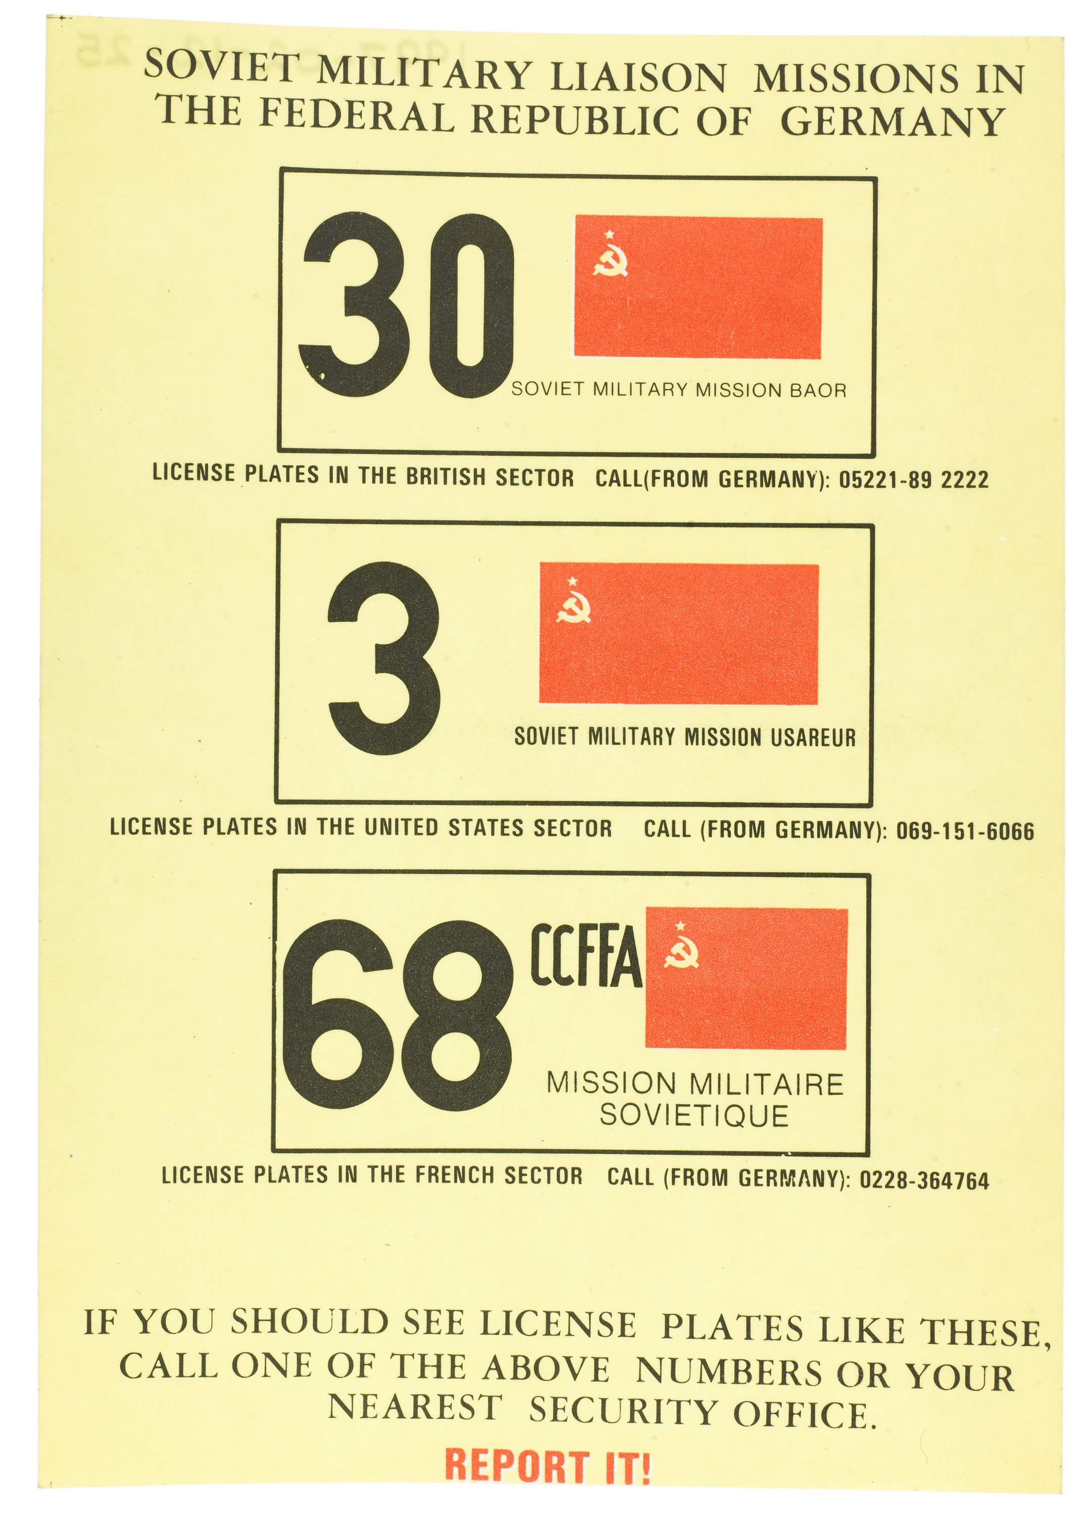
Notes:
Instruction card showing the number plates used by Soviet military liaison missions in the Federal Republic of Germany and instructing personnel to report any sightings of cars bearing these plates; nd.
From a wallet containing various papers and documents relating to Gnr Kim Gittins’ service in Northern Ireland.
NAM. 1997-02-12-25

Slide 28
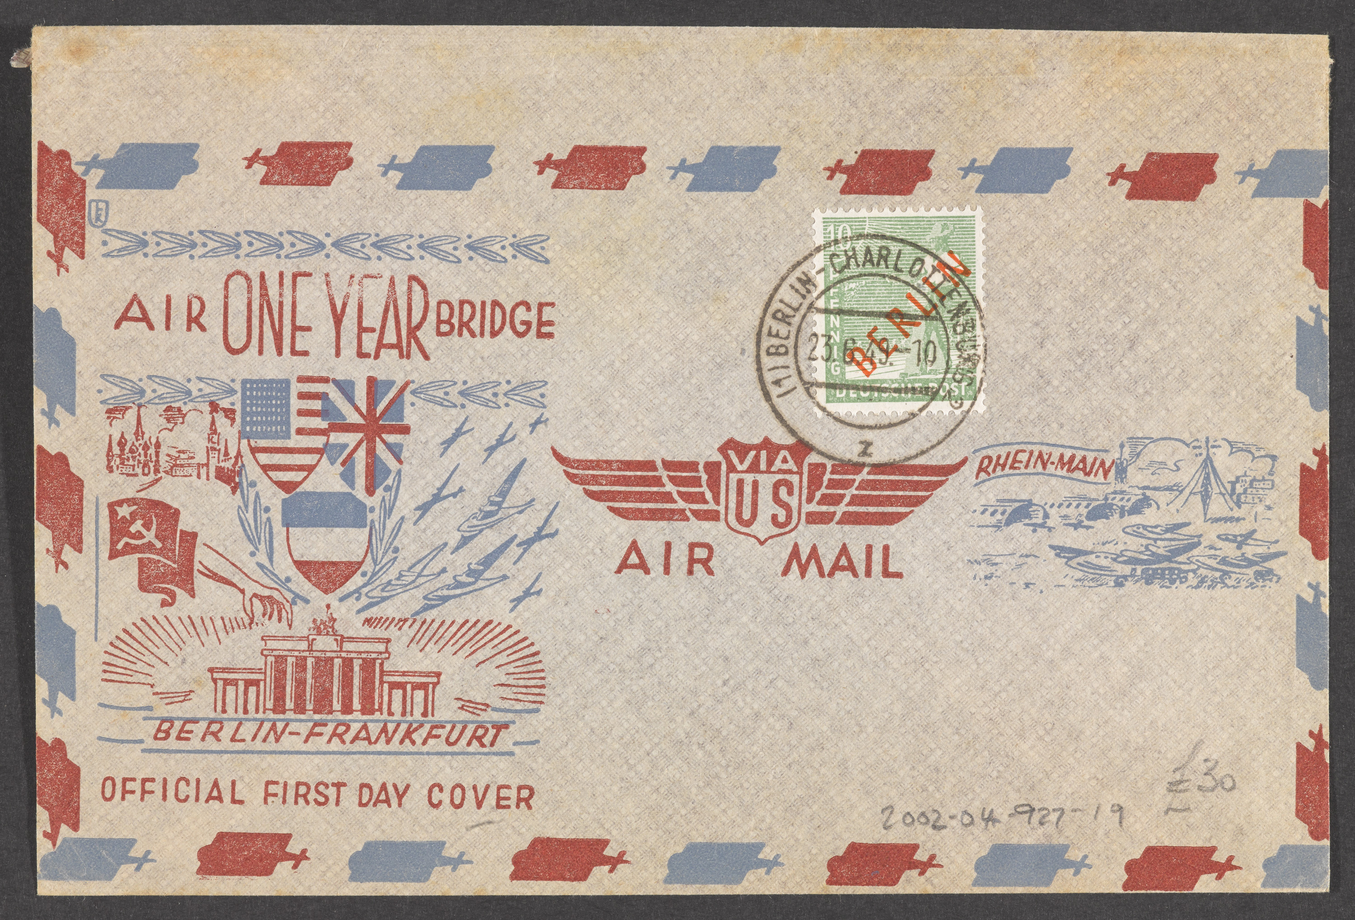
Notes:
US Air Bridge Commemorative Envelope, 23 June 1949.
This US Air Mail commemorative envelope from 23 June 1949 was produced to mark the first anniversary of the Berlin blockade and the Allied efforts to relieve the Western Zones of the city.
In the aftermath of the Second World War, the alliances between the democratic western powers and the Soviet Union quickly broke down. On 24 June 1948, following increased tension and agitation, the Soviets exploited Berlin's location deep inside the Soviet Zone and blockaded the city. The Western Allies responded, and on 26 June, the Berlin Airlift began, an Allied mission to supply the city by air. On 12 May 1949, the Soviets lifted the blockade of West Berlin and the phenomenal operation was drawn to a close the following month.
During the 13 months from 26 June 1948 until 1 August 1949, more than 266,600 flights, carrying more than 2,223,000 tons of food, fuel and supplies, were made to Berlin by British and US aircraft. At its peak, one plane landed every 60 seconds at either Tempelhof, Gatow or Tegel. Even flying boats were used, which landed in the Havel See, and were then unloaded by barges. The Allies had estimated that 4,500 tons of supplies were required per day to keep the garrisons and civilians fed, clothed and heated. In the end they had managed to average a daily rate of 5,579 tons.
The design of the grasping Soviet hand makes it clear how far relations between the former allies had deteriorated, and the triumph of the Allied success. This particular envelope, and the letter it contained, were franked in the British sector of Berlin.
NAM. 2002-04-927-19

Slide 29
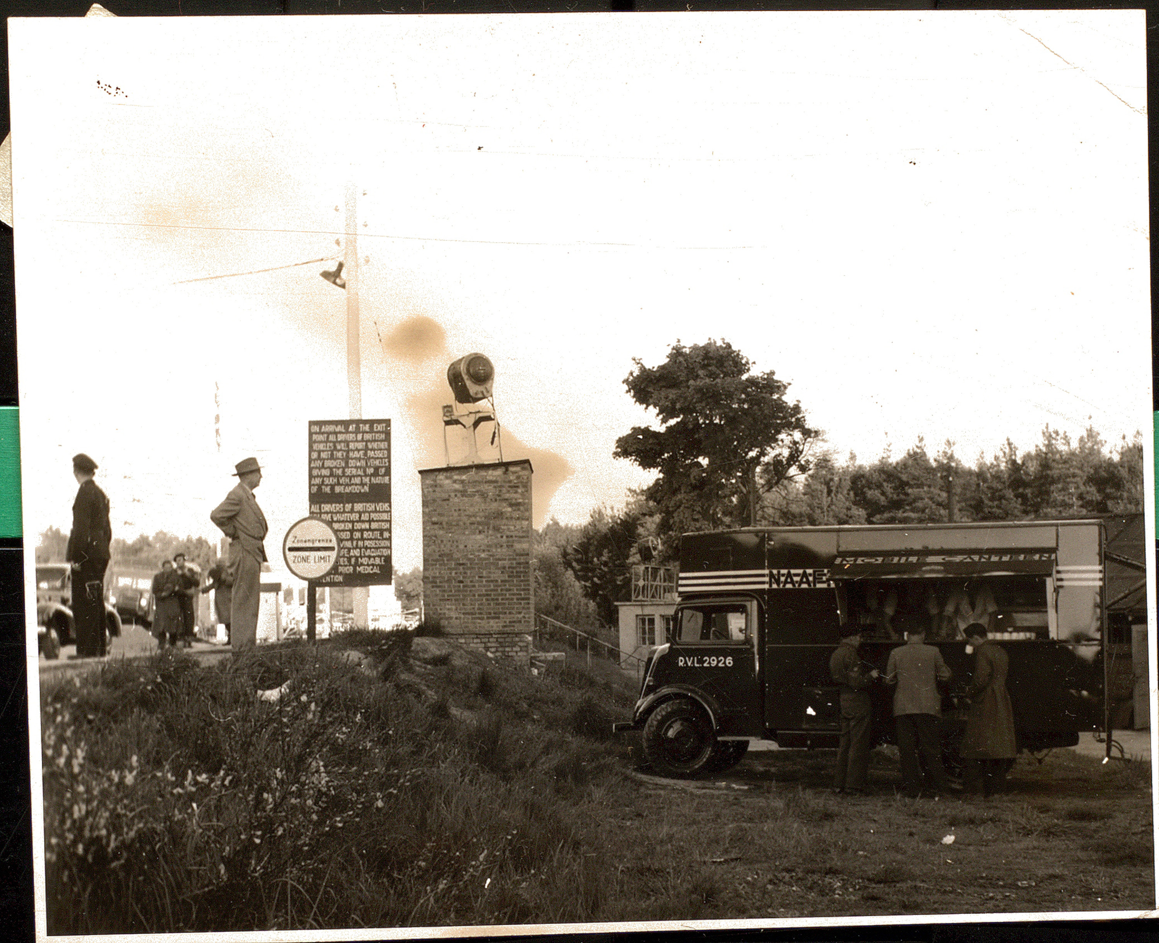
Notes:
Photograph of a NAAFI mobile canteen at the Helmstedt barrier, a few hours before the Berlin blockade was lifted, 11-12 May 1949.
One of 1276 photographs relating to the Navy, Army and Air Force Institutes (NAAFI) and its predecessors, 1914-1997 (c).
NAM. 2000-09-76-971

Slide 30
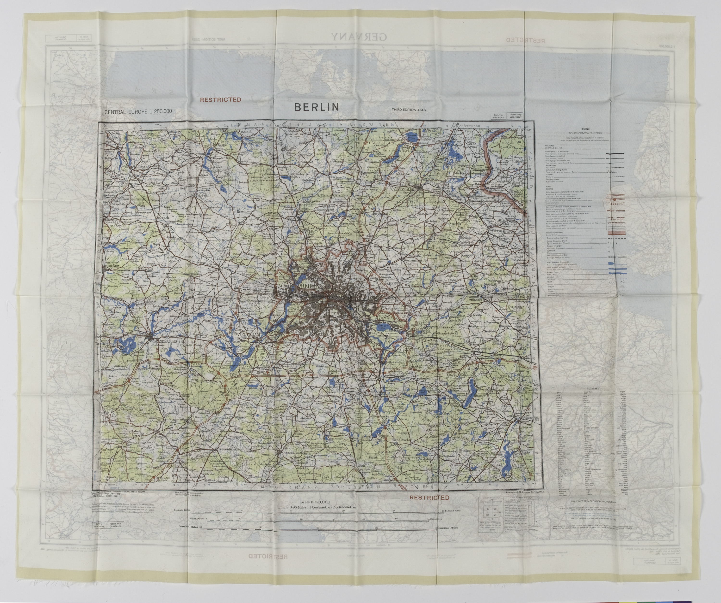
Notes:
Maps from an escape pack issued to British soldiers serving in West Berlin, 1954
During the Cold War, the British garrison in West Berlin was stationed deep inside the Soviet Zone of a divided Germany, isolated from the the British Army of the Rhine in the British Zone the other side of the Inner German Border. Had the Cold War turned hot, access to Berlin would quickly have been cut off by the Soviets - as it had been during the siege that led to the Berlin Airlift of 1948-49. Soldiers in the garrison were therefore issued with escape packs to help them make their way back to Britain via any route - if they could break out.
The packs contained a silk map with Berlin and the surrounding area on one side, and the divided Germany and Europe on the other. The packs also included money, a saw and a notice in four languages asking for safe passage.
NAM. 1994-10-87-1-1

Slide 31
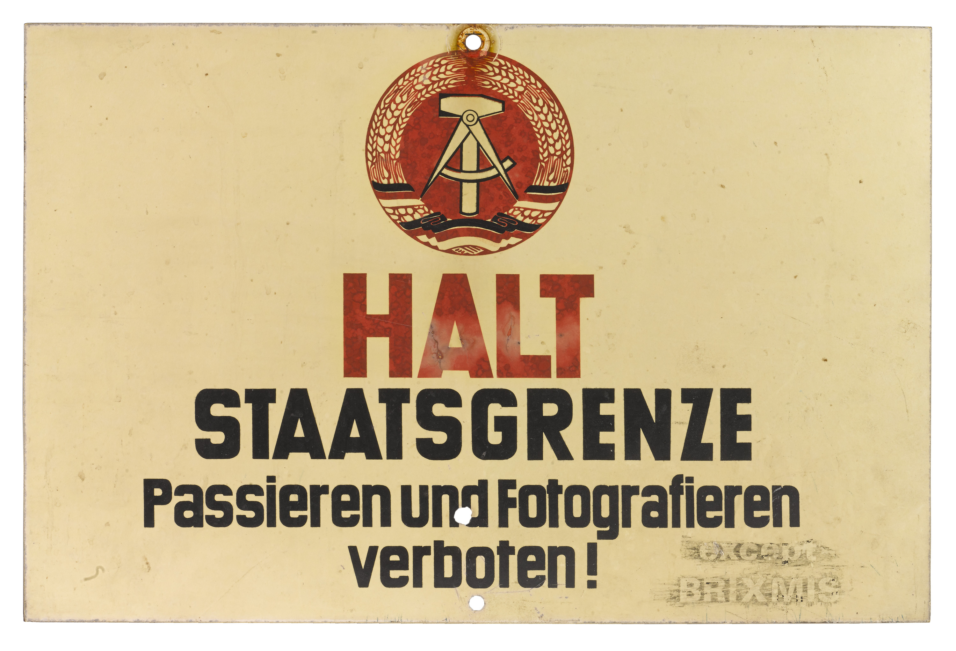
Notes:
German signboard, marking border to Poland or Czechoslovakia, 1985 (c).
Written in German, translates as, ‘HALT, state border crossing and photography forbidden except BRIXMIS’. Associated with BRIXMIS and the Commander in Chief’s mission to the Soviet forces in German, Berlin. Features the central symbol from the East German flag.
Transcription: ‘HALT / STAATSGRENZE / Passieren und Fotografieren / Verboten! / except BRIXMIS’, (translates as, ‘HALT, state border crossing and photography forbidden except BRIXMIS’).
Signs like these were used to mark the eastern borders of the GDR. In a handbook (6th ed., 1987) issued to the border guards by the East German Ministry for Defence it states that this type of sign was used to mark the border alongside the borders to Poland and Czechoslovakia.
NAM. 1992-12-63-1

Slide 32
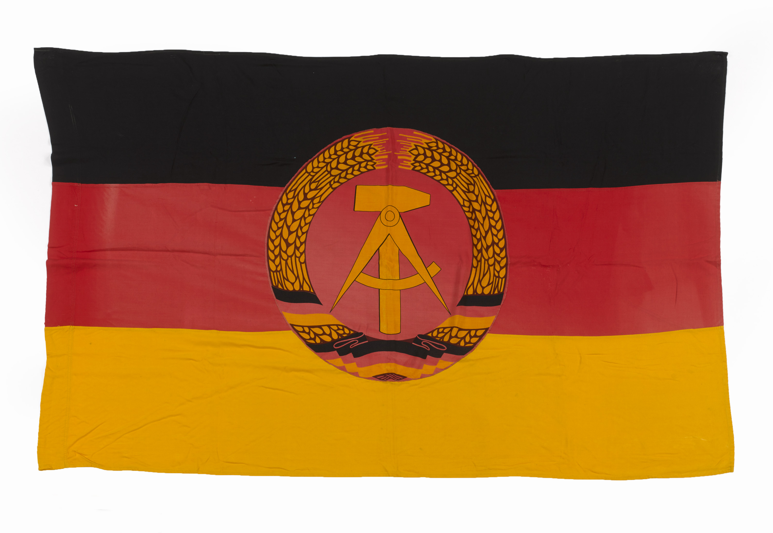
Notes:
German Democratic Republic flag, 1974.
East German flag with yellow, red and black horizontal stripes with the GDR emblem of hammer and a compass within a ring of rye in the centre.
This flag was collected from outside the Soviet Military Cemetery at Treptow Park in East Berlin, immediately prior to the annual National Day parade of the GDR on 7 October, by General Peter Williams while serving as the battalion Intelligence Officer of the 1st Battalion Coldstream Guards, based in Wavell Barracks, Spandau.
NAM. 2018-05-10-1

