Slide 1
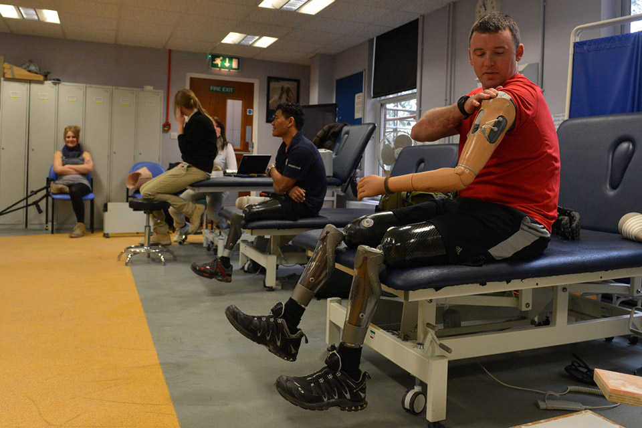


Should soldiers get preferential treatment from the government and society?
Notes:
NAM. 2013-04-26-53
Cpl Matt Webb, 45 Commando, Royal Marines, Defence Medical Rehabilitation Centre, Headley Court.
Digital photograph by Cpl Steve Blake RLC (Army Photographer), Defence Medical Rehabilitation Centre, Headley Court, Surrey, 2011.
Crown copyright.

Slide 2
This PowerPoint presentation contains a selection of images and archives which students can use to prompt discussion and encourage further research. The materials come from the Collection of the National Army Museum (NAM).
Unless otherwise stated in the notes, the images can be freely used for non-commercial purposes within the classroom. You can use the entire presentation or choose individual images for use in other non-commercial contexts. When using individual images in other contexts, please always retain the attribution statements provided in this document (e.g. NAM. 2005-08-66-1).
By downloading this document and using these images you agree to these terms of use, including your use of the attribution statement specified for each object by NAM.

Slide 3
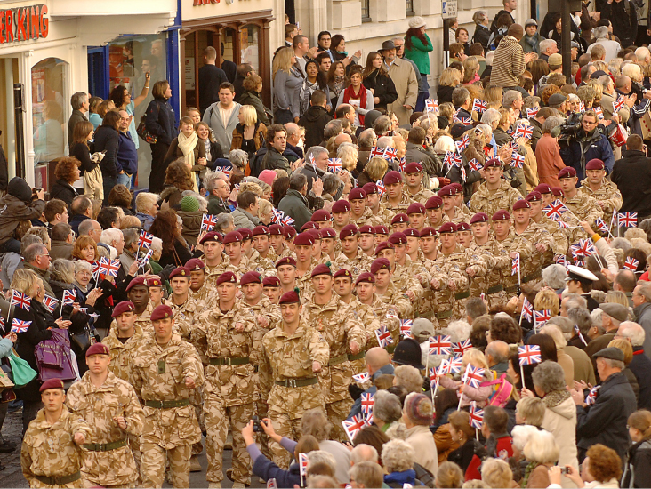
Do soldiers know what they are getting into when they join the Army?
Notes:
NAM. 2016-04-12-141
16 Air Assault Brigade homecoming from Afghanistan, Colchester, 18 Nov 2008.
Digital photograph from a collection of 242 digital images taken and compiled by Sgt Rupert Frere, Royal Logistic Corps.
Associated with Operation HERRICK, Afghanistan (2001-).
Crown copyright.

Slide 4
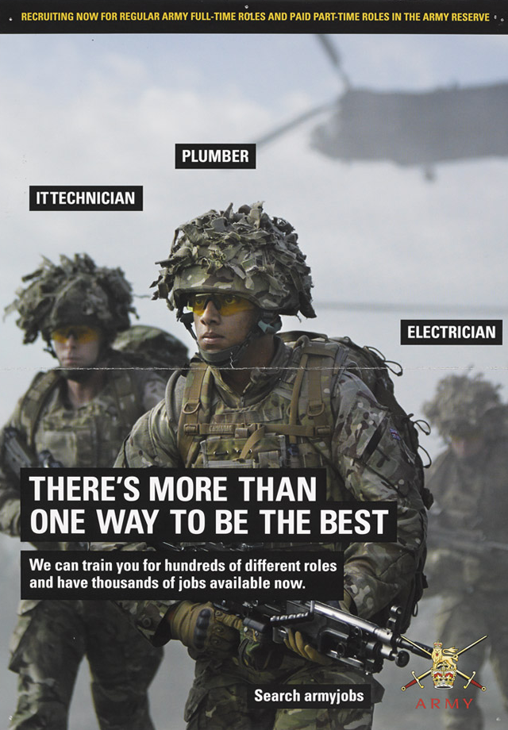
Pros and Cons
Recruitment campaigns emphasise positive aspects of serving in the Army.
Experienced soldiers are able to identify both positive and negative aspects of their military experience.
Many acknowledge that soldiering is not for everyone.
Notes:
NAM. 2015-01-4-9
British Army recruiting poster, 2014 (c).
Advertises the roles of an IT technician, plumber and electrician.
From a collection of nine items of British Army recruitment literature.

Slide 5
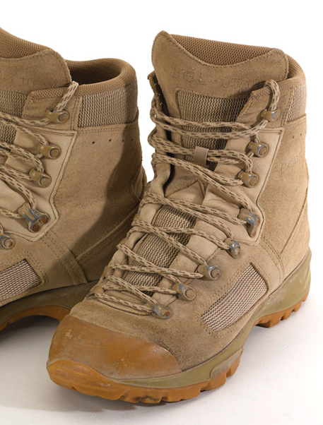
Motivations for joining
Duty and service to country?
Security and pay?
Family tradition?
Adventure?
Travel and meet people?
To fight?
Learn a trade?
Rewarding career?
Sense of purpose/direction?
No other options?
Other…?
Notes:
NAM. 2013-12-6-1
Pair of combat boots with bullet hole, associated with Chief Technician Greg Baker, Royal Air Force, 2011.
Greg was working as an Explosive Ordnance Disposal operator in Afghanistan, making improvised explosive devices safe.
The hole in the toe of the left boot was caused by a sniper bullet fired by an insurgent, which ricocheted off a tree past Greg’s face and into his boot, where it passed through the insole and came to rest against the heel of his sock.
Associated with Afghanistan (2001-2014).
NAM copyright.

Slide 6
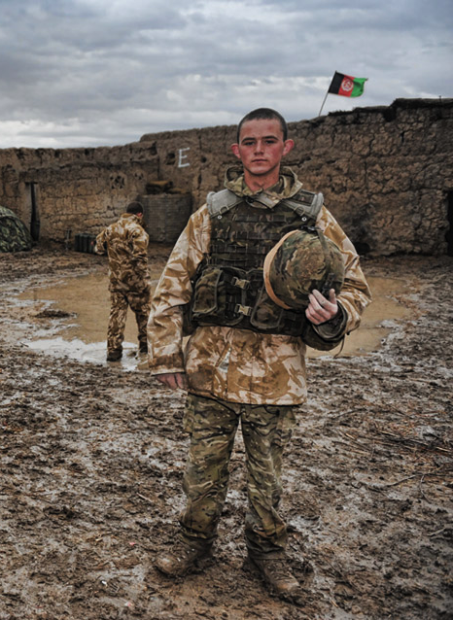
Junior soldiers
The British Army recruits soldiers as young as 16.
They attend college for English, Maths and trade skills, and receive Army training.
They cannot be sent on overseas combat deployments until they have turned 18.
Notes:
NAM. 2015-11-54-8
‘Toy Soldier’, 11 February 2011.
Digital photograph by Sgt Rupert Frere, Royal Logistic Corps, February 2011.
Part of Frere’s HERRICK Portfolio 2, Army Photographic Competition, 2015. Crown copyright.
Fusilier John Bryant, an 18 year old soldier from A Company, 2nd Battalion The Royal Highland Fusiliers. Fusilier Bryant Lived in this compound in the Babaji district of Helmand Province for 6 months.
From a collection of multimedia relating to Sgt Rupert Frere, Royal Logistic Corps, and the Army Photographic Competition in 2015.
Associated with Operation HERRICK, Afghanistan (2001-2014).

Slide 7
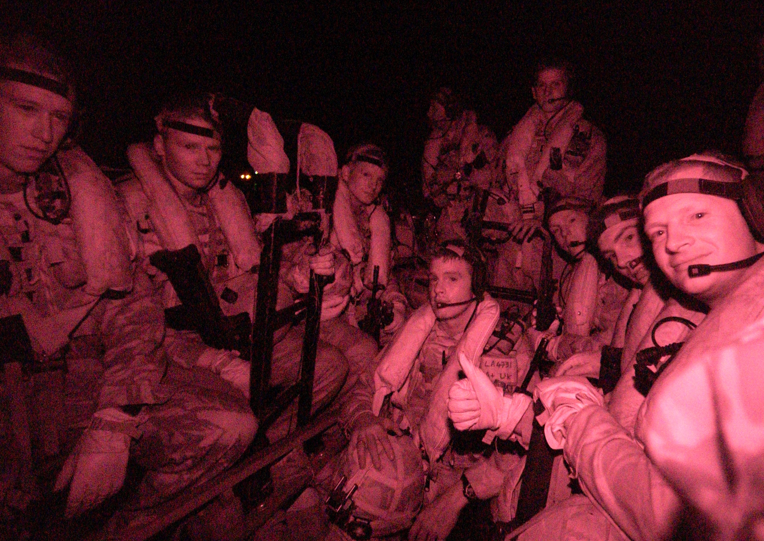
What if Army life is not what soldiers expect?
Notes:
NAM. 2007-06-8-15
An Infra-red camera captures soldiers serving in Basra using boats to travel along the Shatt al-Arab Waterway during the insertion phase of a Search and Arrest operation against local insurgents.
Crown copyright.
One of 47 digital images relating to 20th Armoured Brigade’s deployment in Iraq on Operation TELIC 8, 2006. Photographed by Corporal Anthony Boocock Royal Logistic Corps, 20th Armoured Brigade Media Ops, 19 June 2006.

Slide 8
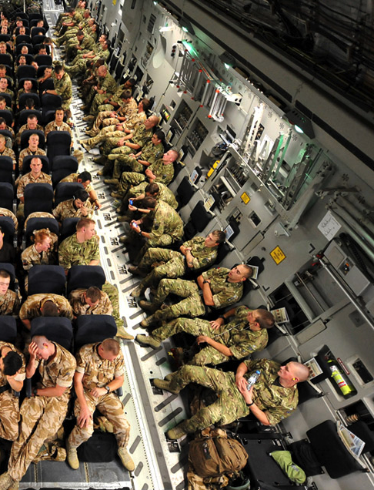
Can you just leave?
The rights of under-18s
After their first six months, under 18s are committed to remain in the Army until they turn 22
If they are within the first 6 months of their contract, and have been in the Army for more than 28 days, they can leave after giving 14 days notice
Notes:
NAM. 2015-11-54-1
‘Prepare for Landing’, interior of a C17 Globemaster transporting 16 Air Assault Brigade personnel to Afghanistan, 30 Aug 2010
Digital photograph by Sgt Rupert Frere, Royal Logistic Corps, 30 Aug 2010.
Part of Frere’s HERRICK Portfolio 1, Army Photographic Competition, 2015.
Soldiers serving with 16 Air Assault Brigade seated in a Royal Air Force C17 Globemaster for the final leg of their journey to Afghanistan.
From a collection of multimedia relating to Sgt Rupert Frere, Royal Logistic Corps, and the Army Photographic Competition in 2015.
Associated with Operation HERRICK, Afghanistan (2001-2014).
Crown copyright.

Slide 9
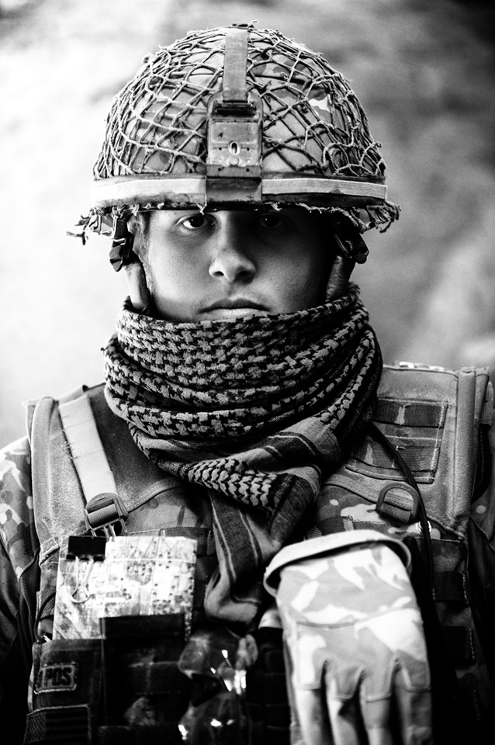
Can you just leave?
The rights of adult soldiers
After the first three months, an adult soldier is committed for four years
If they are within the first 3 months of their contract, and have been in the Army for more than 28 days, they can leave after giving 14 days notice
Notes:
NAM. 2015-11-55-237
Digital photograph by Sgt Rupert Frere, Royal Logistic Corps.
From a collection of digital photographs compiled by Sgt Rupert Frere, Royal Logistic Corps.
Associated with Afghanistan (2001-).
Crown copyright.

Slide 10
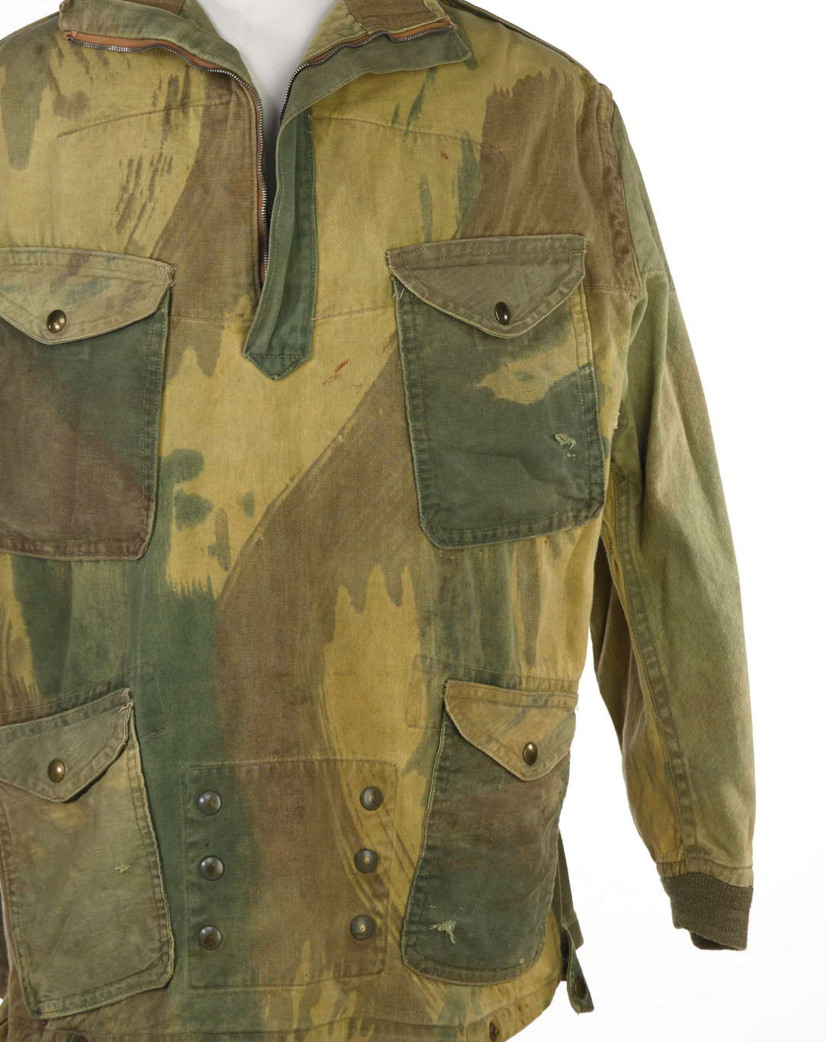
The work of soldiers
They become part of a team, not working as individuals. They follow rules and regulations, and may face long hours and long periods away from home. Work conditions can be challenging. They may have to move home regularly for work.
But soldiers also comment on the benefits of an army career, and the majority are satisfied by their job*.
Notes:
Armed Forces Continuous Attitude Survey 2009; McCartney and Willmott, 2009
NAM 2002-12-1-1
Disruptive Pattern Denison Smock, 1944-1946.
Worn by Lieutenant Timothy Hall, 1st Parachute Squadron, Royal Engineers, at the Battle of Arnhem, Operation MARKET GARDEN, World War Two, North West Europe (1944-1945).
Pale khaki and green smock, with four front pockets. 14 inch zip down the front from the neck to the chest and long sleeves that end in a ribbed cuff.
The back of the smock has numerous bullet holes. Lieutenant Hall was injured by mortar fragments in his back after landing by glider at Arnhem. While in hospital he was asked to ‘darn’ his uniform so that he could wear it when he was discharged into a prisoner of war camp.
Hall was commissioned in the Royal Engineers on 9 May 1943 and made a war substantive lieutenant on 9 November 1943. He was wounded after parachuting into Arnhem (1944). Initially treated by 181 Airlanding Field Ambulance in the Asylum at Wolfheze, Hall was sent to St Elisabeth hospital. He was admitted to Juliana Hospital, Apeldoorn, on 27 September 1944. His injury in the admissions register is described as Hemothorax, left. He remained there until 30 October when he was sent to Stalag VIIA at Moosburg.

Slide 11
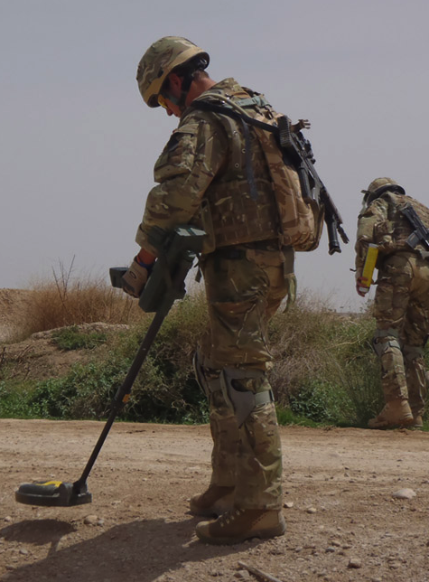
The work of soldiers
Sometimes the governments we elect direct the Army to fight, in what is meant to be the nation’s interest.
Soldiers may not always agree with these conflicts, or the way they are fought.
Soldiers face danger in combat.
They may be killed or injured, sometimes seriously.
Notes:
NAM. 2013-02-2-17
Soldiers (specialising in high-risk search techniques) searching road and road verge for Improvised Explosive Devices.
Associated with Operation HERRICK, Afghanistan (2001-2014) 2004- .
Copyright NAM.

Slide 12
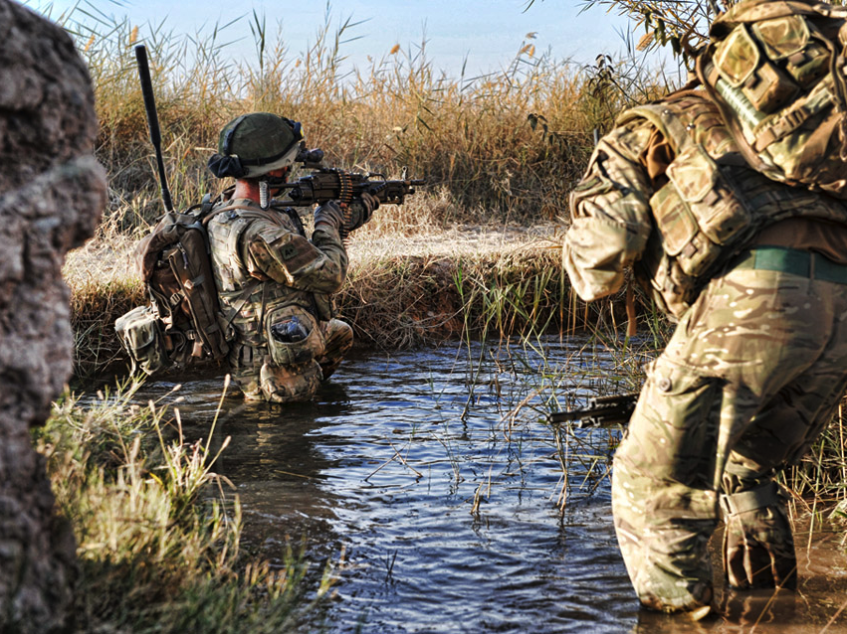
Does soldiers’ work go beyond what is expected in other jobs?
Notes:
NAM. 2015-11-55-167
Soldiers entering a wadi (irrigation channel) in Helmand Province, Afghanistan.
Digital photograph by Sgt Rupert Frere, Royal Logistic Corps.
From a collection of digital photographs compiled by Sgt Rupert Frere, Royal Logistic Corps.
Associated with Afghanistan (2001-).
Crown copyright.

Slide 13
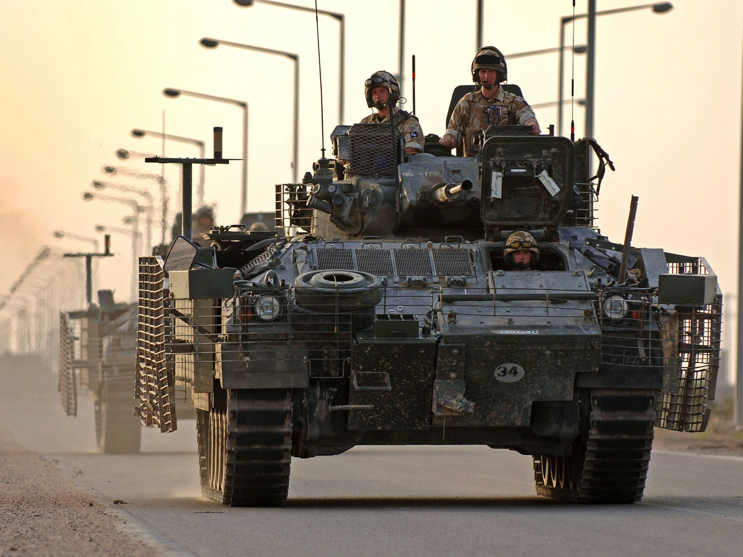
Does society as a whole owe a ‘duty of care’ to soldiers?
Notes:
NAM. 2007-06-8-1
Soldiers from The 1st Battalion, The Princess of Wales’s Royal Regiment (1PWRR) depart Basra Air Station in their Warrior armoured vehicles.
One of 47 digital images relating to 20th Armoured Brigade’s deployment in Iraq on Operation TELIC 8, 2006. Photographed by Corporal Anthony Boocock Royal Logistic Corps, 20th Armoured Brigade Media Ops, 9 May 2006.
Crown copyright.

Slide 14
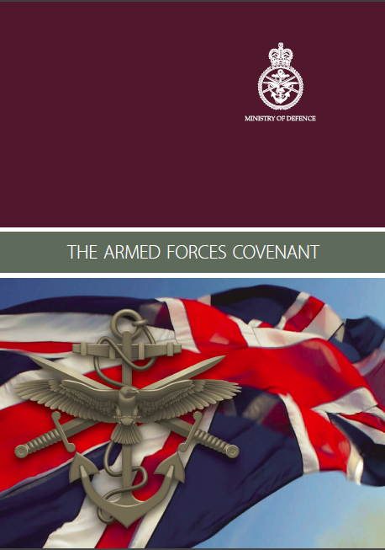
The Armed Forces Covenant
Enshrined in law since 2011
Outlines the moral obligation to soldiers and their families
“It includes voluntary and charitable bodies, private organisations, and the actions of individuals in supporting the Armed Forces. Recognising those who have performed military duties unites the country and demonstrates the value of their contribution.”

Slide 15
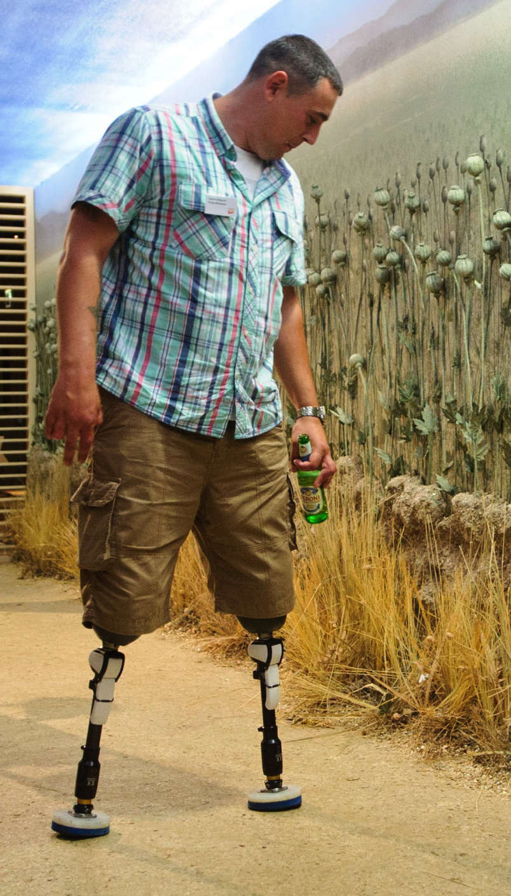
Two key principles
The armed forces community should face no disadvantage compared to other citizens in the provision of public and commercial services
Special consideration is appropriate in some cases, such as to the injured or the bereaved
Use this link to access the Covenant.
Notes:
A soldier who had both legs and several fingers amputated in an IED blast in Afghanistan attends an exhibition opening at the National Army Museum.
NAM copyright.

Slide 16
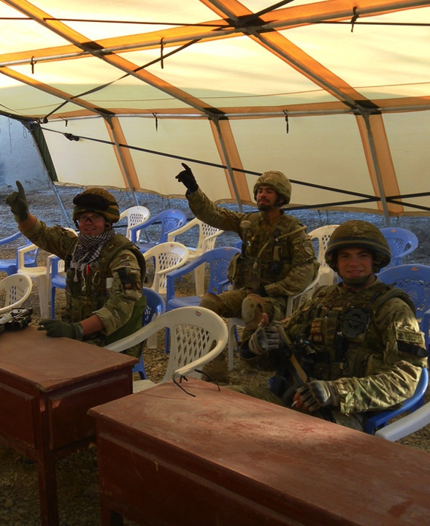
Some examples
Education: “...there should also be special arrangements to support access to schools if a place is required part way through an academic year as a consequence of a posting.”
Housing: “They should have priority status in applying for Government-sponsored affordable housing schemes...”
Notes:
NAM. 2013-02-14-309
Members of 61 Field Squadron, 33 Regiment (Explosive Ordnance Disposal), Royal Engineers, specialist searchers, keep themselves amused posing for photographs in a temporary classroom in Afghanistan.
Associated with Operation HERRICK, Afghanistan (2001-2014) 2004- .
NAM copyright.

Slide 17
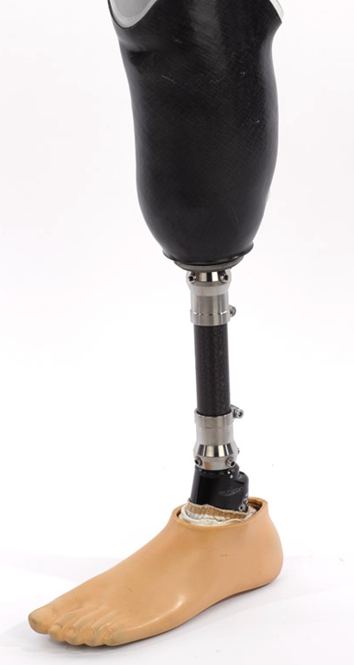
Some examples
Healthcare: “Veterans receive their healthcare from the NHS, and should receive priority treatment where it relates to a condition which results from their service...”
Notes:
NAM. 2013-12-7-1
Left transtibial leg prosthesis with black knee socket and Endolite Echelon foot, 2013 (c).
The black knee socket is moulded to uniquely fit a limb and the foot features hydraulic ankle control that improves users’ stability and confidence on rough and sloping surfaces. Most patients start on half leg prosthetics, or ‘stubbies’, and then progress onto more advanced leg prosthetics. Prosthetics are specially fitted to the recovering service personnel at Headley Court Defence Medical Rehabilitation Centre, according to their clinical need and aptitude for different physical activities.
Associated with Operation HERRICK, Afghanistan (2001-2014) 2004- .

Slide 18
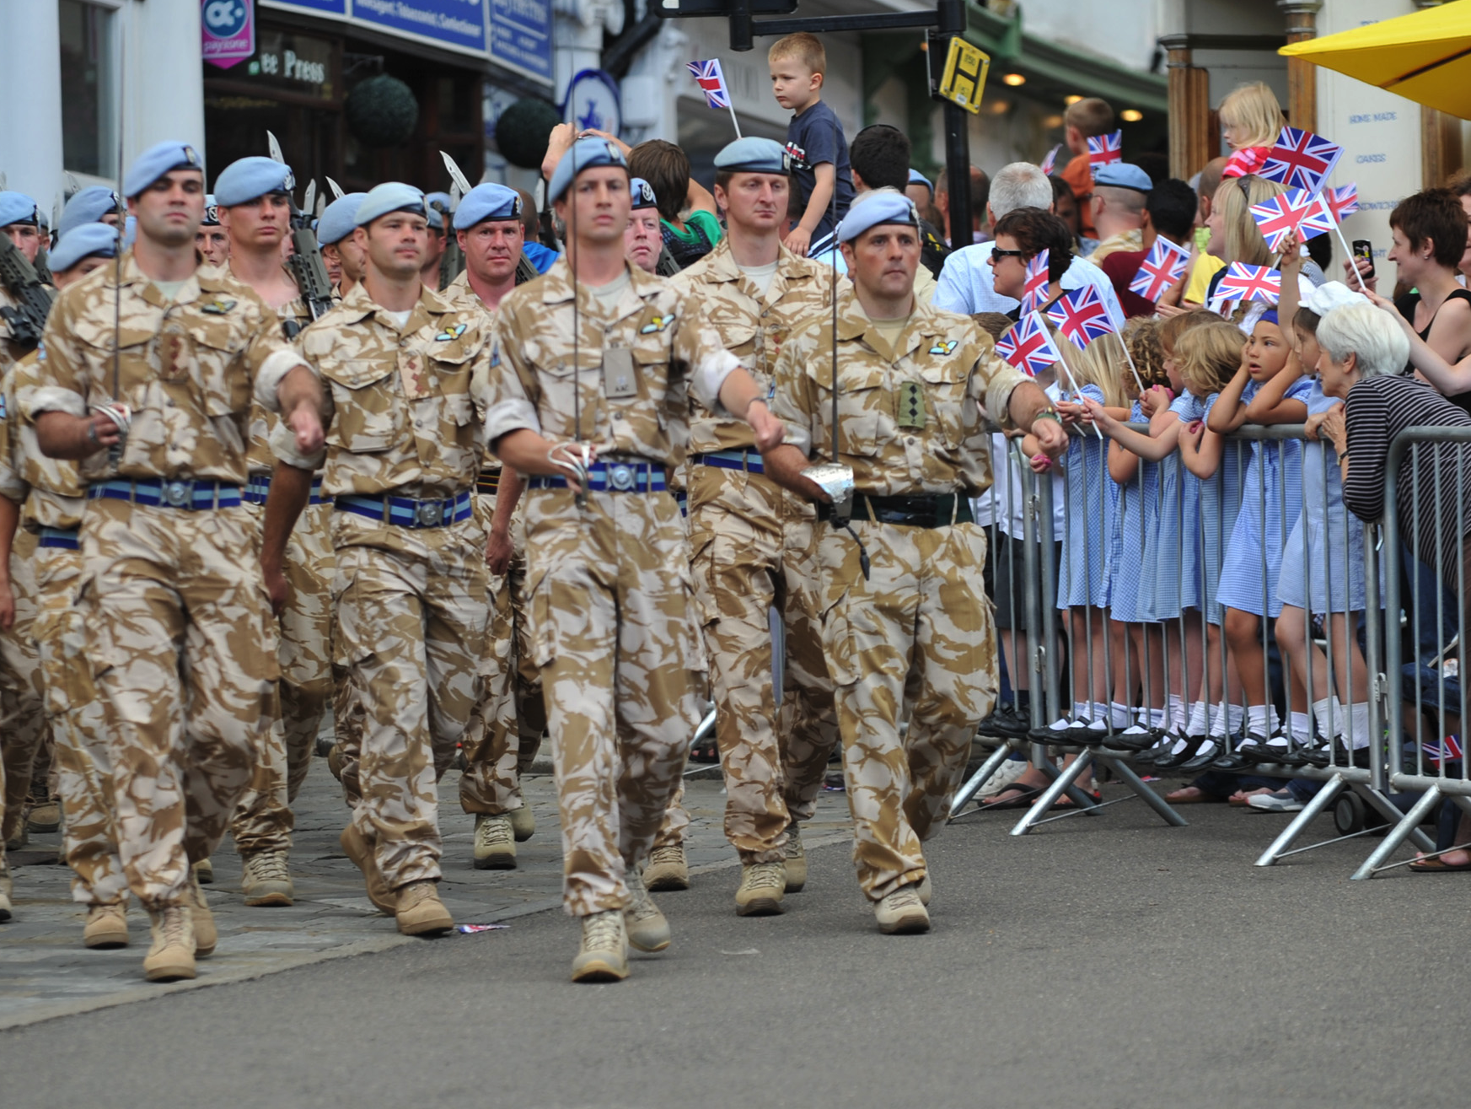
What is meant by the whole of society?
Notes:
NAM. 2016-04-9-167
Digital photograph taken by Sgt Rupert Frere, Royal Logistic Corps. 3 Regiment Army Air Corps (AAC) receive the award of the Honorary Freedom of Bury St Edmunds, 22 Jul 2010. The ceremony featured a parade through the town and the presentation of medals by HRH The Prince of Wales, Colonel in Chief of the AAC. Associated with Operation HERRICK, Afghanistan (2001-).
Crown copyright.

Slide 19
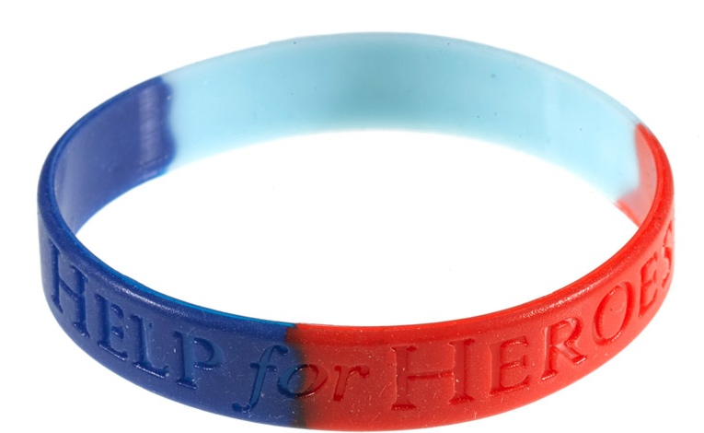
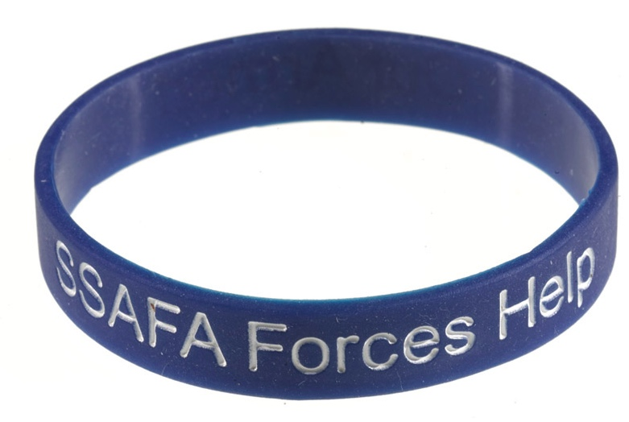
Charities and government
There are currently over 2200 armed forces charities in the UK.
The government and publicly funded charities now work together to support soldiers, veterans and service families.
Funding for charity relies on the visibility and popularity of soldiers.
Notes:
NAM. 2013-02-4-1
Wristband in support of wounded, injured and sick soldiers, sailors and airmen, 2012 (c).
Rubber.
Type H4H, manufactured by the charitable organisation Help for Heroes.
The three colours of the bracelet refer to the Army (red), the Royal Navy (blue) and the Royal Air Force (aquamarine).
NAM. 2013-02-7-5
Wristband in support of Soldiers', Sailors' and Airmen's Families Association (SSAFA) The Soldier’s Charity, 2012 (c).
Rubber.

Slide 20
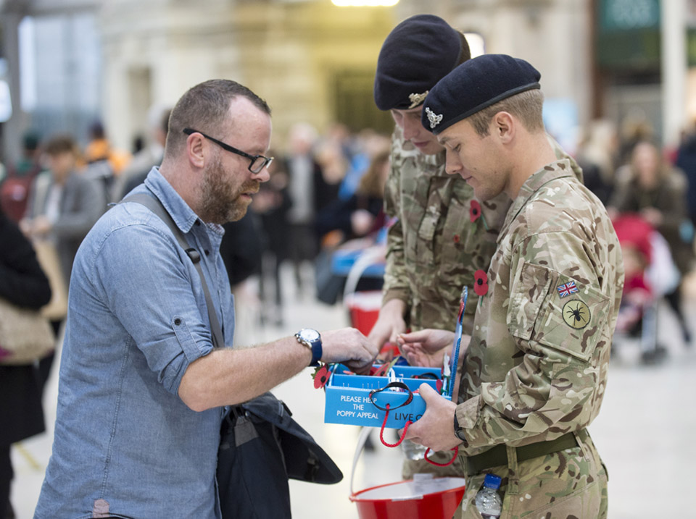
Is it right that charities take on this responsibility?
Notes:
NAM. 2015-11-53-427
Soldiers collecting donations for the Royal British Legion Poppy Appeal, 2015.
Digital photograph by Sgt Rupert Frere, 2015.
From a collection of photographs compiled by Sgt Rupert Frere, Royal Logistic Corps, primarily of British Army units involved in ceremonial duties in London in 2015.
Crown copyright.

Slide 21
Take a view…
Should soldiers get preferential treatment from the government and society?
Notes:
NAM. 2013-04-26-53
Cpl Matt Webb, 45 Commando, Royal Marines, Defence Medical Rehabilitation Centre, Headley Court.
Digital photograph by Cpl Steve Blake RLC (Army Photographer), Defence Medical Rehabilitation Centre, Headley Court, Surrey, 2011.
Crown copyright.

