Slide 1
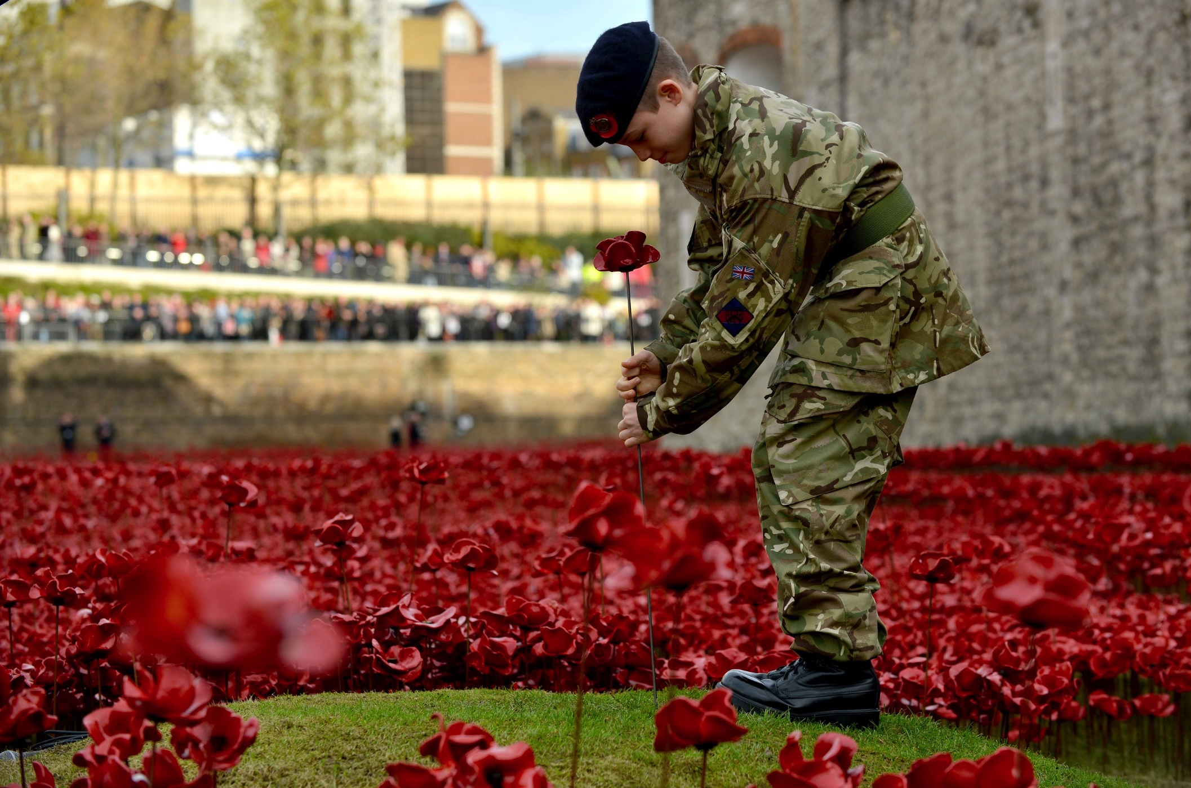
Poppy with pride or poppy with pressure?
Notes:
NAM 2015-11-54-90
13 year old cadet Harry Hayes places the final poppy in the installation ‘Blood Swept Lands and Seas of Red’ at the Tower of London on 11 November 2014.
Digital photograph by Sgt Rupert Frere, Royal Logistic Corps.
From a collection of multimedia relating to Sgt Rupert Frere, Royal Logistic Corps, and the Army Photographic Competition in 2015.
Crown copyright.

Slide 2
This PowerPoint presentation contains a selection of images and archives which students can use to prompt discussion and encourage further research. The materials come from the Collection of the National Army Museum (NAM).
Unless otherwise stated in the notes, the images can be freely used for non-commercial purposes within the classroom. You can use the entire presentation or choose individual images for use in other non-commercial contexts. When using individual images in other contexts, please always retain the attribution statements provided in this document (e.g. NAM. 2005-08-66-1).
By downloading this document and using these images you agree to these terms of use, including your use of the attribution statement specified for each object by NAM.

Slide 3
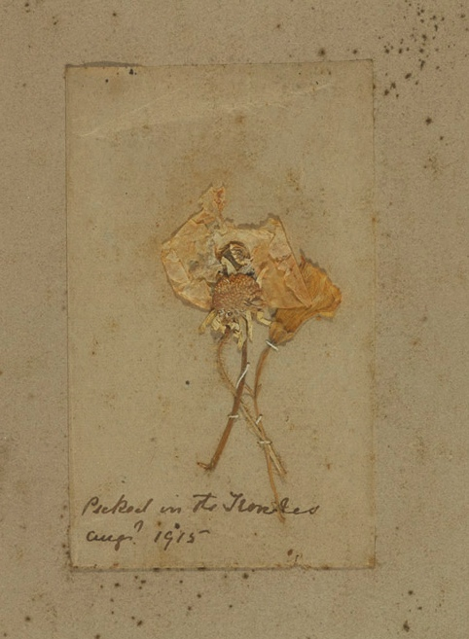
History of the poppy
Bright red Flanders poppies flourish in disturbed earth, and grew well in the battlefields of France and Belgium
Some soldiers collected them as mementoes
Lt Col John McCrae, a Canadian military doctor, was inspired by the sight of flowers growing on the grave of a close friend to write a poem…
Notes:
NAM 2001-01-755-1
Poppy flowers framed and mounted, inscribed in manuscript on mount ‘Picked in The trenches’ Aug 1915’.
Pressed flowers, much faded, stitched with piece of paper bearing handwritten inscription in pen and ink, in varnished wooden frame.
Associated with World War One, Western Front (1914-1918).
From the collection of the former Buffs Regimental Museum.

Slide 4
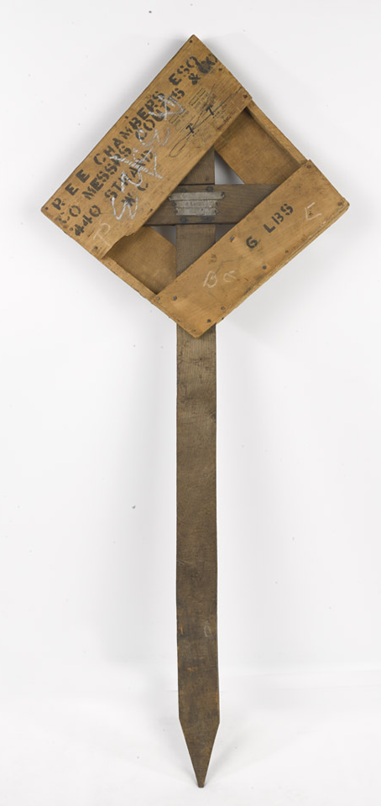
In Flanders Fields
In Flanders fields the poppies blow Between the crosses, row on row, That mark our place; and in the sky The larks, still bravely singing, fly Scarce heard amid the guns below.
We are the Dead. Short days ago We lived, felt dawn, saw sunset glow, Loved and were loved, and now we lie In Flanders fields.
Take up our quarrel with the foe: To you from failing hands we throw The torch; be yours to hold it high. If ye break faith with us who die We shall not sleep, though poppies grow In Flanders fields.
Notes:
NAM. 1983-10-279-1
Temporary grave cross of 2nd Lt Edward Chandos Elliot Chambers, 19th (Service) Bn (3rd Salford) Lancashire Fusiliers, killed at the Battle of the Somme, 1 July 1916; rough cut timber bearing three metal strips engraved with Chambers’ name and regiment; the head is contained in a transit box with three planks either side; stencilled with the names, P E E Chambers and Messrs Coutts and Co, also bearing two Southern railway labels.
Temporary grave crosses were removed and replaced with headstones at a later date.

Slide 5
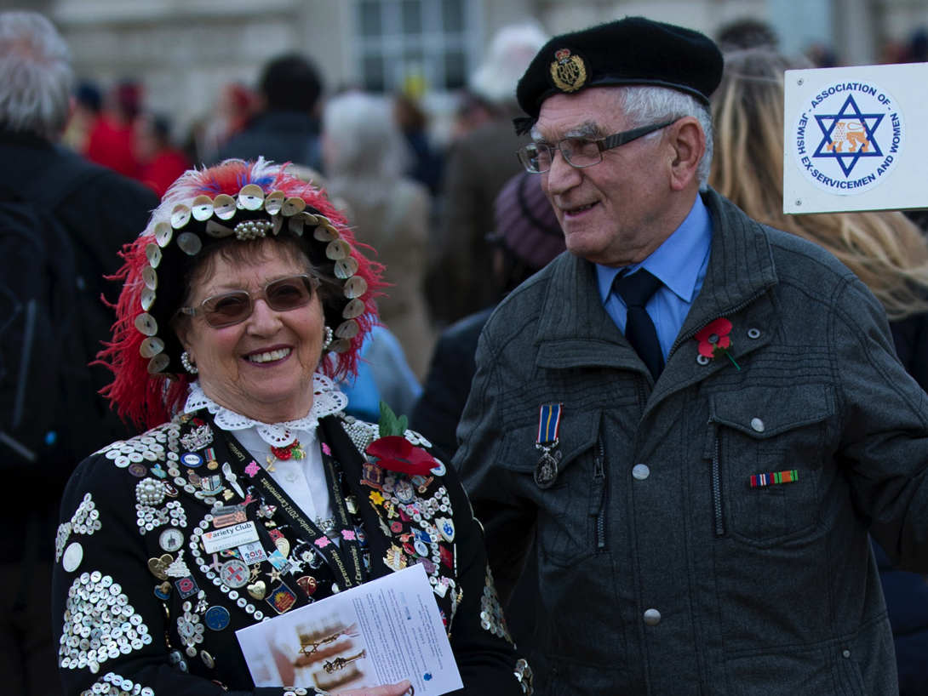
Why do people wear poppies?
Notes:
NAM 2015-11-53-5
Association of Jewish Ex-Servicemen and Women (AJEX) Remembrance Parade, London, 15 Nov 2015.
Digital photograph by Sgt Rupert Frere, Royal Logistic Corps, November 2015.
Crown copyright.

Slide 6
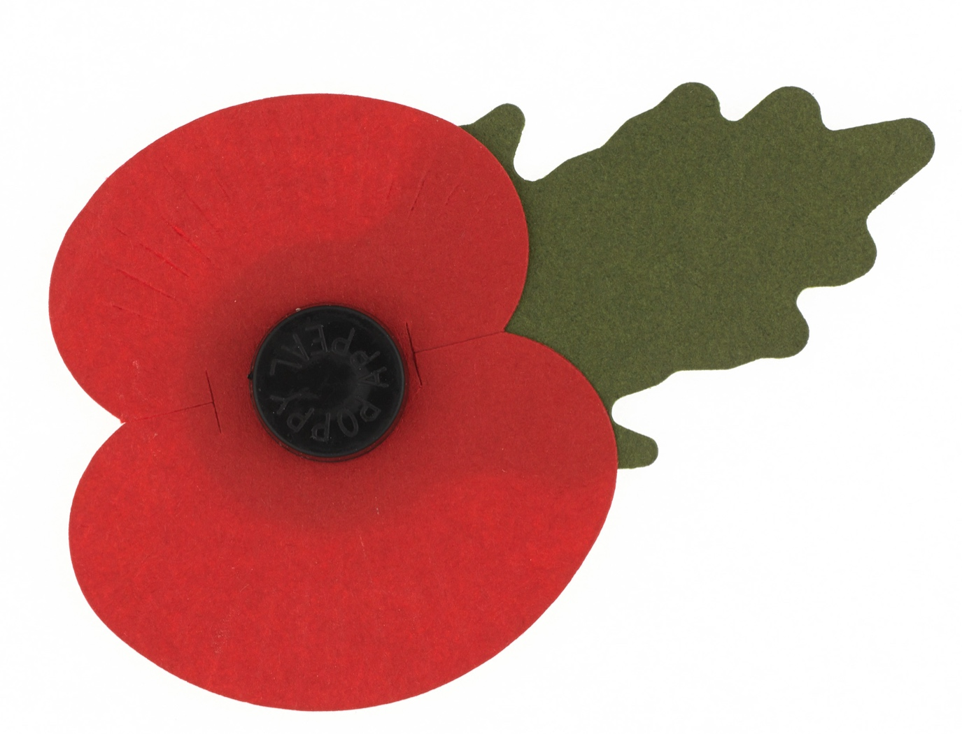
To remember
McCrae’s poem inspired an American academic, Moina Michael, to wear a poppy in remembrance of those who died in conflict
Anna Guérin brought the poppies to England as a fundraising idea
Notes:
NAM 2013-12-14-1
Poppy Appeal lapel badge with leaf, 2012 (c)

Slide 7
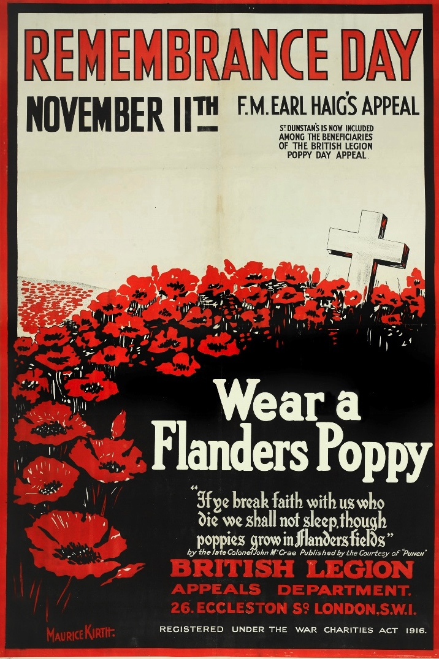
For charity
9 million poppies were ordered for sale by the British Legion in 1921 which sold out almost immediately
£106,000 raised in first ‘Poppy Appeal’
At the time, this could buy you over 100 three-bed homes!
It was used to help veterans of the First World War with employment, housing etc
Notes:
NAM 2014-07-73-1
Remembrance Day/ November 11th/ F.M.Earl Haig’s Appeal/ St. Dunstan’s is now included/ Among the Beneficiaries/ of The British Legion Poppy Day Appeal.
Advertising poster after Maurice Kirth in support of the British Legion, 1925 (c).
St Dunstan’s took that name in 1923, so the poster must date from that year or later.

Slide 8
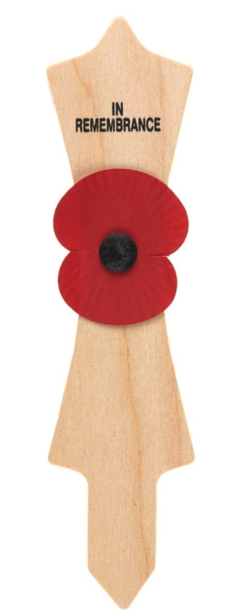
The British Legion says:
The poppy is:
A symbol of remembrance and hope
Worn by millions of people
Red because of the natural colour of field poppies
The poppy is not:
A symbol of death or a sign of support for war
A reflection of politics or religion
Red to reflect the colour of blood
Notes:
NAM 2014-12-6-11
Sikh Khanda memorial marker with attached Remembrance poppy, designed for planting in a Field of Remembrance.
Wooden, with red paper poppy attached with a black plastic centre printed with the words 'POPPY APPEAL' and a pointed end suitable for placing in the ground.
Sold in aid of The Royal British Legion, 2014.

Slide 9
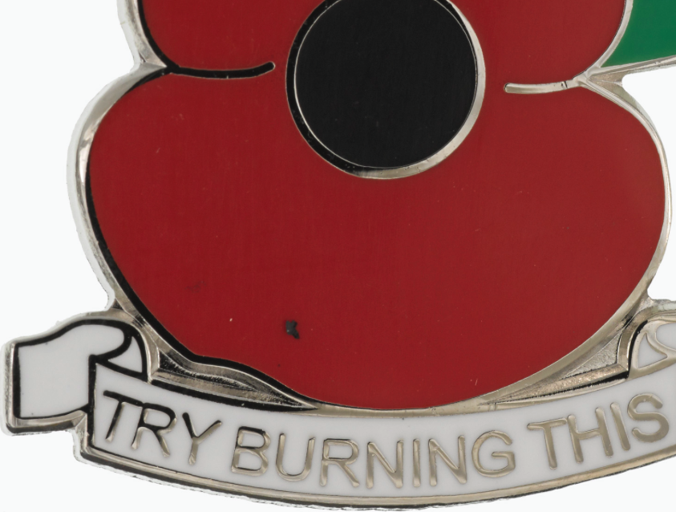
How might people respond to or use the poppy as a symbol?
Notes:
NAM 2014-10-51-1
Poppy lapel badge sold by English Defence League, 2014.
Inscribed ‘Try Burning This’, in reference to Emdadur Choudhury’s burning of a poppy wreath near the Royal Albert Hall as part of a protest by Muslims Against Crusades during the two minute silence on 11 November 2011.

Slide 10
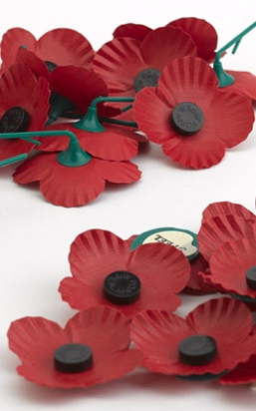
Fundraising for soldiers and families
The British Legion says:
“Wearing a poppy is a personal choice… It is not compulsory but is greatly appreciated by those it helps – our beneficiaries: those currently serving in our Armed Forces, veterans, and their families and dependants.”
Notes:
NAM 2014-11-20-3
Scottish Poppy Appeal lapel badges, 2014 (c).
Produced by the Lady Haig Poppy Factory, Edinburgh for Poppyscotland and the Scottish Poppy Appeal, a distinct charity within The Royal British Legion group of charities.

Slide 11
But is it a personal choice?
“ITV News presenter Charlene White has faced considerable criticism – and even abuse – for her decision not to wear a poppy on air.”
“In 2011 Fifa ruled that England, Scotland and Wales players could not wear poppies on their shirts because its regulations forbade the use of ‘political, religious or commercial messages’. Following a public outcry, teams were permitted to wear poppies on black armbands.”
“The actress Barbara Windsor was widely criticised when she said anyone who didn’t display the symbol could ‘sod off’.”
Notes:
148464
Source bbc.co.uk. Need a statement of the BBC policy?

Slide 12
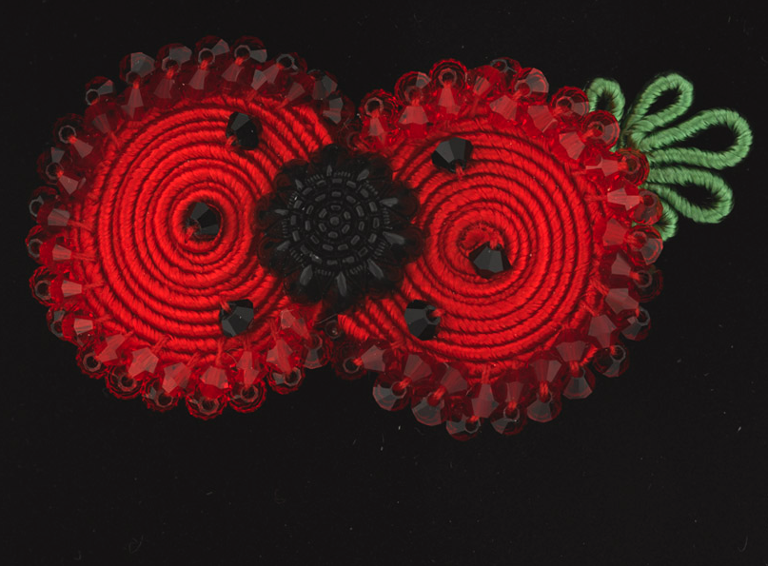
Has the poppy symbol become something else?
Notes:
NAM 2014-10-17-1
Handmade, beaded, soutache World War One Centenary poppy brooch, 2014.
Designed and manufactured for Kleshna Jewellery, London, 2014.
15% from the sale of each poppy is paid to The Royal British Legion Trading Limited.
Soutache is a traditional military appliqué, specifically the application of a special dual core cord developed in the 15th century.
This poppy brooch is hand made with silken Soutache cord and finished in crystal. Swirls of silk Soutache braid were stitched flat to make intricate patterns which created uniform trimmings. Traditionally width, colour and pattern of Soutache is used to indicate rank.

Slide 13
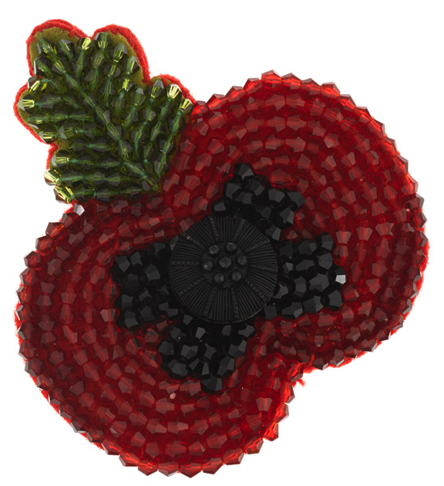
‘Brand’ poppy?
“The market for designer poppies has bloomed in recent years. Fuelled by a wave of celebrity endorsements, jewel encrusted flowers now compete with their less glamorous paper siblings...”
Source: www.ibtimes.co.uk
15% of the proceeds from a poppy like this one goes to the Royal British Legion.
Notes:
NAM 2014-10-21-1
Handmade beaded poppy brooch with a black button in the centre, 2010.
Designed and manufactured for Kleshna Jewellery, London, 2010.
15% from the sale of each poppy is paid to The Royal British Legion Trading Limited.

Slide 14
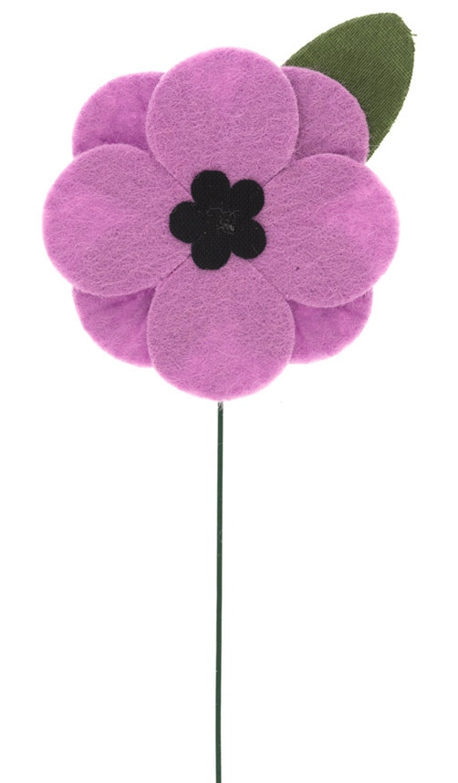
Other poppies
White
First introduced in 1933 and intended as a lasting symbol for peace and an end to all wars.
Purple
For those who wish to remember animals who served and died in the war.
BlackPoppyRose
To commemorate the contribution of black servicemen and women.
These are not made or endorsed by the British Legion.
Notes:
NAM 2014-10-2-1
Animal Aid artificial purple poppy lapel badge or buttonhole, sold by Animal Aid, 2014.
Double flower with black forget-me-not style centre and green leaf, sold to commemorate all the animal victims of war.

Slide 15
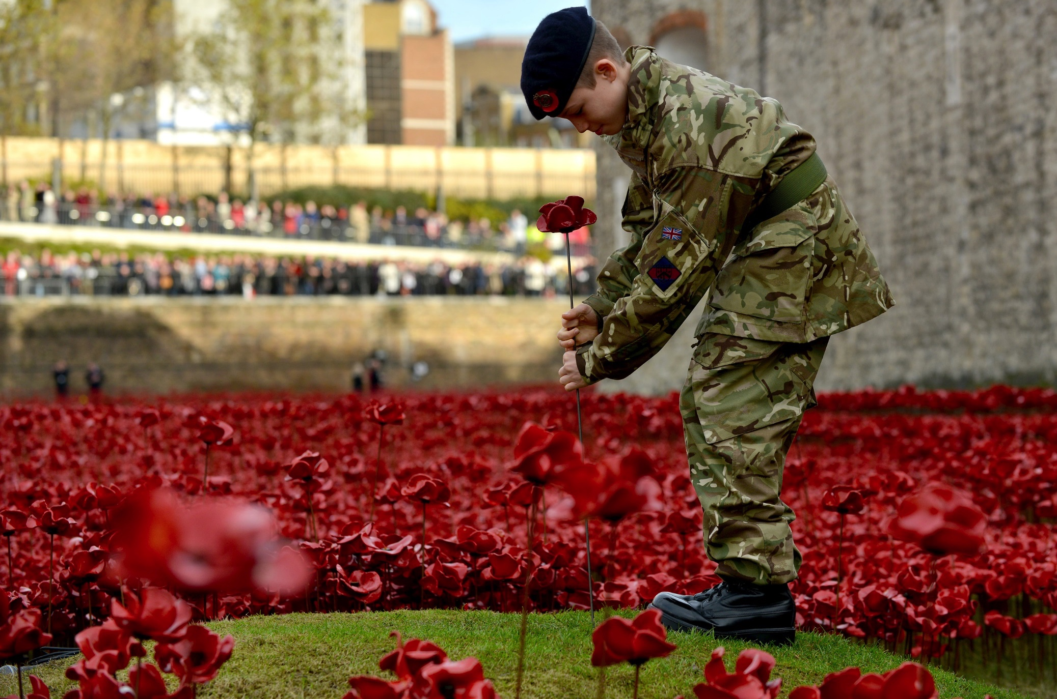
Take a view…
Poppy with pride or poppy with pressure?
Notes:
NAM 2015-11-54-90
13 year old cadet Harry Hayes places the final poppy in the installation ‘Blood Swept Lands and Seas of Red’ at the Tower of London on 11 November 2014.
Digital photograph by Sgt Rupert Frere, Royal Logistic Corps.
From a collection of multimedia relating to Sgt Rupert Frere, Royal Logistic Corps, and the Army Photographic Competition in 2015.
Crown copyright.

