Slide 1
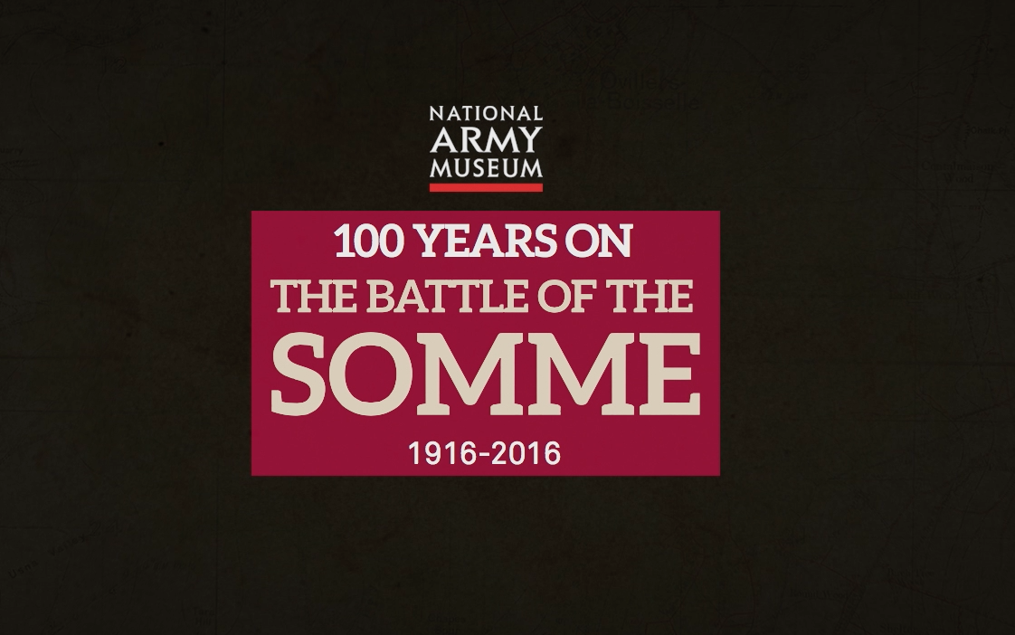


Notes:
This resource gives captioning information for the images used in the accompanying film.

Slide 2
This PowerPoint presentation contains a selection of images and archives which students can use to explore the story of the Battle of the Somme. The materials come from the Collection of the National Army Museum (NAM).
Unless otherwise stated in the notes, the images can be freely used for non-commercial purposes within the classroom. You can use the entire presentation or choose individual images for use in other non-commercial contexts. When using individual images in other contexts, please always retain the attribution statements provided in this document (e.g. NAM. 2005-08-66-1).
By downloading this document and using these images you agree to these terms of use, including your use of the attribution statement specified for each object by NAM.

Slide 3
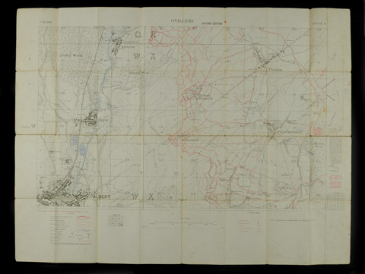
Notes:
Trench map, Meaulte, 62D NE2, edition 2B.
From a collection of papers belonging to Captain Siegfried Sassoon, World War One, Western Front (1914-1918).
The trench maps show the British trenches in blue and the German trenches in red. The battlefield is neatly bisected by a straight road running from Albert in the south-west to Bapaume in the north-east. The poet Siegfried Sassoon fought in the Battle of the Somme. He saw action at Mametz Wood, centre right on the map, where his bravery won him the Military Cross.
NAM. 1995-08-11-18

Slide 4
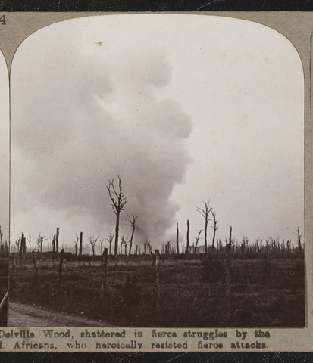
Notes:
Stereoscopic photograph: 'Delville Wood, shattered in fierce struggles by the South Africans who heroically resisted fierce attack'.
One of 100 stereoscopic photographs associated with World War One, Western Front (1914-1918).
From the collection of the former Buffs Regimental Museum.
2001-02-256-54
Stereographs consist of two identical photographs paired in such a way that when seen through a special viewing instrument, a stereoscope, they appear as a three-dimensional images. By 1899 the photographs were mounted on thick card that was given a slight curvature to increase the illusion of depth.

Slide 5
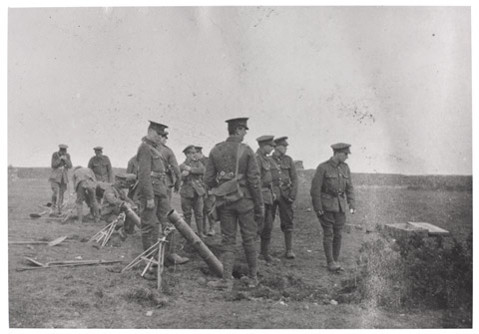
Notes:
‘Firing Practice at Helfaut May 1916. 4 inch Stokes Mortar (as used for firing gas-shells).’
One of 188 copy photographs taken by Lt Patrick Robert Koekkoek, Special Bde, Royal Engineers, World War One, Western Front, 1915-1917.
Lt Koekkoek had pre-War Service with King Edward’s Horse and served initially with 8th Bn East Lancashire Regiment, however, as a trained chemist, once gas warfare began he was transferred to the Royal Engineers’ Special Bde.
Photographs are captioned by Lt Koekkoek.
NAM. 2002-02-902-22

Slide 6
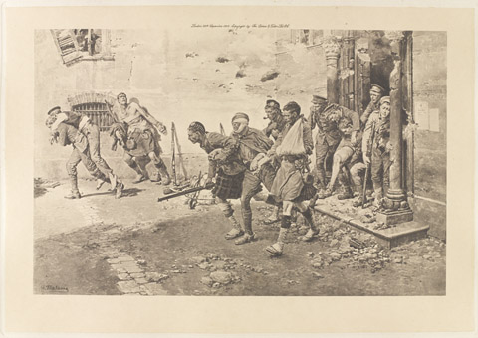
Notes:
‘The Famous Four Days Retreat from Mons: How the wounded helped the wounded’.
Photogravure after Fortunino Matania, 1916.
Published by Fortunino Matania, 1916.
Published by The Sphere and Tatler Limited, 1916.
NAM. 1983-04-82

Slide 7
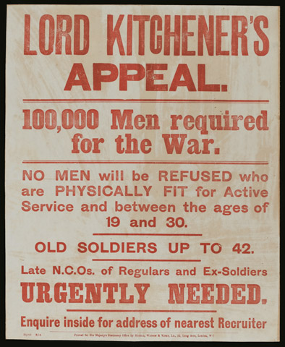
Notes:
Lord Kitchener’s Appeal.
Recruiting poster published by His Majesty’s Stationery Office, August 1914, calling for 100,000 men to join the Army.
Associated with World War One 1914-1918.
NAM. 1996-01-10-1
While many expected the war to be 'over by Christmas’, the Secretary of State for War, Field Marshal Lord Kitchener, realised the conflict would be long and on an unprecedented scale. Britain would have to create a mass army for the first time. He appealed for volunteers for his ‘New Armies’ in August 1914. Recruitment officers were sent to towns, cities, factories and clubs. Propaganda posters were placed all over the country to persuade men to sign up.

Slide 8
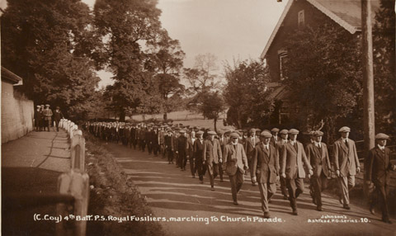
Notes:
Postcard photograph, one of 3, of C Coy, 4th Public Schools Bn Royal Fusiliers in civilian dress marching to a church parade, Ashstead, 1914.
Collected by Fletcher Brewer, who joined the Public Schools Bn Royal Fusiliers as a private soldier, and was later commissioned into the Army Service Corps, 1914-1919.
Associated with World War One (1914-1918).
NAM. 2001-06-121-3

Slide 9
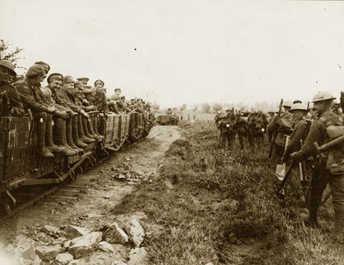
Notes:
‘Light railway and troops moving up’.
From an album of 76 official photographs, 1916-1917.
NAM. 1999-11-70-65

Slide 10
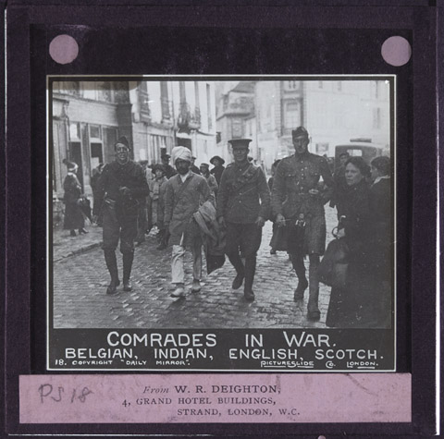
Notes:
Lantern slide of Belgian, Indian, English and Scottish soldiers walking through a town, 1915 (c).
Produced by the Graphic newspaper, 1915 (c).
Associated with World War One, Western Front (1914-1918).
From a group of 31 lantern slides relating to the Indian Army, 1897-1915 (c).
1957-09-18-21

Slide 11
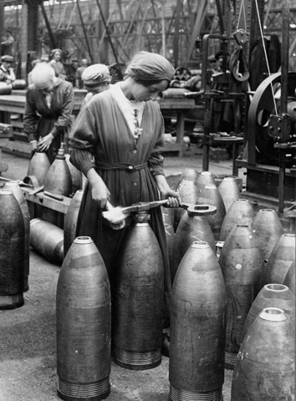
Notes:
Photograph: Women in munitions factory.
From an album of 76 official photographs, 1916-1917.
Associated with World War One, Home Front (1914-1918).
1999-11-70-60
During World War One women volunteered for essential work in order to release men for service in the armed forces. Between 1914-1918, around two million women volunteers replaced men in employment. Many female munition workers suffered from the chemicals they worked with, which turned their skin yellow, prompting the nickname ‘canaries’.

Slide 12
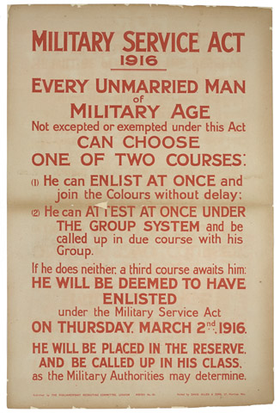
Notes:
Military Service Act 1916.
Lithographic posted published by the Parliamentary Recruiting Committee, No 151.
Printed by David Allen and Sons, no date.
Associated with World War One (1914-1918).
NAM. 2014-07-31-1

Slide 13
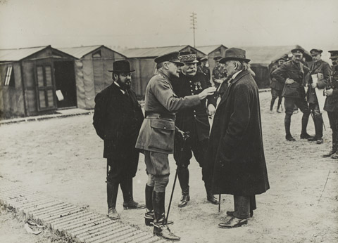
Notes:
The visit of David Lloyd George, 12 September 1916.
The British Minister of Munitions, David Lloyd George (right), General Sir Douglas Haig, General Joffre and the French Under Secretary for Munitions, Albert Thomas (left), discuss the ongoing offensive at 14th Army Headquarters at Meaulte on the Somme.
1995-03-88-12

Slide 14
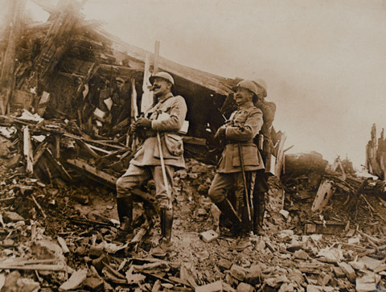
Notes:
‘Watching Battle Progress Amongst Incredible Ruin’.
Photograph of French High Command Officers watching the progress of an attack against a German stronghold on the Somme.
From a collection of 164 British, French and Belgian official photographs, World War One (1914-1918).
NAM. 2002-02-589-77

Slide 15
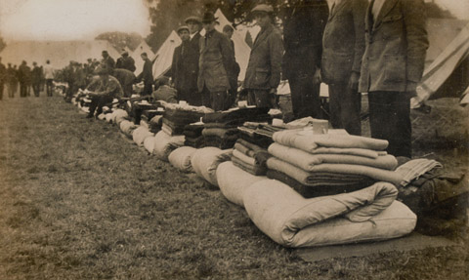
Notes:
Photograph of camp inspection, 1916 (c).
From an album of 284 photographs compiled by 2nd Lt R T Cooper, 16th Bn Middlesex Regiment, 1914-1916, 10th Cadet Bn and 16th Bn Hampshire Regiment, 1916, Royal Engineers, 1916-1919.
NAM. 1993-02-375-186

Slide 16
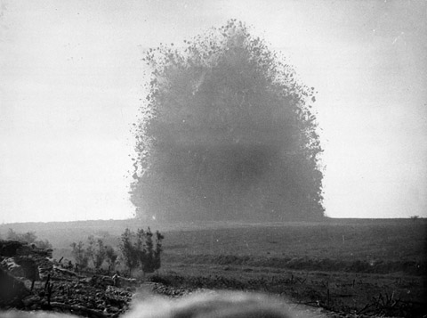
Notes:
The detonation of a mine on the Somme, 1916.
Photograph, World War One, Western Front (1914-1918), 1916.
To supplement the week-long artillery bombardment before the launch of the attack, a mine was dug under the German lines at Hawthorn Redoubt. It was fired 10 minutes before the assault at Beaumont Hamel on the first day of the Battle of the Somme, 1 July 1916. Around 45,000 pounds of Ammonal exploded. The mine caused a crater 130 feet across by 58 feet deep. You can see the tiny figures of British soldiers watching the explosion bottom left.
From a collection of 98 official war photographs.
NAM. 2001-01-279-56

Slide 17
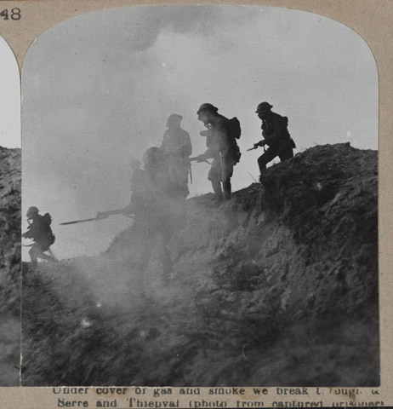
Notes:
Stereoscopic photograph, Under cover of gas and smoke we break through to Serre and Thiepval (photo from captured prisoner), nd.
From a collection of one hundred and one stereoscopic photographs in box one of two entitled ‘The Great War’ including the official series.
With stereoscopic viewer.
Associated with World War One, Western Front (1914-1918).
1972-08-67-1-48

Slide 18
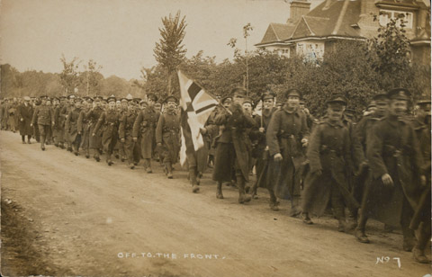
Notes:
‘Off to the Front’.
One of five official war photographs: ‘Off to the Front’, troops marching along a suburban street, World War One (1914-1918)
From the collection of the former Buffs Regimental Museum.
NAM. 2000-12-127-5

Slide 19
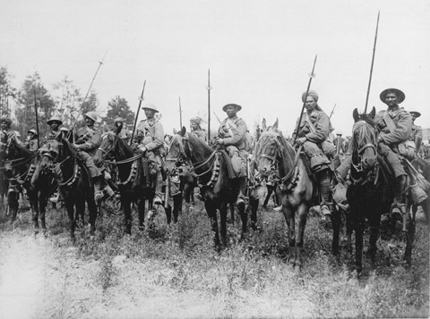
Notes:
Indian Cavalry await the order to advance, Western Front, 1916 (c).
In August 1914 an Indian Corps, including cavalry units, arrived in France. While the infantry were withdrawn to Mesopotamia in December 1915, most of the cavalry remained on the Western Front until 1918. It was hoped that once the enemy's front-line had been broken the cavalry would exploit the breach using their superior speed to reach the enemy's rear positions and destroy supply and communications lines. The static nature of much of the fighting on the Western Front meant that this did not occur and many cavalry soldiers ended up serving as infantrymen.
Collection of 98 official war photographs illustrating the British advance in the Western Front Campaign, World War One (1914-1918).
From the collection of the former Buffs Regimental Museum.
NAM. 2001-01-279-77

Slide 20
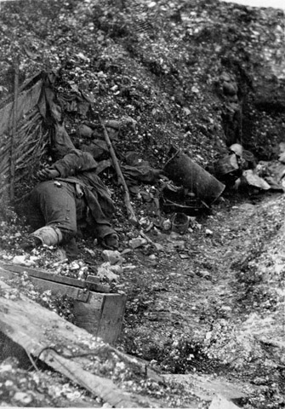
Notes:
‘German Trenches, La Boisselle [sic]. Occupied by the British 1st July 1916’.
One of 188 copy photographs taken by Lt Patrick Robert Koekkoek, Special Bde, Royal Engineers, World War One, Western Front, 1915-1917.
Lt Koekkoek had pre-War Service with King Edward’s Horse and served initially with 8th Bn East Lancashire Regiment, however, as a trained chemist, once gas warfare began he was transferred to the Royal Engineers’ Special Bde. The dead body is a German soldier.
Photographs are captioned by Lt Koekkoek.
2002-02-902-58

Slide 21
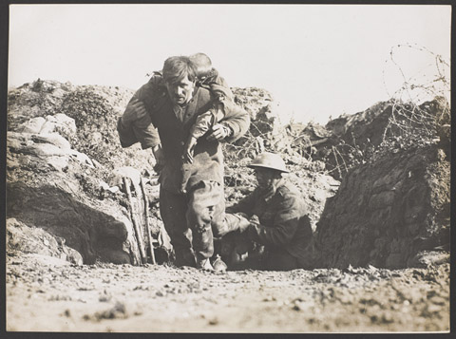
Notes:
Photograph of British soldiers with casualty.
Collection of 98 official war photographs illustrating the British advance in the Western Front Campaign, World War One (1914-1918).
From the collection of the former Buffs Regimental Museum.
NAM. 2001-01-279-55

Slide 22
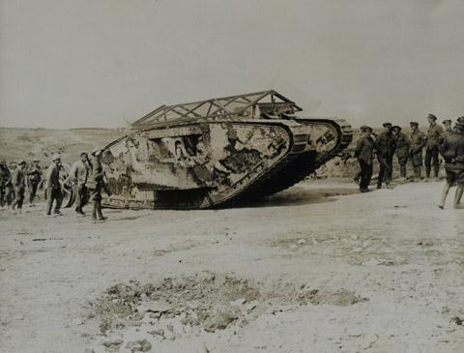
Notes:
Photograph of troops with tank.
Associated with World War One, Western Front (1914-1918).
From a group of 550 photographs, compiled by Lord Henry Seymour Rawlinson while Commander in Chief in India, 1916 (c)-1919.
NAM. 1952-01-33-55-87

Slide 23
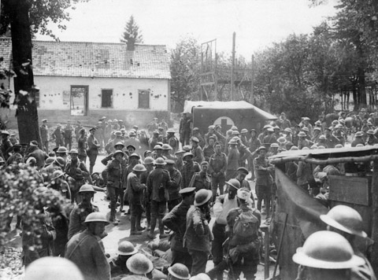
Notes:
Photograph of British wounded at an advanced dressing station behind the Somme front, 1916.
Collection of 98 official war photographs illustrating the British advance in the Western Front Campaign, World War One (1914-1918).
From the collection of the former Buffs Regimental Museum.
NAM. 2001-01-279-19

Slide 24
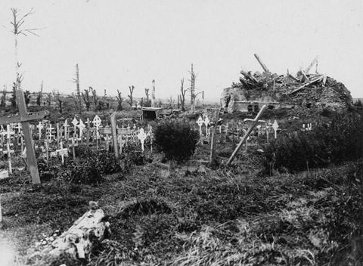
Notes:
'Scene around Contalmaison Chateau, 1917. A year ago the scene of one of the most glorious British victories. The graves of the fallen heroes are always carefully tended, the French inhabitants coming for miles to deposit their floral offerings'.
From a collection of official and aerial photographs of the Western Front, World War One, 1914-1918.
From the collection of the former Buffs Regimental Museum.
NAM. 2001-01-277-11

Slide 25
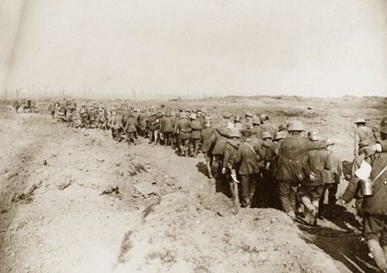
Notes:
German prisoners of war captured during the battle of the Menin Road.
From an album of 76 official photographs, 1916-1917.
Associated with World War One, Western Front (1914-1918).
NAM. 1999-11-70-63

Slide 26
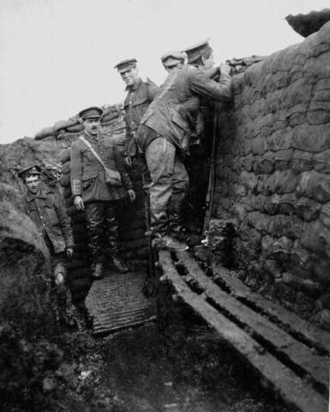
Notes:
‘The South Fortin. Fire Trench at Fonquevilliers [sic], Nov 1915’.
One of 188 copy photographs taken by Lt Patrick Robert Koekkoek, Special Bde, Royal Engineers, World War One, Western Front, 1915-1917.
Lt Koekkoek had pre-War Service with King Edward’s Horse and served initially with 8th Bn East Lancashire Regiment, however, as a trained chemist, once gas warfare began he was transferred to the Royal Engineers’ Special Bde.
Photographs are captioned by Lt Koekkoek.
NAM. 2002-02-902-1

Slide 27
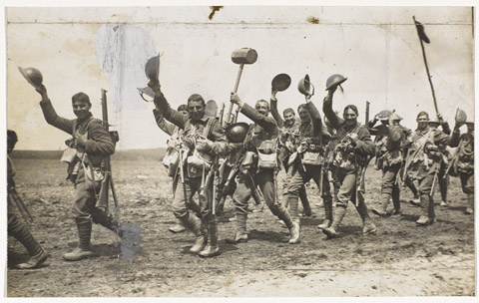
Notes:
‘FIERCE ATTACK BY PRUSSIAN GUARD. VIGOROUS WILTS AND WORCESTERS.
‘The shock of the assault was met mainly by the Wiltshire and Worcestershire men, who, in spite of the heavy shelling to which they had been subjected, stood firm and beat back the enemy, who had severe losses. Considering the importance that the enemy attaches to the ground he has lost in the Thiepval sector, the defeat of the Prussian Guard indicates a declining strength in attack’.
Men of the Worcestershire Regiment marching to the front, waving their helmets and a mallet in the air, Summer 1916.
NAM. 2007-03-7-99

Slide 28
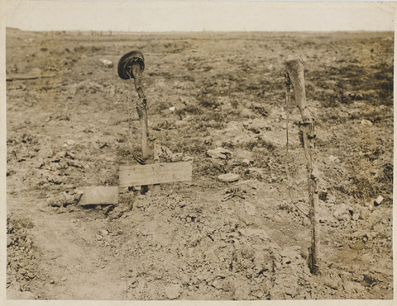
Notes:
‘Grave of an unknown British soldier near Ginchy’.
Shows a cross and grave marked with two rifles, on one of which is hung a service cap. The rank Corporal, unit Connaught Rangers and date Sept are visible. Probably relates to 6th Battalion Connaught Rangers and the Battle of Ginchy, September 1916.
NAM. 2007-03-7-158

