Slide 1


Conscription
Notes:
This resource gives captioning information for the images used in the accompanying film.

Slide 2
This PowerPoint presentation contains a selection of images and archives which students can use to explore the story of one British soldier in the First World War. In the main, the materials come from the Collection of the National Army Museum (NAM). Occasionally these are supplemented by materials from outside the NAM to provide context.
Unless otherwise stated in the notes, the images can be freely used for non-commercial purposes within the classroom. You can use the entire presentation or choose individual images for use in other non-commercial contexts. When using individual images in other contexts, please always retain the attribution statements provided in this document (e.g. NAM. 2005-08-66-1).
By downloading this document and using these images you agree to these terms of use, including your use of the attribution statement specified for each object by NAM.

Slide 3
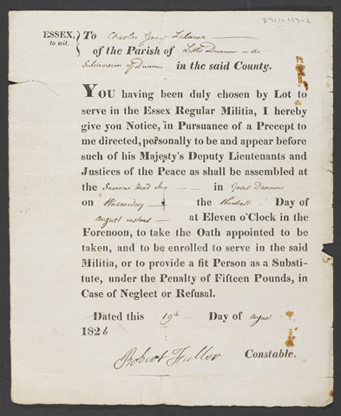
Notes:
Form relating to Charles Gray stating that he had been balloted to serve in the Essex Militia and ordering him to appear or provide a substitute, 19 Aug 1826.
1987-11-117-2

Slide 4
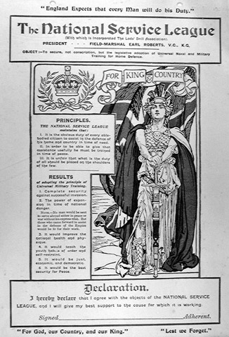
Notes:
Printed cards, two copies, nd.
Stating the aims of the National Service League.
To be signed by an adherent and hung on the wall.
Both unsigned.
From a collection of printed pamphlets relating to the National Service League from 1908 (c).
1974-07-65-8

Slide 5
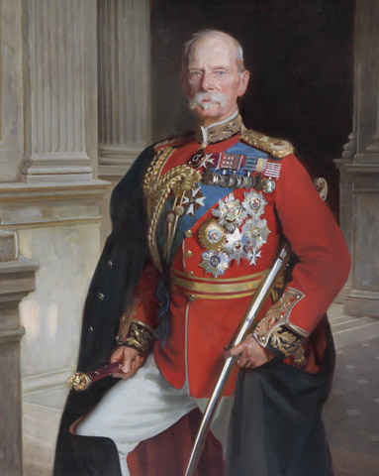
Notes:
Field Marshal Lord Roberts of Kandahar, Pretoria and Waterford VC KG KP GCB OM GCSI GCIE (1832-1914), 1904 (c).
Oil on canvas after the portrait by John Singer Sargent, 1904, in the National Portrait Gallery, by Frank Markham Skipworth (1854-1929), 1917.
Three-quarter-length, in field marshal’s full dress uniform with orders and medals, his sword under his left arm, standing in a pillared portico.
1956-02-194

Slide 6
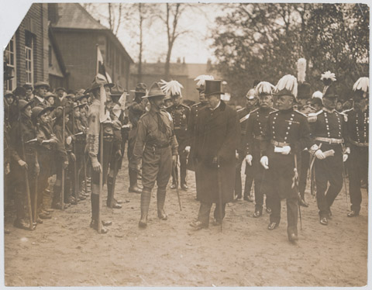
Notes:
Photograph of Viscount Haldane, Lord Warwick, inspecting boy scouts at Chelmsford, Essex, 1910.
One of eleven photographs collected by Col H Cooper CMG CBE, 1881-1912
1970-03-30-10

Slide 7
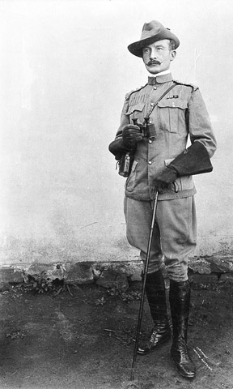
Notes:
Photograph of Col R S S Baden-Powell, full length, 1899.
Photographed by Taylor of Mafeking one Sunday during the siege.
From a group of two photographs relating to the Siege of Mafeking, 1899.
1965-06-77-1

Slide 8
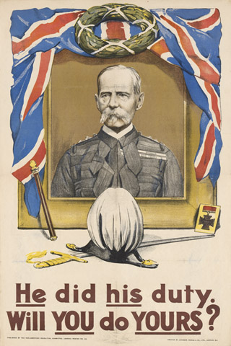
Notes:
Recruiting poster, 'He did his duty. Will You do Yours?', 1914
Chromolithograph recruiting poster, published by the Parliamentary Recruiting Committee, as Poster No 20.
One of 49 posters relating to World War One (1914-1918).
Commemorative portrait of Lord Roberts.
1977-06-81-11

Slide 9
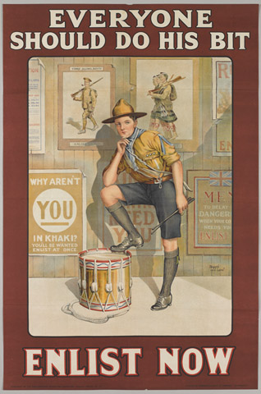
Notes:
‘Everyone Should Do His Bit Enlist Now’, 1915.
Colour photolithograph recruiting poster after Baron Low, published by the Parliamentary Recruiting Committee, as Poster No 121, printed by Roberts and Leete, London, 1915.
A boy scout resting his foot on a drum, in front of a wall covered in recruiting posters, World War One (1914-1918).
2005-11-222

Slide 10
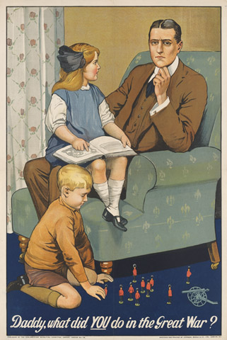
Notes:
Recruiting poster, 'Daddy, what did You do in the Great War?''.
Colour lithograph, after Savile Lumley, published by the Parliamentary Recruiting Committee March 1915, Poster No 79, designed and printed by Johnson, Riddle and Company Limited, 1915. One of a collection of 49 posters, World War One (1914-1918).
A guilt-stricken father sits in an armchair with his daughter on his knee while his son plays with toy soldiers.
1977-06-81-16

Slide 11
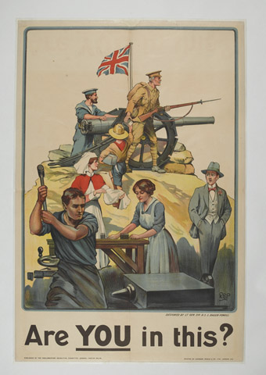
Notes:
Recruiting poster, ‘Are You in this?’, 1915
Chromolithograph after Lt Gen Sir R S S Baden-Powell, poster No 112 published by Parliamentary Recruiting Committee, printed by Johnson, Riddle and Company, London, July 1915
Talented artist, writer, former soldier, and founder of the Scout Movement, Sir Robert Baden-Powell designed this poster to remind people there were many ways in which they could contribute to the war effort. It depicts a civilian watching the patriotic activities of a sailor, a soldier, a boy scout, a nurse, and male and female munitions factory workers.
1977-06-81-29

Slide 12
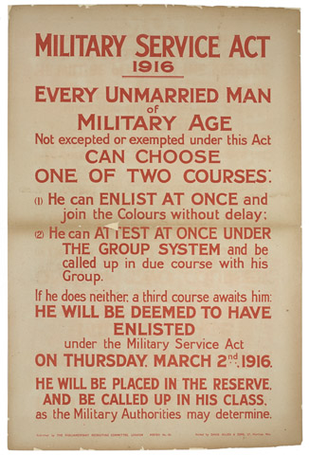
Notes:
Military Service Act 1916.
Lithographic posted published by the Parliamentary Recruiting Committee, No 151, 1915 (c).
Printed by David Allen and Sons, nd.
Associated with World War One (1914-1918).
2014-07-31-1

Slide 13
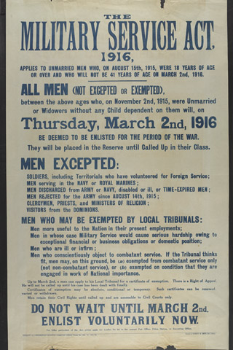
Notes:
The Military Service Act 1916.
Published by the Parliamentary Recruiting Committee, No 153, 1915 (c).
Printed by Roberts and Leete, 1915 (c).
Associated with World War One (1914-1918).
2014-07-32-1

Slide 14
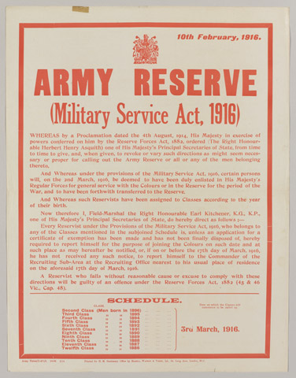
Notes:
Proclamation regarding Army Reserve (Military Service Act, 1916) Army Form D 471/1, dated 10.2.1916.
One of thirteen printed posters produced in Britain between August 1914 - March 1916.
Associated with World War One, Home Front (1914-1918).
1977-06-80-11

Slide 15
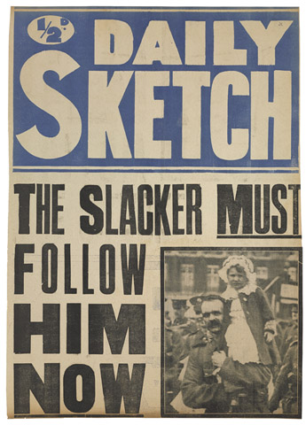
Notes:
Daily Sketch, The Slacker MUST Follow Him NOW.
Printed news-stand poster, with photographic insert of soldier holding a child, 1916 (c).
Associated with World War One (1914-1918).
2014-07-37-1

Slide 16
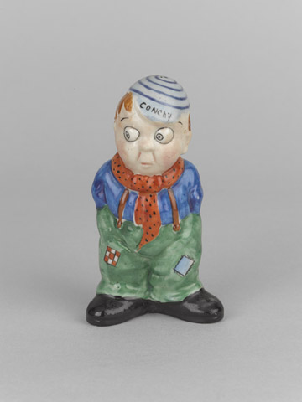
Notes:
‘Conchy’.
Ceramic figurine manufactured by Birks, Rawlins and Company Limited at the Vine Pottery, Stoke on Trent, 1914-1918 (c).
Hand-painted
Example of ‘Birks Grotesques’, it shows a satirical impression of a conscientious objector in civilian dress with his hands in his pockets, wearing a sports cap inscribed ‘conchy’.
Associated with World War One, Home Front (1914-1918).
2014-01-7

Slide 17
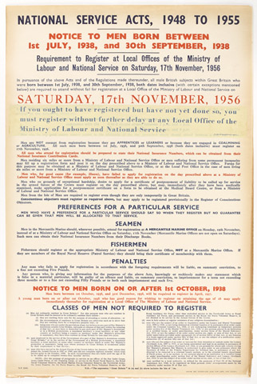
Notes:
Poster: 'National Service Acts, 1948 to 1955. Notice to men born between 1st July 1938 and 30th September 1938. Requirement to register at local offices of the Ministry of Labour and National Service on Saturday 17th November 1956'; includes full details of exempted categories and has a strip of paper pasted on stressing the urgency of registering, this perhaps reflects the fact that November 1956 was the month of the Suez Crisis.

Slide 18
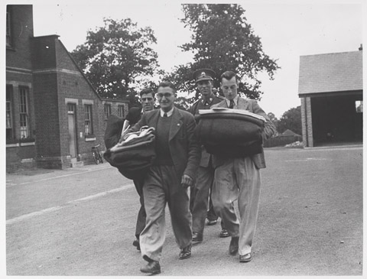
Notes:
Photograph of training in Britain, including the reception of recruits, medical examination, issue of kit, interior of barracks and physical training, weapons training, cooks and relaxing in the canteen.
One of 115 official World War Two photographs of Britain 1939-1940.
1989-10-122-30

Slide 19
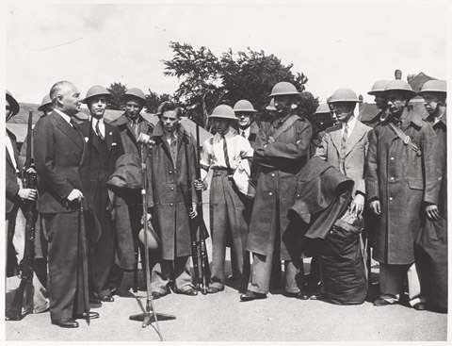
Notes:
Photograph of training in Britain, including the reception of recruits, medical examination, issue of kit, interior of barracks and physical training, weapons training, cooks and relaxing in the canteen.
One of 115 official World War Two photographs of Britain 1939-1940.
1989-10-122-32

Slide 20
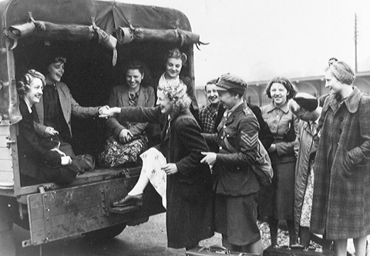
Notes:
One of 63 photographs relating to the recruiting and induction procedure for the Auxiliary Territorial Service, 1941-1942 (c).
Associated with World War Two, Home Front (1939-1945).
1994-07-274-11

Slide 21

Notes:
5000754

Slide 22
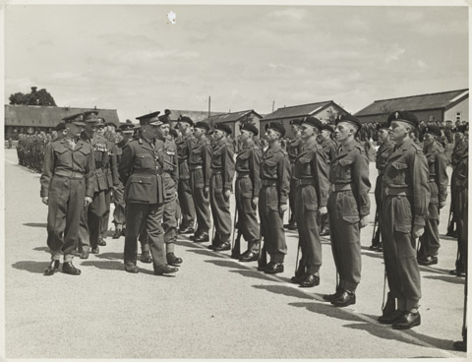
Notes:
Photograph of Maj Gen S W Joslin inspecting the passing out parade of C Coy, Royal Electrical and Mechanical Engineers, Honiton Camp, Devon, 24 Jun 1952.
From a photograph album relating to the National Service of John Heygate with the Royal Electrical and Mechanical Engineers, 1952-1954, including service in the Canal Zone.
2002-11-660-1

Slide 23
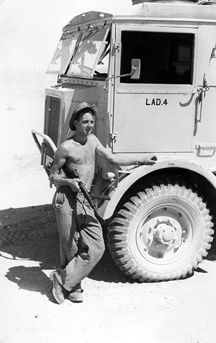
Notes:
Photograph of 74 LAD out on a desert exercise, shows Austin K5 trucks, use of camouflage, Mr Heygate and vehicle recovery, nd.
From a photograph album of photographs relating to the National Service of John Heygate with the Royal Electrical and Mechanical Engineers, 1952-1954, including service in the Canal Zone.
2002-11-660-36

Slide 24
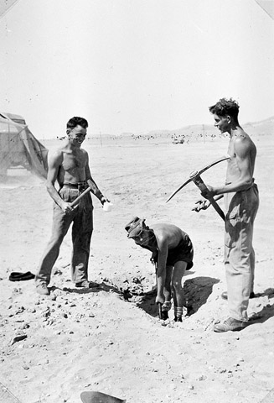
Notes:
Photograph of 74 LAD out on a desert exercise.
From a photograph album of photographs relating to the National Service of John Heygate with the Royal Electrical and Mechanical Engineers, 1952-1954, including service in the Canal Zone.
2002-11-660-41

Slide 25
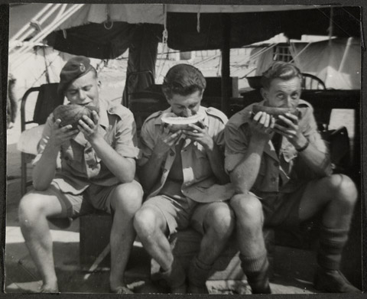
Notes:
One of twenty photographs of Sapper Frederick Tomlinson, No 47 GHQ Survey Sqn, Royal Engineers, and various colleagues, in their barracks at Fayid on the banks of the Sweetwater Canal in the Suez Canal Zone, 1954.
From a photograph album of 318 photographs relating to the National Service of 22677695 Sapper Frederick Tomlinson, who served in Egypt with No 47 GHQ Survey Sqn, Royal Engineers, at Fayid on the banks of the Sweetwater Canal in the Suez Canal Zone, 1952-1954.
Associated with Egypt (1945-1956).
2005-06-746-118

