Slide 1
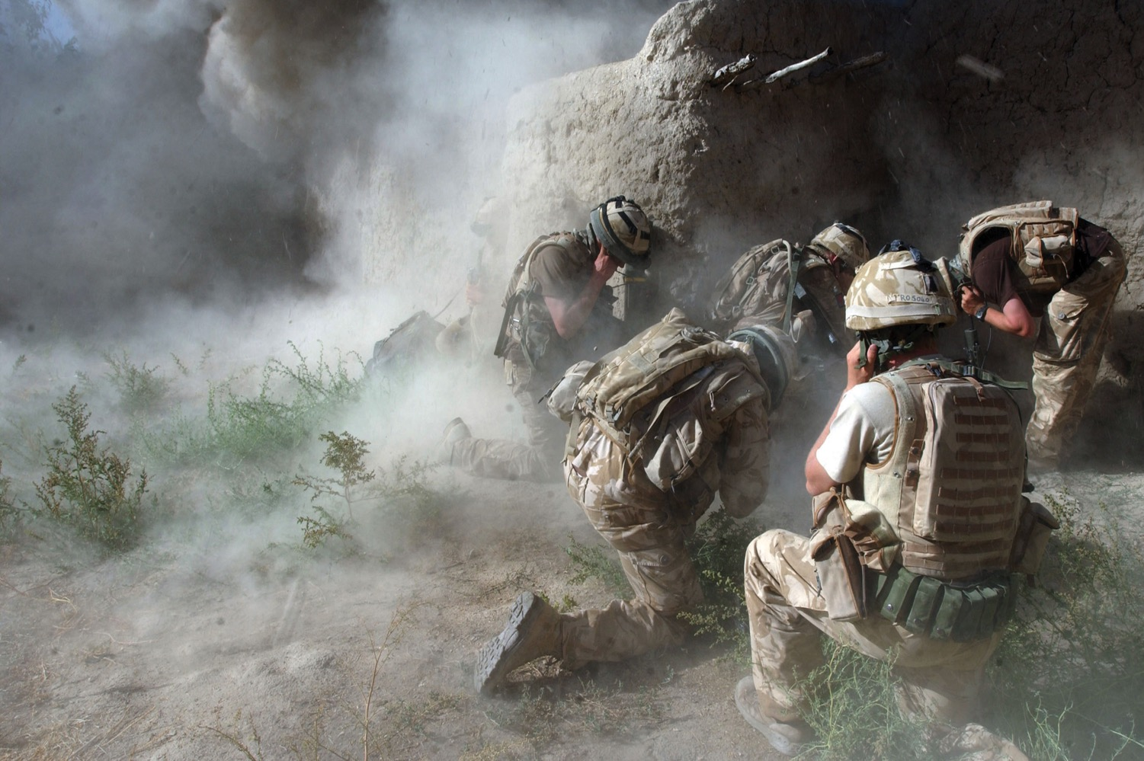
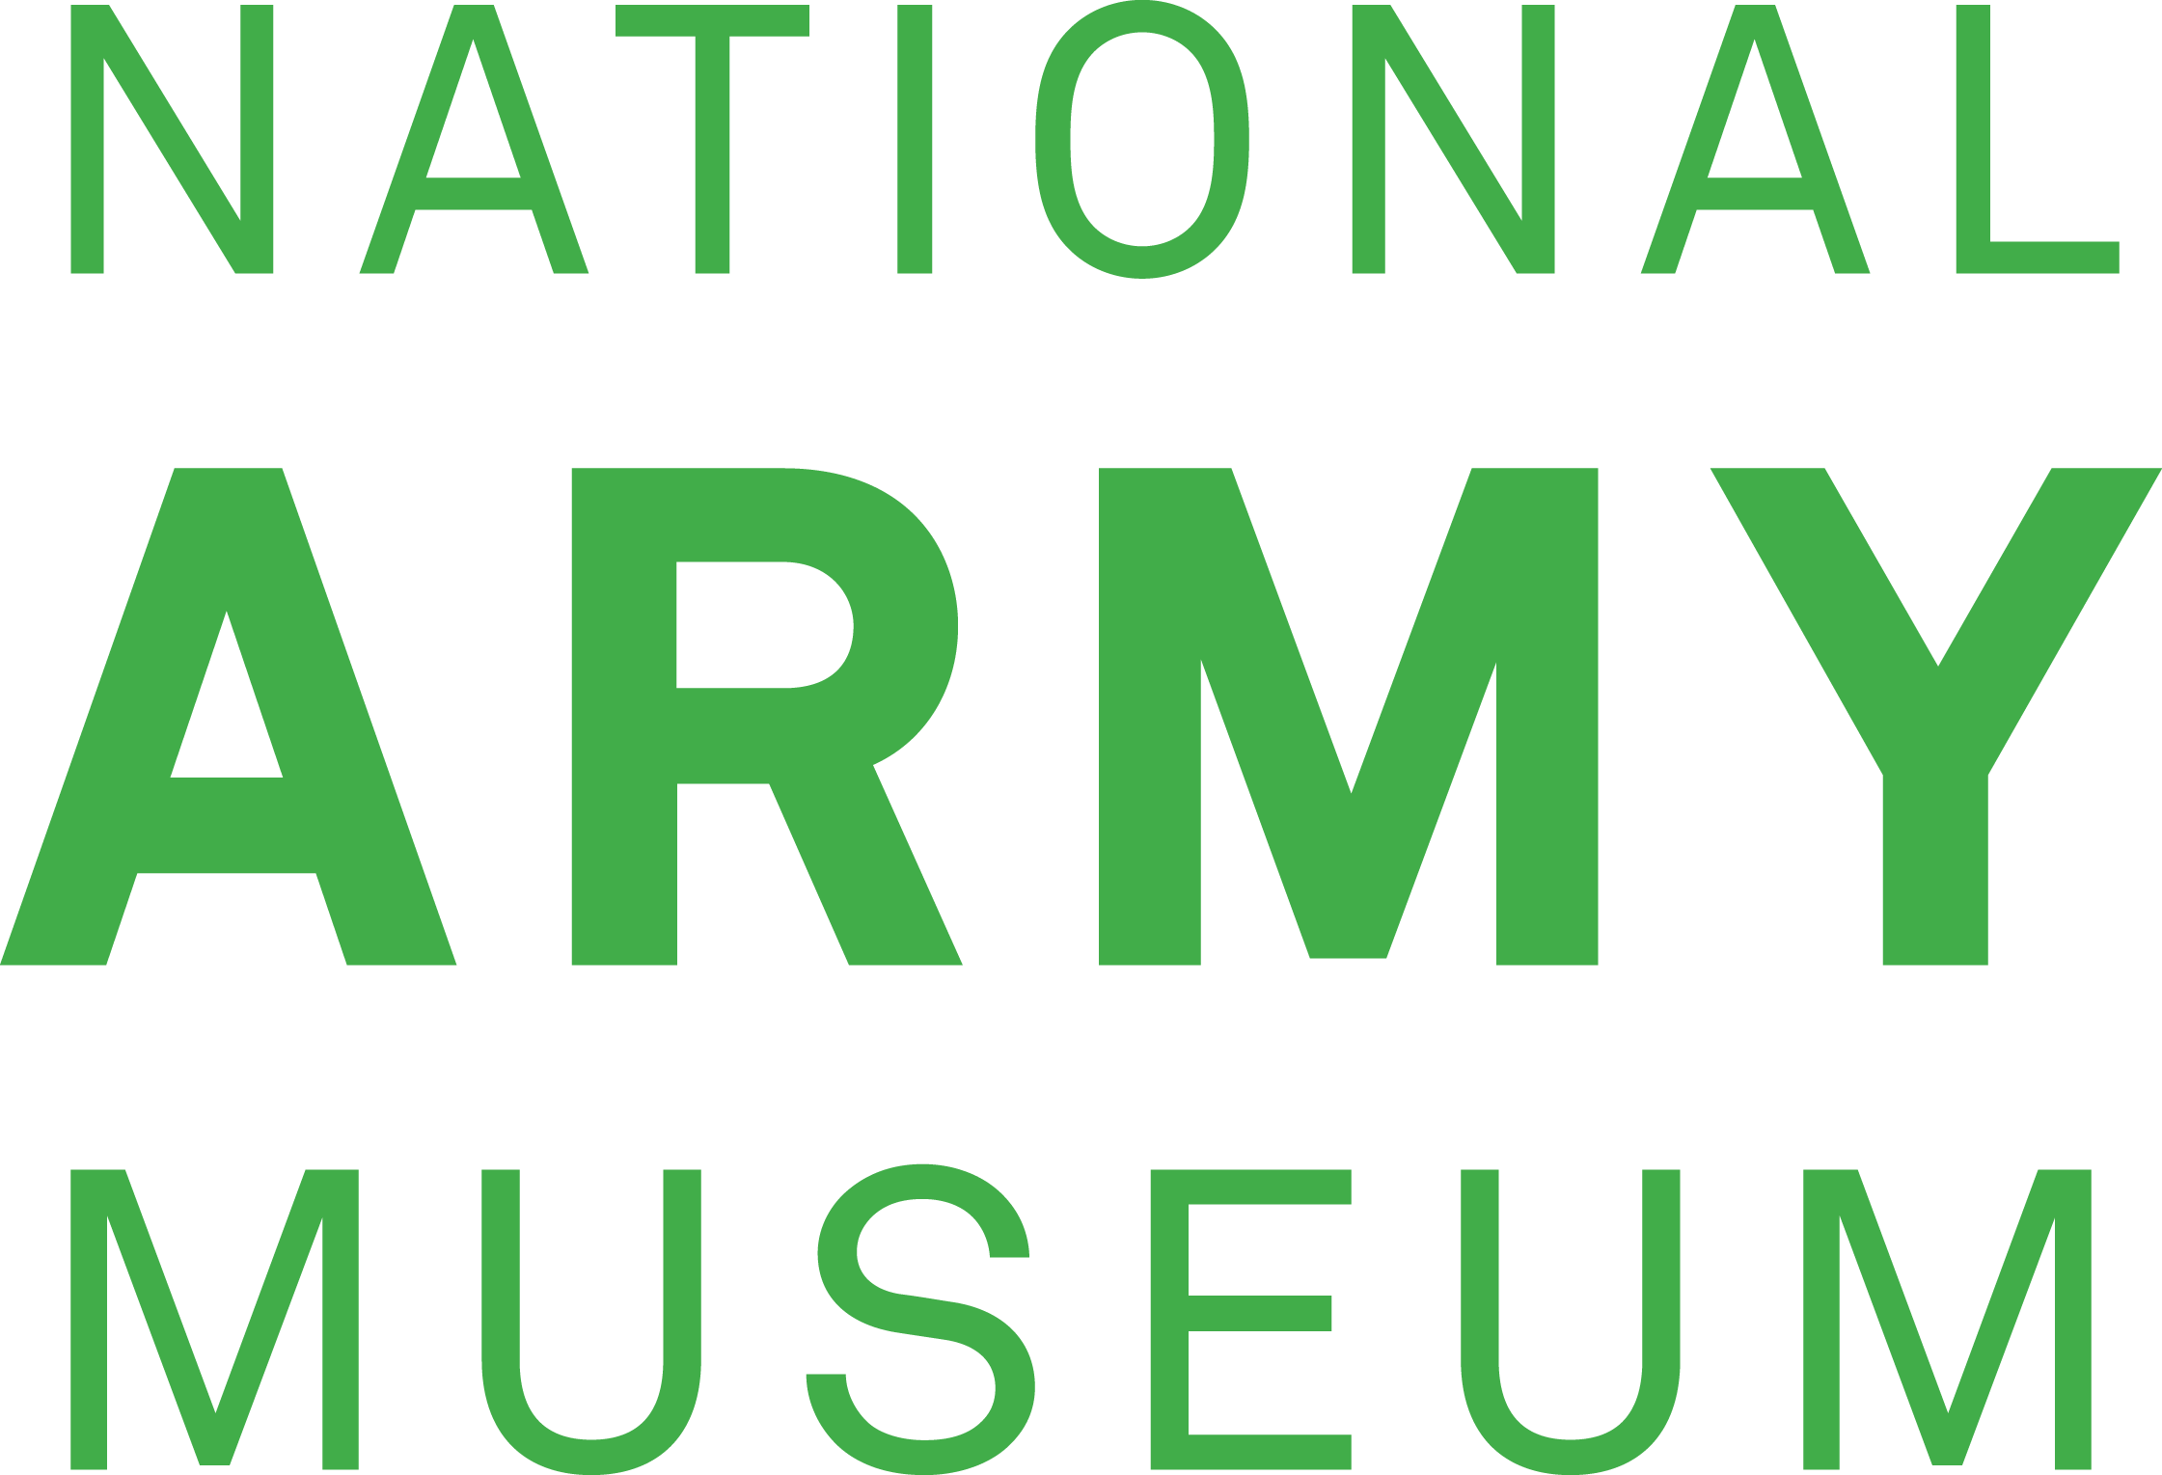
Do we need the British Army?
Notes:
NAM 2013-07-11-73
Soldiers protect their ears against the noise of an explosion.
Digital photograph from a collection of 102 digital images by Sgt Will Craig, Defence Press Office, Army Combat Camera Team, Afghanistan (2001-2014)
Crown Copyright.

Slide 2
This PowerPoint presentation contains a selection of images and archives which students can use to prompt discussion and encourage further research. The materials come from the Collection of the National Army Museum (NAM).
Unless otherwise stated in the notes, the images can be freely used for non-commercial purposes within the classroom. You can use the entire presentation or choose individual images for use in other non-commercial contexts. When using individual images in other contexts, please always retain the attribution statements provided in this document (e.g. NAM. 2005-08-66-1).
By downloading this document and using these images you agree to these terms of use, including your use of the attribution statement specified for each object by NAM.

Slide 3
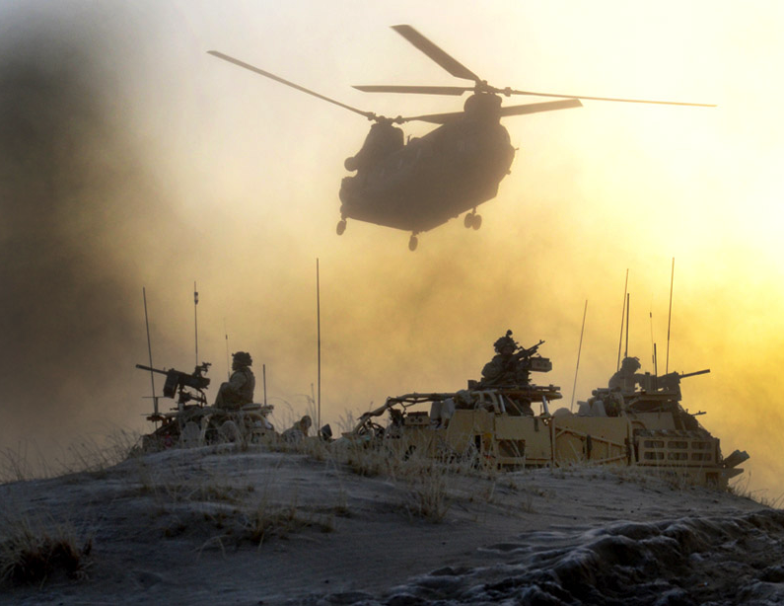
What does the Army say about itself?
Notes:
NAM 2015-11-54-10
‘Re-supply’, 31 December 2012.
Digital photograph by Sgt Rupert Frere, Royal Logistic Corps, 2011.
Part of Frere’s HERRICK Portfolio 2, Army Photographic Competition, 2015.
A Royal Air Force CH47 Chinook helicopter delivers essential supplies to troops of 4 Mechanised Brigade Reconnaissance Force during Operation DAAS in the Dashte Desert, Afghanistan. DAAS was a long range reconnaissance operation, targeting insurgent supply chains in Helmand Province.
From a collection of multimedia relating to Sgt Rupert Frere, Royal Logistic Corps, and the Army Photographic Competition in 2015.
Associated with Operation HERRICK, Afghanistan (2001-2014).
Crown copyright.

Slide 4
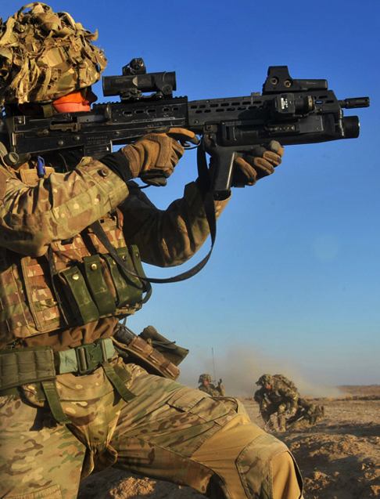
The British Army Today and Tomorrow
A recent document published by the Army, the Army Strategic Narrative, available here, said:
“The British Army – a professional force, resolving crises abroad, serving the nation at home, securing Britain in an uncertain world.”
Notes:
NAM 2015-11-54-5
‘Covering Fire’, Operation HERRICK 17, 6 Jan 2013
Digital photograph by Sgt Rupert Frere, Royal Logistic Corps, 4 Nov 2010.
Part of Frere’s HERRICK Portfolio 1, Army Photographic Competition, 2015.
Corporal Carl Hines, Royal Artillery, provides covering fire while members of the Brigade Reconnaissance Force cross open ground, whilst under heavy enemy fire.
From a collection of multimedia relating to Sgt Rupert Frere, Royal Logistic Corps, and the Army Photographic Competition in 2015.
Associated with Operation HERRICK, Afghanistan (2001-2014).
Crown copyright.

Slide 5
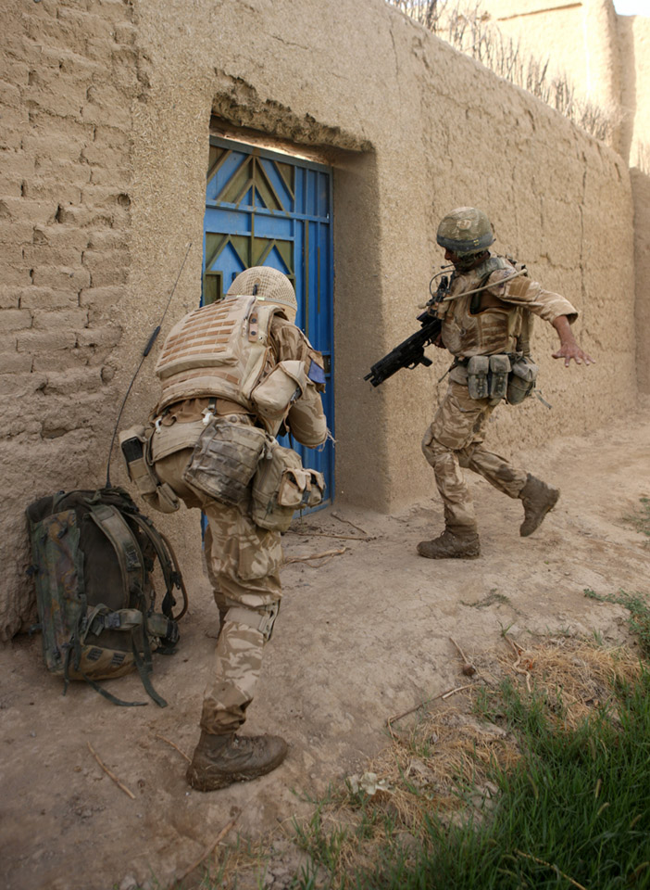
Its Primary Purpose
“…is to fight.”
“Our demonstrated willingness, when necessary, to participate in land conflicts can deter aggressors and reassure our friends… encouraging them to share the burden while underpinning our own security.”
Notes:
NAM 2015-11-56-43
Two soldiers prepare to enter a compound in Helmand Province, Afghanistan.
From a collection of 80 low resolution digital photographs compiled by Sgt Rupert Frere, Royal Logistic Corps. Associated with Afghanistan (2001-).
Crown copyright.

Slide 6
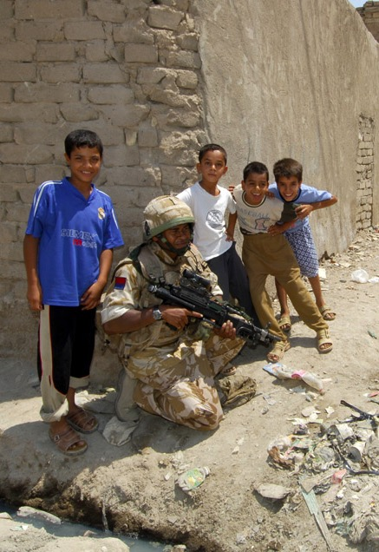
An international role
“The Army makes a significant contribution to averting crises or conflicts and positively influencing global dynamics.”
“...Britain... an advocate of numerous collective defence arrangements, including permanent representation on the UN Security Council.”
Notes:
NAM 2007-06-8-10
A gunner serving with 17 Battery Royal Artillery conducts a foot patrol in the suburbs of Basra city, Iraq, to reassure locals following recent militia fighting.
Photographer, Cpl Anthony Boocock Royal Logistic Corps, 20th Armoured Brigade Media Ops, 5 Jun 2006.
Associated with Operation TELIC 8, Iraq (2003-).
Crown copyright.

Slide 7
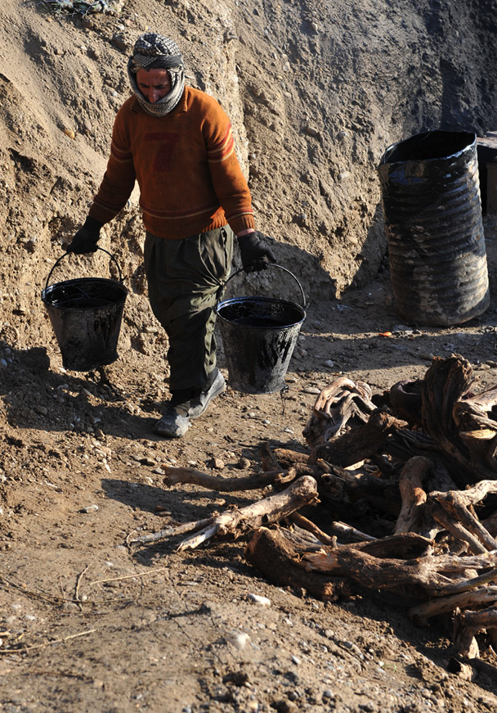
Combating Poverty
“As security is the precursor to prosperity, the British Army provides the foundation for combating poverty and protecting vulnerable populations. This lends further moral weight to our significant financial contributions to the UN.”
Notes:
NAM 2015-11-55-423.
Digital photograph of an unnamed local civilian carrying buckets by Sgt Rupert Frere, Royal Logistic Corps.
From a collection of digital photographs compiled by Sgt Rupert Frere, Royal Logistic Corps.
Associated with Afghanistan (2001-).
Crown copyright.

Slide 8
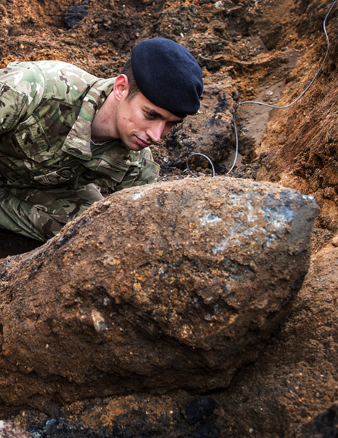
And at home
“...the UK’s domestic safety net.”
“The Army will also continue to support other government departments in safeguarding security at home. Civil emergencies, including natural disasters, pandemics, major accidents and terrorism, have the potential to threaten the welfare of British citizens and the environment.”
Notes:
NAM 2015-11-54-22
‘Bombs Away’, 23 March 2015.
Unexploded bombs from the air raids over England in the Second World War are sometimes discovered in building sites. Bomb disposal experts from the Army can be called in to make them safe.
Digital photograph by Sgt Rupert Frere, Royal Logistic Corps.
One of 12 portfolio shots.
From a collection of multimedia relating to Sgt Rupert Frere, Royal Logistic Corps, and the Army Photographic Competition in 2015.
Crown Copyright.

Slide 9
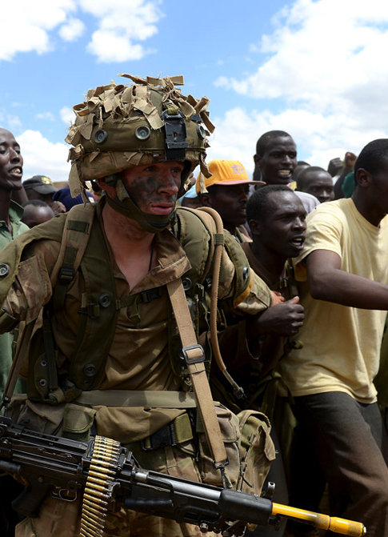
The future
“In the coming years we will significantly expand our activity in the realm of conflict prevention and engagement, but the effectiveness of these activities will stem directly from our strength as a combat-ready Army.”
Notes:
NAM 2015-11-54-16
‘Middleman’, 11 October 2014.
Digital photograph by Sgt Rupert Frere, Royal Logistic Corps.
One of 12 portfolio shots.
From a collection of multimedia relating to Sgt Rupert Frere, Royal Logistic Corps, and the Army Photographic Competition in 2015.
Crown copyright.

Slide 10
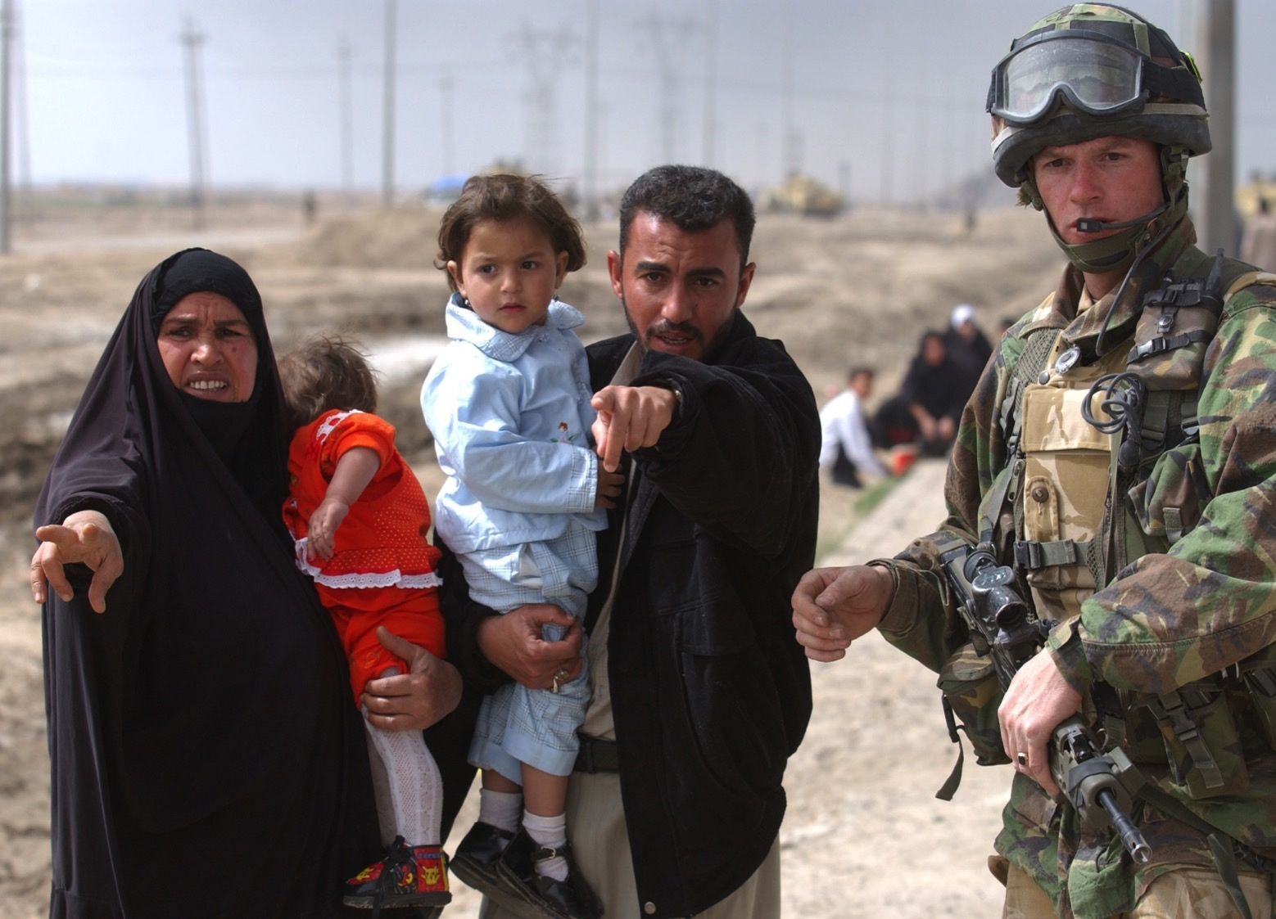
Are there tasks that could be done by someone else?
Notes:
NAM 2005-01-67-26
Digital photograph: A family of Iraqi civilians seek the help of a soldier serving with No 2 Company, 1st Battalion The Irish Guards to locate their other child caught up in the panic caused by incoming small arms fire from Iraqi positions in Basra.
Photographed by WO2 Giles Penfound, Army Media Operations, outskirts of Basra City, southern Iraq, Operation TELIC, 30 March 2003.
Associated with 1 Company, 1st Battalion, The Irish Guards, Iraq (2003-).
Crown Copyright.
The family were part of a column of people fleeing the city of Basra when it and the soldiers of the 1st Battalion No 2 Company, The Irish Guards, manning a checkpoint on the outskirts of Basra, came under small arms fire from two Iraqi positions several hundred metres away.
The Irish guards were trying to give as much protection to the local civilians as well as ensuring no Iraqi Military or Militia slipped through the checkpoint disguised as ordinary civilians. After returning small arms fire and bringing in artillery fire on the two positions the soldiers were then in a position to allow free access across the checkpoint.

Slide 11
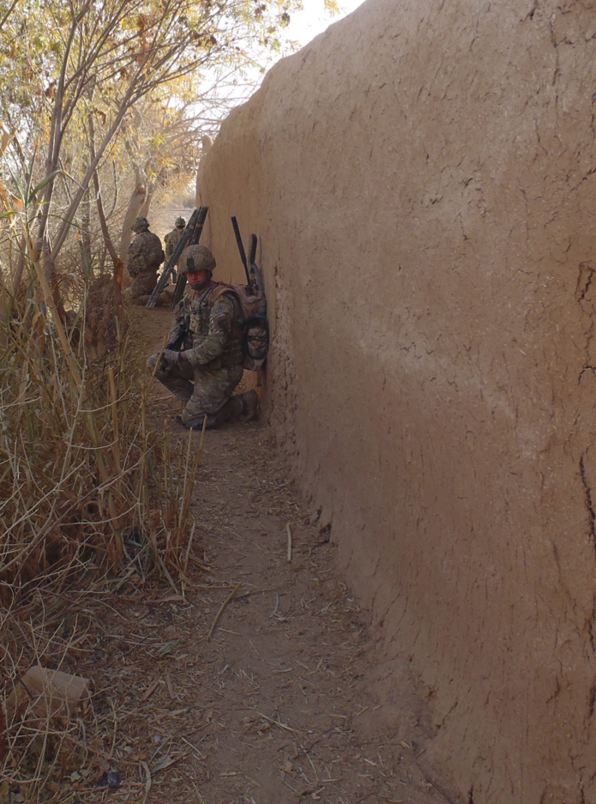
If not the Army
There are more than 20 countries in the world who choose not to have a ‘standing Army’; that is a permanent Army composed of full-time soldiers that is not disbanded during times of peace.
Notes:
NAM 2013-02-13-627
Members of an IED search team wait in the shade of a compound wall in Helmand Province, Afghanistan.
Digital photograph from a collection relating to the service of 61 Field Squadron, 33 Regiment (Explosive Ordnance Disposal), Royal Engineers, dealing with improvised explosive devices (IEDs) in Afghanistan.
Associated with Operation HERRICK, Afghanistan (2001-2014) 2004-.
Copyright NAM.

Slide 12
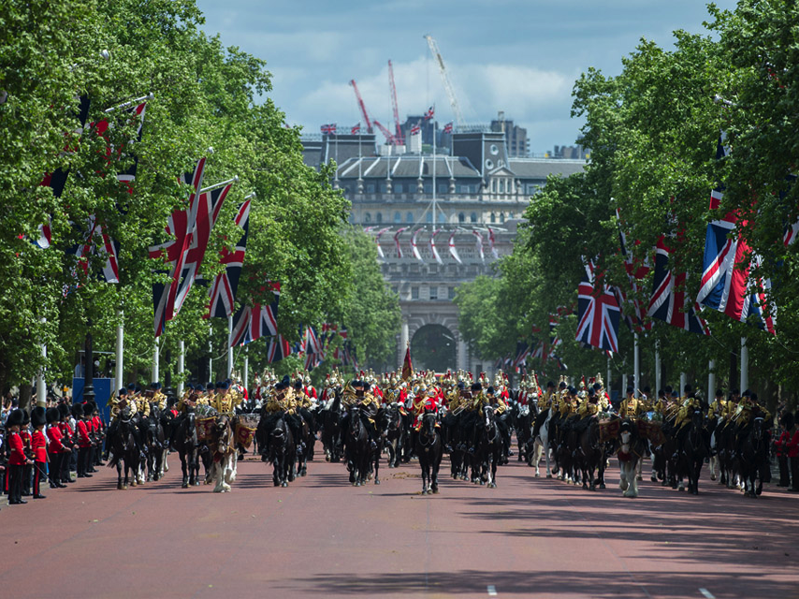
How do other countries manage without an Army?
Notes:
The Massed Band of the British Army's Household Division parade down The Mall, London, 6 June 2015.
Digital photograph by Cpl Max Bryan, 6 June 2015.
From a collection of photographs compiled by Sgt Rupert Frere, Royal Logistic Corps, primarily of British Army units involved in ceremonial duties in London in 2015.
Crown copyright.
Crown copyright.

Slide 13
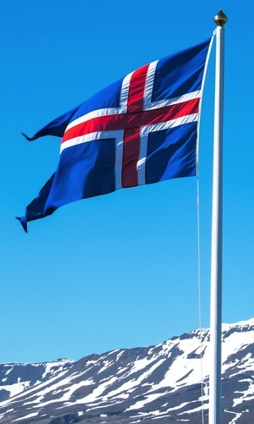
Iceland
Defences include...
The Icelandic Coast Guard which patrols Icelandic waters and airspace
The National Security Unit which handles intelligence operations
A Counter-terrorism Unit which is part of the national police force
International role
Iceland’s Crisis Response Unit participates in international peacekeeping missions
Protectors
NATO and different member states
Notes:
Picture credit
Shutterstock
Image ID: 301266557
Copyright: elxeneize

Slide 14
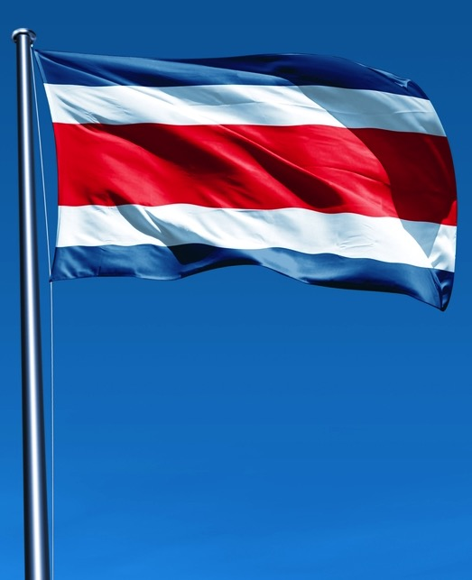
Costa Rica
“The absence of an army is…a source of national pride.”
Source: www.diplomatmagazine.com
Defences include:
A public security force whose role is similar to a police force
A Special Intervention Unit that is organized along military lines to intercept drug traffickers and act as a counter-terrorism unit
Protectors:
After 7,000 U.S. service members were sent to Costa Rica in 2010 to assist in counter-narcotics efforts
Notes:
Picture credit
Shutterstock
Image ID: 301266557
Copyright: elxeneize

Slide 15

Liechtenstein
Defences include...
A police force and a SWAT (Special Weapons and Tactics) team to carry out internal security duties
An army which is only permitted in times of war, but that situation has never occurred
Protectors
No country is defined as having responsibility to defend Liechtenstein in the event of a war or some other attack
Notes:
Picture credit
Shutterstock
Image ID: 301266557
Copyright: elxeneize

Slide 16

Andorra
Defences include...
A national police force, with a small Special Forces Unit trained in counter-terrorism and hostage management
Protectors
Andorra has signed treaties with Spain and France for its protection
Notes:
Picture credit
Shutterstock
Image ID: 301266557
Copyright: elxeneize

Slide 17


Marshall Islands and Palau
Defences include...
Some formerly U.S. administered territories simply never established militaries after achieving independence, instead leaving the U.S. in charge of their defence.
Notes:
Picture credit
Shutterstock
Image ID: 301266557
Copyright: elxeneize

Slide 18
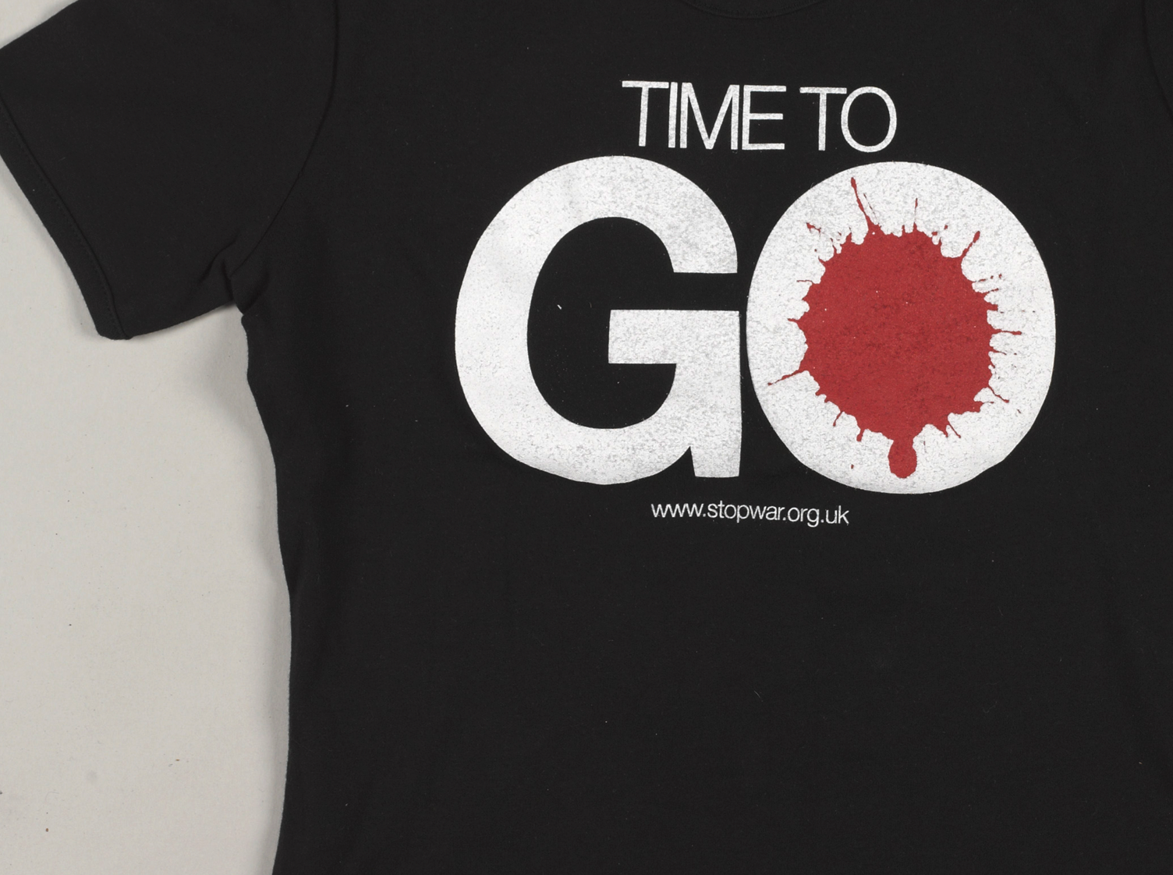
What would be the impact if there were no British Army?
Notes:
NAM 2013-10-5-3
Black T-shirt printed with ‘time to go’, 2006-2011.
Associated with Iraq (2003-2011) and Afghanistan (2001-2014).
Example of a T-shirt worn by protesters on marches against the ‘wars on terror’ in Manchester on 23 September 2006, London and Glasgow on 15 March 2008, and London on 24 October 2009, 20 November 2010 and 8 October 2011. Distributed by Stop the War coalition, an organisation set up in 2001 to coordinate campaigns and demonstrations against the ‘wars on terror’, and designed by David Gentleman.

Slide 19
Take a view…
Do we need the British Army?
Notes:
NAM 2013-07-11-73
Soldiers protect their ears against the noise of an explosion.
Digital photograph from a collection of 102 digital images by Sgt Will Craig, Defence Press Office, Army Combat Camera Team, Afghanistan (2001-2014)
Crown copyright.

