Slide 1


Easter Rising
Notes:
This resource gives captioning information for the images used in the accompanying film.

Slide 2
This PowerPoint presentation contains a selection of images and archives which students can use to explore the story of one British soldier in the First World War. In the main, the materials come from the Collection of the National Army Museum (NAM). Occasionally these are supplemented by materials from outside the NAM to provide context.
Unless otherwise stated in the notes, the images can be freely used for non-commercial purposes within the classroom. You can use the entire presentation or choose individual images for use in other non-commercial contexts. When using individual images in other contexts, please always retain the attribution statements provided in this document (e.g. NAM. 2005-08-66-1).
By downloading this document and using these images you agree to these terms of use, including your use of the attribution statement specified for each object by NAM.

Slide 3
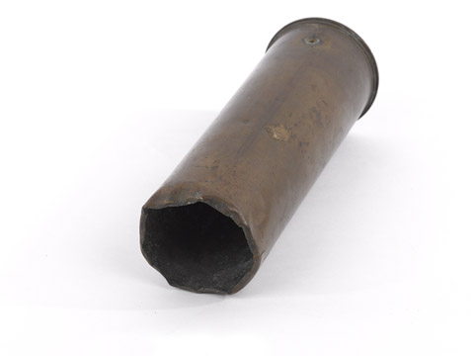
Notes:
18 pdr shell case, fired by the 4th Brigade Royal Artillery during the Irish Rebellion, 1916; stamped with date ‘1915’.
Associated with Easter Rebellion, Ireland (1916-1922).
NAM. 1961-12-73-1

Slide 4
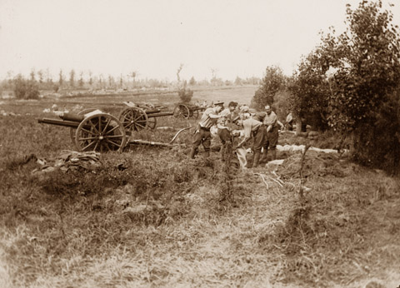
Notes:
Photograph: Gunners dig in on captured territory during the Battle of Messines Ridge.
From an album of 76 official photographs, 1916-1917.
Associated with World War One, Western Front (1914-1918).
Members of the Royal Field Artillery with their 18-pounder field guns. Over 8,000 of these weapons were manufactured during the war and between them fired 100 million shells. With a crew of ten men, it could fire 18-pound shrapnel, high explosive or smoke shells up to six kilometres (over 6,500 yards). The recuperators (the mechanism that returned the gun barrel to its firing position after recoil) of these field guns were wound with thick rope for protection.
NAM. 1999-11-70-49

Slide 5
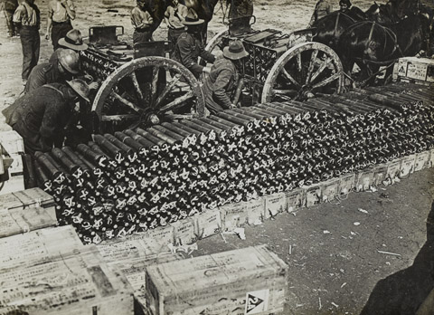
Notes:
New Zealand troops loading ammunition limbers near Albert, September 1918.
Photograph, World War One, Western Front (1914-1918), 1918.
New Zealanders load 18-pound shells into limbers during the Battle of the Somme. During the latter engagement over ten million 18-pound shells were fired. The 18-pounder was the main British and Commonwealth artillery weapon of the War.
From an album of 24 official photographs, including one loose, showing scenes of the Western Front Campaign, 1916-1918 (c), World War One (1914-1918).
NAM. 1995-03-88-17

Slide 6
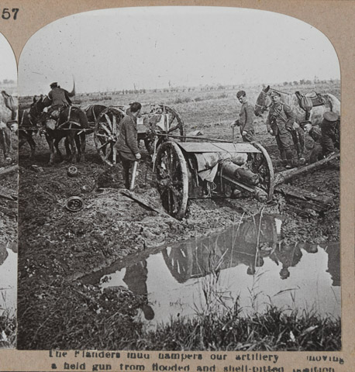
Notes:
Stereoscopic photograph, The Flanders mud hampers our artillery moving a held gun from flooded and shell-pitted position, nd.
From a collection of one hundred and one stereoscopic photographs in box one of two entitled ‘The Great War’ including the official series.
With stereoscopic viewer.
Associated with World War One, Western Front (1914-1918).
Horse-drawn Mk I 18-pounder field guns of the British Expeditionary Force (BEF) negotiate a flooded shell-hole en route to the front. With a crew of ten men, it could fire 18-pound shrapnel, high explosive or smoke shells up to six kilometres (over 6,500 yards).
NAM. 1972-08-67-1-57

Slide 7
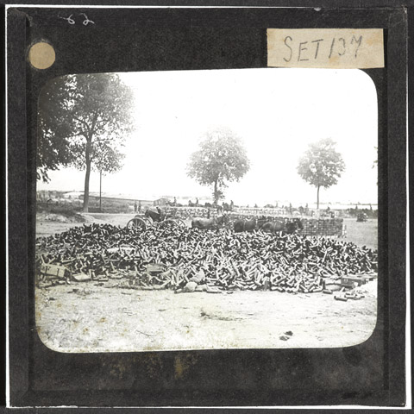
Notes:
Empty shell dump, July 1916.
Lantern slide, World War One, Western Front (1914-1918), July 1916.
The dump contains empty 18-pounder shell cases and their boxes. The shells were used during the bombardment of Fricourt. Prior to their attack on the Somme on 1 July 1916 the Allies fired over 1.5 million shells during a week-long preliminary bombardment of the German lines.
From a box of 50 lantern slides.
NAM. 1978-11-157-29-47

Slide 8
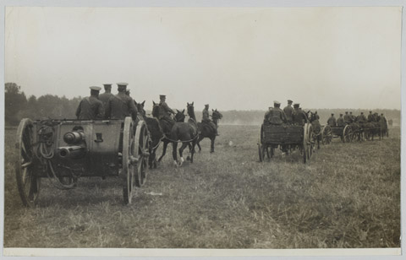
Notes:
Photograph: A battery of British field artillery taking up a position.
Shows an 18 pdr field gun and its crew being pulled by horses across a field in France or Belgium, 1914 (c)-1915 (c).
One of 193 British and Allied Official photographs taken on the Western Front during World War One.
Mounted on card, some with their original captions.
Associated with World War One, Western Front (1914-1918).
The 18-pounder was the main British artillery weapon of the First World War. With a crew of ten men, it could fire 18-pound shrapnel, high explosive or smoke shells up to six kilometres (over 6,500 yards). In August 1914 the British Army was equipped with 1226 of these guns. During the Battle of the Somme (1916) the British fired over 15 million shells. Of those, some 10 million were fired by 18-pounders. With an experienced crew and in good conditions, the 18-pounder could fire at a remarkable 30 rounds a minute.
NAM. 2007-03-7-140

Slide 9
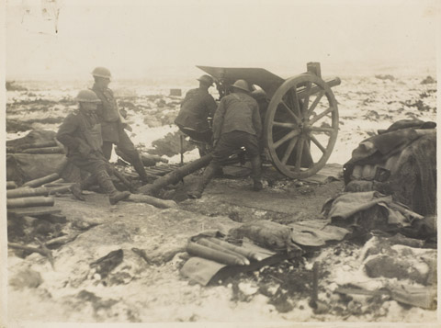
Notes:
Photograph: New Zealand Artillery in action.
Shows four gunners operating an 18-pdr field gun in a snow-covered landscape.
398.
One of 193 British and Allied Official photographs taken on the Western Front during World War One.
Mounted on card, some with their original captions.
Associated with World War One, Western Front (1914-1918).
NAM. 2007-03-7-73

Slide 10
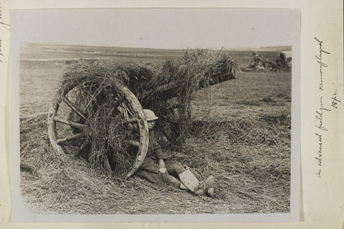
Notes:
The Guns / An advanced field gun camouflaged 18 pr
Photograph of a soldier sitting by the wheels of an 18 pdr gun, which has been covered in grass, 1915-1918.
Associated with World War One, Western Front (1914-1918).
From photograph album of 253 photographs, including 2 loose, compiled by Charles William Stulpnagel (known as Swinton after Dec 1914), 1889-1920.
NAM. 1953-03-31-172

Slide 11
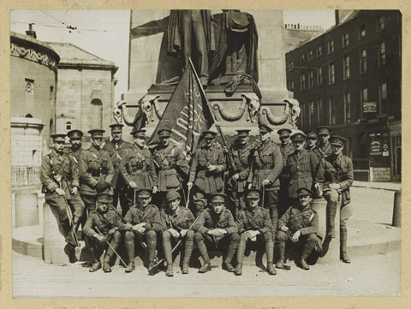
Notes:
Two photographs of groups, with captured Sinn Fein flag, 3rd Bn Royal Irish Regiment, Easter Rebellion, Dublin, 1916.
Associated with Easter Rebellion (1916).
NAM. 1963-11-177-1

Slide 12
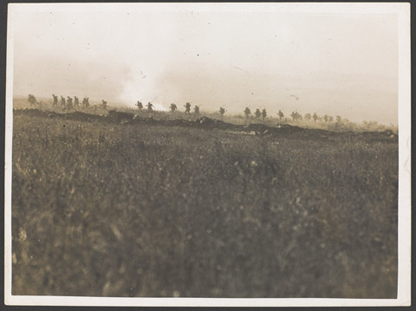
Notes:
Photograph of Infantry advancing in the distance.
Collection of 98 official war photographs illustrating the British advance in the Western Front Campaign, World War One (1914-1918).
From the collection of the former Buffs Regimental Museum.
NAM. 2001-01-279-17

Slide 13
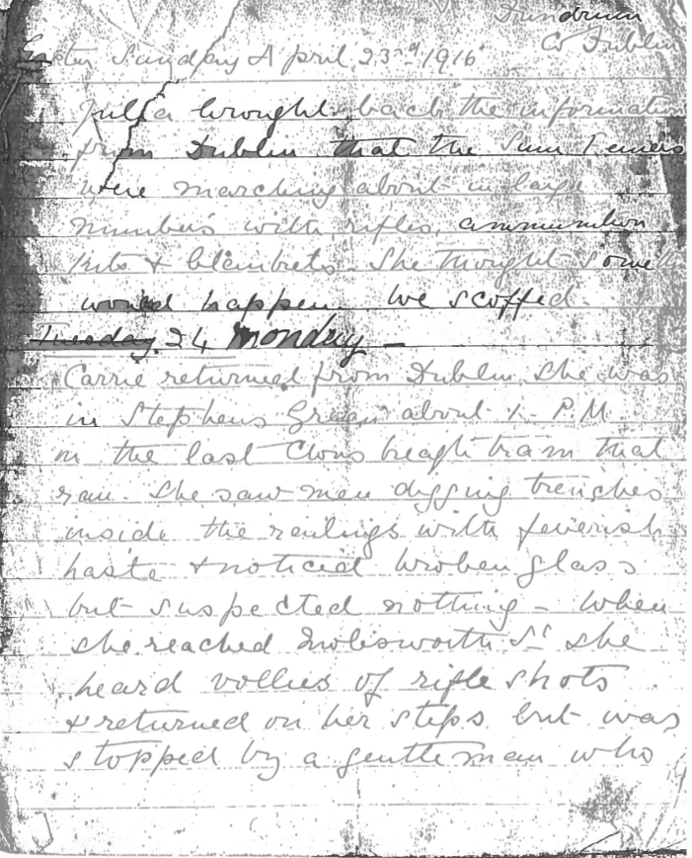
Notes:
Photocopy diary, 1916.
Kept by a 16 year old English nurse.
Associated with the Easter Rebellion, Ireland (1916-1922).
NAM. 1991-12-123-1
‘Easter Sunday April 23rd 1916
Julia brought back the information from Dublin that the Sinn Feiners were marching about in large numbers with rifles, ammunition, kits and blankets. She thought something would happen. We scoffed.
24 Monday
Carrie returned from Dublin. She was in Stephen’s Green about 1 PM in the last [Clonskleagh?] tram that ran. She saw men digging trenches inside the railway with feverish haste + noticed broken glass but suspected nothing. When she reached [Molesworth?] St she heard vollies [sic] of rifle shots and returned on her steps but was stopped by a gentleman who [NEXT PAGE]’

Slide 14
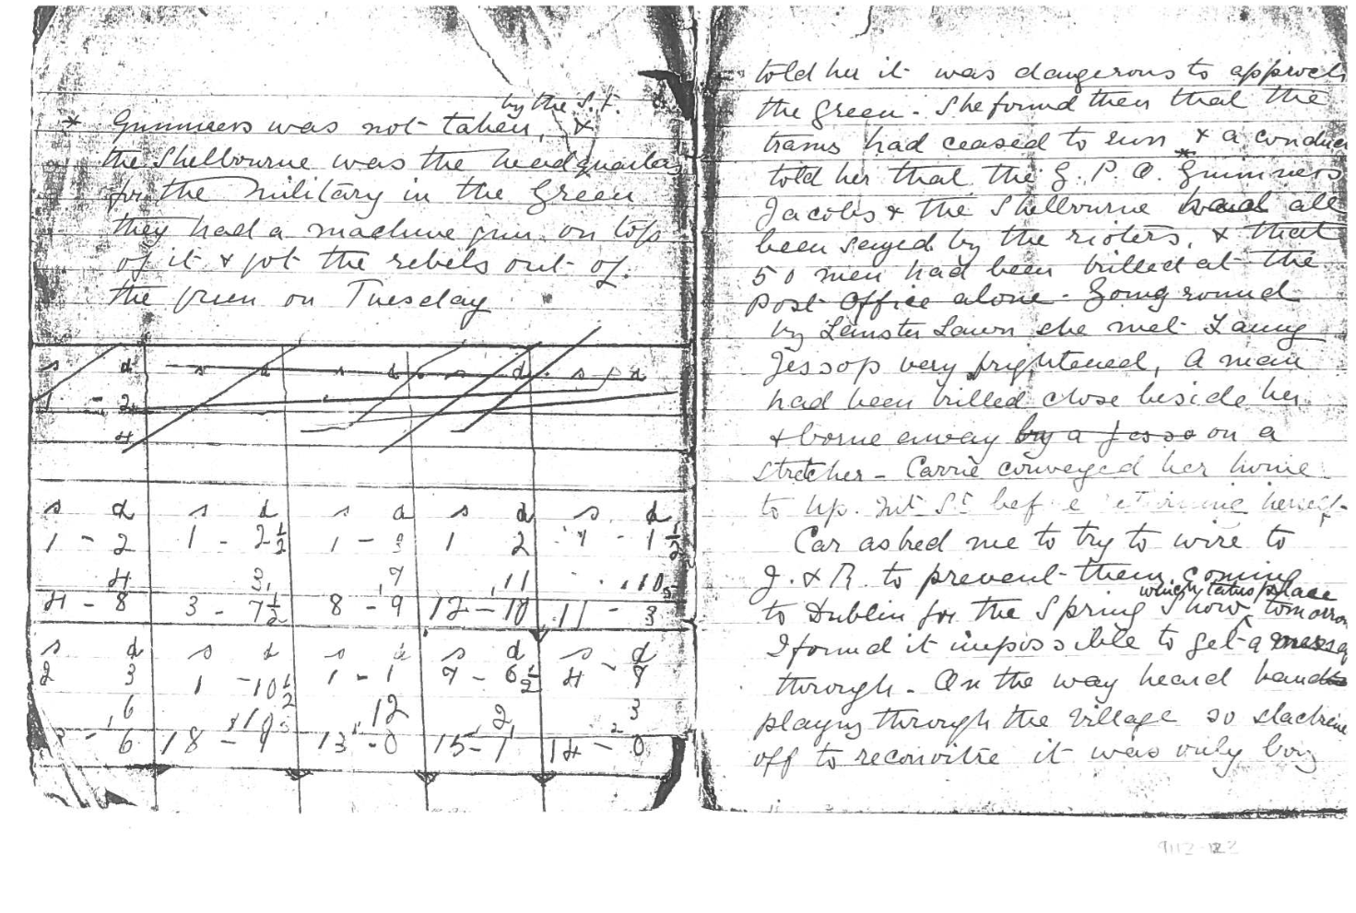
Notes:
Photocopy diary, 1916.
Kept by a 16 year old English nurse.
Associated with the Easter Rebellion, Ireland (1916-1922).
NAM. 1991-12-123-1
‘told her it was dangerous to approach the Green. She found then that the trams had ceased to run. A conductor told her that the GPO*, Guinness, Jacobs and the Shelbourne had all been seized by the rioters + that 50 men had been killed at the Post Office alone. Going round by Leinster Lawn she met Fanny Jessop very frightened. A man had been killed beside her + borne away on a stretcher. Carrie conveyed her home to Up. Mt. St before returning herself.
Car asked me to try to wire J + R to prevent their coming to Dublin for the Spring Show which takes place tomorrow. I found it impossible to get a message through. On the way heard bands playing through the village so […] off to reconoitre [sic] it was only boy [NEXT PAGE]
* Guinness was not taken by the S.F. The Shelbourne was the headquarters for the military in the Green, they had a machine gun on top of it and got the rebels out of the Green on Tuesday
’

Slide 15
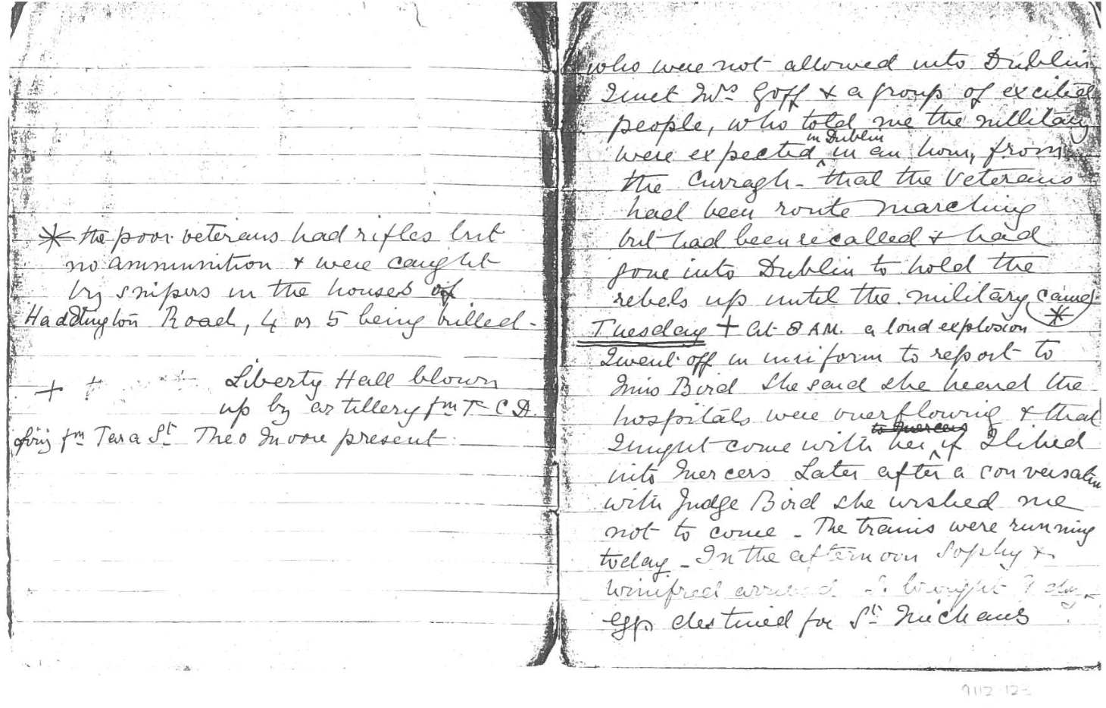
Notes:
Photocopy diary, 1916.
Kept by a 16 year old English nurse.
Associated with the Easter Rebellion, Ireland (1916-1922).
NAM. 1991-12-123-1
‘who were not allowed into Dublin. Met Mrs Goff and a group of excited people, who told me the military were expected in Dublin in an hour from the Curragh - that the veterans had been route marching but had been recalled + had gone into Dublin to hold the rebels up until the military came.
Tuesday+. At 8am a loud explosion*. I went off in uniform to report Miss Bird. She said she heard the hospitals were overflowing and that I might come with her if I liked into Mercers. Later after a conversation with Judge Bird she wished me not to come. The trains were running today. In the afternoon Sophy and Winifred arrived. I brought 9 doz eggs destined for St Michael’s
* The poor veterans had rifles but no ammunition + were caught by snipers in the houses of Haddington Road, 4 or 5 being killed.
+ Liberty Hall blown up by artillery from […CD] Firing from Tera(?) St. Theo Moore present. [NEXT PAGE]’

Slide 16
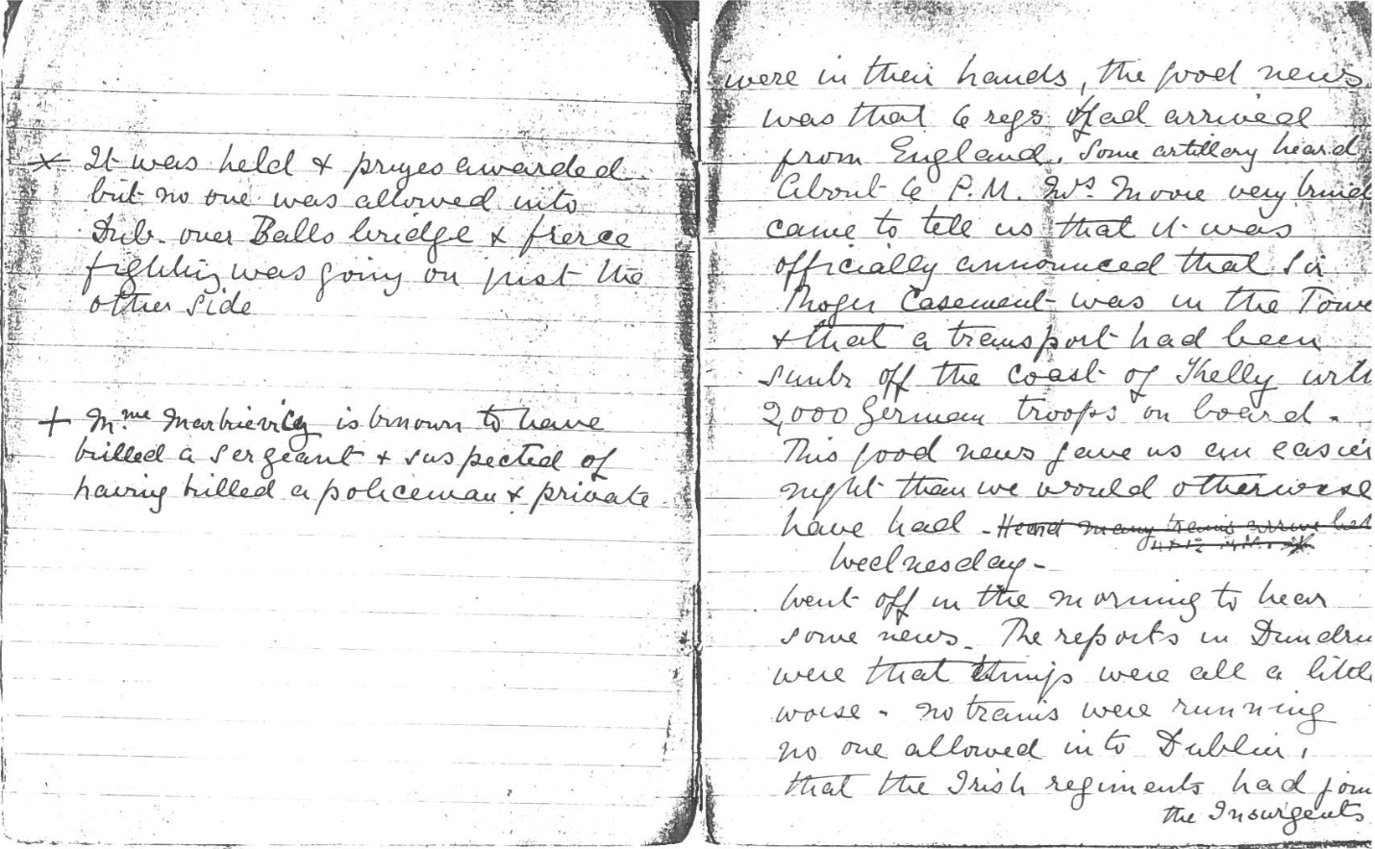
Notes:
Photocopy diary, 1916.
Kept by a 16 year old English nurse.
Associated with the Easter Rebellion, Ireland (1916-1922).
NAM. 1991-12-123-1
‘were in their hands, the good news was that 6 regs had arrived from England. Some artillery heard about 4 PM. Mrs Moore very briefly came to tell us that it was officially announced that Sir Roger Casement was in the town + that a transport had been sunk off the coast of [Kerry?] with 2000 German troops on board. This good news gave us an easier night than we would otherwise have had. It was held and prizes awarded but no one was allowed into Dub over Balls bridge and fierce fighting was going on just the other side.
Wednesday
Went off in the morning to hear some news. The reports in Dundrum were that things were all a little worse. No trains were running, no-one allowed into Dublin, that the Irish regiments had joined the Insurgents [NEXT PAGE]’

Slide 17
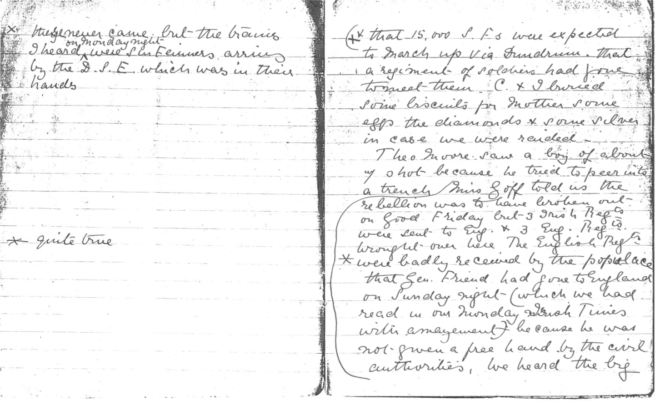
Notes:
Photocopy diary, 1916.
Kept by a 16 year old English nurse.
Associated with the Easter Rebellion, Ireland (1916-1922).
NAM. 1991-12-123-1
‘ + * that 15000 SFs were expected to march up via Dundrum, that a regiment of soldiers had gone to meet them. C and I buried some biscuits for Mother, some eggs, the diamonds + some silver in case we were raided.
Theo Moore saw a boy of about 7 shot because he tried to peer into a trench. Miss Goff told us the rebellion was to have broken out on Good Friday but 3 Irish Regts were sent to Eng + 3 Eng Regts brought over here. The English Regts** were badly received by the populace.. Gen Friend had gone to England on Sunday night (which we had read in our Monday Irish Times with amazement) because he was not given a free hand by the civil authorities. We heard the big [NEXT PAGE]
*these never came but the trains I heard on Monday night were Sinn Feiners arriving by the DSE which was in their hands.
**quite true’

Slide 18
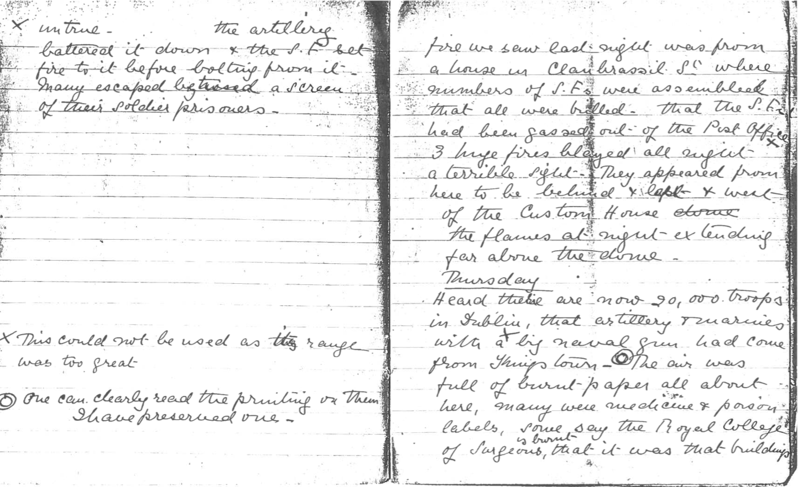
Notes:
Photocopy diary, 1916.
Kept by a 16 year old English nurse.
Associated with the Easter Rebellion, Ireland (1916-1922).
NAM. 1991-12-123-1
‘fire we saw last night was from a house in Clanbrassil St where numbers of SFs were assembled + that all were killed, That the SFs had been gassed out) of the Post Office*. 3 huge fires blazed all night a terrible sight. They appeared from here to be behind + east + west of the Custom House the flames at night extending far above the dome.
Thursday
Heard there are now 20000 troops in Dublin, that artillery + marines with a big naval gun had come from Kingstown**. The air was full of burnt paper all about here***, many were medicine + poison labels. Some say the Royal College of Surgeons is burnt, that it was that building [NEXT PAGE]
*untrue, the artillery battered it down + the S.F. t set fire to it before bolting from it. Many escaped behind a screen of their soldier prisoners.
** this could not be used as the range was too great
*** One can clearly read the printing on them. I have preserved one.’

Slide 19
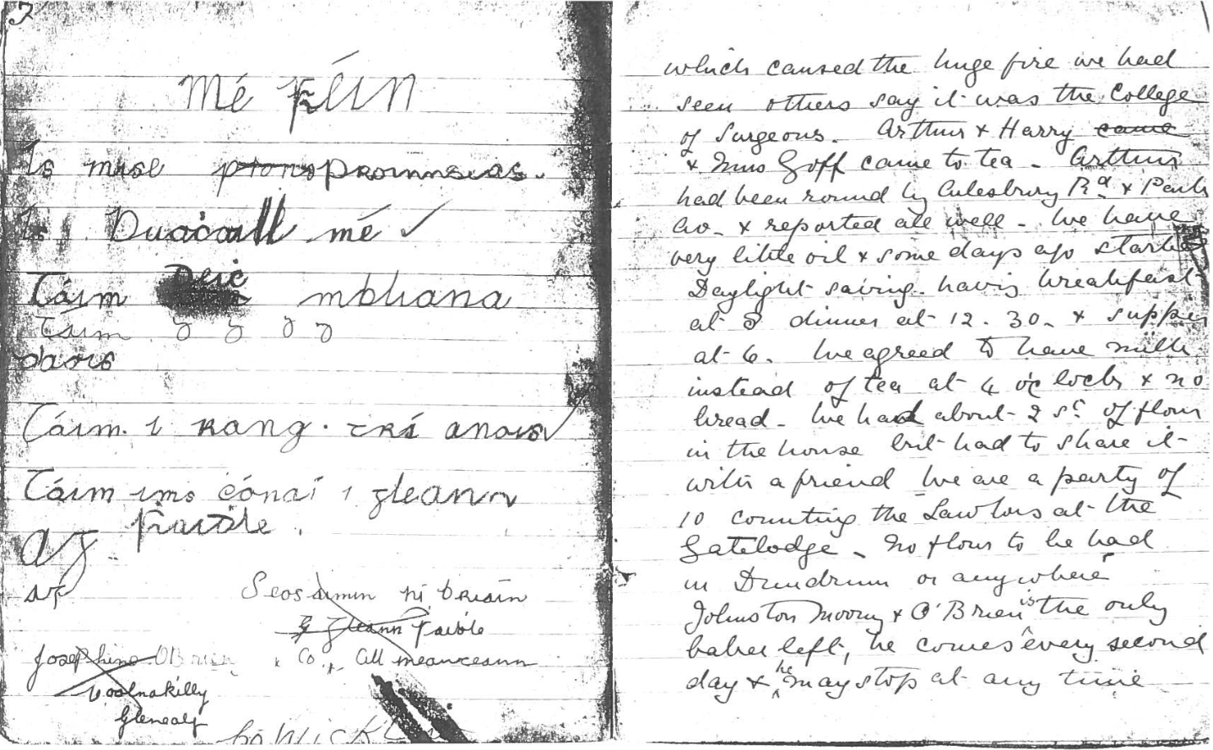
Notes:
Photocopy diary, 1916.
Kept by a 16 year old English nurse.
Associated with the Easter Rebellion, Ireland (1916-1922).
NAM. 1991-12-123-1
‘building which caused the huge fire we had seen. Others say it was the College of Surgeons. Arthur + Harry and Mrs Goff came to tea. Arthur had been round by [Ailsebury] Rd and Pauls Av and reported all well. We have very little oil + some days ago started Daylight Saving having breakfast at 8, dinner at 12.30 + supper at 6. We agreed to have milk instead of tea at 4 o’clock + no bread. We had about 2 [st?]of flour in the house but had to share it with a friend. We are a party of 10 counting the [Lawtons] at the Gatelodge. No flour to be had in Dundrum or anywhere. Johnston, Moony and O’Brien is the only baker left, he comes every second day + he may stop at any time.’

Slide 20
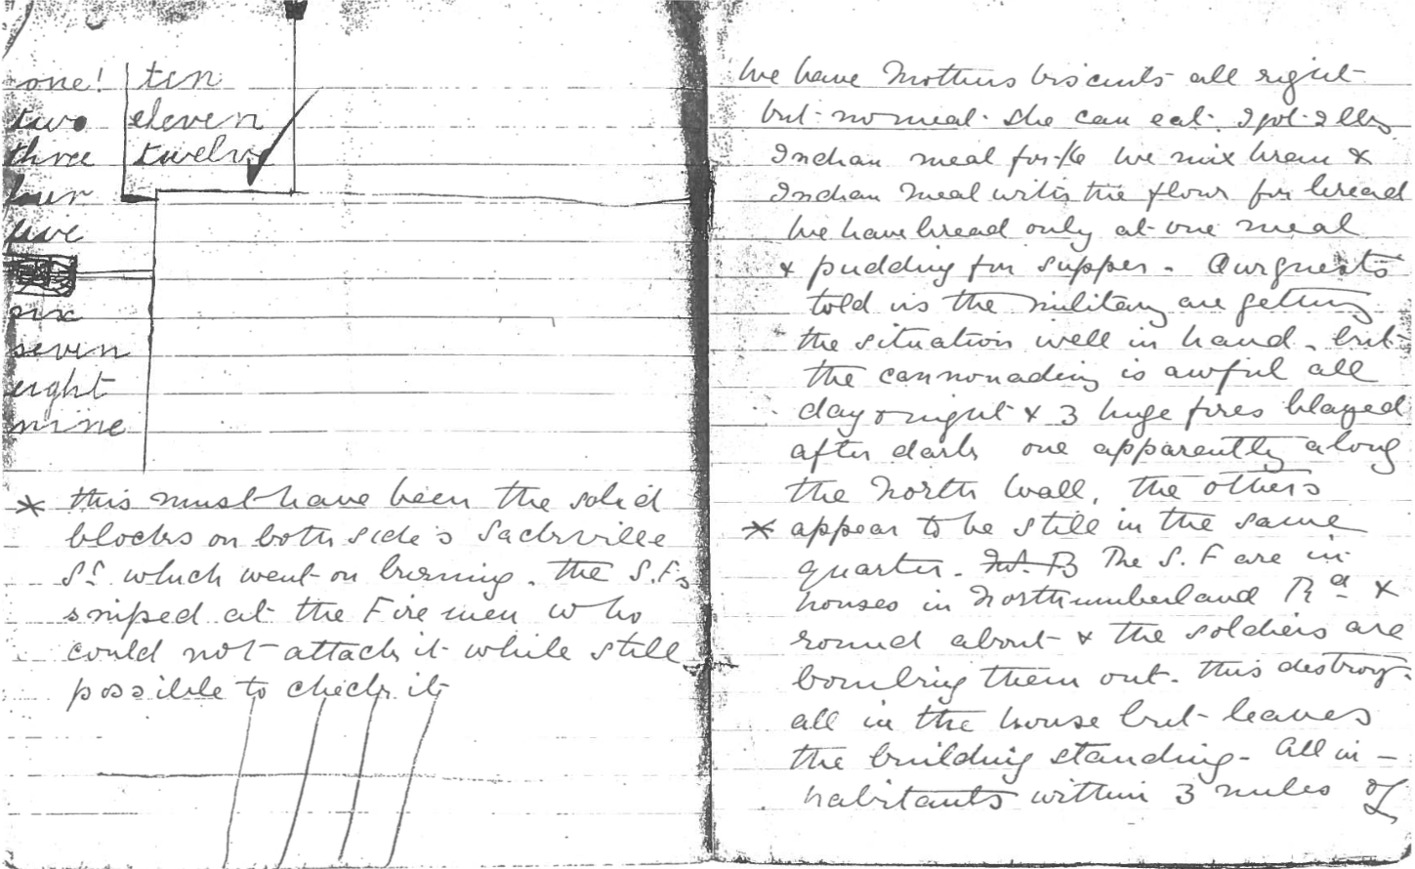
Notes:
Photocopy diary, 1916.
Kept by a 16 year old English nurse.
Associated with the Easter Rebellion, Ireland (1916-1922).
NAM. 1991-12-123-1
‘We have Mother’s biscuits all right but no meal. She can eat 1 pot 2 lbs Indian meal for the […] we mix […] + Indian meal with the flour for bread. We have bread only at one meal and pudding for supper. Our guests tell us that the military are getting the situation well in hand but the cannonading is awful all day and night + 3 huge fires blazed after dark one apparently along the North Wall. The others * appear to be still in the same quarter. The SF are in houses in Northumberland Rd + round about + the soldiers are bombing them out. This destroys all in the house but leaves the building standing. All inhabitants within 3 miles of […]
*This must have been the solid blocks on both sides of Sackville St which went on burning. The SFs sniped at the firemen who could not attack it while still possible to check it. [NEXT PAGE]’

Slide 21
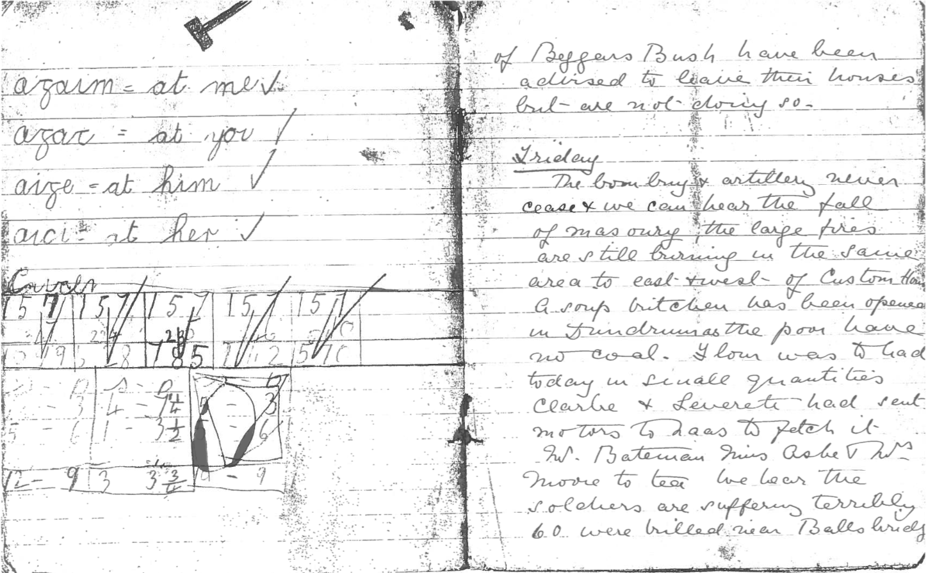
Notes:
Photocopy diary, 1916.
Kept by a 16 year old English nurse.
Associated with the Easter Rebellion, Ireland (1916-1922).
NAM. 1991-12-123-1
‘Beggars Bush have been advised to leave their houses but are not doing so.
Friday
The bombing+ artillery never cease + we can hear the fall of masonry. The large fires are still burning in the same area to east + west of Custom House. A soup kitchen has been opened in Dundrum as the poor have no coal. Flour was to be had today in small quantities. Clarke and Leverett had sent motors to [Naas?] to fetch it. W Bateman, Miss Aske + Mrs Moore to tea. We hear the soldiers are suffering terribly. 60 were killed near Balls bridge [NEXT PAGE]’

Slide 22
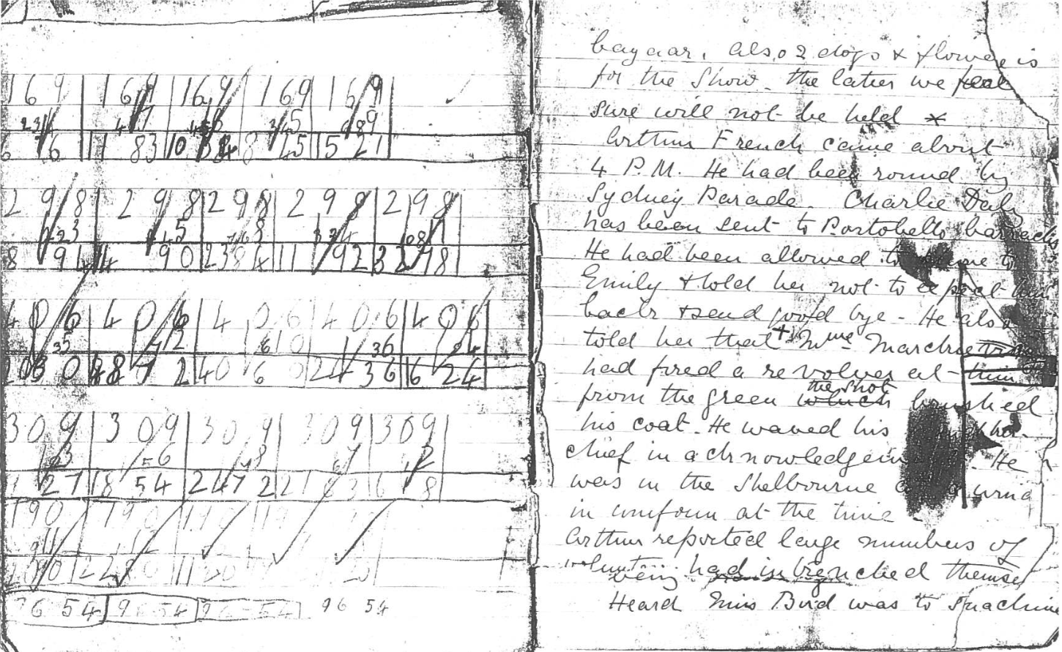
Notes:
Photocopy diary, 1916.
Kept by a 16 year old English nurse.
Associated with the Easter Rebellion, Ireland (1916-1922).
NAM. 1991-12-123-1
‘Bazaar. Also 2 dogs + flowers is for the show. The latter we feel sure will not be held.
Arthur French came about 4 PM. He had been round by Sydney Parade. Charlie Daly has been sent to Portobello barracks. He had been allowed to […] to Emily and told her not to expect them back + said goodbye. He also told her that Madame Markeivicz** had fired a revolver at them from the green. The shot brushed his coat. He waved his handkerchief in acknowledgment. He was in the Shelbourne and in uniform at the time. Arthur reported large numbers of insurgents had intrenched [sic] themselves […]
* It was held and prizes awarded but no one was allowed into Dub over Balls bridge and fierce fighting was going on just the other side.
*Mme Markievicz is known to have killed a sergeant and suspected of having killed a policeman and private. [NEXT PAGE]’

Slide 23
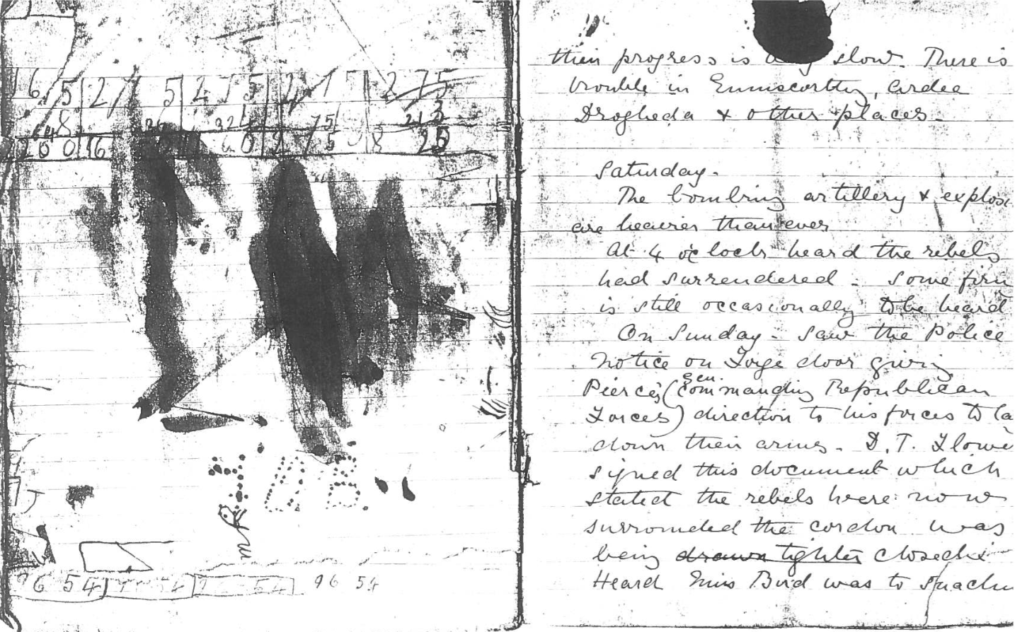
Notes:
Photocopy diary, 1916.
Kept by a 16 year old English nurse.
Associated with the Easter Rebellion, Ireland (1916-1922).
NAM. 1991-12-123-1
‘their progress is very slow. There is trouble in Enniscorthy, Ardee, Drogheda + other places.
Saturday
The bombing, artillery and explosions are heavier than ever.
At 4 o’clock heard the rebels had surrendered. Some firing is still occasionally to be heard. On Sunday saw the police notice on […] door giving Pierce’s [Gen Commanding Republican Forces] direction to his forces to lay down their arms. D.T. […] signed this document which stated the rebels were now surrounded the cordon was being drawn tighter closed.
Heard Miss Bird [Lady Superintendent Charlotte Bird (?) joined the Dundrum (Dublin) Nursing Division, St. John Ambulance Brigade, in 1914. During the 1916 Easter Rising she was Commandant of the emergency auxiliary hospital which was set up by the St. John Ambulance Brigade at the High School in Harcourt Street, Dublin, to care for the wounded during the rebellion] was to [NEXT PAGE]’

Slide 24
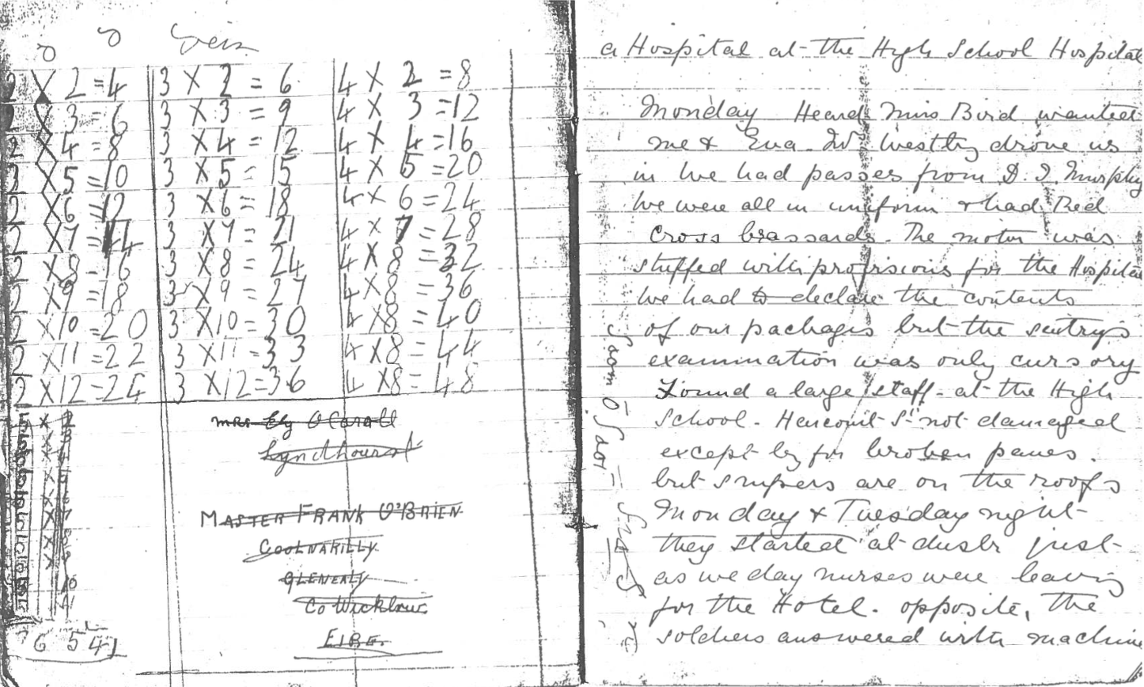
Notes:
Photocopy diary, 1916.
Kept by a 16 year old English nurse.
Associated with the Easter Rebellion, Ireland (1916-1922).
NAM. 1991-12-123-1
‘a Hospital at the High School Hospital.
Monday.
Heard Miss Bird wanted me and Eva. Mrs Westby drove us in we had passes from D.I Murphy. We were all in uniform + had Red Cross brassards. The motor was stuffed with provisions for the Hospital. We had to declare the content of our packages, but the sentry’s examination was only cursory. Found a large staff at the High School. Harcourt St not damaged except for broken panes but snipers are on the roofs Monday and Tuesday night. They started at dusk just as we nurses were leaving for the hotel. Opposite the soldiers answered with machine [NEXT PAGE]’

Slide 25
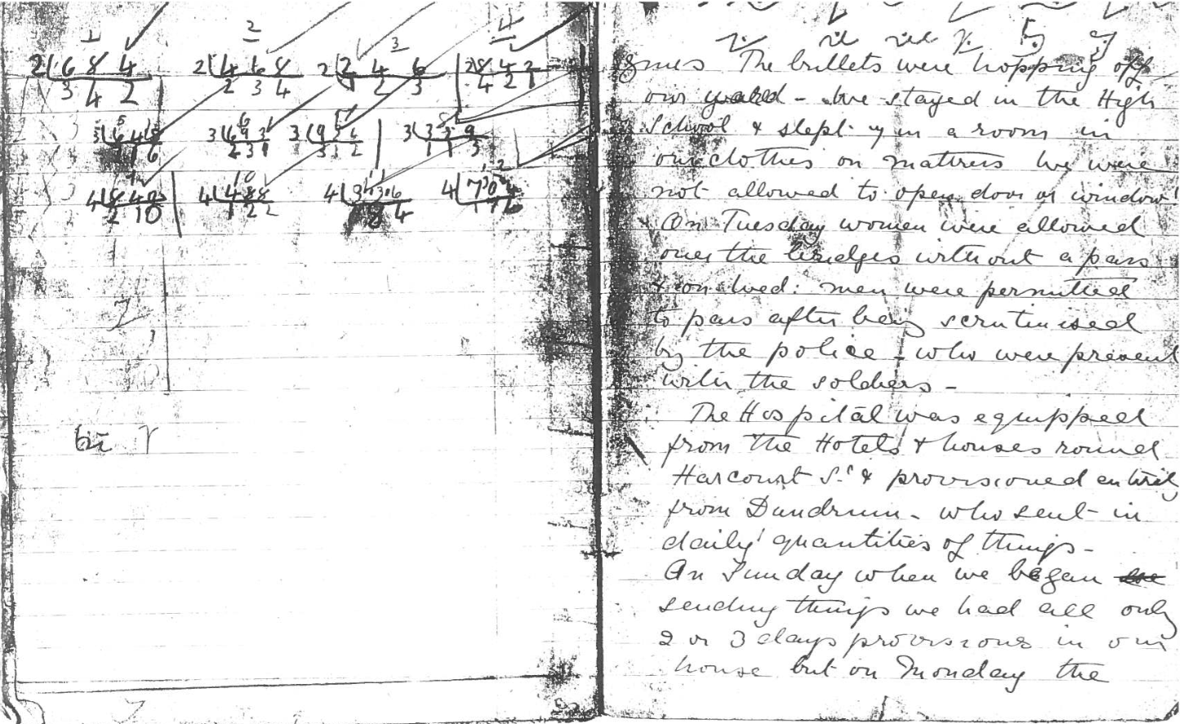
Notes:
Photocopy diary, 1916.
Kept by a 16 year old English nurse.
Associated with the Easter Rebellion, Ireland (1916-1922).
NAM. 1991-12-123-1
‘guns. The bullets were hopping off our yard. We stayed in the High School + slept up in a room in our clothes on mattresses. We were not allowed to open doors or windows. On Tuesday women were allowed over the bridges without a pass + on Wed men were permitted to pass after being scrutinised by the police who were present with the soldiers.
The Hospital was equipped from the Hotels and houses round Harcourt St and provisioned entirely from Dundrum who sent in daily quantities of things.
On Sunday when we began sending things we had all only 2 or 3 days provisions in our house but on Monday the [NEXT PAGE]’

Slide 26
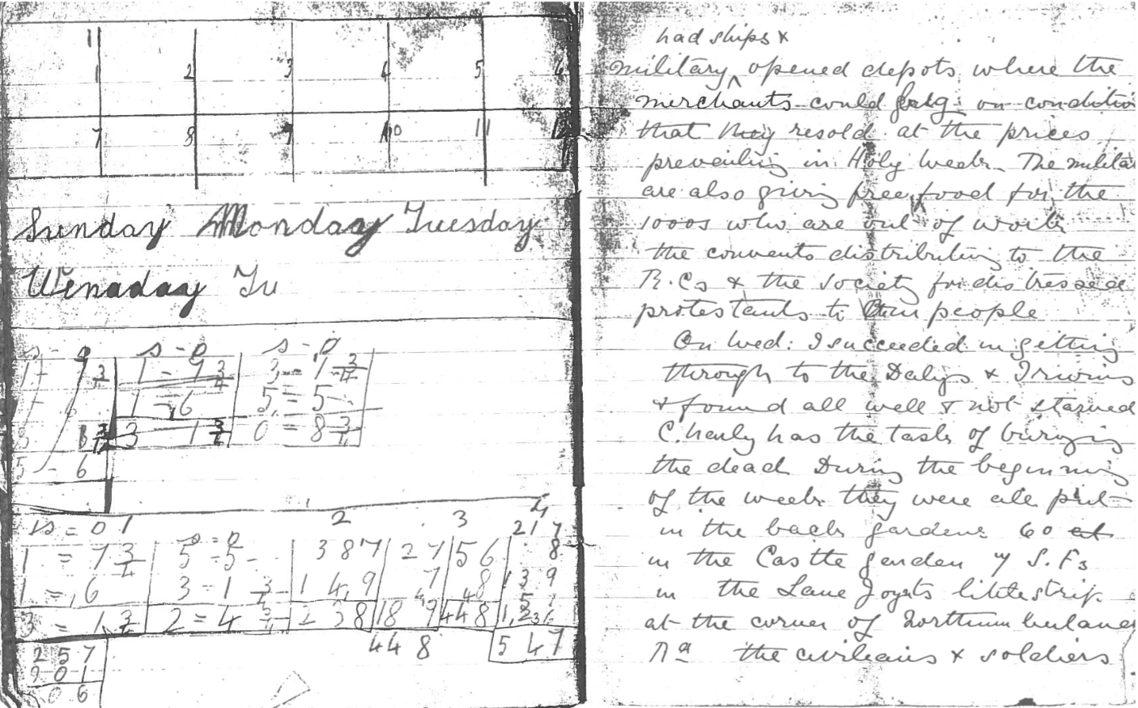
Notes:
Photocopy diary, 1916.
Kept by a 16 year old English nurse.
Associated with the Easter Rebellion, Ireland (1916-1922).
NAM. 1991-12-123-1
‘military opened depots where the merchants could […] on condition that they resold at the prices prevailing in Holy Week. The military are also giving free food for the 1000s who are out of work. The convents distributing to the RCs and the Society for Distressed Protestants to their people.
On Wed I succeeded in getting through to the Dalys + [Irwins?] + found all well + not starved. Charly has the task of burying the dead. During the beginning of the week they were all put in the back gardens, 60 in the Castle garden, with SFs in the Lane, Loyalists little strip at the corner of […] the civilians and soldiers.’

Slide 27
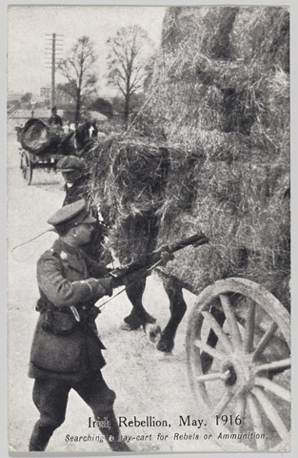
Notes:
Irish Rebellion, May 1916.
Postcard photograph of a British officer searching a hay cart for rebels or ammunition with a rifle and bayonet, May 1916.
Associated with Easter Rebellion, Ireland (1916-1922).
NAM. 1980-01-43-1

Slide 28
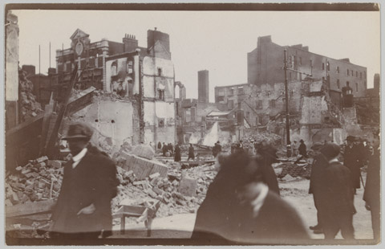
Notes:
One of two prints of a photograph, showing destruction following the Easter Rising in Dublin, 1916.
Possibly in Sackville Street.
Associated with Ireland, Easter Rebellion (1916-1922), 1916.
NAM. 1961-12-594-3

Slide 29
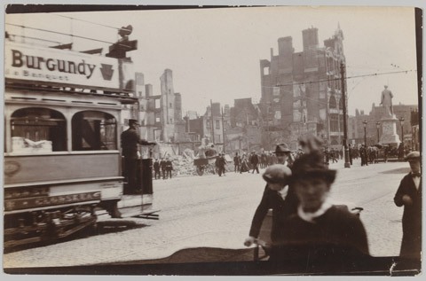
Notes:
One of two prints of a photograph, showing destruction following the Easter Rising in Dublin, 1916.
Possibly in Sackville Street.
Associated with Ireland, Easter Rebellion (1916-1922), 1916.
NAM. 1961-12-594-6

Slide 30
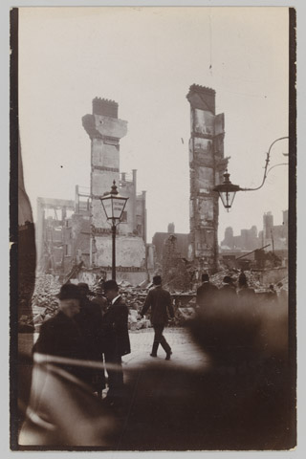
Notes:
One of two prints of a photograph, showing destruction following the Easter Rising in Dublin, 1916.
Possibly in Sackville Street.
Associated with Ireland, Easter Rebellion (1916-1922), 1916.
NAM. 1961-12-594-8

Slide 31
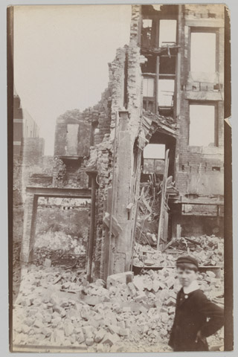
Notes:
One of two prints of a photograph, showing destruction following the Easter Rising in Dublin, 1916.
Possibly in Sackville Street.
Associated with Ireland, Easter Rebellion (1916-1922), 1916.
NAM. 1961-12-594-9

Slide 32
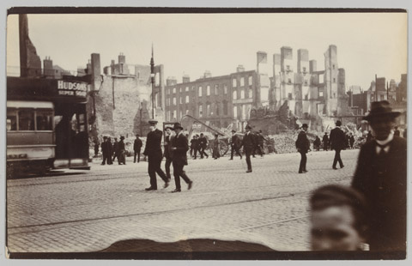
Notes:
One of two prints of a photograph, showing destruction following the Easter Rising in Dublin, 1916.
Possibly in Sackville Street.
Associated with Ireland, Easter Rebellion (1916-1922), 1916.
NAM. 1961-12-594-11

Slide 33
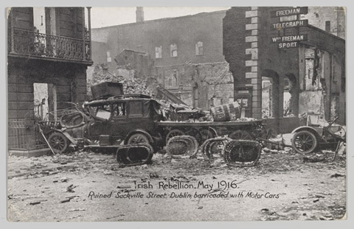
Notes:
Irish Rebellion, May 1916. Ruined Sackville Street, Dublin, barricaded with motor cars.
Commercial postcard by Eason and Sons for the Daily Sketch, nd.
Associated with Ireland, Easter Rebellion (1916-1922), 1916.
NAM. 1961-12-594-13

Slide 34
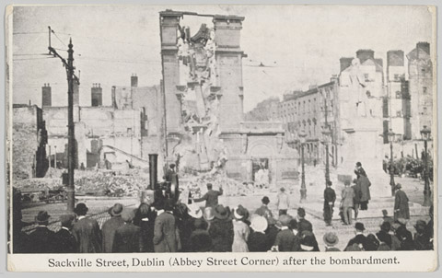
Notes:
Sackville Street, Dublin, (Abbey Street Corner) after the bombardment.
Commercial postcard by Eason and Sons for the Daily Sketch, nd.
Associated with Ireland, Easter Rebellion (1916-1922), 1916.
NAM. 1961-12-594-14

Slide 35
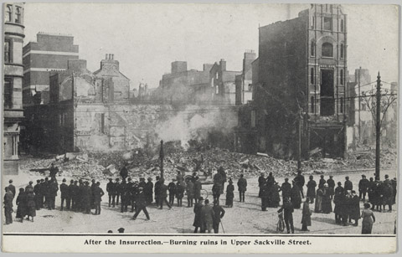
Notes:
After the Insurrection - Burning ruins in Upper Sackville Street.
Commercial postcard by Hely’s Limited, nd.
Associated with Ireland, Easter Rebellion (1916-1922), 1916.
NAM. 1961-12-594-16

Slide 36
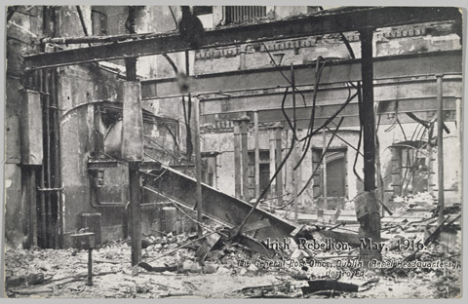
Notes:
Irish Rebellion, May 1916. The General Post Office, Dublin, (Rebel Headquarters) destroyed.
Commercial postcard by Daily Sketch, nd.
Associated with Ireland, Easter Rebellion (1916-1922), 1916.
1961-12-594-17

Slide 37
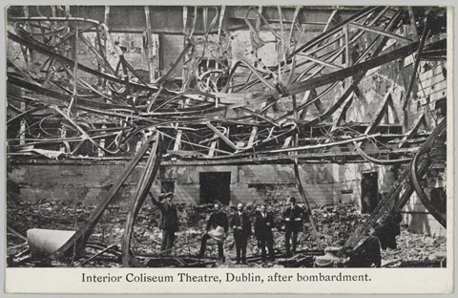
Notes:
Interior Coliseum Theatre, Dublin, after bombardment.
Commercial postcard by Coleman’s, Dublin, nd.
Associated with Ireland, Easter Rebellion (1916-1922), 1916.
NAM. 1961-12-594-18

Slide 38
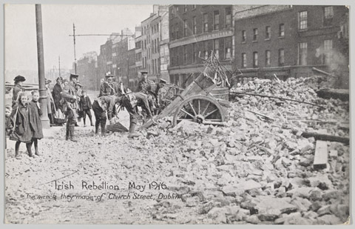
Notes:
Irish Rebellion, May 1916. The wreck they made of Church Street, Dublin.
Commercial postcard by Eason and Sons for the Daily Sketch, nd.
Associated with Ireland, Easter Rebellion (1916-1922), 1916.
1961-12-594-19

Slide 39
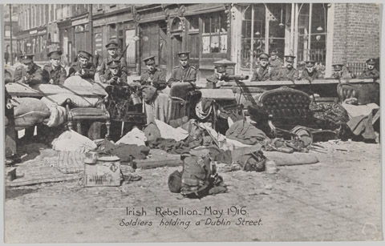
Notes:
Irish Rebellion, May 1916. Soldiers holding a Dublin Street.
Commercial postcard by Eason and Sons for the Daily Sketch, nd.
Associated with Ireland, Easter Rebellion (1916-1922), 1916.
NAM. 1961-12-594-20

Slide 40
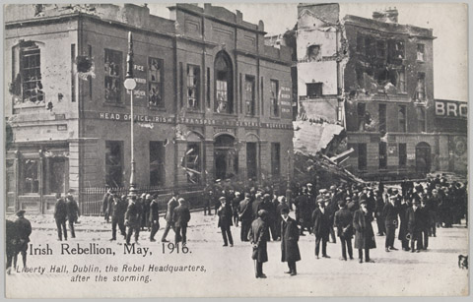
Notes:
Irish Rebellion, May 1916. Liberty Hall, Dublin, the Rebel Headquarters after the storming.
Commercial postcard by the Daily Sketch, nd.
Associated with Ireland, Easter Rebellion (1916-1922), 1916.
1961-12-594-21

Slide 41
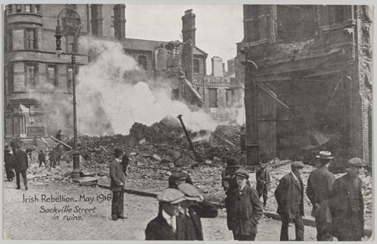
Notes:
Irish Rebellion, May 1916. Sackville Street in ruins.
Commercial postcard by Eason and Sons for the Daily Sketch, nd.
Associated with Ireland, Easter Rebellion (1916-1922), 1916
NAM. 1961-12-594-22

Slide 42
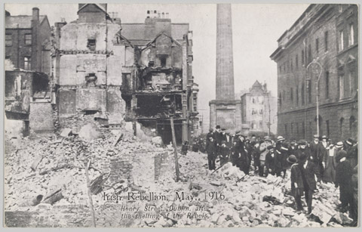
Notes:
Irish Rebellion, May 1916. Henry Street, Dublin, after the shelling of the Rebels.
Commercial postcard by the Daily Sketch, nd.
Associated with Ireland, Easter Rebellion (1916-1922), 1916.
1961-12-594-23

Slide 43
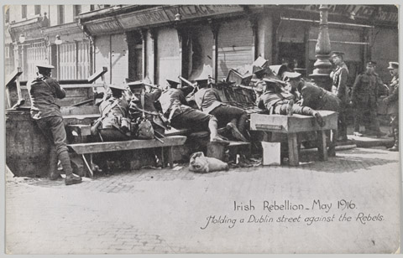
Notes:
Irish Rebellion, May 1916. Holding a Dublin Street against the Rebels.
Commercial postcard by Eason and Sons for the Daily Sketch, nd.
Associated with Ireland, Easter Rebellion (1916-1922), 1916.
NAM. 1961-12-594-24

Slide 44
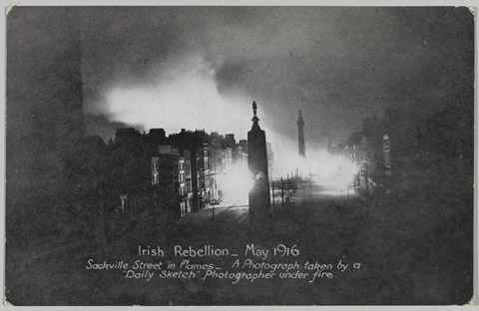
Notes:
Irish Rebellion, May 1916. Sackville Street in flames - a photograph taken by a Daily Sketch photographer under fire.
Commercial postcard by Eason and Sons for the Daily Sketch, nd.
Associated with Ireland, Easter Rebellion (1916-1922), 1916.
NAM. 1961-12-594-25

Slide 45
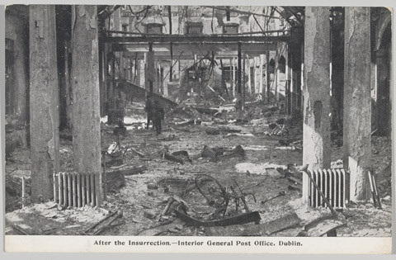
Notes:
After the Insurrection - Interior of the General Post Office, Dublin.
Commercial postcard by Hely’s, Dublin, nd.
Associated with Ireland, Easter Rebellion (1916-1922), 1916.
NAM. 1961-12-594-26

Slide 46
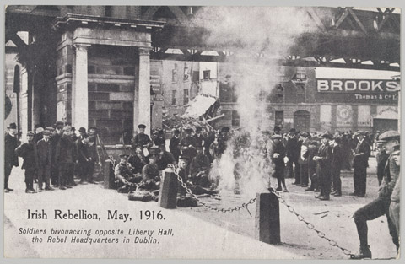
Notes:
Irish Rebellion, May 1916. Soldiers bivouacking opposite Liberty Hall, the Rebel Headquarters in Dublin.
Commercial postcard by the Daily Sketch, nd.
Associated with Ireland, Easter Rebellion (1916-1922), 1916.
NAM. 1961-12-594-27

Slide 47
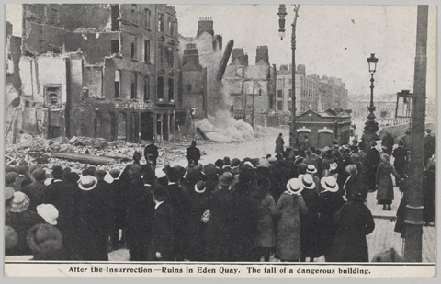
Notes:
After the Insurrection - Ruins in Eden Quay. The fall of dangerous building.
Commercial postcard by Hely’s, Dublin, nd.
Associated with Ireland, Easter Rebellion (1916-1922), 1916.
NAM. 1961-12-594-28

Slide 48
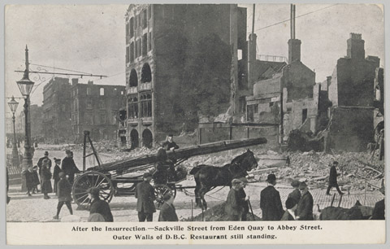
Notes:
After the Insurrection - Sackville Street from Eden Quay to abbey Street, Outer Walls of D.B.C. Restaurant still standing.
Commercial postcard by Hely’s, Dublin nd.
Associated with Ireland, Easter Rebellion (1916-1922), 1916.
NAM. 1961-12-594-29

Slide 49
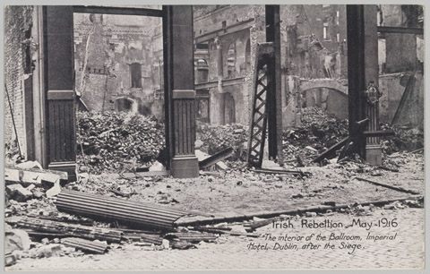
Notes:
Irish Rebellion, May 1916. The interior of the Ballroom, Imperial Hotel, Dublin, after the Siege.
Commercial postcard by the Daily Sketch, nd.
Associated with Ireland, Easter Rebellion (1916-1922), 1916.
NAM. 1961-12-594-30

Slide 50
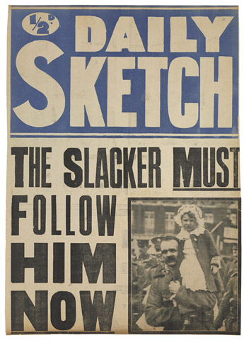
Notes:
Daily Sketch, The Slacker MUST Follow Him NOW.
Printed news-stand poster, with photographic insert of soldier holding a child, 1916 (c).
Associated with World War One (1914-1918).
NAM. 2014-07-37-1

Slide 51
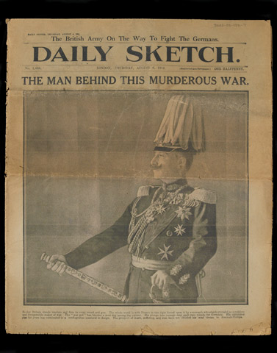
Notes:
Daily Sketch, 6 Aug 1914.
From papers collected by Capt Douglas M Grant, 1914-1965.
NAM. 2002-02-1371-7

Slide 52
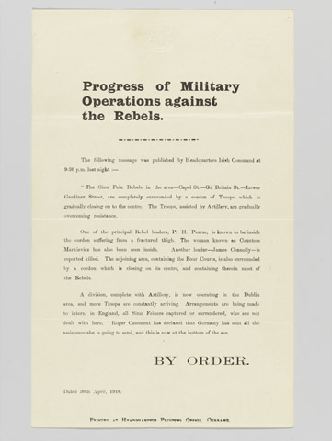
Notes:
Progress of Military Operations against the Rebels.
Printed broadsheet, 30 Apr 1916.
Carrying details of the military cordon surrounding the rebels.
One of three printed broadsheets published on 30 Apr 1916 by British Headquarters Irish Command during the Easter Rising.
Associated with Easter Rebellion, Ireland (1916-1922), 1916.
NAM. 1977-10-50-1

Slide 53

Notes:
Printed broadsheet, 30 Apr 1916.
Announces the surrender of James Connolly.
One of three printed broadsheets published on 30 Apr 1916 by British Headquarters Irish Command during the Easter Rising.
Associated with Easter Rebellion, Ireland (1916-1922), 1916.
NAM. 1977-10-50-2

Slide 54

Notes:
Unconditional Surrender of the Rebel Forces.
Printed broadsheet, 30 Apr 1916.
Details the unconditional surrender order of the Provisional Government signed by Patrick Henry Pearse.
One of three printed broadsheets published on 30 Apr 1916 by British Headquarters Irish Command during the Easter Rising.
Associated with Easter Rebellion, Ireland (1916-1922), 1916.
NAM. 1977-10-50-3

Slide 55

Notes:
The Sinn Fein Revolt in Dublin. the First and Only copy of “The Irish War News” issued by the Sinn Feiners.
One of two prints of a photographic postcard, 1916.
Associated with Ireland, Easter Rebellion (1916-1922), 1916.
NAM. 1961-12-594-1

Slide 56

Notes:
Lantern slide of Belgian, Indian, English and Scottish soldiers walking through a town, 1915 (c).
Produced by the Graphic, 1915 (c).
Associated with World War One, Western Front (1914-1918).
From a group of 31 lantern slides relating to the Indian Army, 1897-1915 (c).
NAM. 1957-09-18-21

Slide 57

Notes:
‘Advance of German Infantry’.
Lantern slide from a box of 73 lantern slides, one of two boxes associated with World War One, Western Front, 1914-1916.
Published by permission of the Illustrated London News, by H C Newton and R S Wright, 3 Fleet Street, London.
Large formation of German infantry advancing across open ground.
One of 29 boxes of lantern slides.
Associated with World War One, Western Front (1914-1918).
NAM. 1978-11-157-24-38

Slide 58

Notes:
A German prisoner is escorted in by Grenadier Guardsmen near Ginchy, 25 September 1916.
Lantern slide from a box of 72 lantern slides, one of two boxes associated with World War One, Western Front, 1914-1916.
One of 29 boxes of lantern slides.
Associated with World War One, Western Front (1914-1918).
NAM. 1978-11-157-25-4

Slide 59

Notes:
Lantern slide from a box of 72 lantern slides, one of two boxes associated with World War One, Western Front, 1914-1916.
One of 29 boxes of lantern slides.
Associated with World War One, Western Front (1914-1918).
NAM. 1978-11-157-25-41

Slide 60

Notes:
Celtic plaid brooch taken from the body of a rebel by Lt M S Payne, Lincolnshire Regiment, during the 1916 Easter Rising in Dublin, 1906-1907.
Silver, in circular form with a large pin, maker unknown, hallmarked Birmingham 1906-1907.
NAM. 1992-11-25

