Slide 1


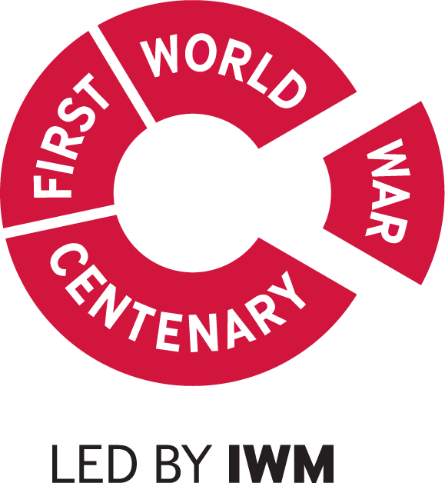
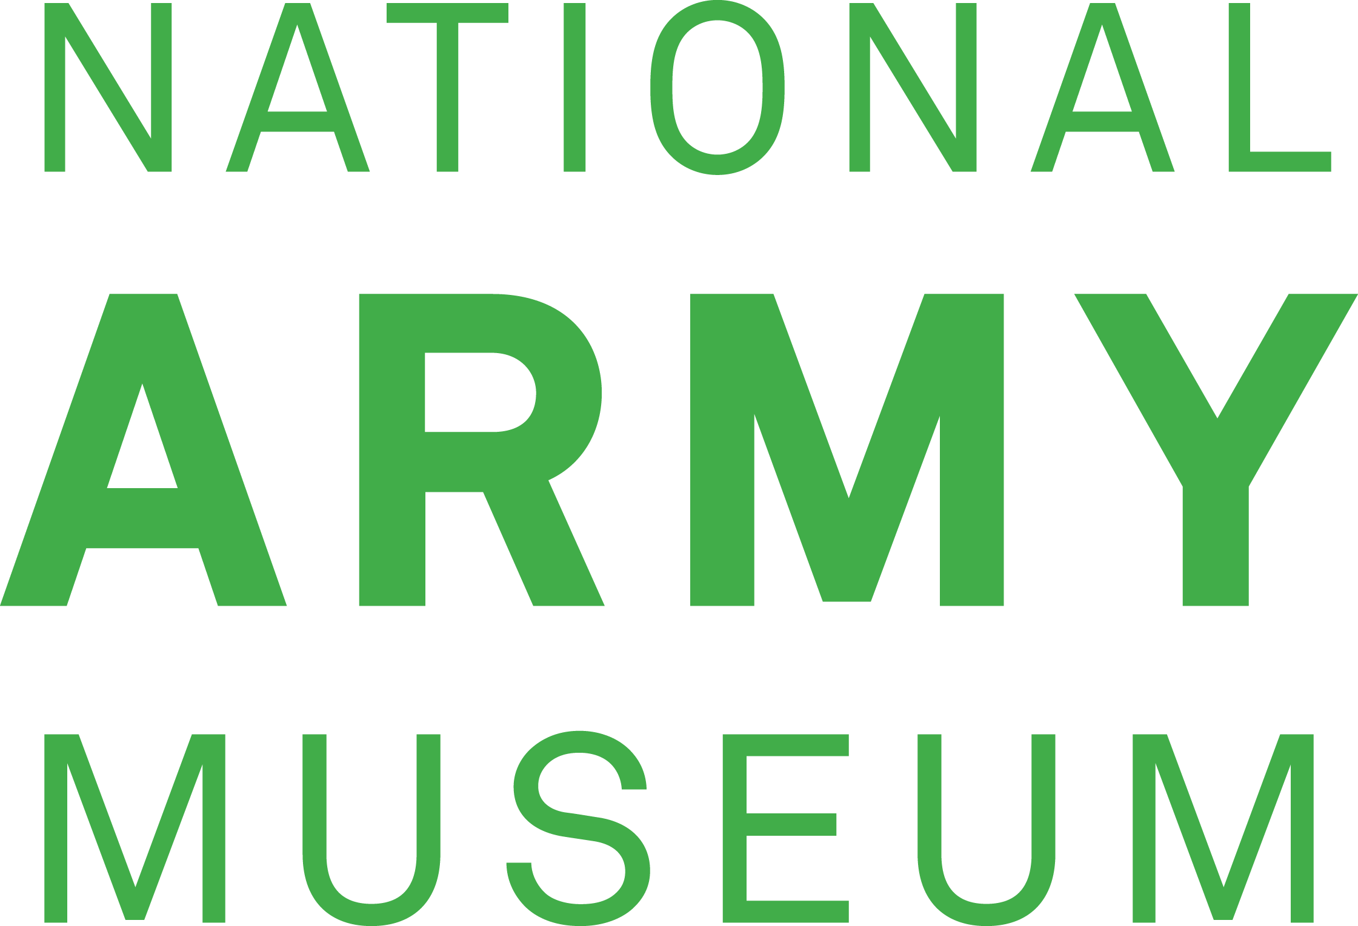
East Africa
Notes:
This resource gives captioning information for the images used in the accompanying film.

Slide 2
This PowerPoint presentation contains a selection of images from the NAM’s photographic collection. The images are designed to be used in conjunction with the associated video and teachers’ notes.
Unless otherwise stated in the notes, the images can be freely used for non-commercial purposes within the classroom. You can use the entire presentation or choose individual images for use in other non-commercial contexts. When using individual images in other contexts, please always retain the attribution statements provided in this document (e.g. NAM. 2005-08-66-1).
By downloading this document and using these images you agree to these terms of use, including your use of the attribution statement specified for each object by NAM.

Slide 3
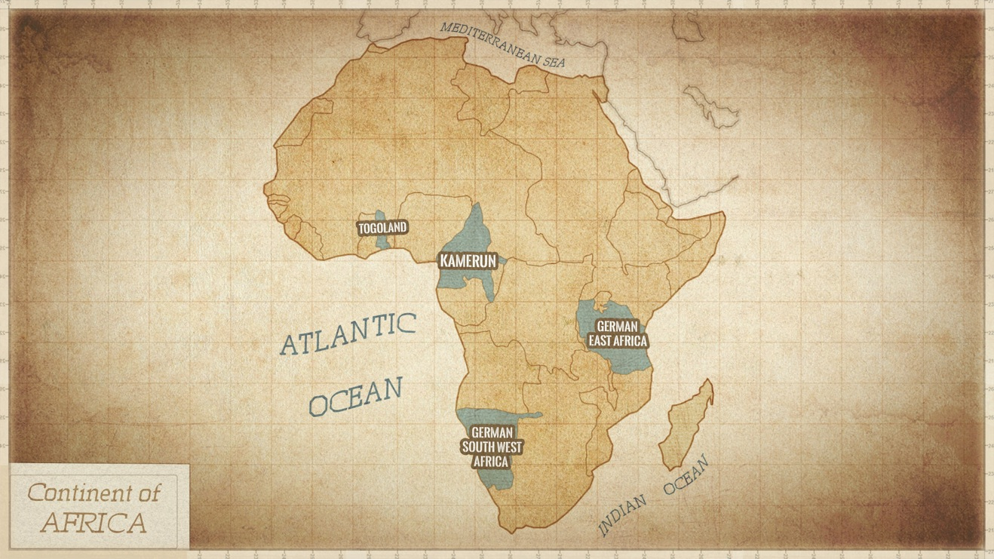

Slide 4
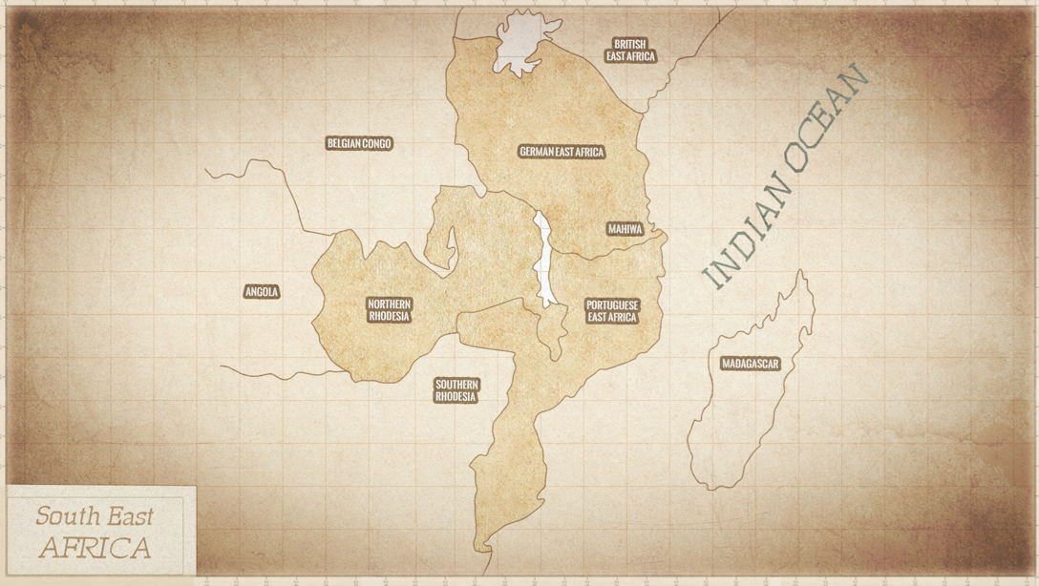

Slide 5
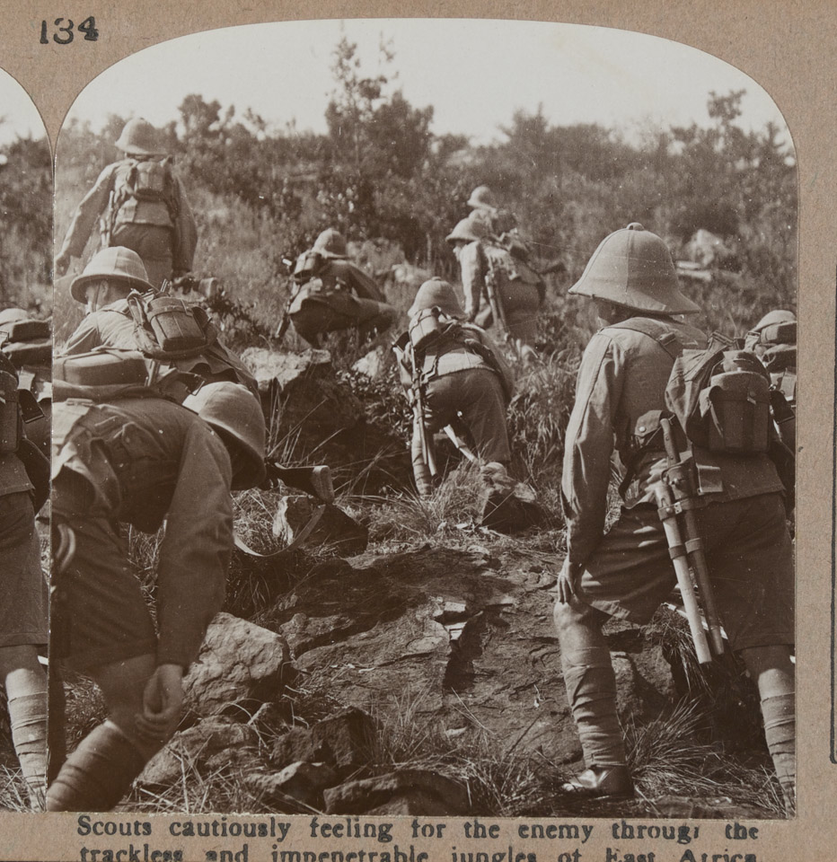
Notes:
Scouts cautiously feeling for the enemy through the trackless and impenetrable jungles of East Africa
NAM. 1972-08-67-2-134
On the outbreak of war in 1914, Colonel Paul von Lettow-Vorbeck was the commander of a small army in German East Africa (Tanzania, Burundi and Rwanda). He was determined to tie down as many Allied troops as he could in the region to prevent them from being deployed elsewhere. During a four-year guerrilla campaign he ran rings around his enemies. With an army that never numbered more than 14,000 men, comprising about 3,000 Germans and 11,000 Askaris (African soldiers), he succeeded in occupying ten times that number of Allied troops.
Many soldiers in East Africa suffered from tropical diseases. One unit, the 9th South African Infantry, began the campaign with 1,135 men in February 1916, but by October was down to 116, having hardly engaged the enemy. For every man the Allies lost in battle, a further 30 were lost through sickness.

Slide 6
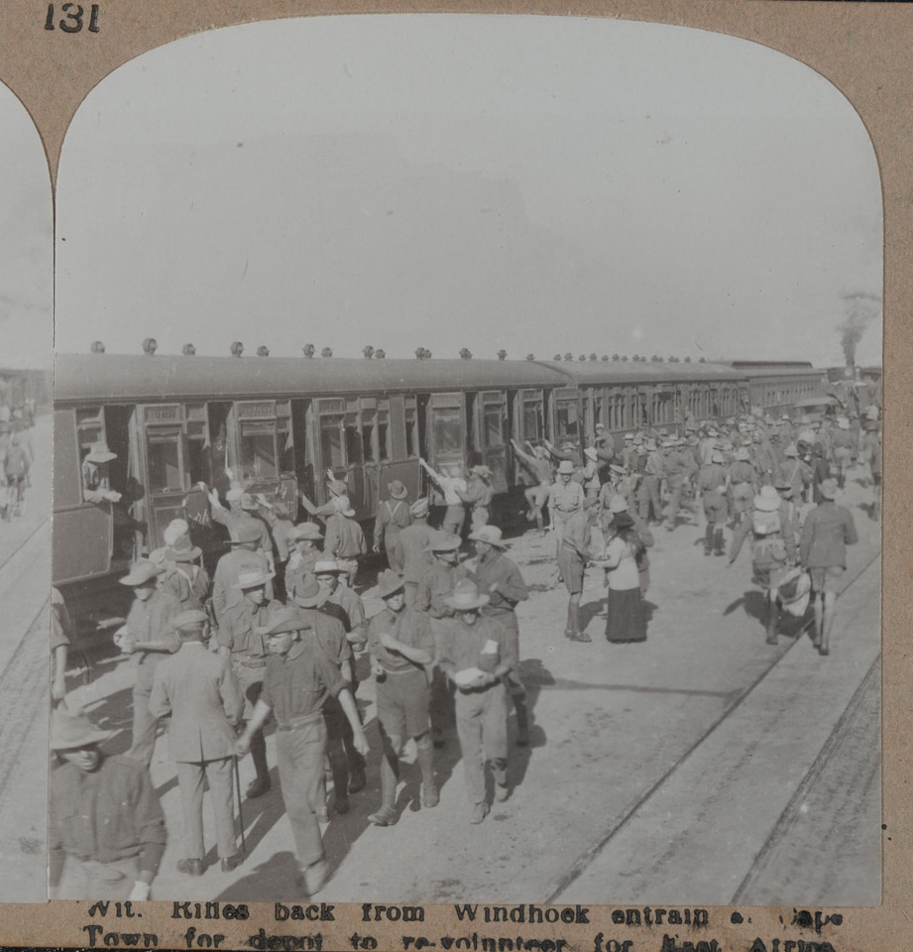
Notes:
Wit. Rifles back from Windhoek entrain at Cape Town for depot to re-volunteer for East Africa
NAM. 1972-08-67-2-131
South African troops, including the 1st Mounted Rifles (1st Natal Carbineers) shown here, had been mobilised along the border of German South-West Africa (Namibia) in August 1914 and the port of Lüderitz had been occupied, but the Boer Revolt delayed further operations apart from skirmishes along the frontier. In March 1915, over 60,000 South Africans, moving in four columns, finally began the occupation of German territory.
From the earliest days of their introduction railways have been regarded as offering the most efficient means for meeting the special needs of military transport in time of war. In becoming a new arm in modern warfare, they have helped to alter its scope and character, but their military efficiency depended very much on their organisation in times of peace.

Slide 7
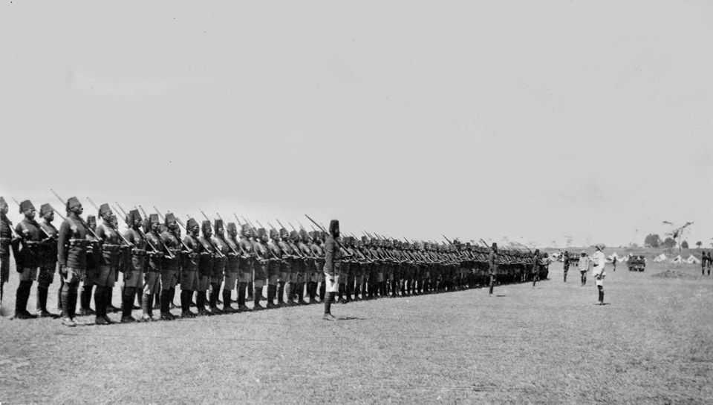
Notes:
Parade of the 2nd Battalion King’s African Rifles, 1914
NAM. 1990-08-141-7
The King's African Rifles (KAR) was a multi-battalion British colonial regiment raised from Britain’s various possessions in British East Africa in the present-day African Great Lakes region. This photo shows the 2nd (Nyasaland) Battalion which fought in German East Africa alongside many other battalions of the King’s African Rifles. During the war the 22 battalions of the regiment suffered 5,117 men killed and wounded with another 3,039 dying from diseases.
All the troops appear in uniform including a fez, long sleeve tunic, cummerbund, and lower leg protection. They all carry rifles with bayonets fixed.

Slide 8
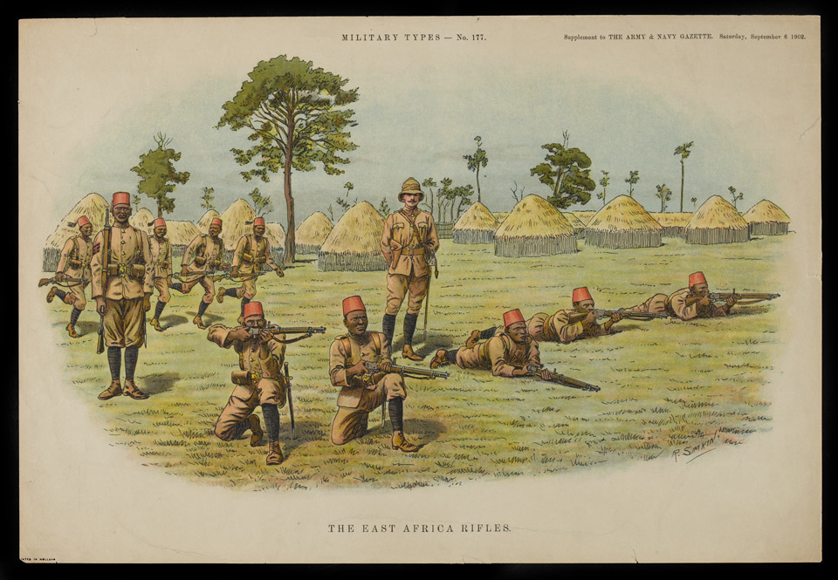
Notes:
The East Africa Rifles, published as a supplement by the Army and Navy Gazette, 6 Sep 1902
NAM. 1965-03-44-37-1
The East African Rifles were raised in 1895 at Mombasa, Kenya, from irregular troops of the British East Africa Company. On 1 Jan 1902 they were united with the Central Africa Regiment and Uganda Rifles to form The King’s African Rifles. The East Africans were designated as the 3rd Battalion.
Colourful images like this would be used to share information about the diversity of troops in the British Army, through magazines and periodicals. This is number 177 in the set of images. The central standing figure is the officer, of white British origin, and the standing figure to the left wears the chevrons of a sergeant, a non-commissioned officer. The background shows the typical accommodation occupied by the population of the area.

Slide 9
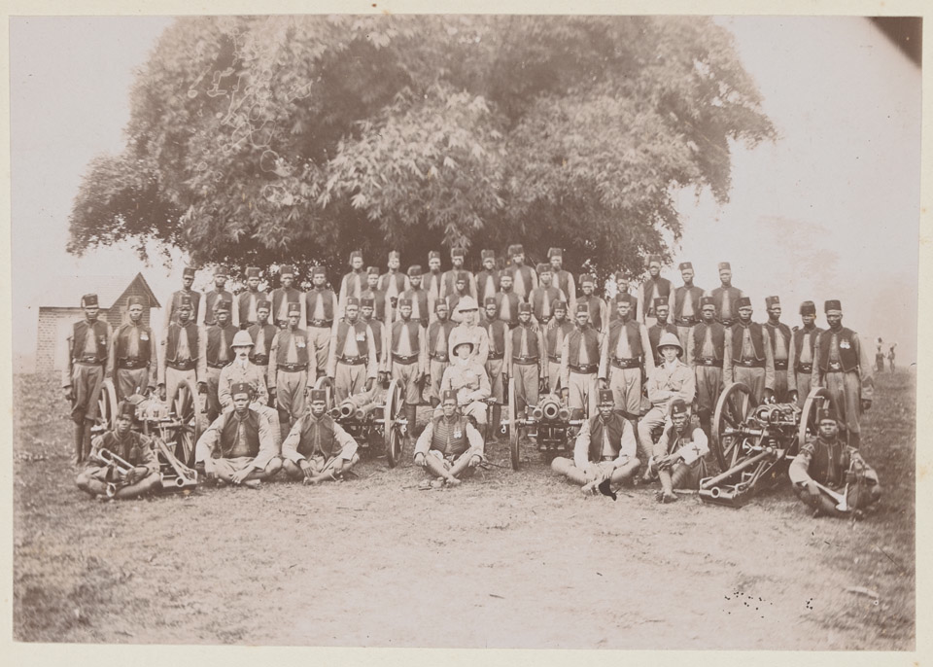
Notes:
Group photograph of the Gold Coast Regiment Battery
NAM. 1978-07-8-4
The Gold Coast Regiment, part of the West African Frontier Force, was raised in 1901 from a nucleus of the Gold Coast Constabulary. The Regiment had initially been formed to keep the peace in the Ashanti region prior to the war. During the First World War, it remained on active service in Togoland, the Cameroons and East Africa almost continuously. The regiment raised a total of five battalions for service during the First World War, all of which served during the East Africa campaign.
The Regiment was 1,428 men strong and had 12 machine guns. The unit also had use of two 2.95 inch mountain guns, and brought 177 specially enlisted and trained gun-carriers for the artillery section and machine-guns. 204 other general carriers supported the companies, in order to carry supplies over long marches and difficult terrain.
Some of the men in the front standing row are wearing medals on the left of their chests. Whether or not these are campaign or conduct medals is uncertain. The officers wear different uniforms to their men, and are of white British origin.

Slide 10
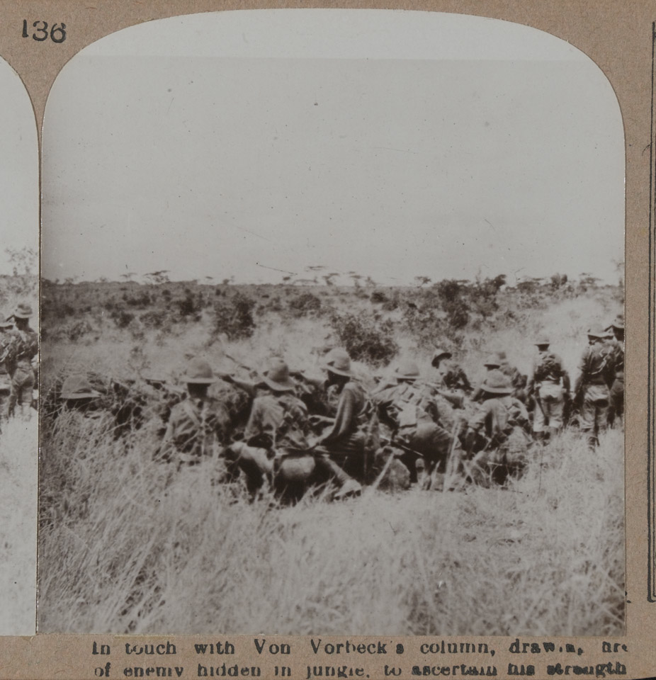
Notes:
In touch with Von Vorbeck’s column, drawing fire of enemy hidden in jungle, to ascertain his strength
NAM. 1972-08-67-2-136
Photograph of troops huddled in tall grass in an open field. The inhospitable terrain proved challenging to forces moving across the landscape. In a setting so dissimilar to the battles fought in Europe, battles in East Africa benefitted from a guerilla tactical style.
On the outbreak of war in 1914, Colonel Paul von Lettow-Vorbeck was the commander of a small army in German East Africa (Tanzania, Burundi and Rwanda). He was determined to tie down as many Allied troops as he could in the region to prevent them from being deployed elsewhere. During a four-year guerrilla campaign he ran rings around his enemies. With an army that never numbered more than 14,000 men, comprising about 3,000 Germans and 11,000 Askaris (African soldiers), he succeeded in occupying ten times that number of Allied troops.

Slide 11
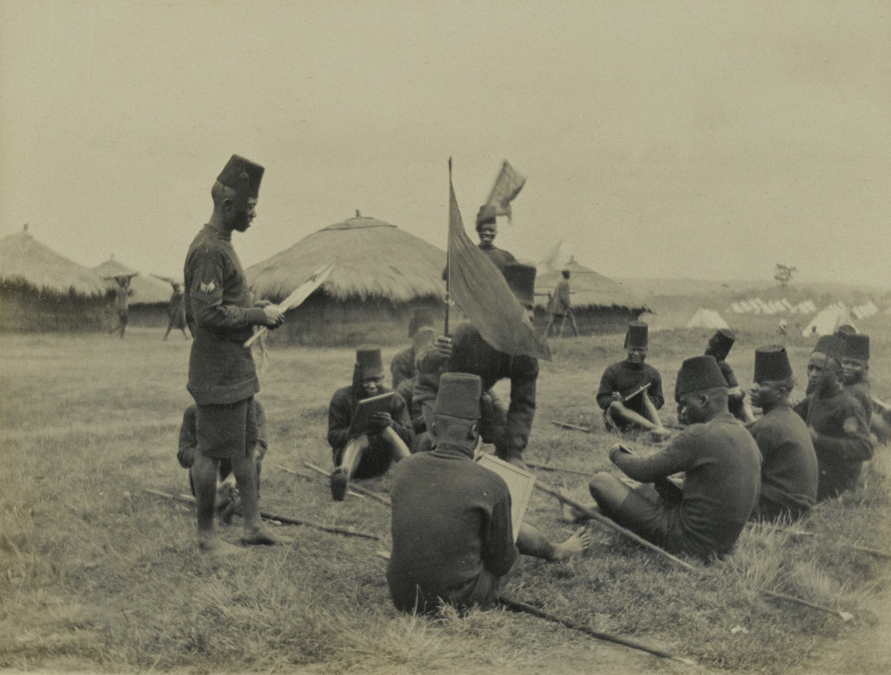
Notes:
‘Native Signallers’, King’s African Rifles, 1916
NAM. 1965-06-73-7
Soldiers of the King’s African Rifles undergo instruction in the use of signalling flags. The soldiers’ lines, consisting of traditional grass huts and standard British Army tents, can be seen in the background. The soldiers are similarly dressed in African uniforms with uniforms, and are carrying spears.

Slide 12
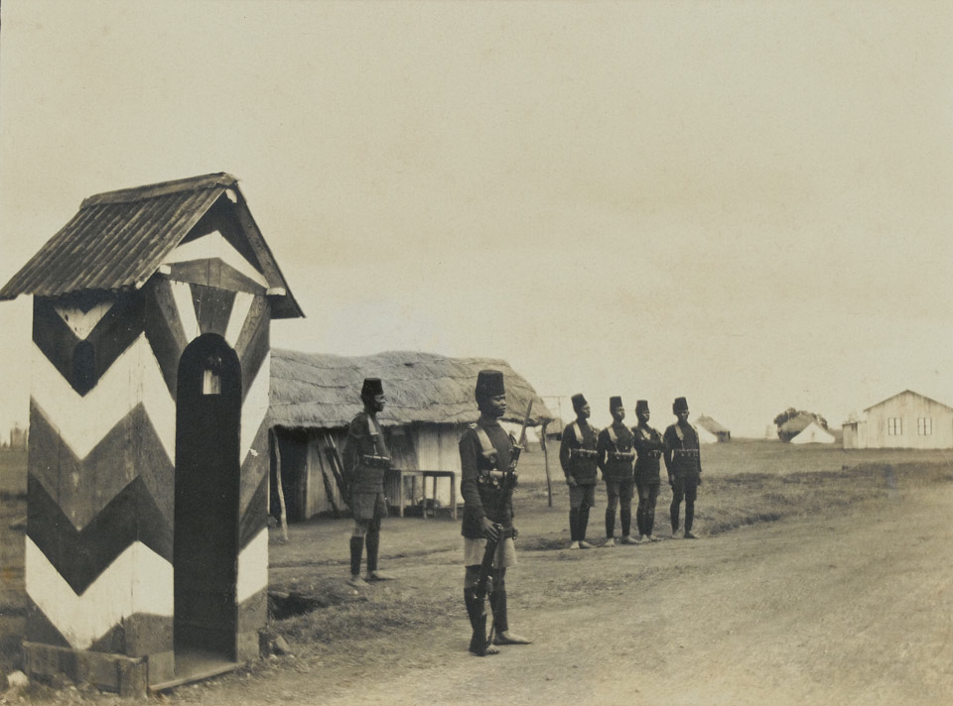
Notes:
Troops of the King’s African Rifles on the march, East Africa, 1916
NAM. 1965-06-73-16
An African soldier stands guard at the entrance to the regimental lines. He wears the uniform fez hat and is armed with a Short Magazine Lee Enfield (SMLE) rifle. Five more soldiers, all of whom are barefoot like the sentry, stand behind him. As recruits to the King’s African Rifles tended not to wear boots in their civilian lives, they were not issued with them in this early period.

Slide 13
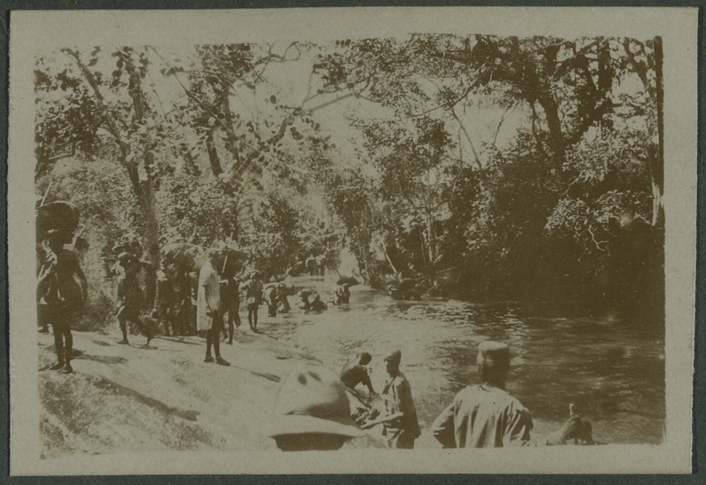
Notes:
Soldiers of the King’s African Rifles crossing a jungle river during operations in East Africa against the German commander Paul von Lettow-Vorbeck and his forces
NAM. 1973-06-12-1-38
Many ‘hostilities-only’ King’s African Rifles battalions were raised during the war to fight alongside the five regular battalions of the regiment. The strategy of the German colonial forces, led by Paul von Lettow-Vorbeck, was to divert forces from the Western Front to Africa. His strategy achieved only mixed results after 1916, when he was driven out of German East Africa and Allied forces became composed almost entirely of South African, Indian, and other colonial troops. The inhospitable terrain proved challenging to forces moving across the landscape. In a setting so dissimilar to the battles fought in Europe, battles in East Africa benefitted from a guerilla tactical style.
The East African Campaign was a series of battles and guerilla actions, which started in German East Africa and spread to portions of Mozambique, Northern Rhodesia, British East Africa, Uganda, and the Belgian Congo.

Slide 14
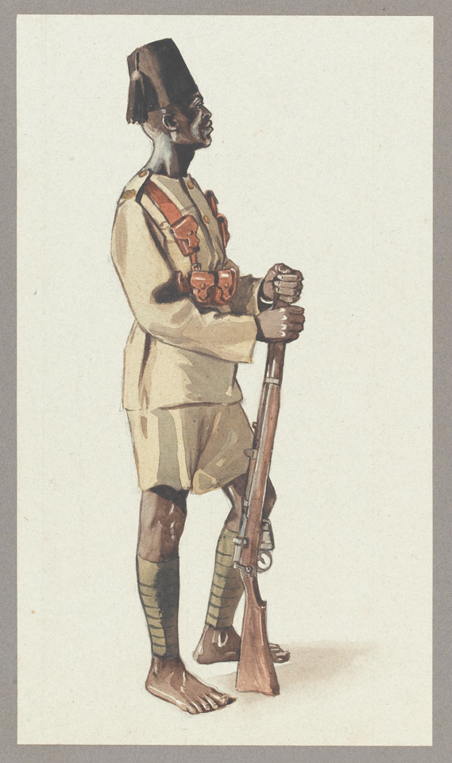
Notes:
A Yao askari, King’s African Rifles, 1914
NAM. 1980-04-60-1
Watercolor portrait of a Yao Askari soldier holding a rifle. He is dressed in a uniform distinguished by his fez, cummerbund, and bare feet.
The Yao were a Moslem people from the region around the southern part of Lake Malawi (formerly in British Nyasaland). They formed the main source of recruits for the King's African Rifles Nyasaland battalions. Originally, the main reason for the large number of Yao volunteers was probably the simple fact that the recruitment office was near Yao areas. However, due to prevailing racial ideals of the time the British interpreted this as a sign of their ‘martial spirit’. This led to an active official policy of enlisting the Yao, which in turn made military service ever more attractive among this group.
Askari is an Arabic, Turkish, Somali, Persian and Swahili word meaning 'soldier'. The term was adopted by European colonial powers to describe locally recruited soldiers. Askaris recruited into the King's African Rifles served as garrison and internal security forces. During the First World War (1914-1918) they also played a leading role in the East African campaign. Originally there was no official uniform, nor standardized weaponry however traditional spears are often carried. Many of the askaris campaigned in their native dress. Officers usually wore civilian clothes.

Slide 15
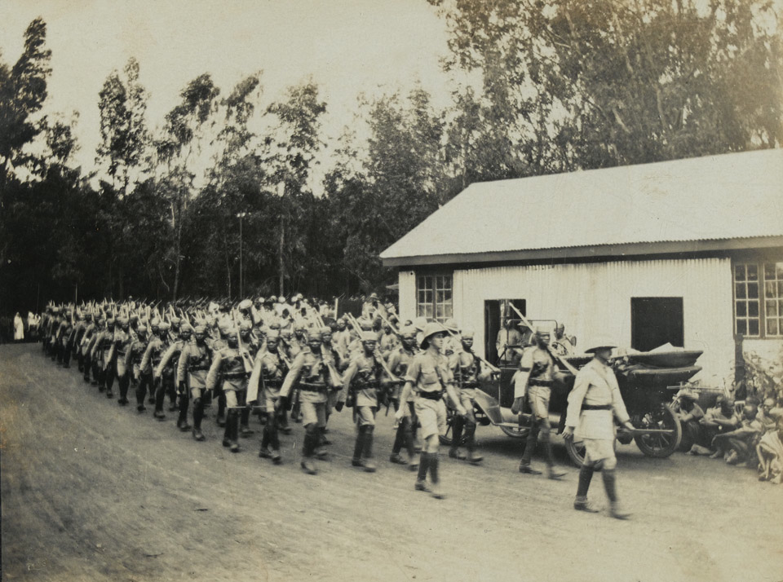
Notes:
King’s African Rifles on the march
NAM. 1965-06-73-14
Photograph of a company of the King’s African Rifles marching through the outskirts of a village. Behind the soldiers is a large building, an automobile, and young men seated on the ground watching the troops go by.
During the First World War German forces in East Africa commanded by Paul von Lettow-Vorbeck conducted successful raids against the neighboring Allied territories. This forced the Allies to mount a large-scale campaign in this region. The King’s African Rifles played a major part and by 1918 had expanded from three to twenty-two battalions and had established a formidable reputation for bush fighting.

Slide 16
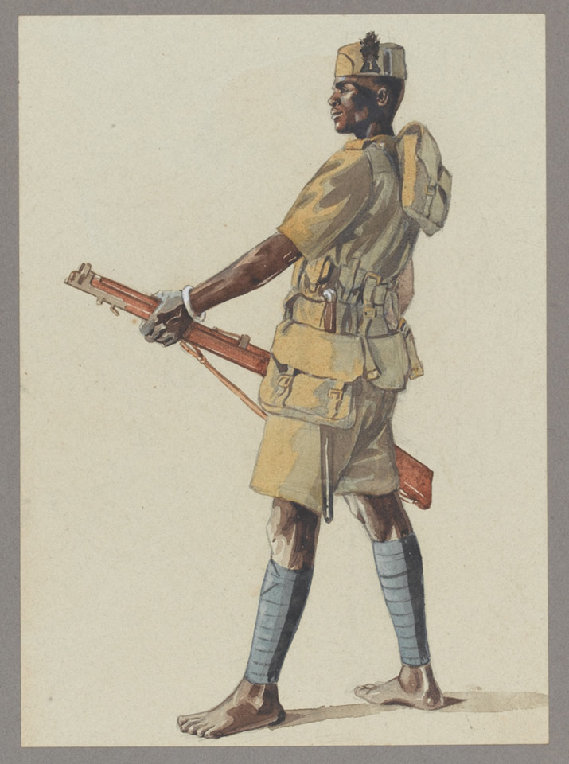
Notes:
An askari of the 1st (Central Africa) Battalion, King’s African Rifles, 1914
NAM. 1980-04-60-2
Watercolor of an Askari solider holding a rifle. He is dressed in khaki uniform and bare foot.
Askari is an Arabic, Turkish, Somali, Persian and Swahili word meaning 'soldier'. The term was adopted by European colonial powers to describe locally recruited soldiers. Askaris recruited into the King's African Rifles served as garrison and internal security forces. During the First World War (1914-1918) they also played a leading role in the East African campaign.
The 1st Battalion were raised in 1902 on the resignation of 1st Battalion, Central Africa Regiment. The other ranks of the battalion were African, while most officers were seconded from British Army regiments.

Slide 17
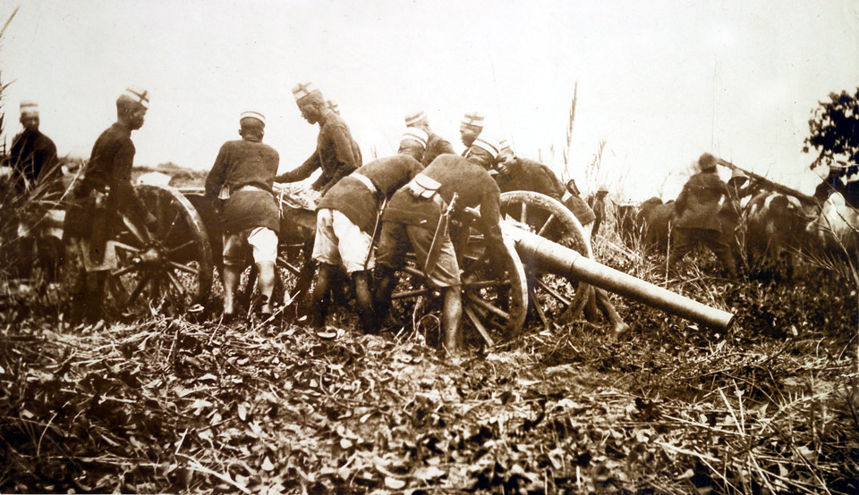
Notes:
Askaris getting field gun into position
NAM. 2002-02-589-141
Photograph of a group of African soldiers moving a field gun into position. The battle field has not been cleared and soldiers struggle to manoeuvre guns and people across the uneven landscape.
Black soldiers from Britain’s African colonies bore the brunt of the fighting against the Germans in East Africa during World War One (1914-1918). The British lost over 10,000 men, two thirds from disease. German losses were about 2,000. The black peoples of East Africa, who served as soldiers and carriers, suffered far more. One recent estimate of black African casualties is 100,000 dead on both sides.

Slide 18
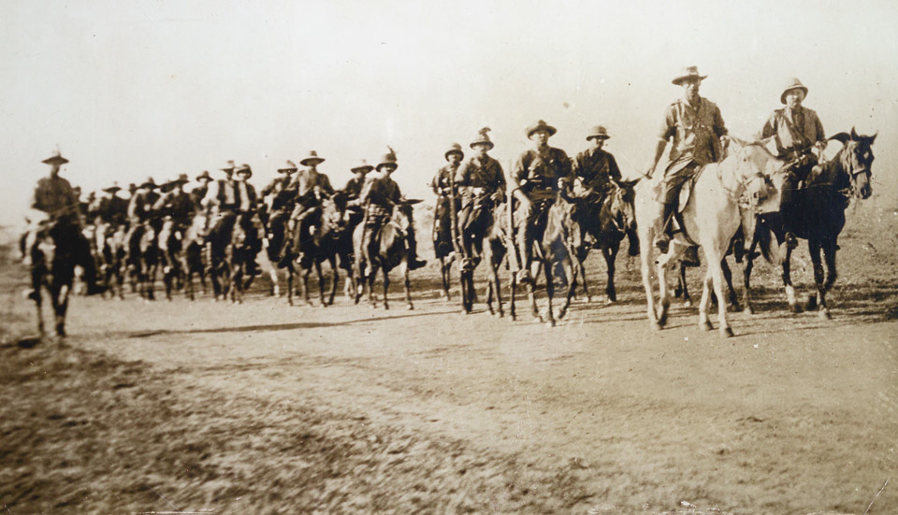
Notes:
‘Germany’s Last Colony Going-Going’, 1915
NAM. 2002-022-589-27
Photograph of East African Mounted Rifles trekking on horseback, East Africa.
The use of horses in the First World War marked a transitional period in the evolution of armed conflict. Cavalry units were initially considered essential offensive elements of a military force, but over the course of the war, the vulnerability of horses to the modern machine gun and artillery fire reduced their utility on the battlefield. This paralleled the development of tanks, which would ultimately replace cavalry in shock tactics.
While the perceived value of the horse in war changed dramatically, horses still played a significant role throughout the war. Horses were used as logistical support during the war as transport across varied terrains, pulling ambulances and supply vehicles, and in reconnaissance to carry messengers.

Slide 19
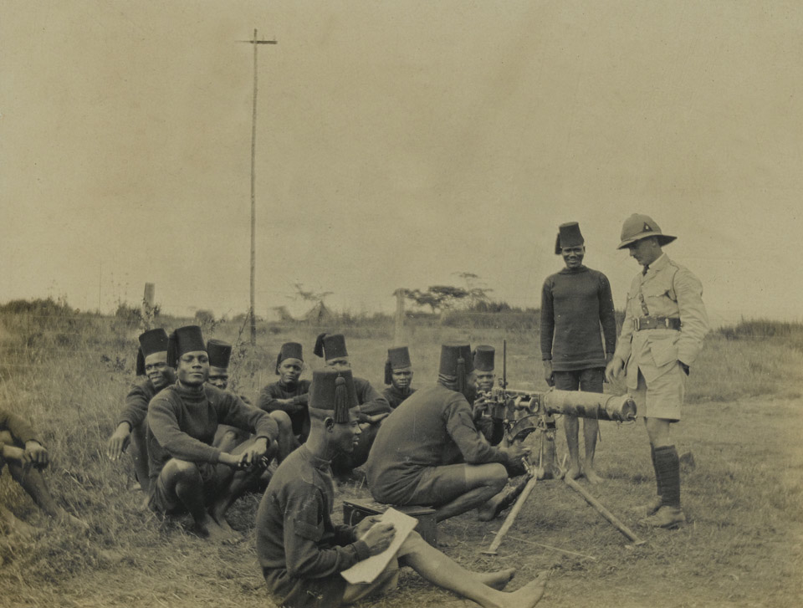
Notes:
Soldiers of the King’s African Rifles receiving instruction in the use of a machine gun, 1916
NAM. 1965-06-73-6
During the East African Campaign the Germans recruited African troops skilled in the art of bush craft, which enabled them both to live off and move swiftly through the region’s inhospitable terrain. These skills combined with extensive training in the use of European weapons enabled Germany’s tiny East African colonial forces (known as Schutztruppen) to resist the superior allied forces arrayed against them. It was the recognition of the abilities of native Africans and the need to mimic this specialized type of warfare on the part of British commanders that led to the wartime expansion of the King’s African Rifles and their extensive employment in this campaign.

Slide 20
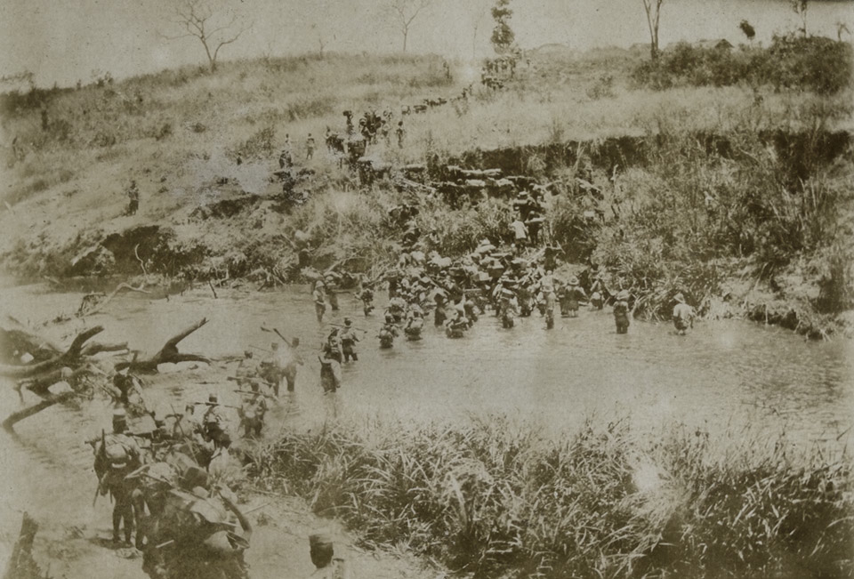
Notes:
River crossing
NAM. 1973-06-12-1-92
The inhospitable terrain proved challenging to forces moving across the landscape. In a setting so dissimilar to the battles fought in Europe, battles in East Africa benefited from a guerrilla tactical style.

Slide 21
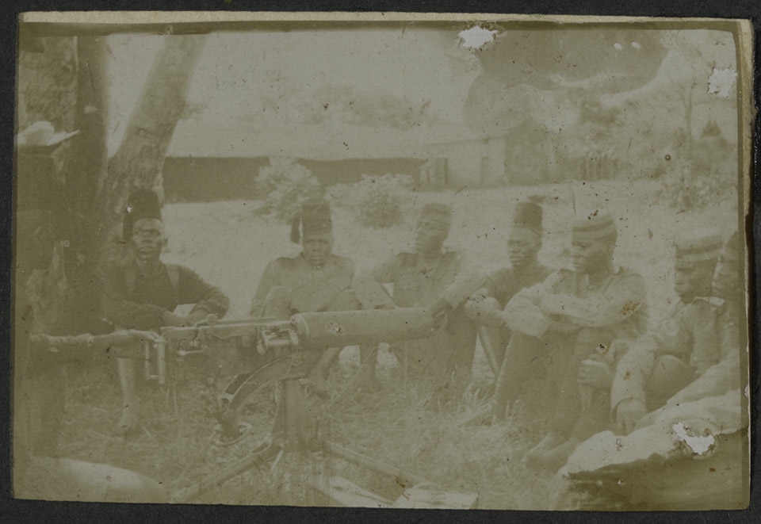
Notes:
Soldiers of the King’s African Rifles undergoing weapons training, c1916
NAM. 1973-06-12-2-44
During the East African Campaign the Germans recruited African troops skilled in the art of bush craft, which enabled them both to live off and move swiftly through the region’s inhospitable terrain. These skills combined with extensive training in the use of European weapons enabled Germany’s tiny East African colonial forces (known as Schutztruppen) to resist the superior allied forces arrayed against them. It was the recognition of the abilities of native Africans and the need to mimic this specialized type of warfare on the part of British commanders that led to the wartime expansion of the King’s African Rifles and their extensive employment in this campaign.

Slide 22
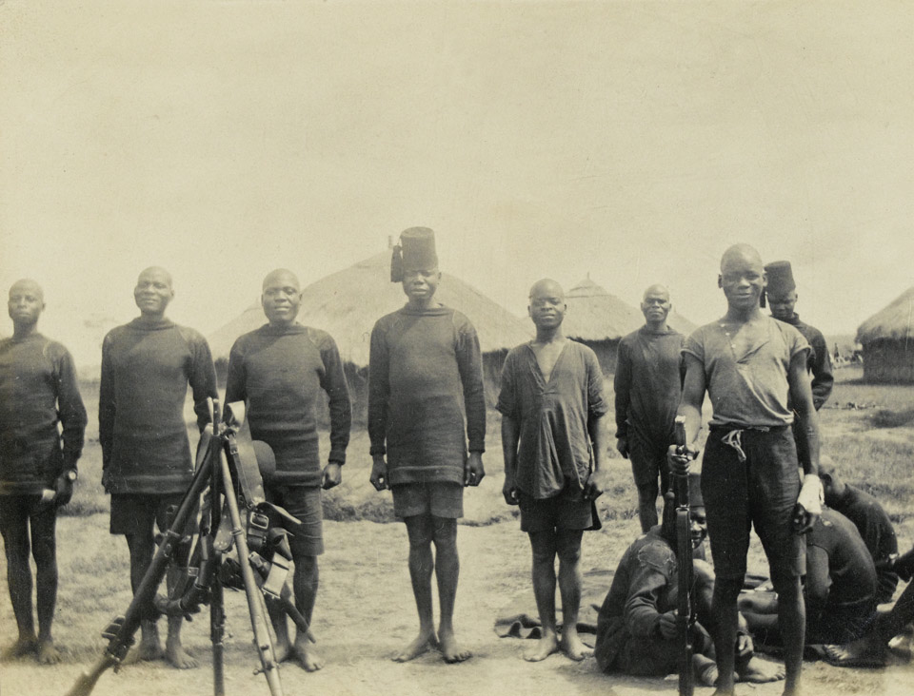
Notes:
Men of the King’s African Rifles pose for a photograph in camp
NAM. 1965-06-73-4
Formed at the beginning of the century from tribesmen in British East Africa (now Kenya) and Uganda, the King’s African Rifles bore the brunt of most of the fighting during the campaign. Locally recruited Africans proved to be the best soldiers in this theatre of war.
During the East African Campaign the Germans recruited African troops skilled in the art of bush craft, which enabled them both to live off and move swiftly through the region’s inhospitable terrain. These skills combined with extensive training in the use of European weapons enabled Germany’s tiny East African colonial forces (known as Schutztruppen) to resist the superior allied forces arrayed against them. It was the recognition of the abilities of native Africans and the need to mimic this specialized type of warfare on the part of British commanders that led to the wartime expansion of the King’s African Rifles and their extensive employment in this campaign.
Locally recruited soldiers were more resistant than their European counterparts to the climate and local diseases. By November 1918 the 'British Army' in this theatre was mainly composed of African soldiers.

Slide 23
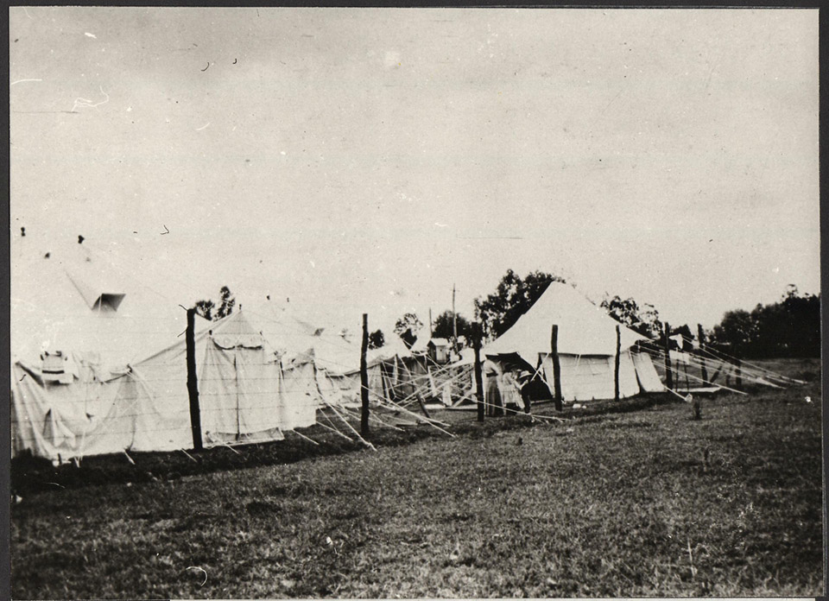
Notes:
‘German Prisoners watching our departure’
NAM. 1965-06-73-15
During the First World War, both sides captured and held prisoners of war. However, in this picture the group watching the troops leaving are a woman and three children, suggesting that they are civilians of German origin who were made prisoner because they were resident in British-occupied or captured territory in British East Africa.

Slide 24
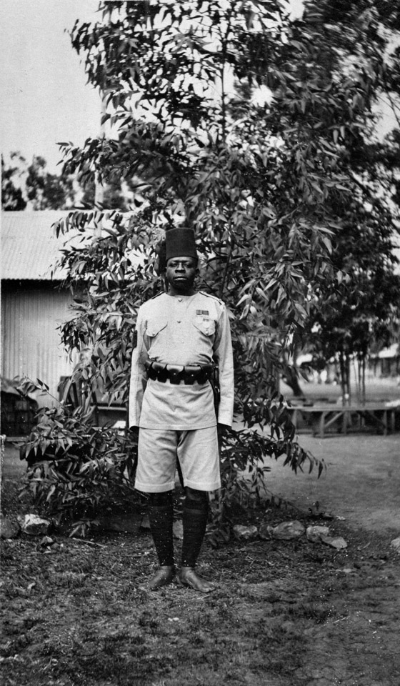
Notes:
A non-commissioned officer of the 2nd Battalion King’s African Rifles
NAM. 1990-08-141-15
Although the King's African Rifles were led by British officers, most of the regiment's non-commissioned officers (NCOs) were African. While British members of the regiment wore standard khaki fatigues, African soldiers wore khaki drill with tall red fezzes and cummerbunds.
The 2nd Battalion had been disbanded in 1911 at Zomba, but was reformed in April 1916 at Nairobi from four companies of the 1st Battalion.

Slide 25
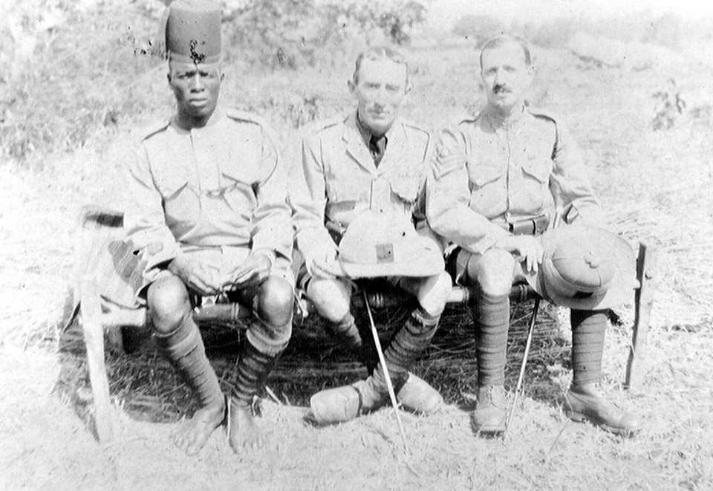
Notes:
African and British officers
NAM. 1973-06-12-1-76
A non-commissioned African officer poses with two commissioned British officers.
A non-commissioned officer obtains his title by rising through enlisted ranks. Commissioned officer positions were not open to African troops, and officers were often seconded from British regiments. While British members of the regiment wore standard khaki fatigues, African soldiers wore khaki drill with tall red fezzes and cummerbunds.

Slide 26
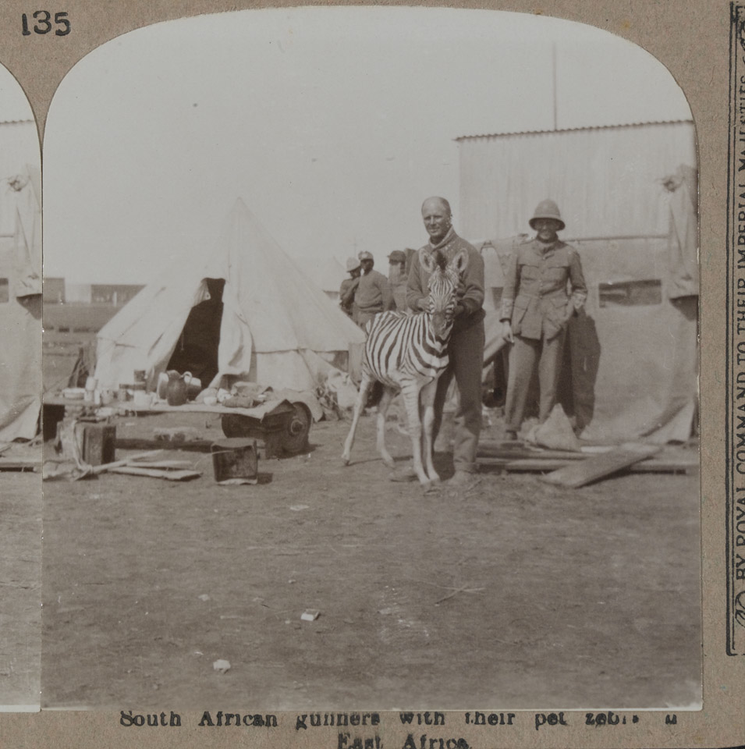
Notes:
South African gunners with their pet zebra in East Africa
NAM. 1972-08-67-2-135
South African gunners take time to pose with their ‘pet zebra’. An image such as this – originally part of a spectroscopic image, which would have appeared three-dimensional to viewers using the spectroscope - would have reinforced the exotic nature of service in Africa to those who were not born there.

Slide 27
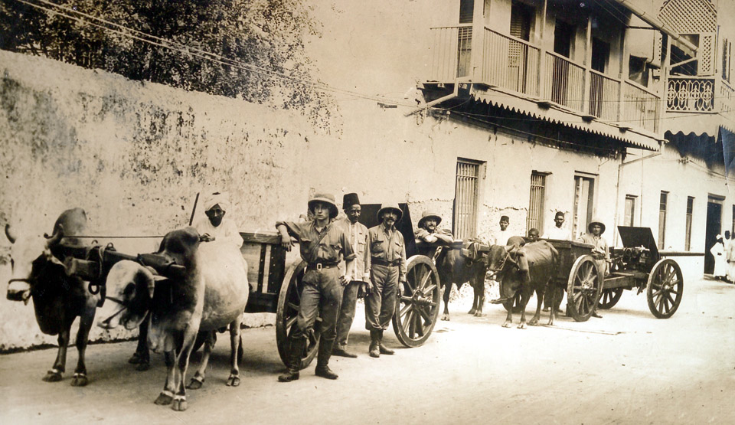
Notes:
British troops and local people with two guns salvaged from HMS ‘Pegasus’ in Zanzibar
NAM. 2002-02-589-23
The original caption of this photograph states the salvaged guns were ‘still useful’.
HMS ‘Pegasus’ was a British cruiser stationed in Zanzibar harbour. On 20 September 1914 it was sunk by SMS ‘Königsberg’, a German vessel,
in a surprise attack in the harbour. Six of the eight guns were salvaged off the Pegasus and utilised during the remainder of the land campaign.

Slide 28
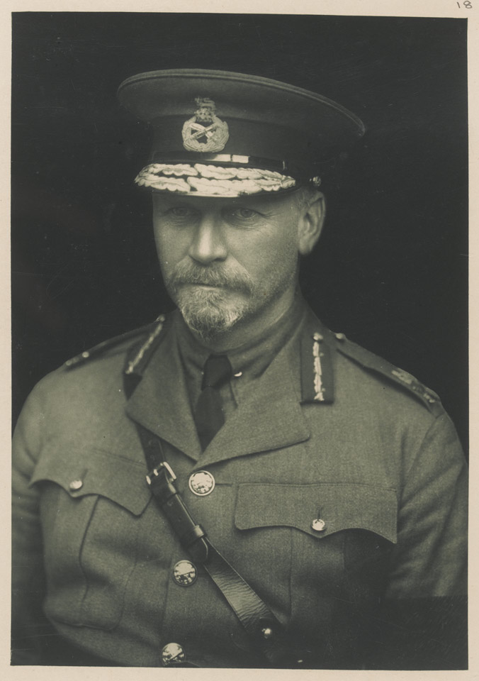
Notes:
General Jan Smuts, 1918
NAM. 1981-03-28-18
General Jan Smuts was a prominent South African and British Commonwealth statesman, and Commander-in-Chief in East Africa during the First World War. Although he had fought the British with great distinction during the Boer War (1899-1902), Smuts was eventually reconciled with his erstwhile enemy, concluding that South Africa's future lay within the British Empire. He therefore supported South Africa's entry into the war and formed the South African Defence Force. In 1915 he and General Louis Botha conquered German South West Africa.
In 1916 Smuts commanded the conquest of German East Africa, but despite mobilising a large force he struggled to defeat Colonel Paul von Lettow-Vorbeck's guerillas. Von Lettow-Vorbeck was still at large when Smuts left to join the Imperial War Cabinet in 1917. He made several morale-raising visits to Allied troops on the Western Front and the following year he helped create the Royal Air Force.
This photo was taken a year before he was elected Prime Minister of the Union of South Africa in 1919.

Slide 29
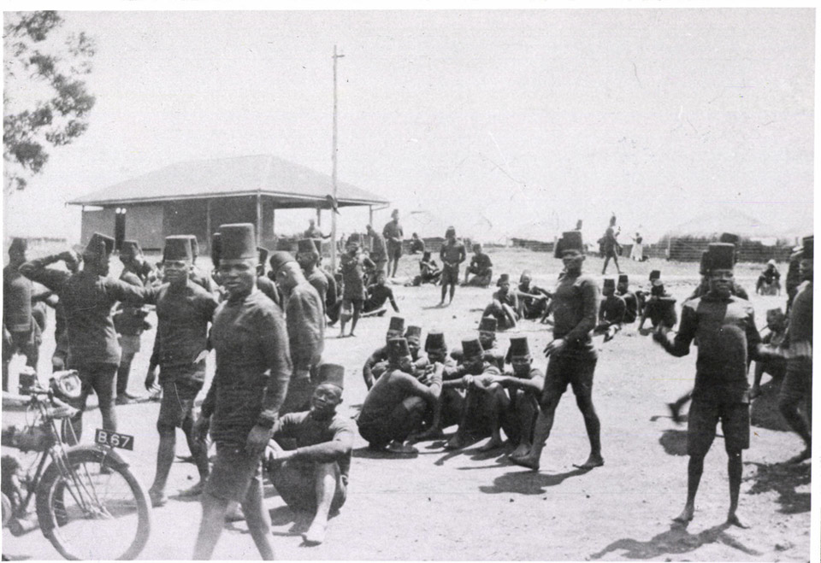
Notes:
Native Troops at Leisure
NAM. 1965-06-73-3
Native troops from the 1st, 2nd or 3rd Battalion of the King’s African Rifles are photographed spending free time in the dry landscape surrounding a small building. Care has been taken to record them in an unposed fashion, walking and talking in relaxed groups.

