Slide 1
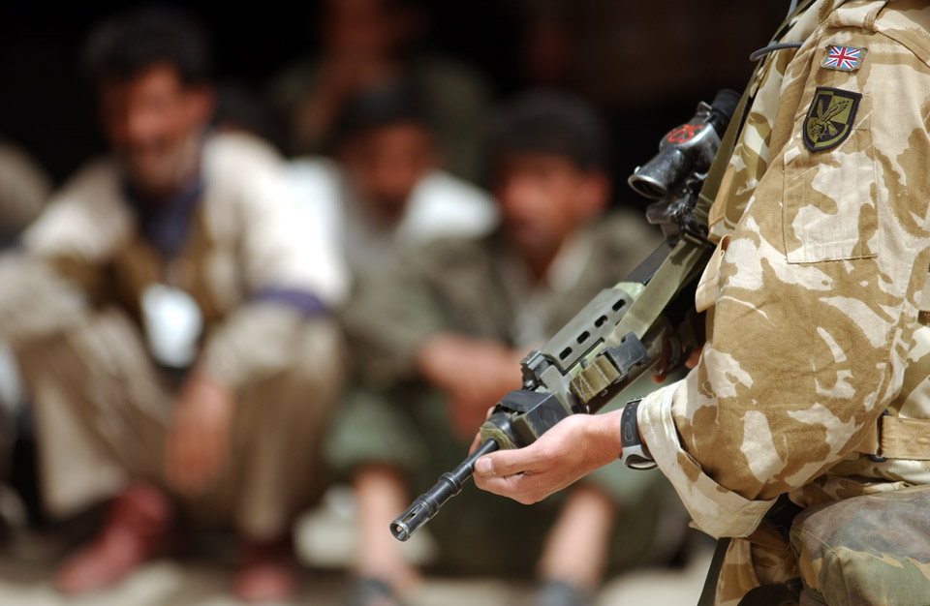

When is it right to send the Army to fight?
Notes:
NAM. 2005-01-67-20
Digital photograph: A soldier serving with the 1st Battalion The Royal Irish Regiment stands guard over several hundred Iraqi POW’s held at a transit base before they are moved onto a safer area away from the conflict.
Crown copyright.
Photographed by WO2 Giles Penfound, Army Media Operations, southern Iraq, Operation TELIC, 24 March 2003.
From a CD entitled 'Iraq Conflict. Operation Telic', compiled by WO2 Penfound, for an exhibition at the NAM provisionally entitled 'Conflict' (Project: Operation TELIC).
Associated with 1st Battalion, The Royal Irish Regiment, Iraq (2003-).

Slide 2
This PowerPoint presentation contains a selection of images and archives which students can use to prompt discussion and encourage further research. The materials come from the Collection of the National Army Museum (NAM).
Unless otherwise stated in the notes, the images can be freely used for non-commercial purposes within the classroom. You can use the entire presentation or choose individual images for use in other non-commercial contexts. When using individual images in other contexts, please always retain the attribution statements provided in this document (e.g. NAM. 2005-08-66-1).
By downloading this document and using these images you agree to these terms of use, including your use of the attribution statement specified for each object by NAM.

Slide 3
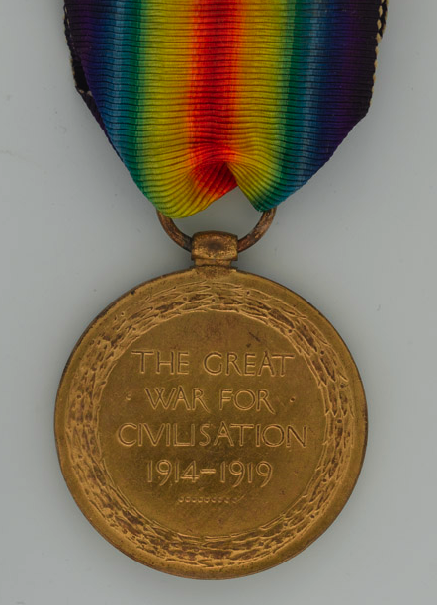
Motivations
Different motives have been used at different times to send the Army to fight.
Is it about Britain, the national interest and economics?
Is it about people? British nationals, or people from other countries?
Is it for political reasons?
Are the motives always straightforward or clear cut?
Notes:
NAM. 2002-02-921-2
Reverse of the Allied Victory Medal 1914-19.
From a collection of medals awarded to Cpl Henry Eggleston, The Buffs (East Kent Regiment) and the 16th Bn, Machine Gun Corps.
Associated with World War One, Western Front (1914-1918).
Henry ‘Harry’ Eggleston enlisted with The Buffs (Royal East Kent Regiment) in Oct 1914, he was transferred to the newly formed Machine Gun Corps in 1915, and was with the first shipment of this unit sent to France in Feb 1916, he served in France and Belgium until Apr 1917, at which time he was recalled to England to instruct recruits. He was sent to France again in June 1918.
Cpl Eggleston was demobilised in Belgium, Jun 1919.

Slide 4
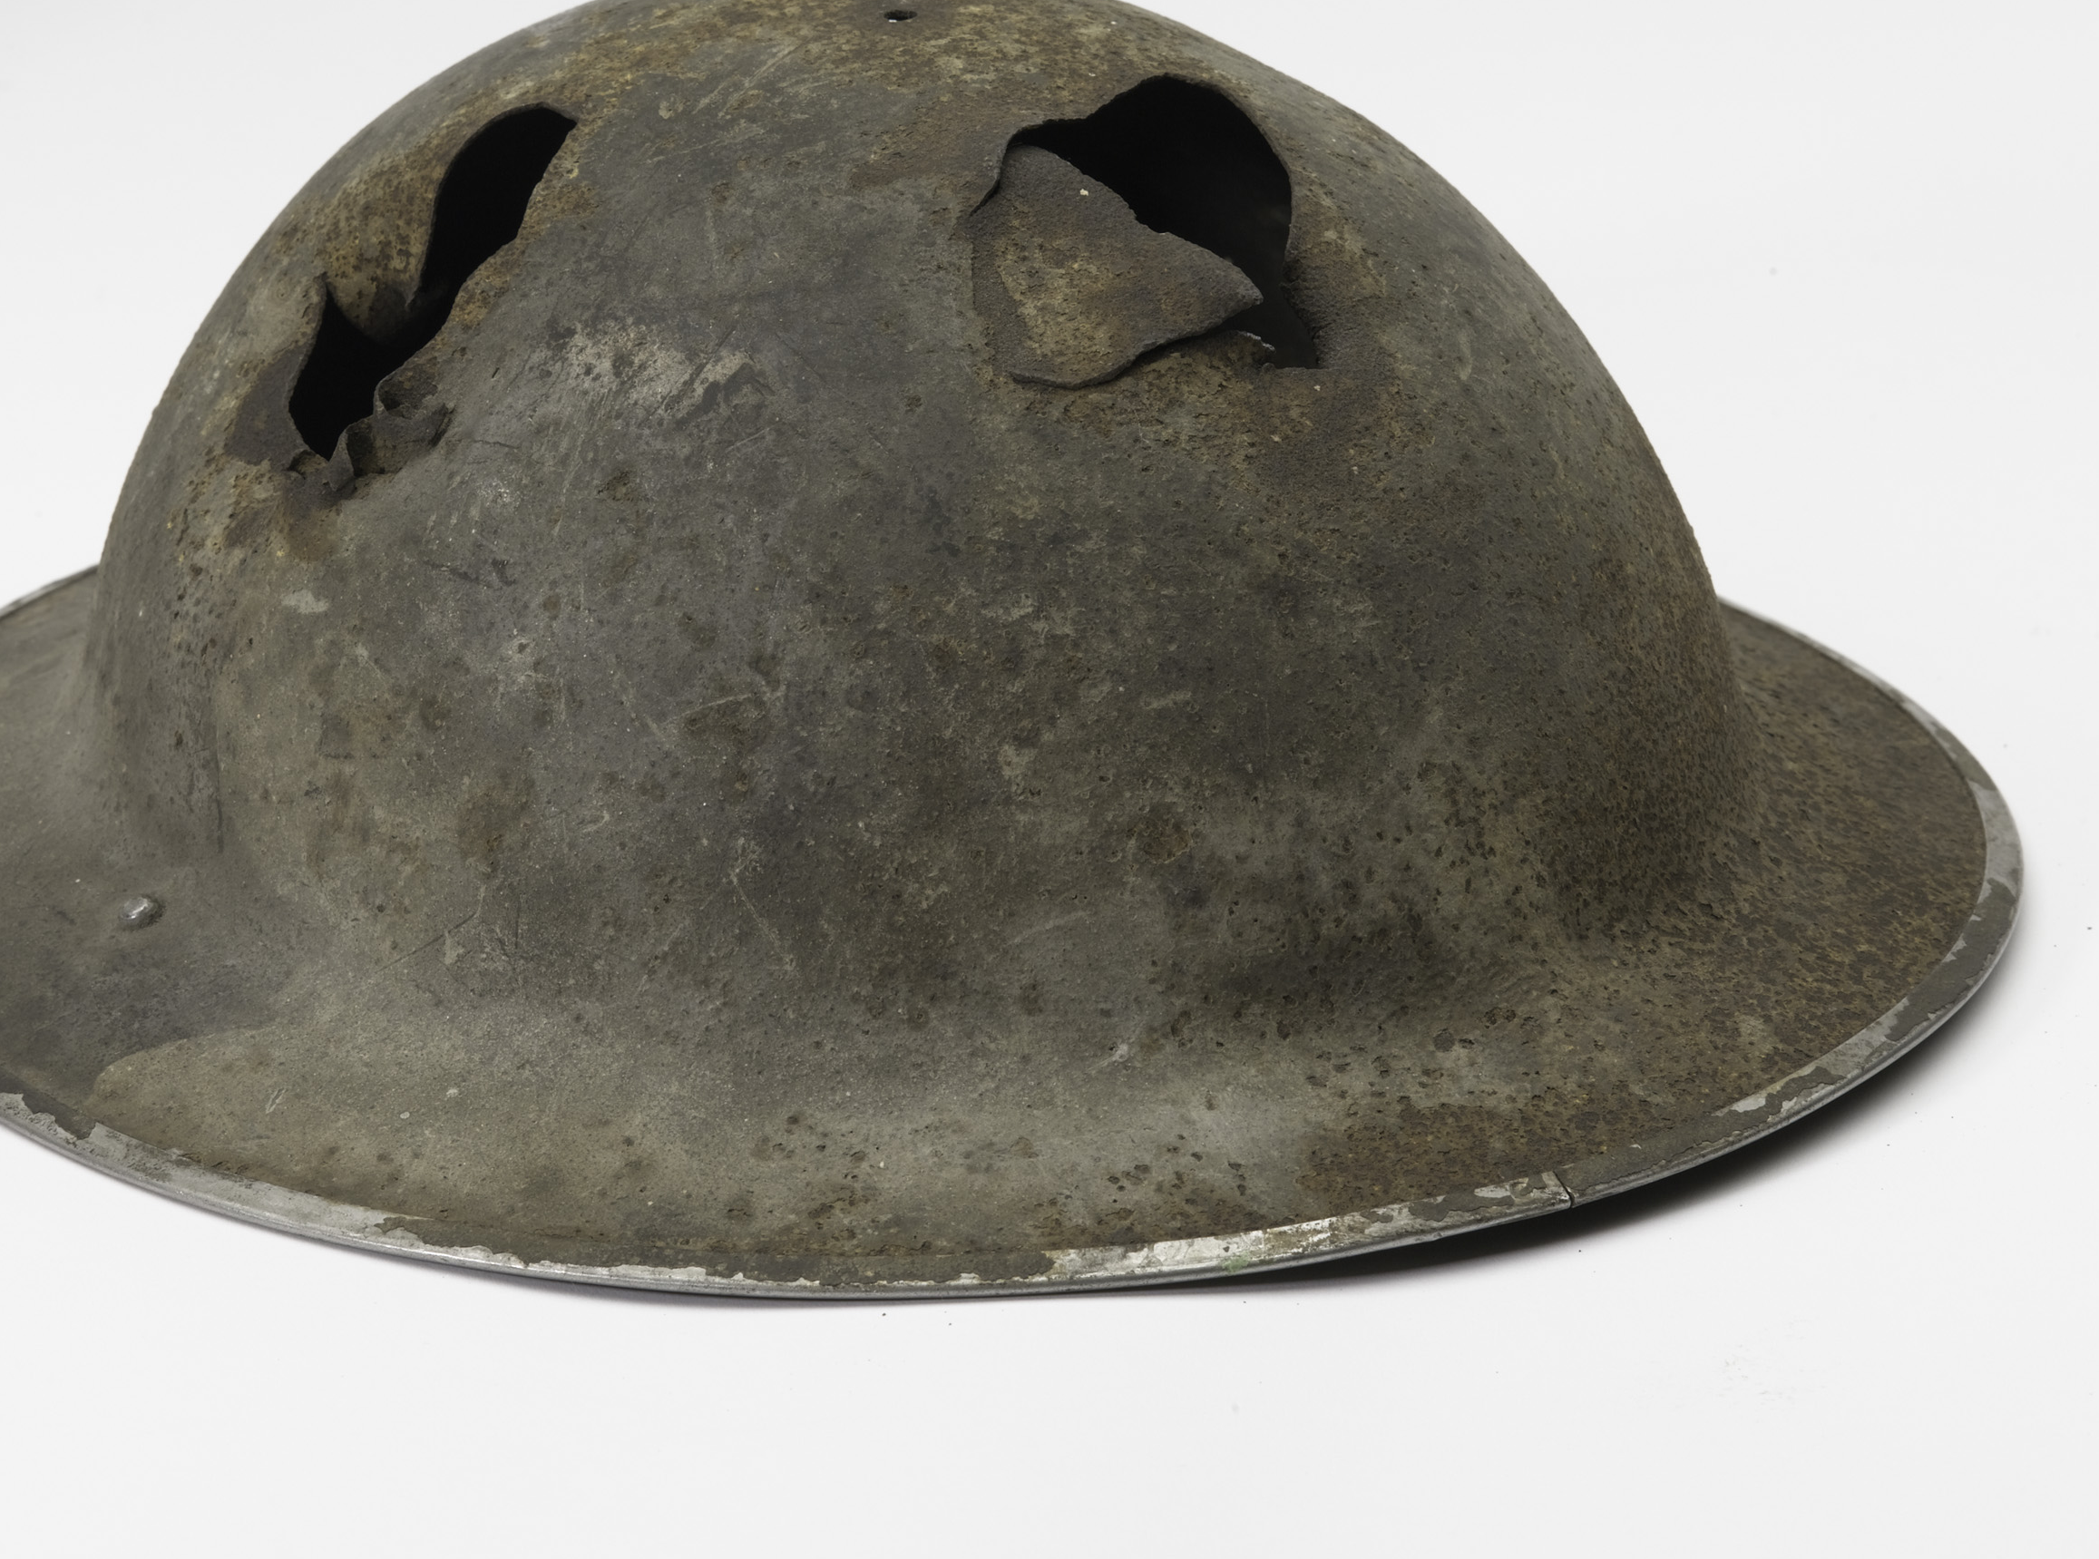
What will be achieved by fighting?
Notes:
NAM. 1989-02-5-1
British Mk 2 steel helmet worn by John Henry Knowler, Army Commandos, 1944 (c).
Dome of the helmet has two large holes in it, seemingly the entrance and exit points of the same projectile.
The chinstrap remains and is marked with the owner’s name.
Rim is stamped with the maker’s initials, ‘J.S.’;
Associated with the Dieppe Raid, World War Two, North West Europe (1941-1943), 1942

Slide 5
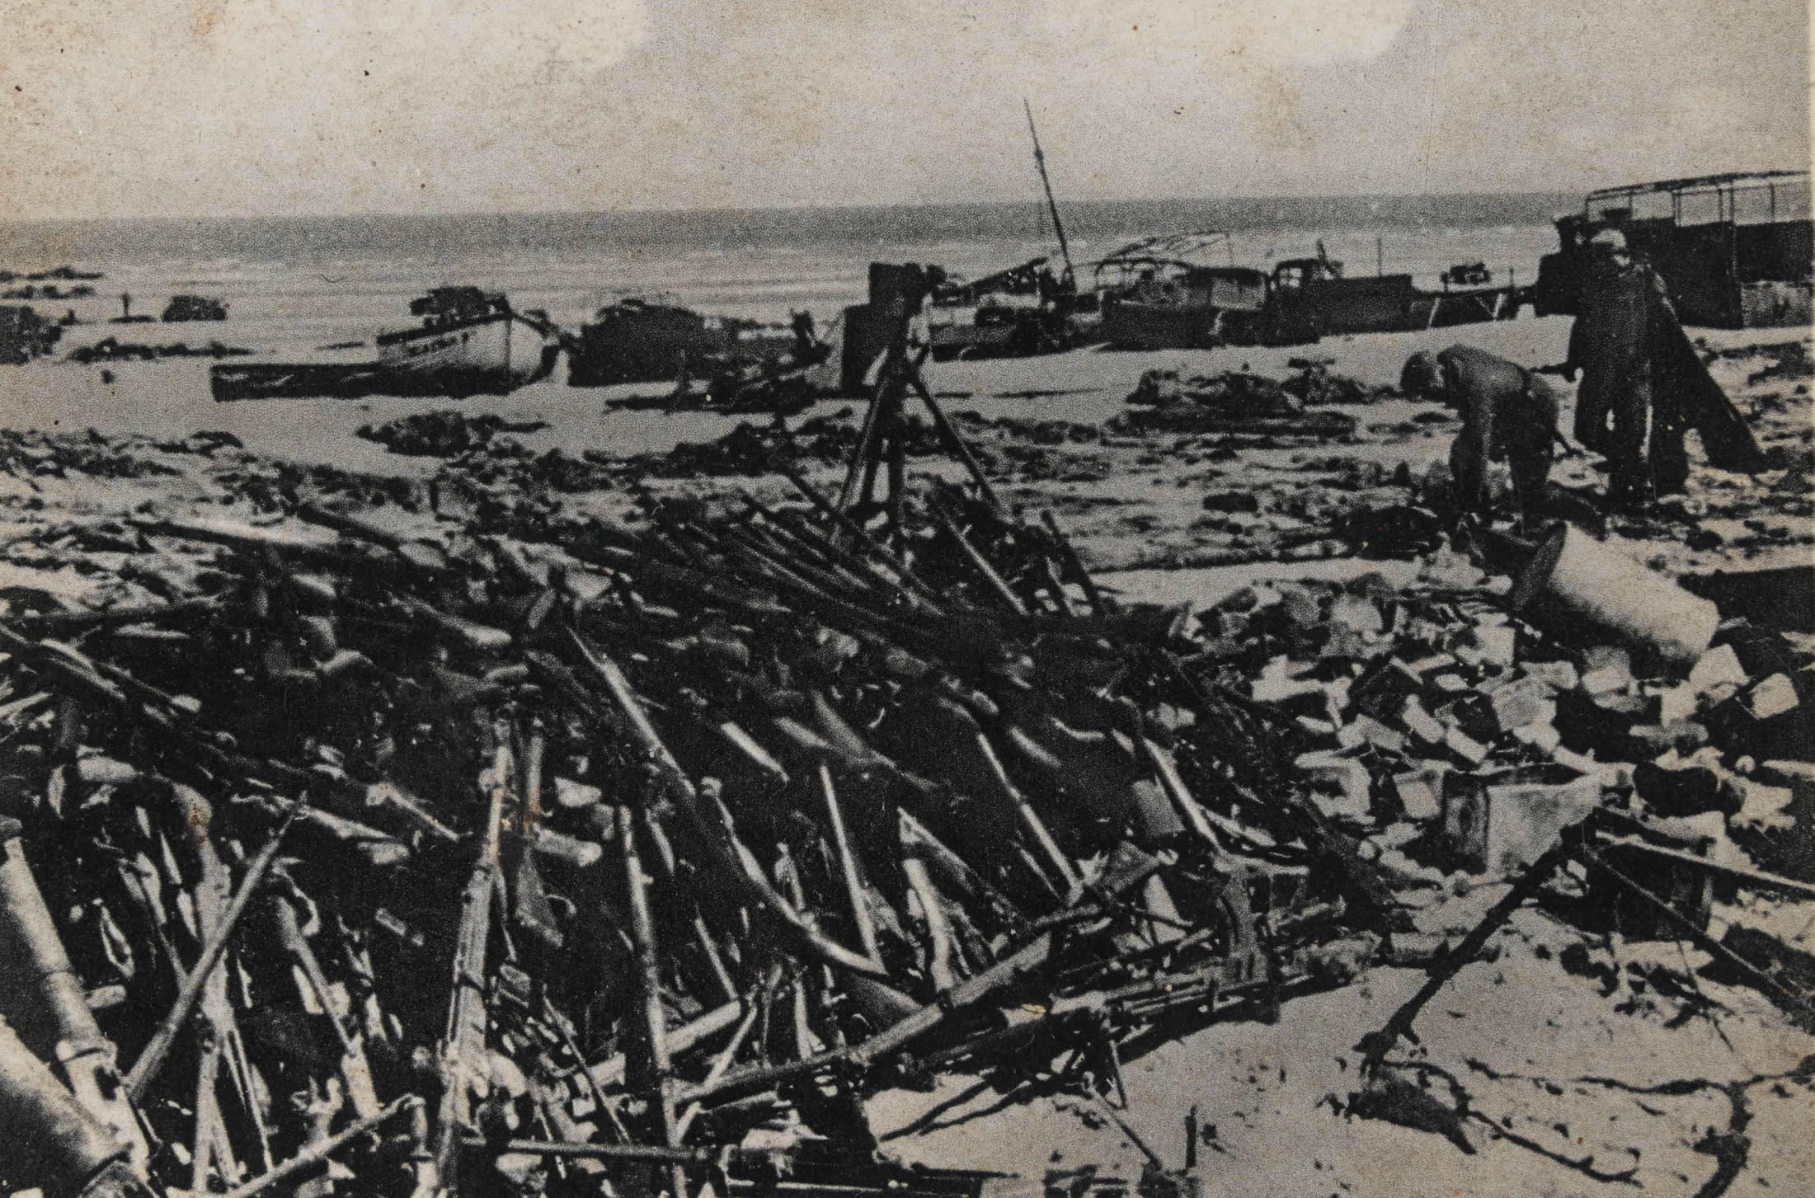
Why was the Army sent to fight?
Case study: The Second World War
Notes:
NAM. 2001-03-39-8
Photograph of piled rifles and abandoned boats, 1940.
From a set of 20 German propaganda photographs showing the aftermath of the Dunkirk evacuation.
Associated with World War Two, North West Europe (1939-1943).

Slide 6
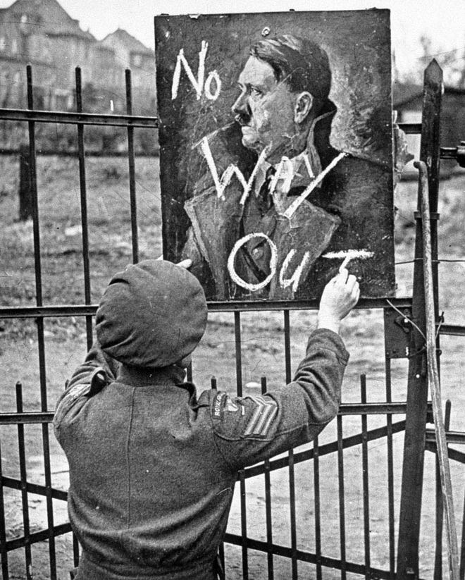
Reasons
Hitler’s increasingly aggressive foreign policy led to German occupation of the whole of Czechoslovakia.
This breached the written guarantee Hitler had issued to Chamberlain in Munich in 1938, stating that he had no further territorial demands to make in Europe.
Notes:
NAM. 1997-01-52-9
A British soldier writing ‘No Way Out’ on a portrait of Adolf Hitler. Copyright NAM.
From a collection of 23 official photographs. Associated with World War Two, North West Europe (1944-1945).

Slide 7
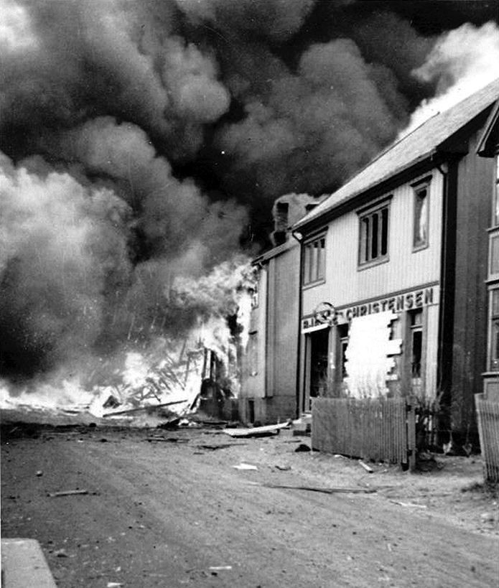
Reasons
Britain and France subsequently agreed to support Poland if Germany invaded.
On 1st September 1939, Hitler attacked Poland.
Two days later, Britain and France – in keeping with their mutual agreement – declared war on Germany.
Notes:
NAM. 1984-07-16-35
A burning building in Norway, 1940.
One of a collection of one hundred and two photographs, photographed and collected by A D C Smith, Army Commandos.
Associated with World War Two, Norway and North West Europe (1939-1945).
Out of copyright.
Out of copyright.

Slide 8
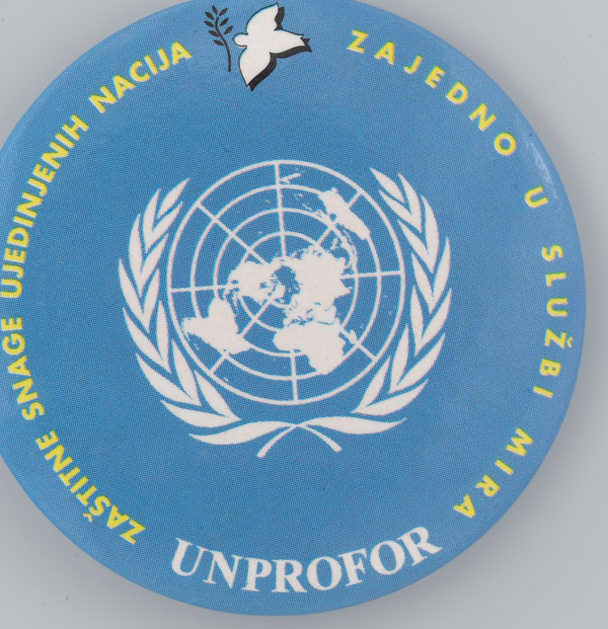
The UK and the World
Since the end of the Second World War, government decides whether the British Army will support United Nations (UN) and North Atlantic Treaty Organization (NATO) missions around the world.
Notes:
NAM. 1999-06-38-1
Lapel Badge, 1995 (c).
Plastic coated printed paper with metal fittings, made for the United Nations Protection Force.
Collected from NATO UNPROFOR, Bosnia, April 1995.
The badge is circular with white print on blue ground.
Such badges were handed to local children in Bosnia by United Nations soldiers.

Slide 9
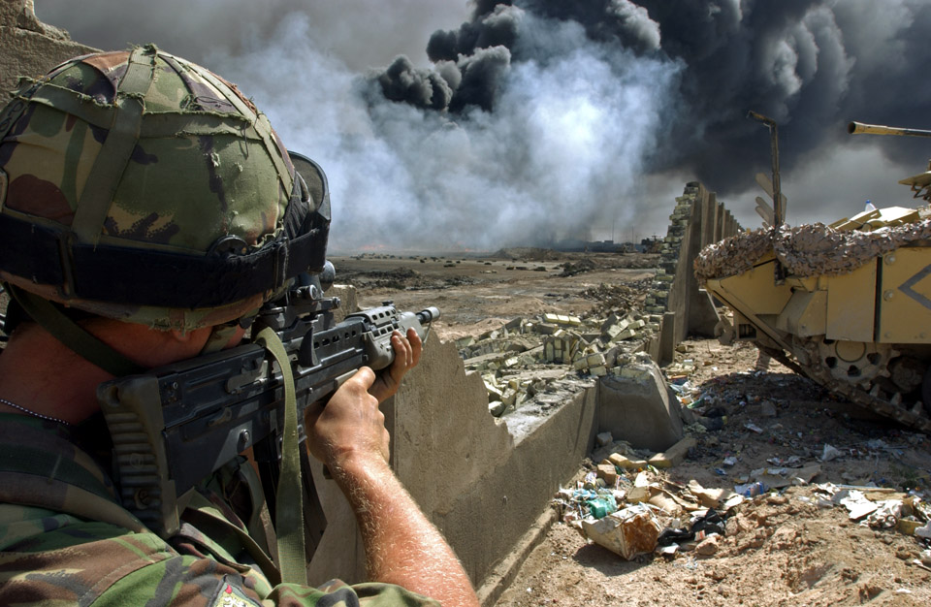
Why was the Army sent to fight?
Case study: The Iraq War 2003
Notes:
Digital photograph: A soldier serving with No 1 Company 1st Battalion The Irish Guards looks for possible Iraqi enemy positions as Royal Engineer technicians prepare to cap one of the burning oil wells within the city of Basra.
Photographed by WO2 Giles Penfound, Army Media Operations, Bridge Four, Basra, southern Iraq, Operation TELIC, 3 April 2003.
Crown copyright.
Associated with 1 Company, 1st Battalion, The Irish Guards and Royal Engineers, Iraq (2003-).
In a dawn raid on a university/ factory complex within sight of their patrol base at Bridge Four on the outskirts of Basra the Irish Guards attacked and cleared the base after coming under fire from small arms, mortars and SAM Missile systems which were fired from Iraqi positions at a British Lynx Helicopter supporting the Irish Guards.

Slide 10
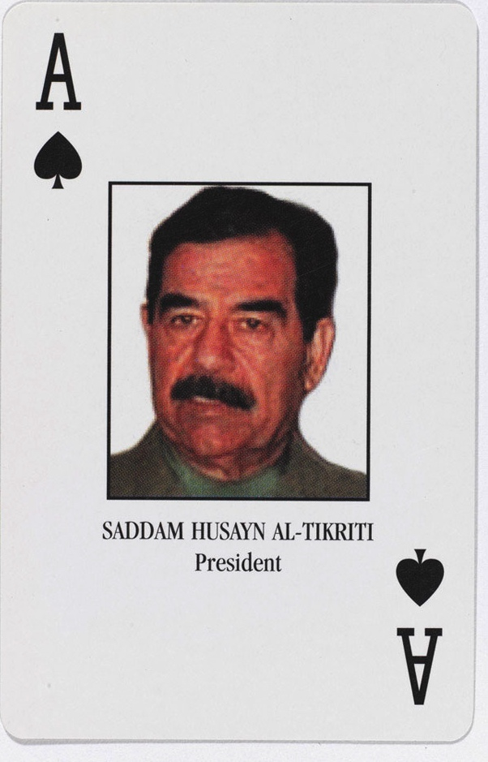
Reasons
Saddam Hussein was the President of Iraq, serving from July 1979 to April 2003
He was widely condemned in the West for the brutality of his dictatorship
In March 2003, a coalition led by the United States and supported by the United Kingdom launched an attack on Iraq
Notes:
NAM. 2003-06-57-1
Playing card featuring Saddam Hussein, from Set of Most-Wanted Iraqi ‘Personality Identification' playing cards, 2003
52 regular cards and two jokers, one inscribed with 'Arab Titles' and examples and the other inscribed with 'Iraqi Military Ranks', and a cover card; the set wrapped in cellophane, in original box
Colour photolithographic cards, published by the Liberty Playing Card Company, Texas, USA and issued to the British Army, 2003.
Associated with Iraq (2003-).
The playing cards show the name and a photograph (or silhouette) of each of the 52 'Most Wanted' members of Saddam Hussein's regime; these include Saddam himself (the Ace of Spades), his sons Uday and Qusay (the Aces of Hearts and Clubs), General Ali Hasan Al-Majid, known as 'Chemical Ali' (the King of Spades) and Deputy Prime Minister Tariq Aziz (the 8 of Spades).

Slide 11
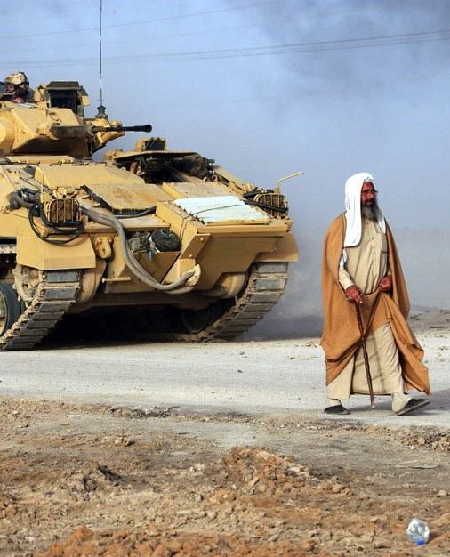
Reasons
The governments of the US and UK claimed that Iraq’s alleged possession of weapons of mass destruction (WMD) posed a threat to their security and that of their coalition/regional allies
Public opposition to the war led to protests
Notes:
NAM. 2005-01-67-25
Digital photograph: An Iraqi civilian walks in front of a Warrior Infantry Fighting Vehicle of 3 platoon No 1 Company The First Battalion The Irish Guards.
Photographed by WO2 Giles Penfound, Army Media Operations, Basra City, southern Iraq, Operation TELIC, 29 March 2003.
Crown copyright.
The soldiers manning the checkpoint on the bridge into/out of Basra were there to show a presence and to prevent Iraqi soldiers and militia leaving the city to possibly fight coalition forces.

Slide 12
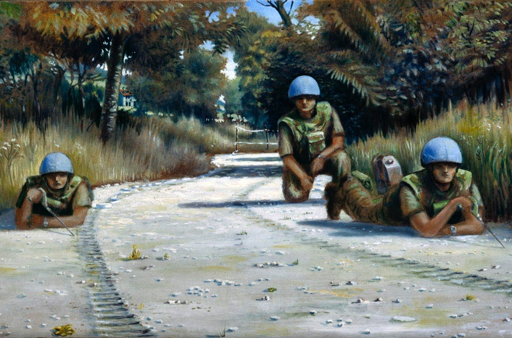
Why was the Army sent to fight?
Case study: Bosnia
Notes:
NAM. 1997-10-141-1
Mine-clearing by hand near Vitez, Bosnia, 1994.
Oil on board signed lower left by Jonathan Wade (b 1960), inscribed verso 'started summer 1994/ finished 1997’.
In 1994 the artist, Jonathan Wade, a former officer of The Royal Highland Fusiliers, visited Bosnia to paint military subjects, sometimes basing his work on photographs. The unit depicted here is 49 Squadron, Royal Engineers, from 33 Engineer Regiment (Explosive Ordnance Disposal), engaged in the highly dangerous work of mine clearance. The unit had suffered one fatal casualty prior to Wade's visit.
In this painting, three sappers crawl along a road, two with hand-held mine prodders to feel for mines and one resting behind with a jerrycan of water and a kitbag. The two men with prodders are working as a pair, with one slightly ahead of the other. This standing operating procedure ensures that if either man sets off a mine, then only one of them is on a level with it. The men should be wearing protective visors over their faces when engaged in mine clearance, but Wade noted that these are sometimes discarded as they tend to impede vision.
The sappers each carry a roll of white mine tape laid out behind them to indicate how far they have cleared. In the background, more white tape attached to six foot pickets hammered into the ground indicates that mine clearance has not been completed beyond that point.

Slide 13
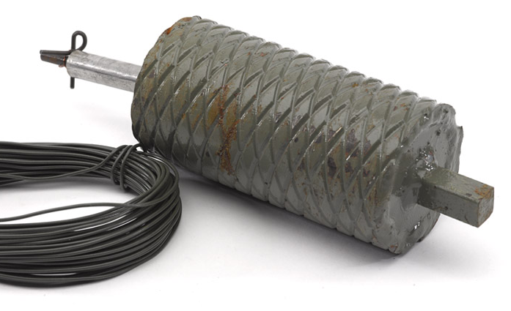
Reasons
Bosnia-Herzegovina used to be part of a country called Yugoslavia which was made up of different regions
Yugoslavia underwent a bloody break-up in the early 1990s
Bosnia became a major battleground in a violent and bitter multi-sided civil war when it declared independence in 1992
Notes:
NAM. 1997-09-66-1
TMR-2A anti-personnel mine used by the former Yugoslav Army, 1995 (c); made by SDPR, Beograd, Yugoslavia; copy of USSR POM - 2 and C2ECH PP - Mi - 5b stake mine.

Slide 14
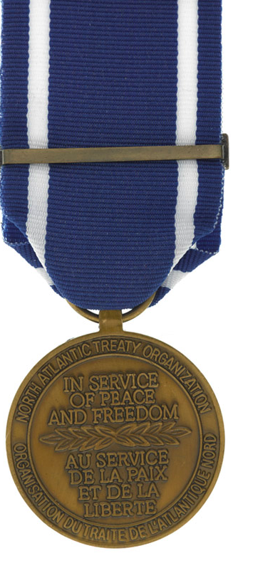
Reasons
The population of Bosnia was comprised of three ethnic groups: Serbian, Croatian and Muslim. The Bosnian Serb population saw their future as being joined with Serbia, now an independent neighbouring state
The Bosnian Serbs isolated Bosnian Muslims and carried out an ‘ethnic cleansing’ campaign
During the war there were instances of brutality on each side
The British Army became involved through their peacekeeping and conflict missions, mandated by the United Nations and NATO
Notes:
NAM. 1999-05-48-2
NATO Medal 1994, Former Yugoslavia.

Slide 15
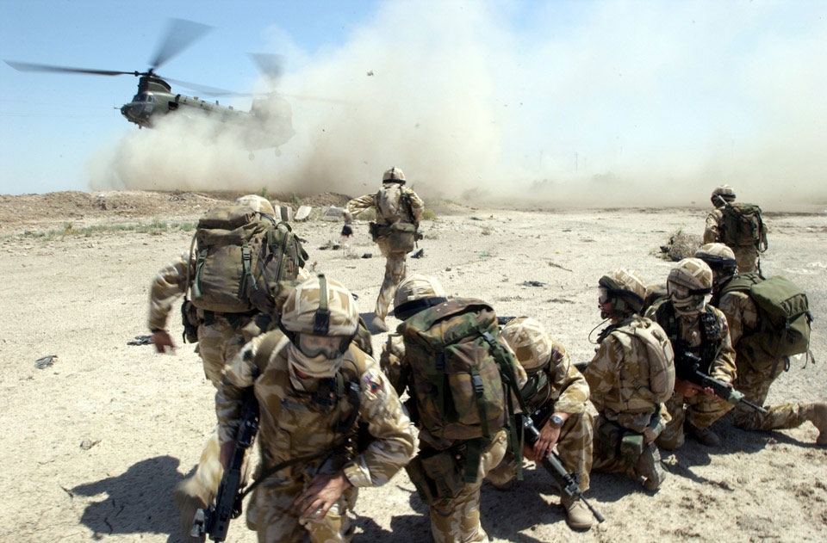
Are there any clear cases where the Army should be sent to fight?
Notes:
NAM. 2005-01-67-1
Digital photograph: Soldiers from the RECCE and PATROLS Platoon, Fire Support Company of The 1st Battalion The Royal Welch Fusiliers (1 RWF) mount heliborne Eagle VCP's (Vehicle Check Points).
Two teams of soldiers were deployed to various locations by RAF (Royal Air Force) Chinook helicopters where they performed spot checks on passing traffic in an attempt to deter the possible smuggling of weapons and or contraband around areas of importance.
Photographed by WO2 Giles Penfound, Army Media Operations, Basra, southern Iraq, Operation TELIC 4, 2 July 2004.
Crown copyright.

Slide 16
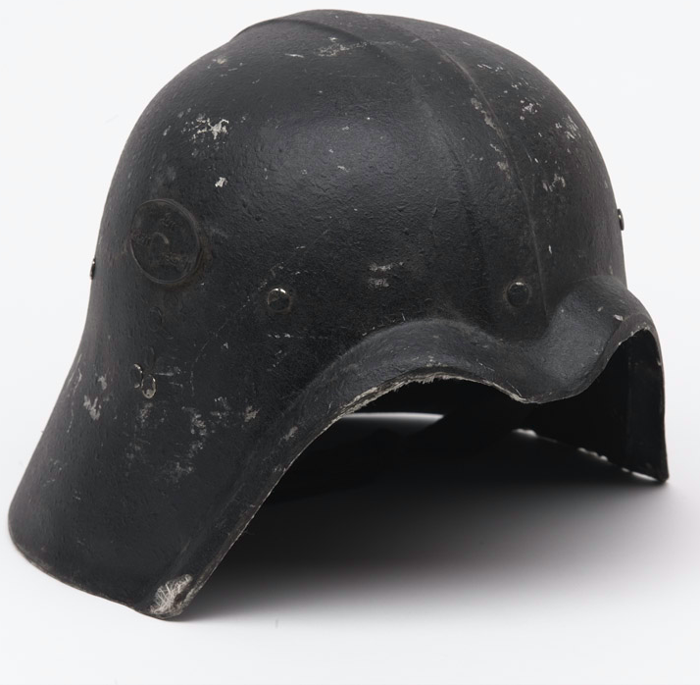
Deciding to fight
The Army doesn’t choose who or where it fights – that’s decided by our government.
How much say should the following have in a decision:
  The Prime Minister?
  The Cabinet?
  The House of Commons?
  The Houses of Parliament?
  The Monarch?
  The Army?
  The UK’s citizens?
Notes:
NAM. 2004-01-53-1
Helmet, Fedayeen Forces, Iraq, nd.
Manufactured in Iraq.
Black ballistic resistant plastic, elongated at the back to cover the neck.
Canvas straps attached but no padding.
Positioned on helmet on the left hand side, a small logo showing a map of Iraq.
Made for the Fedayeen forces who fought in support of Saddam Hussein during Iraq (2003-).

Slide 17
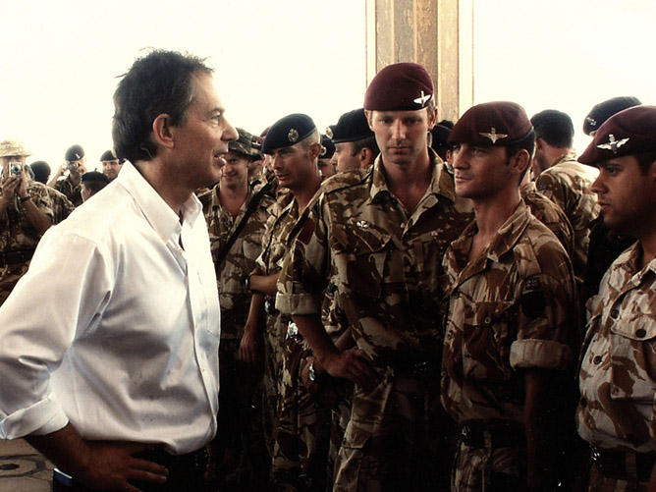
What evidence should decision makers have before approving military action?
Notes:
NAM. 2012-10-22-320
Untitled photograph taken by Graham Thomas, early June 2003.
Shows Prime Minister Tony Blair speaking with assembled troops of the Desert Rats in Basra Palace during the Prime Minister’s first visit to Iraq.
From a collection of British soldiers’ photographs taken during Operation TELIC, Iraq, 2003.
Crown copyright.
Submitted for an Army photographic competition.
Associated with Operation TELIC and the Liberation of Basra, Iraq (2003- ) 2003.

Slide 18
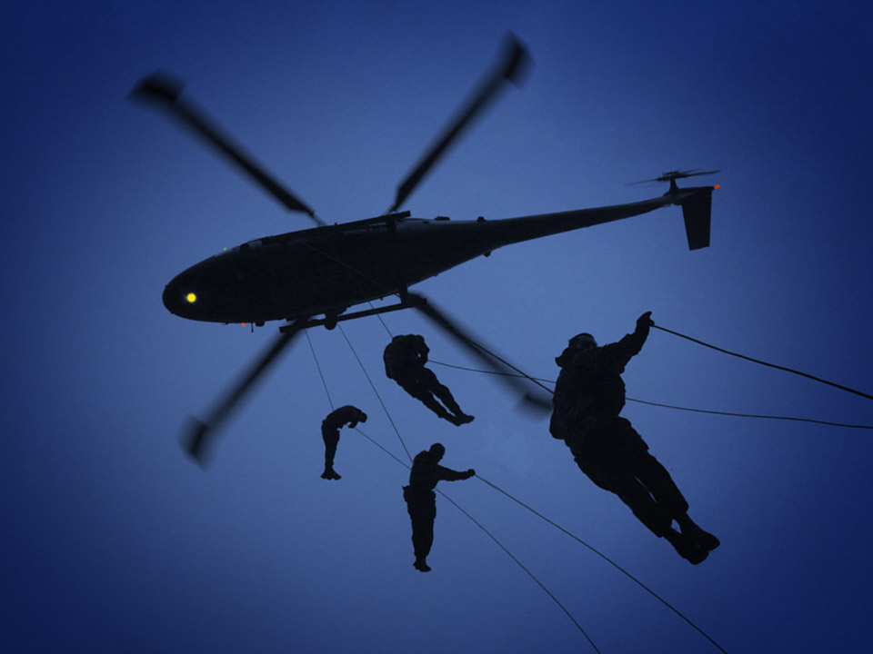
Should the public know about or approve any military activity by the British Army?
Notes:
NAM. 2012-10-22-320
One of a set of 201 images from a DVD of multimedia relating to explosive ordnance work in the United Kingdom and Iraq.
Crown copyright.

Slide 19
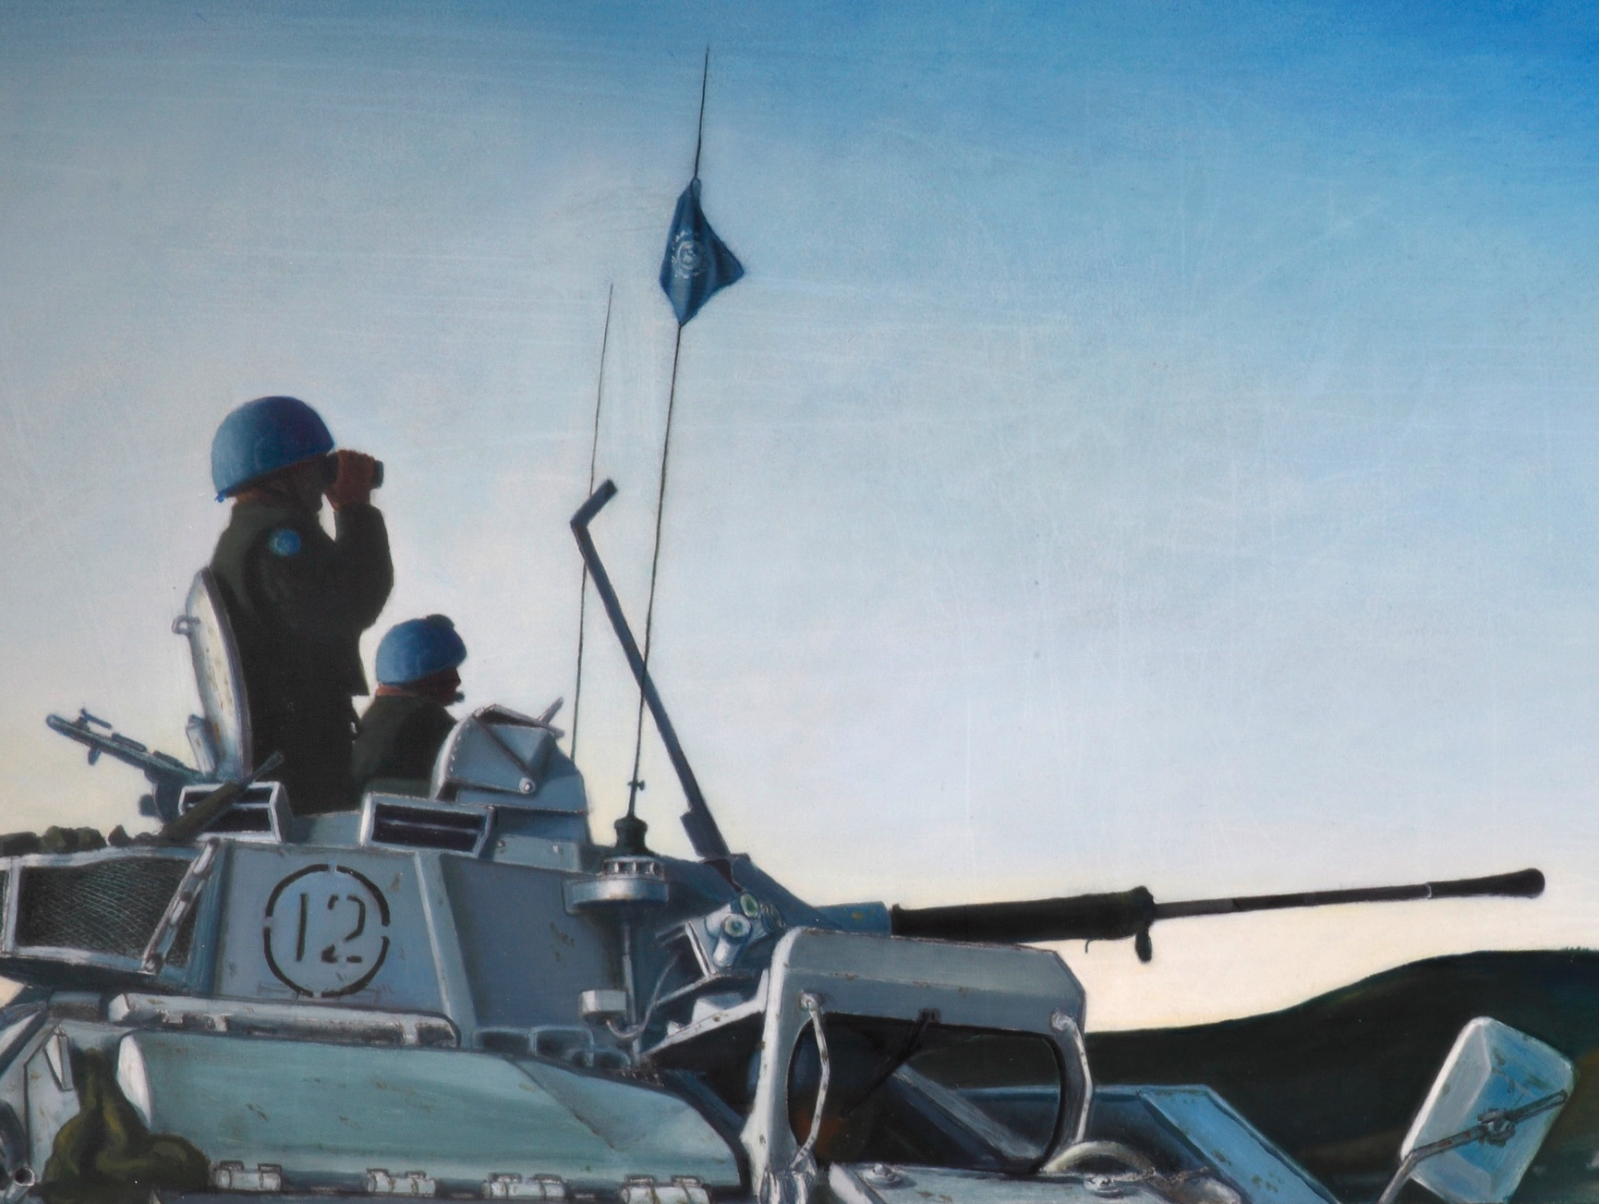
How do you decide whether fighting was the right decision?
Notes:
NAM. 1999-06-13-1
Balkan Dusk, Bosnia, 1994, after a photograph taken by a member of the 2nd Battalion the Royal Anglian Regiment.
Oil on board signed and dated lower right by Jonathan Wade (b 1960), Royal Highland Fusiliers, 1994 (c).
This painting is based on a photograph of a Warrior, or Combat Vehicle, Personnel, Tracked, of the 2nd Battalion Royal Anglian Regiment, taken on Mount Igman, near Sarajevo in 1994.
An unidentified non-commissioned officer of C Company stands in the turret to survey the terrain, accompanied by his gunner, Private Wayne Allen. Nicknamed ‘The Poachers’ from their predecessor the Royal Lincolnshire Regiment, the 2nd Battalion, Royal Anglian Regiment began their six-month roulement in Bosnia, Operation GRAPPLE 4, on 8 May 1994. As part of UNPROFOR, the United Nations Peace-keeping Force in Former Yugoslavia, the vehicle flies the United Nations flag from a radio antenna. The angled pole appearing to intersect it is a wire-cutter, to prevent the decapitation of crewmen by wire strung across the road by members of the warring factions. Projecting from the front is Warrior’s main armament, the 30 mm Rarden cannon.
During Operation GRAPPLE, British troops’ duties included convoy escort to ensure the safe passage of humanitarian aid to the needy. While accompanying convoys into Sarajevo, they were regularly fired upon by Bosnian Serbs from Mount Igman and other heights overlooking the city. They also manned checkpoints along convoy routes and at points of potential confrontation. Many troops found a terrible contrast between the beauty of the countryside and the atrocities committed by the conflicting sides in this civil war.

Slide 20
Take a view…
When is it right to send the Army to fight?
Notes:
NAM. 2005-01-67-20
Digital photograph: A soldier serving with the 1st Battalion The Royal Irish Regiment stands guard over several hundred Iraqi POW’s held at a transit base before they are moved onto a safer area away from the conflict.
Crown copyright.
Photographed by WO2 Giles Penfound, Army Media Operations, southern Iraq, Operation TELIC, 24 March 2003.
From a CD entitled 'Iraq Conflict. Operation Telic', compiled by WO2 Penfound, for an exhibition at the NAM provisionally entitled 'Conflict' (Project: Operation TELIC).
Associated with 1st Battalion, The Royal Irish Regiment, Iraq (2003-).

