Slide 1
Black History in the NAM Collections
African Soldiers Remembered (1900 – 1957)

Slide 2
Bandsman Yessafu
Gold Coast Regiment, 1900
Notes:
Photograph, 1900 (c).
Bandsman Yessafu was a Mamprusi from the White Volta area in the north of the Gold Coast (now Ghana). This image depicts his tribal markings on his face.
From a photograph album of 238 photographs taken and collected by Colonel O M Harris, Royal Artillery 1897-1914.
NAM Accession Number
NAM. 1978-07-7-16

Slide 3
Sergeant-Major Bobie
2nd Northern Nigeria Regiment, West African Frontier Force, Nigeria, 1901 (c)
Notes:
Sergeant-Major Bobie, 'C' Company, 2nd Northern Nigeria Regiment, West African Frontier Force, Nigeria, 1901 (c)
Nigerian men served in the regiment as private soldiers and as non-commissioned officers (NCOs), led by British officers and NCOs. Sergeant-Major Bobie was one of the most senior African soldiers in the regiment at this time.
From photograph album of 145 photographs associated with the Nigeria Regiment and West Africa, 1901-1902.
NAM Accession Number
NAM. 1969-04-48-1
The Northern Nigeria Regiment was formed in 1901 after Nigeria became a British protectorate. In the Northern Nigeria Regiment, as with all British African army units, African soldiers could not serve as officers.
From photograph album of 145 photographs associated with the Nigeria Regiment and West Africa, 1901-1902.
NAM Accession Number
NAM. 1969-04-48-4

Slide 4
Sergeant-Major Bobie, Sergeant Musa and Lance Corporal Taubu and their wives,
2nd Northern Nigeria Regiment, West African Frontier Force1901 (c)
Notes:
Sergeant-Major Bobie, Sergeant Musa and Lance Corporal Taubu and their wives, Nigeria, 1901 (c)
Three non-commissioned officers of the 2nd Northern Nigeria Regiment, West African Frontier Force, pose for a photograph with their wives. The Northern Nigeria Regiment was formed in 1901 when Nigeria became a British protectorate.
From photograph album of 145 photographs associated with the Nigeria Regiment and West Africa, 1901-1902.
NAM Accession Number
NAM. 1969-04-48-7

Slide 5
Private Yacuba
The Northern Nigeria Regiment, West African Frontier Force, 1902
Notes:
Private Yacuba, The Northern Nigeria Regiment, West African Frontier Force, May 1902
Photograph, West Africa, 1902.
Private Yacuba served as an Orderly to a British officer at Iheri in Nigeria. The West African Frontier Force had been formed in 1900 under the control of the Colonial Office and officered by the British Army.
NAM Accession Number
NAM. 1969-04-48-21

Slide 6
Private Adiatoto and Private Awo, 'C' Company, 2nd Northern Nigerian Regiment, 1902 (c)
Notes:
Hospital assistants Private Adiatoto and Private Awo, 'C' Company, 2nd Northern Nigerian Regiment, 1902 (c)
Photograph, West Africa, 1902 (c).
The Northern Nigeria Regiment was raised in 1901 by the amalgamation of the West African Field Force (raised 1897) and the Royal Niger Constabulary (raised 1886) companies in Northern Nigeria.
From photograph album of 145 photographs associated with the Nigeria Regiment and West Africa, 1901-1902.
NAM Accession Number
NAM. 1969-04-48-42

Slide 7
Regimental Sergeant Major Awaleh Farah
Somaliland Camel Corps, 1933 (c)
Notes:
Regimental Sergeant Major Awaleh Farah of the Somaliland Camel Corps, 1933 (c)
Photograph, East Africa, 1933 (c).
Like many other colonial units, the Somaliland Camel Corps was staffed by British officers and locally recruited soldiers. The Somalians had a long tradition of using camels as they were ideal beasts for the dry climate and barren terrain of their country. Regimental Sergeant Major (RSM) Awaleh Farah was the senior non-commissioned officer (NCO) of his unit.
From an album of 63 photographs compiled by Lieutenant-Colonel H B Holt, Somaliland Camel Corps, 1933-1934.
NAM Accession Number
NAM. 1976-03-59-38

Slide 8
Sergeant Walisema
King’s African Rifles, 1940
Notes:
Sergeant Walisema being decorated, 1940 (c)
Photograph, World War Two, 1940 (c).
In 1938, the regimental strength of the King's African Rifles amounted to 94 officers (all British), 60 African NCOs and 2821 other ranks. After the outbreak of war, these men (Sergeant Walisema included) provided the trained nucleus for the rapid expansion of the regiment. By March 1940, its strength had reached 883 officers, 1,374 NCOs and 20,026 other ranks.
From a collection of 93 photographs of the King's African Rifles.
NAM Accession Number
NAM. 1963-01-55-12

Slide 9
Regimental Sergeant Major Khamis Jumna, The King's African Rifles, 1940 (c)
Notes:
Photograph, World War Two, 1940 (c).
RSM Khamis Jumna was from Sudan and served between 1905-1945. He was twice wounded and received nine medals including an MBE, East and Central Africa Medal 1906, East Africa Medal 1906-1907 (bars for 'Kisili', British Somaliland, 1909), the 1914 Star, British War Medal, Victory Medal, Long Service and Good Conduct Medal and the Africa Star 1939-45.
From a collection of 93 photographs of the King's African Rifles.
NAM Accession Number
NAM. 1963-01-55-75

Slide 10
Sergeant Makindi
King’s African Rifles, Burma, 1944
Notes:
Sergeant Makindi giving the battalion snipers lessons in compass-reading, Burma, 1944 (c)
Photograph, World War Two, Far East, 1944 (c).
Sergeant Makindi of the King's African Rifles was from Tanganyika and shortly before this photograph was taken had managed to get his intelligence patrol back to the unit HQ with all his men safe, having obtained the required information despite being ambushed by the Japanese on three occasions.
From an album of 190 photographs associated with the 11th East African Division and the King's African Rifles.
NAM Accession Number
NAM. 1982-06-58-65

Slide 11
Sergeant-Major Yowere bin Odong
4th (Uganda) Battalion, The King's African Rifles, 1944
Notes:
Platoon Sergeant-Major Yowere bin Odong DCM, 4th (Uganda) Battalion, The King's African Rifles, 1944 (c)
Photograph, World War Two, Far East, 1944 (c).
Yowere was the sergeant-major of Number 8 Platoon in 'A' Company. He is wearing the ribbon of the Distinguished Conduct Medal (DCM), awarded for his bravery in attacking a Japanese position at Leik Hill in Burma on 22 October 1944.
The citation for his award reads:
'Although wounded in the leg and only able to hobble he continued to lead his platoon against stiff opposition and personally led a 'Blitz' attack against an enemy LMG [Light Machine-Gun] in a bunker, capturing it and killing four of the enemy, and thus enabling the remainder of the Company to advance on its objective. He continued in action until the whole objective was made secure and by his staunchness and coolness throughout was the inspiration of his men.’
From an album of 608 photographs compiled by Colin Campbell of the King's African Rifles.
NAM Accession Number
NAM. 1997-08-57-502

Slide 12
Major Seth Anthony, the first African to gain a King's Commission, 1944 (c)
Notes:
Photograph, World War Two, Far East (1941-1945), 1944 (c).
Anthony (1915-2008) was from the Gold Coast (now Ghana) and already an officer cadet in the local forces when he enlisted in the Gold Coast Regiment of the Royal West African Frontier Force in 1939. Initially involved in the training of recruits, in 1941 he was sent for officer training at Sandhurst, being commissioned as second lieutenant in 1942. He later served in Burma with the 81st West African Division.
Anthony ended the war with the rank of major, having been mentioned in dispatches on several occasions. Appointed a Member of the Most Excellent Order of the British Empire (MBE) of the Military Division, he later worked as an Assistant District Officer in the years prior to the Gold Coast's independence. He later served as Ghana's first permanent representative at the United Nations in New York.
From an album of 28 photographs relating to West African troops in Burma, World War Two.
NAM Accession Number
NAM. 1992-07-54-19

Slide 13
Lance-Corporal Kisele Kilonzo
East African Reconnaissance Regiment, Burma, 1945
Notes:
Driver-mechanic Lance-Corporal Kisele Kilonzo, East African Reconnaissance Regiment, working on a tank, Burma, 1945
Photograph, World War Two, Far East, 1945.
Kisele Kilonzo was a Mkamba tribesman from Kenya. His tribal markings are visible on his arm as he repairs the tracks of an M3 tank. The East African Reconnaissance Regiment, part of 11th East African Division, was equipped with armoured cars and light tanks.
From an album of 147 photographs associated with Brigadier M W Briggs, 11th East African Division and the King's African Rifles.
NAM Accession Number
NAM. 1982-06-59-132
Lance-Corporal Kisele Kilonzo, East African Reconnaissance Regiment, looking out from the driver's hatch of his tank, 1945
Photograph, World War Two, Far East, 1945.
The East African Reconnaissance Regiment, part of 11th East African Division, was equipped with armoured cars and light tanks. Kilonzo's vehicle was probably a Stuart III, the British designation for the American M3A1 light tank.
From an album of 147 photographs associated with Brigadier M W Briggs and the 11th East African Division and the King's African Rifles.
NAM Accession Number
NAM. 1982-06-59-131

Slide 14
Sergeant Yowana
4th (Uganda) Battalion, The King's African Rifles, 1945 (c)
Notes:
Sergeant Yowana MM, 4th (Uganda) Battalion, The King's African Rifles, 1945 (c)
Photograph, World War Two, East Africa, 1945 (c).
Yowana was awarded the Military Medal (MM) for 'bravery in the field' during the campaign in Burma. He received his award during an inspection of his unit by General E C R Mansergh, GOC, 11th East African Division.
From an album of 608 photographs compiled by Colin Campbell of the King's African Rifles.
NAM Accession Number
NAM. 1997-08-57-503

Slide 15
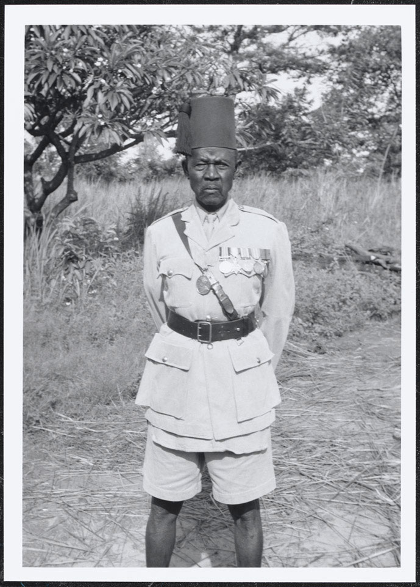
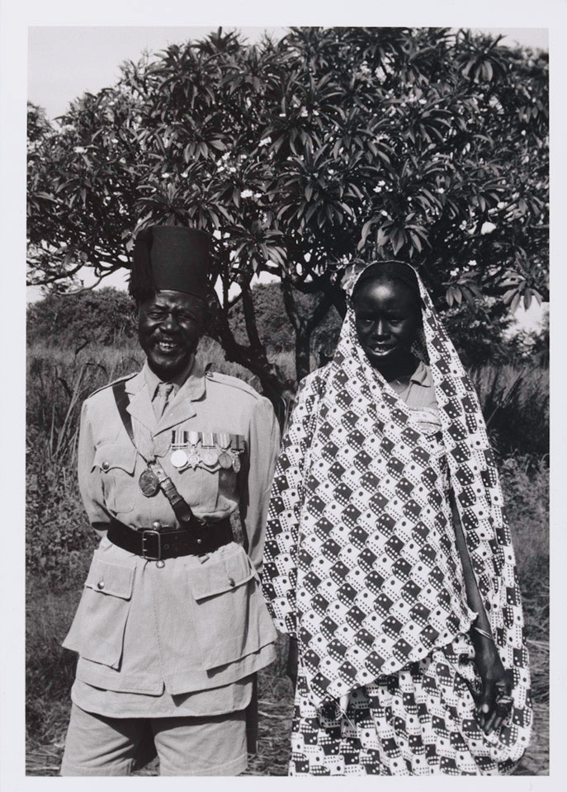
Ramadan Effendi
4th (Uganda) Battalion, King's African Rifles, 1956-1957 (c) (below, with his wife)
Notes:
Ramadan Effendi, 4th (Uganda) Battalion, King's African Rifles, and his wife, at his home near Gulu, Acholi Province, 1956-1957 (c)
Photograph by Lieutenant Roger Perkins, 4th (Uganda) Battalion King's African Rifles, 1956-1957.
Ramadan Effendi was a senior Warrant Officer in the 4th (Uganda) Battalion, King's African Rifles. He wears the traditional parade uniform of the regiment, comprising khaki drill with a tall fez. Pictured at his home near Gulu, Acholi Province.
NAM Accession Number
NAM. 1991-03-14-1
Ramadan Effendi MM, 4th (Uganda) Battalion, The King's African Rifles, at his home near Gulu, Acholi Province, 1956-1957 (c)
Photograph by Lieutenant Roger Perkins, 4th (Uganda) Battalion King's African Rifles, 1956-1957.
Ramadan Effendi is depicted wearing dress uniform and the traditional fez of the regiment. As well as the Military Medal (MM), he held the 1914-15 Star, British War Medal, Victory Medal and the Defence Medal 1939-45. Pictured at his home near Gulu, Acholi Province.
NAM Accession Number
NAM. 1991-03-14-32

