Slide 1
Black History in the NAM Collections
Army and Empire in the
First and Second World Wars

Slide 2
First World War: Caribbean Regiments

Slide 3
'Young Men of the Bahamas'
Notes:
'Young Men of the Bahamas’
This recruiting poster was produced in the West Indies by the Gleaner Company Limited of Kingston, Jamaica. Thousands of men and women from across the British Empire volunteered to fight Britain's enemies during World War One (1914-1918). The Caribbean was no different and men from across the region served in the Army and the Royal Navy.
NAM Accession Number
NAM. 2014-03-7-4

Slide 4
Watching aircraft, September 1918
Notes:
Lantern slide, World War One, Western Front (1914-1918), 1918.
Members of the British West Indies Regiment observe aircraft above their camp on the Albert to Amiens Road. Their regiment had been raised in October 1915 and its battalions served in France, Italy, Africa and the Middle East. When the British West Indies Regiment served on the Western Front there was an official reluctance to deploy its men in front-line positions, rather than as labourers in the rear. Such attitudes were based on racial stereotypes about the lack of 'martial spirit' possessed by Caribbean men. Such views resulted in a mutiny at Taranto in Italy in 1918 where members of the regiment were being used on labouring duties that included the cleaning of latrines for white troops and Italian labourers.
From a box of 73 lantern slides.
NAM Accession Number
NAM. 1978-11-157-24-52

Slide 5
First World War: Campaigns in Africa

Slide 6
A Yao askari, King's African Rifles, 1914
Notes:
Watercolour by Margaret Metcalfe (1877-1972), 1914 (c).
The Yao were a Muslim people from the region around the southern part of Lake Malawi (formerly in British Nyasaland). They formed the main source of recruits for the King's African Rifles Nyasaland battalions. Originally, the main reason for the large number of Yao volunteers was probably the simple fact that the recruitment office was near Yao areas. However, due to prevailing racial ideals the British interpreted this as a sign of their 'martial spirit'. This led to an active official policy of enlisting the Yao, which in turn made military service ever more attractive among this group.
NAM Accession Number
NAM. 1980-04-60-1

Slide 7
Askaris moving a field gun into position, 1914 (c)
Notes:
Photograph, World War One, East Africa, 1914 (c).
Black soldiers from Britain's African colonies bore the brunt of the fighting against the Germans in East Africa during World War One (1914-1918). The British lost over 10,000 men, two thirds from disease. German losses were about 2,000. The black peoples of East Africa, who served as soldiers and carriers, suffered far more. One recent estimate of black African casualties is 100,000 dead on both sides.
From a collection of 164 official photographs.
NAM Accession Number
NAM. 2002-02-589-141

Slide 8
The Nigerian Regiment Artillery under Lieutenant O T Frith with a field gun, 1914 (c)
Notes:
Photograph, World War One, West Africa, 1914 (c).
The five-battalion strong Nigeria Regiment, Royal West African Frontier Force, was formed by the amalgamation of the Northern Nigeria Regiment and the Southern Nigeria Regiment in January 1914. The regiment served throughout World War One in West Africa, assisting in the capture of the German colonies of Togoland and Kamerun (now Cameroon).
Collected by Lieutenant Mark Culling Carr Gomm.
NAM Accession Number
NAM. 1987-05-8-1

Slide 9
A King's African Rifleman by a sentry box, 1916
Notes:
Photograph, World War One, Africa (1914-1916), 1916.
An African soldier stands guard at the entrance to the regimental lines. He wears the traditional fez hat. Five more soldiers, all of whom are bare foot like the sentry, stand behind him. As recruits to the King's African Rifles tended not to wear boots in their civilian lives they were not issued with them in this early period.
One of 16 photographs associated with King's African Rifles.
NAM Accession Number
NAM. 1965-06-73-16

Slide 10
Men of the King's African Rifles, 1916 (c)
Notes:
Photograph, World War One, East Africa, 1916 (c).
Formed at the beginning of the 20th century from tribesmen in British East Africa (now Kenya) and Uganda, the King's African Rifles played a key role during the East African campaign. Locally recruited soldiers were considered more resistant than their European counterparts to the climate and local diseases. By November 1918 the 'British Army' in this theatre was mainly composed of African soldiers.
One of 16 photographs associated with King's African Rifles.
NAM Accession Number
NAM. 1965-06-73-4

Slide 11
Soldiers of the King's African Rifles receiving instruction in the use of a machine gun, 1916
Notes:
Photograph, World War One, East Africa (1914-1918), 1916.
During the East African Campaign the Germans recruited African troops skilled in the art of bush craft, which enabled them both to live off and move swiftly through the region's inhospitable terrain. These skills combined with extensive training in the use of European weapons enabled Germany's tiny East African colonial forces (known as Schtztruppen) to resist the superior Allied forces arrayed against them. It was the recognition of the abilities of African troops and the need to mimic this specialised type of warfare on the part of British commanders that led to the wartime expansion of the King's African Rifles and their extensive employment in this campaign.
One of sixteen photographs associated with King's African Rifles.
NAM Accession Number
NAM. 1965-06-73-6

Slide 12
A senior NCO of 2nd Battalion, The King's African Rifles, 1916 (c)
Notes:
Photograph, World War One, East Africa, 1916 (c).
Although the King's African Rifles were led by British officers, most of the regiment's non-commissioned officers (NCOs) were African. The second battalion had been disbanded in 1911 at Zomba but was reformed in April 1916 at Nairobi from four companies of the 1st Battalion.
One of 27 photographs collected by Major William Dickinson, 2nd Bn King's African Rifles.
NAM Accession Number
NAM. 1990-08-141-15

Slide 13
General Jan Smuts visiting African labourers on the Western Front, 1917 (c)
Notes:
Lantern slide, World War One, Western Front (1914-1918), 1917 (c).
General Jan Smuts supported South Africa's entry into the war and formed the South African Defence Force. In 1915 he and General Louis Botha conquered German South West Africa.
In 1916 Smuts commanded the conquest of German East Africa, but despite mobilising a large force he struggled to defeat Colonel Paul von Lettow-Vorbeck's guerrilla forces. Von Lettow-Vorbeck was still at large when Smuts left to join the Imperial War Cabinet in 1917. He made several morale-raising visits to Allied troops on the Western Front and the following year he helped create the Royal Air Force.
From a box of 72 lantern slides.
NAM Accession Number
NAM. 1978-11-157-25-51

Slide 14
Second World War: Caribbean Women of the ATS

Slide 15
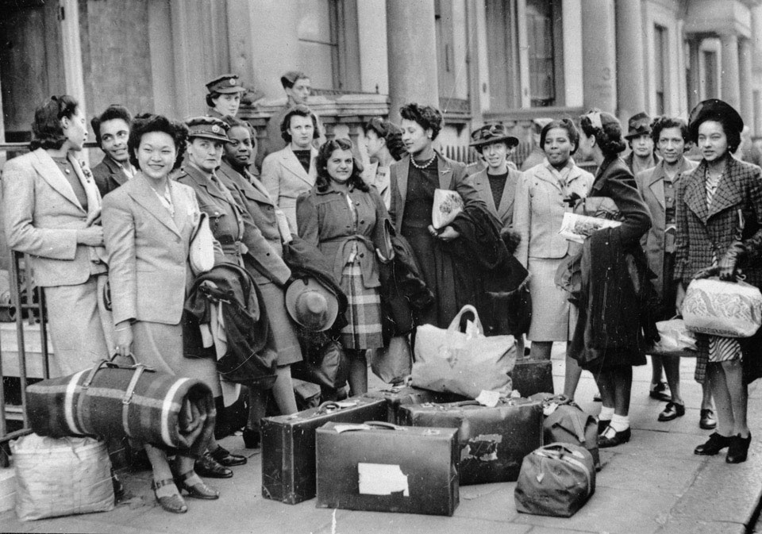
West Indian women in civilian dress with luggage, 1943 (c)
Notes:
Photograph, World War Two, 1943 (c).
The first contingents of West Indian women to serve in Britain's armed forces arrived in Britain in 1943. Approximately 70 served with the ATS (Auxiliary Territorial Service) and 80 with the RAF (Royal Air Force). Significant numbers of other West Indians arrived in Britain during the Second World War (1939-1945), serving in the armed forces or war industries. Many of these, together with other workers from across the Empire and Commonwealth, chose to stay in Britain after the war.
One of 69 photographs relating to the West Indies Auxiliary Territorial Service, 1943-1947.
NAM Accession Number
NAM. 1994-07-283-56

Slide 16
A West Indian member of the Auxiliary Territorial Service (ATS), 1943 (c)
Notes:
Photograph, World War Two, 1943 (c).
In October 1943 a group of 30 women from across the Anglophone Caribbean arrived in Britain. They were the vanguard of over 100 West Indian women eventually recruited to the ATS in Britain. Despite the wartime personnel shortage these pioneers faced a long struggle to be accepted as War Office officials were often hostile to the recruitment of black women.
One of 69 photographs relating to the West Indies Auxiliary Territorial Service, 1943-1947.
NAM Accession Number
NAM. 1994-07-283-1

Slide 17
West Indies Auxiliary Territorial Service office workers, 1943 (c)
Notes:
Photograph, World War Two, 1943 (c).
Women servicing with the Auxiliary Territorial Service (ATS) were employed in a number of roles, such as clerks, drivers, orderlies and cooks. Many moved on to higher clerical duties as their experience increased. West Indian women already living in Britain worked as nurses and in factories. Back in the West Indies women helped the war effort by working in hospitals and agriculture. However, British acceptance of the United States’ 'color bar' meant only white West Indian women were recruited to serve in the ATS section attached to the British military mission in Washington.
One of 69 photographs relating to the West Indies Auxiliary Territorial Service, 1943-1947.
NAM Accession Number
NAM. 1994-07-283-39

Slide 18
West Indies ATS personnel exercise on a beach, 1943-1947
Notes:
Photograph from a collection of 69 photographs relating to the West Indies Auxiliary Territorial Service, 1943-1947.
In October 1939 the Secretary of State for the Colonies, Malcolm MacDonald, announced that, for the duration of the war, British colonial subjects including those 'not of pure European descent', could enter the British armed forces. The War Office was more reluctant to recruit black people than the Colonial Office, and this delayed the arrival of volunteers from the Caribbean to Britain. It was not until 1943 that the War Office agreed to a scheme for the recruitment of black West Indian women into the Auxiliary Territorial Service (ATS).
NAM Accession Number
NAM. 1994-07-283-19

Slide 19
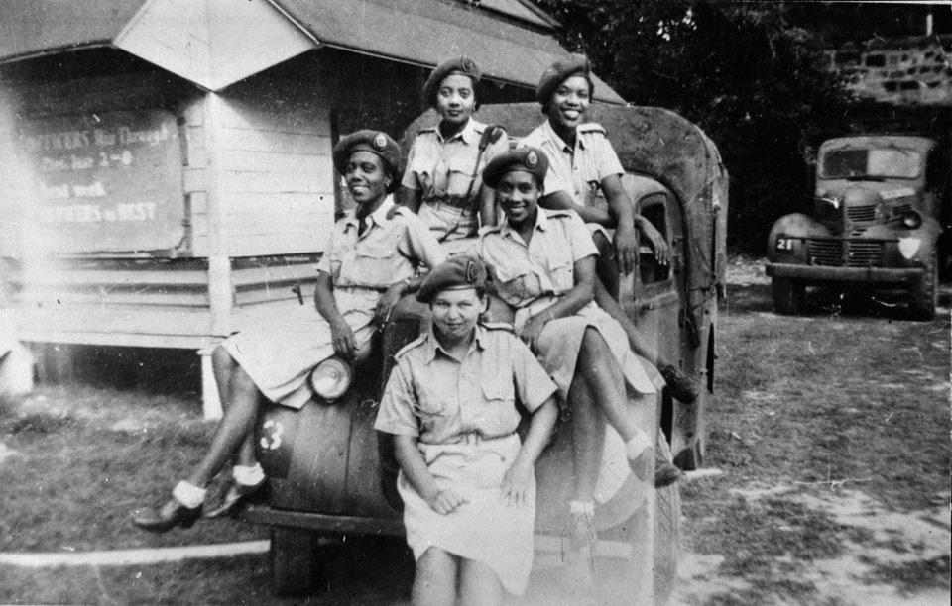
Five members of the West Indies Auxiliary Territorial Service sitting on a military vehicle, 1943 (c)
Notes:
Photograph, World War Two, 1943 (c).
In the early stages of the Second World War black Caribbean women wishing to support the war effort were given little support or encouragement by the British government. Voluntary groups in the West Indies were given no financial support from the War Office in London and those wishing to travel to Britain were discouraged either by the racial prejudice of recruiting officers or by policies such as that which stipulated that those wishing to serve in Britain had to pay there own passage across the Atlantic. However, in face of the exigencies of war which necessitated the total mobilisation of the Empire and Commonwealth citizens it became clear that this discriminatory policy could not stand. By 1943 West Indian Women were allowed to join the uniformed services and by the end of the war many hundreds had seen service with these organisations and thousands more contributed through work in essential industries and agriculture.
One of 69 photographs relating to the West Indies Auxiliary Territorial Service, 1943-1947.
NAM Accession Number
NAM. 1994-07-283-50

Slide 20
Second World War: Deployment of African Forces

Slide 21
Formation badge of 81st West African Division, 'Black Tarantulas', 1943 (c)
Notes:
Cloth badge with black spider on yellow ground.
The 81st West African Division was formed in Nigeria on 1 March 1943. It was composed of units from the Gambia, Nigeria, Sierra Leone and the Gold Coast (now Ghana). The emblem of a black tarantula spider on a yellow background was chosen as their formation badge. The badge continues the long tradition of using animals to represent qualities with which an organisation would like to be associated. The 81st hoped to have the attributes of the mischievous part-spider part-man African folk hero known as 'Anansi’. The 81st West African Division fought most notably in Burma during World War Two (1939-1945). It arrived in India in August 1943. The 3rd (West Africa) Brigade was detached to the Chindits, intended to garrison jungle bases for the raiding columns. The remainder of the division took part in the Second Arakan campaign during 1944, operating in the Kaladan Valley on the flank of Indian XV Corps. Paletwa is located in the Kaladan Valley near the Indian frontier.
NAM Accession Number
NAM. 1991-10-74-1

Slide 22
Troops of the Royal West African Frontier Force in the Arakan, Burma, 1944 (c)
Notes:
Oil on canvas by Captain Hugh Micklem, 1991.
The units depicted represent part of the 81st West African Division 'The Black Tarantulas'. These troops acquired a formidable reputation for their ability to wage war under extremely difficult conditions. The picture depicts infantry and artillery receiving an air drop of supplies. The artist served with the HQ of the 81st Division.
NAM Accession Number
NAM. 1991-07-138-1

Slide 23
Bofors gun crew from the King's African Rifles, 1939-1945 (c)
Notes:
Photograph, World War Two, 1939-1945 (c).
The Bofors 40 mm gun was the most widely used Allied anti-aircraft gun of the Second World War. The gun was quick firing, reliable and versatile. It had sufficient punch to knock out all types of aircraft and yet was light enough to be adapted to a mobile role. The gun had been adopted by 17 nations by the end of the War and a version of it is still in use with naval forces today.
From a collection of 93 photographs of the King's African Rifles.
NAM Accession Number
NAM. 1963-01-55-27

Slide 24
A detachment of the King's African Rifles marching from Garsen to Galbanti, 1939-1941 (c)
Notes:
Photograph, World War Two, East Africa, 1939-1941 (c).
The soldiers depicted are probably from the 3rd (Kenya) Battalion. As well as their Short Magazine Lee Enfield (SMLE) rifles and kit, they also carry bundles on their heads in the traditional manner.
From an album of 608 photographs compiled by Colin Campbell of the King's African Rifles.
NAM Accession Number
NAM. 1997-08-57-89

Slide 25
'Tradition and modern war', an Askari (a Ngoma) with traditional headdress and identity tags, 1942
Notes:
Photograph, World War Two, 1942.
A soldier from the 4th (Uganda) Battalion, The King's African Rifles, wears both his army identification tags and a traditional head dress, while taking part in a Ngoma ceremony during 1942.
From an album of 608 photographs compiled by Colin Campbell of the King's African Rifles.
NAM Accession Number
NAM. 1997-08-57-290

Slide 26
Signallers with the King's African Rifles taking down a message, 1943
Notes:
Photograph, World War Two, Far East, 1943.
Signallers made an invaluable contribution to the success of the King's African Rifles in Burma. Signallers faced a plethora of difficulties in the harsh climate. These included steep hills, torrential monsoon rainfall, heat and humidity, which all served to block or weaken radio signals. This combined with the weight and limited reliability of the radio sets, the problems with batteries and charging engines, the constant laying and repairing of telephone cable, illustrates the magnitude of their achievement in maintaining effective communications during the campaign.
From a collection of 93 photographs of the King's African Rifles.
NAM Accession Number
NAM. 1963-01-55-84

Slide 27
Nigerian soldiers with their Mallam, 1944 (c)
Notes:
Photograph, World War Two, Far East, 1944 (c).
Nigerian soldiers, probably from a battalion of the Nigeria Regiment of 81st West African Division, sit with their Mallam, an Islamic teacher, during a break from the fighting in Burma.
From an album of 36 photographs compiled by Captain E B Mee (later Major), Royal Signals, 81st West African Division.
NAM Accession Number
NAM. 1996-08-382-35

Slide 28
Victory in Europe Day celebrations at Nairobi, Kenya, May 1945
Notes:
Photograph, World War Two, 1945.
A battalion of the King's African Rifles, accompanied by a band, parade through the crowded streets of the Kenyan capital as cheering crowds look on.
One of 51 photographs collected, and possibly taken, by Gunner S J Church in Nairobi, Kenya, 1945.
NAM Accession Number
NAM. 2005-07-723-8

