Slide 1
From Buried among Kings: the story of the Unknown Warrior and the wider NAM collection
First World War
Memorials

Slide 2
About this resource
This PowerPoint presentation contains a selection of images and archives which students can use to explore First World War memorials. The materials come from the Collection of the National Army Museum (NAM).
Unless otherwise stated in the notes, the images can be freely used for non-commercial purposes within the classroom. You can use the entire presentation or choose individual images for use in other non-commercial contexts. When using individual images in other contexts, please always retain the attribution statements provided in this document (e.g. NAM. 2005-08-66-1).
By downloading this document and using these images you agree to these terms of use, including your use of the attribution statement specified for each object by NAM.

Slide 3
WWI memorials from
Buried among Kings: the story of the Unknown Warrior

Slide 4
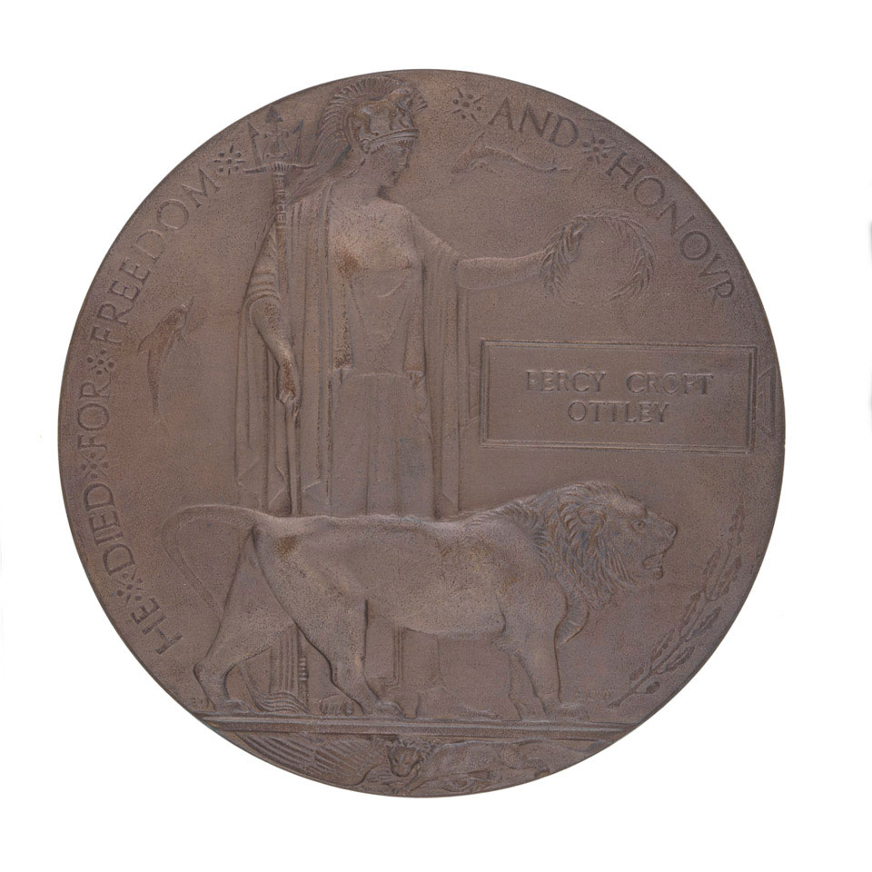
Commemorative medallion, 1914-1918
Notes:
Circular, bronze memorial plaque or medallion issued to the relatives of the 1.3 million Commonwealth service personnel killed during World War One (1914-1918).
Commonly known as the 'Dead Man's Penny', the plaque was designed by Edward Carter Preston (1885-1965) who was commissioned after winning a War Office competition. The figure of Britannia holds a trident while a lion, a symbol of Britain's strength, stands beside her. She gestures with an olive branch towards the soldier's name, held in a rectangular panel. The medal is inscribed, 'She Died for Freedom and Honour'. Dolphins on either side of the panel represent Britain's naval power and below the standing lion, another lion is shown pouncing on an eagle, symbolising Britain's victory over Germany.
The Commonwealth War Graves Commission records the death of Private Percy Crofts Ottley (service number 515413), on the 23 November 1917, aged 32, on the Cambrai Memorial at Louveral. Ottley was born in Ranskill, Nottinghamshire on 31 August 1885. Before the war Ottley was a bank clerk with Messrs Beckett and Company of Doncaster.
NAM Accession Number
NAM. 2007-04-42-3

Slide 5
Photograph showing the unveiling of an Indian War Memorial at Neuve-Chapelle, 1927
Notes:
Photograph showing the unveiling of an Indian War Memorial at Neuve-Chapelle, 1927
NAM Accession Number
NAM. 1965-10-221-94

Slide 6
Photograph postcard of a village War Memorial
Notes:
Photograph postcard of a village War Memorial
NAM Accession Number
NAM. 1999-07-23-26

Slide 7
Model of the cenotaph erected in Whitehall, London in memory of the fallen in the great war 1914-1918
Notes:
Model of the cenotaph erected in Whitehall, London in memory of the fallen in the great war 1914-1918
NAM Accession Number
NAM. 2002-09-72-1

Slide 8
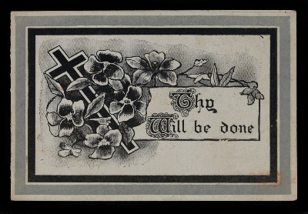
Memorial card for the Unknown Warrior interred in Westminster Abbey, 11 November 1920
Notes:
Printed by East London Printing Company, this card commemorates the burial of the Unknown Warrior in Westminster Abbey, London. The idea for a tomb was championed by Reverend David Railton, who had served as a British Army chaplain on the Western Front. He felt that it was important that the funeral of one unidentified soldier was recognised at a national level to symbolise the burials and funerals of all the unidentified soldiers. From a collection of eight documents relating to G/2914 Pte Alfred Price, 7th Battalion, The Buffs (East Kent Regiment).
NAM Accession Number
NAM. 2001-11-39-8

Slide 9
WWI memorials from
the wider NAM collection

Slide 10
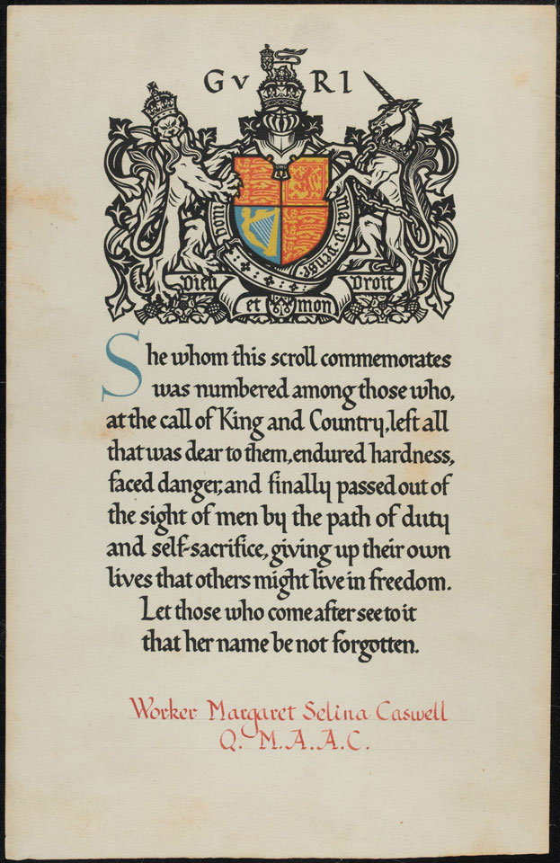
Scroll accompanying Commemoration Medallion 1914-1918 for Margaret Selina Caswell, Queen Mary's Army Auxiliary Corps
Notes:
Caswell (1896-1918) joined the Women's Army Auxiliary Corps (WAAC) at Tidworth in 1917. The WAAC (re-named Queen Mary's Army Auxiliary Corps in April 1918) had been formed that year to free up valuable and experienced soldiers from the rear areas for front line service. Women were employed in a variety of jobs. As well as cooking and waiting on officers, they served as clerks, telephone operators, store-women, drivers, printers, bakers and cemetery gardeners. Given the rank of worker, Margaret was sent to France where she worked as a waitress at an officers club' at Abbeville camp. During the night of 29-30 May 1918 German aircraft attacked QMAAC Camp 1 at Abbeville and one of their bombs fell into a protection trench killing 22-year-old Caswell and eight of her colleagues and wounding a further seven.
NAM Accession Number
NAM. 1998-01-34-1

Slide 11
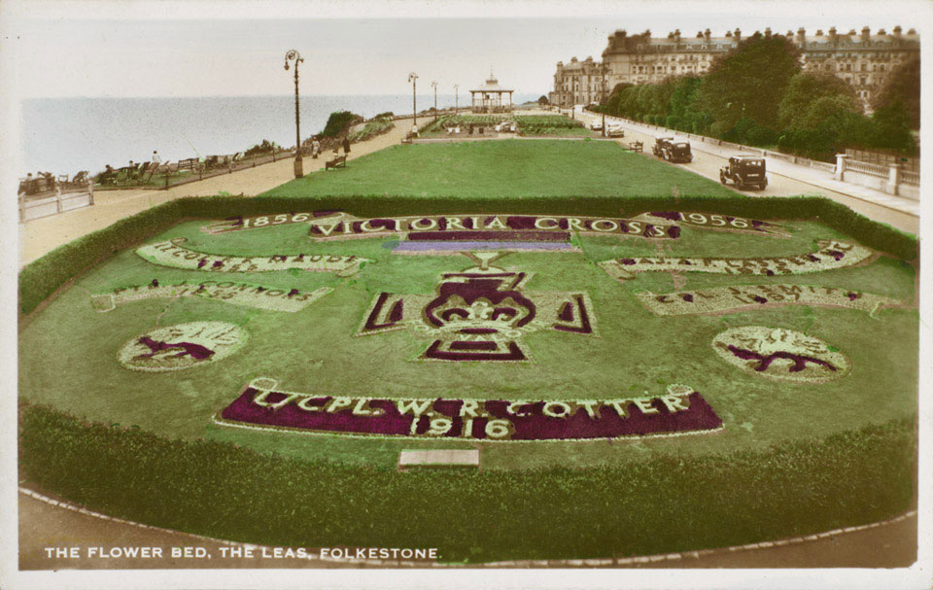
Memorial flowerbed to A/Corporal William Cotter, the Leas, Folkestone
Notes:
William Richard Cotter of 6th (Service) Battalion, The Buffs (East Kent Regiment) was posthumously awarded the Victoria Cross (VC) for an act of gallantry on 6-7 March 1916 near the Hohenzollern Redoubt at Loos. He was commemorated in his hometown of Sandgate in Kent on a memorial tablet in the entrance lobby of the Chichester Hall and by this flower bed on the front at Folkestone.
NAM Accession Number
NAM. 2001-01-316-2

Slide 12
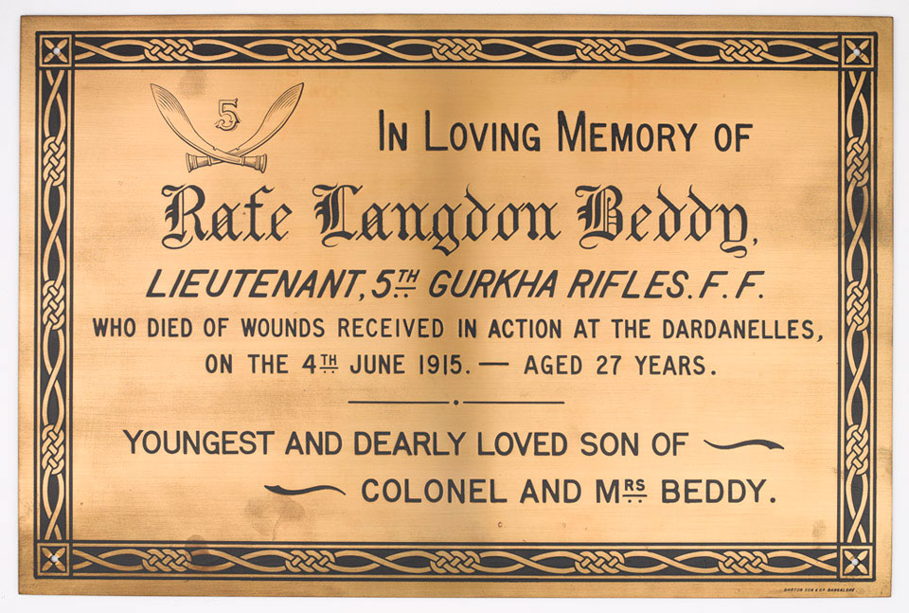
Commemorative plaque, Lieutenant Rafe Langdon Beddy, 5th Gurkha Rifles Frontier Force, 1915
Notes:
Commemorative plaque made by Barton and Sons, from the Punjab Frontier Force Memorial Wall No 6, with a dedication from Colonel and Mrs Beddy, 1915.
After the Partition of India in August 1947 the Frontier Force units were divided between the Indian and Pakistan Armies. It was then decided that the memorials to the Punjab Frontier Force, the 'Piffers', erected in the garrison churches should be relocated to England, and in 1951 they were installed in the Parish Church of St Luke's, Chelsea. Lieutenant Beddy died of wounds on the 4 June 1915, aged 27 years, during the Dardenelles campaign in World War One (1914-1918). The Commonwealth War Graves Commission records Beddy's grave at Pink Farm Cemetery at Helles on the Gallipoli Peninsula.
NAM Accession Number
NAM. 1998-10-84-1

Slide 13
Statuette of a saddled horse, a memorial to members of 14th Lancers killed in World War One
Notes:
Silver, no details, 1918 (c).
After the War the 14th Murray's Jat Lancers chose this beautifully modelled saddled horse as a memorial to all ranks of the regiment killed in action. It usually stands on a plinth inscribed with the names of all the men of the regiment who died. On 21 September 1920 the 14th Murray's Jat Lancers and 15th Lancers (Cureton's Multanis) were amalgamated at Sialkot to form the 20th Lancers.
NAM Accession Number
NAM. 1974-12-81-1

Slide 14
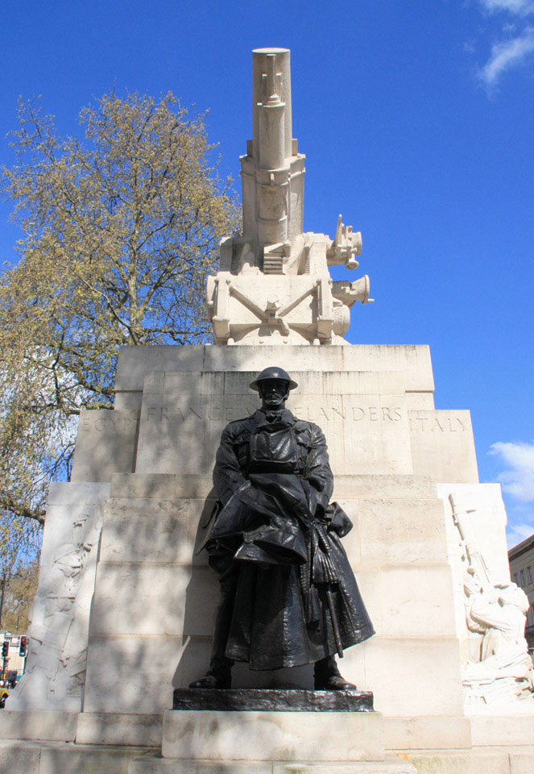
Royal Artillery Memorial, Hyde Park Corner, London Below: 1925; right: 2015
Notes:
1. Photograph postcard by Wildt and Kray, 1925 (c).
The memorial is dedicated to the remembrance of all ranks of the Royal Regiment of Artillery who lost their lives during the First World War (1914-1918). It was designed by the sculptor Charles Sargeant Jagger (1885-1935) and the architect Lionel Godfrey Pearson (1879-1953). The memorial was unveiled by Prince Arthur, the Duke of Connaught and Strathearn on 18 October 1925. It consists of a monumental sculpture in stone of a howitzer on a large plinth, with stone reliefs and four bronze figures of Royal Artillery personnel. Jagger was a veteran of World War One and received the Military Cross for gallantry. He was wounded at Gallipoli and on the Western Front.
NAM Accession Number
NAM. 1987-12-33-1
2. Digital photograph by Rod Cooper, 2015.
The memorial is dedicated to the remembrance of all ranks of the Royal Regiment of Artillery who lost their lives during the First World War (1914-1918). It was designed by the sculptor Charles Sargeant Jagger (1885-1935) and the architect Lionel Godfrey Pearson (1879-1953). The memorial was unveiled by Prince Arthur, the Duke of Connaught and Strathearn on 18 October 1925. It consists of a monumental sculpture in stone of a howitzer on a large plinth, with stone reliefs and four bronze figures of Royal Artillery personnel. Jagger was a veteran of World War One and received the Military Cross for gallantry. He was wounded at Gallipoli and on the Western Front. This bronze figure, one of four on the memorial, represents a Royal Artillery officer. The figure was modelled on Eugene Paul Bennett VC, an officer from Jagger's unit, the Worcestershire Regiment.
NAM Accession Number
NAM. 2016-04-112-17

Slide 15
Bronze medal commemorating the unveiling of the Australian War Memorial, 1938
Notes:
King George VI unveiled the memorial at Villers-Bretonneux in France on 22 July 1938. It commemorates the 10,700 Australians who died in France and Belgium during the First World War. Designed by Sir Edwin Lutyens between 1927 and 1932, the memorial was not completed until 1938 due to spending cuts during the Great Depression.
NAM Accession Number
NAM. 1981-07-4-1

Slide 16
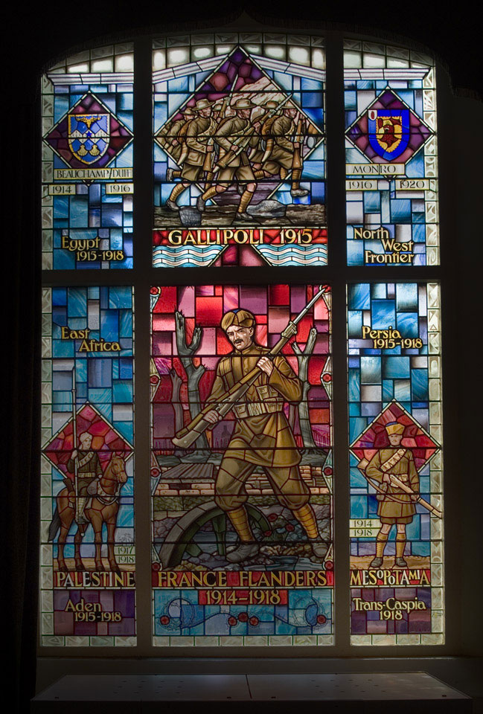
Stained glass window memorial to the Indian Soldier, 1970
Notes:
Designed by David Maile and made by G Maile and Sons, 1970.
This stained glass window commemorates the service of Indian Army soldiers during World War One (1914-1918). The central detail depicts a sepoy advancing through a war torn landscape, with shelled tree stumps behind. The campaigns in which Indian soldiers served are listed around the edge and include France and Flanders, Egypt, Palestine, East Africa, Persia, Mesopotamia, Gallipoli and the North West Frontier of India.
NAM Accession Number
NAM. 2003-05-172-1

Slide 17
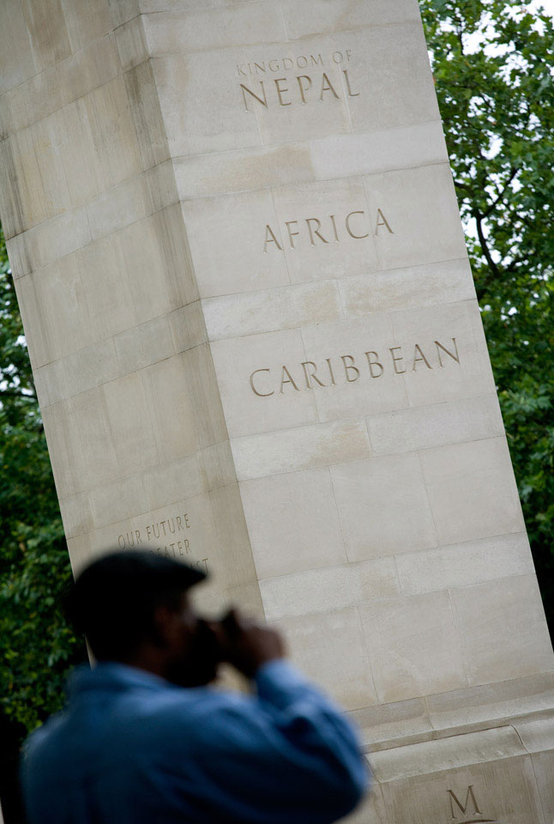
Memorial Gates, Constitution Hill, 2008
Notes:
Photograph by Giles Penfound, August 2008.
Queen Elizabeth II officially inaugurated the Memorial Gates on 6 November 2002. The memorial gates honour the sacrifice and legacy of the five million men and women from the Indian subcontinent, Africa and the Caribbean who volunteered to serve with the Armed Forces during the two World Wars.
NAM Accession Number
NAM. 2008-08-18-78

