Slide 1

West Indian Soldier
Learning virtual exhibition tour
Sources from the
National Army Museum

Slide 2
About this resource
This PowerPoint presentation contains a selection of images and archives which students can use to explore the West Indian Soldier story. The materials come from the Collection of the National Army Museum (NAM).
Unless otherwise stated in the notes, the images can be freely used for non-commercial purposes within the classroom. You can use the entire presentation or choose individual images for use in other non-commercial contexts. When using individual images in other contexts, please always retain the attribution statements provided in this document (e.g. NAM. 2005-08-66-1).
By downloading this document and using these images you agree to these terms of use, including your use of the attribution statement specified for each object by NAM.

Slide 3
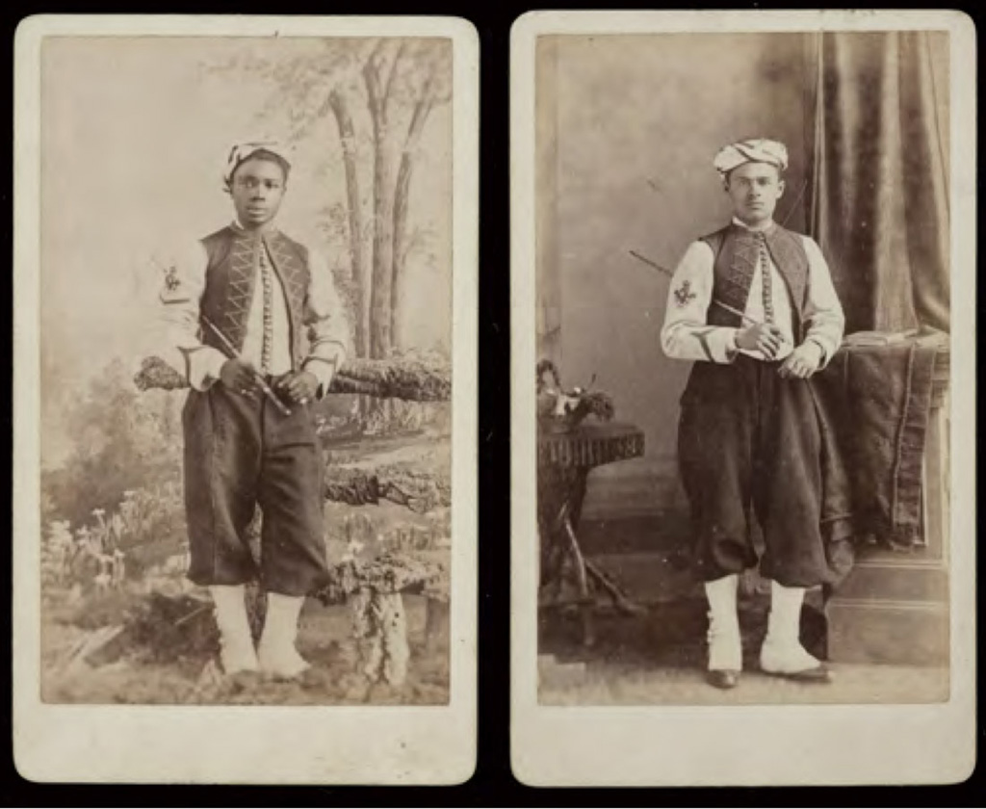
Lance Corporal Johnston and Private Castell, West India Regiment, 1888 (c)
Notes:
Albumen print by Nelson Brothers, 12 King Street, Twickenham, 1888 (c).
Studio portraits of two members of the West India Regiment wearing the regiment's distinctive zouave uniform. Until 1858, soldiers of the West India Regiments wore uniforms similar to the rest of the British Army. But Queen Victoria, impressed by the exotic appearance of the French Army's North African zouaves, instructed them to adopt the same style. The popularity of the zouave uniform in the mid-19th century is also evident in the American Civil War in which both sides raised colourful zouave units. This uniform was only worn by black soldiers, who were not permitted to rise beyond non-commissioned rank. The white officers never formally adopted the zouave uniform, although many wore parts of it on active service. It remained a part of the West India Regiment Dress Uniform until 1914 and was worn by the regimental band until disbandment.
NAM Accession Number
NAM. 2021-02-5-1-1

Slide 4
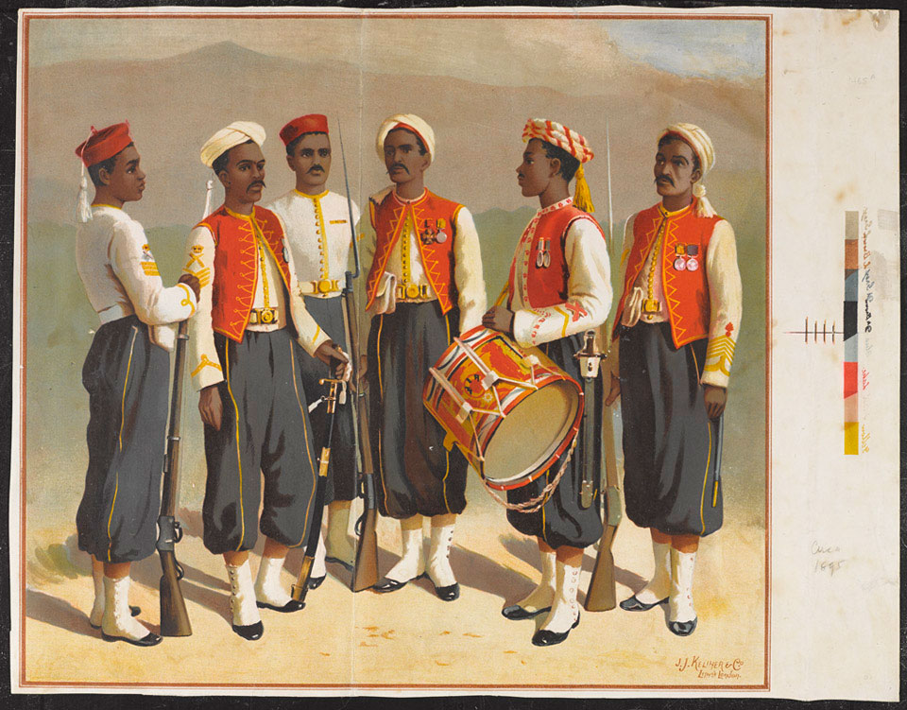
Group of soldiers from the West India Regiment, 1895 (c)
Notes:
Chromolithograph by an unknown artist, published by J J Keliher and Company, London, 1895 (c).
Shows a group of West India Regiment soldiers including four non-commissioned officers, a private and a drummer.
The West India Regiment was an infantry unit of the British Army recruited from and normally stationed in the Caribbean colonies. Between 1795 and 1888 there were between one and 12 West India Regiments. From 1888 there was one regiment of two battalions. The Regiment served in West Africa during the second half of the nineteenth century and in the Middle East during World War One (1914-1918). The two battalions were amalgamated into a single battalion in 1920. This was disbanded in 1927. The regiment was briefly revived in 1958 during the short-lived Federation of the West Indies, but finally abandoned in 1962.
NAM Accession Number
NAM. 1995-12-304-1

Slide 5
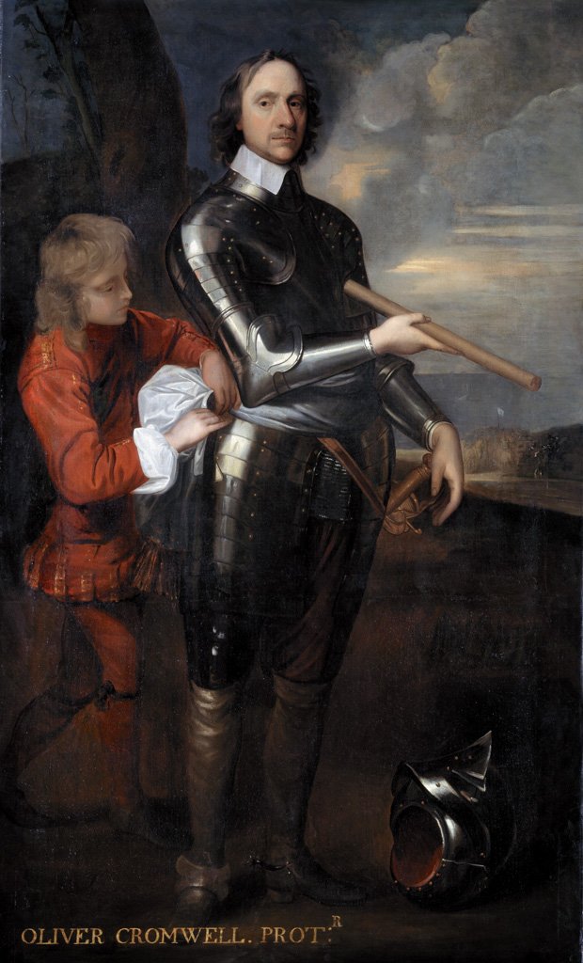
Oliver Cromwell (1599-1658), Lord Protector of England, 1650 (c)
Notes:
Oil on canvas, artist unknown, after Robert Walker (1599 (c)-1658 (c)), 1650 (c).
Cromwell rose to prominence in the committees of the House of Commons and fought in the early campaigns of the Civil Wars of Britain (1639-1651) under the Parliamentarian Earl of Essex. In 1644, he commanded the cavalry of the Eastern Association at the Battle of Marston Moor; in 1645 he was in command of the cavalry of the newly-formed New Model Army at the Battle of Naseby.
By the time of the execution of King Charles I in 1649, Cromwell had become the foremost general in the New Model Army, a force of men chosen for their prowess and dedication rather than by name or wealth. He gained enormous prestige with victories at the Battles of Preston (1648), Dunbar (1650) and Worcester (1651). This was not diminished by his harsh campaign in Ireland (1649-1650) which was marked by the massacres at Drogheda and Wexford. He continued the Elizabethan policy of settling Protestants in Ireland and came to symbolize this hated policy which gave England political dominance. In 1653 Cromwell became Lord Protector of England, a position he held until his death in 1658. He was buried at Westminster Abbey. However, upon the Restoration of the monarchy, his body was disinterred and, with other regicides, his head was placed upon a pole above Westminster Hall.
This portrait has suffered as a result of its sitter's controversial career, having been slashed across the face. Ironically, the artist Walker borrowed the pose from the work of Van Dyck, King Charles I's painter.
NAM Accession Number
NAM. 1988-11-1-1

Slide 6
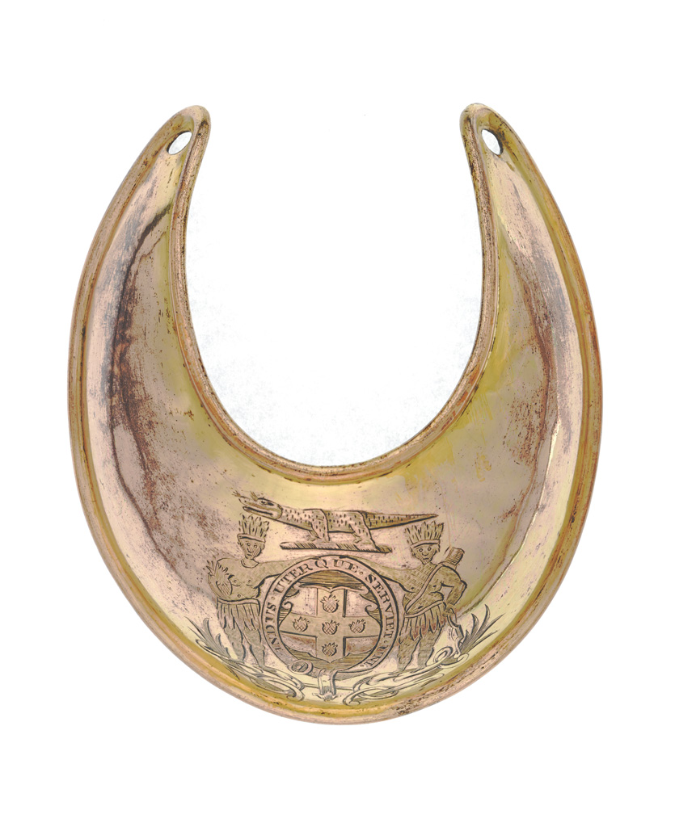
Gorget of the Jamaica Militia, 1810
Notes:
Gilt copper gorget engraved with the Jamaican coat of arms.
The crocodile from the crest of the coat of arms was also used on its own as a symbol for Jamaica.
Officers wore gorgets around the neck as a sign that they were on duty.
The British raised militia forces across the West Indies during the seventeenth and eighteenth centuries to help defend the colonies from foreign attack but also to ensure internal security. During the pre-emancipation period militias were used to deter or counter slave revolts and to hunt down escaped slaves. The militias were predominantly white, drawing their recruits from small landowners, indentured servants and landless freemen.
NAM Accession Number
NAM. 1984-06-163-1

Slide 7
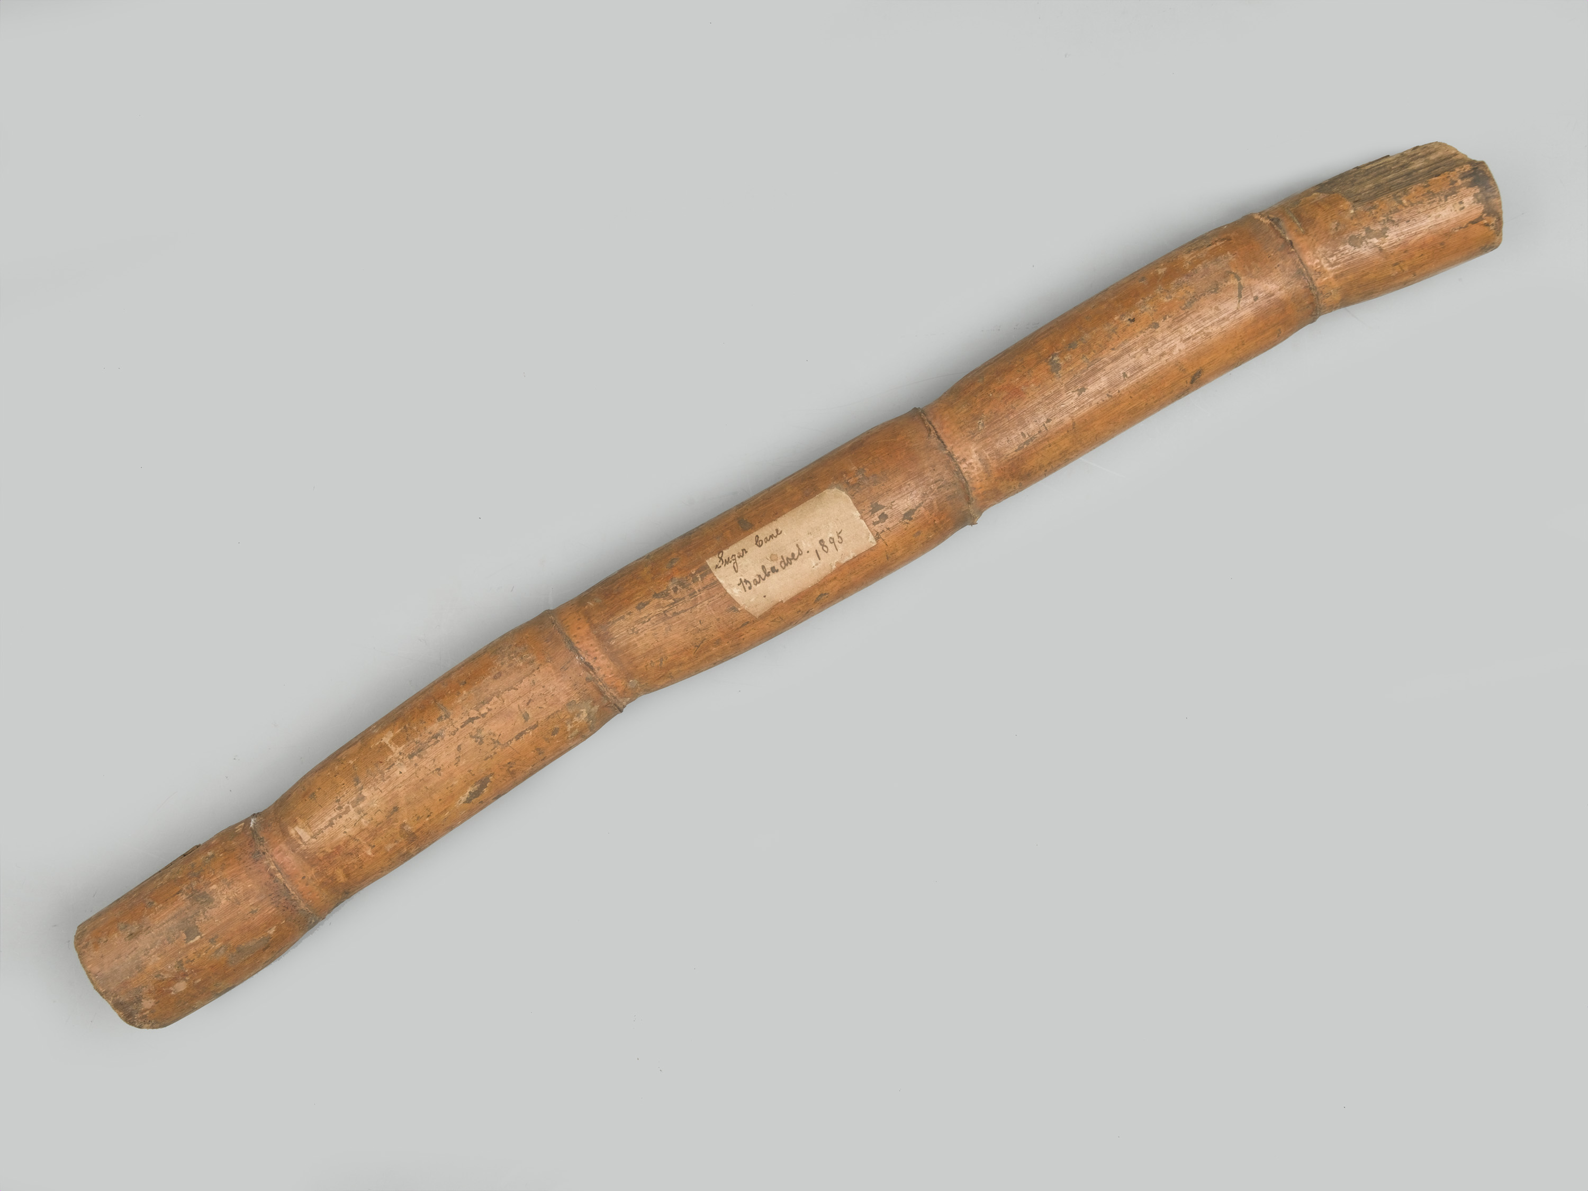
Cane inscribed ‘Sugar Cane Barbados 1895’
Notes:
Cane inscribed ‘Sugar Cane Barbados 1895’
Sugar cane; cylindrical sectioned piece of cane with four irregular rings; bearing a label inscribed in manuscript ‘Sugar Cane Barbados 1895’; the cane was brought from the West Indies by Pte R W Cattely, 1st Bn Connaught Rangers.
NAM Accession Number
NAM. 1956-02-950-1

Slide 8
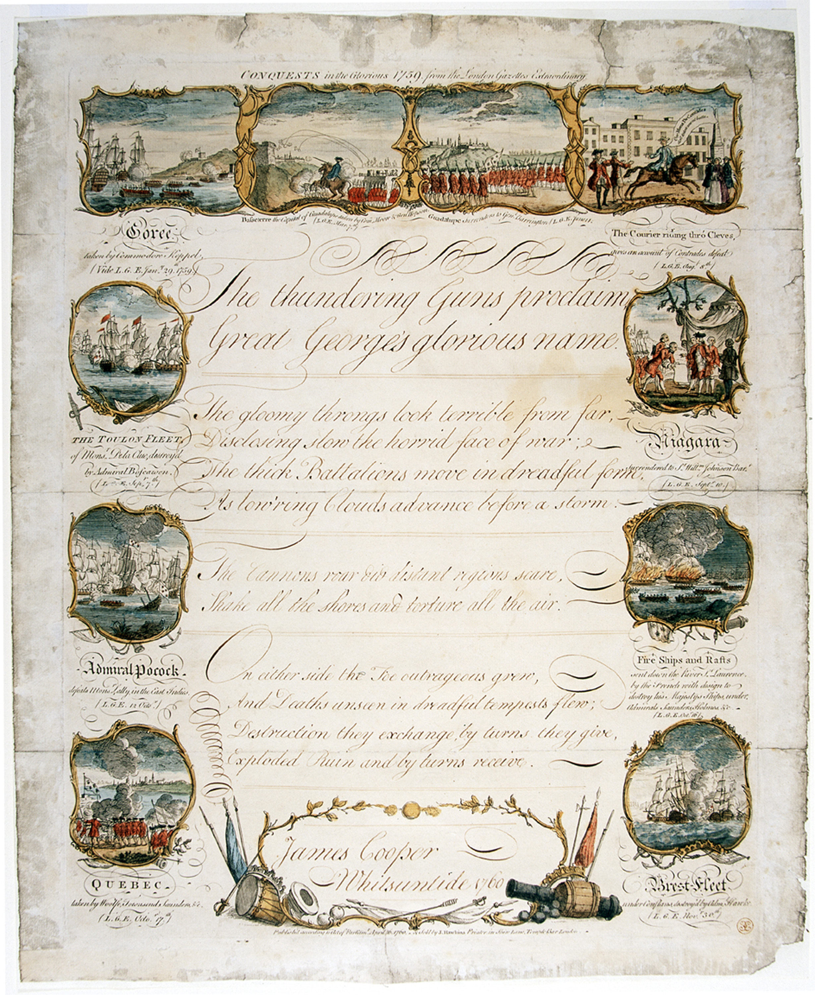
‘Conquests in the Glorious 1759’
Notes:
Engraving published by J Hawkins, London, 1760.
Penmanship sampler illustrating actions in the London Gazettes extraordinary - two showing capture of Guadeloupe and one of Quebec the surrender at Niagara and “six other naval and historical incidents”.
1759 was Britain’s most successful year in the Seven Years War. There were British victories in Canada and the West Indies as well as in Europe and at sea. This child’s handwriting sampler illustrates a number of these actions.
NAM Accession Number
NAM. 1971-02-33-94-1

Slide 9
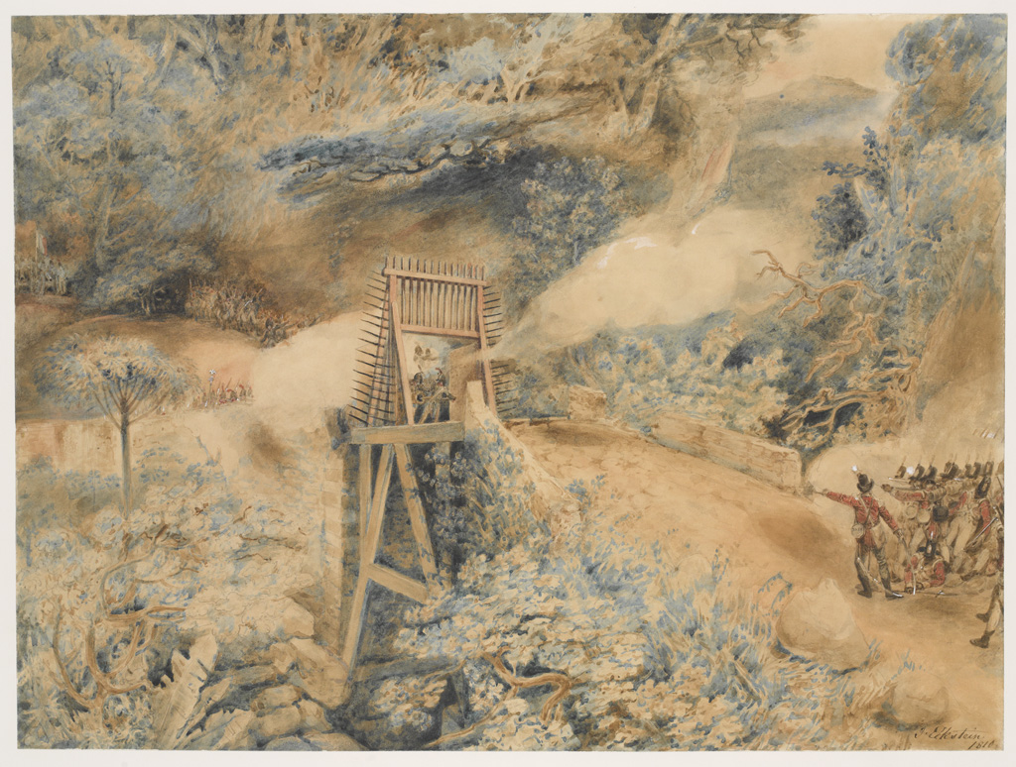
The 3rd West India Regiment fire on French troops at a bridge head, on the Ile de Cabret or Terre d’en Haut, April 1809.
Notes:
Watercolour, signed lower right ‘J Eckstein /1810’, by John Eckstein (fl.1787-1838), 1810.
The 3rd West India Regiment was raised in 1798 from freed slaves in North America and slaves purchased in the British West Indies. After the slave trade ended in 1807, the British also recruited in West Africa and from among Africans freed when the Royal Navy intercepted foreign slave ships en route to the Americas.
The semi-enforced recruitment of so-called ‘liberated Africans’ contributed to three mutinies in the West India Regiments between 1802 and 1837. On some occasions the West India Regiments fought French slave troops (France finally abolishing slavery in 1848).
During the Napoleonic Wars the 3rd West India Regiment served at St. Lucia (1803), the Danish Virgin Islands (1807) - now the US Virgin islands, Martinique (1809), The Saintes (1809) and Guadeloupe (1810).
Associated with Napoleonic Wars, West Indies (1803-1810).
NAM Accession Number
NAM. 1976-02-47-1

Slide 10
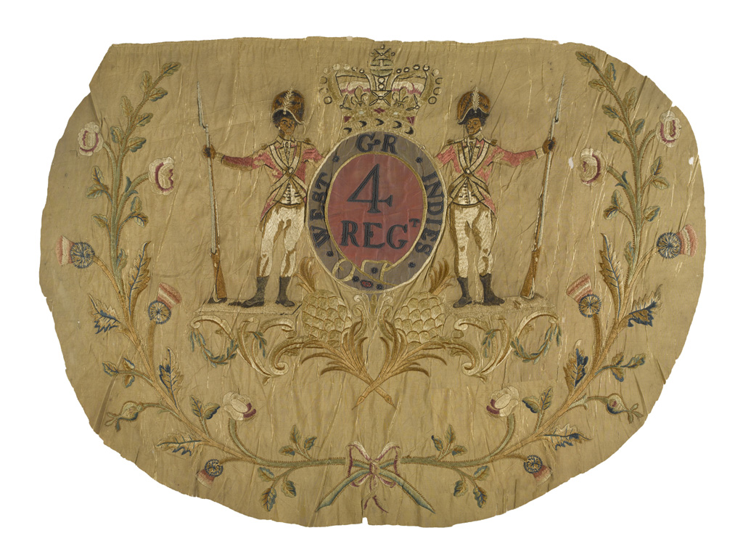
Regimental Colour, 4th West India Regiment, 1795-1804 (c).
Notes:
This is the centre portion of a colour (an infantry flag). It is delicately embroidered with two infantrymen.
The 4th West India Regiment was raised in 1795 as Nicholl's Regiment of Foot and served at Martinique (1809) and Guadeloupe (1810) during the Napoleonic Wars (1803-1815) before disbandment in 1819. The regiment was re-established in 1862 going on to serve in the Gold Coast (1863-1864), British Honduras (1866) and Gambia (1866) before final disbandment in 1869.
NAM Accession Number
NAM. 1956-08-74-1

Slide 11
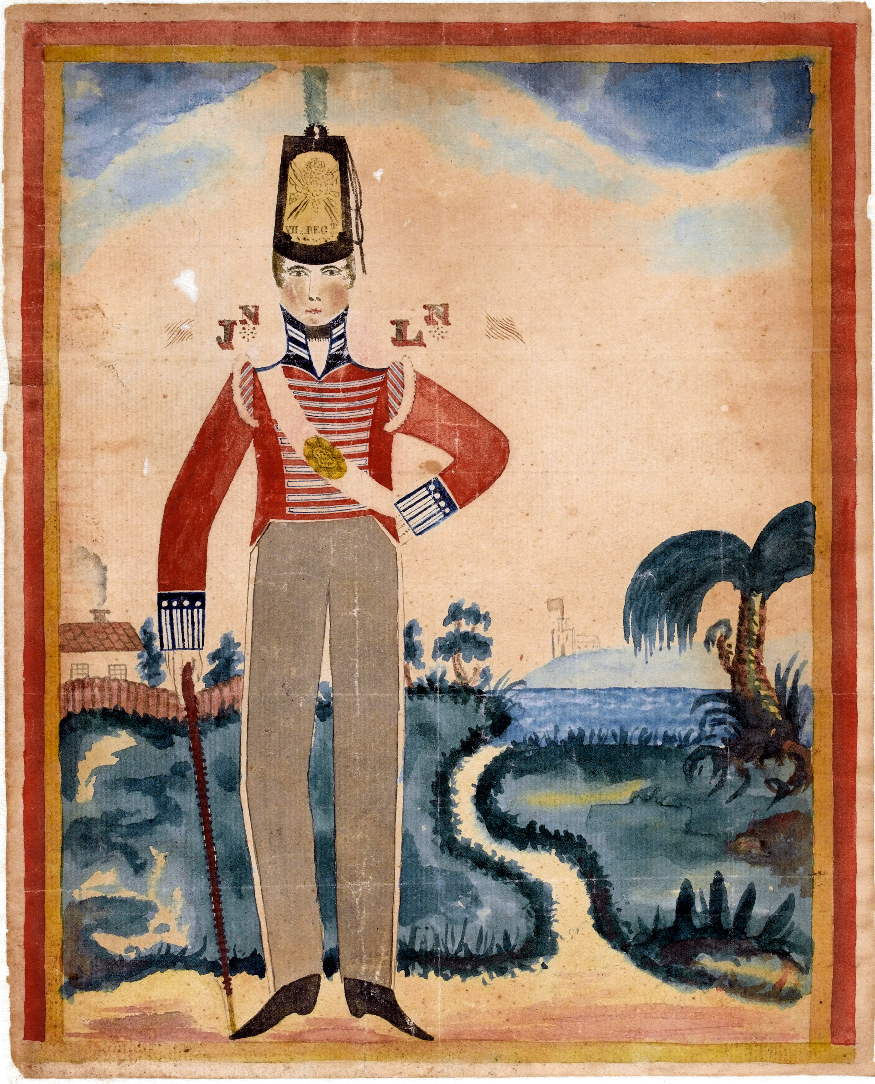
A Private of the 7th (Royal Fusiliers) in the Caribbean, 1805 (c).
Notes:
Watercolour by an unknown artist, 1805 (c).
The 7th served in the West Indies from 1802 until 1806 when it moved to Ireland. Many soldiers dreaded a posting there as the tropical climate of the Caribbean took its toll on European soldiers. Around 90 per cent of the 45,000 white troops who died there during the wars against Revolutionary and Napoleonic France (1793-1815) were killed by disease rather than the enemy.
NAM Accession Number
NAM. 2001-04-169-1

Slide 12
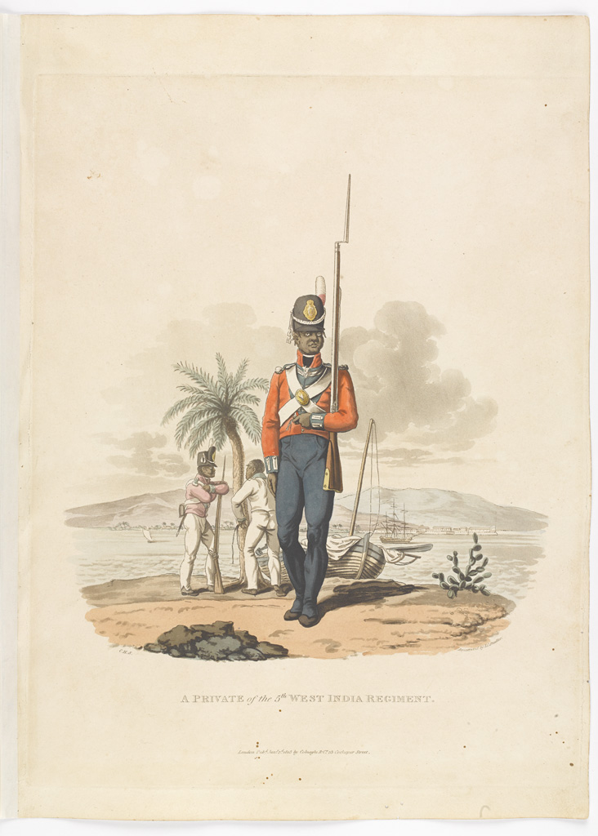
A Private of the 5th West India Regiment, 1815
Notes:
Aquatint by J C Stadler after Charles Hamilton Smith.
From Charles Hamilton Smith's ‘Costumes of the Army of the British Empire, according to the last regulations 1812’, published by Colnaghi and Co, 1812-1815.
Many European soldiers stationed in the Caribbean succumbed to tropical diseases. The failed British intervention in Saint Domingue (modern Haiti) was also very costly in manpower terms. The Army therefore looked elsewhere for recruits and between 1795 and 1807 estimates suggest 13,400 Creole and newly arrived Africans slaves were purchased for the West India Regiments. The reliance on slave conscripts was a factor in the prolongation of the slave trade to 1807.
NAM Accession Number
NAM. 1950-11-33-42

Slide 13
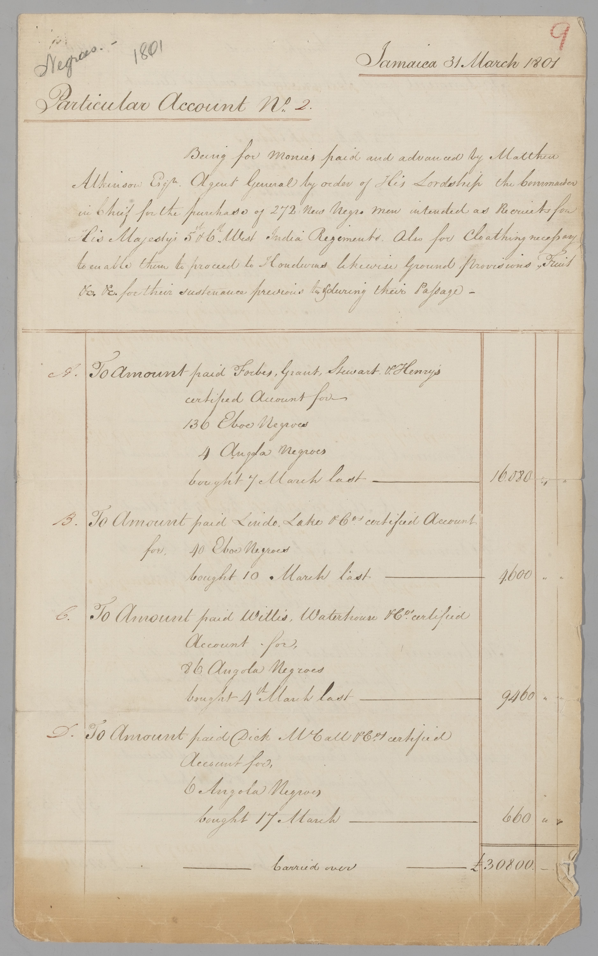
Account detailing the cost of buying and clothing 272 African slaves for service in 5th and 6th West India Regiments, March 1801
Contains offensive language
Notes:
Two accounts detailing the cost of buying and clothing 272 African slaves for service in 5th and 6th West India Regiments, and their transport to Honduras, March 1801.
From a collection of papers relating to the Earl of Balcarres period as Commander-in-Chief Jamaica, 1794-1801.
The West India Regiments were used to protect the plantation-slave economies of Britain’s Caribbean possessions. They also took part in the wars against Revolutionary and Napoleonic France. The harsh environment of the Caribbean took a heavy toll on European units so the War Office raised regiments of black soldiers who were thought to be more tolerant of the climate. Although freed slaves from North America were initially recruited, prior to the abolition of the slave trade in 1807 most soldiers were purchased from plantations and the slave ships arriving from West Africa. The final cost of buying and equipping the slaves listed on this account was over £32,600, worth more than £1 million in today’s money.
NAM Accession Number
NAM. 1975-08-55-3

Slide 14
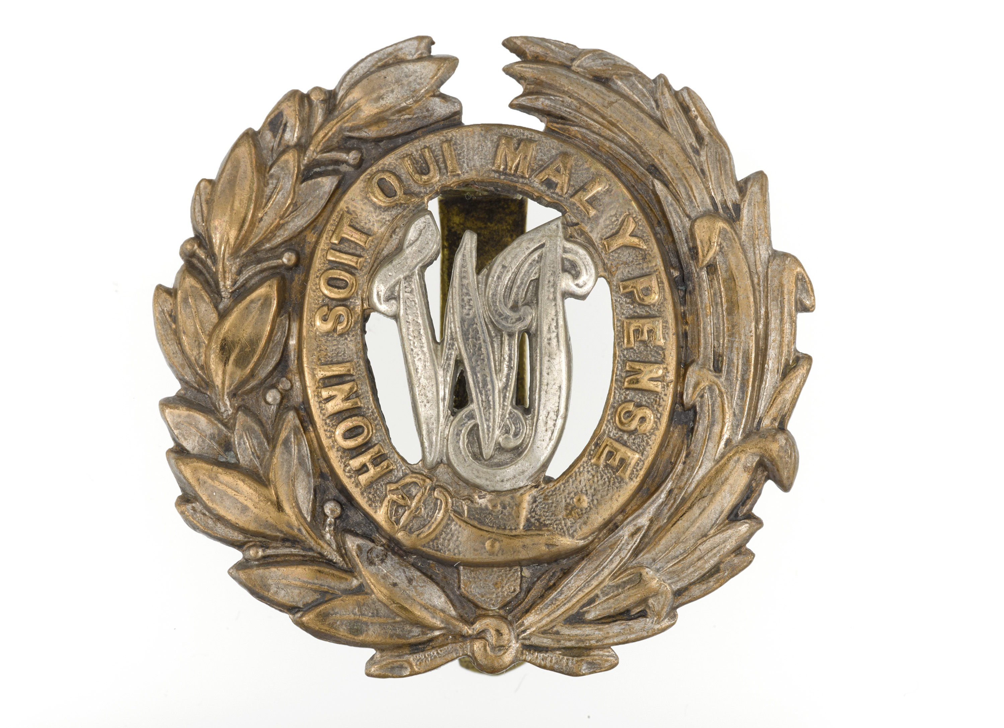
Cap badge, West India Regiment, nd.
Notes:
Brass, gilt silver.
Wreath with monogram ‘WI’, within garter bearing the motto, ‘Honi Soit Qui Maly Pense’
NAM Accession Number
NAM. 1986-01-57-14

Slide 15
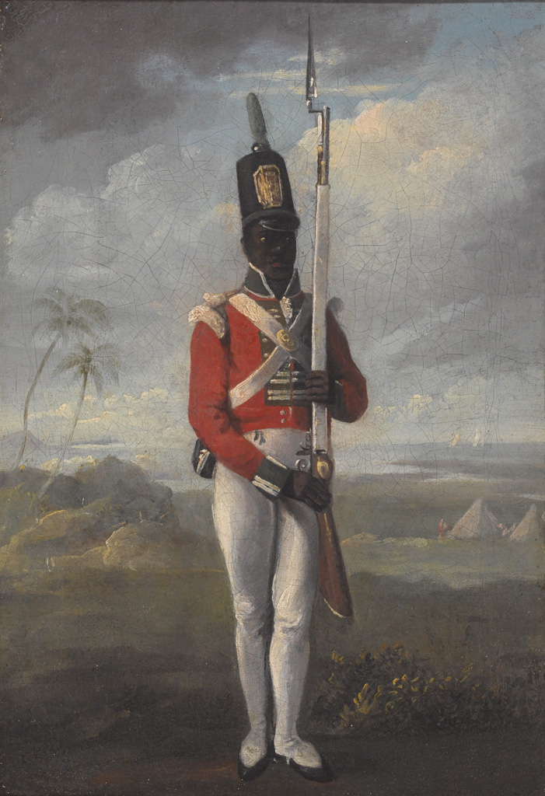
A private of the 8th West India Regiment, 1804 (c).
Notes:
Oil painting on canvas, artist unknown, 1803 (c).
This historically significant portrait depicts a private soldier of a light company of the 8th West India Regiment.
Elements of the 8th West India Regiment, stationed at Fort Shirley on the island of Dominica, rose in revolt on 8 April 1802. The regiment's white officers were killed or driven out of the fort. The mutiny was quickly suppressed with around 100 mutineers killed by a relief force of soldiers, militia and marines. Several ringleaders were either executed or flogged. The 8th West India Regiment was disbanded as a result of the mutiny, with the surviving soldiers transferred to other units. Reorganisation of the West India Regiments in 1803 led to the re-establishment of the 8th West India Regiment.
In the Court of Inquiry into the mutiny Governor Alexander Johnstone, who was also Colonel-in-Chief of the Regiment, was alleged to have withheld pay and used the soldiers as cheap labour to clear land. Rumours of disbandment and a return to slave status was deemed to have been the key reason for the rising. Johnstone lost his post and was recalled to England. He was, however, acquitted of all charges relating to the mutiny at his court martial at the Royal Hospital in March 1805.
NAM Accession Number
NAM. 2018-07-13-1

Slide 16
Page of Mutiny Act 1807, including Paragraph CII
Contains offensive language
Notes:
The Mutiny Acts were a series of annual acts passed by parliament to govern the use of the English, later British, Army. The first Mutiny Act was passed in 1689 following the 'Glorious Revolution', after a section of the Army mutinied out of loyalty to King James II following his succession by William of Orange.
The Mutiny Act 1807 finally declared the West India Regiments free men. It was issued by King George III on 23rd March, two days before the Bill abolishing the slave trade. The eight lines of Paragraph CII freed around ten thousand men immediately, the largest number of slaves liberated in the Americas in one single event to that date. It marked the first major step taken by Britain to end slavery, which was eventually abolished throughout the British Empire in 1833. After the abolition of the slave trade, the Army conscripted men from foreign slave ships intercepted by the Royal Navy, which policed the Atlantic Ocean and African coastline.
NAM Temp. Number
11835

Slide 17
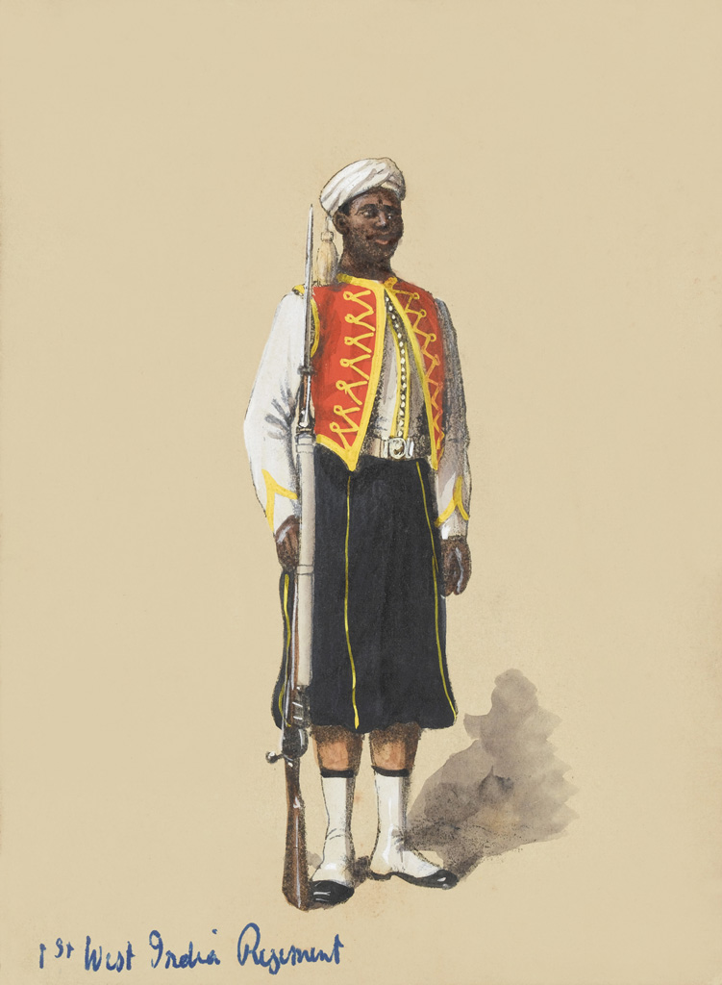
Private in full dress, 1st West India Regiment, 1900
Notes:
After Richard Simkin, 1850-1900 (c).
From an album of 115 lithographs of 'Uniform studies of Foot Guards, Line Infantry, Yeomanry and Indian Army units, of various dates, 1850-1900 (c)'.
Made by Forster Groom and Company, London.
NAM Accession Number
NAM. 1982-04-152-95

Slide 18
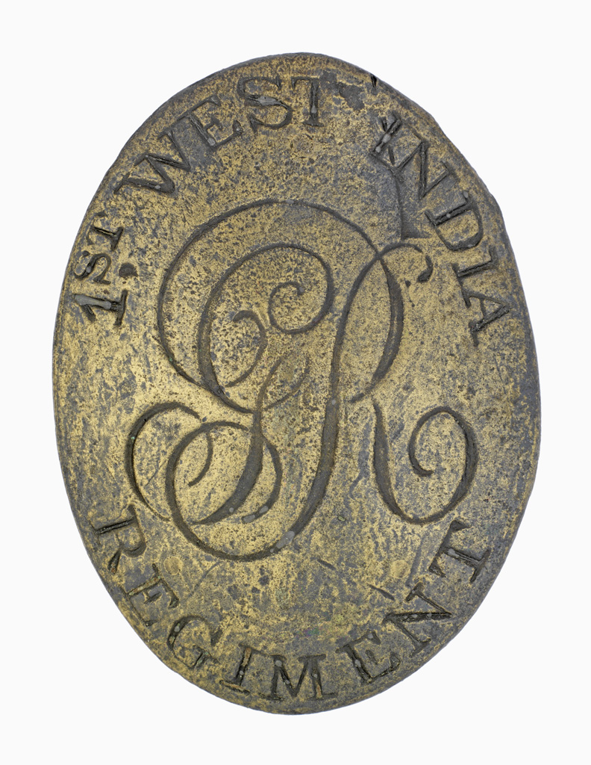
Shoulder belt plate, other ranks, 1st West India Regiment, 1800 (c)
Notes:
Oval metal shoulder belt plate, inscribed, '1st West India Regiment', with the royal cipher, 'GR', for King George III, in the centre.
The 1st West India Regiment was raised in 1795 as Whyte's Regiment of Foot. Initially it was an amalgamation of two units formed by the British during the American War of Independence (1775-1783), the Black Carolina Corps and Malcolm's Rangers, a force recruited on the island of Martinique. By the mid-1790s however, many of its soldiers were enslaved Africans purchased by the British Army. Indeed, the British reliance on slave conscripts to garrison the Caribbean was a factor in the prolongation of the slave trade to 1807.
NAM Accession Number
NAM. 1983-03-59-1

Slide 19
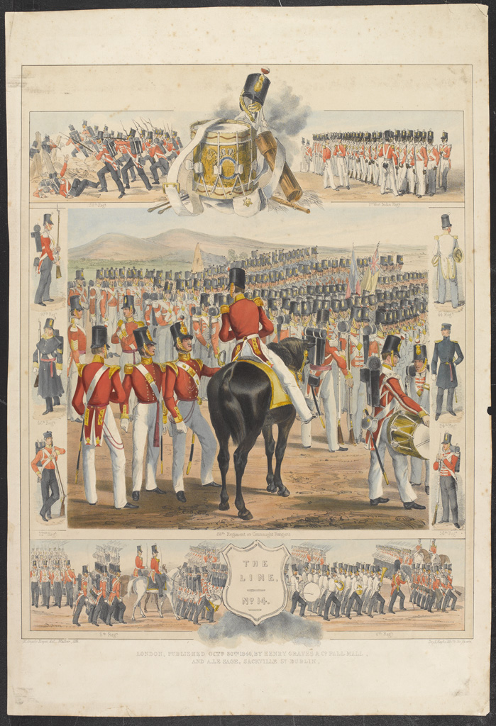
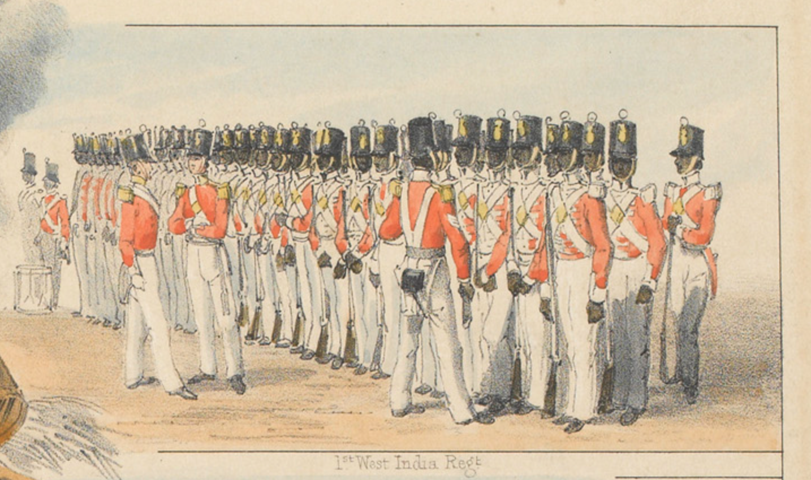
‘The Line No.14’, 1846, featuring a study of the 1st West India Regiment on parade
Notes:
'The Line No.14'
Coloured lithograph by Walker after Michael Angelo Hayes, published by Henry Graves and Company, Pall Mall, London, and A Le Sage, Sackville Street, Dublin, 1846.
A central image of the 88th Regiment of Foot (Connaught Rangers) on parade. Smaller vignettes of the 8th (The King's) Regiment of Foot marching with a band, the 58th (Rutlandshire) Regiment of Foot in battle, and the 1st West India Regiment on parade. Six smaller studies of soldiers from different regiments: 36th (Herefordshire) Regiment of Foot, 24th (2nd Warwickshire) Regiment of Foot, 44th (East Essex) Regiment of Foot, 97th (Earl of Ulster's) Regiment of Foot, 46th (South Devonshire) Regiment of Foot and the 22nd (The Cheshire) Regiment of Foot.
NAM Accession Number
NAM. 1982-04-211-8

Slide 20
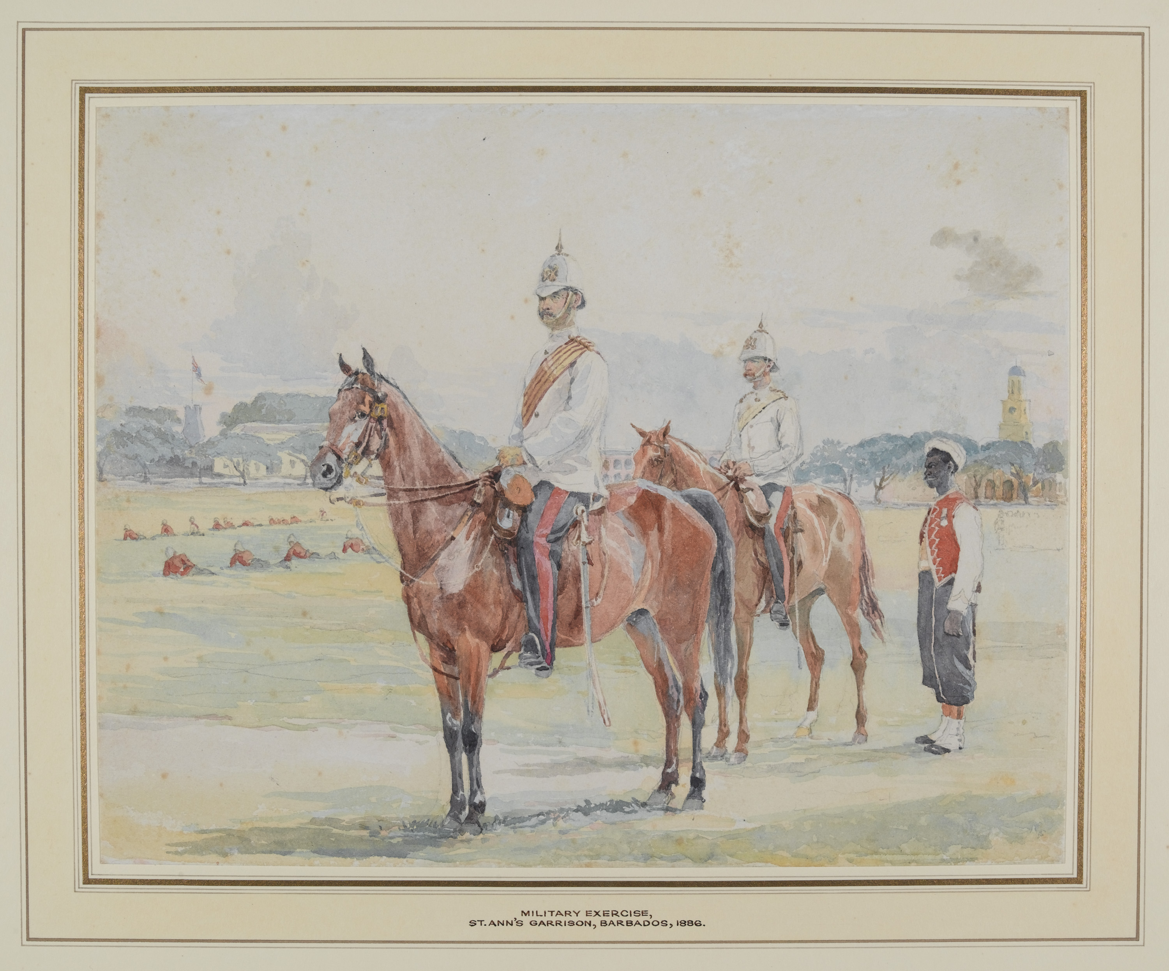
Two Officers and a Private of the West India Regiment watching an exercise at St Ann’s Garrison, Barbados, 1886
Notes:
Watercolour over pencil, artist unknown, 1886.
Mounted officers in tropical dress.
In the background, rows of infantrymen lie flat on the ground in a training exercise, with garrison buildings beyond. The former military prison of St Ann’s Garrison became a museum in the 1930s.
NAM Accession Number
NAM. 2007-05-79-1

Slide 21
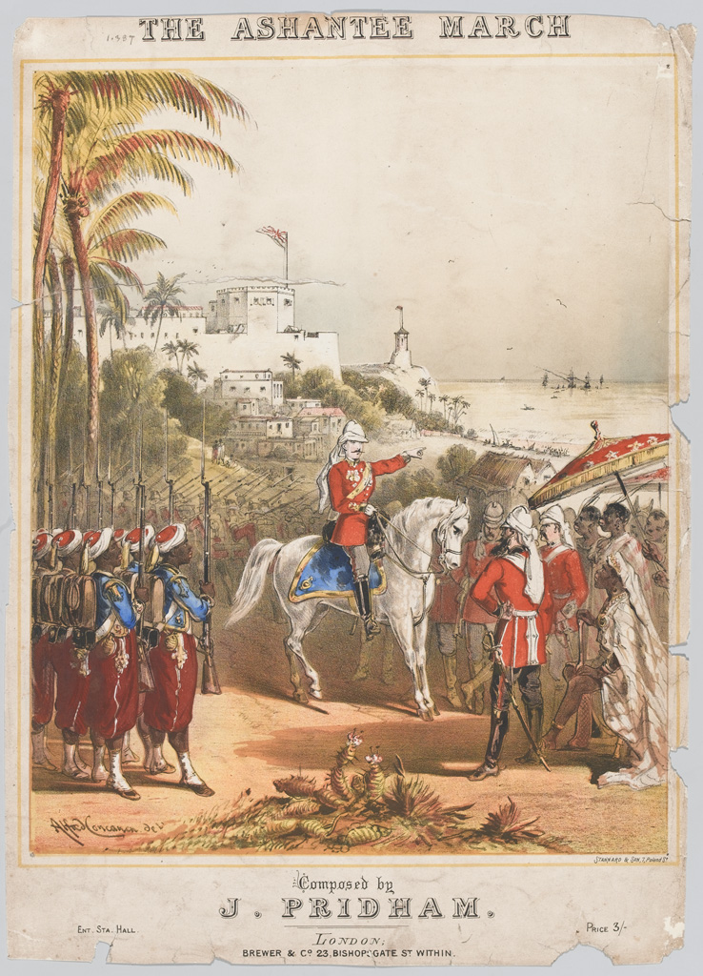
‘The Ashantee March’, composed by J Pridham, 1874
Notes:
Lithograph after Alfred Concanen, published by Brewer and Co, 1874 (c).
Soldiers of the West India Regiment parade before British officers on the cover of sheet music published to mark General Garnet Wolseley's campaign against the forces of Kofi Karikari, King of the Ashanti, during the 2nd Ashanti War (1873-1874). As well as the West India Regiment, Wolsely's force included African levies of the Hausa Constabulary.
In an age before television and radio, musical interpretations of imperial campaigns were a popular form of entertainment and news.
NAM Accession Number
NAM. 1974-10-100-1

Slide 22
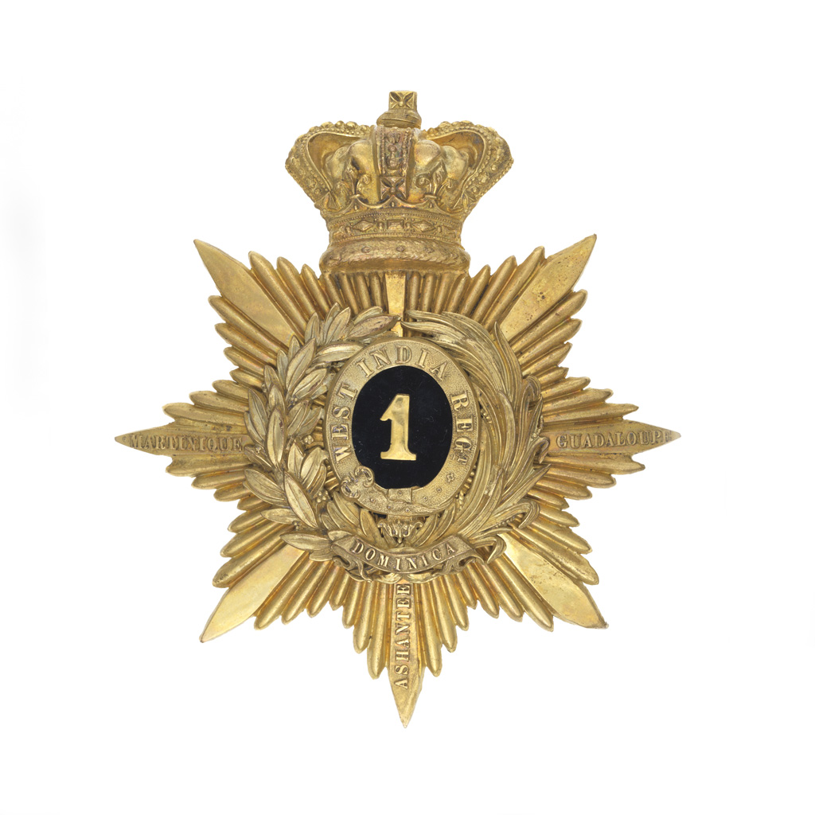
Helmet plate, officers, 1st West India Regiment, gilt metal, 1880 (c)
Notes:
Superimposed upon an eight-pointed, rayed star, upon the arms of which are the battle honours, 'Martinique; Guadaloupe; Ashantee', a wreath of laurel and palm, having superimposed upon its base, a scroll bearing the battle honour, 'Dominica’. Within the wreath, a garter bearing the title, 'West India Regt', which encircles the numeral, '1' upon a black velvet ground.
Above all, is a monarchial crown.
Associated with Seven Years War, West Indies (1756-1763), 1762.
NAM Accession Number
NAM. 1970-12-117-1-2

Slide 23
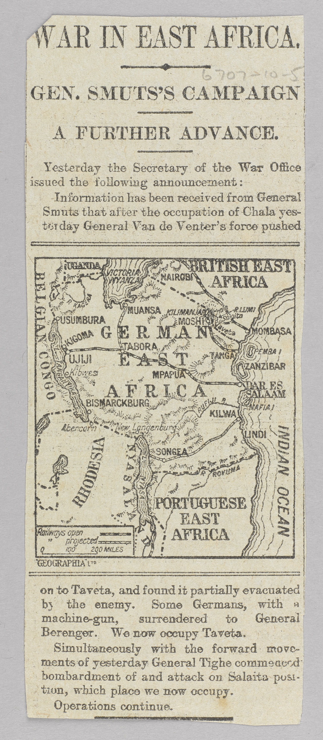
Newspaper cutting on General Smuts's campaign, 1916
Notes:
From papers relating to Major-General Sir James Marshall Stewart, World War One, East Africa (1914-1918).
NAM Accession Number
NAM. 1967-07-10-5

Slide 24
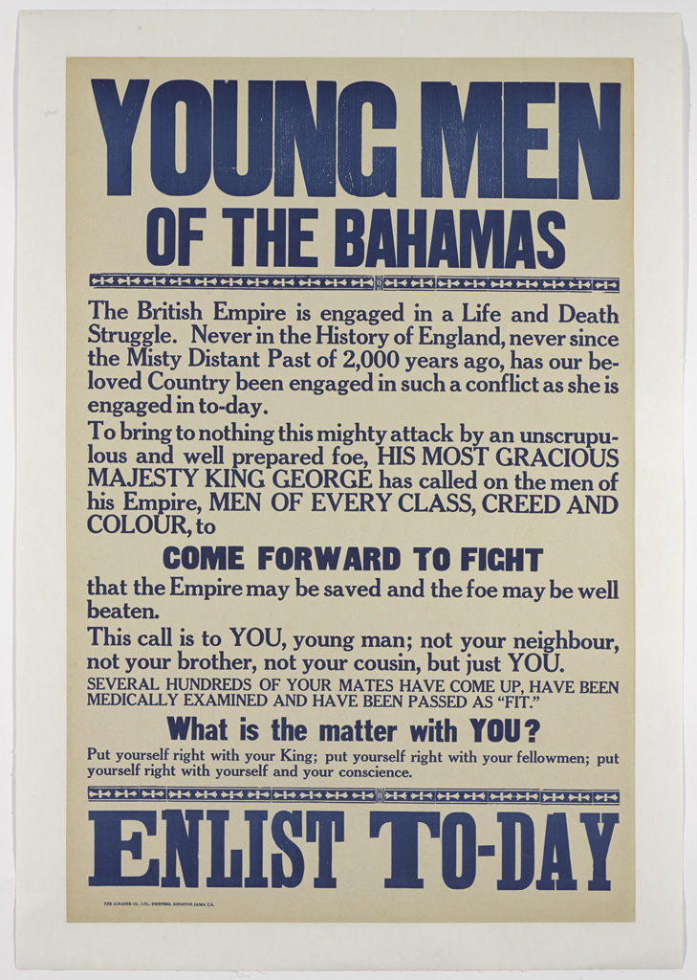
‘Young Men of the Bahamas’, First World War
Notes:
Recruiting poster.
This recruiting poster was produced in the West Indies by the Gleaner Company Limited of Kingston, Jamaica. Thousands of men and women from across the British Empire volunteered to fight Britain's enemies during World War One (1914-1918). The Caribbean was no different and men from across the region served in the Army and the Royal Navy.
NAM Accession Number
NAM. 2014-03-7-4

Slide 25
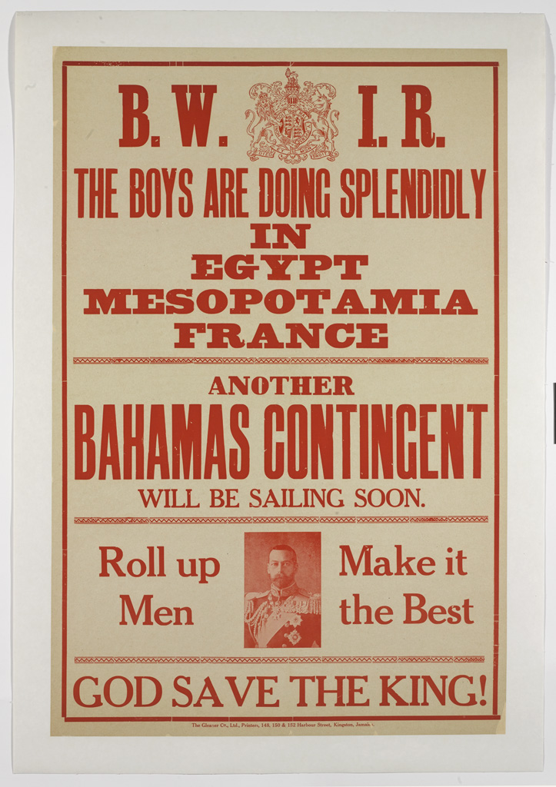
‘B.W.I.R. The Boys are doing Splendidly in Egypt Mesopotamia France’, First World War
Notes:
Recruiting poster.
Printed by The Gleaner Company Limited, 148 and 130 Harbour Street, Jamaica.
The British West Indies Regiment (BWIR) was raised in October 1915 from volunteers living in Jamaica, Trinidad and Tobago, Barbados, the Bahamas, British Honduras, Grenada, British Guiana, the Leeward Islands, St Lucia and St Vincent. The majority of the 15,600 eventual recruits came Jamaica, and served with the British forces in North Africa, France, Mesopotamia and Palestine.
This poster was aimed at potential recruits in the Bahamas and was probably published in early 1916 after two initial 'contingents' of local men had already arrived in the listed war theatres. In total 486 Bahamians volunteered for the BWIR, with others serving in the regular British, Canadian and American armies.
Stylistically, the poster echoes those published in Britain during the opening weeks of the war, with the Royal Arms prominently displayed at the top and a clear injunction to fight for the King. Other recruiting posters published in the British West Indies were similarly unambiguous; reminding locals that it was their duty to defend the 'mother country', even though many would have had no direct ties with Great Britain.
NAM Accession Number
NAM. 2014-03-7-3

Slide 26
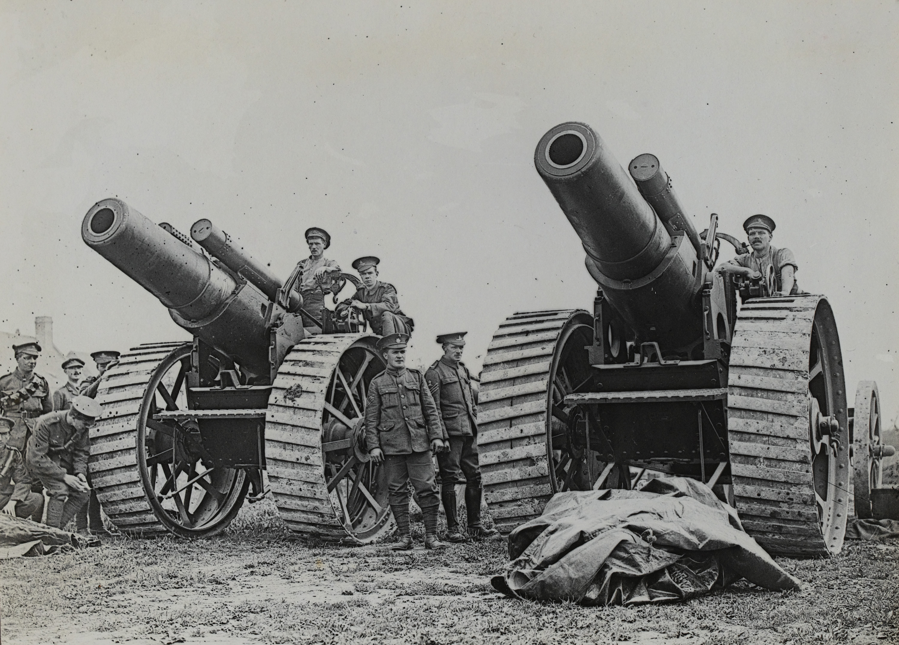
8-inch howitzers of 135th Siege Battery at La Houssoye on the Somme, 25 August 1916
Notes:
Photograph, World War One, Western Front (1914-1918), 1916.
The 8-inch howitzer had a range of about 12,300 yards (11.24 km) and fired a 200lb (90.8 kg) shell. Most heavy artillery weapons were used by units of the Royal Garrison Artillery, whereas the Royal Field Artillery tended to use lighter guns that were mobile.
From an album of 22 official photographs.
NAM Accession Number
NAM. 1995-03-86-12

Slide 27
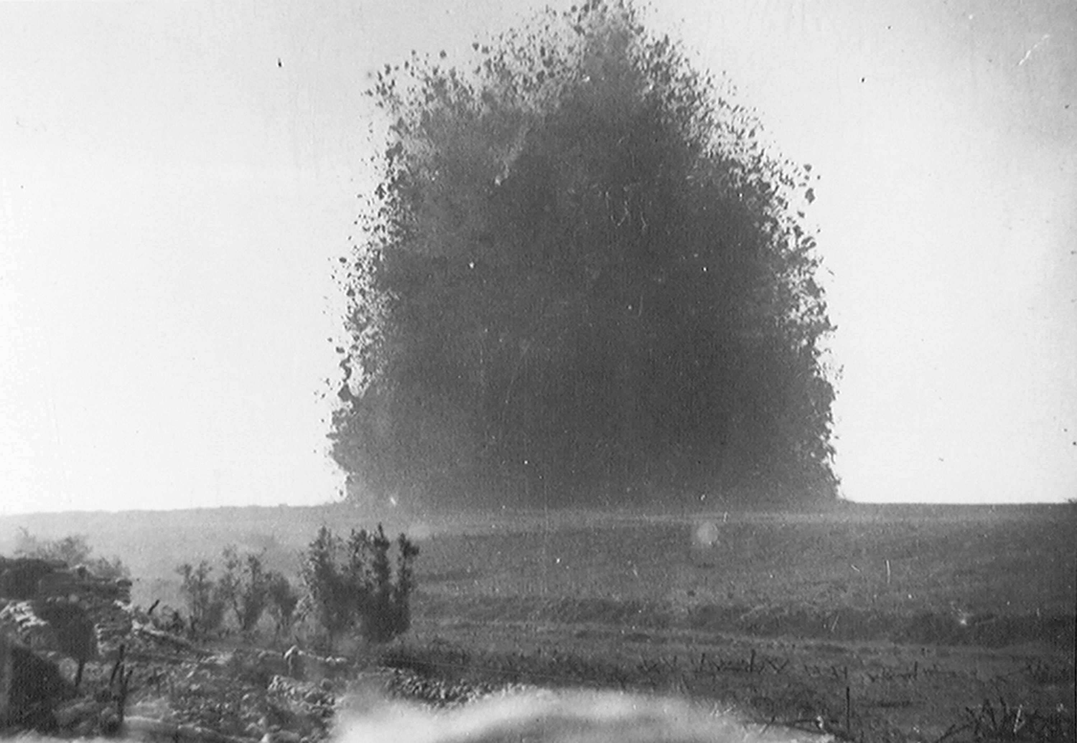
The detonation of a mine on the Somme, 1916
Notes:
Battle of Albert. The mine under German front line positions at Hawthorn Redoubt, Battle of the Somme, 1 July 1916
Official photograph associated with World War One, Western Front (1914-1918).
This mine was fired 10 minutes before the assault at Beaumont Hamel on the first day of the Battle of the Somme, 1 July 1916. 45,000 pounds of ammonal exploded. The mine caused a crater 130 feet across by 58 feet deep.
From a group of 550 photographs, compiled by Lord Henry Seymour Rawlinson while Commander in Chief in India, 1916 (c)-1919.
NAM Accession Number
NAM. 1952-01-33-55-293

Slide 28
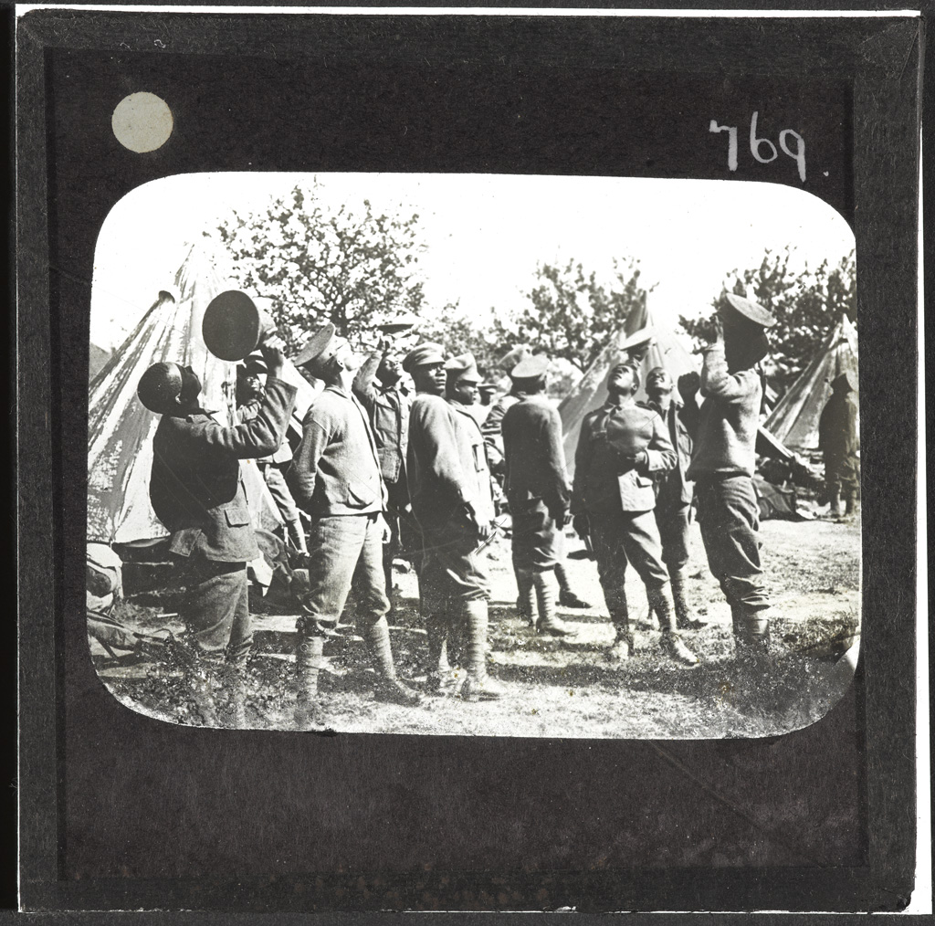
Watching aircraft, September 1918.
Notes:
Lantern slide, World War One, Western Front (1914-1918), 1918.
Members of the British West Indies Regiment observe aircraft above their camp on the Albert to Amiens Road. Their regiment had been raised in October 1915 and its battalions served in France, Italy, Africa and the Middle East.
When the British West Indies Regiment served on the Western Front there was an official reluctance to deploy its men in front-line positions, rather than as labourers in the rear. Such attitudes were based on racial stereotypes about the lack of 'martial spirit' possessed by Caribbean men.
Such views resulted in a mutiny at Taranto in Italy in 1918 where members of the regiment were being used on labouring duties that included the cleaning of latrines for white troops and Italian labourers.
From a box of 73 lantern slides.
NAM Accession Number
NAM. 1978-11-157-24-52

Slide 29
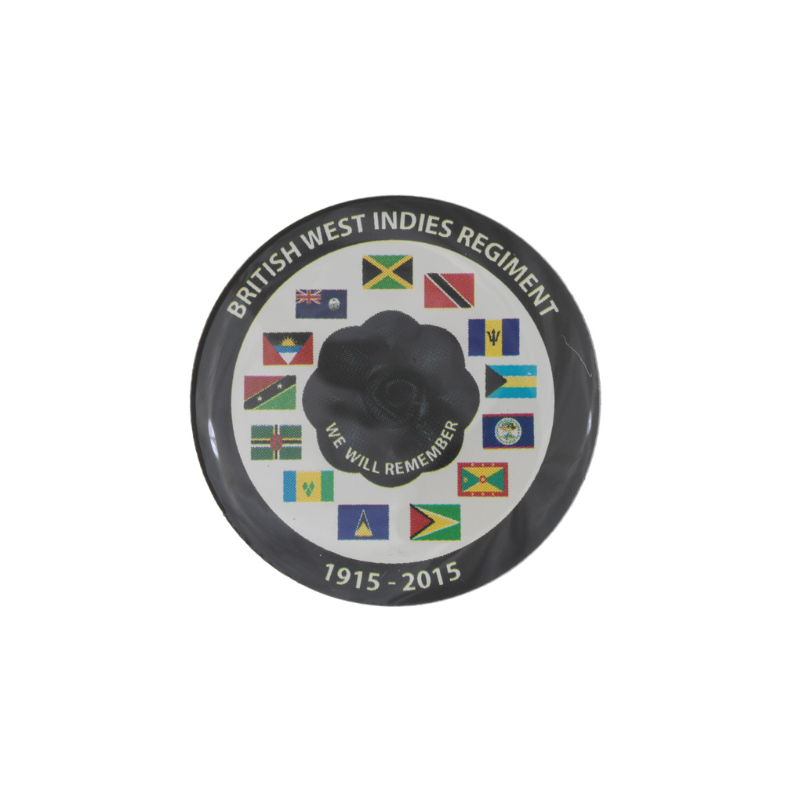
British West Indies Regiment, Remembrance pin badge, 2015 (c).
Notes:
Metal, 2015 (c).
White badge with a black poppy at the centre bearing the phrase ‘we will remember’. Around the black poppy are the four flags of (clockwise): Jamaica, Trinidad and Tobago, Barbados, Bahamas, Belize, Grenada, Guyana, St Lucia, St Vincent and the Grenadines, Dominica, Saint Kitts and Nevis, Antigua and Barbuda, Anguilla. The design is encircled within a black border with ‘British West Indies Regiment’ across the top and ‘1914-2014’ across the bottom.
The black poppy is associated with the remembrance of black, African and Caribbean contribution to warfare. This badge specifically commemorates the contribution of soldiers in the British West Indies Regiment.
One of three pin badges produced to commemorate the service of Black, African and Caribbean soldiers’ contribution to warfare.
NAM Accession Number
NAM. 2020-01-1-1-2

Slide 30
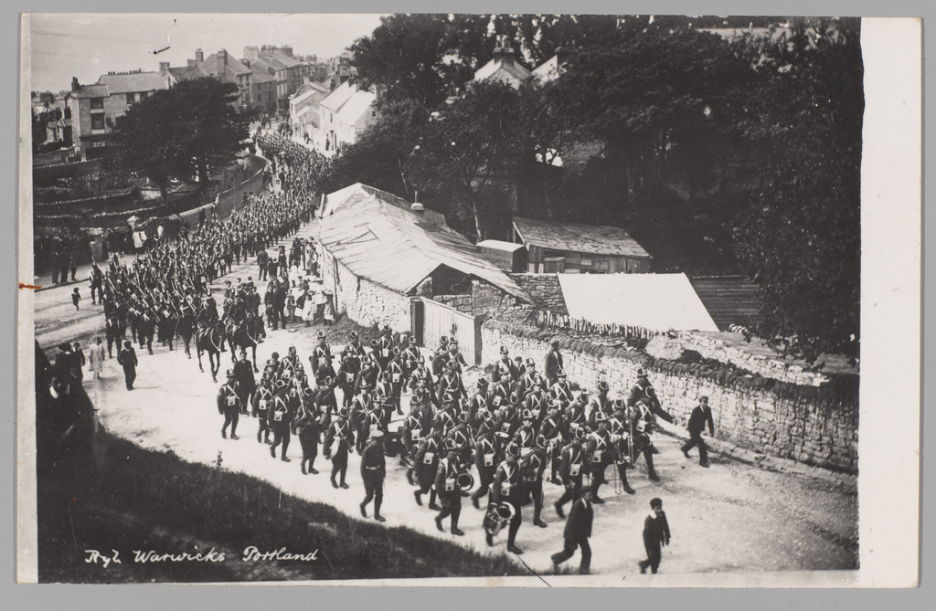
Soldiers of the Royal Warwickshire Regiment marching through Portland, Dorset, 5 August 1914
Notes:
Postcard photograph, World War One, Home Front (1914-1918), 1914.
The soldiers probably belonged to either 1/5th or 1/6th Battalions, units of the Territorial Force. They are shown marching through Portland the day after Britain declared war on Germany. The men took over from the regular garrison which had joined the British Expeditionary Force in its move to the continent. The following March both the 1/5th and 1/6th Battalions were themselves sent to France.
NAM Accession Number
NAM. 1982-05-74-1

Slide 31
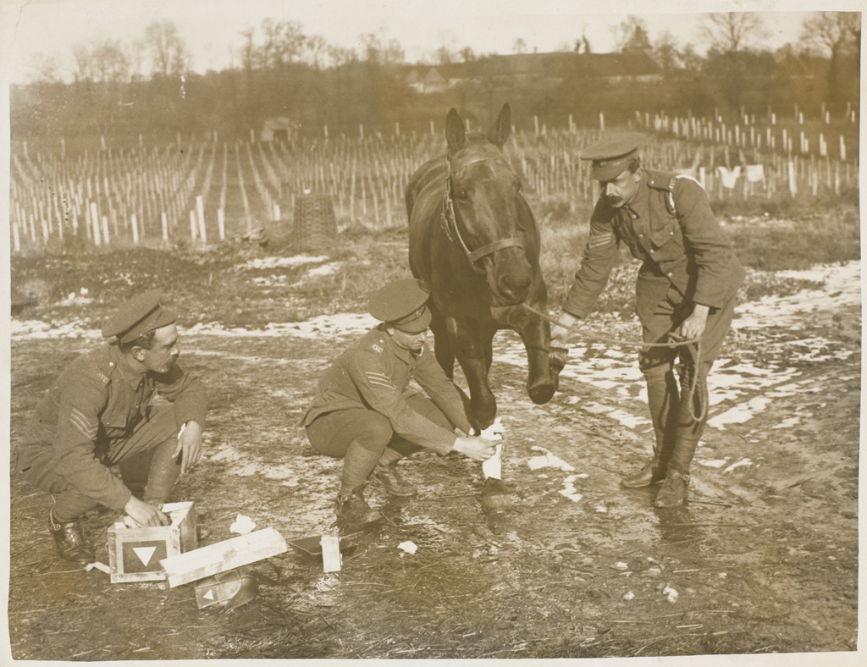
Treating a wounded horse, 1917 (c)
Notes:
Photograph, World War One, Western Front (1914-1918), 1917 (c).
During the war, the British Army used thousands of horses and mules to move its guns, supplies, equipment and transport the wounded. It treated its animals with greater care than ever before. Around 80 per cent of the horses and mules treated by the Army Veterinary Corps were successfully returned to duty.
NAM Accession Number
NAM. 2007-03-7-182

Slide 32
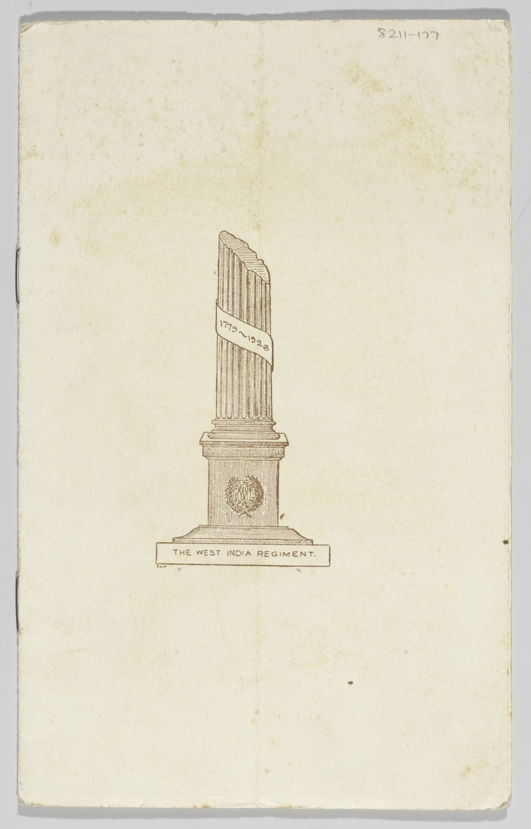
Printed programme for Trooping of the Colour of the West India Regiment prior to disbandment, on the Polo Ground Up Park Camp Jamaica, 27 Oct 1926.
Notes:
The Regimental Colours were trooped for the last time and then crated to be shipped back to Britain. On 18 February 1927 the colours were taken to Buckingham Palace and presented to King George V. They were later transferred to St. George's Chapel, Windsor Castle, where they still hang, displaying 132 years of loyal service.
NAM Accession Number
NAM. 1982-11-177-1

Slide 33
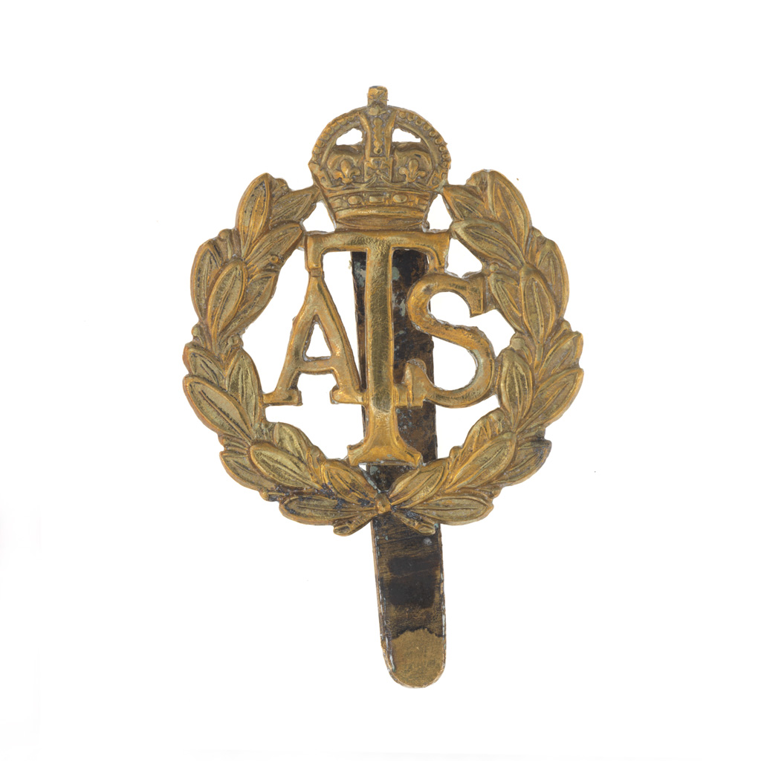
Other rank's gilding metal cap badge, Auxiliary Territorial Service, 1938 (c)-1949 (c)
Notes:
Inscribed with letters, 'ATS' within a laurel wreath surmounted by a monarchial crown.
From a collection of seven badges, 1938 (c)-1949 (c).
NAM Accession Number
NAM. 2003-05-176-1

Slide 34
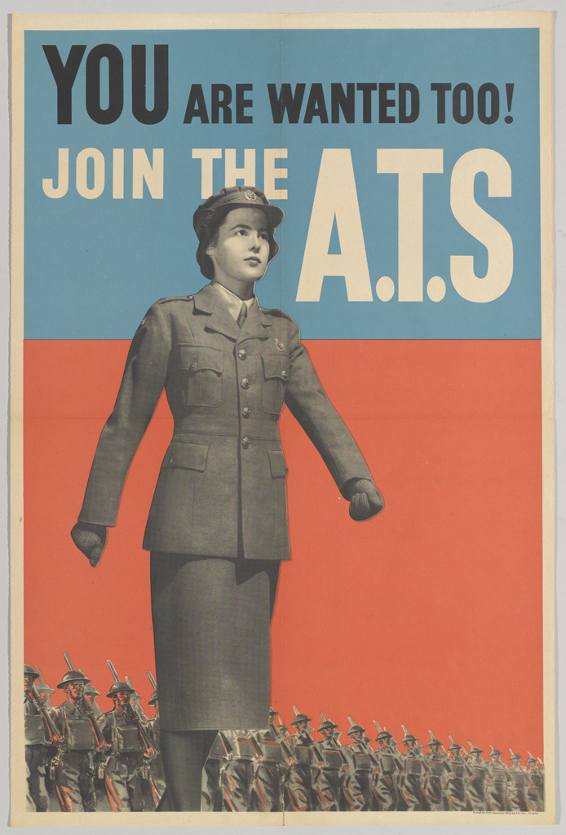
'You are Wanted Too! Join the ATS', 1941 (c)
Notes:
Colour photolithograph recruiting poster, unknown artist, published by HM Stationery Office, 1941 (c).
The first women recruited to the Auxiliary Territorial Service (ATS) worked as cooks, clerks and storekeepers. As time went on the range of duties expanded and women served as office, mess and telephone orderlies, drivers, postal workers and ammunition inspectors. Women were not allowed to fight in battle but as more and more men were called overseas to serve, their duties extended to include radar operators, military police, gun crews, and many other operational support tasks. By June 1945, there were over 190,000 members of the ATS from all across the British Empire and Commonwealth.
NAM Accession Number
NAM. 1993-11-1-117-1

Slide 35
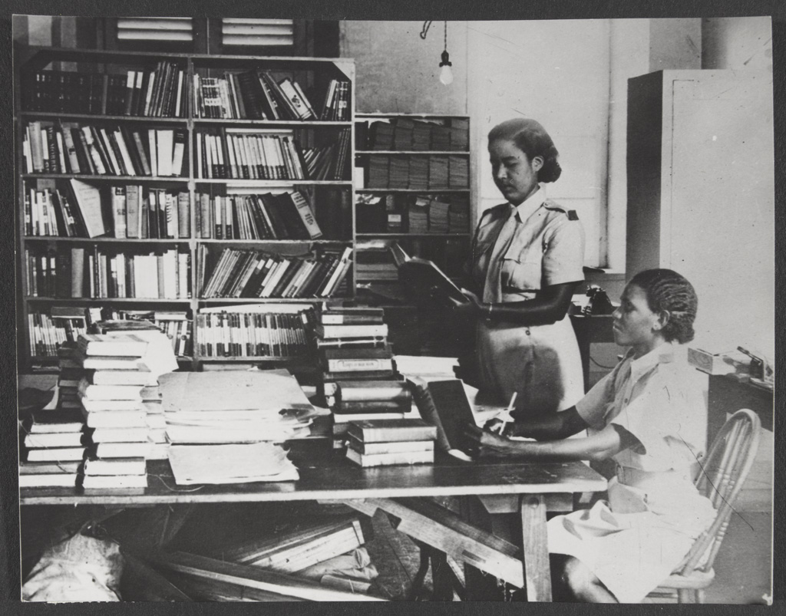
Two librarians of the West Indies Auxiliary Territorial Service, Trinidad, 1945
Notes:
An inside view of the ATS library at St James Depot, Port of Spain, Trinidad, showing two librarians at work. The bag at the bottom left of the picture contains magazines and other literature for troops.
One of 69 photographs relating to the West Indies Auxiliary Territorial Service, 1943-1947.
Part of Ministry of Information Second World War Official Collection.
NAM Accession Number
NAM. 1994-07-283-39

Slide 36
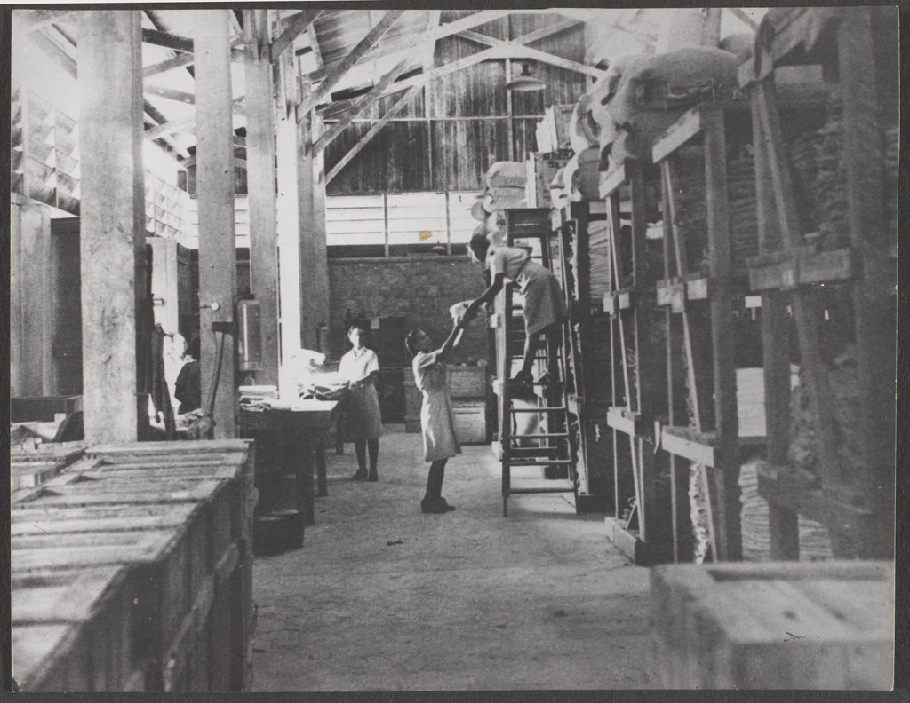
Three members of the West Indies Auxiliary Territorial Service working in stores, 1943 (c) - 1947 (c)
Notes:
One woman stands halfway up a ladder and hands a large textile item down to another woman.
Photograph from a collection of 69 photographs relating to the West Indies Auxiliary Territorial Service, 1943-1947.
NAM Accession Number
NAM. 1994-07-283-37

Slide 37
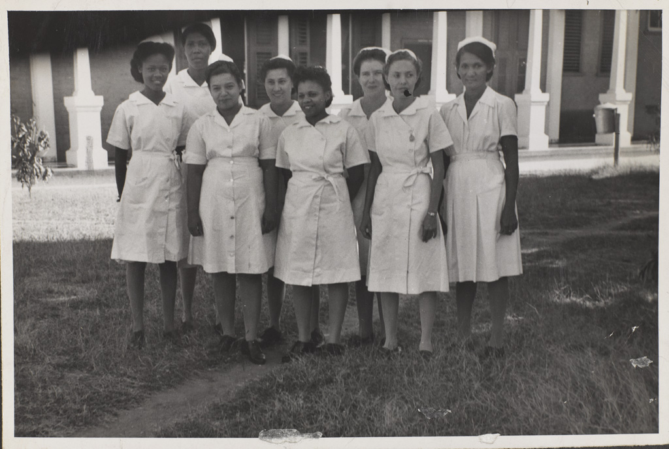
West Indian nurses standing outside a hospital, 1943 (c) - 1947 (c)
Notes:
Photograph from a collection of 69 photographs relating to the West Indies Auxiliary Territorial Service, 1943-1947.
NAM Accession Number
NAM. 1994-07-283-10

Slide 38
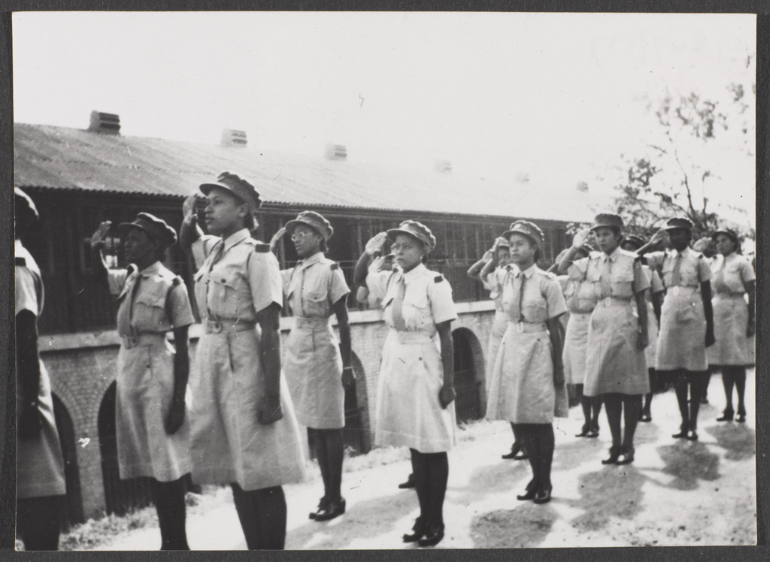
Auxiliary Territorial Service personnel on a railway platform, 1943 (c)
Notes:
Photograph, World War Two, 1943 (c).
Members of the West Indies Auxiliary Territorial Service (ATS) salute as a train arrives. The Caribbean women who joined the ATS were employed as clerks, storewomen, drivers, orderlies and cooks.
One of 69 photographs relating to the West Indies Auxiliary Territorial Service, 1943-1947.
NAM Accession Number
NAM. 1994-07-283-14

Slide 39
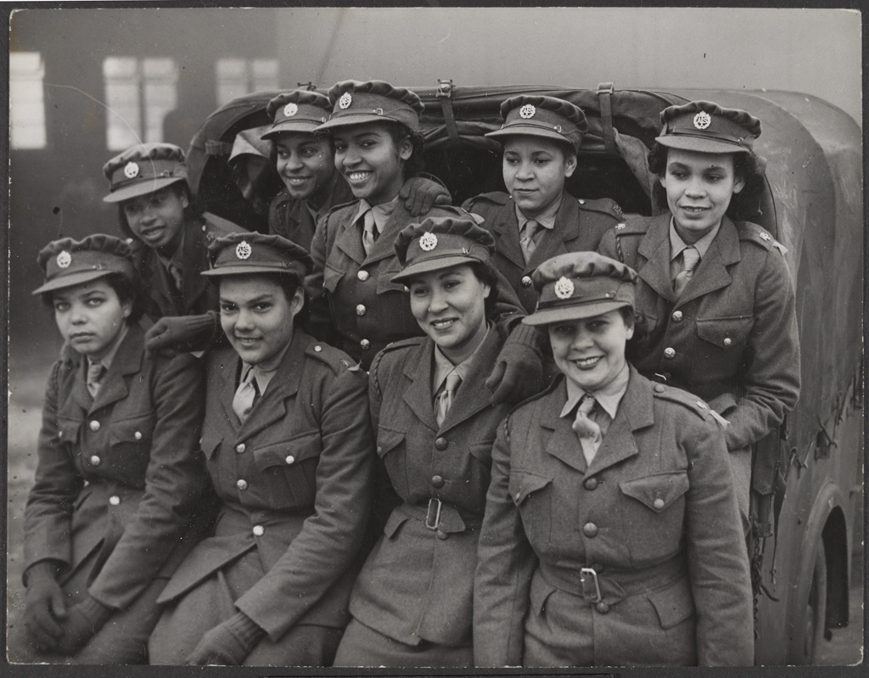
Women of the West Indies Auxiliary Territorial Service, 1944 (c)
Notes:
Group photograph of women from the West Indies serving in the Auxiliary territorial Service, 1943 (c)- 1947 (c). The women on the back row are kneeling in the back of a truck and the front row are sitting on the edge. Duplicate of part 57.
Photograph from a collection of 69 photographs relating to the West Indies Auxiliary Territorial Service, 1943-1947.
Black women from the West Indies had to overcome formidable barriers of prejudice when they attempted to join Britain’s uniformed services during the Second Word War. In the early years of the war they were rejected by the War Office, initially on the grounds of colour, then later with the dubious argument that they would find it difficult to adapt to the climate and culture of Britain and so would be unable to discharge their duties effectively. However, this barrier was eventually broken down in the face of the growing demand for service personnel and when the Colonial Office pressed for a non-discriminatory recruitment policy on the grounds than it would greatly improve relations between Britain and the Caribbean. From 1943 Black Women were allowed to enlist in the Auxiliary Territorial Service (ATS) and RAF (Royal Air Force) and be posted to Britain.
NAM Accession Number
NAM. 1994-07-283-66

Slide 40
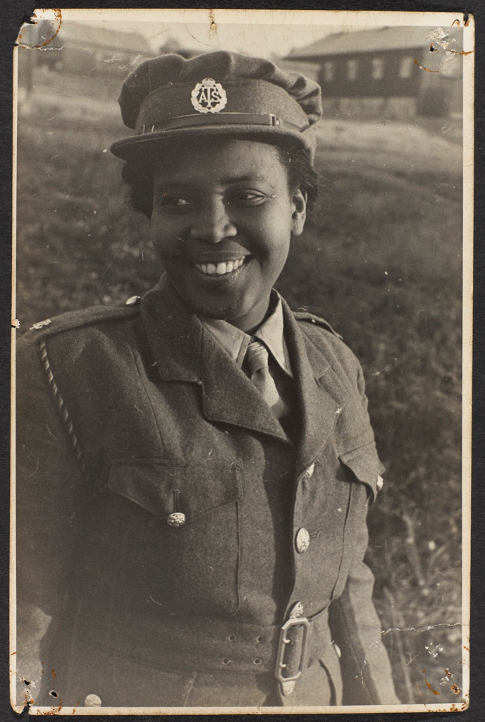
Photograph of a West Indian member of the Auxiliary Territorial Service (ATS), 1943-47.
Notes:
Photograph of a West Indian member of the Auxiliary Territorial Service (ATS), 1943-47.
In October 1943 a group of 30 women from across the Caribbean arrived in Britain. Motivated by loyalty to the ‘mother country’, they were the vanguard of over 100 West Indian women eventually recruited to the ATS in Britain. Despite the wartime personnel shortage these pioneers faced a long struggle to be accepted for enlistment by a sexist and racist War Office that seemed determined to restrict black people from the British women’s military services.
One of 69 photographs relating to the West Indies Auxiliary Territorial Service, 1943-1947.
NAM. 1994-07-283-1

Slide 41
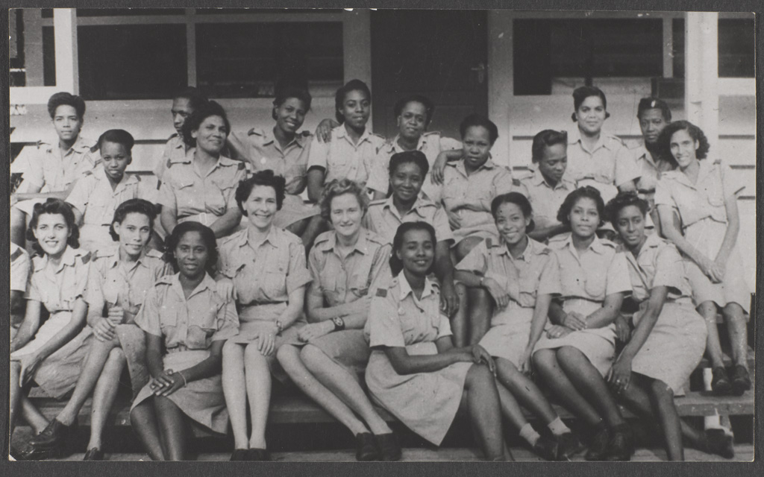
A West Indian detachment of the Auxiliary Territorial Service, 1943 (c)
Notes:
Group photograph of members of the West Indian Auxiliary Territorial Service, 1943 (c).
The Women's Auxiliary Territorial Service (ATS) was established in September 1938. As well as Britain, recruits were sought from the Dominions, India and the West Indies. Six hundred West Indian women volunteered of whom half stayed in the Caribbean while 200 served in the United States and 100 in Britain.
One of 69 photographs relating to the West Indies Auxiliary Territorial Service, 1943-1947.
NAM Accession Number
NAM. 1994-07-283-24

Slide 42
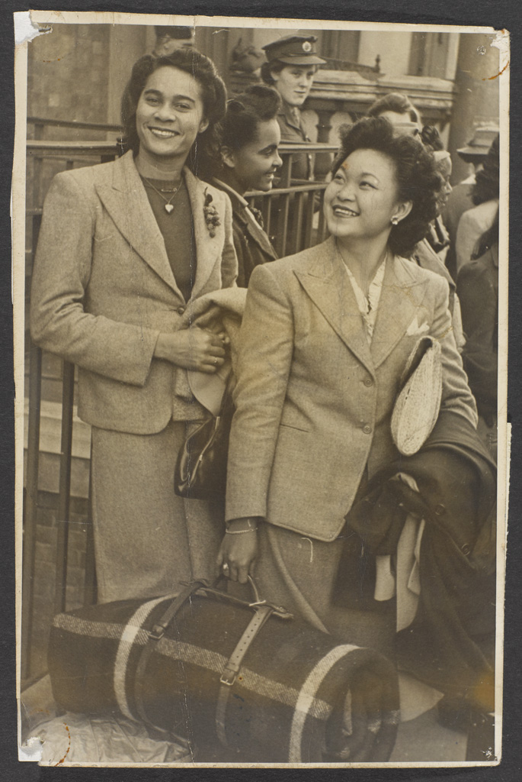
West Indian women in civilian dress with luggage, 1943 (c)- 1947 (c)
Notes:
Photograph of two women from the West Indies arriving in Britain to join the Auxiliary Territorial Service, 1943 (c)- 1947 (c). Both are wearing civilian clothing and one is carrying her luggage.
Photograph from a collection of 69 photographs relating to the West Indies Auxiliary Territorial Service, 1943-1947.
NAM Accession Number
NAM. 1994-07-283-4

Slide 43
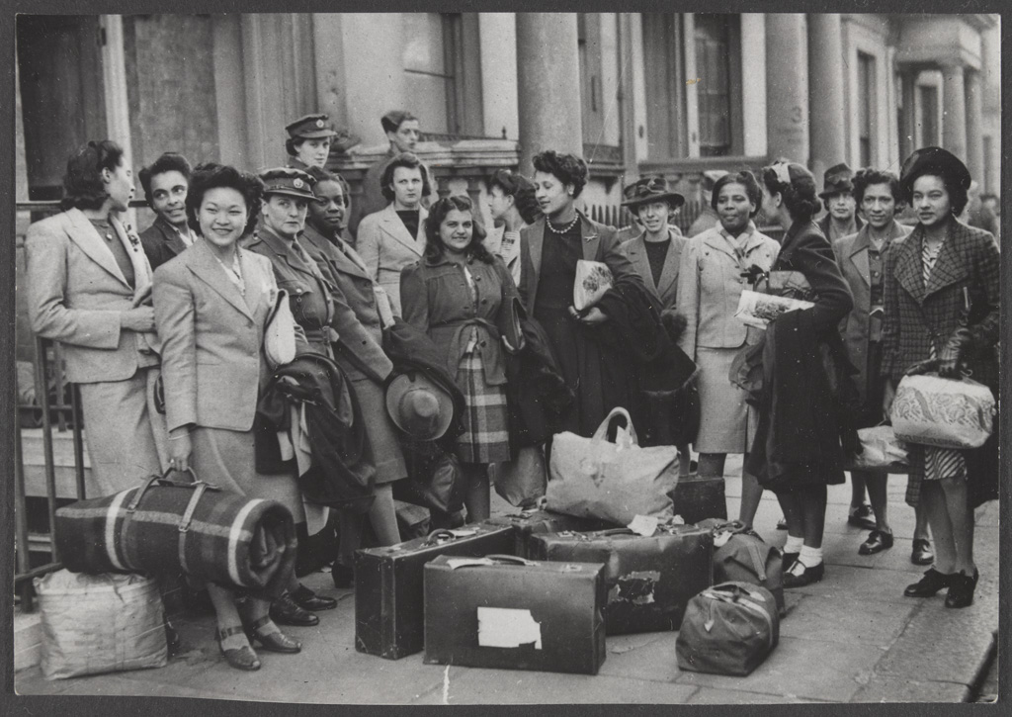
West Indian women in civilian dress with luggage, 1943 (c)- 1947 (c)
Notes:
One of 69 photographs relating to the West Indies Auxiliary Territorial Service, 1943-1947.
The first contingents of West Indian women to serve in Britain’s armed forces arrived in Britain in 1943. Approximately 70 served with the ATS (Auxiliary Territorial Service) and 80 with the RAF (Royal Air Force). Significant numbers of other West Indians arrived in Britain during the Second World War, serving in the armed forces or war industries. Many of these, together with other workers from across the Empire and Commonwealth, choose to stay in Britain after the war. This suggests that migration into Britain from these areas should be dated from this period rather than from arrival of the Empire Windrush in 1948 as is conventional.
NAM Accession Number
NAM. 1994-07-283-56

Slide 44
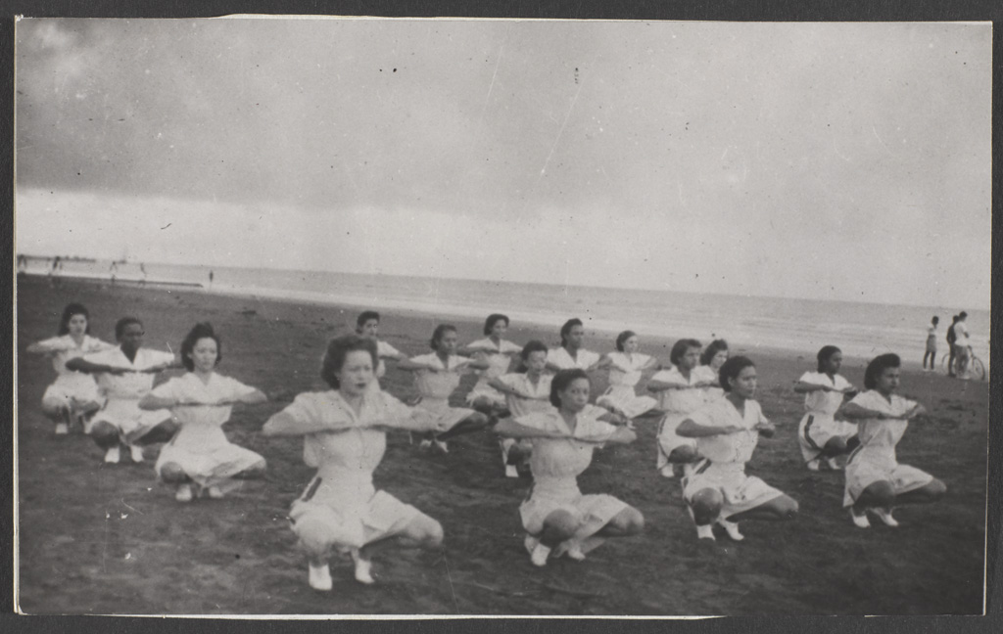
West Indies Auxiliary Territorial Service personnel exercise on a beach, 1943-1947
Notes:
Photograph from a collection of 69 photographs relating to the West Indies Auxiliary Territorial Service, 1943-1947.
NAM Accession Number
NAM. 1994-07-283-19

Slide 45
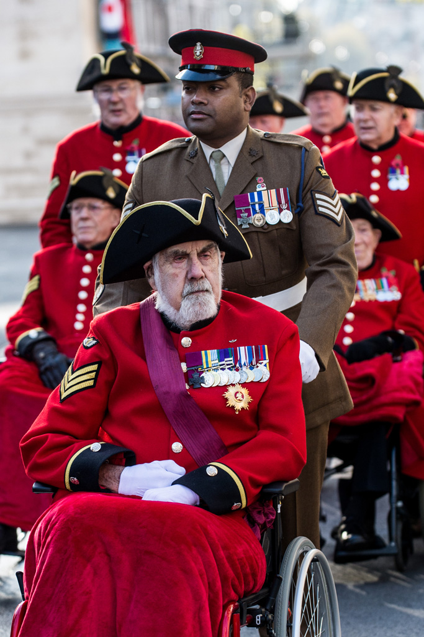
Lance Sergeant Johnson Beharry, Princess of Wales’s Royal Regiment (Queen’s and Royal Hampshires), with a Chelsea Pensioner, Remembrance Sunday, 2016
Notes:
Digital image by Sgt Rupert Frere, Royal Logistic Corps, 2016.
Johnson Beharry VC COG was born in Grenada. Serving as a Private in the Princess of Wales’ Royal Regiment on 1st May 2004 during service in Iraq , he successfully guided his damaged vehicle and five others out of danger following an enemy ambush. He then proceeded to rescue his wounded comrades from the vehicle, all the while exposed to heavy enemy fire. On 11th June, he was again ambushed whilst driving and was seriously wounded in the head by an enemy grenade but successfully drove the vehicle out of danger before losing consciousness. In 2005, Beharry was awarded the Victoria Cross for 'extreme gallantry and unquestioned valour'. He was the first recipient of the award in over 30 years.
From a collection of digital photographs compiled by Cpl Tom Seaton-Norton, Royal Logistic Corps associated with British Army ceremonial events 2014-2017.
NAM Accession Number
NAM. 2018-01-78-49

Slide 46
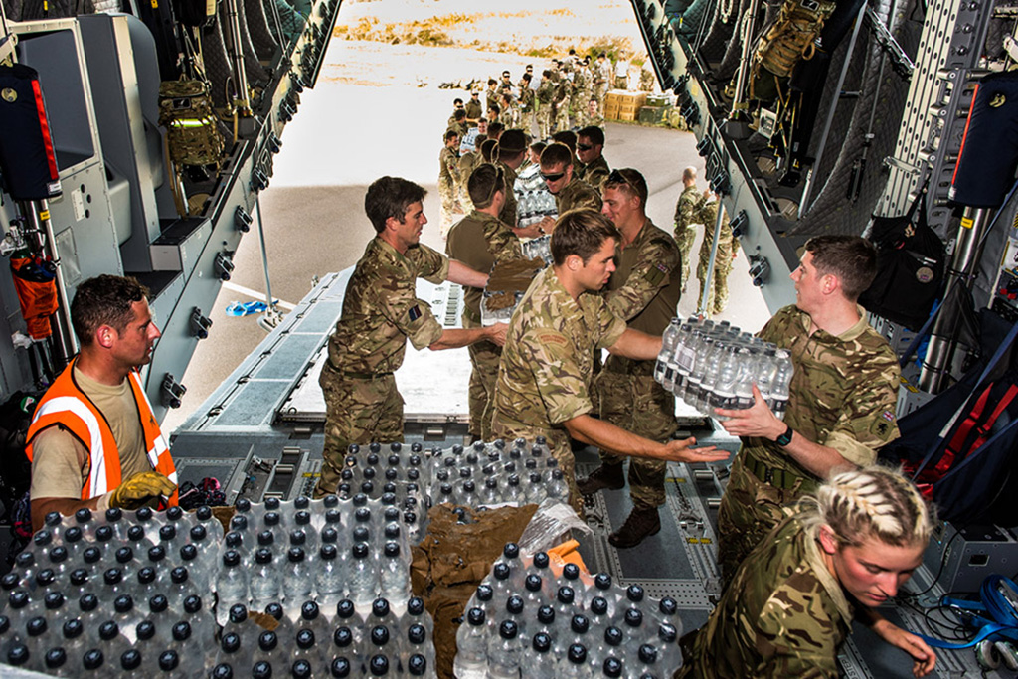
'Hurricane Irma 2', 2017
Notes:
Digital photograph by Corporal Darren Legg, from a DVD of 2017 Army Photographic Competition Entries.
Royal Marines and Army Commandos unload supplies of drinking water in the Turks and Caicos Islands.
Operation RUMAN, 2017, was the humanitarian operation to provide relief to British Overseas Territories in the Caribbean and North Atlantic, in the aftermath of Hurricane Irma and prior to Hurricane Maria.
NAM Accession Number
NAM. 2017-10-33-41

Slide 47
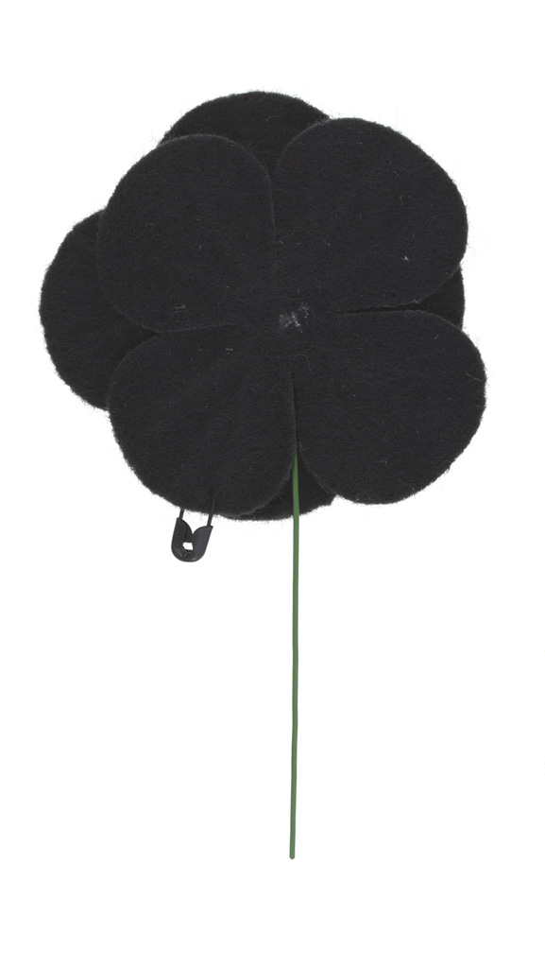
Black Poppy Rose lapel badge, 2015 (c)
Notes:
Black felt commemorative poppy with black centre and green stem, with safety pin.
The Black Poppy Rose campaign was launched in 2010 with the aim of acknowledging and commemorating the contribution to war efforts of black, African, Caribbean and Pacific island communities since the sixteenth century. The mission statement of the Black Poppy Rose organisation is, 'Established with the aim of enlightening people of all nations, of the African /Black /West Indian /Pacific Islanders contribution to history.’
NAM Accession Number
NAM. 2016-01-8-1

