Slide 1
Florence Nightingale
in the National Army Museum collections
Source Pack

Slide 2
Paper lantern used by Florence Nightingale, 1855 (c)
Notes:
Florence Nightingale (1820-1910) was famous for her work at the Military Hospital at Scutari in Turkey during the Crimean War (1854-1856). During her rounds there she used this paper lantern. At first, the male Army doctors did not want Nightingale and her nurses at Scutari and were contemptuous of their ability to help. After the arrival of fresh casualties from the Battle of Inkerman in November 1854, the staff were soon fully stretched. They now accepted the nurses’ aid. The 'Lady-in-Chief', as Florence was called, improved medical and sanitary arrangements, set up food kitchens, washed linen and clothes, wrote home on behalf of the soldiers and introduced reading rooms. Before Nightingale nursing was not considered a respectable profession. With the exception of nuns, the women who worked as nurses were often ill trained and poorly disciplined.
Florence was determined to encourage educated, 'respectable' women into nursing. Her work in the Crimea set the standards for modern nursing and helped transform its public image. She became something of a legend in her own lifetime, but was publicity-shy and appalled at the adulation she received. One of the main creators of the Nightingale cult was Henry Wadsworth Longfellow who immortalised her as the ‘Lady with a Lamp’ in his poem Santa Filomena:
‘A Lady with a lamp shall stand
In the great history of the land,
A noble type of good
Heroic Womanhood’.

Slide 3
Model of carriage used by Florence Nightingale during the Crimean War, 1856 (c)
Notes:
The carriage is black with four wheels, two high arched mud guards on either side of the central mounting step. Body is ribbed with wooden beams and painted to represent wickerwork. Hood painted black and covers entire surface including model figure of Florence Nightingale. Each wheel has 16 spokes painted with red central line, axel hubs covered with silver foil. Carriage and two wooden horses painted brown with fabric manes and tails, one of which has a wooden cut out rider wearing red tunic and blue trousers.
On her second visit to the Crimea in March 1856, the exertion of travelling to the scattered field hospitals took its toll on Florence Nightingale’s delicate health and, to spare her riding, she was given a mule cart. This however overturned one night on the rough tracks and so Colonel William McMurdo of the Land Transport Corps presented her instead with this, her Crimean carriage, which also served as an ambulance. The original carriage is in the Collections of the Florence Nightingale Museum Trust.
NAM. 1967-06-76-1

Slide 4
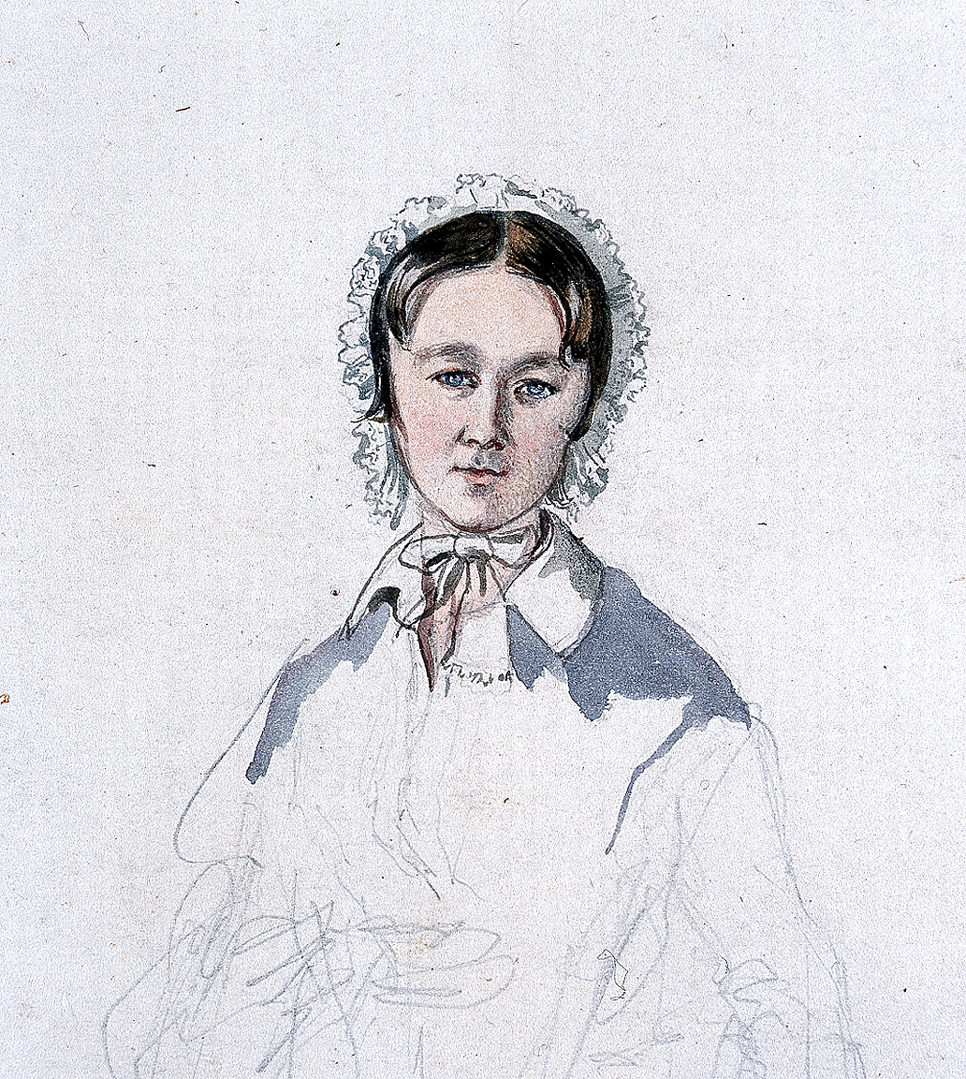
Florence Nightingale, 1856
Notes:
‘Florence Nightingale May 14 ’56 her own signature. Miss Nightingale done from nature but not advance[d] enough to be very like’.
Unfinished pencil, pen and ink and watercolour by Colonel (later General Sir) The Honourable George Cadogan (1814-1880).
Following reports in 'The Times' of the soldiers' suffering in the Crimean War (1854-56), Florence Nightingale answered a government appeal for nurses and was appointed 'Superintendent of the Female Nurses in the Hospitals in the East'. Florence and her nurses improved medical and sanitary arrangements, set up food kitchens, washed linen and clothes, wrote home on behalf of the soldiers and introduced reading rooms.
Before Nightingale nursing was not considered a respectable profession. With the exception of nuns, the women who worked as nurses were often ill trained and poorly disciplined. Most were working-class. Florence was determined to encourage educated, 'respectable' women into nursing. Her work in the Crimea set the standards for modern nursing and helped transform its public image.
From an album of paintings and sketches (with some paper ephemera) of Colonel (later General Sir) The Honourable George Cadogan, 1st (or Grenadier) Regiment of Foot Guards; also known as ‘Cadogan’s Crimea’, 1854-1856.
NAM. 1998-06-128-71

Slide 5
Florence Nightingale, 1854 (c)
Notes:
Lithograph, Colnaghi's Authentic Series, published November 1854.
Born into a wealthy family, Florence Nightingale overcame the narrow opportunities offered to girls of her station and, despite the censure of her family in 1851 she completed a course of nursing training in Germany.
Following reports in 'The Times' of the soldiers' suffering in the Crimean War (1854-1856), Florence answered a government appeal for nurses and was appointed 'Superintendent of the Female Nurses in the Hospitals in the East'. Florence and her nurses improved medical and sanitary arrangements, set up food kitchens, washed linen and clothes, wrote home on behalf of the soldiers and introduced reading rooms.
Before Florence Nightingale nursing was not considered a respectable profession. With the exception of nuns, the women who worked as nurses were often ill trained and poorly disciplined. Most were working-class. Florence was determined to encourage educated, 'respectable' women into nursing. Her work in the Crimea set the standards for modern nursing and helped transform its public image. For the rest of her life she continued to campaign for improved sanitary conditions in both military and civilian hospitals.
NAM. 1969-08-27-1

Slide 6
Florence Nightingale, 1860 (c).
Notes:
Photograph, 1860 (c).
Florence Nightingale was a legend in her own lifetime. Born into a wealthy family, she overcame the narrow opportunities offered to girls of her station and, despite the censure of her family, in 1851 she completed a course of nursing training in Germany. Following reports in The Times of the soldiers’ suffering in the Crimean War (1854-1856), Florence answered the appeal for nurses and was appointed ‘Superintendent of the Female Nurses in the Hospitals in the East’. The 'Lady-in-Chief', as Florence was called, improved medical and sanitary arrangements, set up food kitchens, washed linen and clothes, wrote home on behalf of the soldiers and introduced reading rooms.
Before Florence Nightingale nursing was not considered a respectable profession. With the exception of nuns, the women who worked as nurses were often ill trained and poorly disciplined. Florence was determined to encourage educated, 'respectable' women into nursing. Her work in the Crimea set the standards for modern nursing and helped transform its public image. Despite putting nursing in the public eye, Florence herself was publicity-shy and appalled at the adulation she received.
Beginning in 1896 Florence was not able to leave her bed and is believed to have had what is now known as Chronic Fatigue Syndrome. Yet despite being bedridden for many years, she still campaigned tirelessly to improve health standards. Florence died on 13 August 1910 aged ninety. The offer of burial in Westminster Abbey was declined by her relatives, and she is buried in the graveyard at St. Margaret Church in East Wellow, near her parent’s home.
NAM. 1963-12-227-1

Slide 7
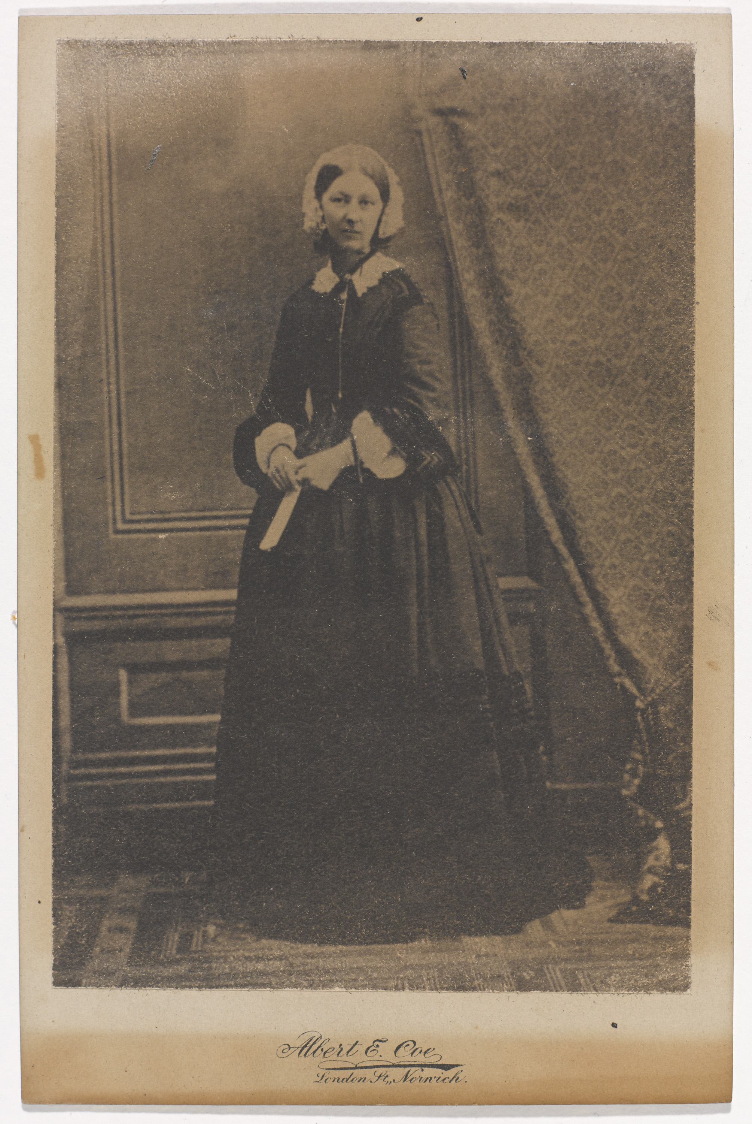
Florence Nightingale, 1856
Notes:
Photograph by Albert E Coe, London St, Norwich, 1856.
Born into a wealthy family, Florence overcame the narrow opportunities offered to girls of her station and, despite the censure of her family in 1851 she completed a course of nursing training in Germany.
Following reports in 'The Times' of the soldiers' suffering in the Crimean War (1854-1856), Florence answered a government appeal for nurses and was appointed 'Superintendent of the Female Nurses in the Hospitals in the East'. Florence and her nurses improved medical and sanitary arrangements, set up food kitchens, washed linen and clothes, wrote home on behalf of the soldiers and introduced reading rooms.
Before Florence Nightingale nursing was not considered a respectable profession. With the exception of nuns, the women who worked as nurses were often ill trained and poorly disciplined. Most were working-class. Florence was determined to encourage educated, 'respectable' women into nursing. Her work in the Crimea set the standards for modern nursing and helped transform its public image. For the rest of her life she continued to campaign for improved sanitary conditions in both military and civilian hospitals.
NAM. 1980-07-137-1

Slide 8
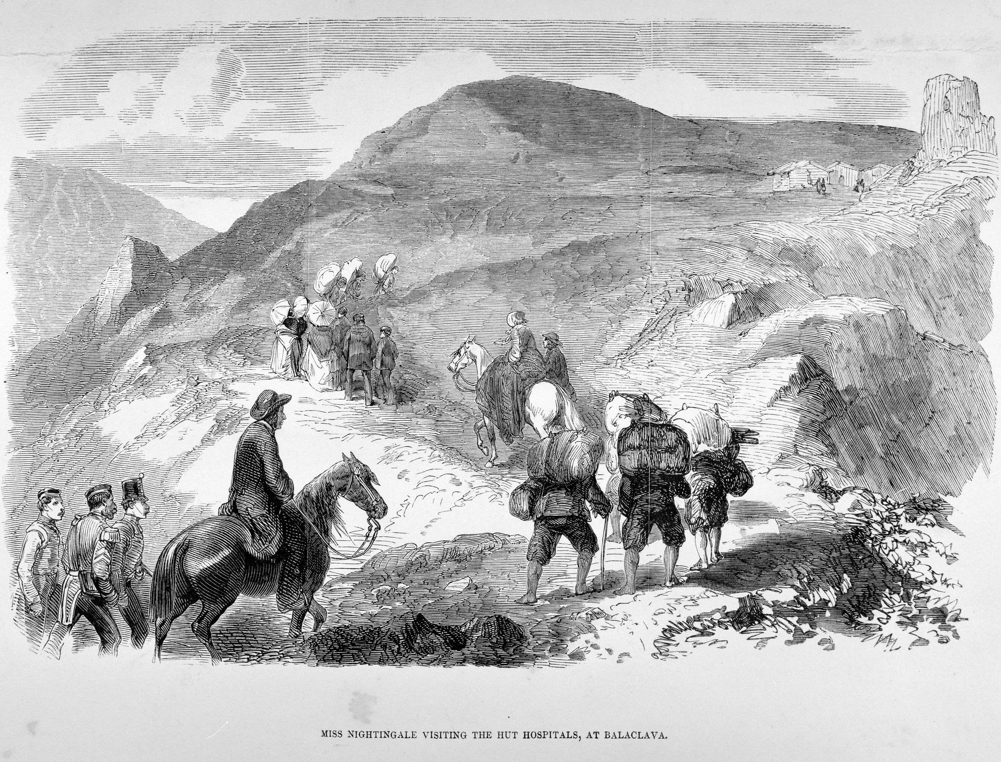
‘Miss Nightingale visiting the Hut Hospitals at Balaclava’
Notes:
Proof copy of wood engraving of Florence Nightingale.
Reproduction from 'The Illustrated London News’.
Associated with the Crimean War (1854-1856).
NAM. 1968-06-328-1

Slide 9
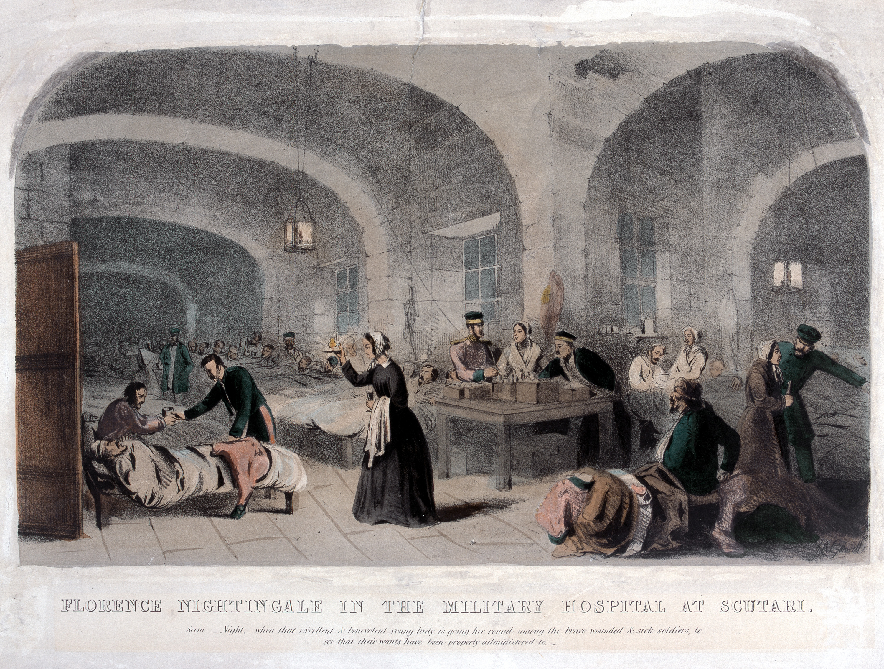
’Florence Nightingale in the Military Hospital at Scutari’, 1855 (c)
Notes:
Coloured lithograph by and after Joseph Austin Benwell, published by Peter Jackson, The Caxton Press, London and Liverpool, 1856 (c).
In this night scene, Florence Nightingale is shown on her inspection rounds of the cramped wards of the hospital at Scutari during the Crimean War (1854-1856). In what was to become an iconic image of her, Miss Nightingale is seen holding a lamp in her hand.
NAM. 1978-10-57-1

Slide 10
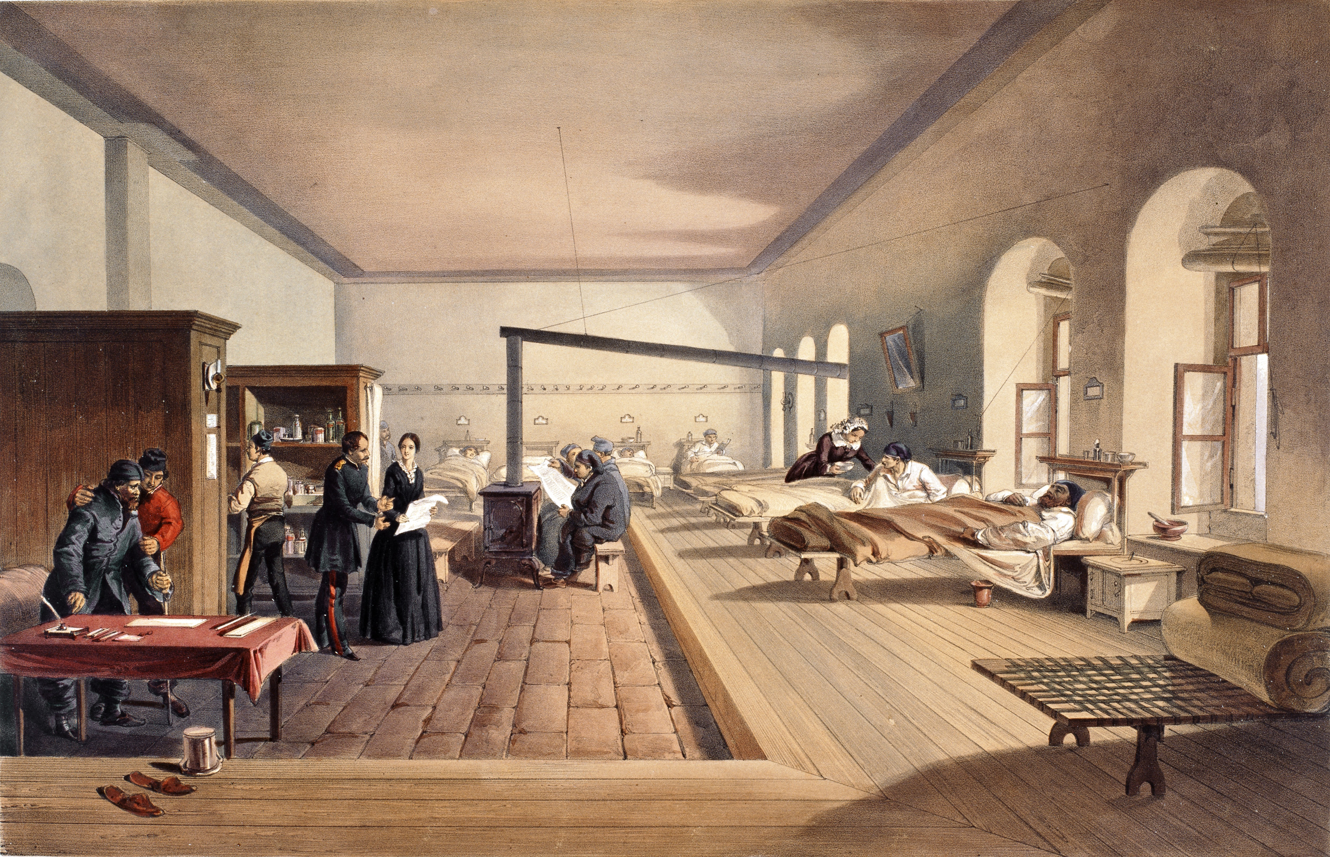
‘One of the Wards of the Hospital at Scutari’, 1856
Notes:
Coloured tinted lithograph by E Walker, 1856. One of 41 lithographs from 'The Seat of War in the East - Second Series', after William Simpson, published by Paul and Dominic Colnaghi, printed by Day and Son.
Florence Nightingale (1820-1910) was famous for her work at the Military Hospital at Scutari in Turkey during the Crimean War (1854-1856). At first, the male Army doctors did not want Nightingale and her nurses at Scutari and were contemptuous of their ability to help. After the arrival of fresh casualties from the Battle of Inkerman in November 1854, the staff were soon fully stretched. They now accepted the nurses’ aid. The 'Lady-in-Chief', as Florence was called, improved medical and sanitary arrangements, set up food kitchens, washed linen and clothes, wrote home on behalf of the soldiers and introduced reading rooms.
NAM. 1971-02-33-491-34

Slide 11
Florence Nightingale, 1862
Notes:
Marble bust by Sir John Robert Steell (1804-1891).
As the ‘Lady with the Lamp’, Florence Nightingale (1820-1910) was a legend in her own lifetime. Born into a wealthy family, she overcame the narrow opportunities available to girls of her station and, despite the censure of her family, in 1851 she completed a course of nursing training in Germany. Following reports in 'The Times' of the soldiers’ suffering in the Crimean War (1854-1856), Florence answered the appeal for nurses and was appointed ‘Superintendent of the Female Nurses in the Hospitals in the East’. In November 1854 she arrived with 38 nurses at Scutari opposite Istanbul on the Bosphorus coast of Turkey. There they were faced with a dirty and vermin-ridden hospital, converted from a barracks, which lacked even basic equipment and provisions. Overflowing with more sick than wounded troops, the death rate rose to 42 per cent in February 1855, but by June ‘The Lady-in-Chief’, as Florence was known, had improved conditions to such an extent that it dropped to two per cent.
This bust was paid for and presented to Florence by the Non-Commissioned Officers and Men of the British Army. Publicity-shy and appalled at the adulation she received, when asked to lend this bust to the Victorian Era Exhibition, held to commemorate Queen Victoria’s 1897 Diamond Jubilee, Florence initially refused but eventually relented. Confirming her worst fears, the bust was sacrilegiously venerated by visitors almost as a holy relic. Nevertheless, she was touched by the report that an anonymous visitor, possibly a veteran of the Crimea, came every day to dress it with fresh flowers.
NAM. 1963-10-193-1

Slide 12
Statuette of Florence Nightingale helping a wounded soldier, 1856 (c)
Notes:
Statuette of Florence Nightingale helping a wounded soldier, 1856 (c).
Parian ware (biscuit porcelain), designed by Theodore Phyffers, manufactured by Copeland, 1856 (c).
The contemporary fame of Florence Nightingale (1820-1910) was reflected in the production of merchandise commemorating her achievements.
Until the development of the medium of biscuit porcelain and then Parian ware in the nineteenth century, sculpted portraits, usually carved from marble, had been the exclusive preserve of the rich. Parian ware was superior to biscuit porcelain, being finer and visually more pleasing as well as cheaper than its crude forerunner.
NAM. 1966-04-1-1

Slide 13
Gold enamelled brooch, presented to Florence Nightingale by Queen Victoria, 1855
Notes:
Gold, with diamonds and enamel, said to have been designed by Prince Albert The Prince Consort (1819-1861), manufactured by R and S Garrard and Co, 1855.
Sometimes referred to as the ‘Nightingale Jewel’, this brooch, the design of which was supervised by Prince Albert, is engraved verso with a dedication from Queen Victoria, ‘To Miss Florence Nightingale, as a mark of esteem and gratitude for her devotion towards the Queen’s brave soldiers, from Victoria R. 1855’. The brooch was not intended to serve merely as a piece of jewellery, but rather, in the absence of a medal or established decoration suitable for presentation to such a female civilian, it stood as a badge of royal appreciation.
NAM. 1963-10-280-1

Slide 14
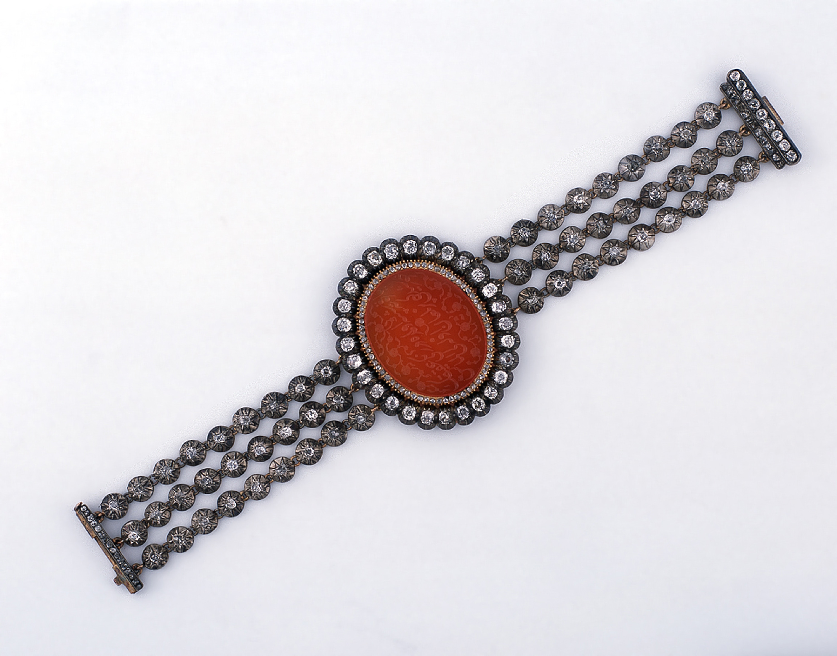
Bracelet presented to Florence Nightingale by the Sultan of Turkey in 1856
Notes:
This magnificent bracelet is centrally set with an oval cornelian stone engraved with Arabic text, surrounded by numerous small rose-cut and 28 cushion-shaped diamonds, supported on each side by three rows of nine cushion-shaped diamonds; with a rectangular clasp set with three rows of cushion-shaped stones. The total weight of diamonds is approximately 8.6 carats.
The bracelet was presented to Florence Nightingale by the Sultan before her return to Britain on 28 July 1856. The gift was accompanied by a financial donation for the nurses and hospitals. In a letter from Queen Victoria to the Secretary of State for War, Fox Maule, 2nd Baron Panmure (and later 11th Earl of Dalhousie), dated 27 July 1856, the Queen refers to Nightingale’s application for permission to accept these presents:
‘The Queen returns this letter of Miss Nightingale’s. She had already heard of the gifts of the Sultan’s, through Lord Stratford, who communicated with Lord Clarendon on the subject, and asked the Queen’s permission for Miss Nightingale to accept the bracelet, as well as the sum of money for the Nurses and Hospitals. The Queen entirely approves of the intended distribution of the money’.
On her death in 1910, this bracelet was one of a number of items, along with the ‘Nightingale Jewel’ and the marble bust of Florence Nightingale, that were donated to the Royal United Service Institution by the executors of her estate, in accordance with her desire that they should be ‘where the soldiers could see them’.
NAM. 1963-10-281-1

Slide 15
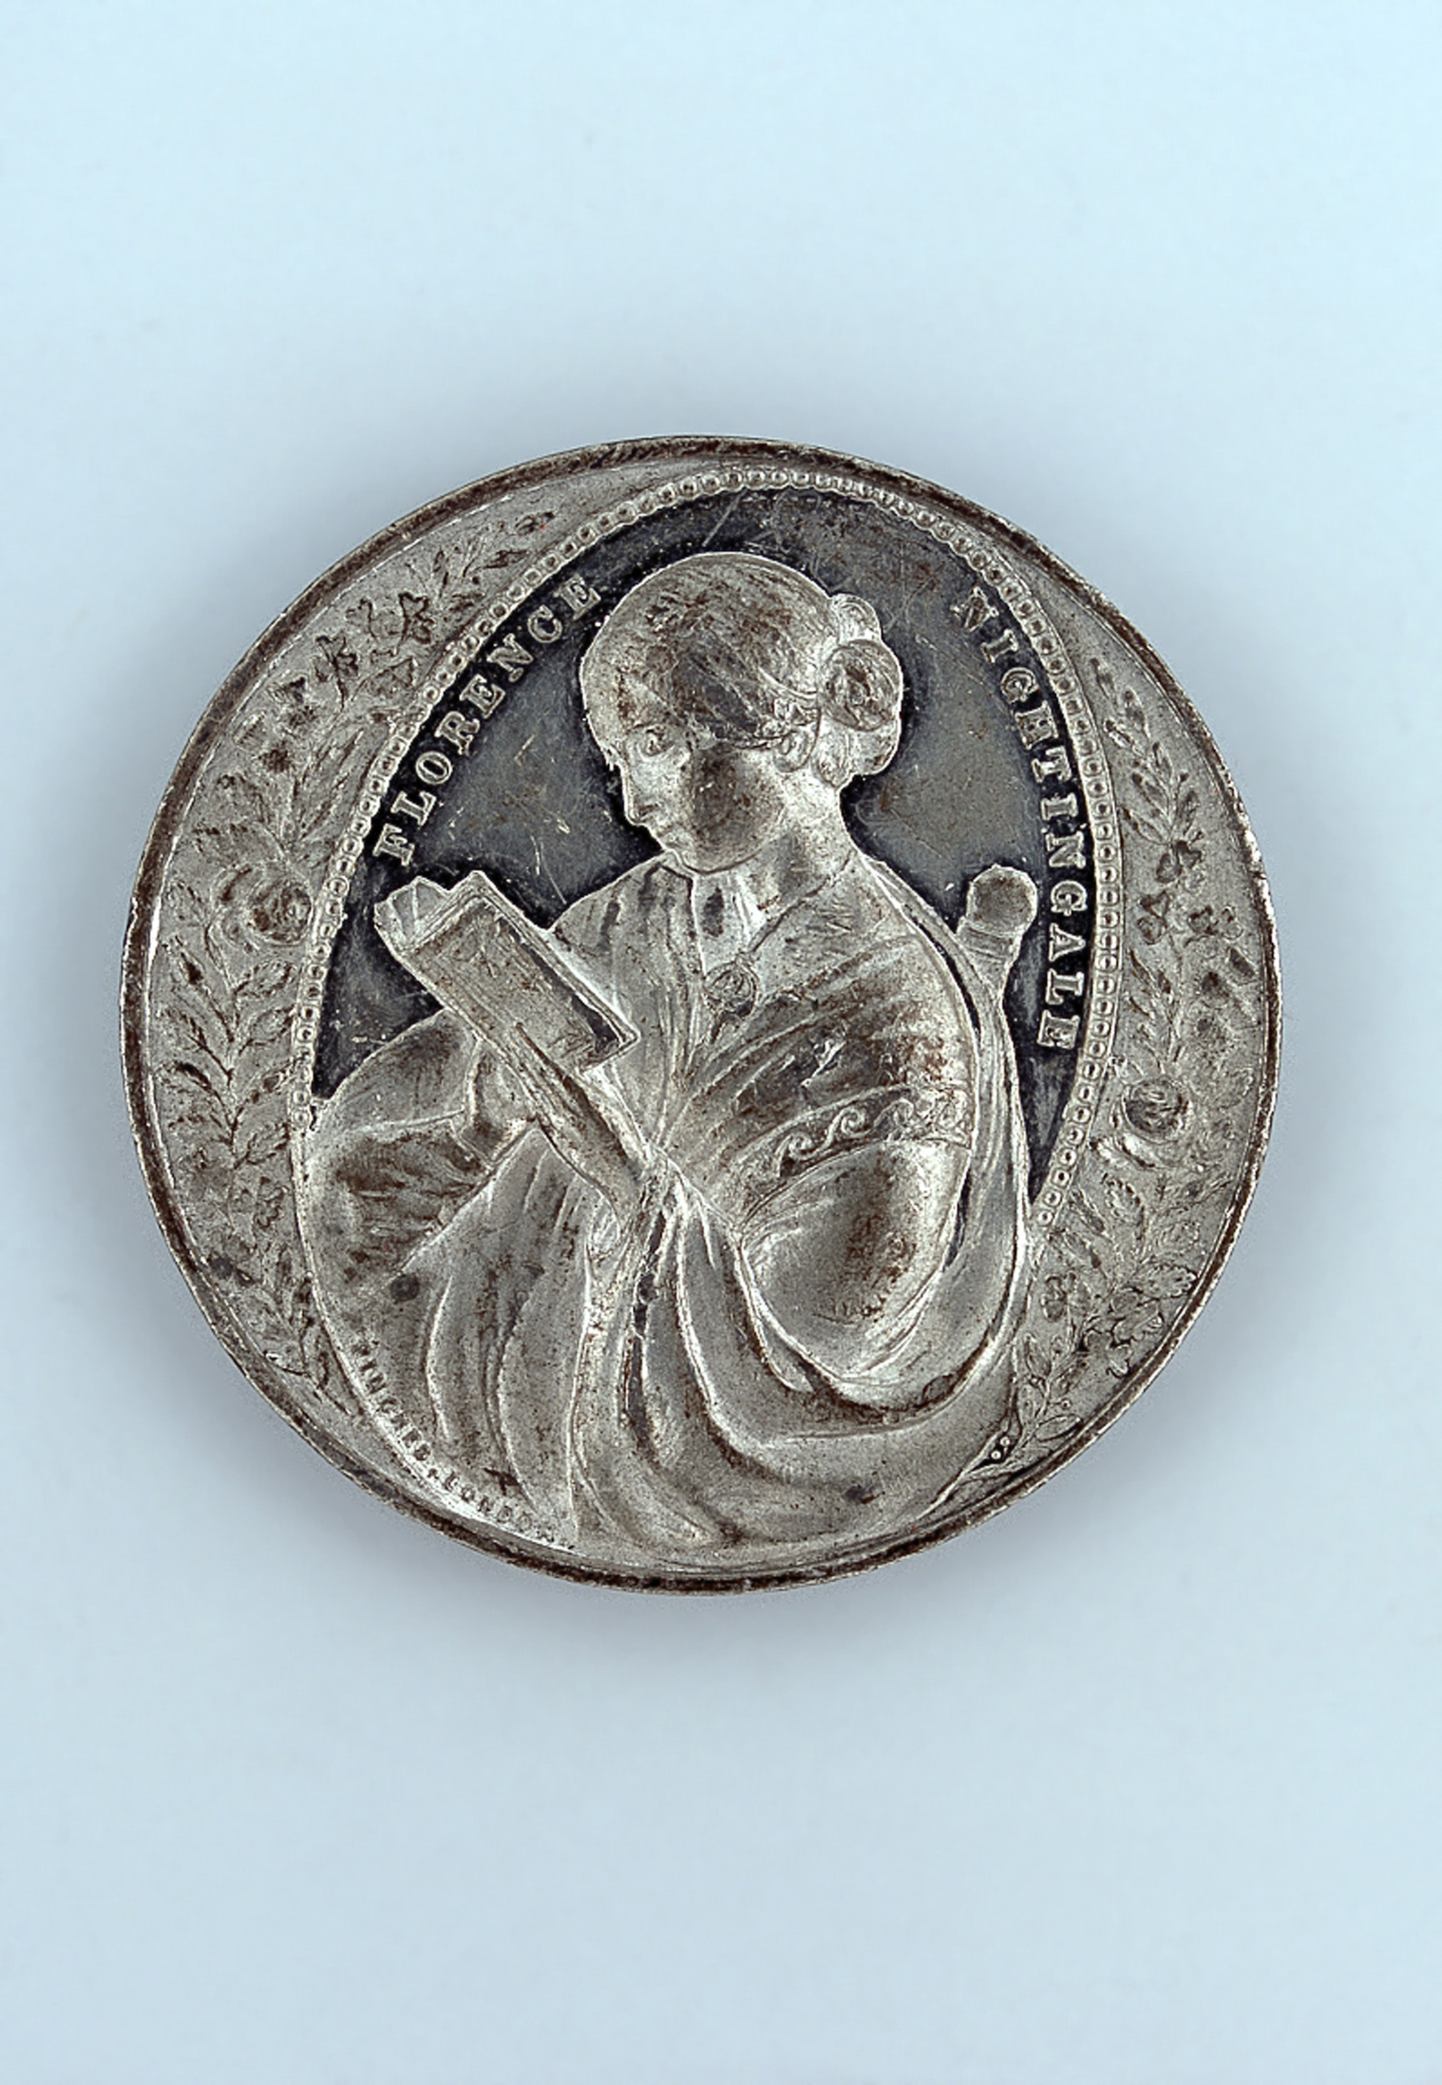
Medal commemorating Florence Nightingale, 1856 (c)
Notes:
White metal, John Pinches Ltd.
Following reports in 'The Times' of the soldiers' suffering in the Crimean War (1854-56), Florence Nightingale answered a government appeal for nurses and was appointed 'Superintendent of the Female Nurses in the Hospitals in the East'. Florence and her nurses improved medical and sanitary arrangements, set up food kitchens, washed linen and clothes, wrote home on behalf of the soldiers and introduced reading rooms.
Before Nightingale nursing was not considered a respectable profession. With the exception of nuns, the women who worked as nurses were often ill trained and poorly disciplined. Most were working-class. Florence was determined to encourage educated, 'respectable' women into nursing. Her work in the Crimea set the standards for modern nursing and helped transform its public image.
The obverse of this medal depicts a half-length figure of Florence reading a book, within a beaded oval frame. On either side are sprays of roses, thistles and shamrocks. The reverse carries an oval badge flanked by palm sprays and bearing the words: 'BLESSED ARE THE MERCIFUL'. Above it are three mullets and at the centre is a cross in splendour surmounted by a crown and the letters VR. Below is a scroll inscribed: CRIMEA, and the around the edge of the medal the inscription: 'AS A MARK OF ESTEEM AND GRATITUDE FOR HER DEVOTION TO THE QUEEN’S BRAVE SOLDIERS’.
NAM. 1979-07-133-1

Slide 16
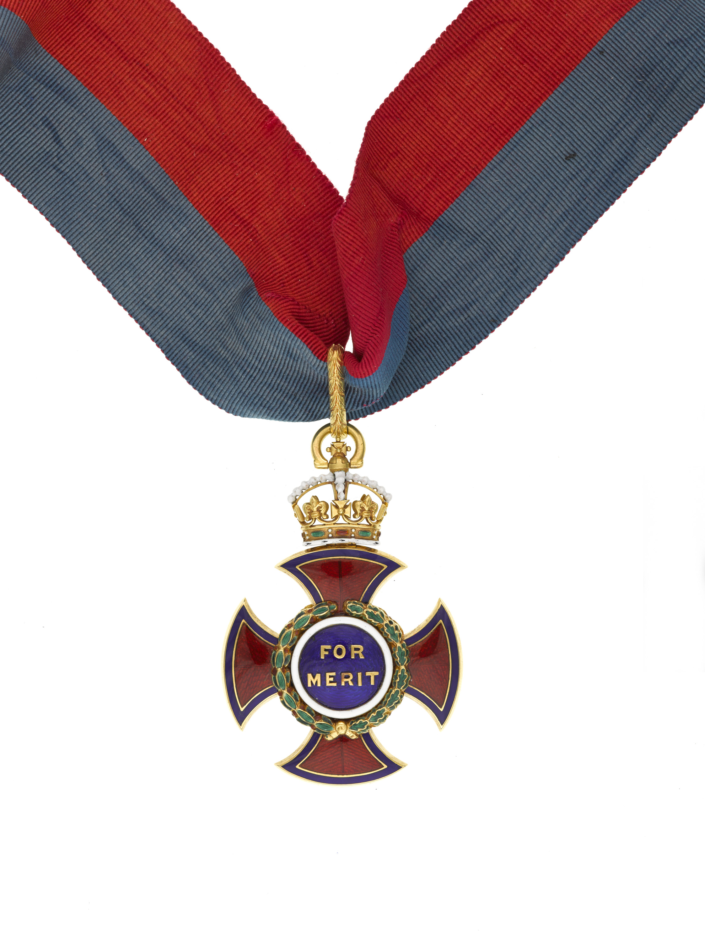
Order of Merit awarded to Florence Nightingale, 1907
Notes:
Since its institution in 1902, the Order of Merit has to date only admitted eight women, of which Florence Nightingale was the first. This highly prestigious Order, of which British membership is limited to the Sovereign and a maximum of 24 others at any one time, comprises six admirals, six generals and twelve civilians eminent in the fields of art, music and literature.
From medal group including, Order of the Hospital of St John of Jerusalem, Order of St John, Royal Red Cross, Geneva Cross, and Norwegian Red Cross Society Badge of Honour.
NAM. 1963-10-54-1

