Slide 1
The Blitz and the Home Front
in the National Army Museum collections
Source Pack

Slide 2
About this resource
This PowerPoint presentation contains a selection of images and archives from the Collection of the National Army Museum (NAM).
Unless otherwise stated in the notes, the images can be freely used for non-commercial purposes within the classroom. You can use the entire presentation or choose individual images for use in other non-commercial contexts. When using individual images in other contexts, please always retain the attribution statements provided in this document (e.g. NAM. 2005-08-66-1).
By downloading this document and using these images you agree to these terms of use, including your use of the attribution statement specified for each object by NAM.

Slide 3
Newspaper cutting, Nazi aircraft recognition chart, Second World War
Notes:
NAM. 1994-07-205-4

Slide 4
German reprint of Ordnance Survey Map showing Canterbury, Second World War
Notes:
NAM. 2000-10-467-1

Slide 5
‘Wellington’, an aircraft from a Czech bomber unit that operated from Britain, leaving its home base at moonrise for Germany, Second World War
Notes:
NAM. 2002-06-6-3

Slide 6
Bomb damage, London, 18 October 1940
Notes:
Between September 1940 and May 1941 London was constantly bombed in the 'Blitz'. The Germans hoped to 'soften up' the British population and to destroy its morale before their planned invasion. During this period more than 20,000 Londoners were killed and 1.4 million were bombed out of their homes.
NAM. 2006-12-102-37

Slide 7
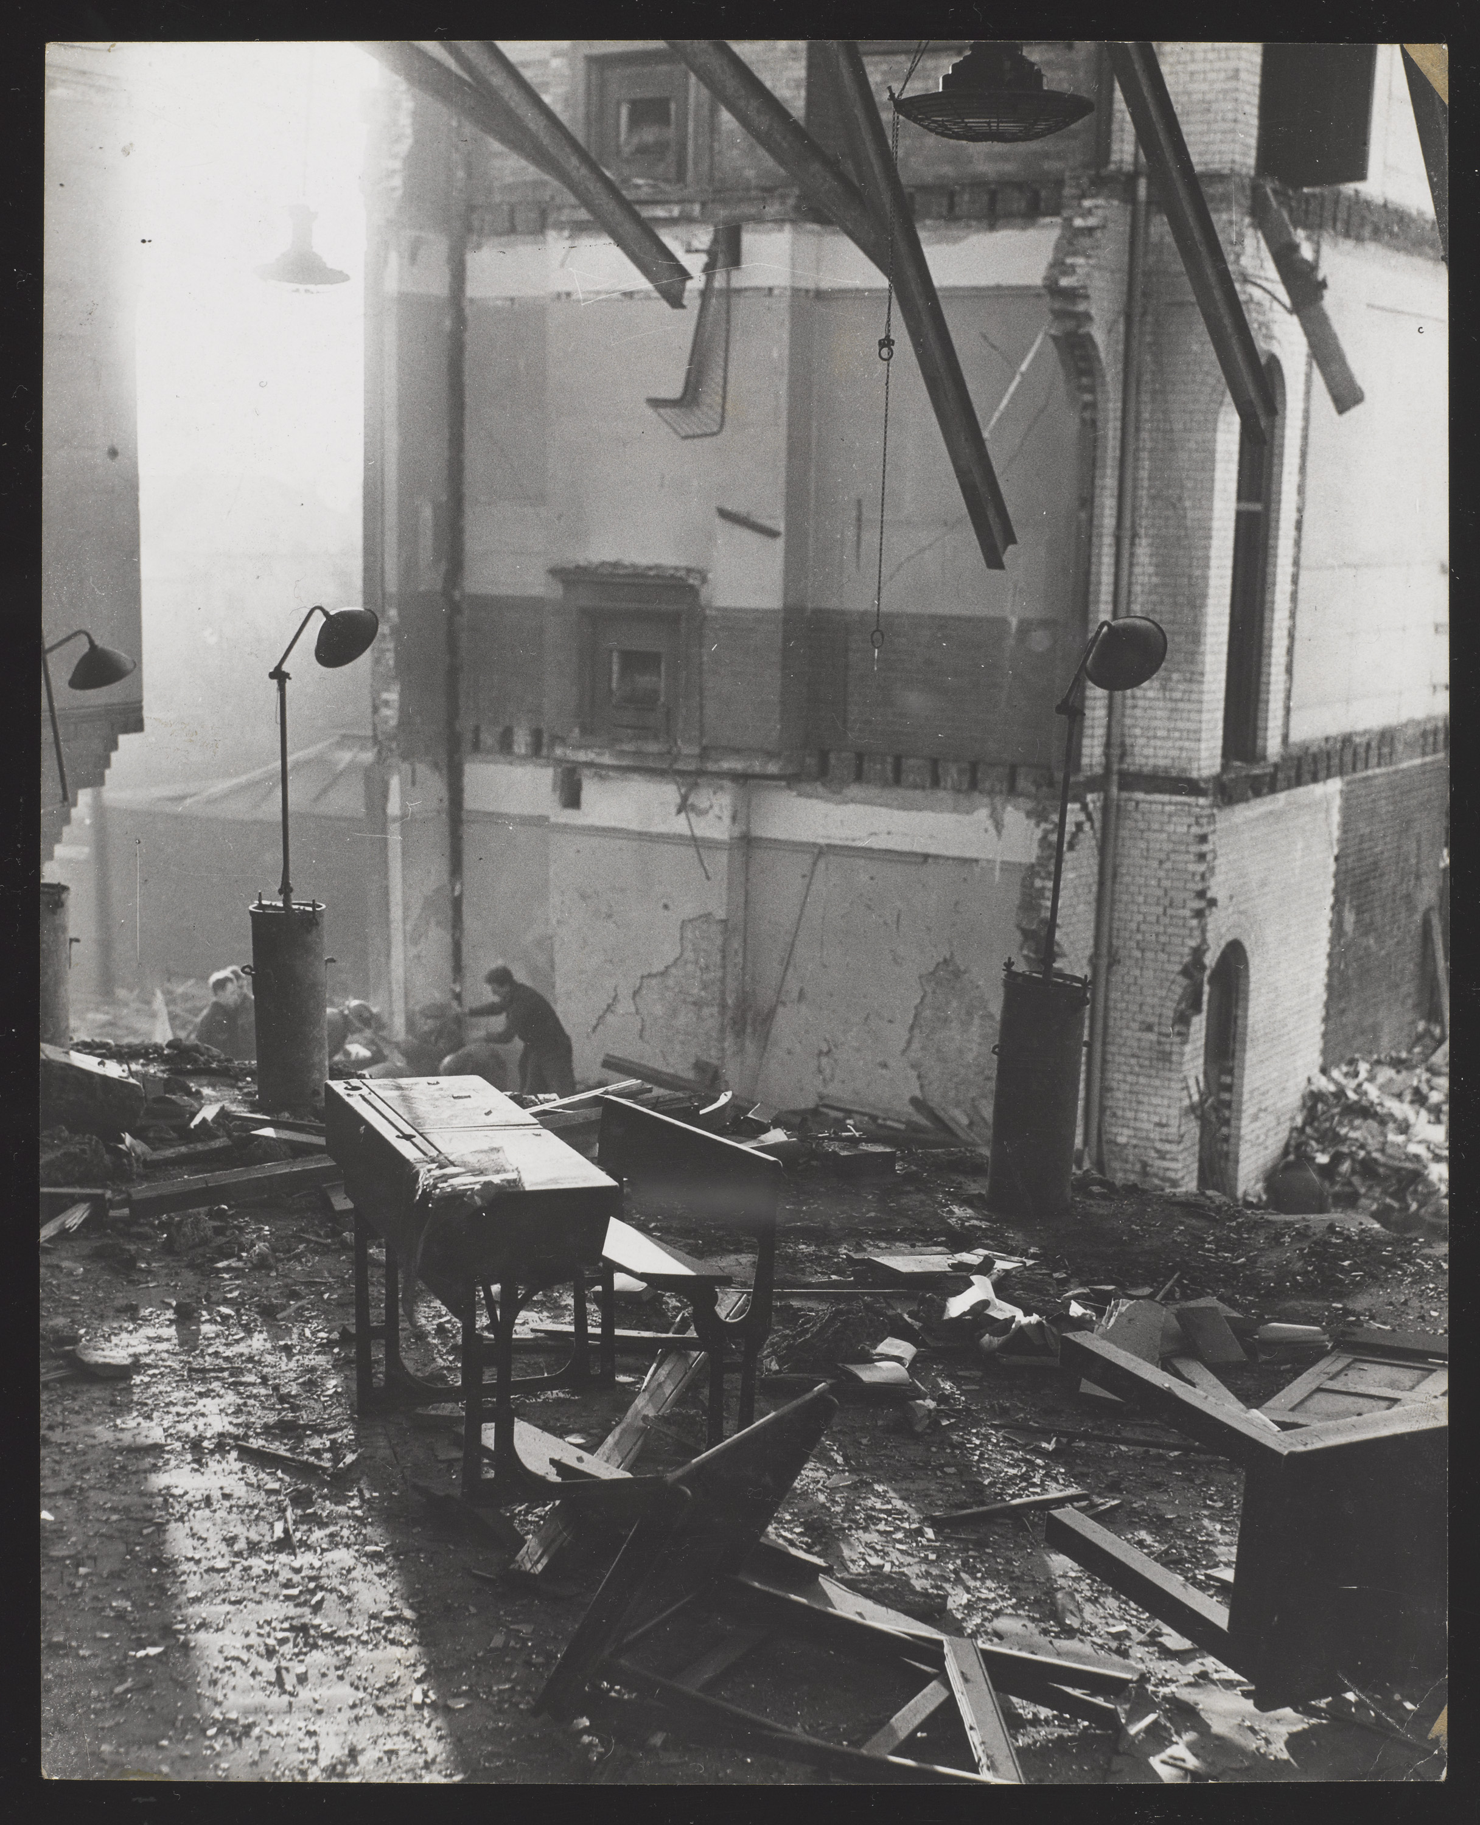
One of the bombed classrooms of a London school, 1940 (c)
Notes:
The classroom looks down upon the rescue work in operation, with people continuing to search through the debris twenty four hours after the German daylight attack. Forty five children lost their lives during the attack.
NAM. 2002-06-6-6

Slide 8
'Injured Man Salvages Belongings’, picture issued 18 October 1940
Notes:
NAM. 2006-12-102-36

Slide 9
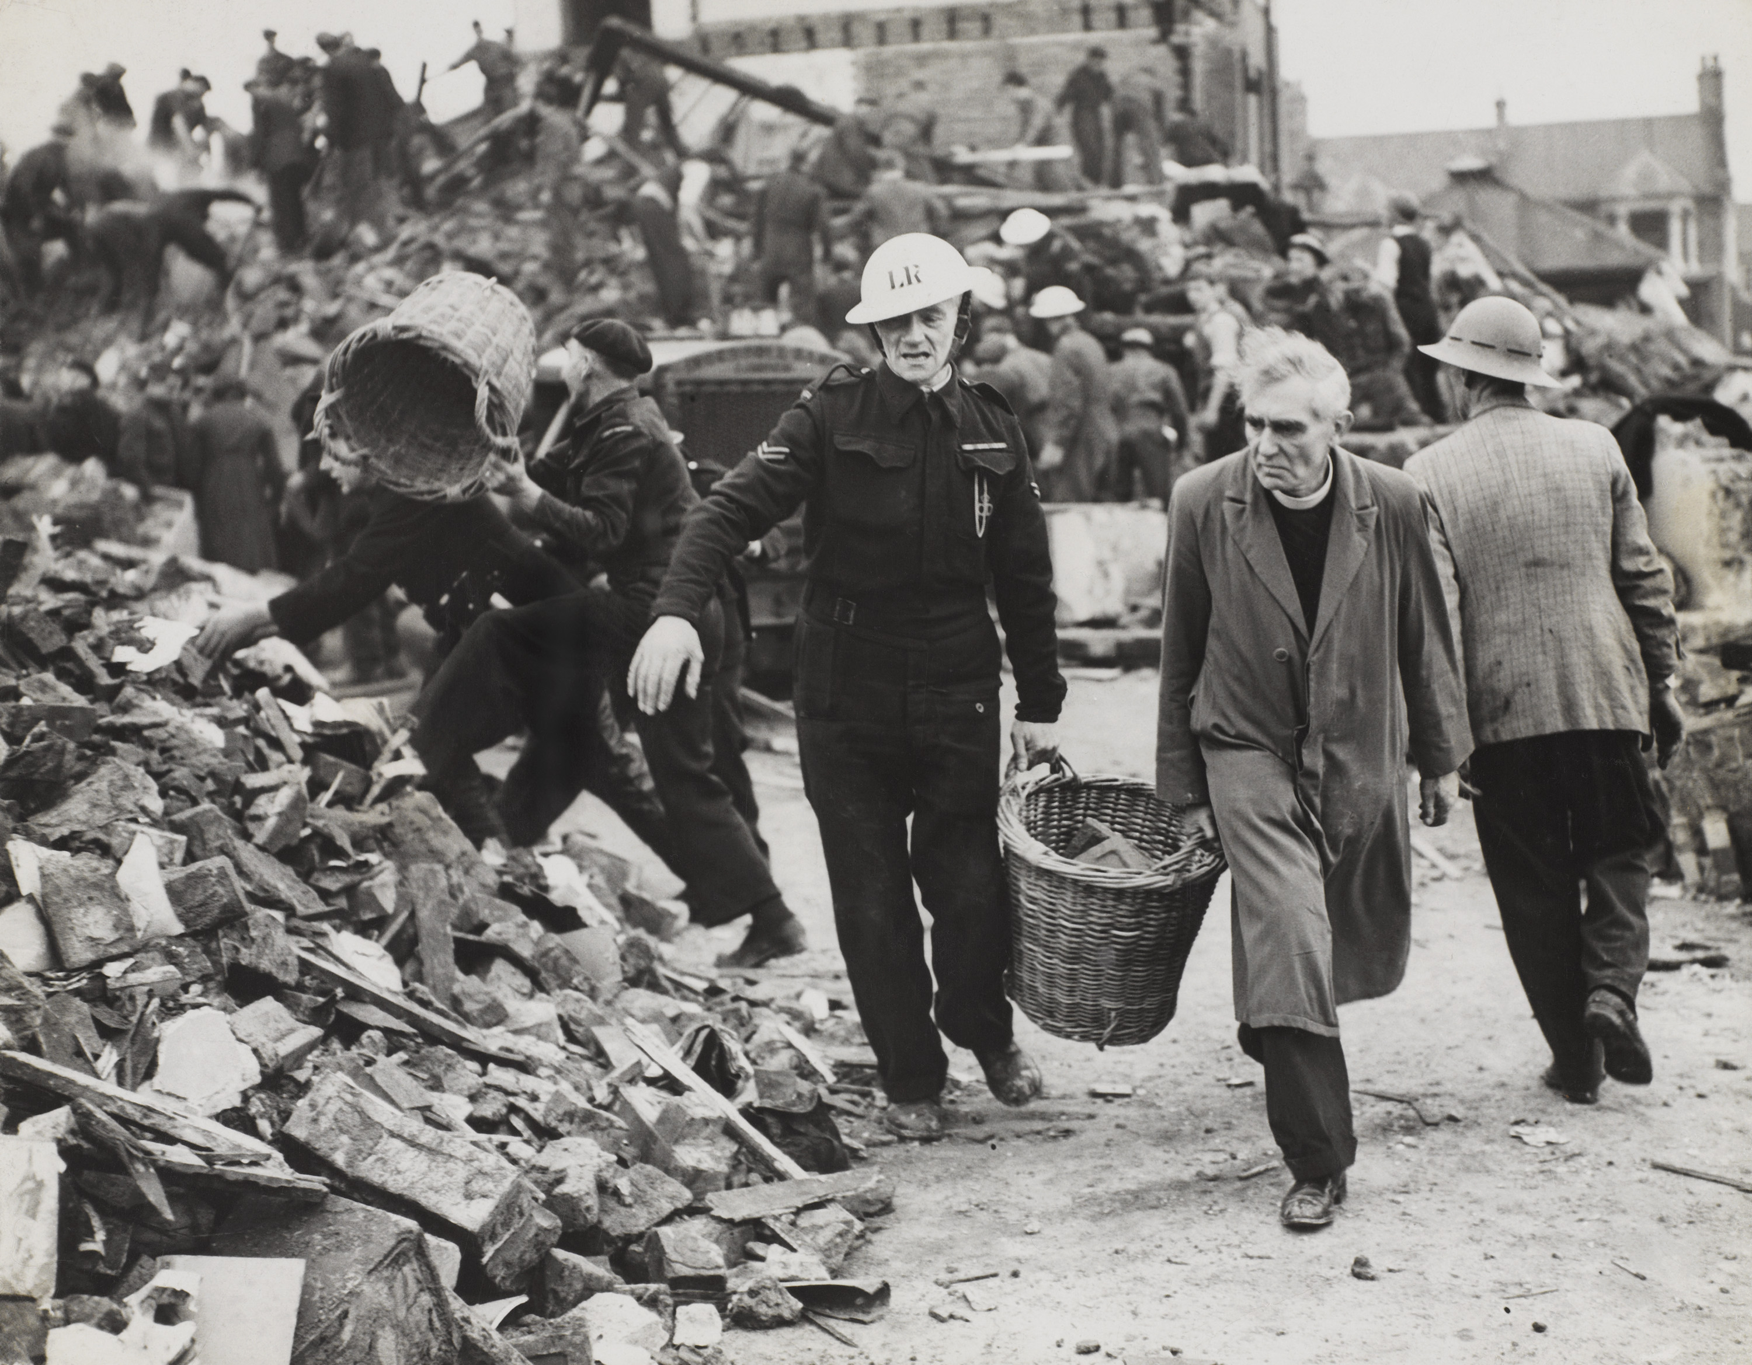
A clergyman and Civil Defence workers helping to clear the debris of a school, London, 1940
Notes:
The workers searched for survivors in a school that was damaged by a bomb during a daylight raid. More than 20 children were killed. Between September 1940 and May 1941 London was constantly bombed in the 'Blitz'. During this period more than 20,000 Londoners were killed and 1.4 million were bombed out of their homes.
NAM. 2002-06-6-5

Slide 10
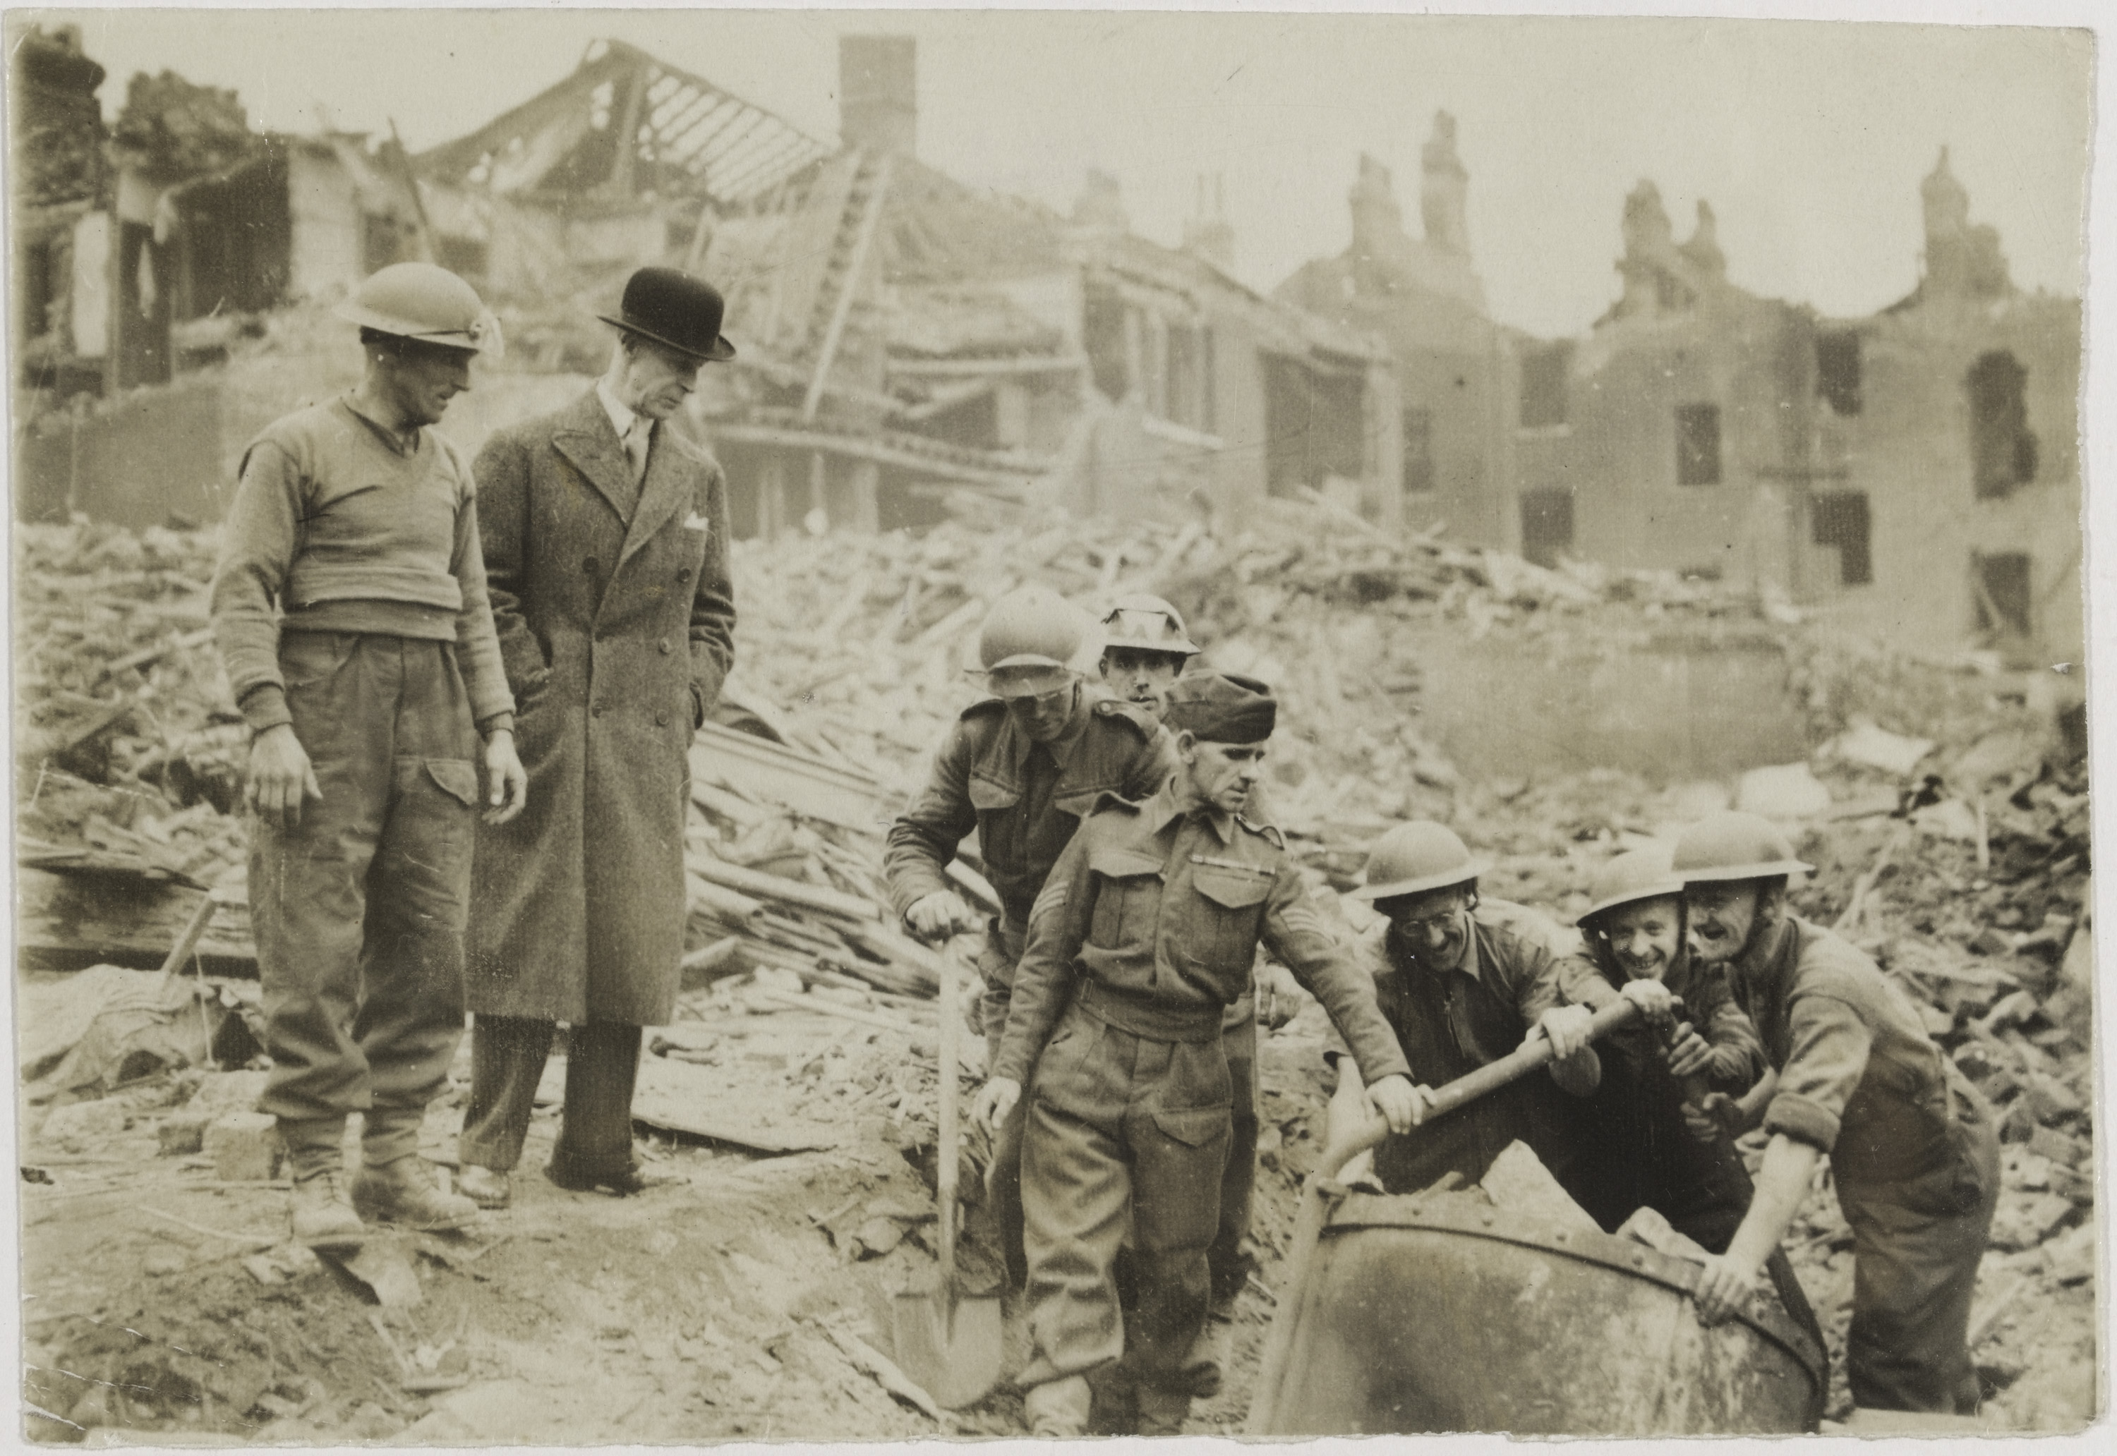
Clearing bomb-damaged houses, London, 1940
Notes:
During the Blitz around 5,000 members of the Pioneer Corps, armed with picks and shovels, helped clear the rubble and debris caused by the German bombing of London. The Blitz was the name given to the constant bombing of London between September 1940 and May 1941. During this period more than 20,000 Londoners were killed and 1.4 million were bombed out of their homes. That meant that one in every six people in the capital had no place to live.
NAM. 2006-12-102-58

Slide 11
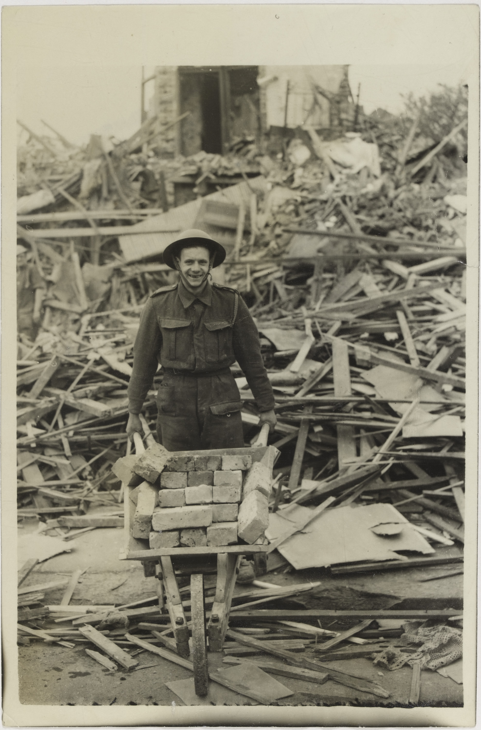
'5,000 Old Sweats Begin The Clear-Up Today', October 1940
Notes:
During the Blitz around 5,000 members of the Pioneer Corps, armed with picks and shovels, helped clear the rubble and debris caused by the German bombing of London. The soldier shown here collects intact bricks that would later be used in the construction of air raid shelters. The Blitz was the name given to the constant bombing of London between September 1940 and May 1941. During this period more than 20,000 Londoners were killed and 1.4 million were bombed out of their homes. That meant that one in every six people in the capital had no place to live.
NAM. 2006-12-102-29

Slide 12
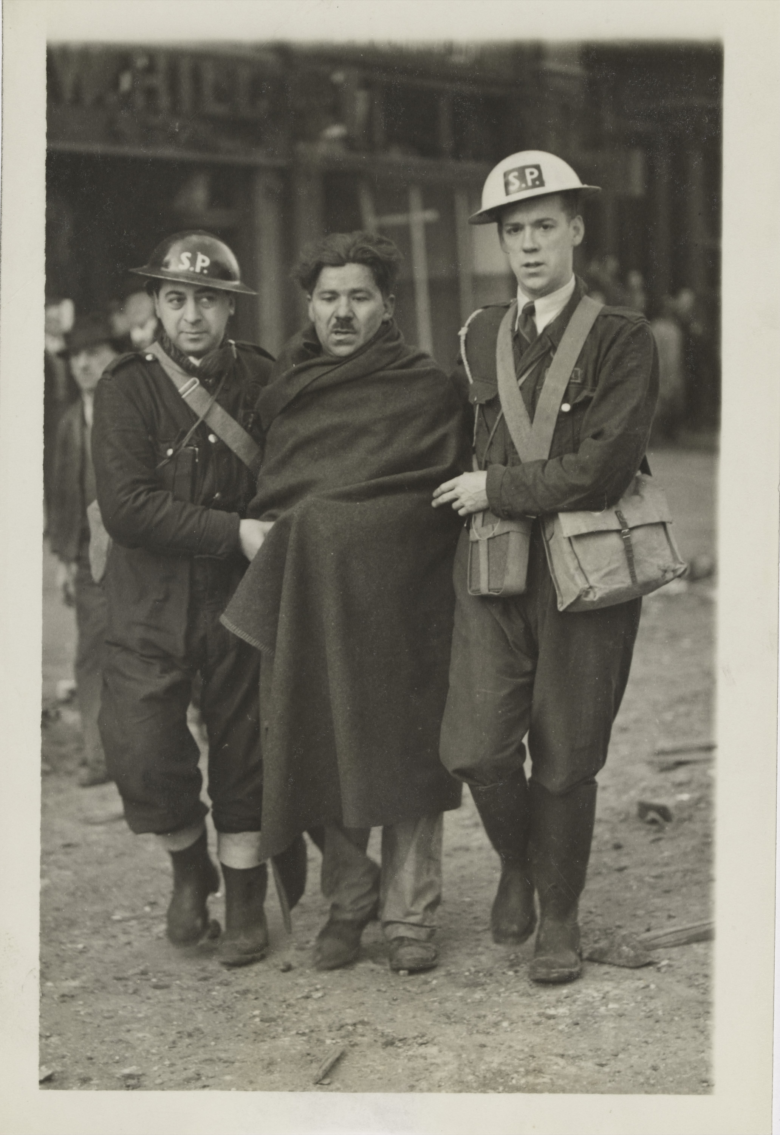
'London Raid Damage This Morning', 8 October 1940
Notes:
An injured man is helped through a damaged London street by Air Raid Precautions (ARP) staff. The 'SP' on their helmets denotes that they are from a stretcher party.
Between September 1940 and May 1941 London was constantly bombed in the 'Blitz'. During this period more than 20,000 Londoners were killed. The German raid of 8 October saw serious fires in Bermondsey and Rotherhithe alongside damage to government buildings in Whitehall and Charing Cross station.
NAM. 2006-12-102-33

Slide 13
'Wartime London by moonlight’, Second World War
Notes:
Shows a view of Piccadilly Circus at night, the statue of Eros is in the centre covered, presumably for protection.
NAM. 2006-12-102-3

Slide 14
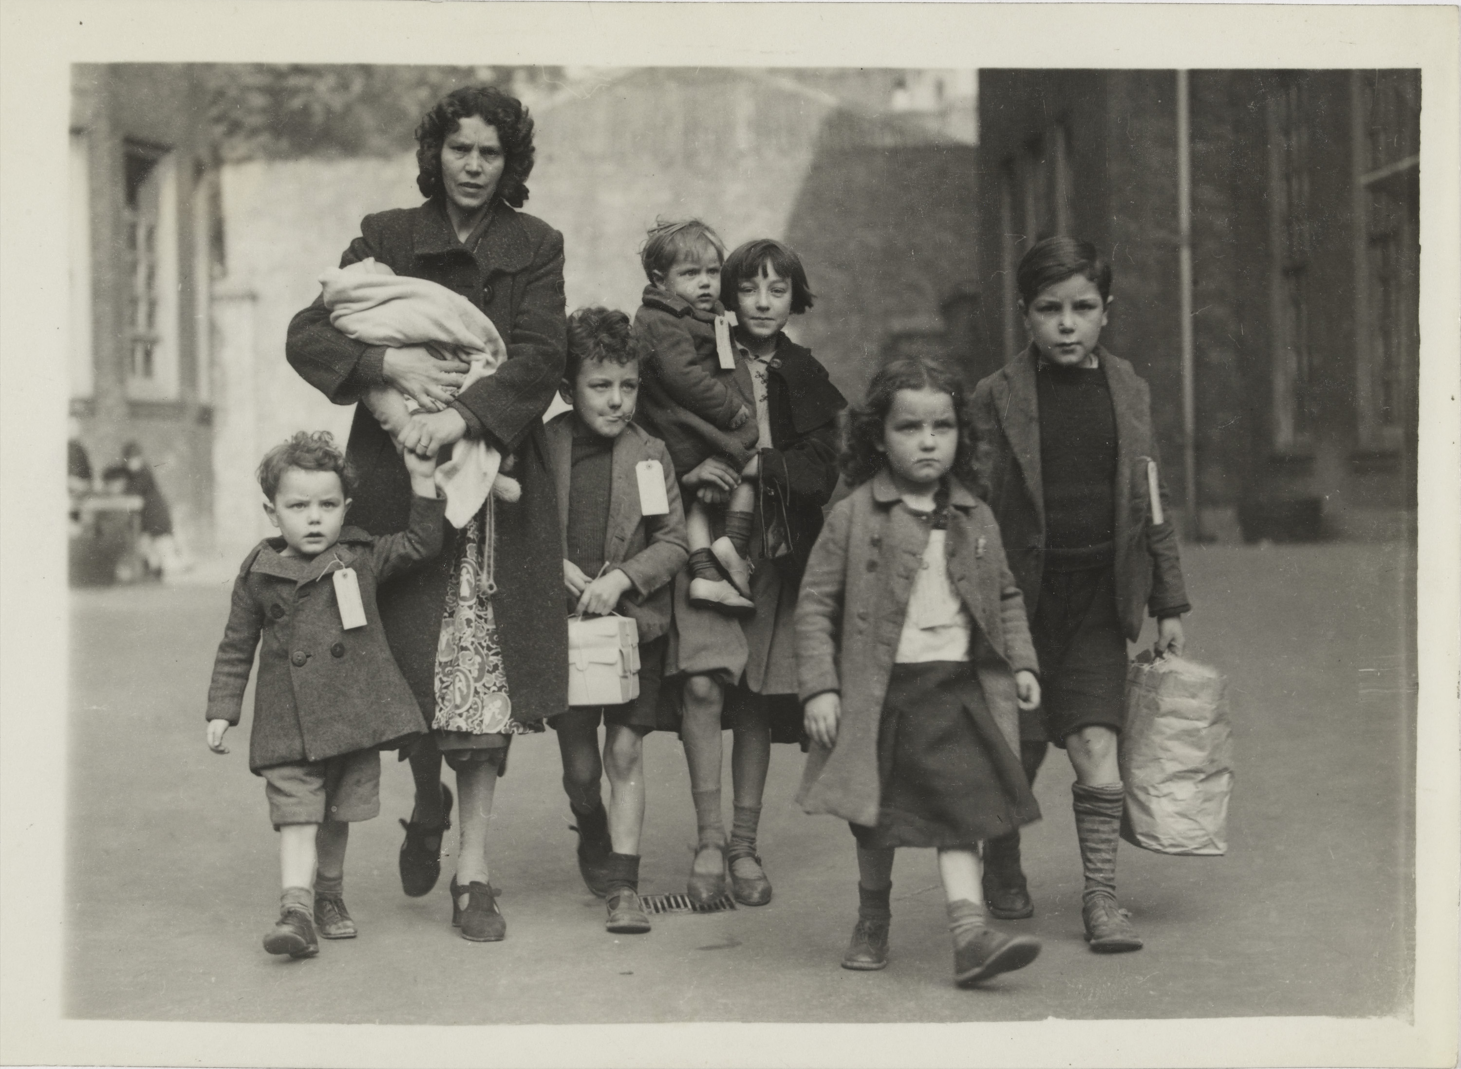
Bombed out mothers and children leave London, 1941
Notes:
Shows a mother named Mrs Rowland and her seven children being evacuated.
During the London 'Blitz' (September 1940 to May 1941) over 20,000 Londoners were killed and 1.4 million were bombed out of their homes. One in every six people in the capital had no place to live. Many of these people were sent to temporary accommodation in locations outside of the capital.
NAM. 2006-12-102-27

Slide 15
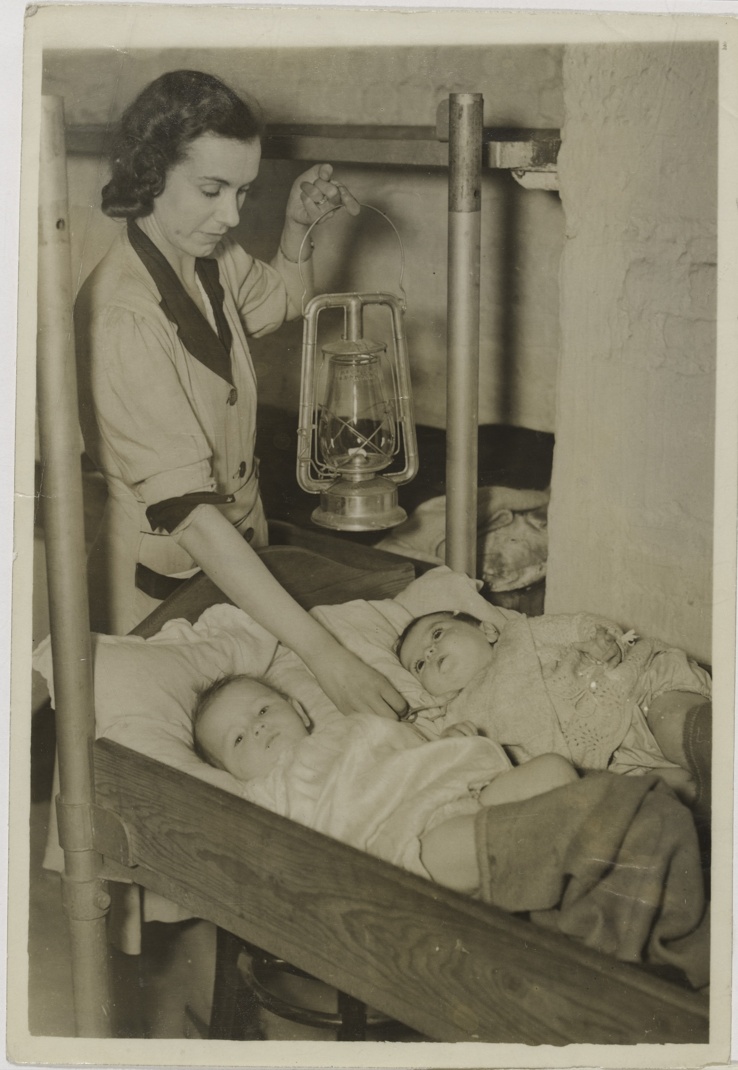
‘Happy Nights for Babies in St Martins Crypt’, 3 October 1940
Notes:
Vivien Langdale aged six months (left) and Sylvia Segal aged six months are tucked in for the night by a woman helper at St Martin-in-the-Fields church, Trafalgar Square, London. During the war the crypt was used as a public air raid shelter. The church also housed a canteen for members of the armed forces.
NAM. 2006-12-102-22

Slide 16
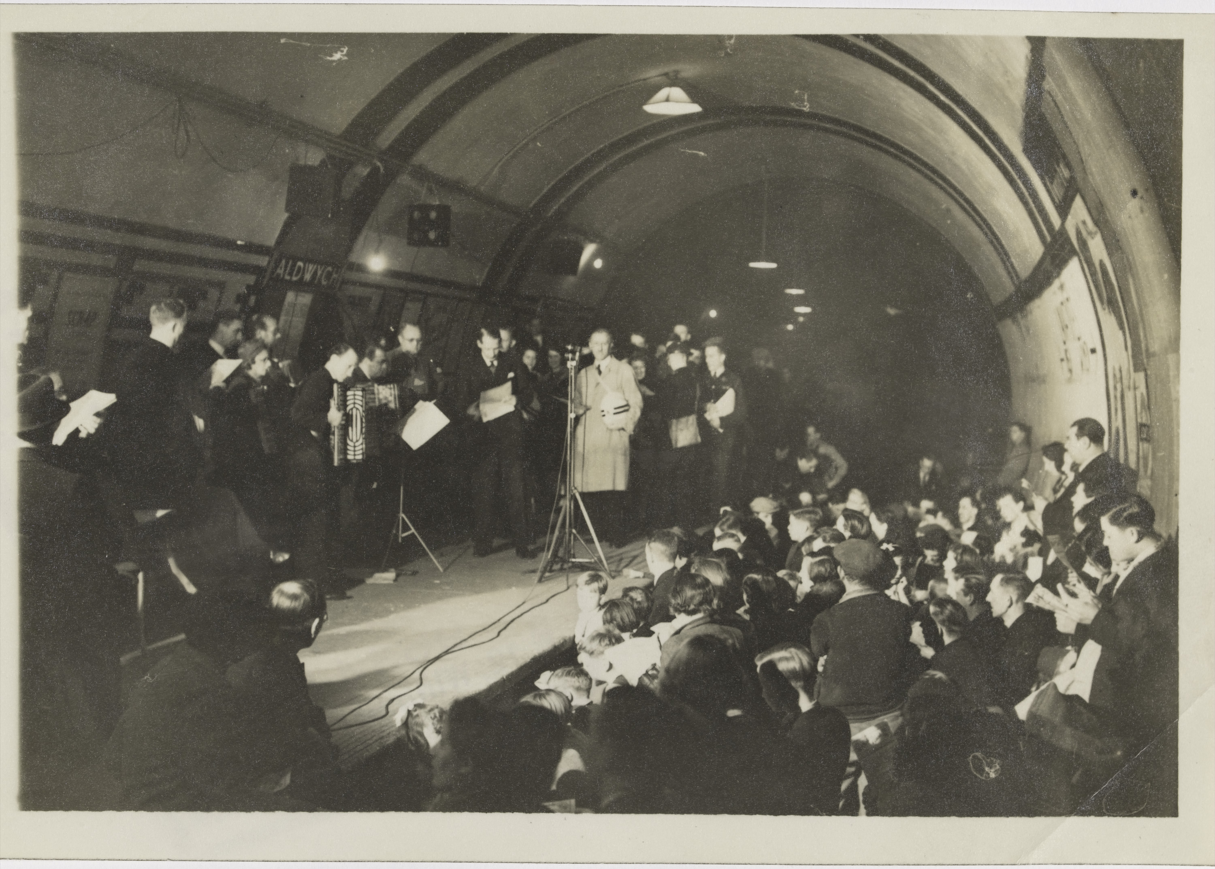
‘E.N.S.A. Underground’, 12 October 1940
Notes:
The Entertainments National Service Association (ENSA) was established in 1939 to provide entertainment for military personnel. ENSA operated as part of the Navy, Army and Air Force Institutes (NAAFI). It also provided concerts for the general public as in this photograph of an ENSA show for Londoners sheltering in Aldwych underground station.
NAM. 2006-12-102-31

Slide 17
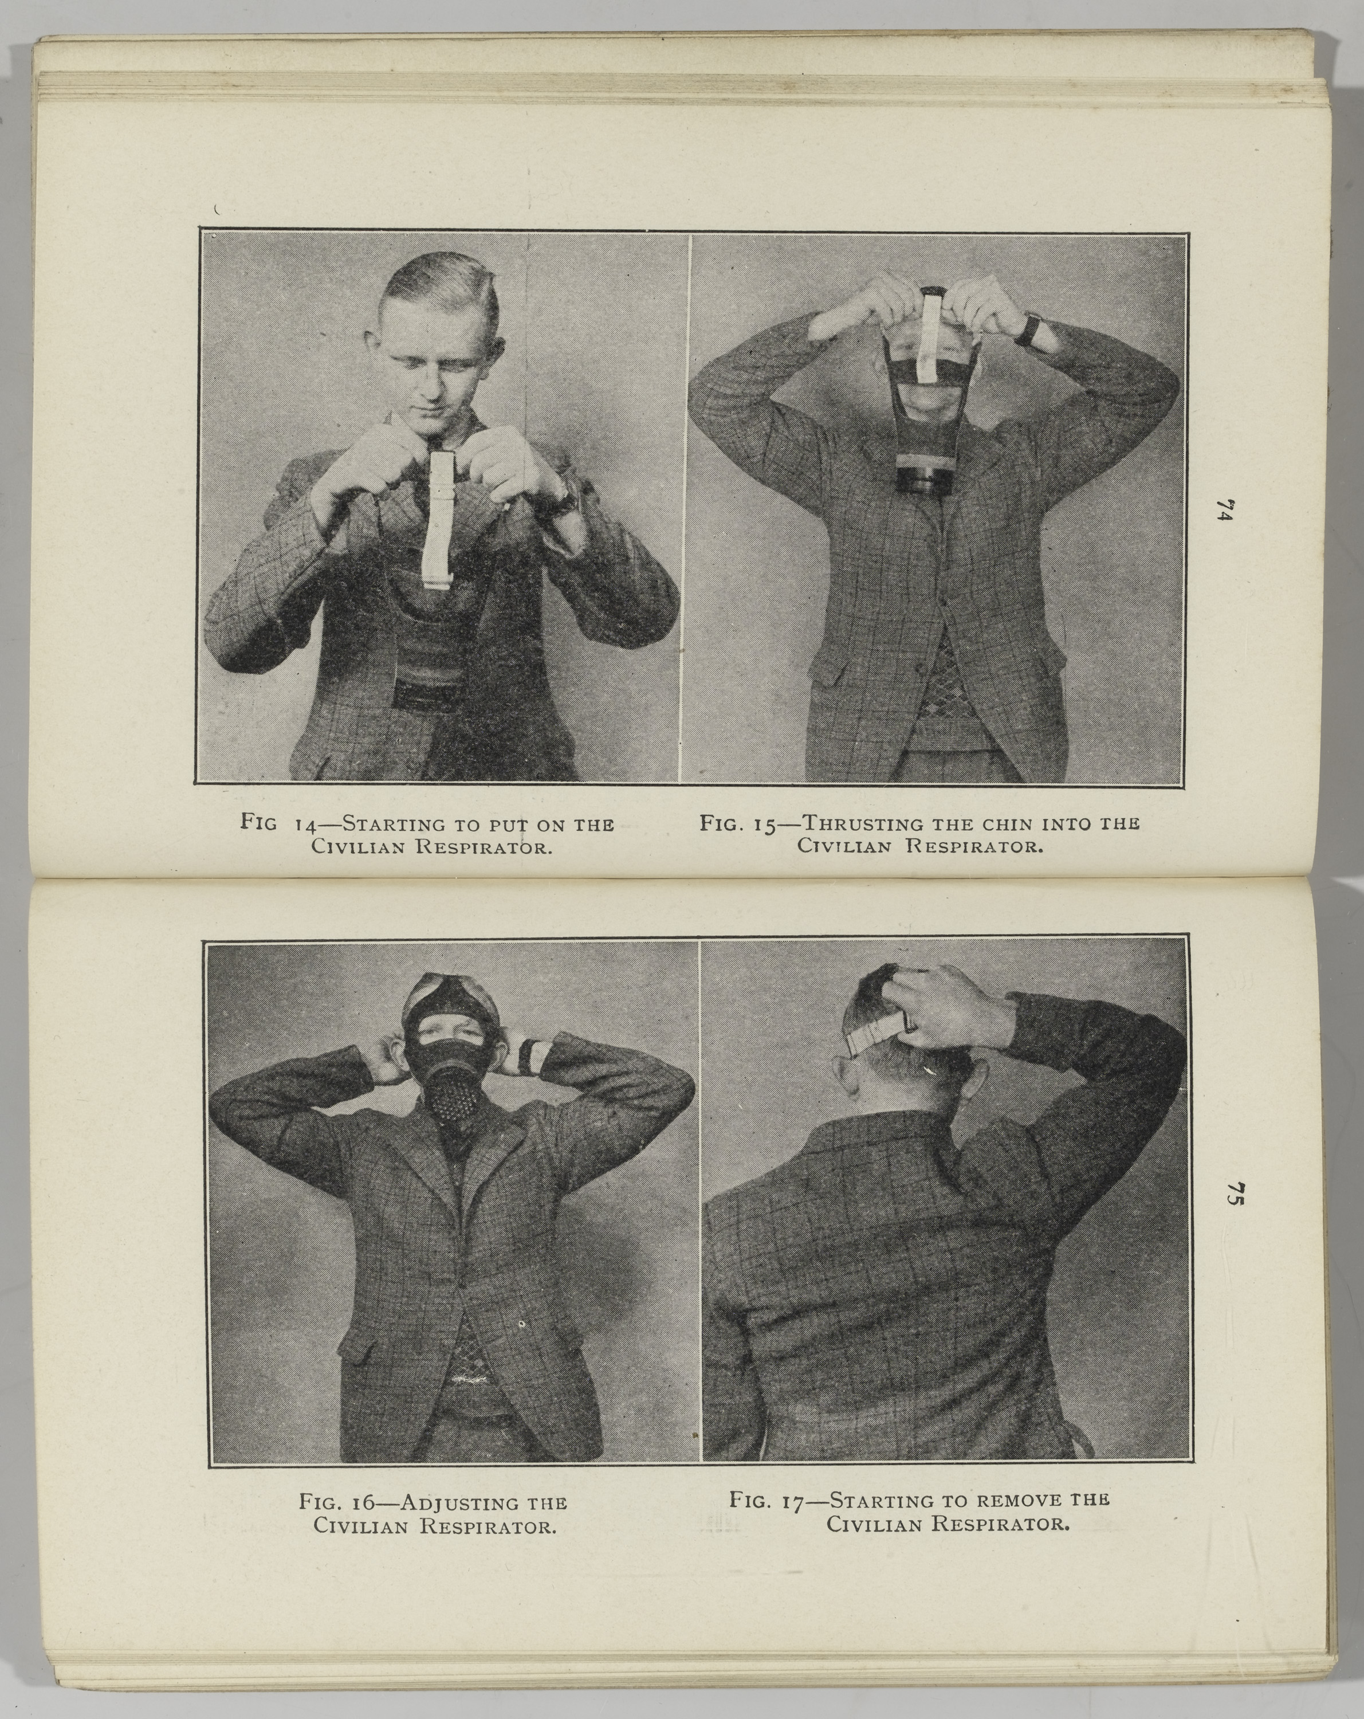
'Personal Protection against Gas’, 1939
Notes:
Air Raid Precautions Handbook No 1 (2nd edition) published for the Home Office, HMSO, 1939.
British civilians were issued with gas masks on the eve of the Second World War. People were instructed to carry their gas masks at all times in case of attack. Although the Germans had large stockpiles of gas they never used them, believing that the Allies had also developed similar chemical agents and would respond in kind to their use.
NAM. 2007-08-12-8

Slide 18
'Toddler's Donald Duck Mask', 1940 (c)
Notes:
All British military personnel and civilians were issued with gas masks on the outbreak of war. People were instructed to carry their gas masks at all times in case of attack. Although the Germans had large stockpiles of nerve gas they never used them, believing that the Allies had also developed nerve agents and would respond in kind to their use. Several models of childrens' masks were given nicknames such as 'Mickey Mouse' and 'Donald Duck'.
NAM. 1989-04-116-3111-1

Slide 19
‘Station Names Replaced’, October 1940
Notes:
‘The Ministry of Transport has now allowed station names to be replaced. Any size may be used under the station roof, providing it cannot be seen or understood from a low-flying aircraft or a highway; and lettering three-inches high may be used in the open with the same provision’.
Shows the replacing of one of the large size name-plates at a London station this morning. A passenger looks on.
NAM. 2006-12-102-24

Slide 20
‘Keep Calm and Carry On’, 1939
Notes:
Propaganda poster, unknown artist.
NAM. 2000-07-3-1

Slide 21
Recruiting poster, Auxiliary Territorial Service, 1941 (c)
Notes:
Colour photolithograph by unknown artist, published by H.M. Stationery Office, 1941 (c) .
NAM. 1993-11-1-117-1

Slide 22
‘ATS Eyes of the Guns’, 1940 (c)
Notes:
Colour photolithograph by Beverley Pick, published by H.M. Stationery Office, 1940 (c).
Many anti-aircraft batteries had male and female personnel. Members of the Auxiliary Territorial Service (ATS) served as gunners, range finders, height-fighters and sound detectors while others operated search lights and radar equipment.
NAM. 1993-11-1-124-1

Slide 23
ATS personnel operating anti-aircraft defences, 1942 (c)
Notes:
Many anti-aircraft batteries had male and female personnel. Members of the Auxiliary Territorial Service (ATS) served as gunners, range finders and sound detectors while others operated search lights and radar equipment.
NAM. 1994-07-279-84

Slide 24
Auxiliary Territorial Service searchlight crew, 93rd (M) Searchlight Regiment, 1942 (c)
Notes:
Auxiliary Territorial Service searchlight and two crew members, wearing ‘teddy bear’ coats and mittens.
NAM. 1995-01-57-16

Slide 25
Two librarians of the West Indies Auxiliary Territorial Service, Trinidad, 1945
Notes:
An inside view of the ATS library at St James Depot, Port of Spain, Trinidad, showing two librarians at work. The bag at the bottom left of the picture contains magazines and other literature for troops.
NAM. 1994-07-283-39

Slide 26
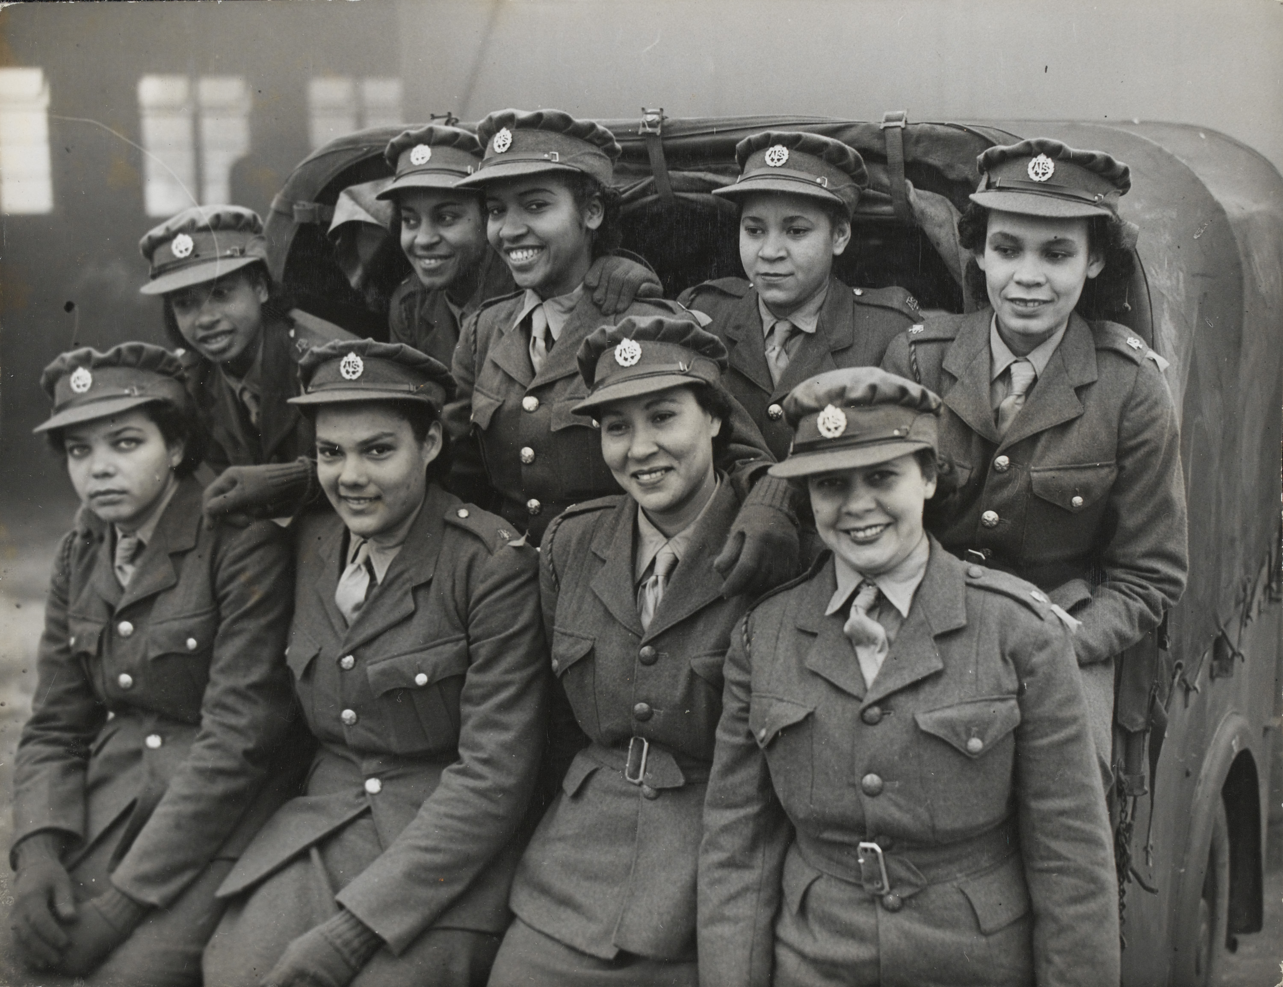
Women of the West Indies Auxiliary Territorial Service, 1944 (c)
Notes:
Black women from the West Indies had to overcome formidable barriers of prejudice when they attempted to join Britain’s uniformed services during the Second Word War. In the early years of the war they were rejected by the War Office, initially on the grounds of colour, then later with the dubious argument that they would find it difficult to adapt to the climate and culture of Britain and so would be unable to discharge their duties effectively.
However, this barrier was eventually broken down in the face of the growing demand for service personnel and when the Colonial Office pressed for a non-discriminatory recruitment policy on the grounds than it would greatly improve relations between Britain and the Caribbean. From 1943 Black women were allowed to enlist in the Auxiliary Territorial Service (ATS) and RAF (Royal Air Force) and be posted to Britain.
NAM. 1994-07-283-66

Slide 27
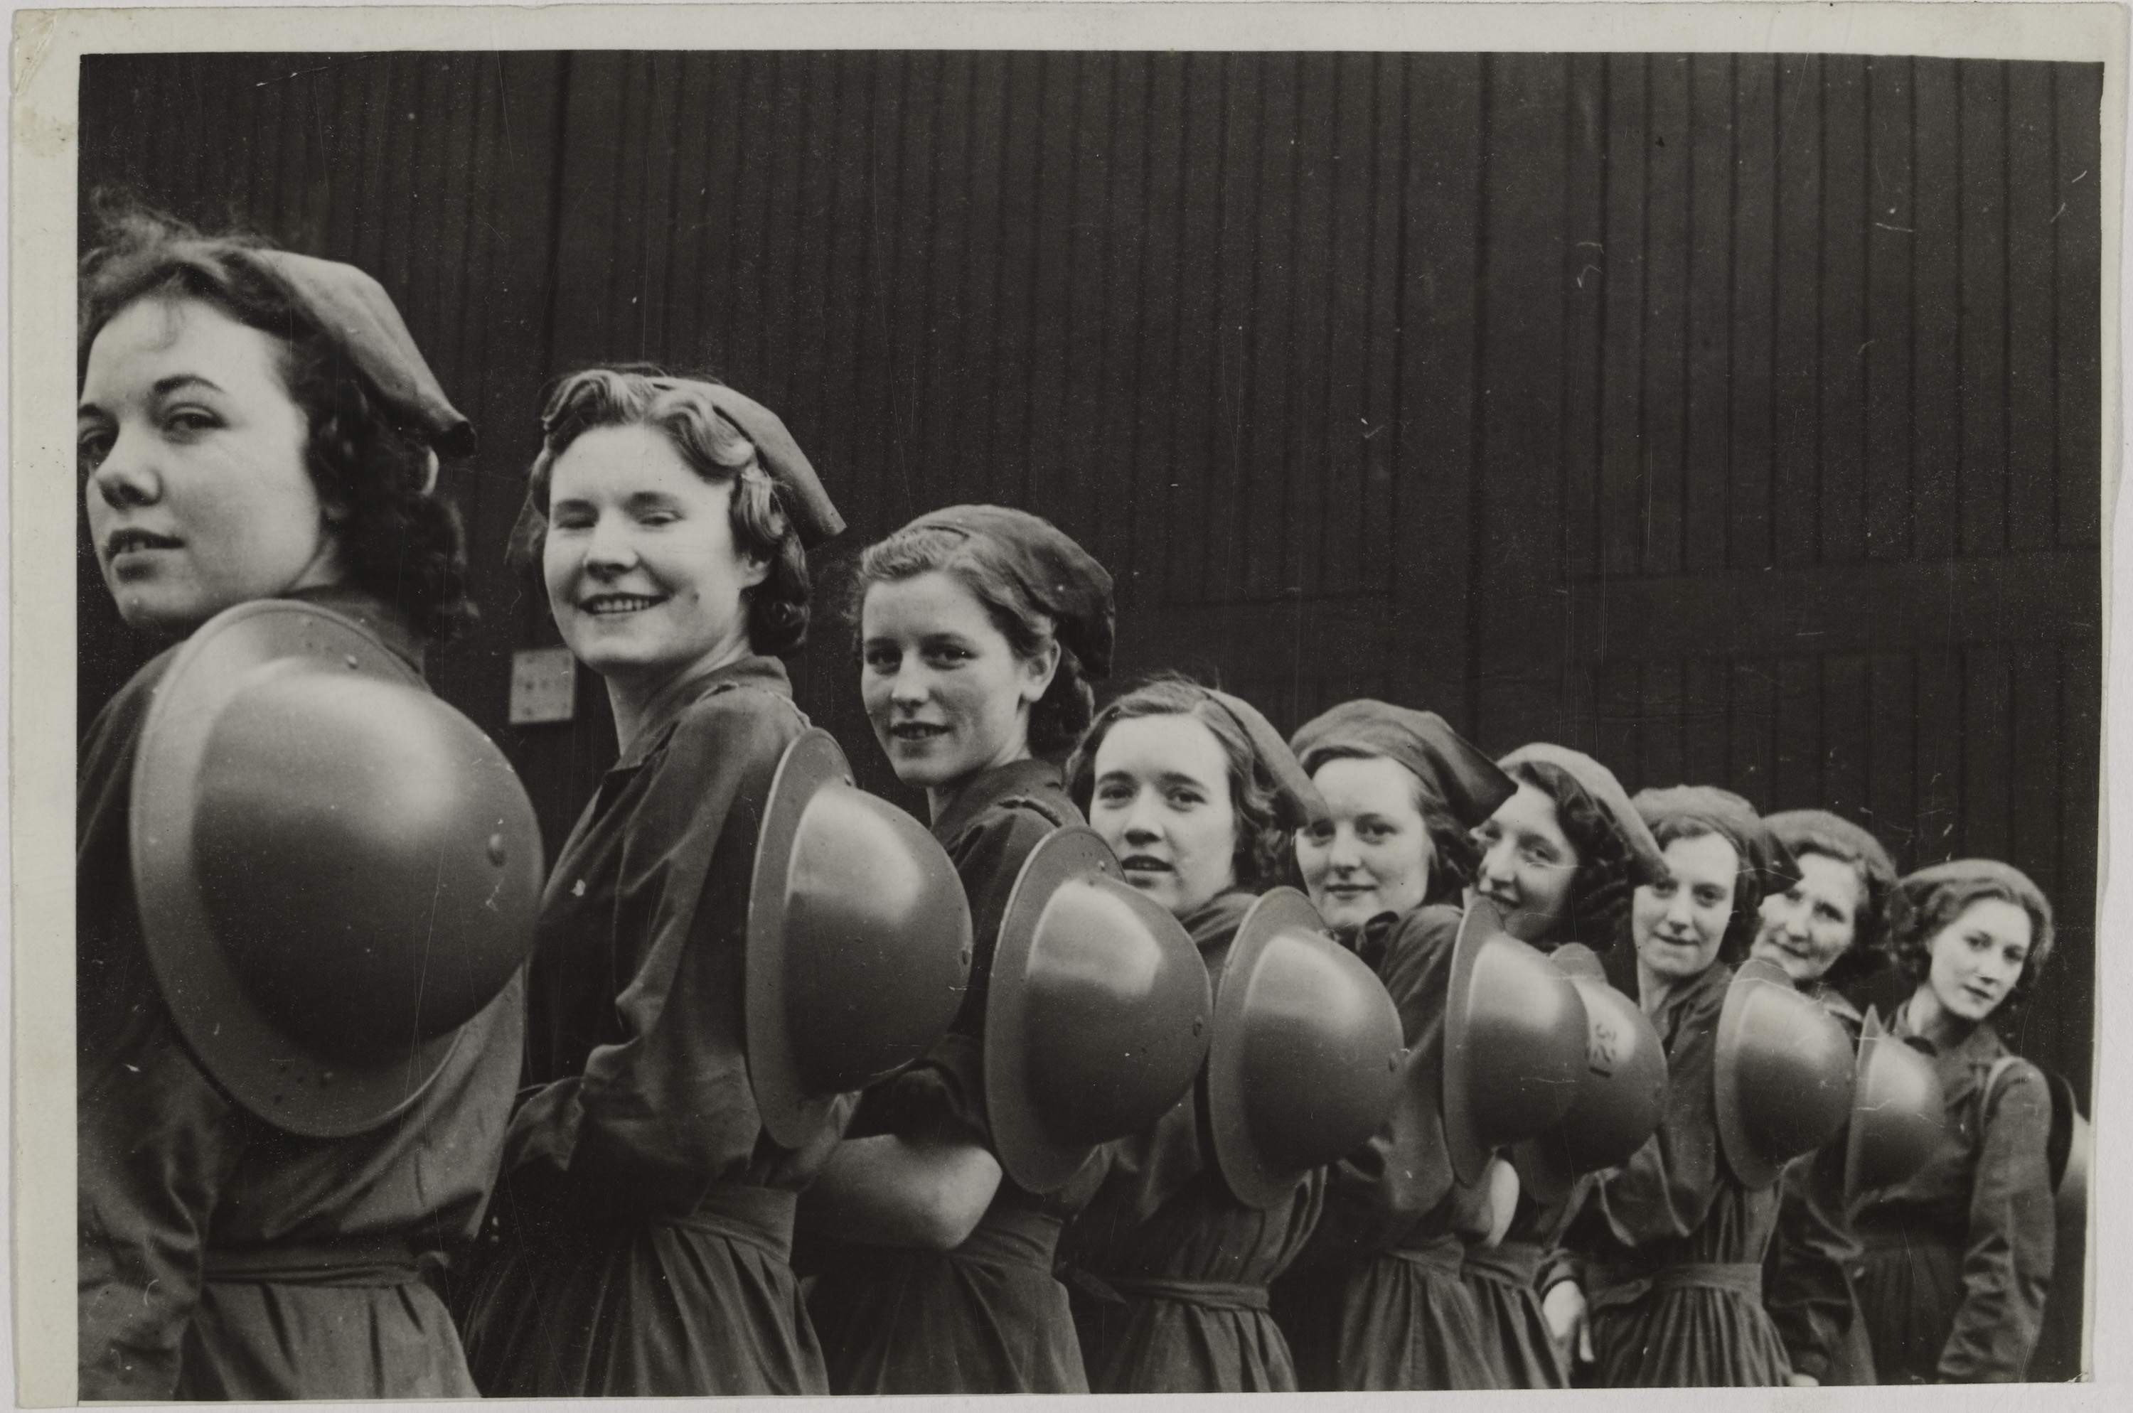
'Steel Helmets for Munitions Girls in a Northern Factory', 1940 (c)
Notes:
Munition workers were issued with grey 'Brodie' style steel helmets to protect against shrapnel and falling debris during air-raids. Thousands of women worked in British factories during the war. They released manpower for the armed forces.
NAM. 2006-12-102-15

Slide 28
'Miss Betty Crawford cutting steel plates with an oxygen and gas cutter - one of the vital jobs of shipbuilding in one of Britain's giant yards', 1941 (c)
Notes:
For the first two years of the Second World War thousands of women volunteered for essential work in order to release men for service in the armed forces. By 1941 however, it was clear that volunteers alone were not going to meet the demands of wartime production. In December of that year the National Service Act made the conscription of women legal. At first, only single women aged 20-30 were called up, but by mid-1943, almost 90 per cent of single women and 80 per cent of married women were employed in essential war work.
NAM. 2006-12-102-15

Slide 29
'All over Britain, from office and factory, a vast Civilian Army has sprung up to defend our country to the last inch’, 1940 (c)
Notes:
In 1940 the Local Defence Volunteers were formed. They consisted of individuals too old or too young to be assigned to front-line units, or people in reserved occupations. The organisation was eventually re-titled the Home Guard and was a defence against possible German invasion. The units were improvised and poorly equipped, but they were dedicated to their duties and helped maintain morale during the dark days of 1940. These volunteers are on patrol in northern Scotland.
NAM. 2006-12-102-8

Slide 30
Entrance to Home Guard Camp/ Col: Llewellyn, Western Command, 1942
Notes:
Oil on card by Ray Howard-Jones (b 1903), 1942, signed and dated at lower right by the artist.
NAM. 1995-05-14-1

Slide 31
Coastal defences, 1940 (c)
Notes:
A soldier stands guard beside a gun battery on the English coast. After the fall of France in 1940 Britain was put on invasion alert. Defences were built all over southern England, beaches were mined and the Army, Navy and Royal Air Force put on standby.
NAM. 2006-12-102-11

Slide 32
Dad’s Army board game box, 1974 (c)
Notes:
Manufactured by Strawberry Fayre by Denys Fisher.
NAM. 2015-07-12-1

Slide 33
No 2 Platoon ‘B’ Company 5th City of London (Press) Bn Home Guard 1944
Notes:
NAM. 1976-03-45-1-1

Slide 34
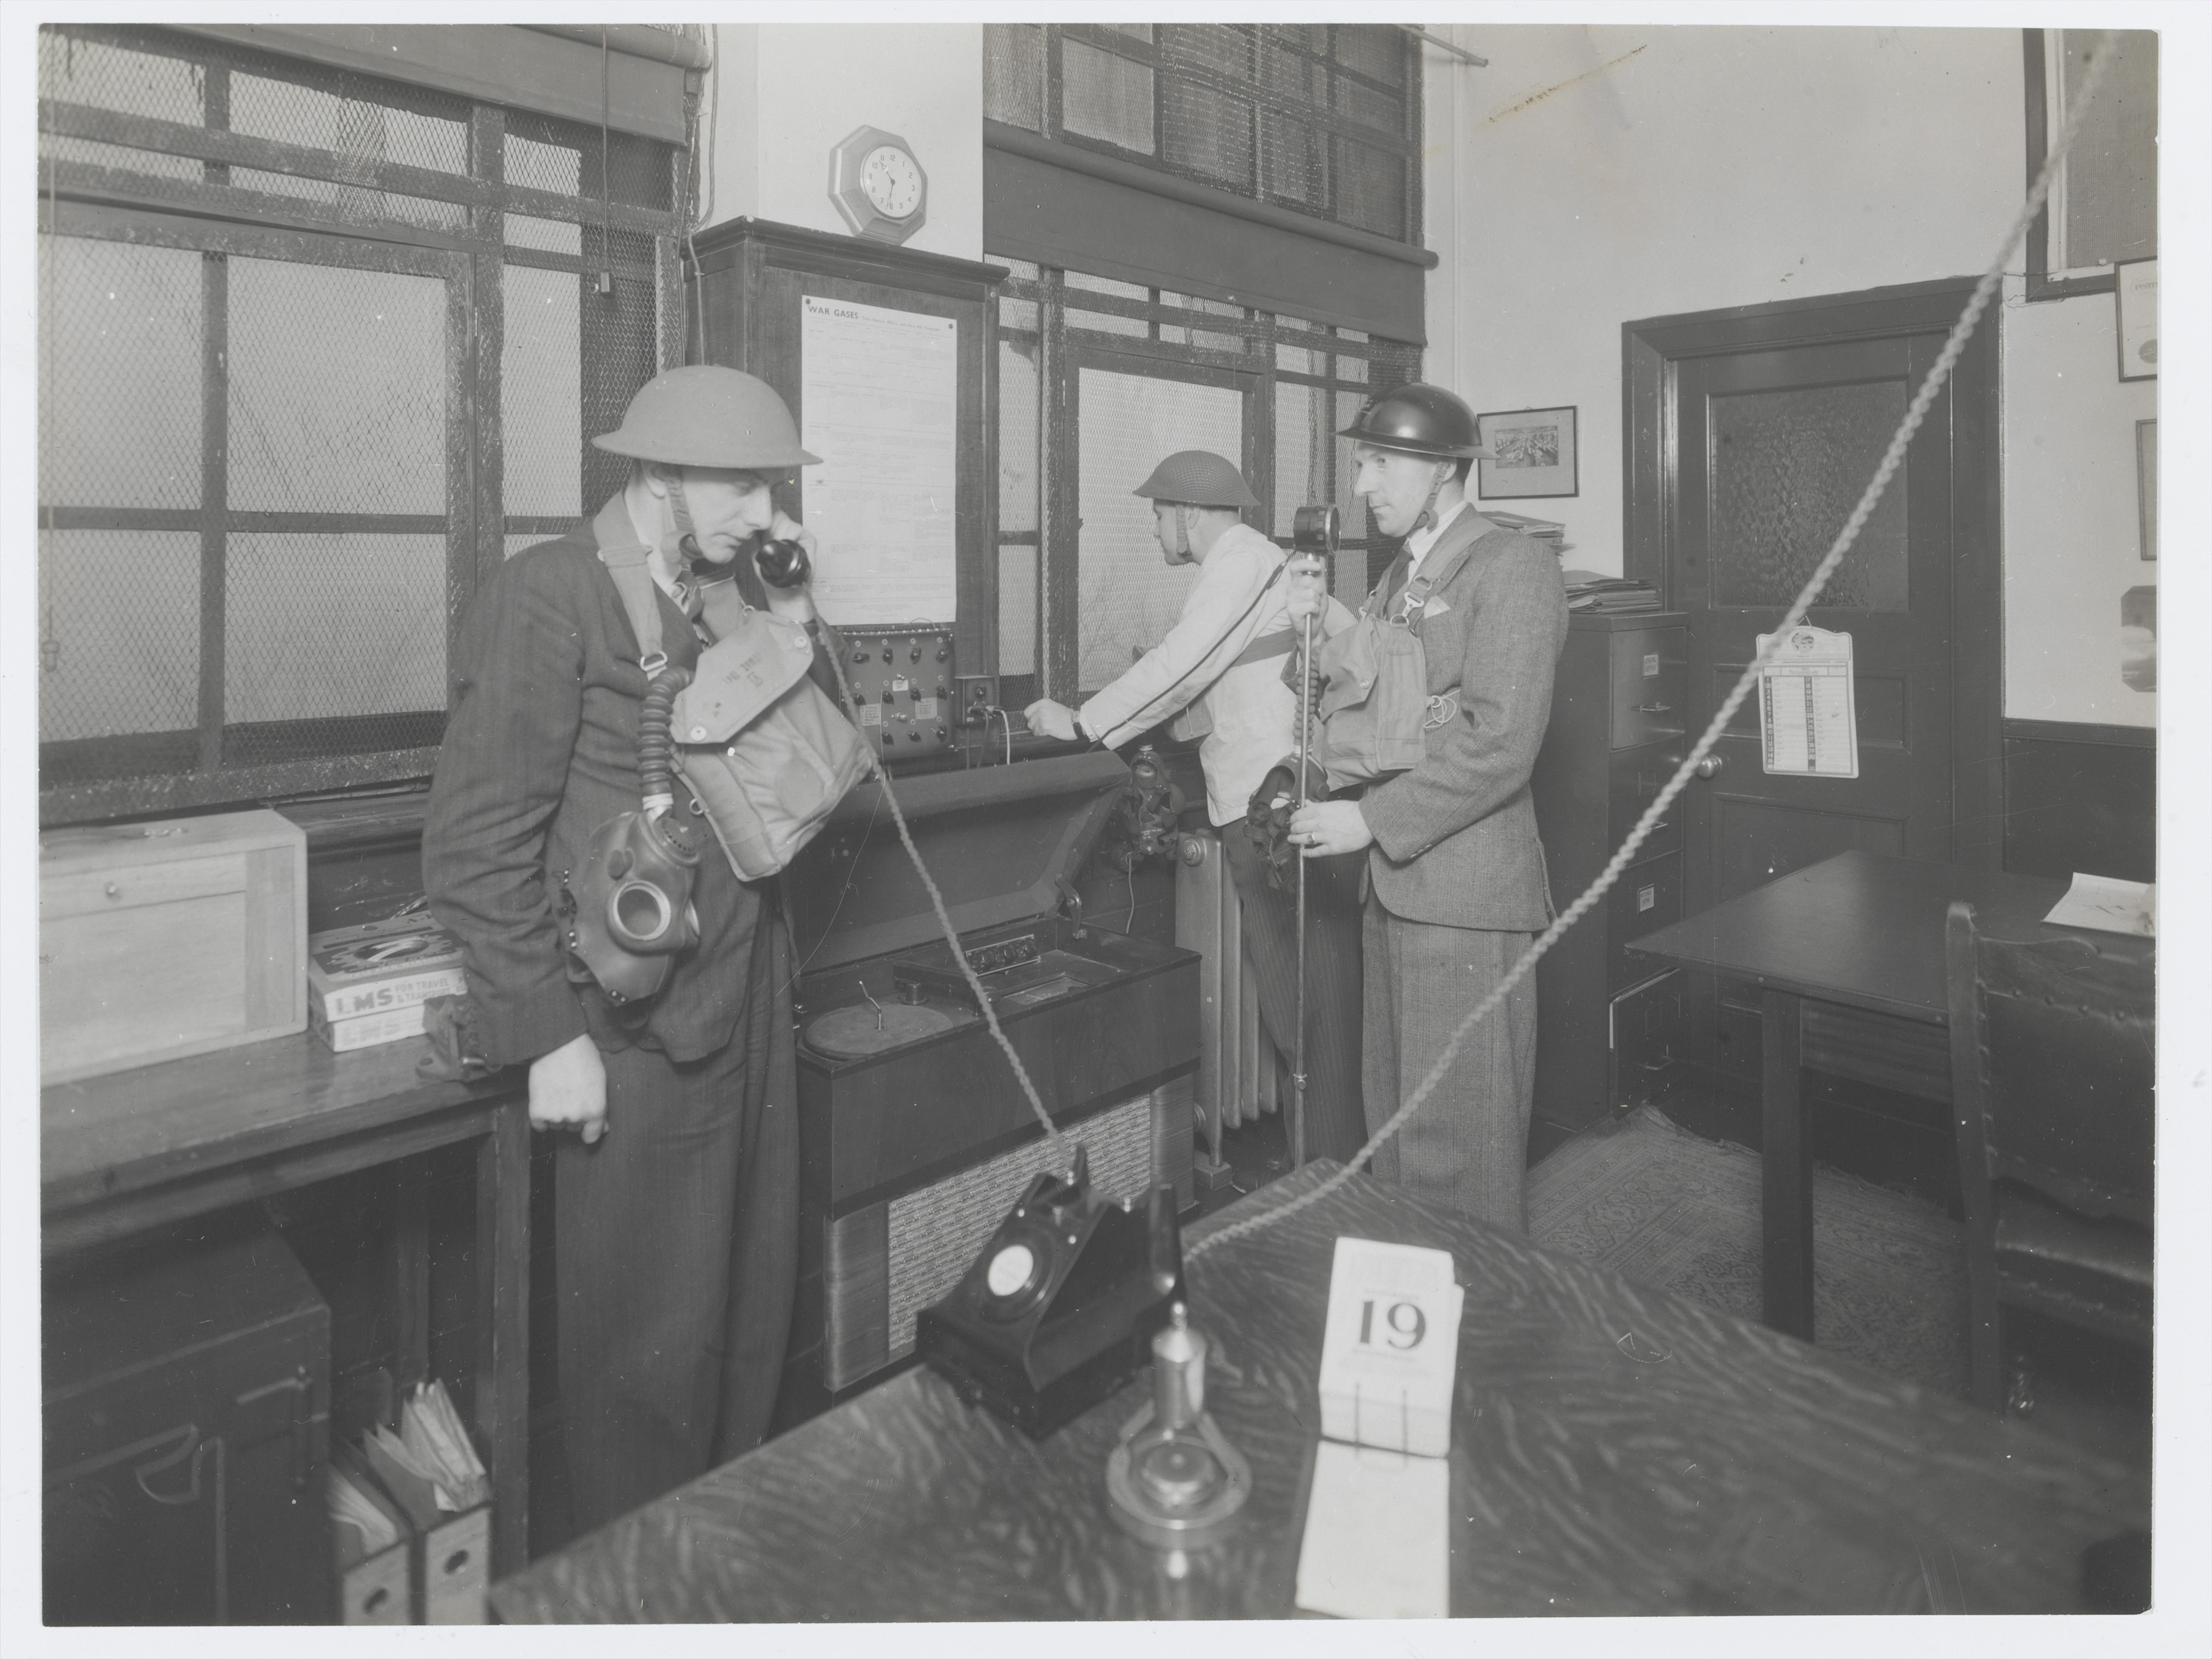
Home Guard personnel in communication centre, wearing civilian clothing with tin hats and gas masks, 1943 (c)
Notes:
In 1940 the Local Defence Volunteers were formed. They consisted of individuals too old or too young to be assigned to front-line units, or people in reserved occupations. The organisation was eventually re-titled the Home Guard and was a defence against possible German invasion. The units were improvised and poorly equipped, but they were dedicated to their duties and helped maintain morale during the dark days of 1940. No. 3 Platoon was raised from the employees of A H Hunt (Capacitors) Limited of Wandsworth.
NAM. 2001-01-459-4

Slide 35
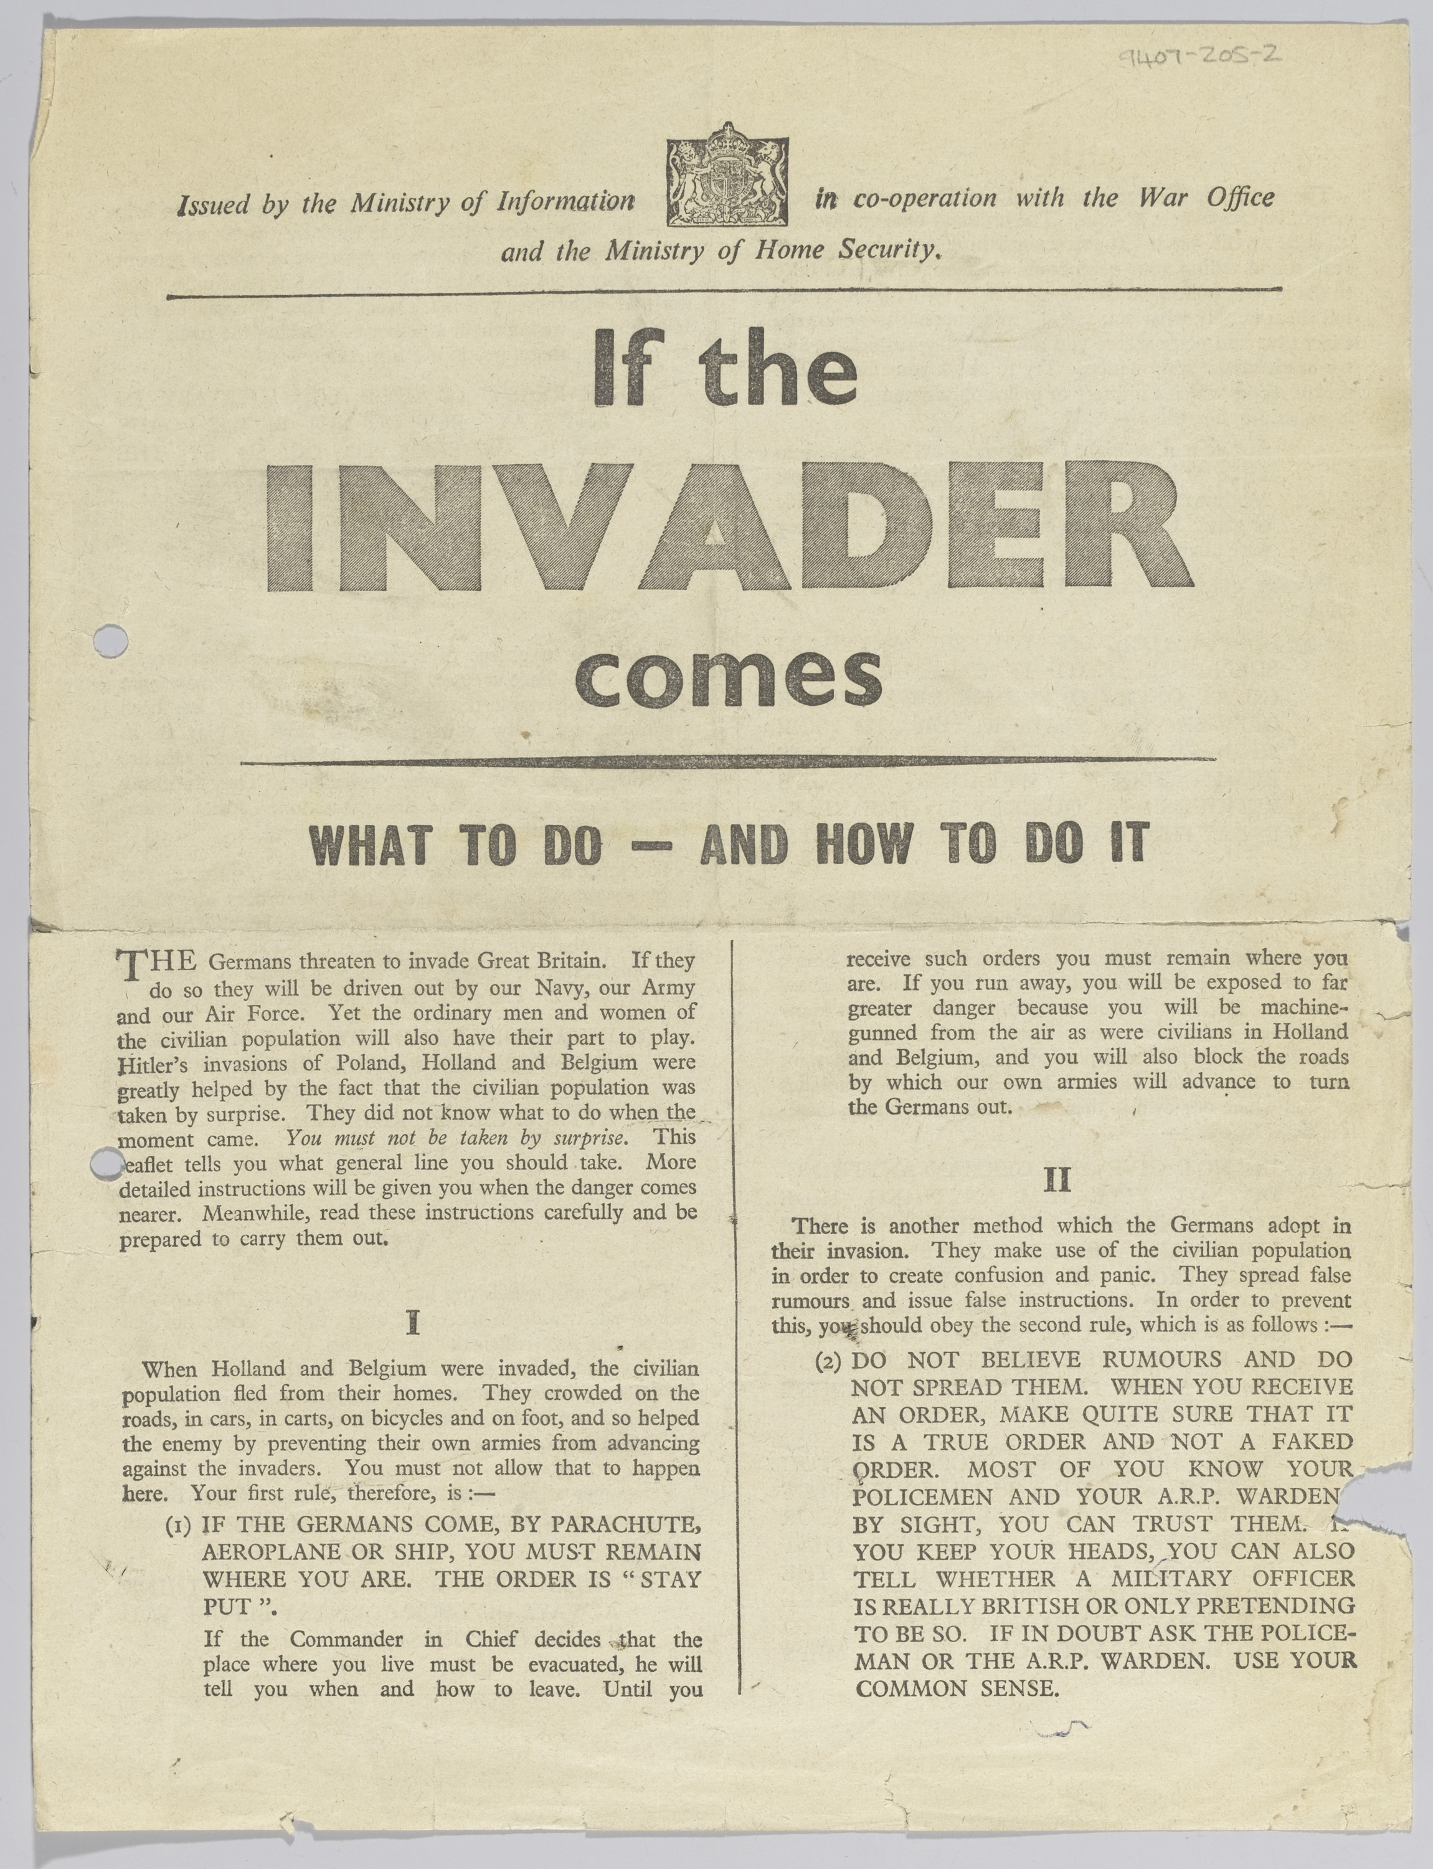
Ministry of Information leaflet collected by D Delay while serving in the Home Guard, 1943-44
Notes:
This leaflet gives details on action to be taken by civilians in the event of a German invasion during the Second World War.
Apart from the training given to the Home Guard, the civilian population was given relatively little guidance about what to do in the event of an invasion. They key instructions from leaflets like this were to stay put, avoid spreading rumours, only take order from uniformed British officials and listen to the wireless for instructions.
When the Local Defence Volunteers were formed, it was open to men aged between 17 and 65 otherwise unfit or ineligible for military service, who had fired a rifle and were ‘capable of free movement’. These qualifications were not rigourously tested, and at first the force was an under-equipped militia-style group. But the LDV, later renamed the Home Guard, evolved into a well-equipped and well-trained army of 1.7 million men who were readied for invasion.
Men of the Home Guard still had civilian jobs, but undertook German language lessons and were trained in patrolling Britain’s urban and rural areas, taking part in exercises involving Air Raid Precautions personnel and the police. The Home Guard had a role in providing useful training for young men prior to them reaching military age and being called up to the army.
NAM. 1994-07-205-2

Slide 36
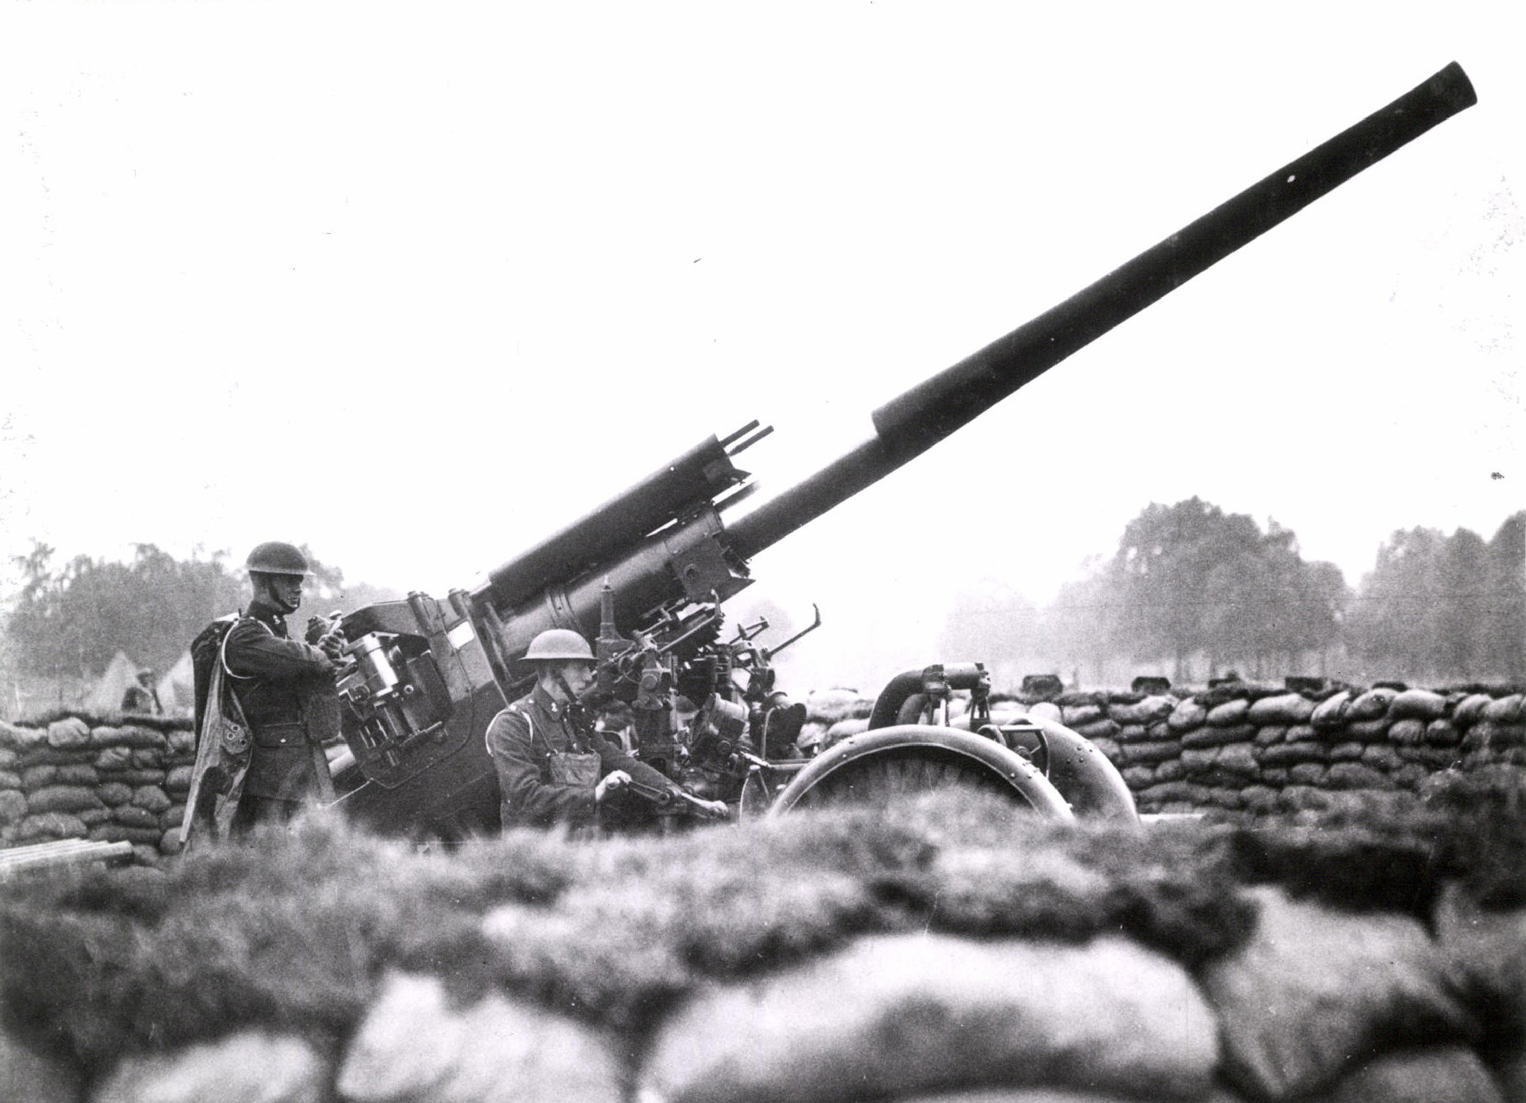
Photograph of 3.7in anti-aircraft gun in a London park, Second World War
Notes:
NAM. 1976-05-31-8

Slide 37
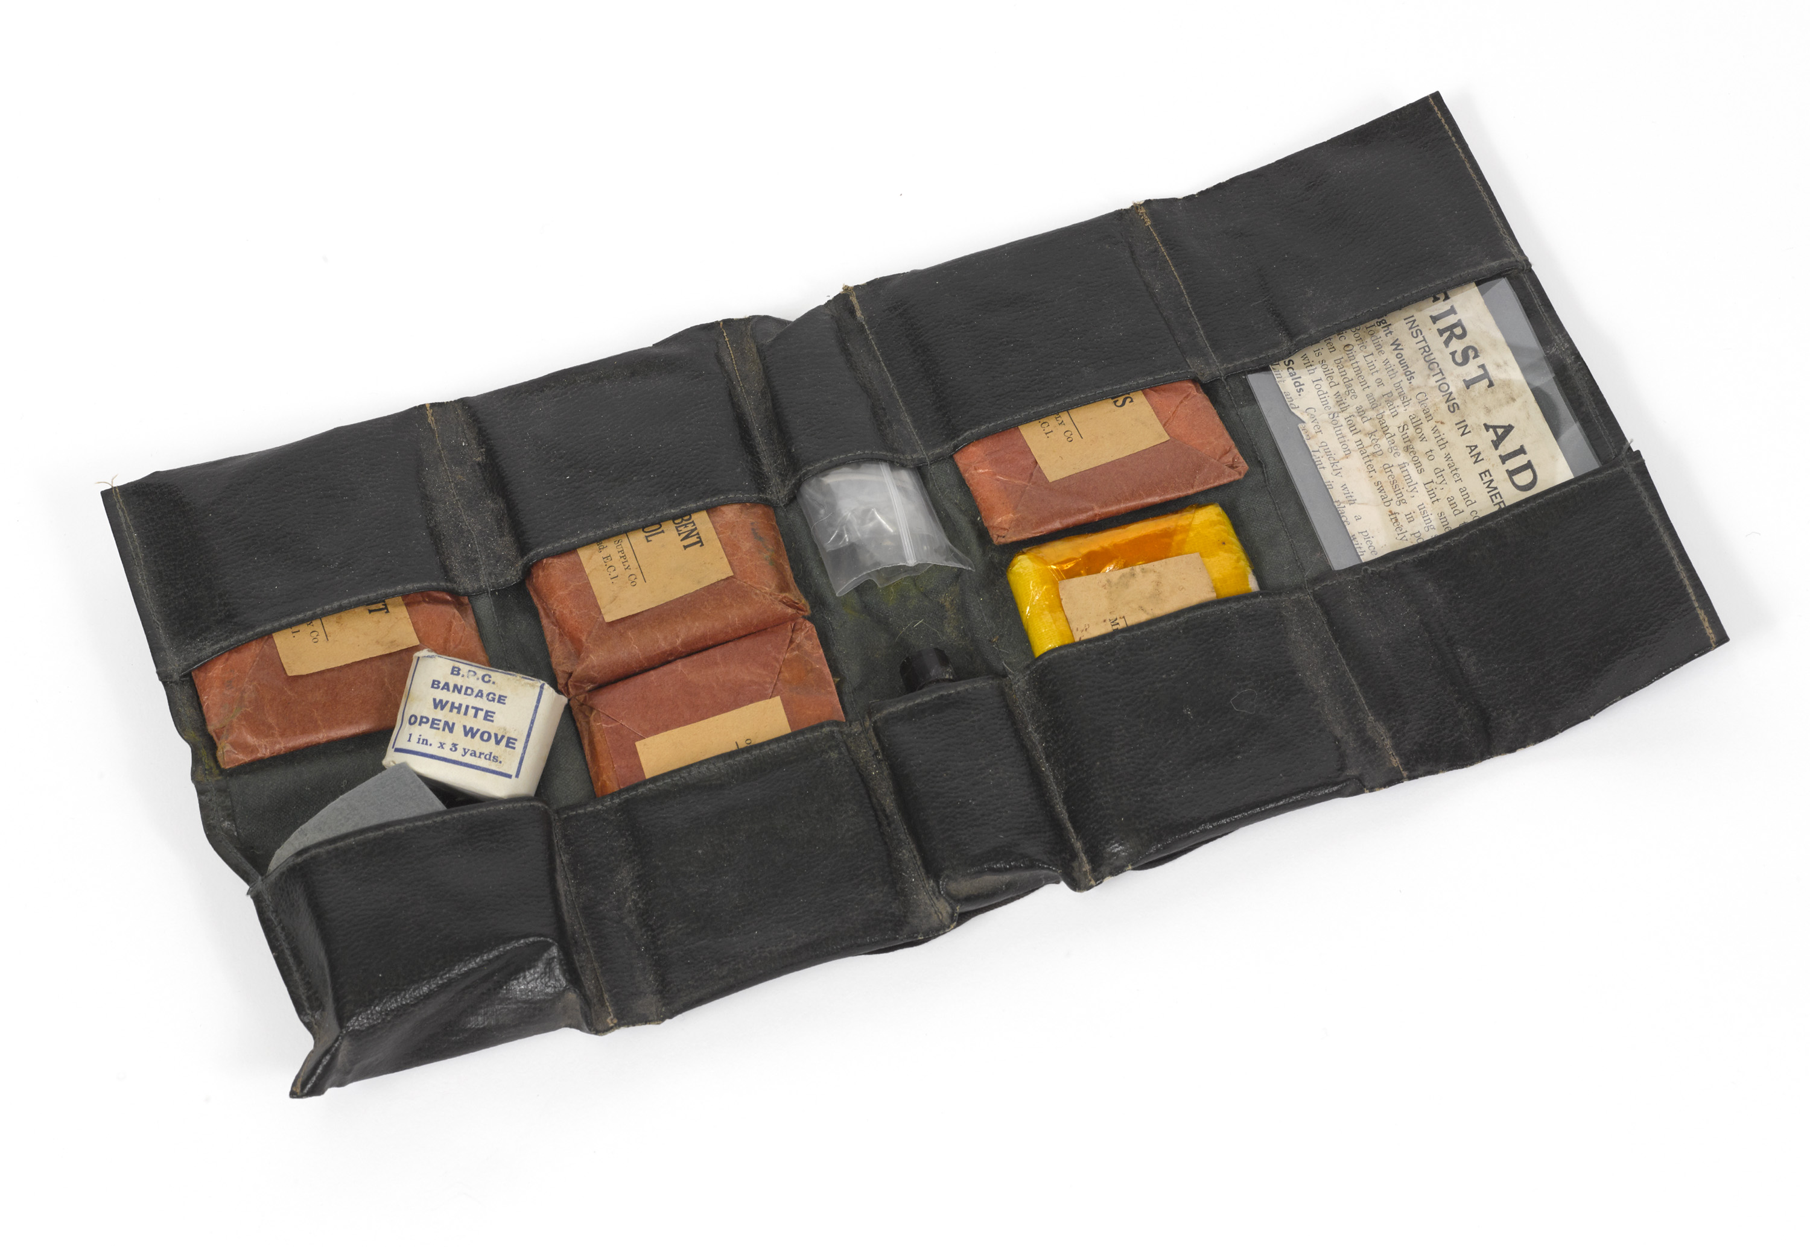
Medical kit case associated with the Auxiliary Ambulance Service, Second World War
Notes:
NAM. 2018-01-52-1

Slide 38
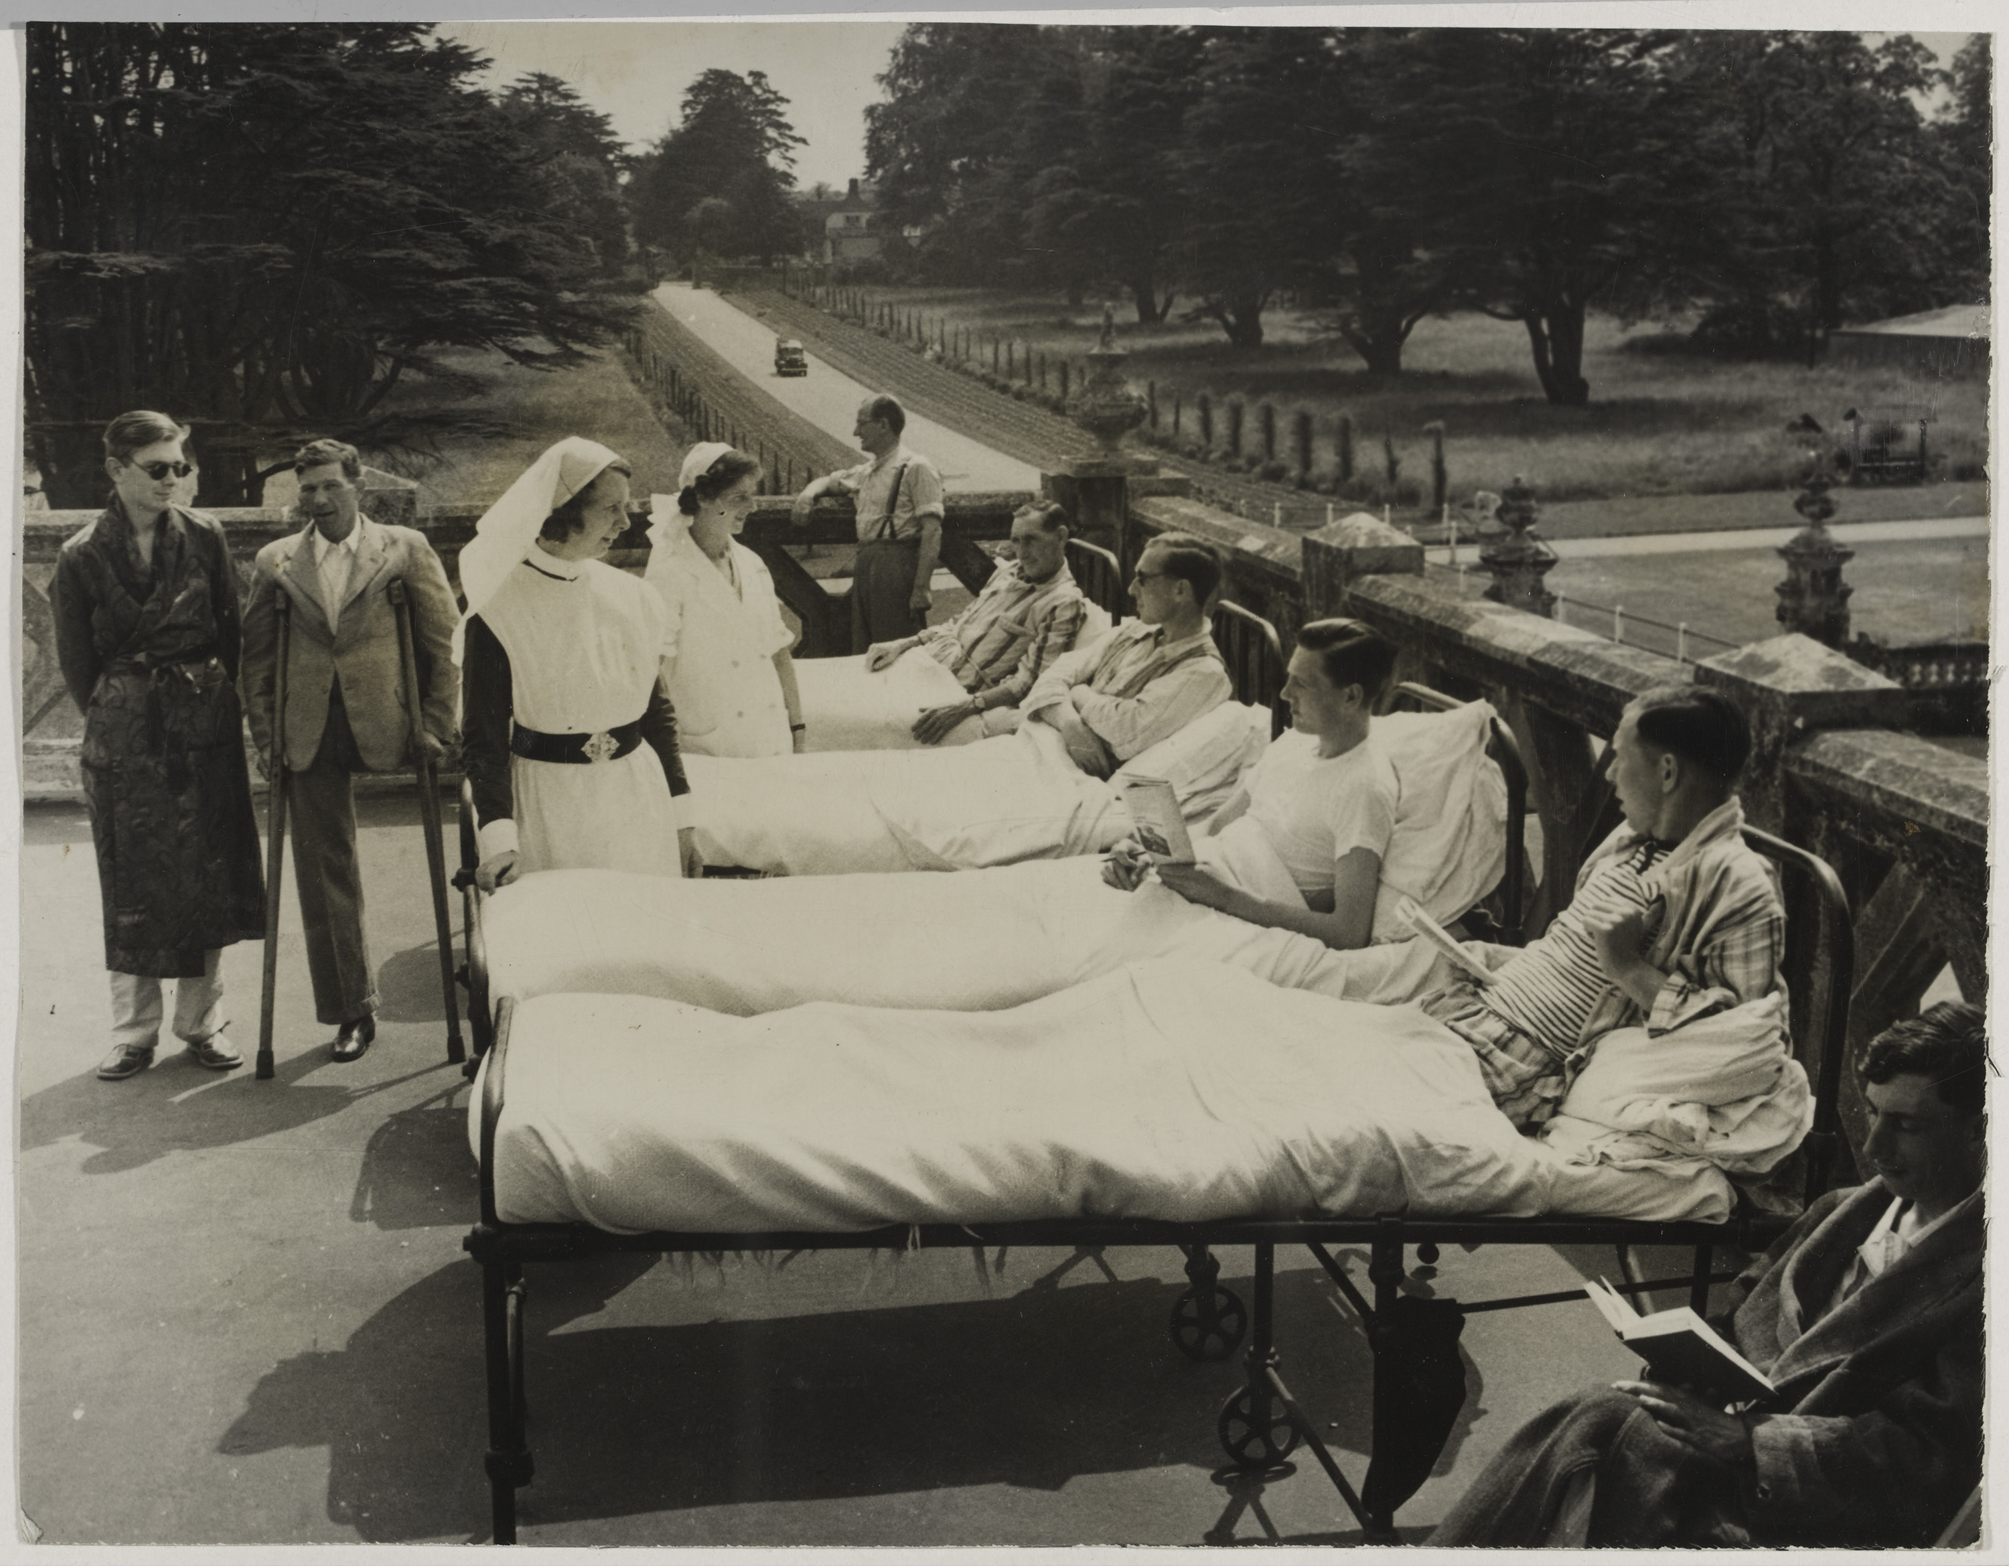
Wounded soldiers convalescing at Preston Hall, Aylesford, Kent, 1940 (c) -1941 (c)
Notes:
Shows wounded soldiers, some in beds, on the balcony towards the back of Preston Hall, chatting with two nurses and reading.
Preston Hall, originally built in around 1102, became the Royal British Legion Village in the 1920s and the Hall was used as a hospital during the First and Second World War.
NAM. 2006-12-102-2

Slide 39
'Bombed London Rheumatism Clinic Received £1200 From U.S. War Charity’, 15 October 1940
Notes:
‘When this London Rheumatism Clinic received damage from a bomb explosion a short time ago, rendering part of the building unusable, the British War Relief Charity Society, of the U.S. wired £1200 to provide new equipment’.
Shows a nurse working among the wreckage in the damaged part of the Rheumatism clinic in London, recently bombed.
NAM. 2006-12-102-26

Slide 40
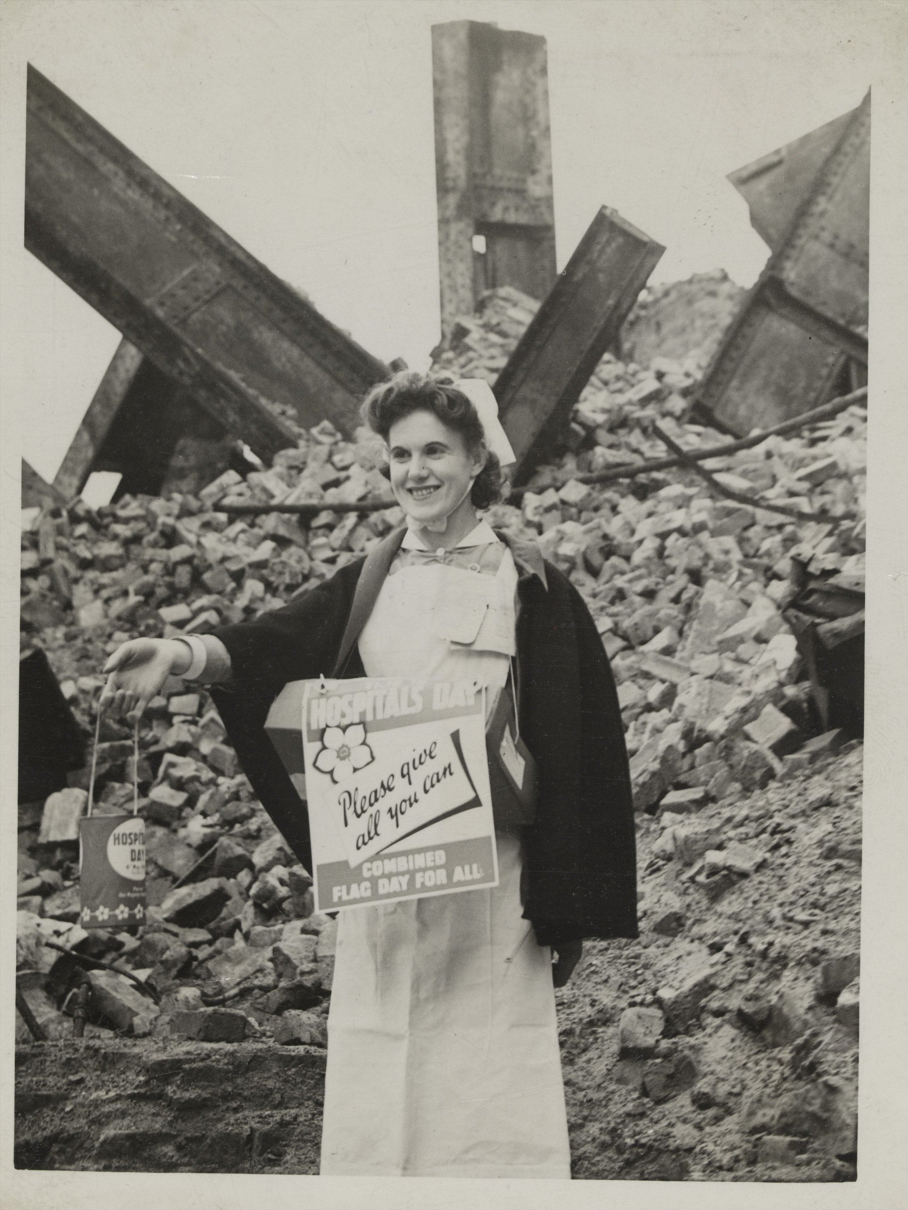
‘Hospital Day’, 6 May 1941
Notes:
‘Today is Hospital Day, and collections are being made to help all voluntary hospitals in London’.
Shows a nurse making her appeal amid the ruins of war damage near her hospital.
NAM. 2006-12-102-41

Slide 41
'Queen Visits Casualty Evacuation Train’, 13th October 1939
Notes:
‘Queen Elizabeth paid a visit of inspection to a casualty evacuation train at a London railway station. The train is one of a number based in Greater London for the purpose of evacuating air raid casualties to the advantage base hospitals in outer areas’.
NAM. 2006-12-102-18

Slide 42
Air Raid Precautions (ARP) warden’s helmet, 1940 (c)
Notes:
Following the outbreak of the Second World War the British government mobilised around 200,000 Air Raid Precautions (ARP) volunteer wardens. Eventually over one million people served as wardens during the conflict. During enemy raids they directed people to air raid shelters, but they also helped enforce the blackout, assisted with fire-fighting, rescued people and policed bombed-out buildings. Their steel helmet had 'W' for Warden in bold white writing across it.
NAM. 1998-12-170-1

Slide 43
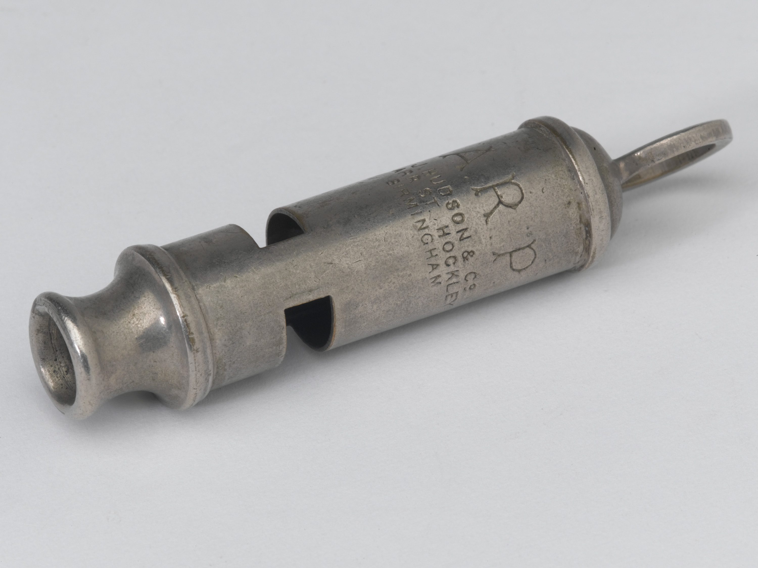
Infantry steel whistle used by Air Raid Precautions, 1940 (c)
Notes:
Following the outbreak of the Second World War the British government mobilised around 200,000 Air Raid Precautions (ARP) volunteer wardens. Eventually over one million people served as wardens during the conflict. During enemy raids they directed people to air raid shelters, but they also helped enforce the blackout, assisted with fire-fighting, rescued people and policed bombed-out buildings.
NAM. 2001-02-462-1

Slide 44
Air Raid Precautions (ARP) Warden Sonia Straw GM, 1940
Notes:
Nineteen-year-old Sonia Vera Carlyle Straw, an air raid warden at Caterham, was awarded the George Medal (GM) during a raid in which she attended a number of badly injured women and children and treated several people for shock. She carried on without assistance all throughout the raid.
NAM. 2006-12-102-28

Slide 45
District Warden's Log Book, Air Raid Damage Scrap Book, 1940-1941
Notes:
NAM. 1988-12-36-1

Slide 46
German incendiary bomb, type B1.3E, 1938 (c)
Notes:
Incendiary bombs were designed to start fires. They were usually dropped in tandem with high-explosive bombs. During the London Blitz (7 September 1940-May 1941) thousands of incendiary devices caused widespread damage to the docks and industrial centres of the capital. The fires they caused also destroyed thousands of houses.
NAM. 2009-09-19-1

Slide 47
King George VI inspects firemen at Lambeth HQ, October 1940
Notes:
London's fireman were in the front line during the 'Blitz'. Between September 1940 and May 1941 London was constantly bombed and the capital's firemen struggled to contain fires caused by incendiary devices. During this period more than 20,000 Londoners were killed and 1.4 million were bombed out of their homes.
NAM. 2006-12-102-35

Slide 48
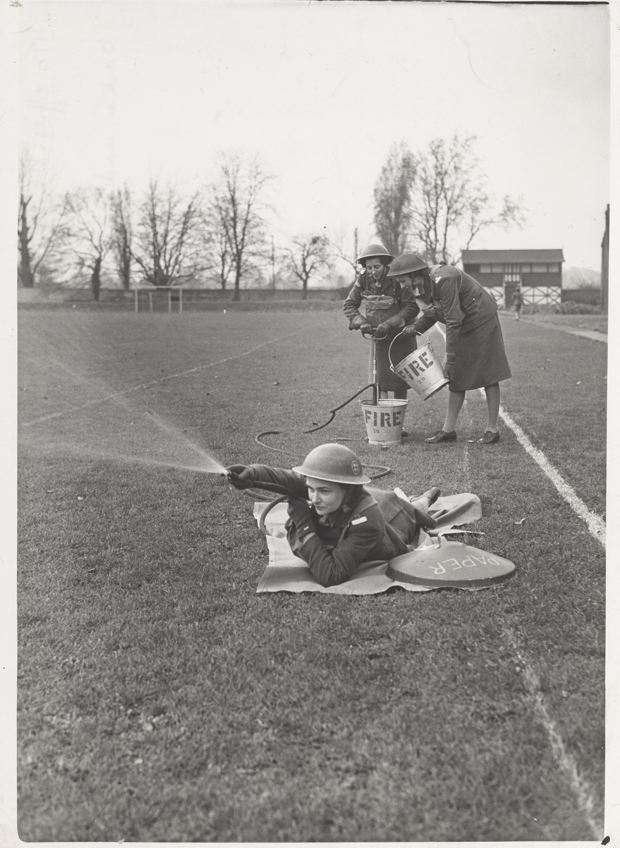
ATS cadets under instruction for fire fighting at Officer Cadet Training Centre, Windsor, 1939 (c) -1945 (c)
Notes:
NAM. 1994-07-275-204

Slide 49
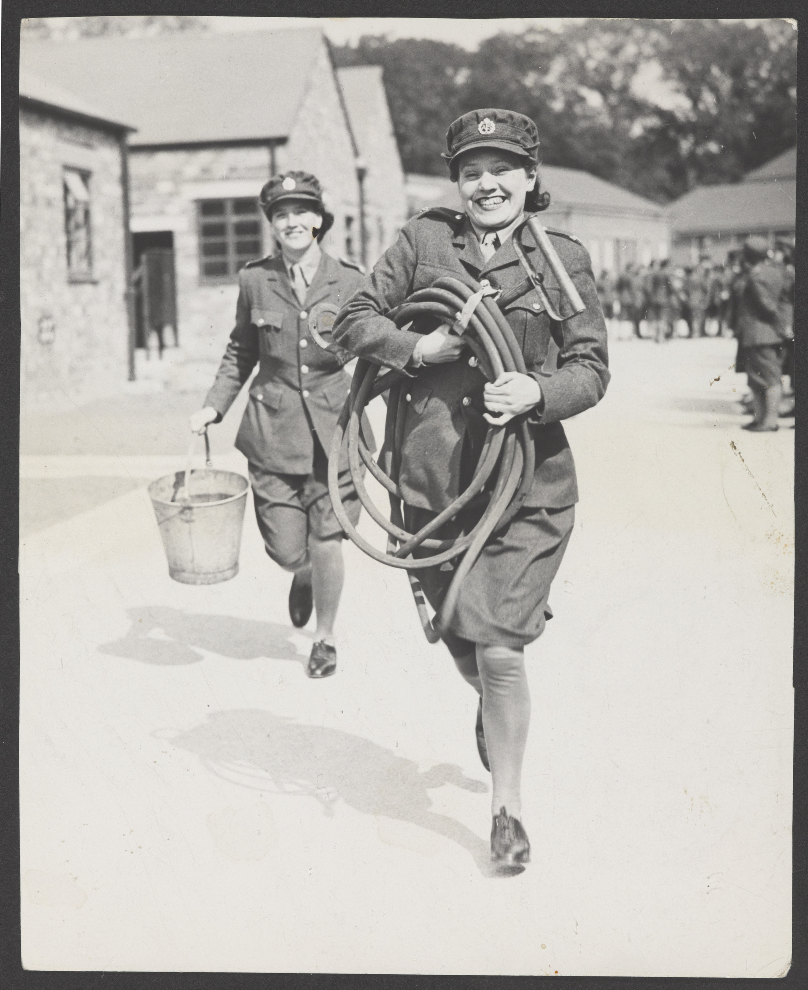
Two Auxiliary Territorial Service personnel doing a fire drill at the ATS Training Wing of the Cheshire Regiment, Chester, 1941
Notes:
The woman in the foreground carries a stirrup pump.
NAM. 1994-07-275-203

Slide 50
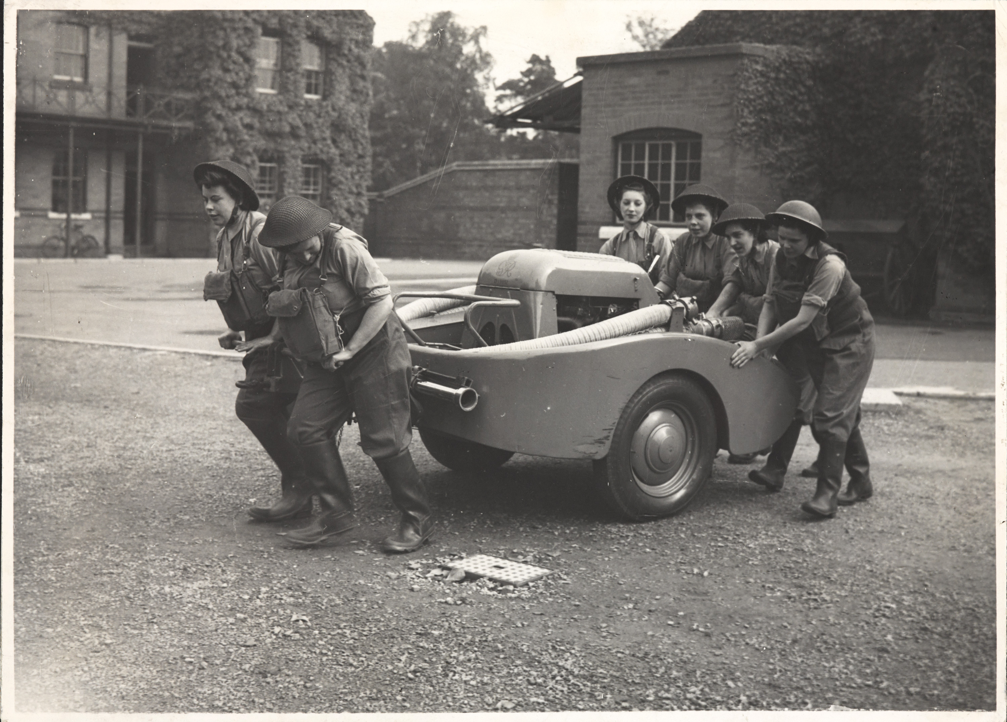
A.T.S. Fire Squad man handling their pump, 1 October 1941
Notes:
An Auxiliary Territorial Service (ATS) six woman fire squad maneuvering a fire pump trailer during fire-fighter training in October 1941.
NAM. 1994-07-275-208

Slide 51
Instructions to firewatchers and equipment to be carried, 1941 (c)
Notes:
NAM. 2007-08-12-17

Slide 52
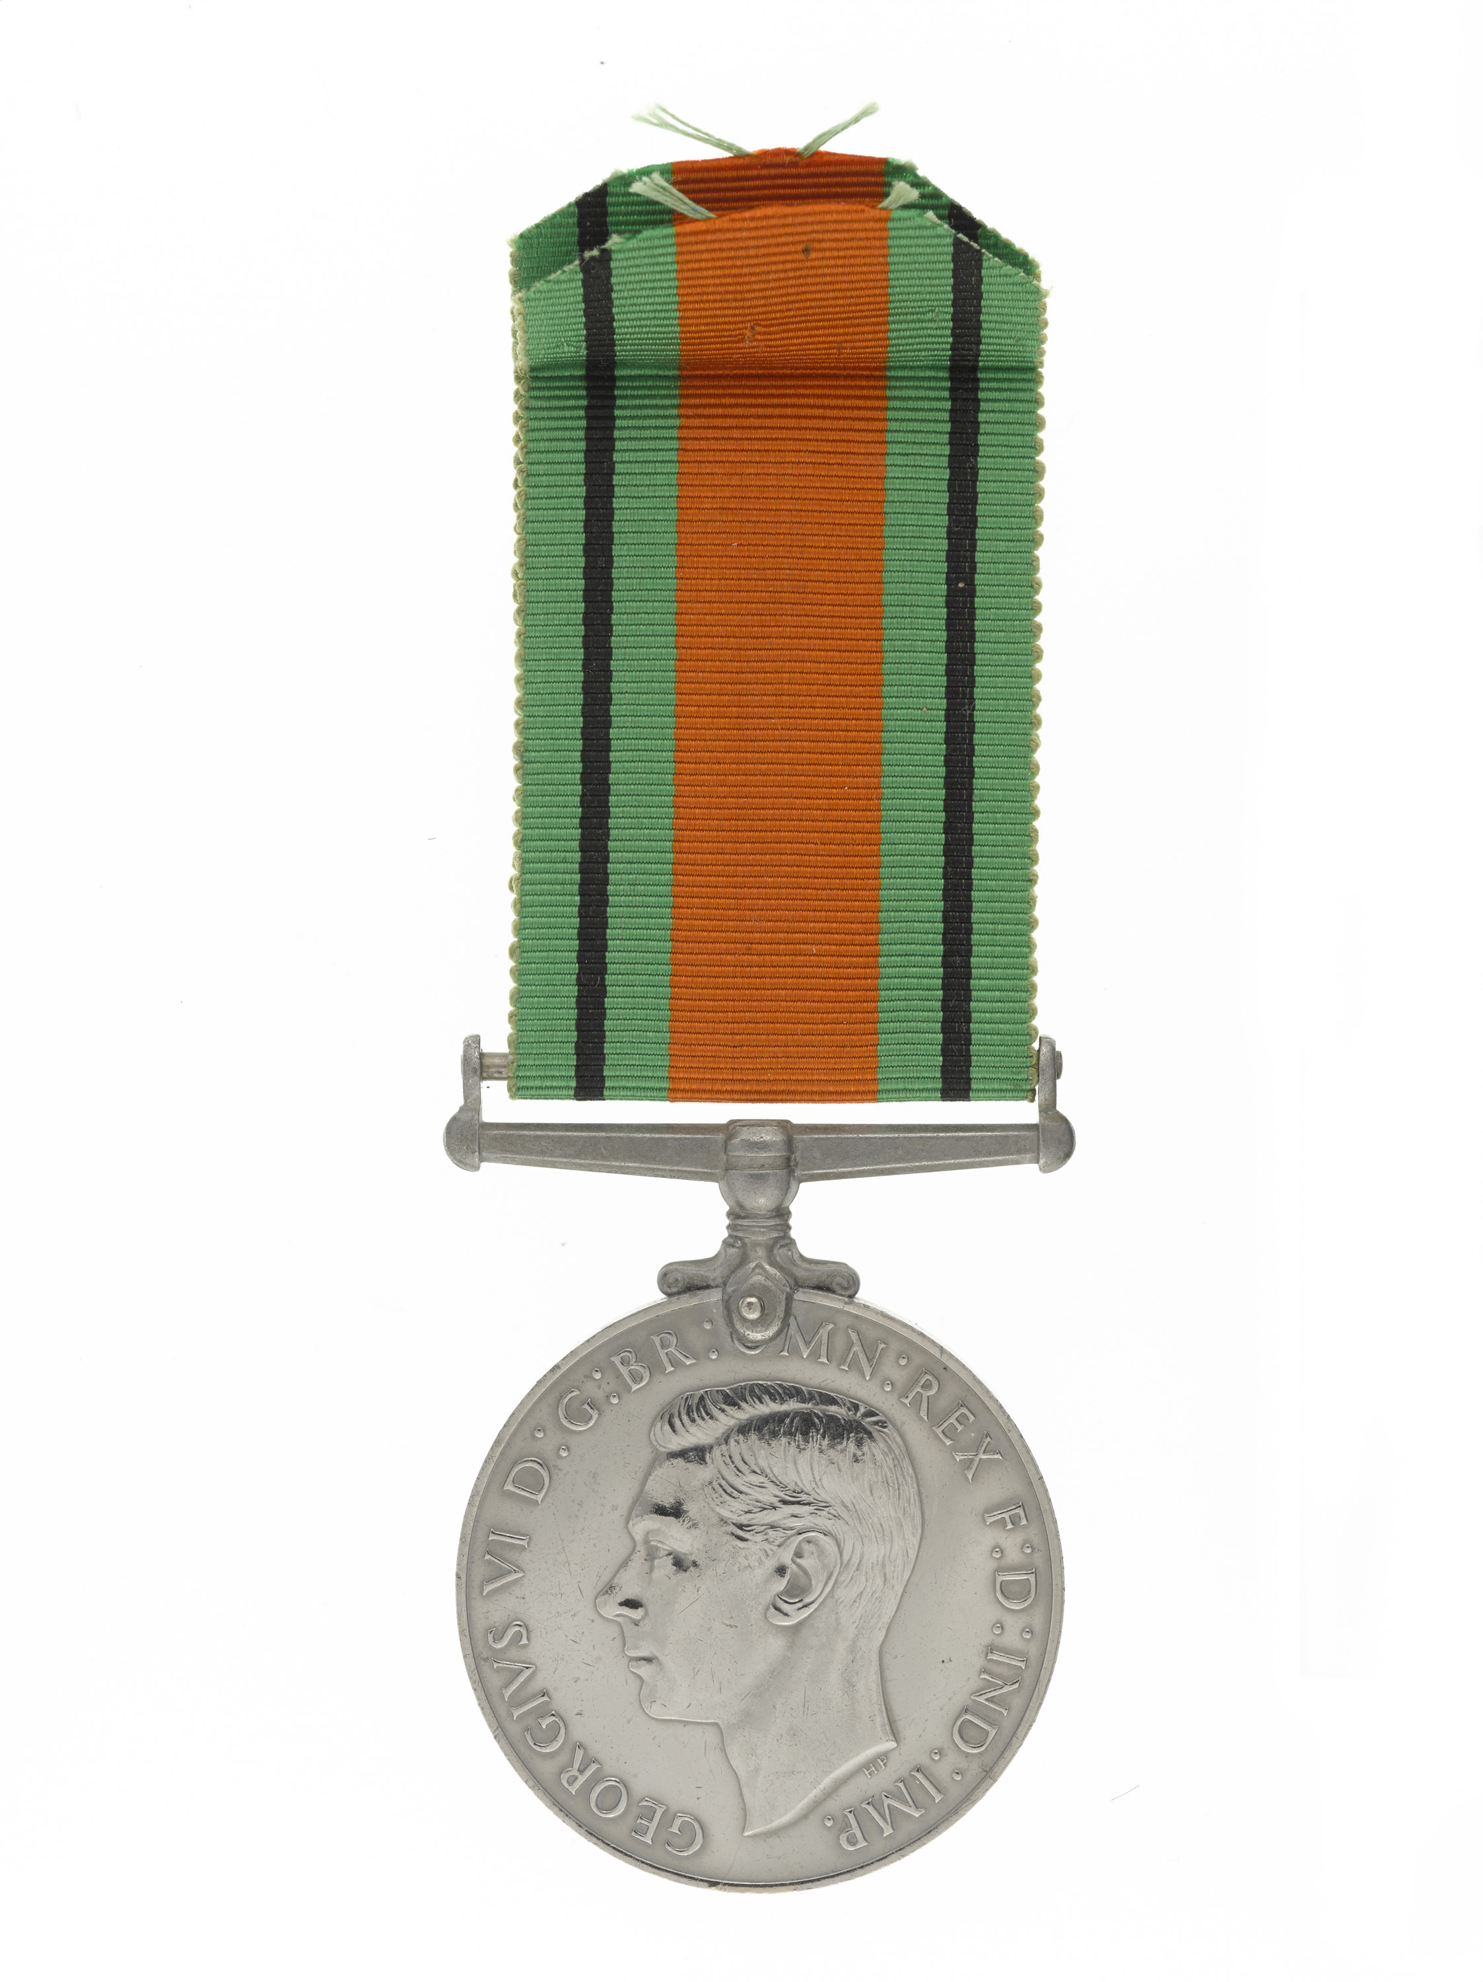
Defence Medal 1939-45, Lance-Corporal Margaret Emma Richards GM, Auxiliary Territorial Service
Notes:
Defence Medal 1939-45, Lance-Corporal Margaret Emma Richards GM, Auxiliary Territorial Service.
Circular campaign medal with, on the obverse (designed by Thomas Humphrey Paget), the head of King George VI and the inscription, ‘GEORGIVS VI D:G:BR:OMN:REX F:D:IND:IMP.’. On the reverse (designed by Harold Parker), the Royal Crown on an oak sapling, with lion and lioness supporters flanked by the dates, ‘1939’ and ‘1945’, above stylised waves and the medal name, ‘The Defence Medal’, within the exergue. The green ribbon has a central band of orange and two thin black stripes.
Margaret Richards of the Auxiliary Territorial Service (ATS) was awarded the George Medal (GM) after she gave first aid to soldiers wounded in an ammunition depot explosion, despite the risk of further explosions.
Struck in cupro-nickel or silver, the Defence Medal 1939-45 was instituted in May 1945 and was more widely distributed than the 1939-45 Star. Its recipients included personnel who had served for at least three years in Britain during the Second World War. The medal was awarded to non-operational service personnel and for certain civilian services, such as Civil Defence. Commonwealth and Colonial personnel in some services, deployed away from their homes, were also eligible. The ribbon colours are symbolic: the green refers to the green and pleasant land of England, the black stripes represent the blackout and the orange stripe represents the fire bombing of the Blitz.
NAM. 1993-02-519-2

